Slide 1

Portland Building,
University Park,
UK
University of
Nottingham
Ningbo Campus, China
UNMC campus, Malaysia

Slide 2
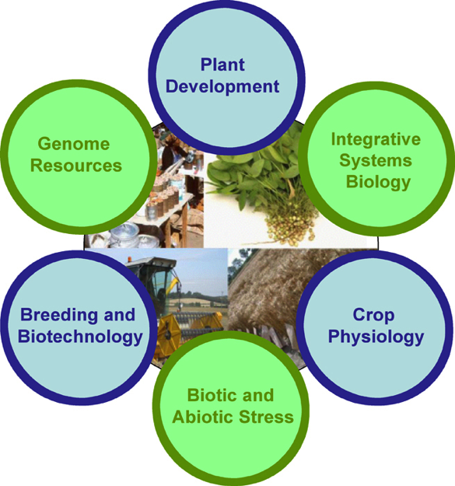
Plant & Crop Sciences
Largest UK University-based community of plant and crop scientists.
Ranked No 2 for Research Power
28 research laboratories >150 researchers.
Centre for Plant Integrative Biology
NASC – Genomic resource centre

Slide 3
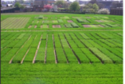
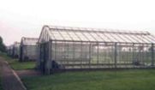
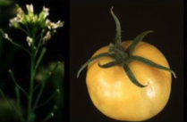
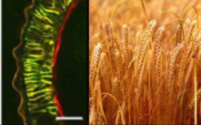
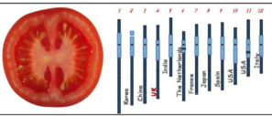
Plant and Crop Sciences
Plant physiology and genetics – from cellular level to the field.
Developing superior germplasm and trait analysis for agricultural improvement.
Using model species to identify key genes control important agronomic traits and then translate to crops.

Slide 4
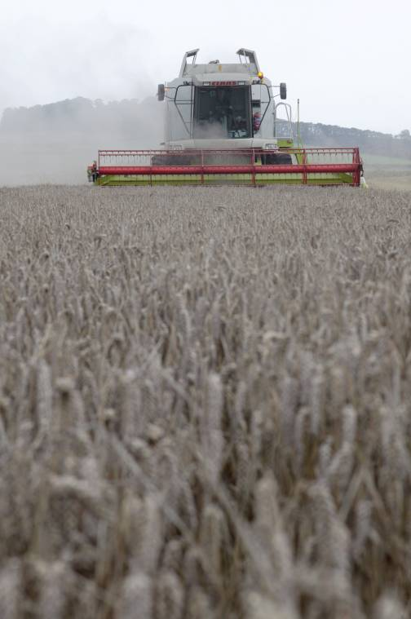
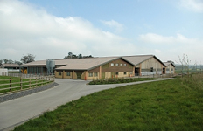
University Farm
445 hectares
Three sites
Arable & dairy
Organic and ES
Why?
  Research
  Teaching
  Commercial
Notes:
20 hectares of land at Bunny are organic

Slide 5
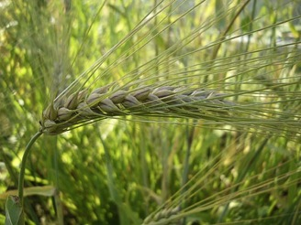
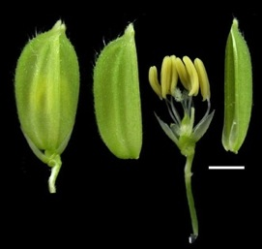
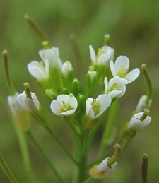
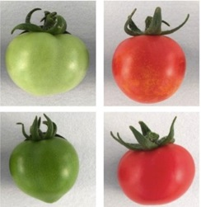
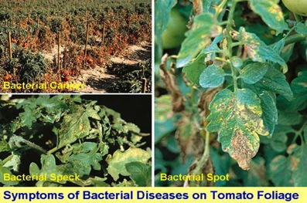
Sustainable Production-Physiology & Biotechnology
Integrative Systems Biology
(Bennett, Holdsworth, Seymour, Wilson, Band)
Sustainability of UK wheat production
(King & King; Foulkes, Sparkes, Murchie)
Controlling fertility to increase crop yield
(Wilson, Foulkes, Mayes)
Selection of traits for increased crop production
(Mayes, Foulkes, Sparkes, Ray, Broadley)
Increased shelf-life and quality of food
(Seymour, Grierson)
Biotic and abiotic stress
(Holdsworth, Dickinson, Ray, Foulkes, Murchie)
Manipulation of metabolic pathways
(Fray, Bennett, Holdsworth)
Notes:
environmental impact of livestock systems, eg methane from dairy units.
infection by exploiting the natural models of susceptibility (humans and chickens) and resistance (pigs and ducks) to develop new approaches to safeguard animal and human health.

Slide 6
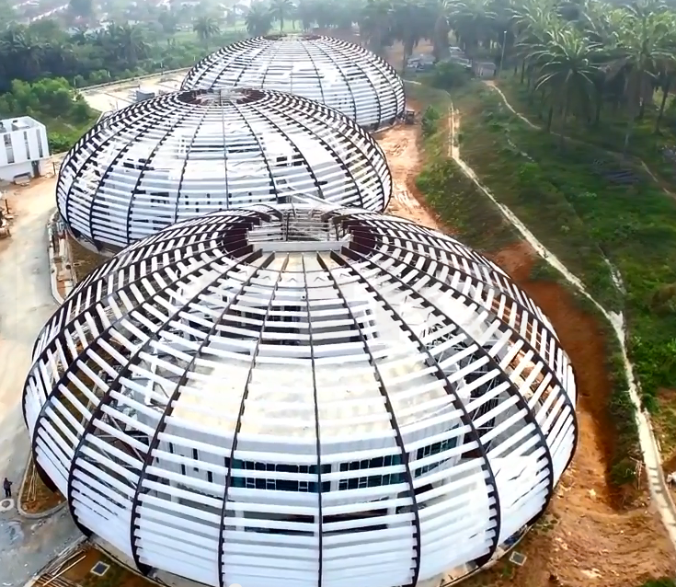

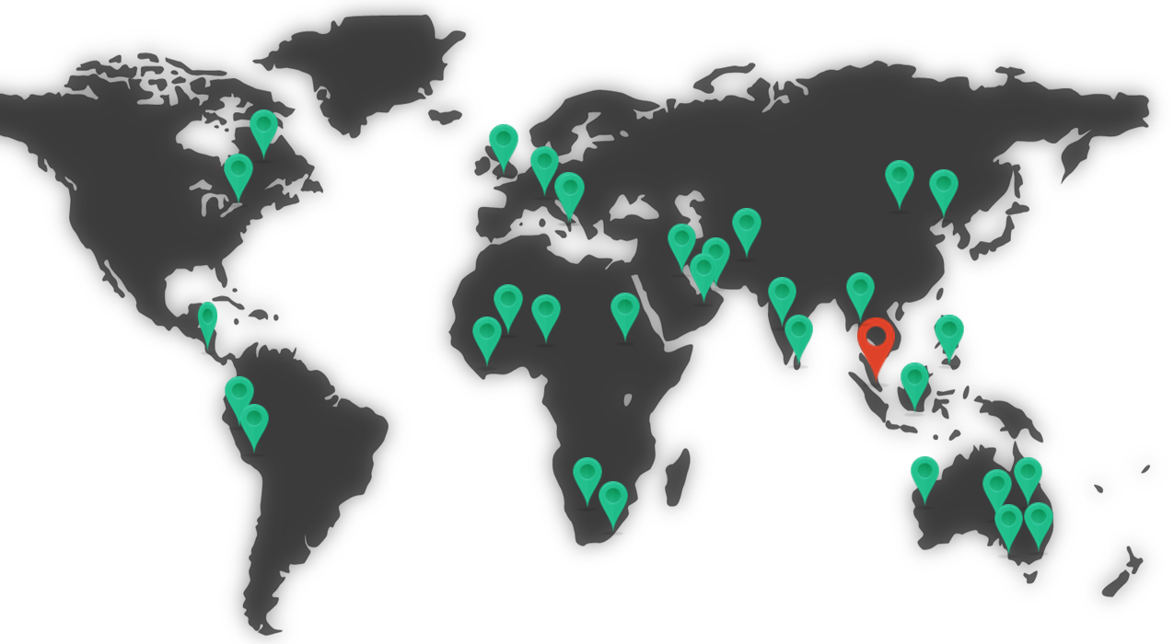
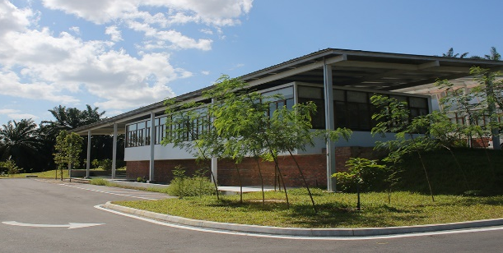
- Not for profit company without shareholders
- Guarantors: Government of Malaysia
University of Nottingham
- International remit dedicated to quantitative and
comparative research on underutilised crops
for food, feed, fuel and materials
HQ next to the UoN Malaysian Campus
Research partners world-wide
49 Ha Field Research Centre in old oil palm
June 2011: (initial 7 years funding for staff and infrastructure, opened by Malaysian PM)
Feb 2013: Doctoral Training Partnership begins (currently 50 PhDs; 15 more expected by 2017)
June 2014: Field Research Station opened and active
Sep 2015: HQ completed and opened
Copyright CFF 2015

Slide 7
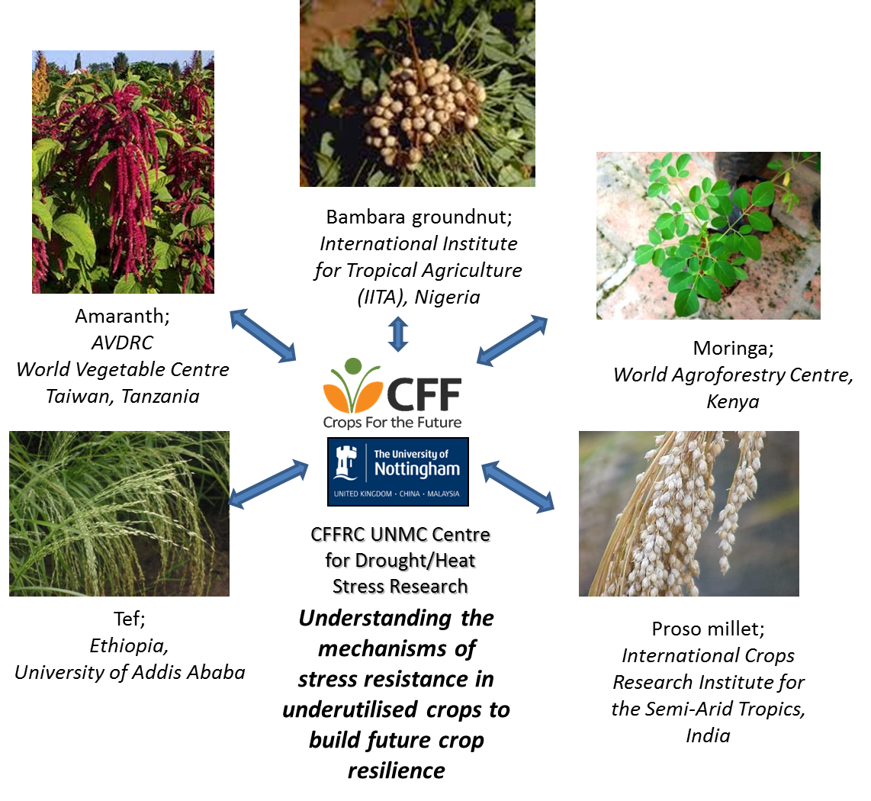
An alternative to trying to reintroduce resource use efficiency into
major crops which have lost it, is to re-examine underutilised crops,
many of which have always been grown under low input systems
Copyright CFF 2015

Slide 8
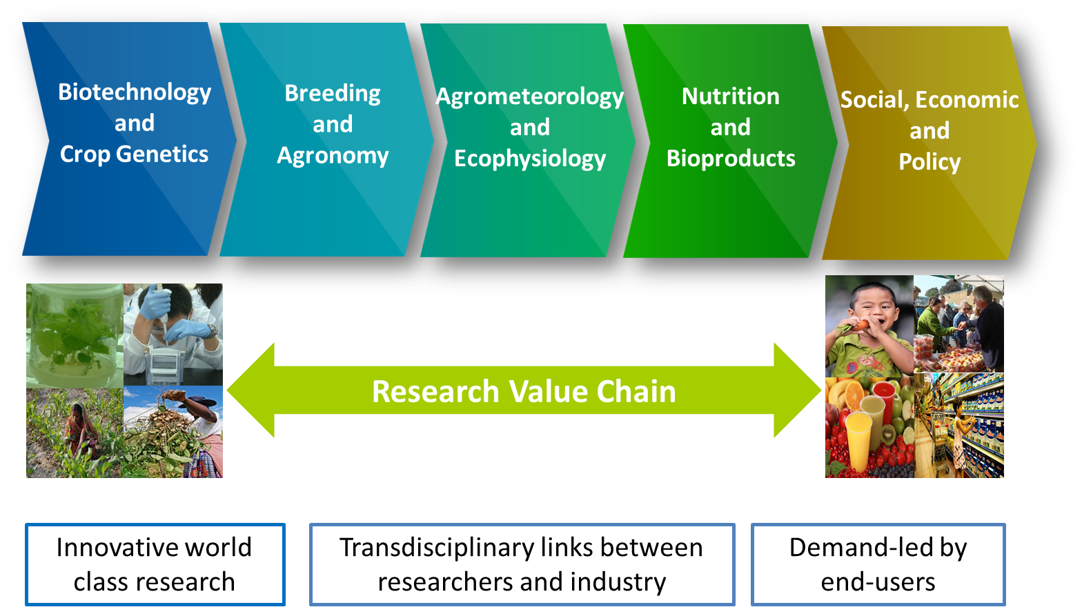
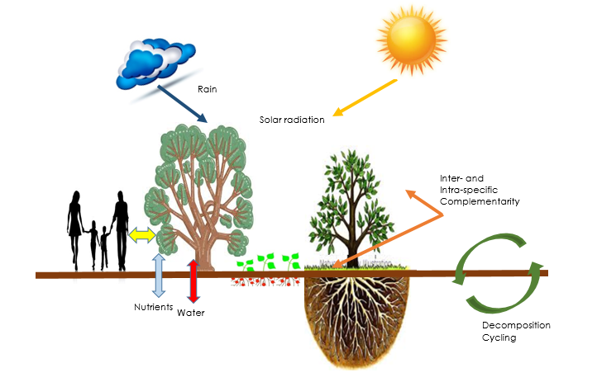
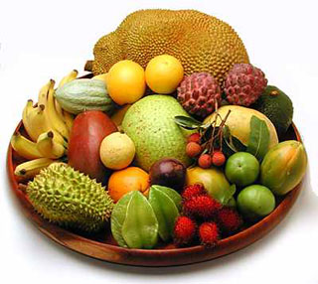
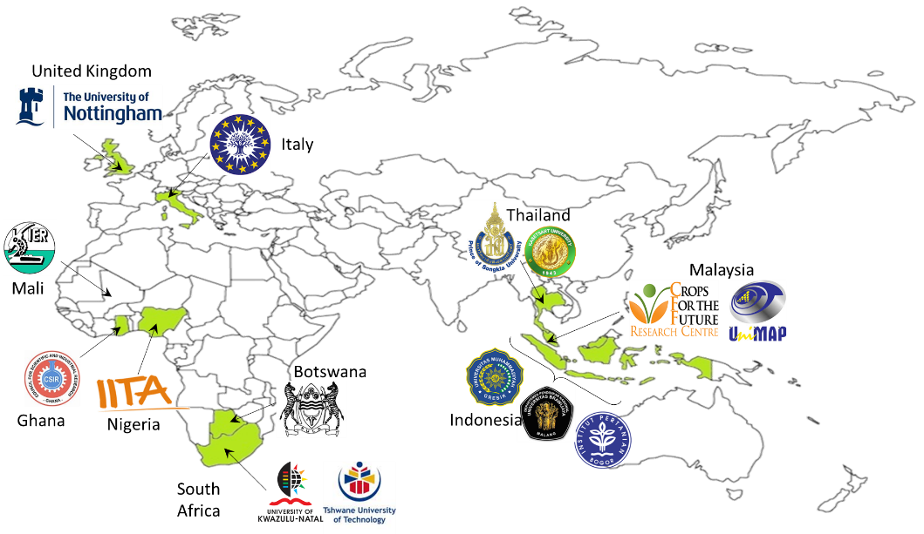
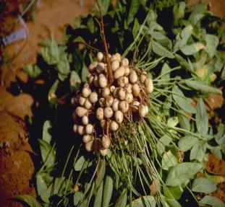

Current Programmes
SAGEPLUS
FoodPLUS
FishPLUS
BamYIELD Research and Field Partner Network
BamYIELD
www.cropsforthefuture.org; www.bamyield.org
www.bambaragroundnut.org; www.cff-unmc-dtp.com
CropBASE
Copyright CFF 2015

Slide 9

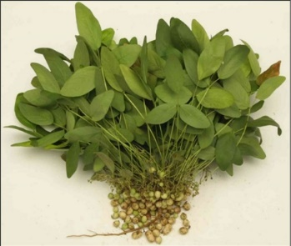
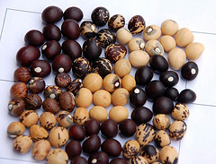
Why Bambara groundnut?
Strengths:
Drought tolerance
Grows in semi- arid and tropical environments
Nitrogen fixing
Fast growing (4-5 months)
3rd most important nutrient legume in sub-Saharan Africa
Drawbacks
Photoperiod sensitive
Variability within landraces
Lack of commercial varieties
Limited markets & value added
products
Opportunities
Food security
Income generation
Product development
Human dietary diversification
Animal feed
Copyright CFF 2015

Slide 10
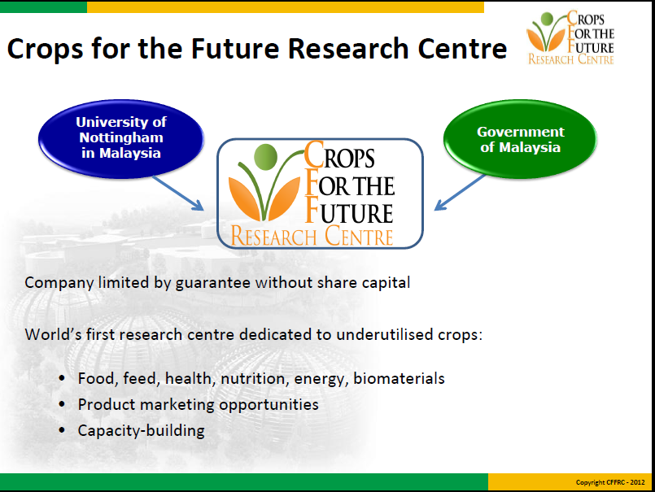
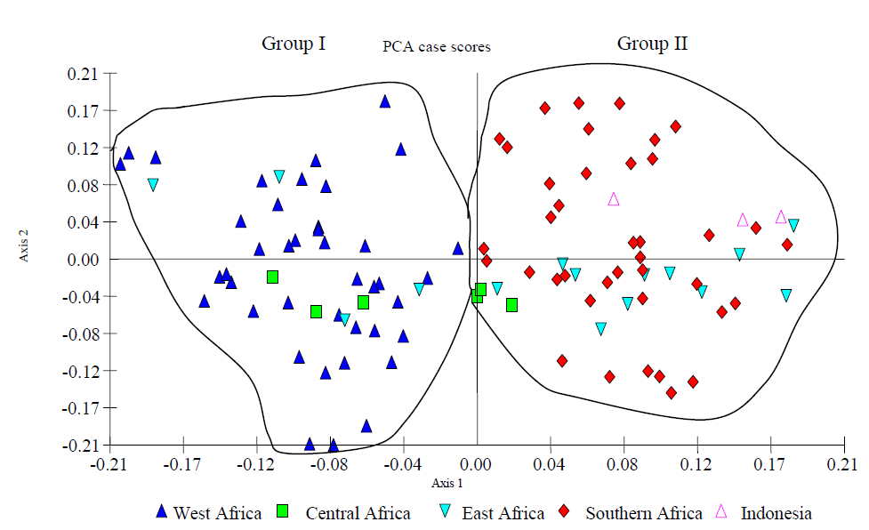
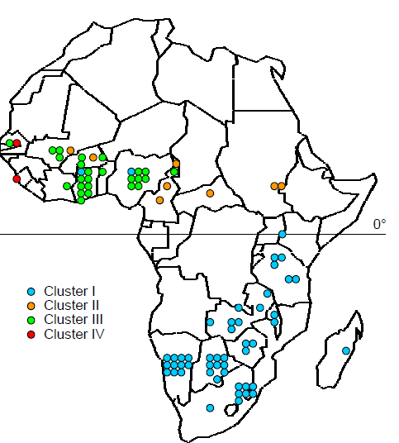
Genetic diversity of germplasm
Clear differentiation between West and South+East African accessions
SSR-based genetic diversity analysis (PCA)
DArT microarray analysis
Crosses to introduce new variation could be made between agro-ecologically matched accessions but from different breeding groups
Molosiwa et al., 2015; Siise et al., 2015
Copyright CFF 2015

Slide 11
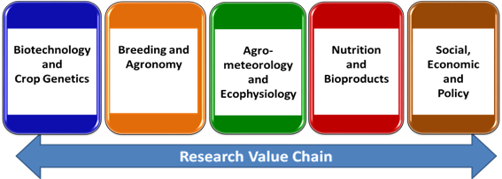
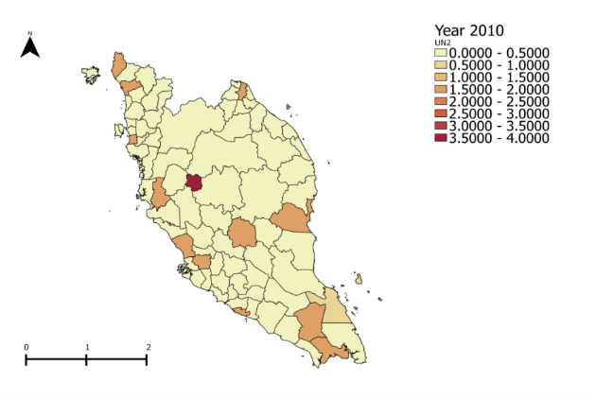
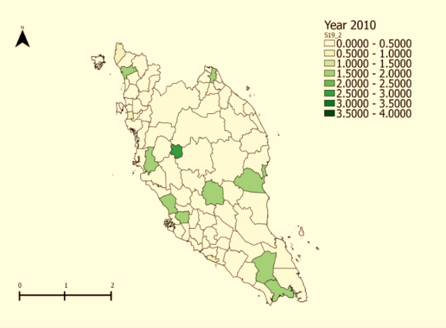
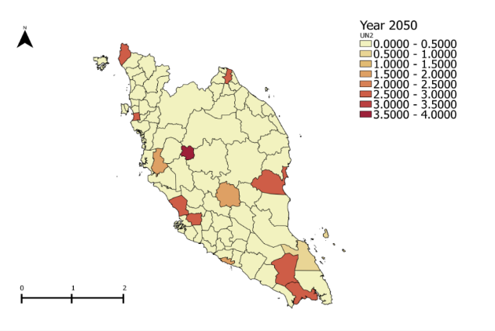
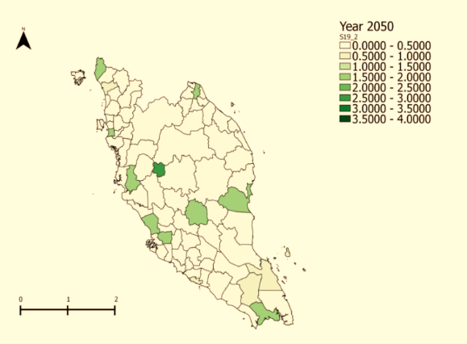
Agrometeorology & Ecophysiology
Climate and growth modelling using BG
2010
2010
Model predictions for crop growth in Malaysia for 2 African landraces: Uniswa Red and S19-3 with CropBASE colleagues
Provide baseline data for future field experiments for proof of concept
Uniswa Red (Swaziland; sub-humid)
S19-3(Namibia; arid)
2050
2050

Slide 12
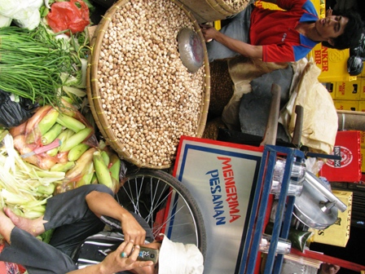
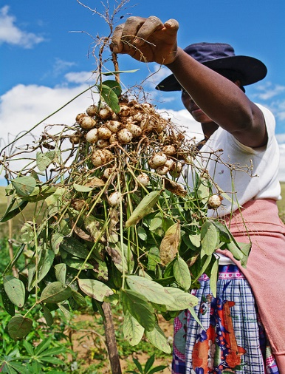
Socio, Economics and Policy
Improving livelihood of local communities
1) Value Chain research in Indonesia
Assessment of co-operative model set up for BG cultivation, and production of raw material for direct commissioning of processing by the farmers, socio-economic impact on local community
2) End user research in Africa
    Acceptance of local community towards BG as a crop, and as a food source (Ghana, Nigeria and Tanzania)
    Understanding consumption, utilisation, marketing constraints

Slide 13
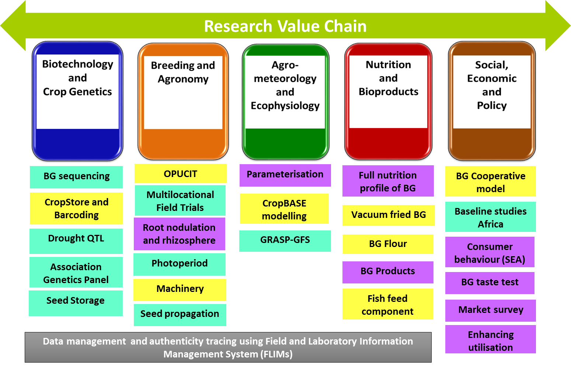

BamYIELD
Copyright CFF 2015

Slide 14
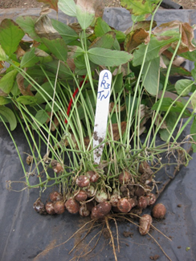
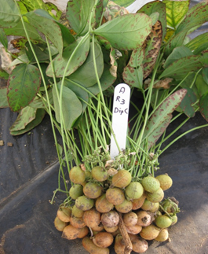
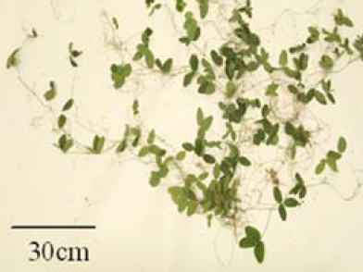
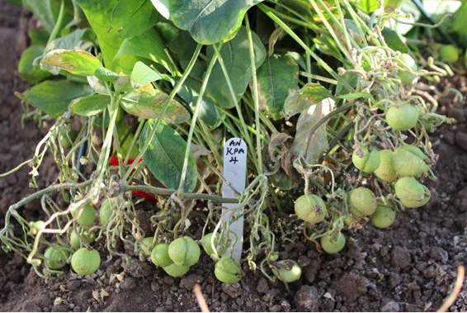
Genetic maps
3 populations with genetic maps so far, segregating for different traits
  Photoperiod sensitivity
  Growth habit (domesticated x domesticated)
  Growth habit (domesticated x wild)
Tiga Necaru (domesticated)
‘semi-spreading’
VSSP11 (wild)
‘spreading’ ancestor
DipC (domesticated)
‘bunched’
‘less-sensitive to photoperiod’
Ankpa4 (domesticated)
‘sensitive to photoperiod’
Composite linkage groups consisting of DArT, SSR and DArTseq markers; manuscript submitted to Genome
Copyright CFF 2015

Slide 15
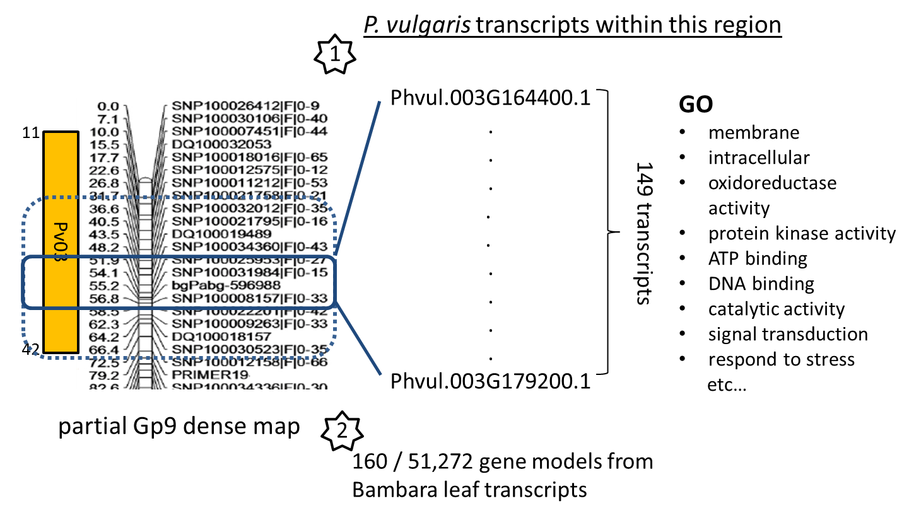
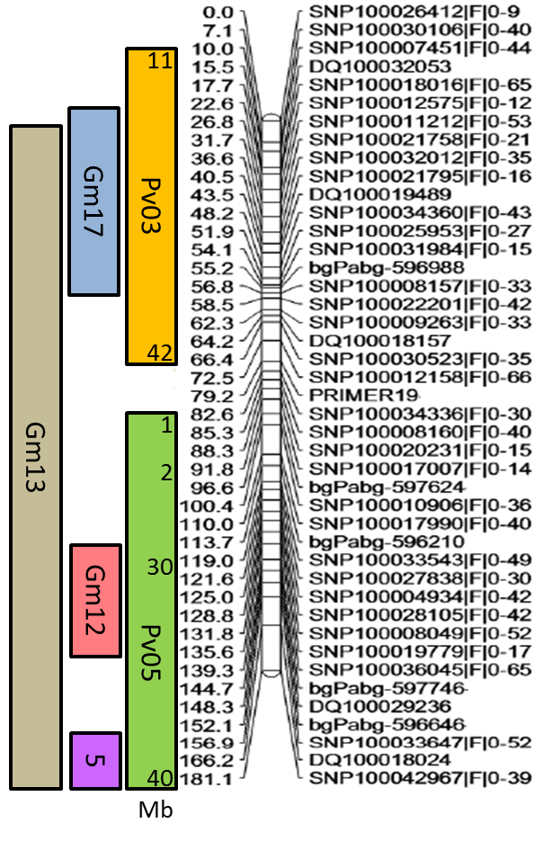
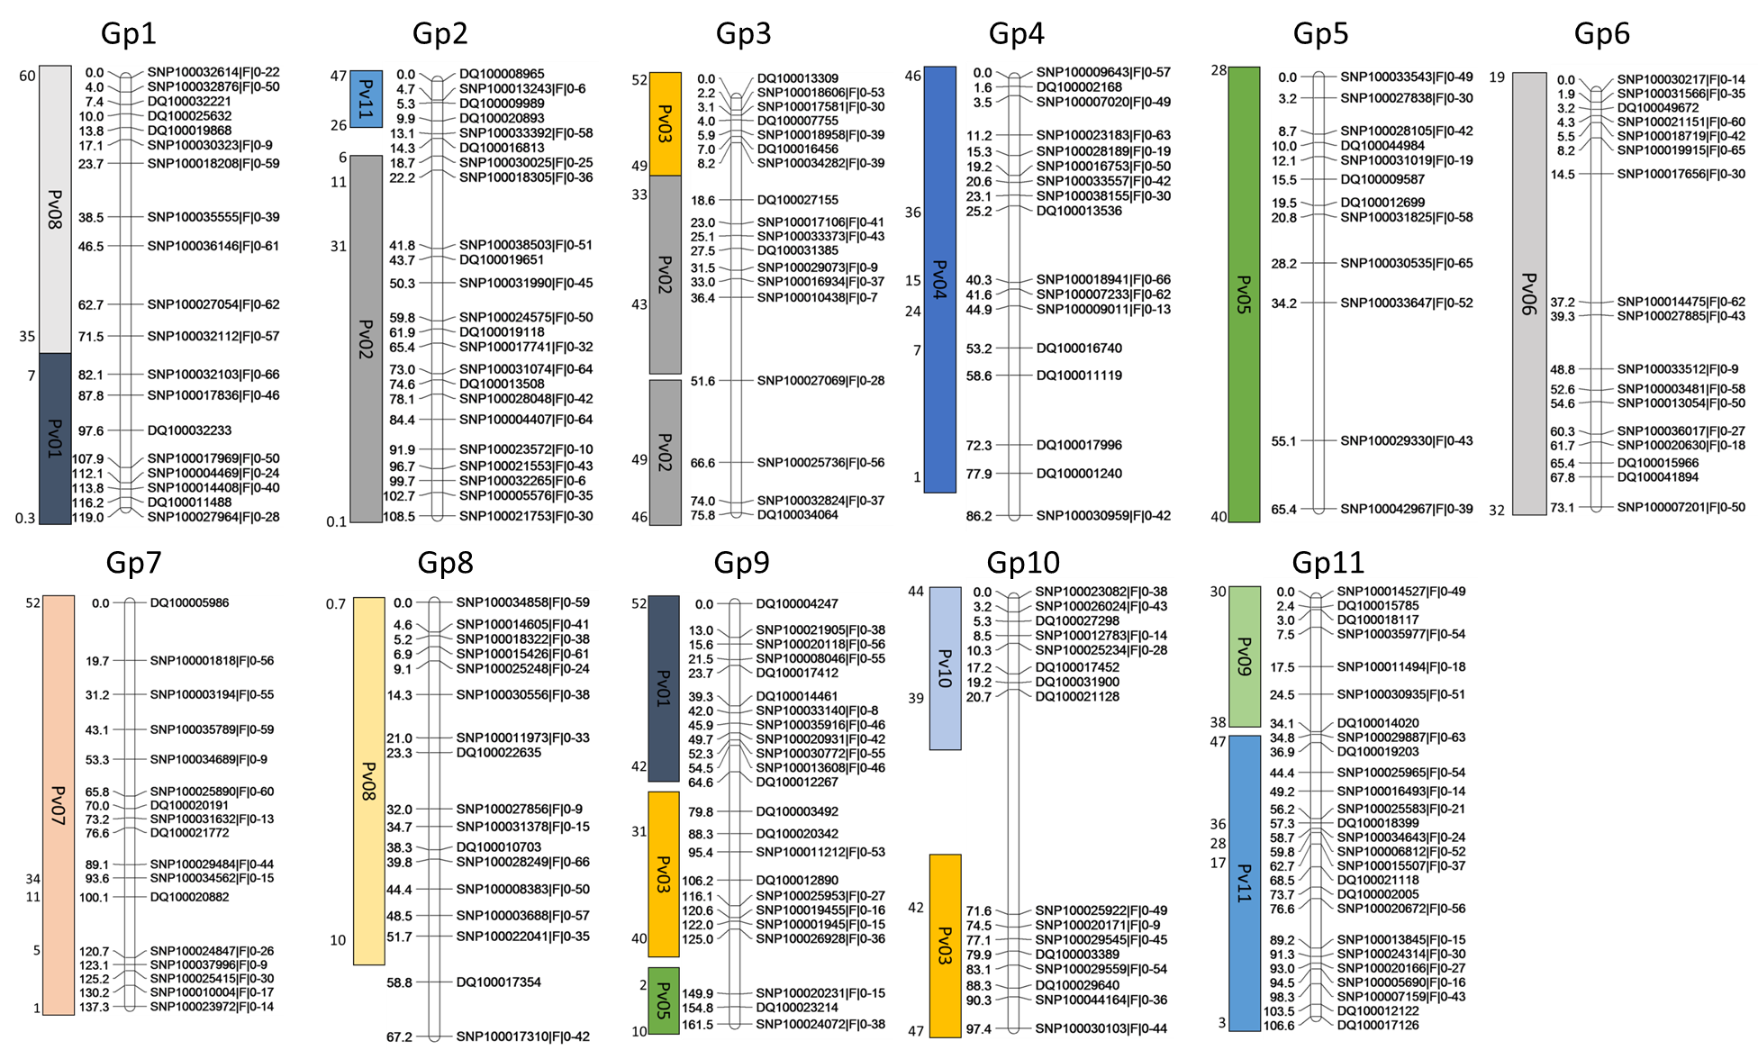
Translation; by focusing on trait of interest eg. peduncle length
Peduncle length QTL
LOD
Gp9 high dense map
Bambara genetic
map to Phaseolus v.
genome sequence
using GBS tags

