Slide 1
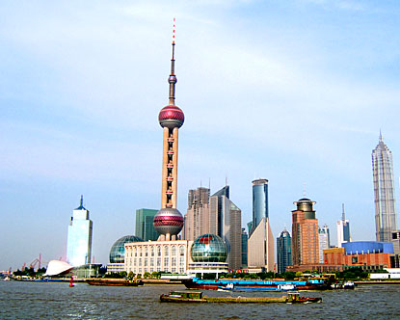
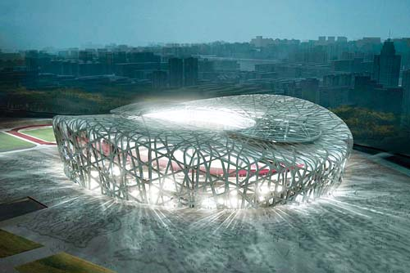
Can China become the next economic superpower
Zhihong Yu
GEP, School of Economics
University of Nottingham

Slide 2
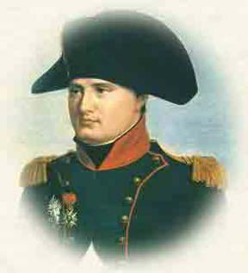
Quand la chine s'éveillera,
le monde tremblera
When China wakes up,
the world will shake
Napoleon , early 19th century

Slide 3
Outline
China’s rise and integration into the world economy
Drivers behind China’s economic miracle
Challenges to China’s sustainable economic growth
The current financial crisis and China’s role in the world economy

Slide 4
Outline
China’s rise and integration into the world economy
Drivers behind China’s economic miracle
Challenges to China’s sustainable economic growth
The current financial crisis and China’s role in the world economy

Slide 5
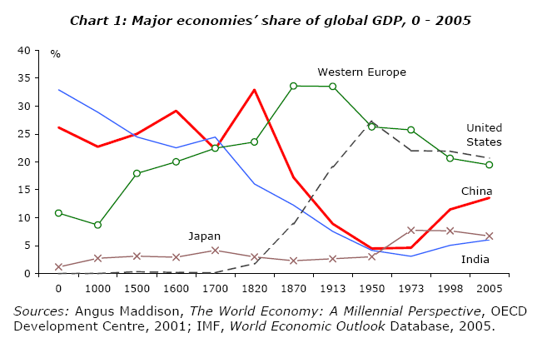
The rise of Chinese Economy
1839: Opium War
1978:Reform and open policy
NB: GDP measured in real terms (PPP)

Slide 6
The rise of Chinese Economy

Slide 7
The rise of Chinese Economy

Slide 8
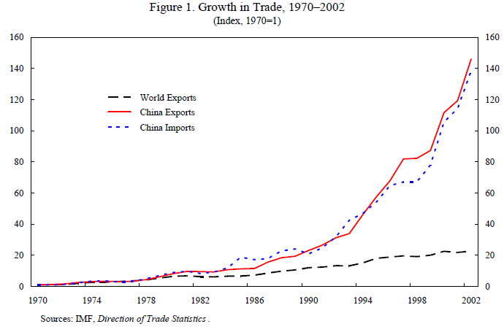
China’s integration into the world Economy

Slide 9
China’s integration into the world Economy

Slide 10
China’s integration into the world Economy

Slide 11
China’s integration into the world Economy

Slide 12
China’s integration into the world Economy
Top Countries by Foreign Exchange Reserves (March 2012)
Rank | Country | Billion USD (end of month)
1 | People's Republic of China | $ 3,305
2 | Japan | $ 1,303
3 | Eurozone | $ 936
4 | Saudi Arabia | $ 541
5 | Russia | $ 514

Slide 13
China’s integration into the world Economy
Top Foreign holders of U.S. Treasuries (March 2009)
Holder
Total
China
$767.9 Billion
Japan
$686.7 Billion
Caribbean
$213.6 Billion
OPEC
$192.0 Billion
Russia
$138.4 Billion
United Kingdom
$128.2 Billion

Slide 14
Poverty reduction in China
Source: Qian Yingyi , 2009

Slide 15
Summary
China
is the world’s third largest economy, and top three largest exporter in manufacturing
has uninterrupted growth (average 10% per year) since 1979
has the world’s largest foreign exchange reserve (most in US dollars)
has lifted hundreds of millions of people above poverty

Slide 16
The Puzzle of China’s Rise
China’s economic miracle is not anticipated by economists
“ No observer,participant,or analyst, either in Beijing or elsewhere , anticipated China’s enormous surge, now entering its fourth decade, which has rocketed the People’s Republic to unprecedented global prominence”
- Thomas Rawski

Slide 17
Outline
China’s rise and integration into the world economy
Drivers behind China’s economic miracle
Challenges to China’s sustainable economic growth
The current financial crisis and China’s role in the world economy

Slide 18
Drivers of China’s rise
Successful transition reform planned to market economy
Opening up to the world under in the new era of globalisation

Slide 19
Transition from Planned to market economy
Problems of the planned economy pre-1978

Slide 20

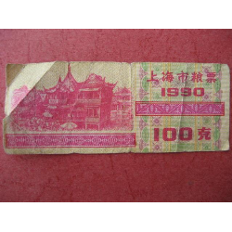
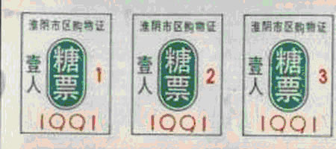
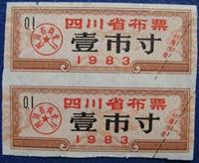
Coupons of the Planned economy

Slide 21
Transition from Planned to market economy
Problems of the planned economy pre-1978
Reform strategy : options faced by Deng
  Gradualism v.s. Big Bang
  Economic reform first vs. Political reform first

Slide 22
Transition from Planned to market economy
Problems of the planned economy pre-1978
Reform strategy : options faced by Deng
  Gradualism v.s. Big Bang
  Economic reform first vs. Political reform first
Unusual path of transition based on experimentalism
  1979-1992: the first stage, reforming the planning system
    Agriculture, market price liberalisation, profit incentives in state enterprises, special economic zones, financial reform
  1993-present: the second stage, building the market system
    Privatisation of state enterprises, FDI and trade liberalisation, constitutional amendments on private ownership , WTO entry

Slide 23
Transition from Planned to market economy

Slide 24
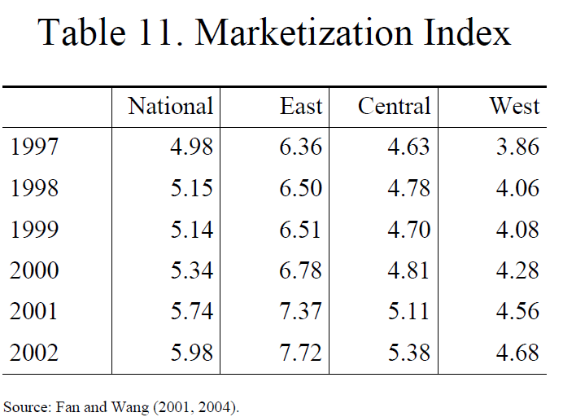
Transition from Planned to market economy

Slide 25
China’s opening up to the world economy
Trade liberalisation

Slide 26
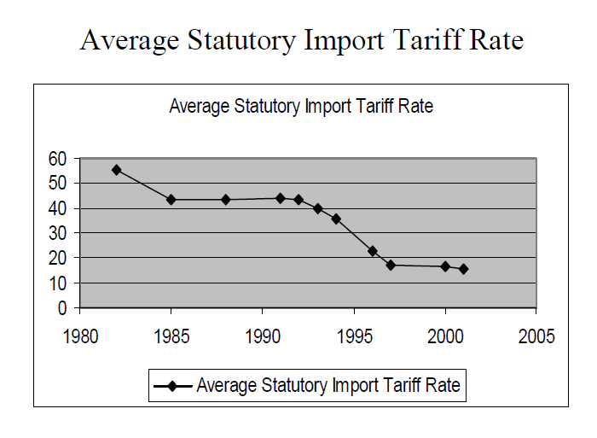
China’s opening up to the world economy

Slide 27
China’s opening up to the world economy
Trade liberalisation
Foreign direct investment liberalisation

Slide 28
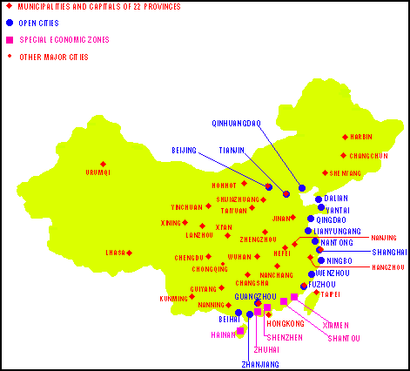
China’s opening up to the world economy

Slide 29
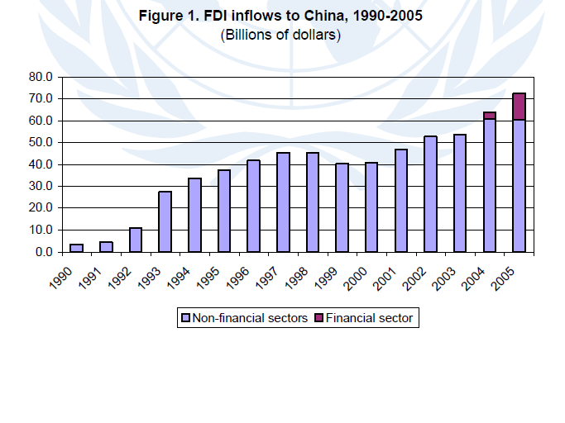
China’s opening up to the world economy

Slide 30
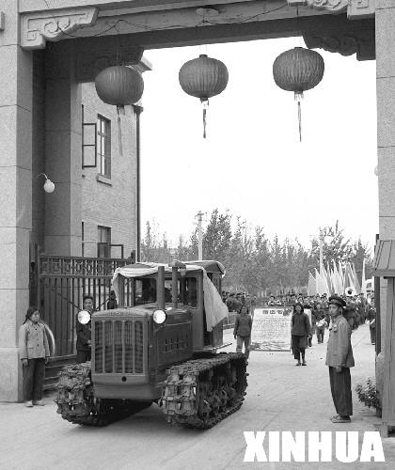
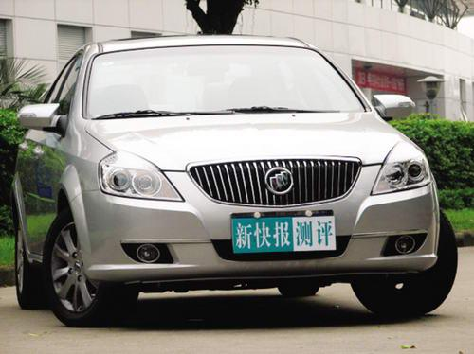
China’s opening up to the world economy
“Forward” truck (1980s)
Shanghai General Motor(2008)

Slide 31
Outline
China’s rise and integration into the world economy
Drivers behind China’s economic miracle
Challenges to China’s sustainable economic growth
The current financial crisis and China’s role in the world economy

Slide 32
Problems of China’s sustainable growth
Low GDP per capita and rising inequality

Slide 33
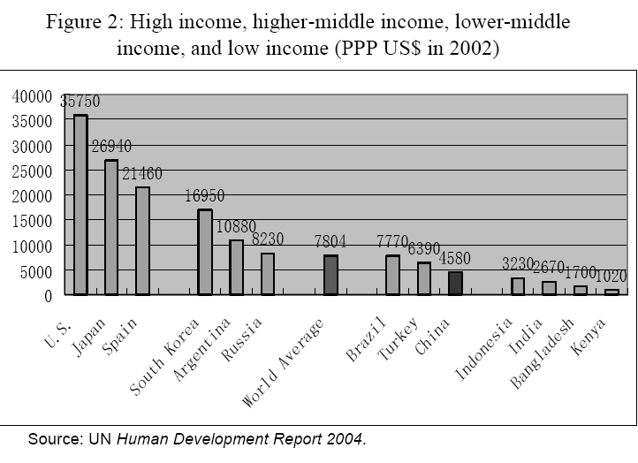
Problems of China’s sustainable growth

Slide 34
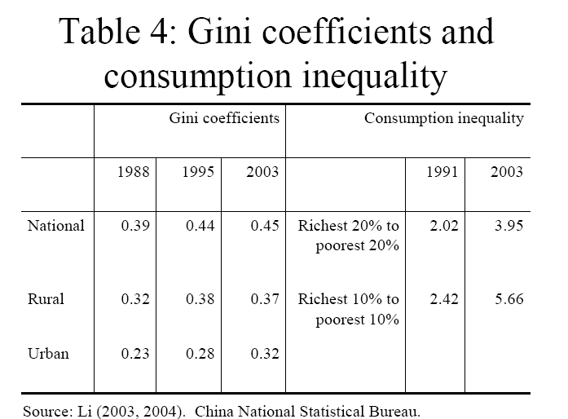
Problems of China’s sustainable growth

Slide 35
Problems of China’s sustainable growth
Low GDP per capita and rising inequality
Heavy state intervention and the rule of law

Slide 36
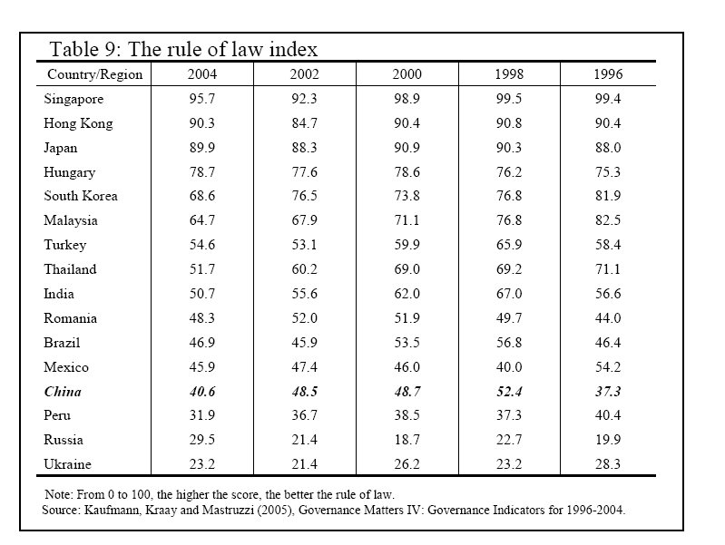
Problems of China’s sustainable growth

Slide 37
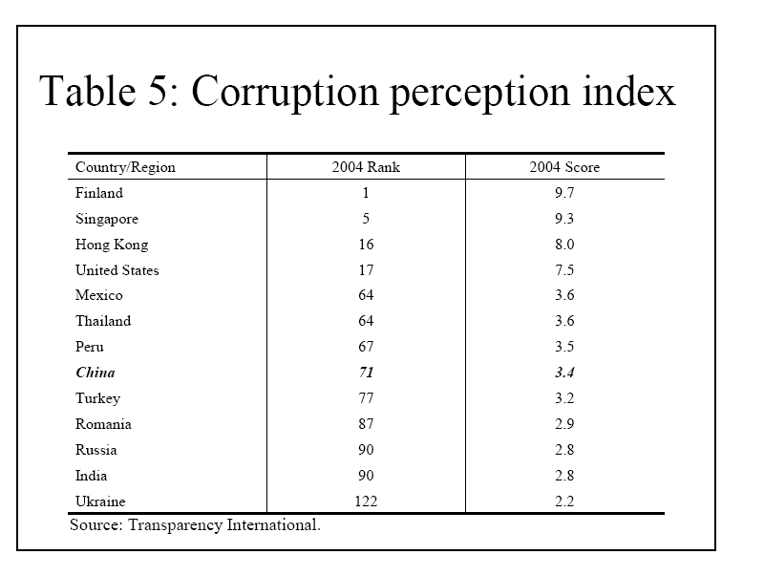
Problems of China’s sustainable growth

Slide 38
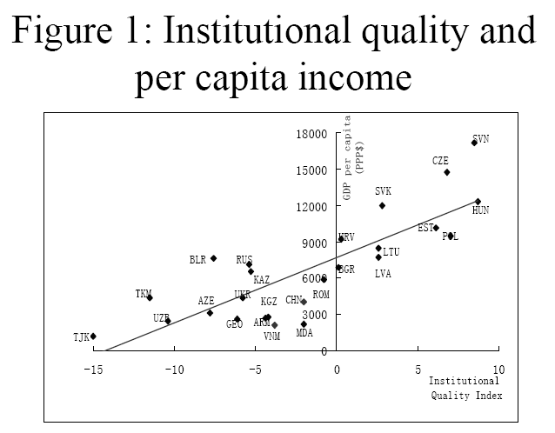

Slide 39
Problems of China’s sustainable growth
Low GDP per capita and rising inequality
Heavy state intervention and the rule of law
Growth mainly depends on inputs/capital accumulation, rather than innovation and technology

Slide 41
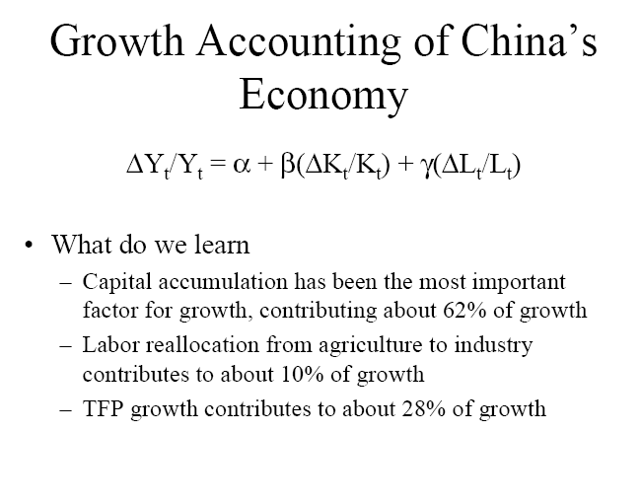
Problems of China’s sustainable growth
Source: Qian 2009

Slide 42
Problems of China’s sustainable growth
Low GDP per capita and rising inequality
Heavy state intervention and the rule of law
Growth mainly depends on inputs rather than technology
Political reform lagging behind economic reform

Slide 43

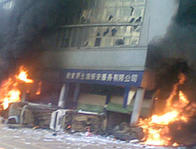
Problems of China’s sustainable growth
Political conflicts increased by seven folds in the last decade according to police record
Poor ability of the government to manage conflicts
Long run growth at risk in the absence of a stable political environment

Slide 44
Outline
China’s rise and integration into the world economy
Drivers behind China’s economic miracle
Challenges to China’s sustainable economic growth
The current financial crisis and China’s role in the world economy

Slide 45
Financial Crisis and China
Effects of the financial crisis on Chinese economy
China’s response to the crisis
China’s role in stabilising the world economy during the current crisis

Slide 46
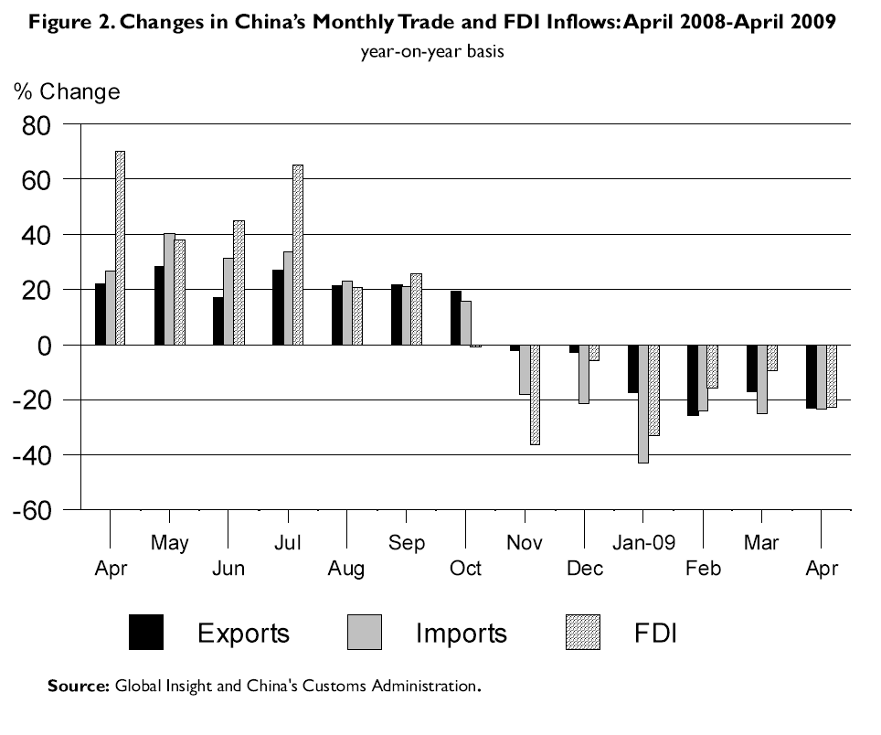
Effects of the crisis

Slide 47
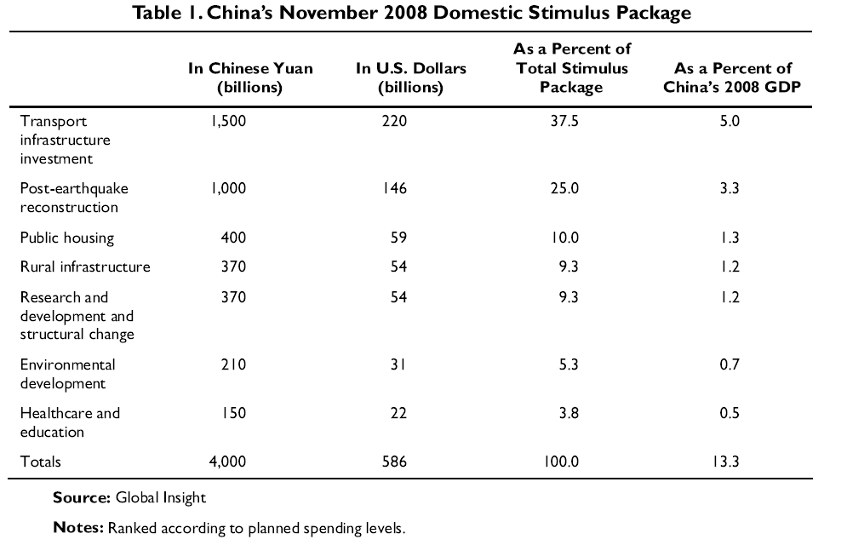
Response to the crisis

Slide 48
China’s role in stabilising the world economy
GDP growth rate (%)

Slide 49
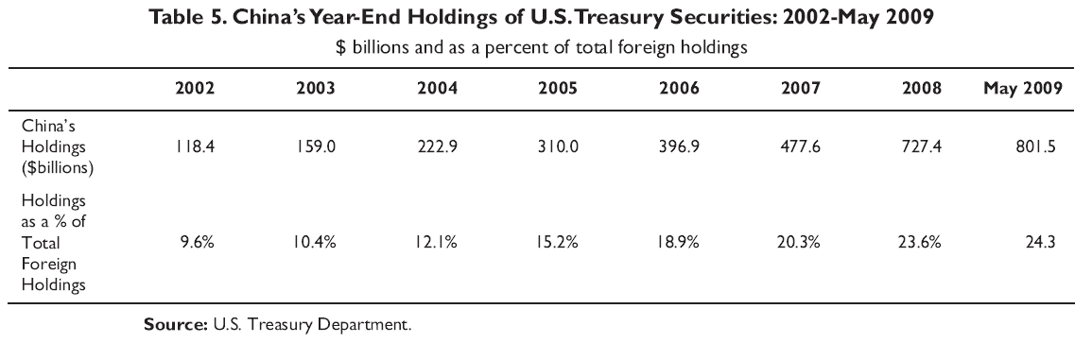
China’s role in stabilising the world economy

Slide 50
Conclusion
China has achieved unprecedented economic success in the last three decades .
China is already a major economic power, but still not a superpower
There are many severe pitfalls which China has to overcome before it can become an dominant player in the international economic scene on a sustained basis
China can not save the world from the crisis , but it can, and should, help by playing a responsible role in the stabilising the world economy in the years to come.

