Slide 1



Festschrift Conference in Honour of
Professor Chris Milner
Organised in conjunction with The World Economy
Hosted by the School of Economics, CREDIT and GEP, University of Nottingham
Sponsored by Maxwell Stamp

Slide 2
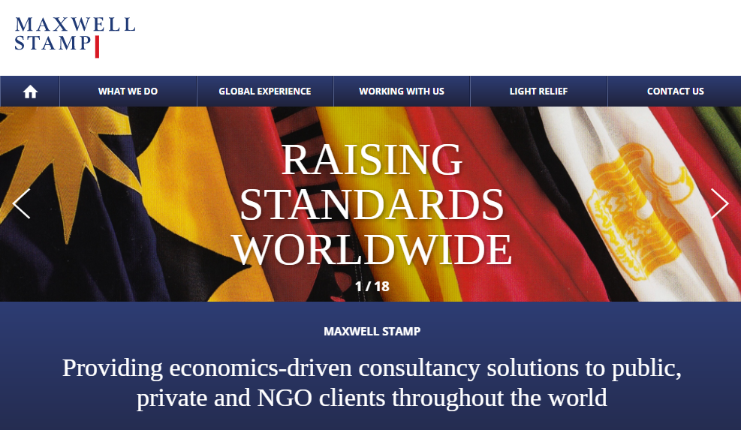

Slide 3
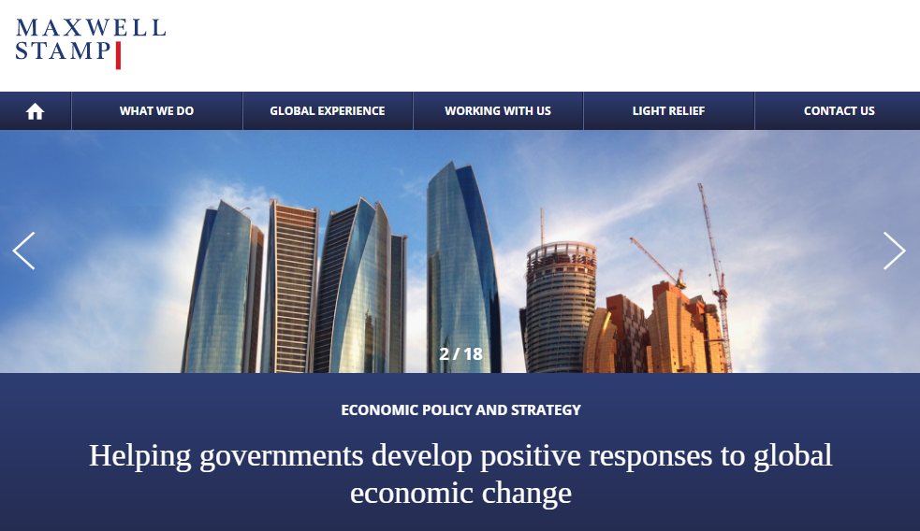

Slide 4
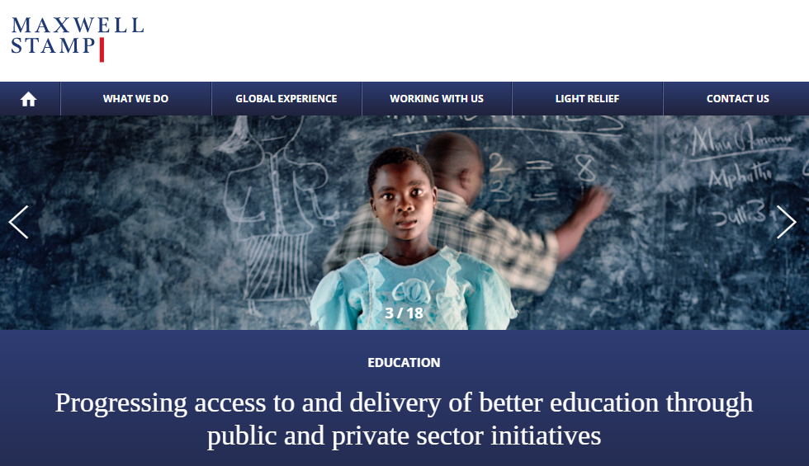

Slide 5
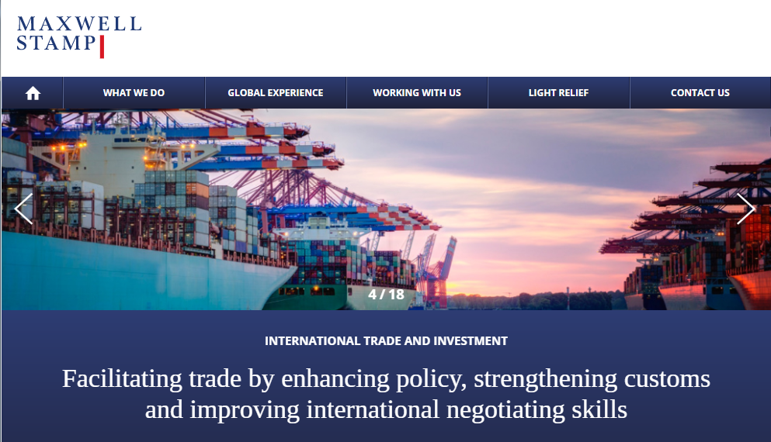

Slide 6
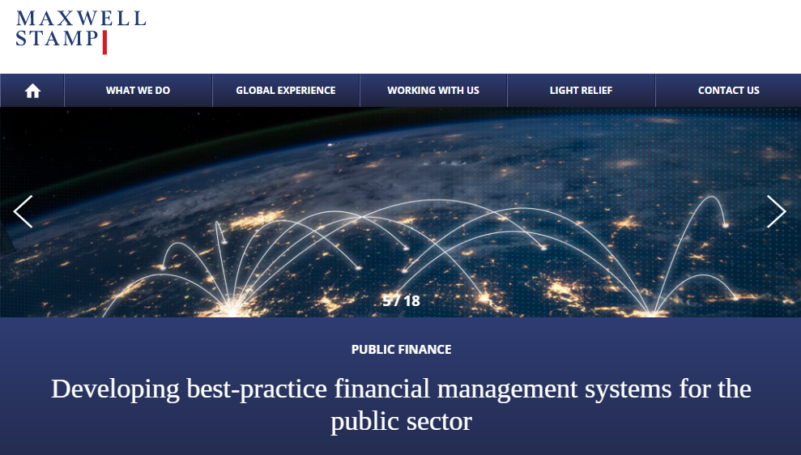

Slide 7
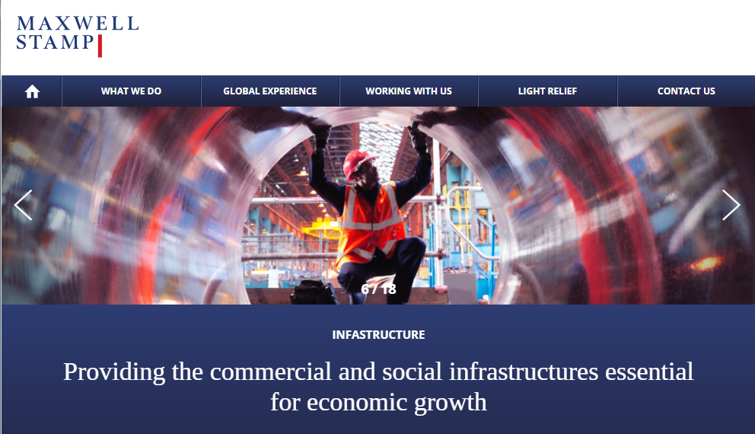

Slide 8
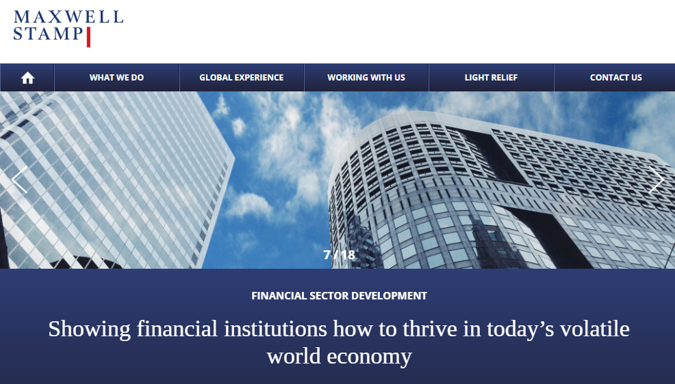

Slide 9
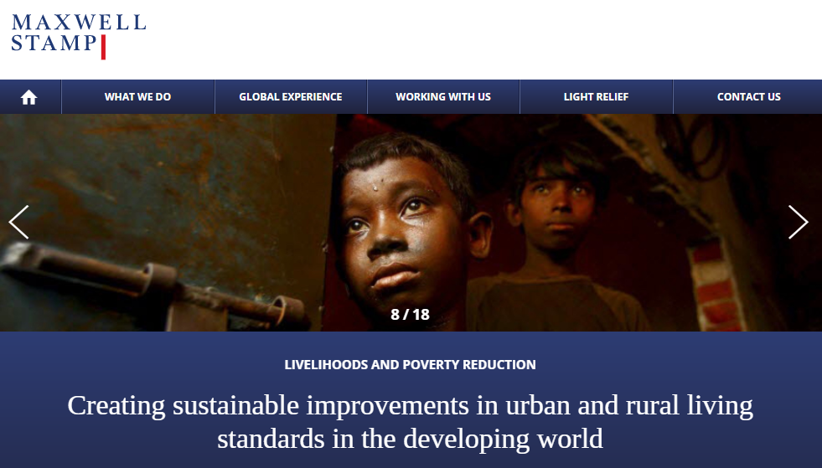

Slide 10
