Slide 1
David Smith
David Smith
Sunday Times
September 2011
Copyright © 2011 CIL Ltd. All rights reserved.

Slide 2
The world in an age of instability
Can emerging economies meet the growth challenge?

Slide 3
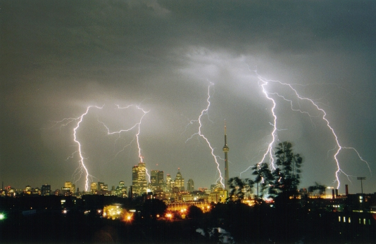
Three years after the biggest financial storm in a century

Slide 4
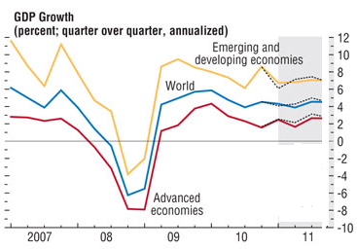
The global recovery started well

Slide 5
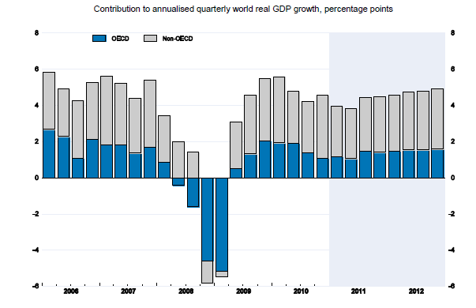
Driven by emerging economies

Slide 6
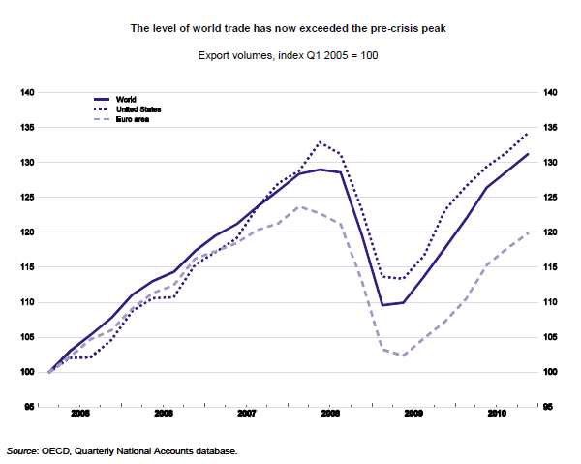
And a world trade rebound

Slide 7
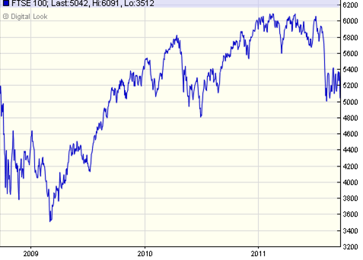
But stock markets tell the story
7

Slide 8
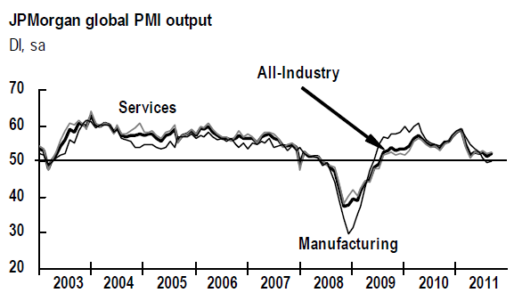
Of a world that’s lost momentum

Slide 9
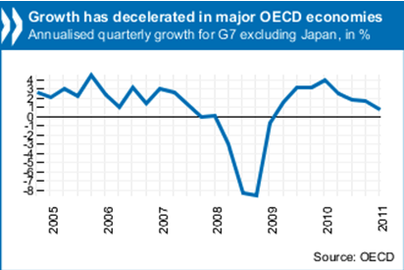
Particularly in advanced economies

Slide 10
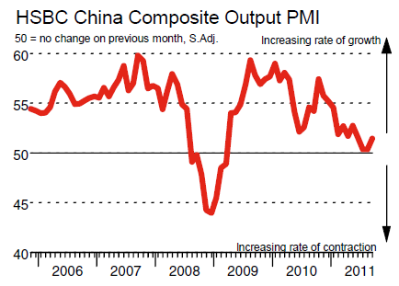
But even China is not immune

Slide 11
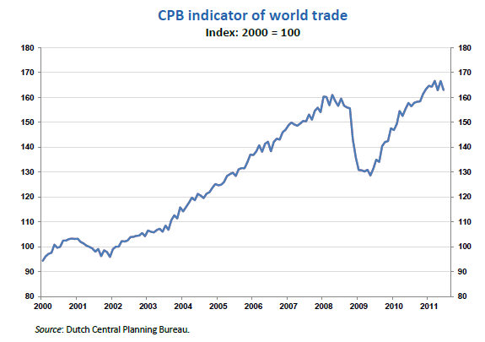
And the trade rebound has stalled

Slide 12
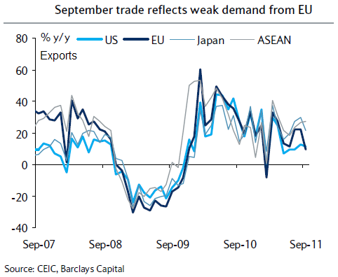
Hitting Chinese exports

Slide 13
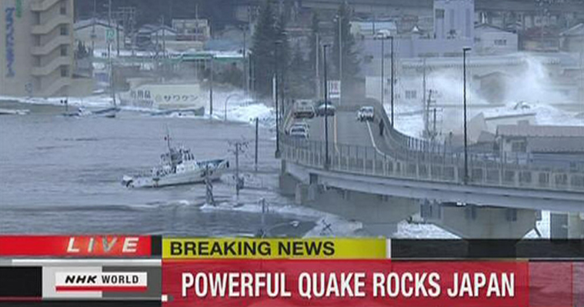
Because of this …

Slide 14
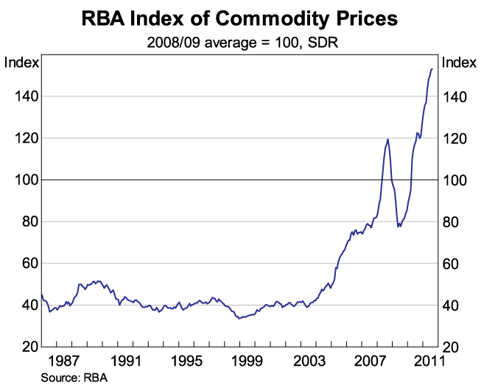
Commodity-driven inflation

Slide 15
The US debt downgrade

Slide 16
Fears of another banking crisis

Slide 17
And most of all the eurozone

Slide 18
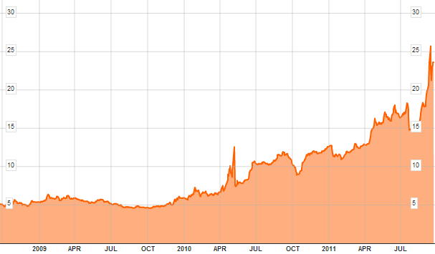
Beware of Greeks bearing bonds

Slide 19
A short-term eurozone ‘bazooka’
Recapitalising eurozone banks (as in the US and UK in 2008-9.
Using and leveraging the €440 billion European Financial Stability Facility.
Increasing the haircuts/partial default of Greece, while ring-fencing others.

Slide 20
Long-term options for the euro zone
A rapid move towards fiscal union – spreading the deficits around.
Muddling through
Partial break-up: Greece leaves and defaults, ring-fence and bolster banks and the rest.
Narrowing the euro: a smaller number of compatible economies stay in.
Disintegration and a return to national currencies.

Slide 21
An emerging economy locomotive?

Slide 22
How interdependent is the world?
Let me begin by stating my problem. For the past hundred years the rate of growth of output in the developing world has depended on the rate of growth of output in the developed world. When the developed grow fast the developing grow fast, and when the developed slow down, the developing slow down. Is this linkage inevitable? Arthur Lewis, 1979 Nobel Lecture

Slide 23
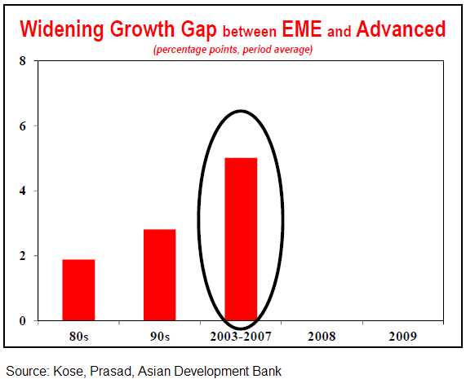
An emerging/advanced growth gap

Slide 24
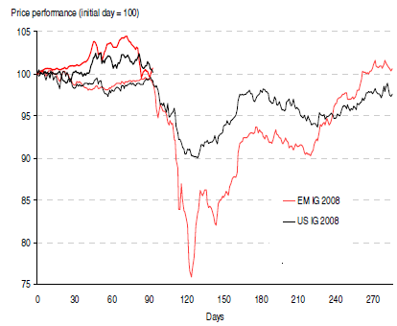
2008 gave decoupling a bad name

Slide 25
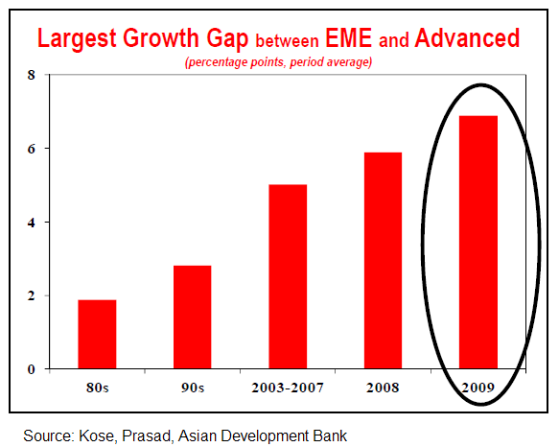
But in fact the growth gap widened

Slide 26
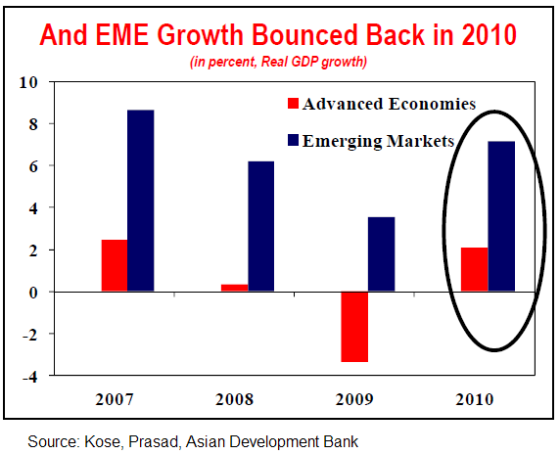
And was maintained in the upturn

Slide 27
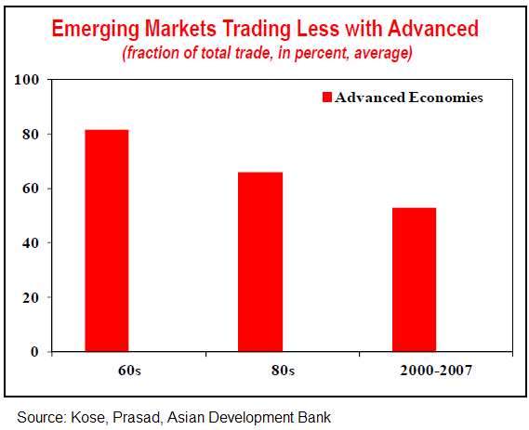
Trade dependency has declined

Slide 28
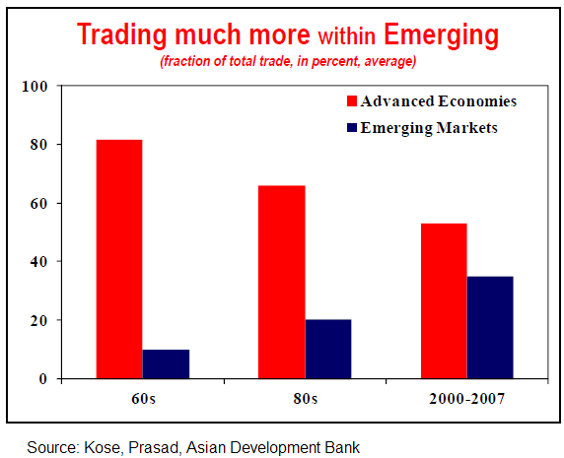
More dependent on other emerging

Slide 29
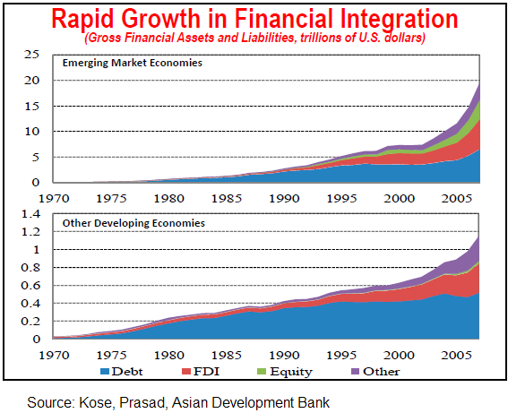
But financial linkages are stronger

Slide 30
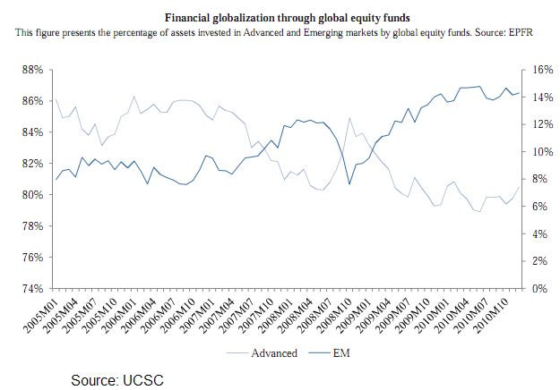
Financial coupling/real decoupling

Slide 31
Fiscal divergence (1)

Slide 32
Fiscal divergence (2)

Slide 33
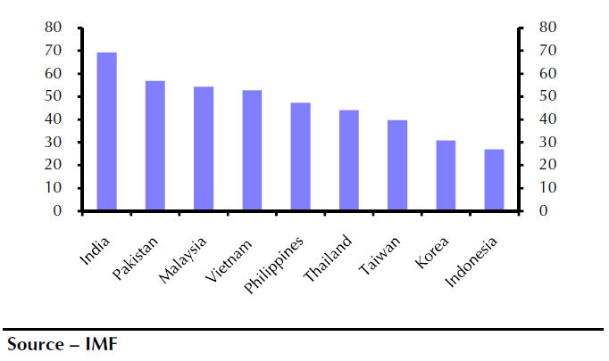
Generally lower levels of public debt

Slide 34
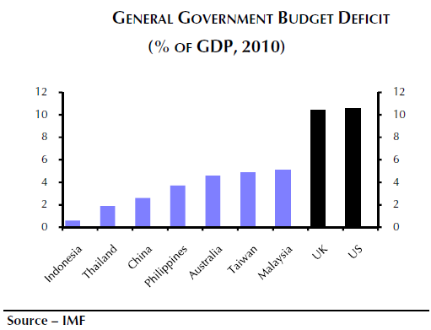
And lower budget deficits

Slide 35
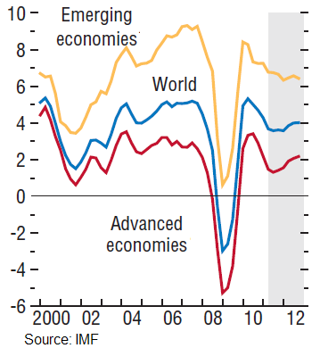
Economic divergence to persist

Slide 36
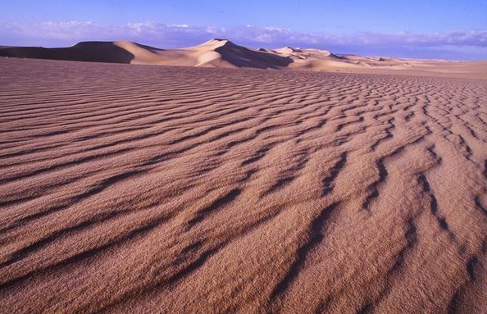
The global economy’s shifting sands

Slide 37
China and India were mighty before

Slide 38
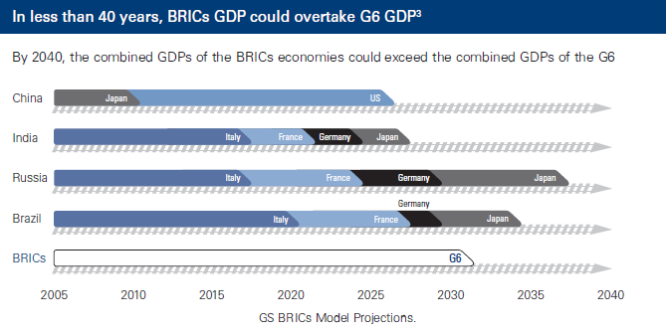
And they’re becoming mighty again

Slide 39
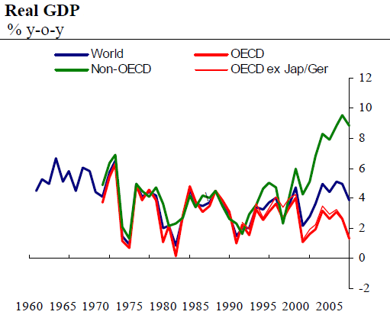
Start of the great divergence

Slide 40
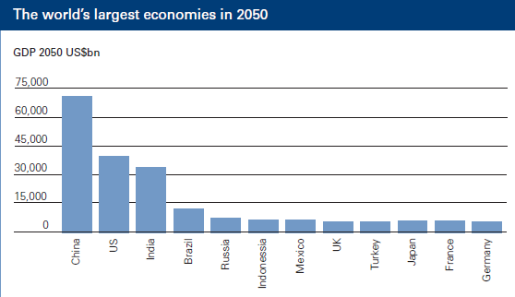
Can anything stop their rise?

Slide 41
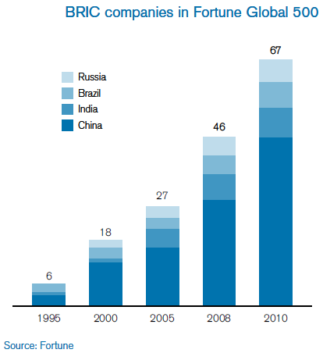
BRICs’ firms start to show their power

Slide 42
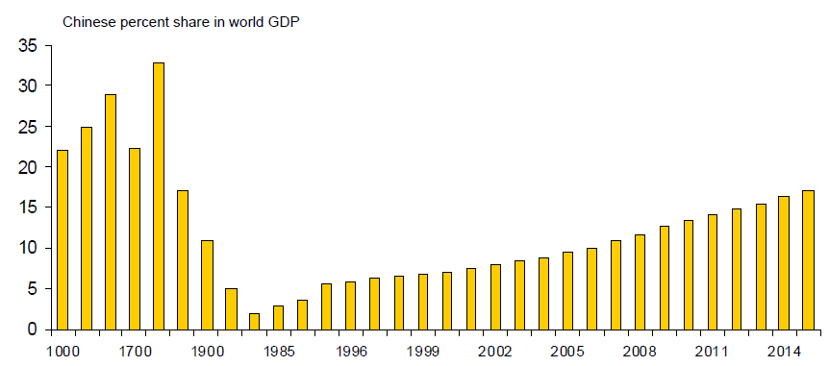
Back to the future

Slide 43
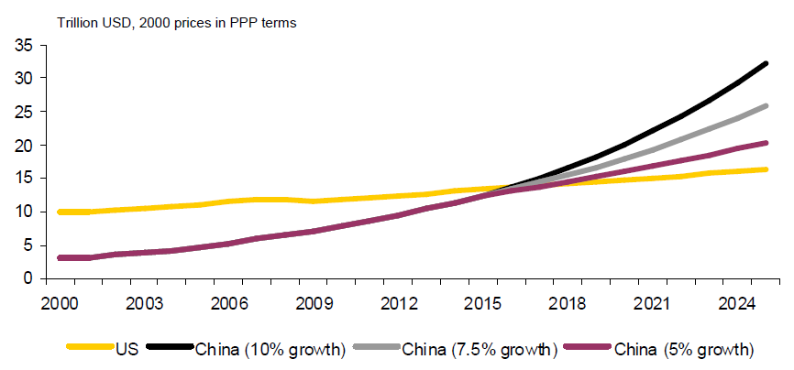
But how quickly will it happen?

Slide 44
Driving the rest of the world
‘China and India, with large, increasingly urban populations, are both in the midst of their own ‘industrial revolutions’, igniting the Brazilian and Russian economies in a demand-and-supply cycle.’ Goldman Sachs

Slide 45
China reformed earlier

Slide 46
And barely missed a beat in the crisis

Slide 47
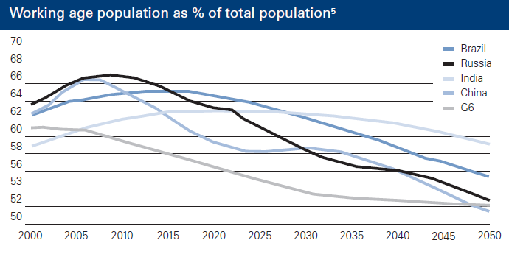
India’s demographic advantage

Slide 48
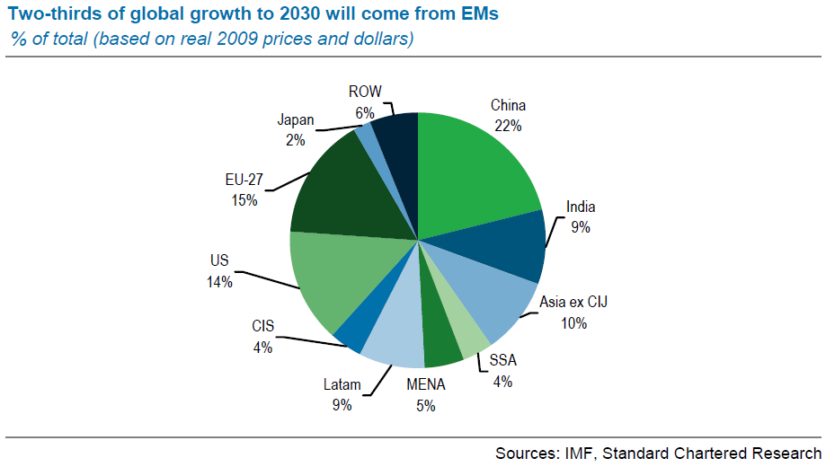
Where the growth will come from

Slide 49
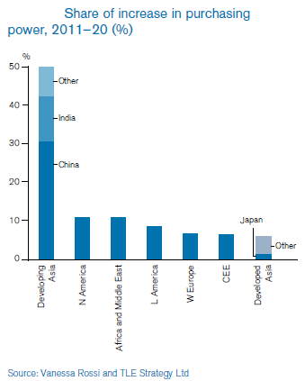
Mainly but not just Asia

Slide 50
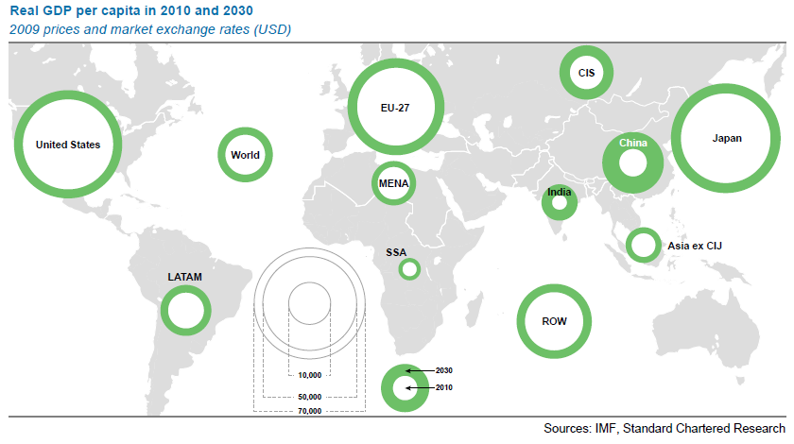
Closing the per capita gap

Slide 51
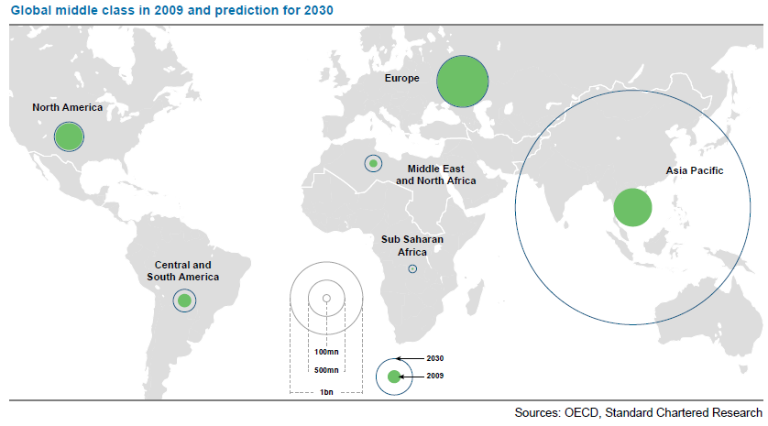
A rising Asian middle class

Slide 52
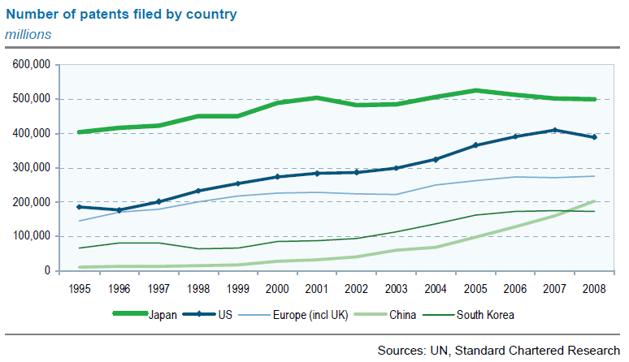
Closing the innovation gap?

Slide 53
Accelerating the global shift
2007: China was expected to overtake Japan’s GDP in 2015, America in the mid-2030s.
2010: China has already overtaken Japan; will overtake America in the 2020s.
Global crisis and its aftermath has accelerated the shift by 5-10 years.
China, India and America will be the world’s big three: only one is flagging.

Slide 54
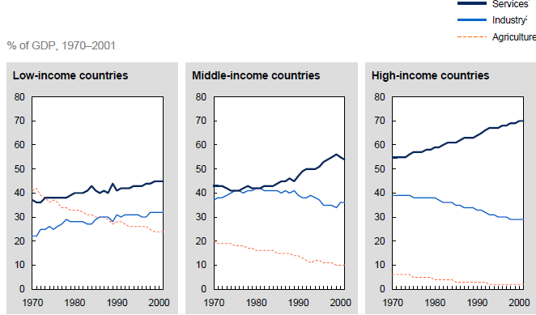
Agriculture to manufacturing to services

Slide 55
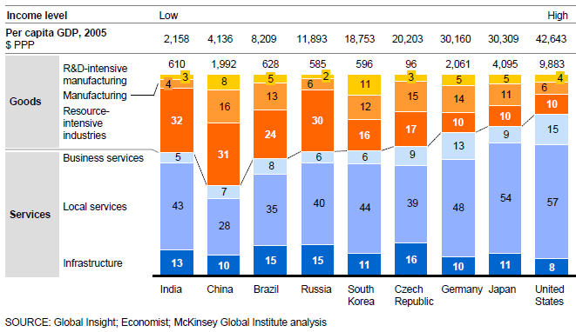
Emerging world will shift to services

Slide 56
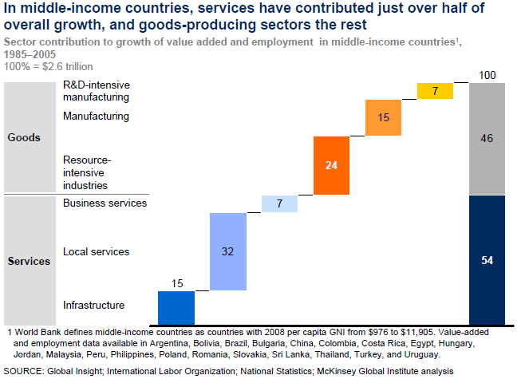
Which are the growth sectors? (1)

Slide 57
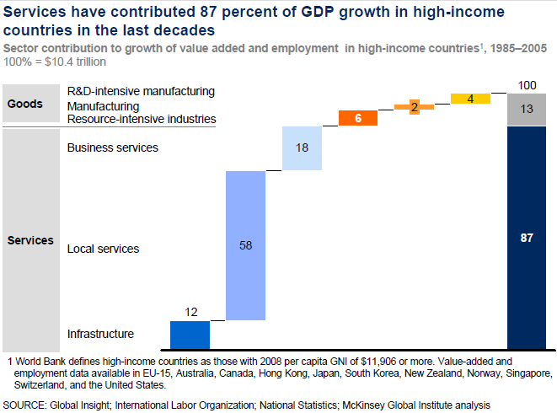
Which are the growth sectors? (2)

Slide 58
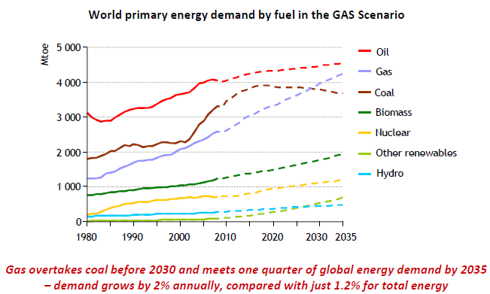
Dash for gas to prevent energy gap

Slide 59
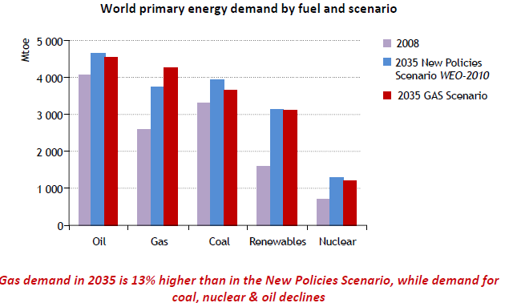
In a time of still-rising energy demand

Slide 60
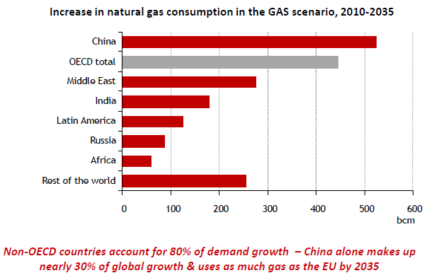
Particularly in the emerging world

Slide 61
What could go wrong (short-term)?
Credit Crunch II – refinancing and deleveraging by the banks.
Sovereign debt – the euro zone and beyond.
Currency wars – China versus America as the new heavyweight bout but also others.
Protectionism – either provoked by or in addition to currency manipulation.
Fiscal consolidation and the economic and political reaction to it.
The unknown unknowns.

Slide 62
What could go wrong (long-term?)
Politics – a backlash against capitalism; pressures for greater democracy; inequality.
Growth momentum fades dramatically as the easy catch-up phase comes to an end.
Globalisation goes into reverse, led by the actions of the advanced economies.
Resource constraints.

Slide 63
Summing up
Global crisis has been a big moment for the BRICs and emerging economies in general
They can meet the growth challenge.
Shift to the East advanced by 5-10 years – maybe more - as a result of the crisis
In the short to medium-term, powerful industrial impetus, strong demand for energy, commodities.
Biggest danger is a second advanced-world financial crisis. Financial linkages ensure an emerging-economy effect.

