Slide 1
Care planning: the law, accountability and the patient.
Richard Pitt and Nigel Plant
November 2013

Slide 2
Agenda’s of care
Service user involvement
Expert patients
Partnership working
Interprofessional working
Compassionate care
Accountable practice

Slide 3
The purpose of care plans
Reflect the needs of the patient
Communicate nursing actions
Demonstrate our philosophy and values of care
Patient centred
Individualised
Recovery focussed- personalised and negotiated
Reflect the context of care , the patients support etc

Slide 4
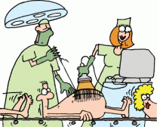
‘Production line mentality’ (Crawford & Brown, 2010)

Slide 5
Care plans aren’t -
Defensive accounts
Records for the coroner
Not an audit tool
A check list of tasks completed

Slide 6
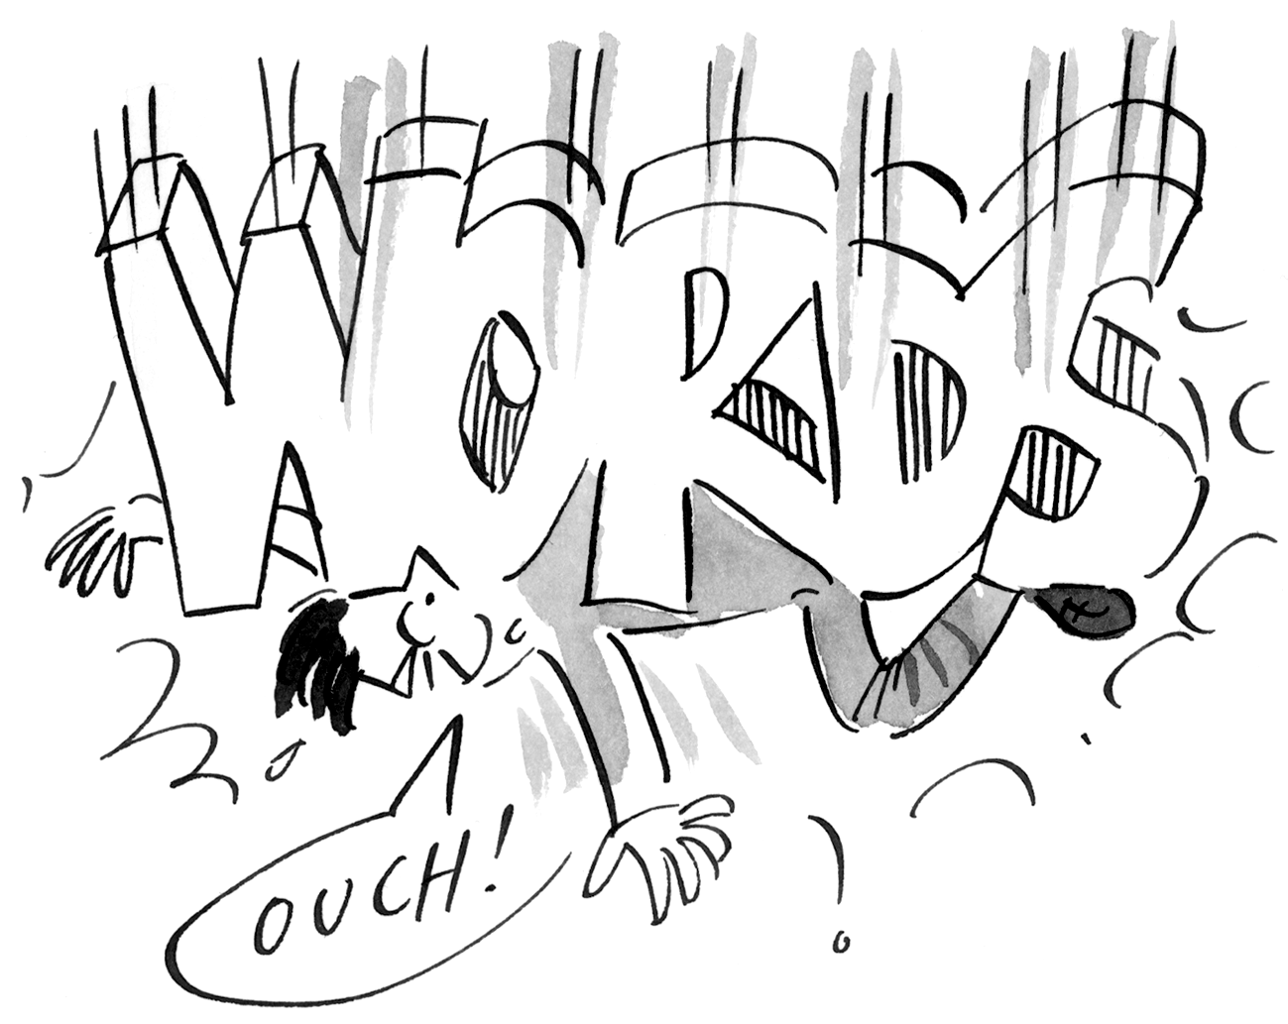
Poor communication
Fatalities
Poor compliance
Patient dissatisfaction
Poor outcomes
Litigation
Patient disempowerment
© Nelson Thornes 2006
Francis Report 2013, Berwick Report 2013

Slide 7
Accountable practice
What is it to be accountable?
Common themes:
Accountability v responsibility
Answerability
Blame
To give account of ones actions

Slide 8
But also:
Professional practice/professional standing
Best evidence
The patients experience
Improving service delivery
Quality of care
(Care Quality Commission)

Slide 9
Accountability and the Law:
Duty of care
Confidentiality/ sharing of information
Data protection
Safeguarding
(MHA 1983; MCA 2005;

Slide 10
Professional accountability
Professional standards
Duty of care
Standards for record keeping
Local policy
Patients preferences
Evidence based intervention/care
NMC; GMC; HCPC; GPC

Slide 11
Accountability and Ethics
Autonomy
Beneficence
Non maleficence
Justice
(Beuchamp and Childress 1981)
Truth telling and honesty
Over to you……

Slide 12
The self: expectations
Personal Values
Beliefs
Attitudes
Responsibility
Standards

Slide 13
Discussion
And
Questions

