Slide 1

Responsible innovation – some lessons from nanotechnology
Richard Jones
University of Sheffield

Slide 2
What do we mean by “responsible innovation”?
(How) can we steer the development of science and technology so that it meets widely shared societal goals?
An old idea – but every generation needs to re-examine it in a new science and innovation policy context

Slide 3
“Responsible innovation” now
A term of art in science policy discourse, e.g.
Owen, Stilgoe, Macnaghten (for EPSRC)
“A commitment to care for the future through collective stewardship of science and innovation in the present”
Von Schomberg (for EU Framework Program)
“Responsible Research and Innovation is a transparent, interactive process by which societal actors and innovators become mutually responsive to each other with a view to the (ethical) acceptability, sustainability and societal desirability of the innovation process and its marketable products( in order to allow a proper embedding of scientific and technological advances in our society).”

Slide 4
Von Schomberg’s four signatures of irresponsible innovation
Technology push
  GMOs in Europe
Neglect of fundamental ethical principles
  E-patient records in the Netherlands
Policy Pull
  Security theatre
Lack of precautionary measures and technology foresight
  Asbestos, hormones as growth promoters

Slide 5
Collingridge’s control dilemma
When a technology is young enough to influence its future trajectory, you can’t know where it will lead
When a technology is mature enough for you to have a good idea of its consequences, it’s too late to change it – it’s locked-in

Slide 6
Why is responsible innovation difficult?
Because we don’t know the future
Can we be responsible in the way we think about the future?
  No
    Because the future is essentially pre-ordained (Technological determinists)
    Because of the radical limits to our knowledge (Hayekians)
  Yes
    Because we can rationally plan the outcomes we desire (State planners)
    Because we can reflexively adjust the process of innovation as it happens through a process of “anticipation, reflection and inclusive deliberation” (Responsible innovators)

Slide 7
Many dimensions of responsibility
Responsible practise of science
Responsibility about potential consequences – health, environmental etc
Responsibility about visions of the future
Responsible salesmanship
  To governments and funding agencies
  To investors
  To the public
Notes:
The technological imaginary

Slide 8
“Emerging technologies”
The focus has been on “emerging technologies”
  Nanotechnology
  Synthetic biology
  Geoengineering
  Stem cell science
  etc.
Potentially controversial areas at an early stage of development…
… but is it right to think about such areas as “things” that “emerge”?

Slide 9
What is nanotechnology?
A new interdisciplinary branch of applied science which creates useful materials and devices by control of matter on length scales from 1 - 100 nm
A socio-political project to reshape the physical science research community, driven by changes in science policy and the wider innovation landscape

Slide 10
Some disclaimers
This is a personal view…
My views are:
Not systematically supported by evidence
Based on my experience primarily in the UK
Not objective in that I was a participant, not an observer

Slide 11
1987-now: experimental soft matter physicist
1994 – size dependent properties in polymers
Glassy polymers become melt-like when confined to nanoscale dimensions

Slide 12
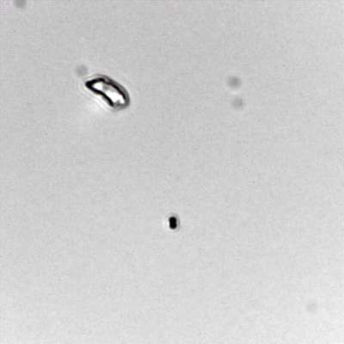
1987-now: experimental soft matter physicist
1994 – size dependent properties in polymers
2010 – swimming micro- and nano- particles
Glassy polymers become melt-like when confined to nanoscale dimensions
Randomly aggregated self-motile particles exhibit different swimming behaviours

Slide 13
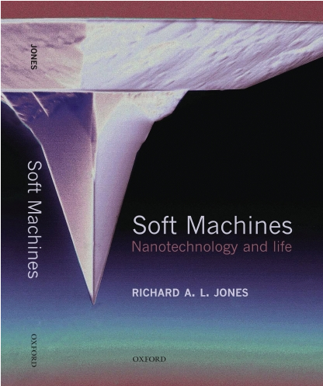
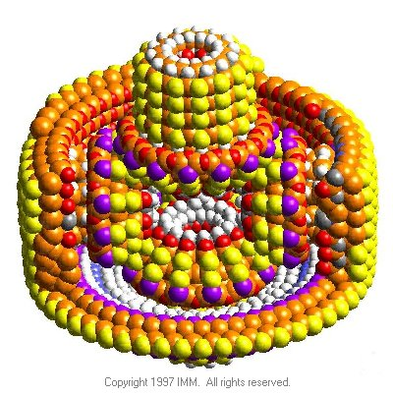
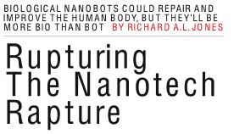
1998 – now: “soft nanotechnology” advocate
A critique of Drexler’s vision of nanotechnology as “the principles of mechanical engineering applied to chemistry”
OUP, 2004
“Nanotechnology should be more like biology than engineering”
2008 IEEE Spectrum
Singularity special issue

Slide 14
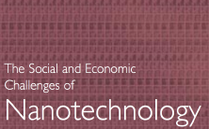

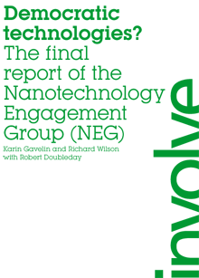
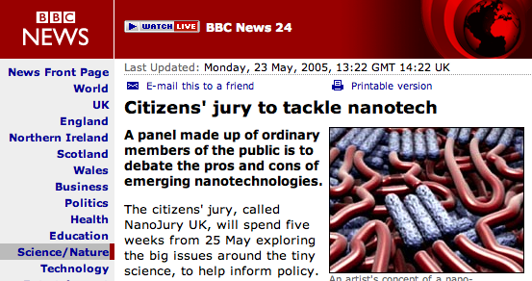
2005 – now: advocate for public engagement
2007
Wood, Jones, Geldart 2003
Nanojury UK
2005

Slide 15
2007 - 2009: Programme Director RCUK “Nanoscience engineering through application”
2005 Physics International Review:
‘One particular area still requiring attention is nanoscience. This area of research has become a very large area of emphasis worldwide, yet the UK lacks coherence and international visibility in the field.’
Response:
“EPSRC will lead a focused programme, committing £40m, designed to pull basic research through to application. This will consolidate earlier investments, support goal-driven research programmes and generate critical mass in required skills in this interdisciplinary subject.”
New research through goal-oriented “Grand Challenges”

Slide 16
Where did nanotechnology come from?
From outside science:
From within science:
A name
Many pre-existing fields whose existing rhetoric could be adapted, contending to inherit the label
New images and metaphors from popular science writers, science fiction gain wide currency
Major changes in the (Anglo-American) innovation system follow from 1980s political re-alignment
Move from discovering phenomena and testing theories to making gizmos
Biotechnology envy from the physical sciences
Promoters of “nanobusiness”
Discourse of national competitiveness – the “China threat”
An unerring nose for funding opportunities

Slide 17
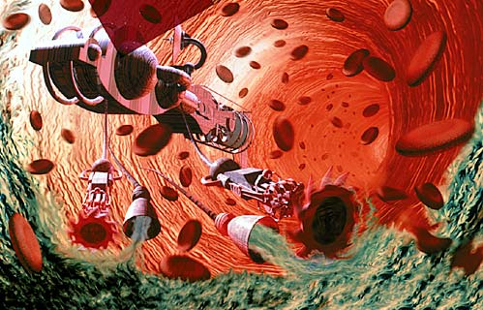
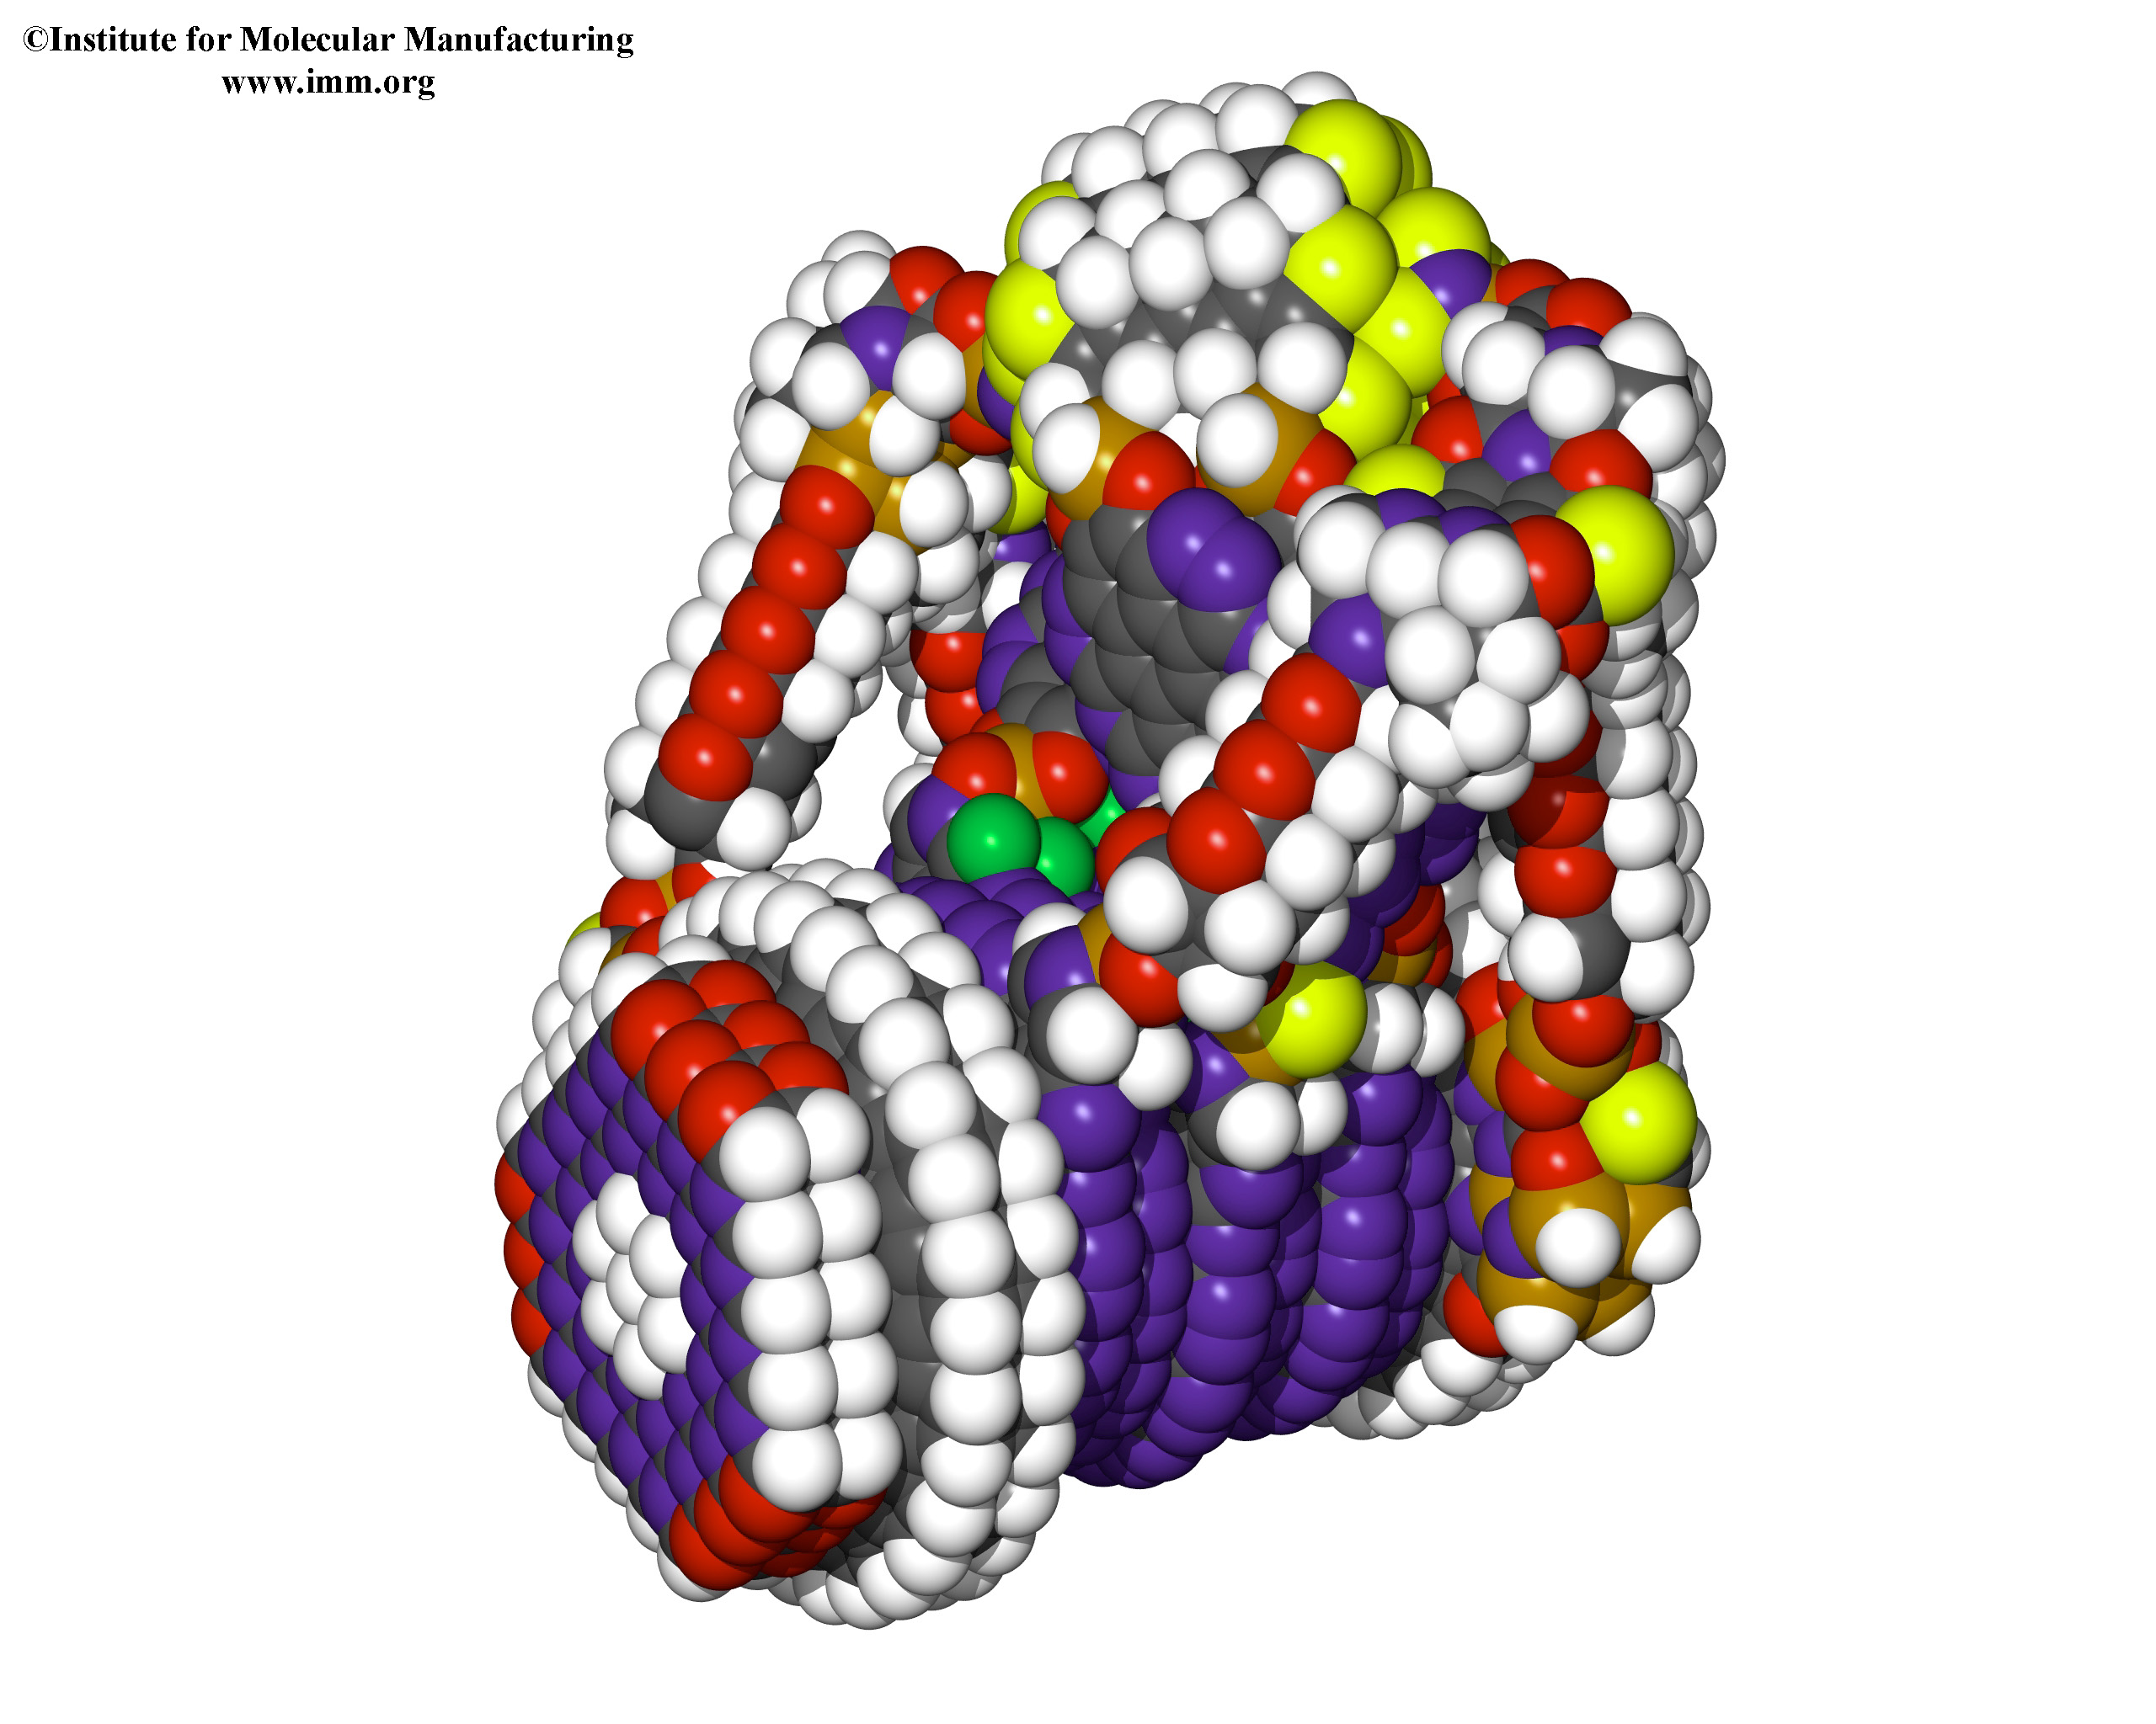
A name:
Nanotechnology
A stock of images
A set of slogans:
“engines of creation”
“shaping the world atom by atom
“Software control of matter”

Slide 18
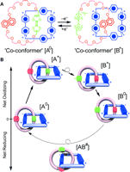
“We made a nanowidget”
We report the world’s first/smallest nanowidget
We describe a complex set of operations to make the nanowidget
We carried out a series of rather indirect measurements to demonstrate the nanowidget working
We summarise it all in this attractive cartoon, (ideal for powerpoint)
We promise that in the future, when such nanowidgets can be mass produced, something will be revolutionised
In the meantime, we have this nice paper in Nature/Science/Nano Letters

Slide 19
Between promises and applications…
Nanotechnology was forged from many already-existing fields
  Some were rich in promises
  Some already had applications
Each field had its own:
  Symbolic breakthroughs and famous victories
  Leaders, spokespeople, hierarchies
  Shared narratives

Slide 20
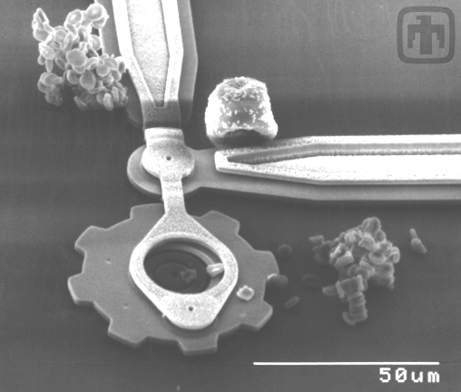
The many roots of nanotechnology
Precision engineering
The original sense introduced by Taniguchi, 1974

Slide 21
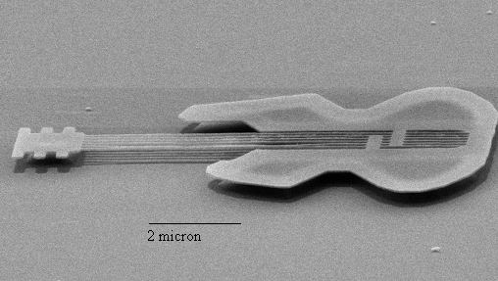
The many roots of nanotechnology
Microfabrication for microelectronics
Phase shift photolithography
E-beam lithography
Alec Broers

Slide 22
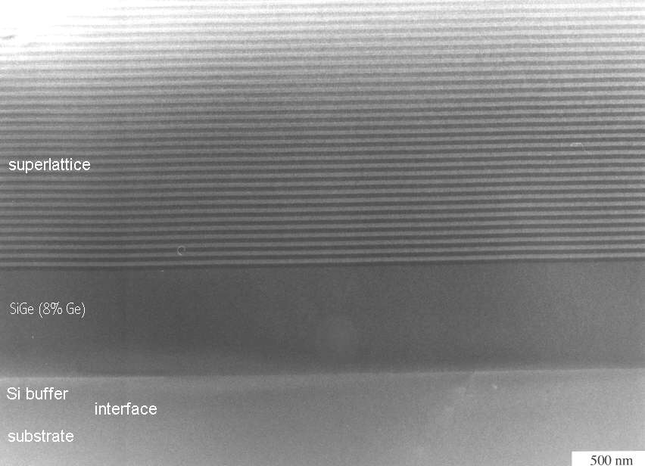
The many roots of nanotechnology
“Mesoscale physics” and low-dimensional semiconductors
Molecular beam epitaxy
Klaus von Klitzing

Slide 23
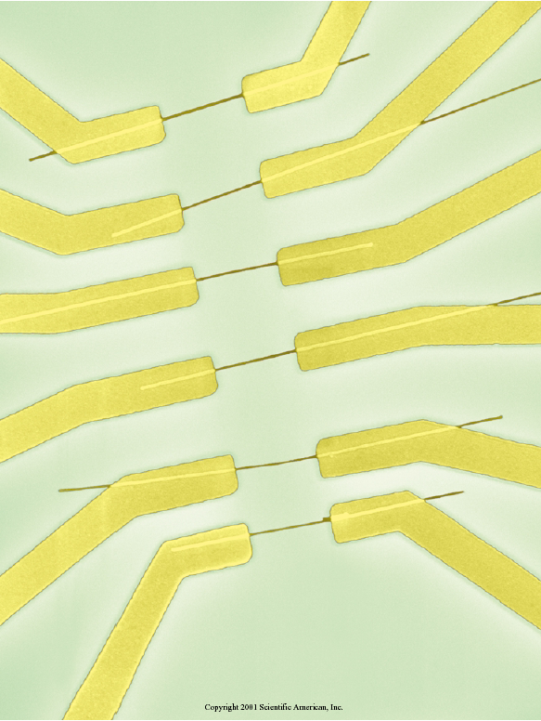
The many roots of nanotechnology
Molecular electronics
Aviram, Ratner
Schön
In the USA, a persistent louche reputation:
“The field suffers from an excess of imagination and a deficiency of accomplishment”
J. Hopfield, 1992

Slide 24
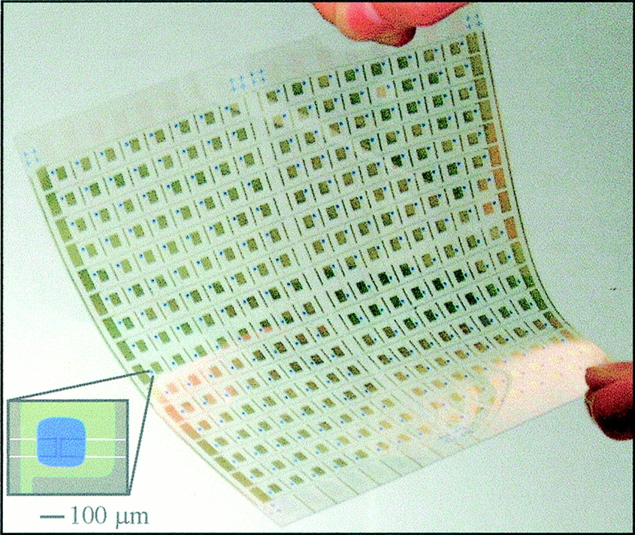
The many roots of nanotechnology
Plastic electronics
Alan Heeger, Richard Friend

Slide 25
The many roots of nanotechnology
Cluster chemistry
Smalley and Kroto

Slide 26
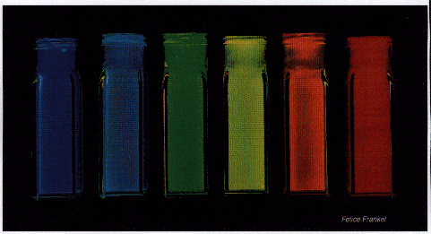
The many roots of nanotechnology
Colloid science and powder technology
Quantum dots
Nanoscale titanium dioxide

Slide 27
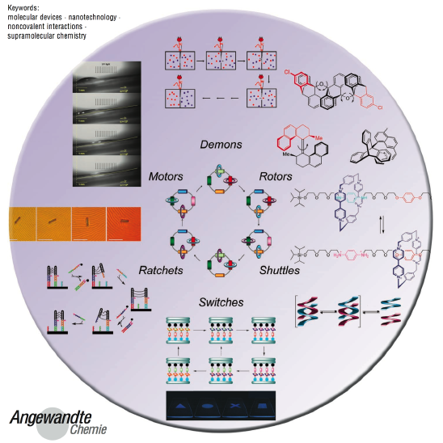
The many roots of nanotechnology
Supramolecular chemistry
Complicated molecular architectures through weak bonding
Catenanes and rotaxanes
“Molecular machines”
Jean-Marie Lehn
Fraser Stoddart

Slide 28

The many roots of nanotechnology
Surface science
STM and AFM
Binnig and Rohrer, Eigler

Slide 29
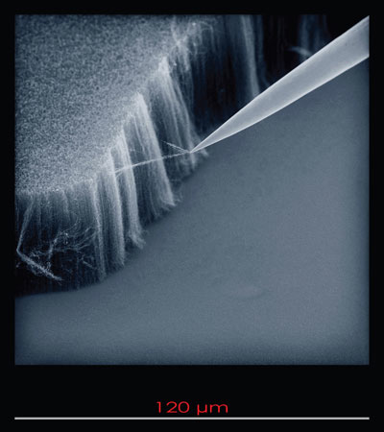
The many roots of nanotechnology
Materials science
Size dependent strength – “whiskers”
Griffith
“Molecular composites”

Slide 30
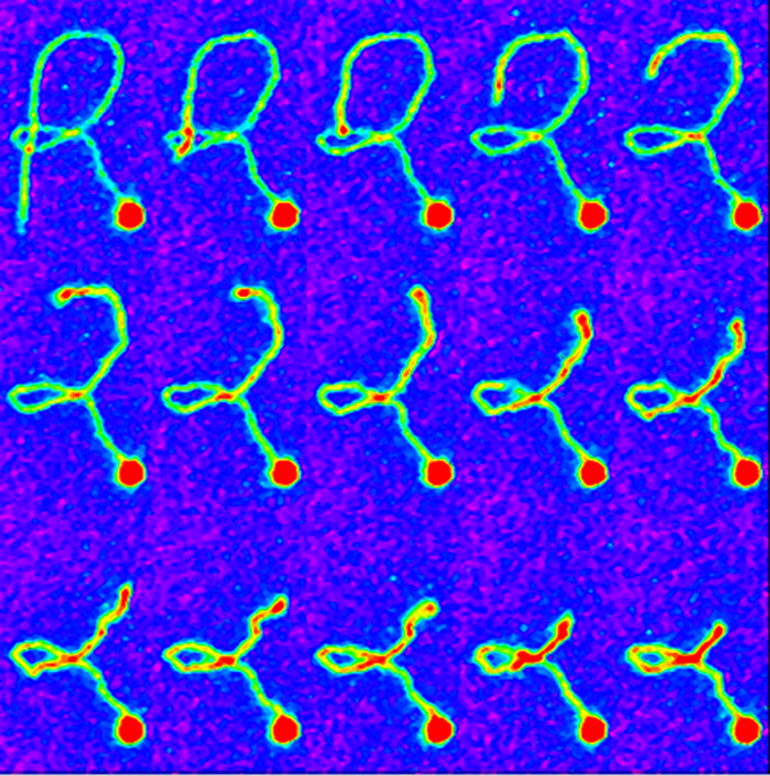
The many roots of nanotechnology
Single molecule biophysics
Optical tweezers, SPM
Steve Chu

Slide 31
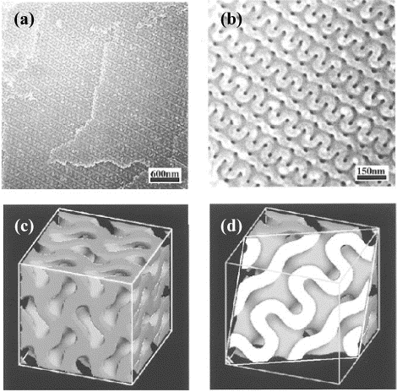
The many roots of nanotechnology
Soft matter physics
Self-assembly, block copolymers
Pierre-Gilles de Gennes

Slide 32
Which field prevails?
None has, ultimately none will
Different in different countries
Tension between:
  High status academic champions
  Connection to actual products
These fields are tough, self-confident, transnational – they resist socio-political projects
They will outlive nanotechnology, but will have been changed by it

Slide 33
Changing national innovation systems in the Anglo-American world
“Basic Science”
R&D
Business Unit
Business Unit
Universities
Corporate laboratory
Business Unit
Business Unit
Conglomerate – IBM, ICI, GE, GEC, Bell

Slide 34
Changing national innovation systems in the Anglo-American world
“Basic Science”
R&D?
Business Unit
Business Unit
Universities
Business Unit
Business Unit
Deregulation and “unlocking shareholder value”
Disappearance of monopoly rents sustaining corporate labs
Breakup of conglomerates into independent business units

Slide 35
The ascendancy of intellectual property
Outsourced
University:
Protectable intellectual property
Identification of market need
Nanotech
Company:
A patent portfolio
Manufacturing
Incorporation into finished product
Markets:
Venture Capital
R&D?
Marketing
National Nanotechnology Centres?

Slide 36
The end of the endless frontier
“Science: The Endless Frontier”, Vannevar Bush, 1945
Basic
science
Applied science
Technological development
New products and services
Prosperity!
Basic scientists do not and should not consider applications
But applications will emerge from basic science
And the nations that support the basic science will gain economic rewards
“Linear model” of innovation
Was science really ever like this?
Should it be?

Slide 37
A new context
Pressure from governments for publicly funded science to deliver clearer economic and societal benefits
Emphasis on goal-oriented, intrinsically interdisciplinary science, with agenda set by a societal and economic context rather than by an academic discipline - “Mode II Knowledge Production” (Gibbons)
Science contextualised by societal challenges – e.g. energy, ageing population

Slide 38
Some problems
Who defines the societal need?
Who has the expertise to define the technically possible in strongly multidisciplinary projects?
Who subjects the social theories of scientists to critical scrutiny?

Slide 39
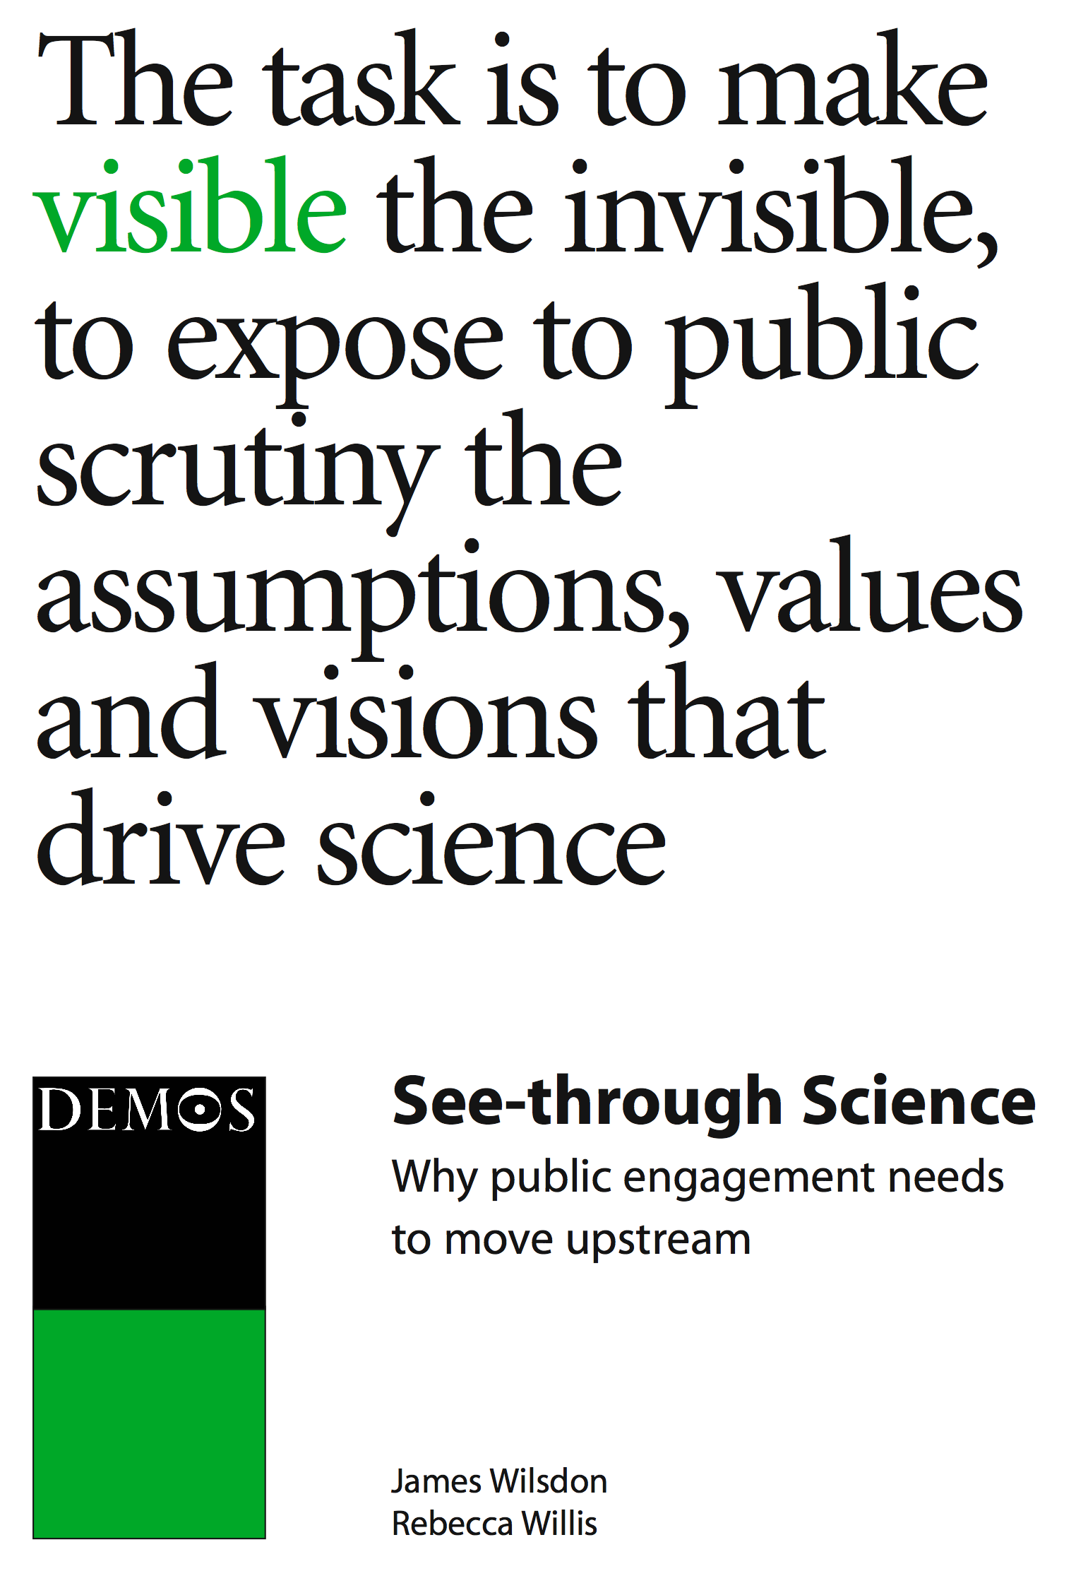
The rise of upstream engagement
Public Understanding of Science – “Bodmer report”, 1985
Lancaster critique of the “deficit model”, Brian Wynne
2004

Slide 40
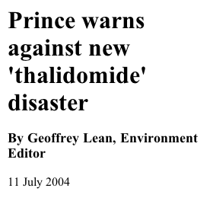
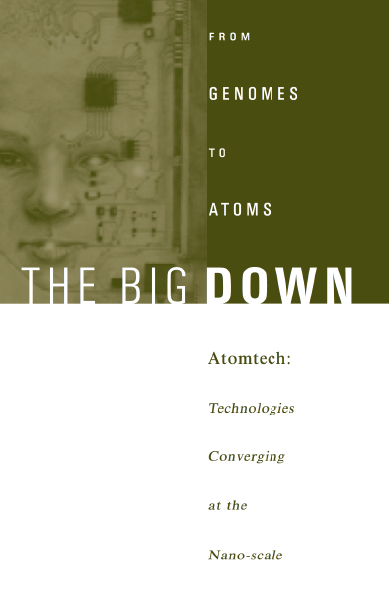
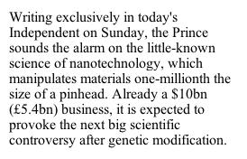

Enter nanotechnology
11 July 2004
2003

Slide 41
“Nanoscale science: opportunities and uncertainties”
Royal Society/Royal Academy of Engineering report, 2004
Working group included:
Scientists and engineers
Social scientists and philosophers
Representatives of NGOs
“a constructive and proactive debate about the future of nanotechnologies should be undertaken now – at a stage when it can inform key decisions about their development and before deeply entrenched or polarised positions appear.”
Royal Society report, 2004

Slide 42
What problem was public engagement trying to solve ?
1. Fear of an “anticipatory backlash”
  The shadow of GM
  Grey goo and “The future doesn’t need us”
  Nanoparticle toxicity and the shadow of asbestos

Slide 43
What problem was public engagement trying to solve?
Helping to make sounder decisions about highly interdisciplinary science in the context of societal needs
Keeping hold of the public value of science in the face of growing marketisation

Slide 44
Nanotechnology for medicine and healthcare - a case study
EPSRC - “Grand Challenge” in Nanotechnology for Medicine and Healthcare
Large scale, integrated, goal-oriented, interdisciplinary activities (~£30 million over 6 years)
Need to focus on a narrower area…
… How to decide on the program’s scope?
General intention announced November 2007
Consultation period Jan - May 2008
Outline call issued June 2008
Full proposals by October 2008 for May 2009 start

Slide 45
The consultation process
Strategic Advisory Team - committee of ~12 experts, including academics, industry, with international representation.
Wider consultation with academics, “users” (clinicians, pharmaceutical industry)
“Town meeting”
Why not seek public views too?

Slide 46
Public dialogue on Nanotechnology for healthcare - general points
Strong support for medicine/healthcare as a priority for nanotechnology
Explicit rejection of an unduly precautionary approach
Preference for technology that empowers people to take control of their own health and lives
Concerns about who benefits
Concerns about risk and governance

Slide 47
Public dialogue on Nanotechnology for healthcare - specific issues
Rank order for potential topics:
Aspiration/concern
1 | Early diagnosis | Information that enables people to make changes
2 | Targeted drug delivery | Treating serious diseases and reduce side effects
3 | Controlling pathogens | Low tech solution more effective?
4 | Regenerative medicine | Toxicity, Fate, Human enhancement
5 | Accelerating drug discovery | Who benefits from public purse?
6 | Theranostics | Disempowering

Slide 48
Who could be against public engagement?
Scientists
  An infringement of the sovereignty of the independent republic of science
Politicians
  Contrary to the principles of representative democracy and/or
  Contrary to the principle that the market is the only viable way of aggregating peoples’ preferences
…and it costs a lot of money

Slide 49
The “independent republic of science”
Michael Polanyi (Minerva 1:54-74, 1962)
  “the pursuit of science by independent self-co-ordinated initiatives assures the most efficient possible organization of scientific progress. And we may add, again, that any authority which would undertake to direct the work of the scientist centrally would bring the progress of science virtually to a standstill.”
  “You can kill or mutilate the advance of science, you cannot shape it. For it can advance only by essentially unpredictable steps, pursuing problems of its own, and the practical benefits of these advances will be incidental and hence doubly unpredictable.”
Division of moral labour between basic science, who can’t/shouldn’t consider the ethics of potential applications, and applied scientists, who should
    "Once the rockets are up, who cares where they come down
    That's not my department," says Wernher von Braun.
    Tom Lehrer
Against the direction of science – by politicians, or by the public
Science as a Hayekian self-made order
A widely held view in the scientific community

Slide 50

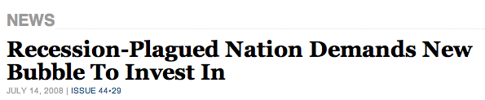

After nanotechnology?
EPSRC/BBSRC Dialogue, 2010

Slide 51
Three lessons from nanotechnology for synthetic biology
It’s not about risk, it’s about trust
Blowing bubbles in the economy of promises
Mind that metaphor

Slide 52

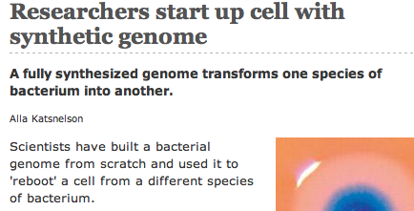

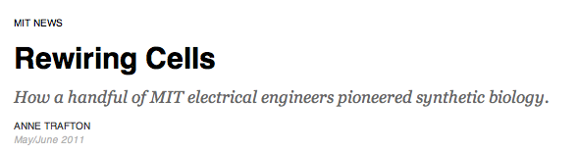
Mind that metaphor…

Slide 53
Metaphors from ICT
Nanotechnology – “digitising matter”
Synthetic biology – “digitising biology”
Innovation in ICT is easy, cheap and fast…
But innovation in the material world takes longer and costs more
And the biological world is even more difficult

Slide 54
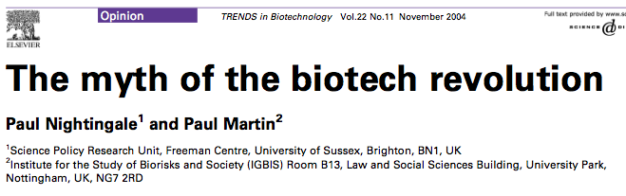
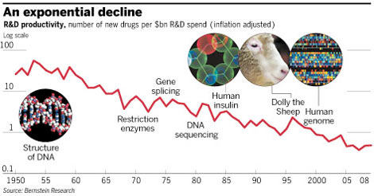
Bio innovation isn’t accelerating
http://www.ft.com/cms/s/0/46d4a950-348e-11e0-9ebc-00144feabdc0.html

Slide 55
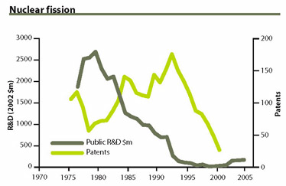
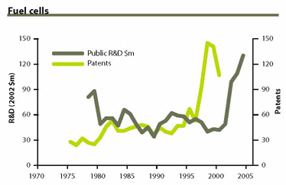
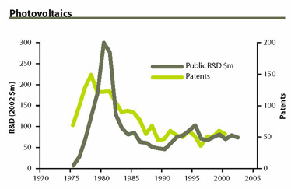
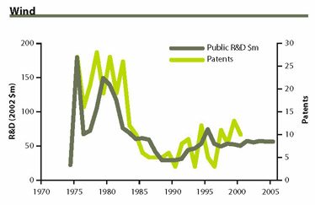
Energy innovation (mostly) isn’t happening
Kammer and Nemet, Reversing the incredible shrinking energy R&D budget
http://www.issues.org/22.1/realnumbers.html

Slide 56
Responsible innovation
How can we get the innovation we need…
…rather than innovation that damages society and the environment?
Science policy that uses “anticipation, reflection and inclusive deliberation” to steer the innovation process may help…
But there may be wider issues of political economy at stake as well.

