Slide 1
Welcome
Sarah Speight
PVC for Education and Student Experience
Notes:
Thank you for opportunity to speak/meet today

Slide 2
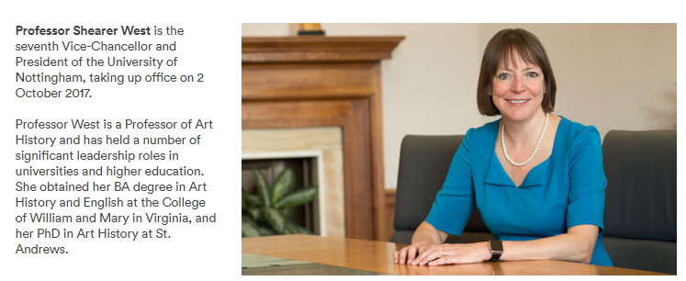
Who are we?
1881 University college opened – original building now occupied by NTU
1928 move to University Park (Jesse Boot gift of Highfields)
1948 Royal Charter – The University of Nottingham
UK campuses (c.35,000 students): Sutton Bonington (former Midlands Agricultural College), Medical School, Jubilee Campus, Kings Meadow Campus, Castle Meadow Campus
UNM – opened in 2000 (c.5000 students)
UNNC – opened in 2004 (c.8000 students)
Russell Group, research intensive

Slide 3
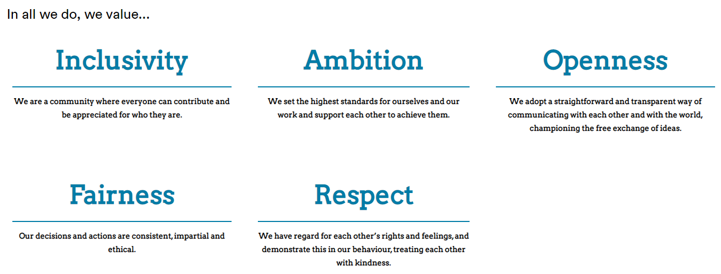
University Strategy

Slide 4
University Goals
Solving problems and improving lives
Supporting potential
Developing the campus experience
Cultivating a global mindset
Fostering creativity, discovery and experiment
Contributing to Sustainable Development Goals
Embedding Collaboration in all that we do
Delivered through our 5 faculties, 21 schools and 5 departments (Engineering), and Professional Services

Slide 5
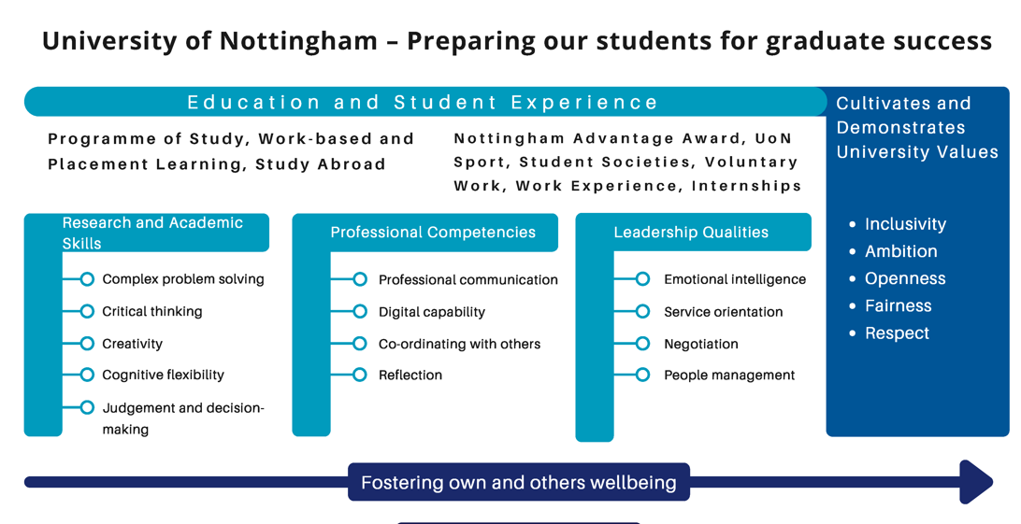
Our educational eco-system

Slide 6
Our External Examiners
Lend their expertise to help us maintain academic standards
Scrutinise our policies & processes
Identify our good & poor practice, & share experience & learning from elsewhere
Help us to ensure good student outcomes
Thank you!

Slide 7
Thank you
Sarah Speight
PVC for Education and Student Experience
Notes:
Thank you for opportunity to speak/meet today

