Slide 1

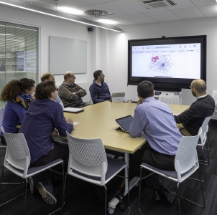

Title page – Principles of Corporate Governance course brochure
Principles of Corporate Governance
A one-day course for implementing good governance in a corporate setting

Slide 2

Course overview
          Corporate governance has grown rapidly in the last 20 years and has become common for companies, charities, universities and local authorities. Understanding good governance and implementing its principles are therefore critical for organisational success.
This one-day course is designed to guide participants through the intricacies of corporate governance, focusing on identification, implementation, and influence. It also covers the best practices and latest developments in corporate governance, including recent updates to the corporate governance code in the UK. By the end of the day, participants will be equipped with the knowledge and tools to influence and develop appropriate governance structures within their organisations.
Through interactive sessions, case studies, and group discussions, participants will explore real-world examples and gain insights into effective governance practices. The course also includes an open discussion and Q&A session, allowing participants to engage in dialogue about the challenges and best practices of governance.
The course is ideal for professionals across various industries who are involved in or aspire to roles with governance responsibilities. This includes managers, executives, board members, and other decision-makers.
The course provides participants with opportunities to learn from and network with like-minded peers.

Slide 3
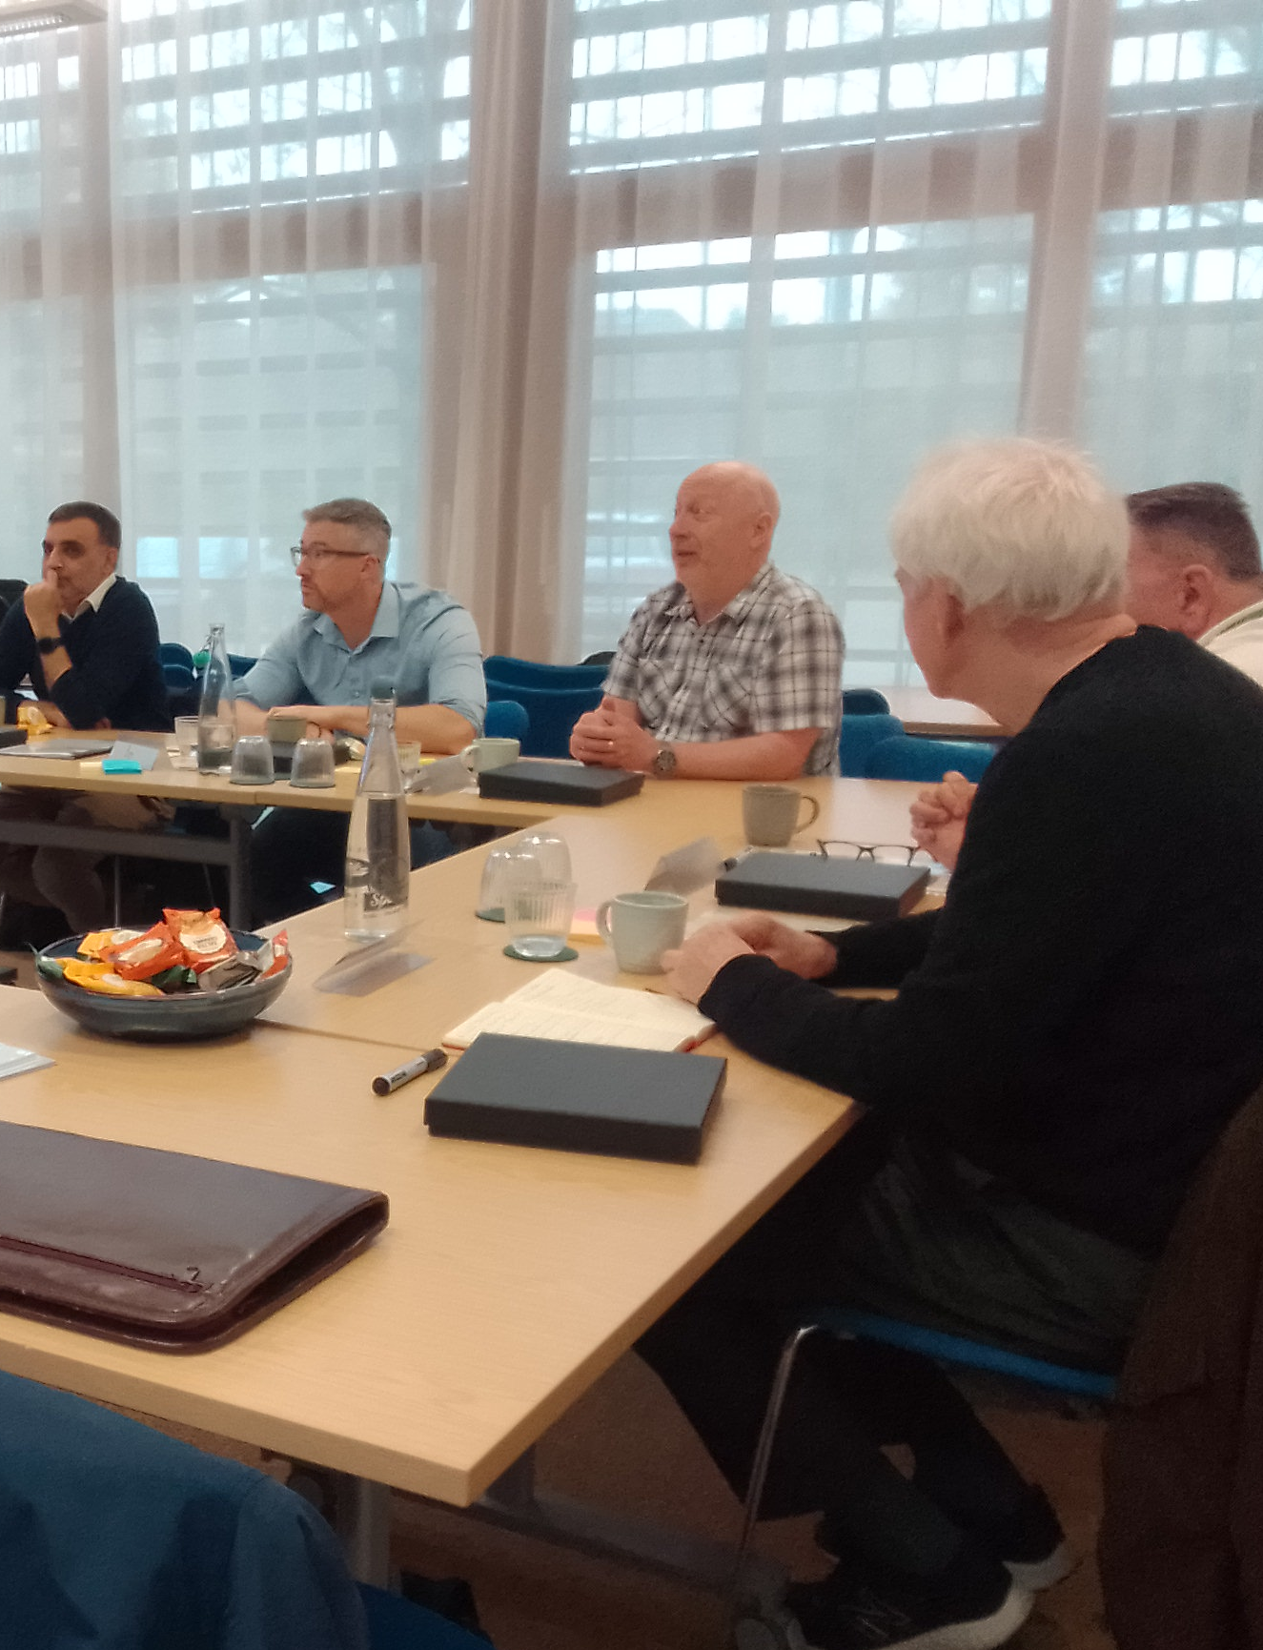
Course benefits
            By the end of the course, participants will:
            possess an understanding of corporate governance, its principles and mechanisms
            understand the problems that corporate governance seeks to overcome, including the separation between ownership and control, and information asymmetry
            be able to identify the underlying principles, structures and mechanisms of corporate governance, including the role of the board of directors, audit committee, controls, shareholders’ rights and remuneration policy and executive compensation
            have an understanding of how to positively influence corporate governance dynamics within their organisations, fostering a culture of transparency, accountability, and ethical decision-making
            In turn, organisations will benefit from improved governance, leading to enhanced reputation, stakeholder trust, and sustainable growth.
Our experienced facilitators bring a wealth of practical knowledge and industry insights to enrich the learning experience.

Slide 4
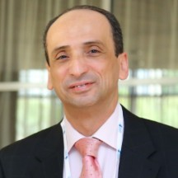
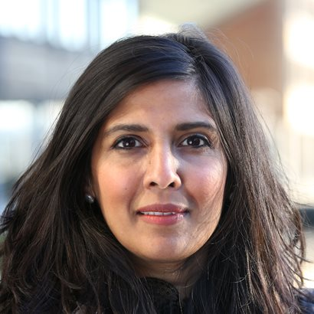
Delivery team
          Dr Tarek Abdelfattah
          Associate Professor,
          Accounting
Tarek Abdelfattah is an Associate Professor in Accounting at Nottingham University Business School, with a PhD in Accounting & Finance from Durham University. He has extensive teaching experience in the UK, UAE, and Egypt. Tarek's research focuses on financial reporting, corporate governance, and auditing. His work has been published in leading international journals. Tarek has secured funds in two projects with the FRC related to his work on extended audit reporting and corporate remuneration reporting.
Tarek has substantial practical experience in consultancy and training within the accounting, finance, and governance fields. He provided consultations and designed professional courses for private and governmental organizations in the UK and MENA region. His industry engagement extends to close collaborations with professional agencies and advisory roles for various companies.
          Dr Michelle Stirk
          Associate Professor,
          Accounting
Dr Michelle Stirk is an Associate Professor in Accounting at Nottingham University’s Business School. She has a particular interest in the area of management control, behaviour change, and performance measurement as related to management accounting and sustainability. She is a chartered management accountant and previously held several senior accountant posts in both the public and private sectors. Her research and teaching are interdisciplinary and draw upon her wealth of practical and academic experience gained over 20 years.
*Speakers subject to change

Slide 5






About Nottingham University Business School
  Among an elite group of business schools
  Ingenuity Lab
  Location
The course will be delivered on the University of Nottingham’s award-winning campuses, some of the most beautiful study environments in the UK. They boast eco-friendly and sustainable buildings, green spaces and wildlife.
Nottingham University Business School is among an elite group of business schools worldwide that hold ‘triple crown’ accreditation from the three most influential accrediting organisations: AACSB, AMBA, and EQUIS. Employers recognise the accolade as a mark of high standards, quality, and reputation.
The Ingenuity Lab is a bespoke incubator and accelerator which is situated on the Jubilee Campus. It is home to over 300 start-ups and 70 Entrepreneurs-in-residence and hosts regular networking and KX events related to entrepreneurship.
  Small Business Charter Award
  University of Nottingham Rankings
The School also holds a Small Business Charter (SBC) Award in recognition of its role in engaging with the needs of the regional business community and its leadership in providing enterprise skills development.
Ranked* 32nd in Europe and 16th in the UK, the University of Nottingham is a founding member of the Russell Group of research-intensive universities. The university is also positioned 7th in the UK for research power**.
* QS World University Rankings: Europe 2024, ** REF 2021.

Slide 6

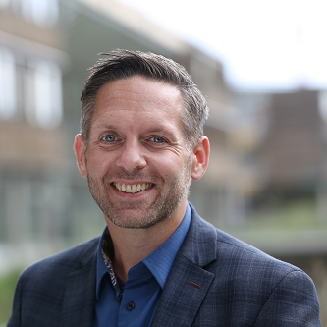


Further information
  Find out more
  To find out more information about the course, and to register your interest in attending, please visit our website (below), and follow the link to the Principles of Corporate Governance course webpage.
  Accessibility
We believe that all delegates should be able to participate in Executive Education programmes and we aim to make them accessible. We commit to ensuring this as far as possible and we will work with you to accommodate any adjustments that you require.
    Fee
The course fee is £595.
This includes study materials, lunch and refreshments.
    Alumni discount
All University of Nottingham alumni are entitled to a 20% fee reduction. Please provide details on registration.
For an informal discussion about the course, please contact our Senior Operations Manager, Nick Proverbs.
Email: Nick.Proverbs@nottingham.ac.uk
Phone: 07739039858
Find out more nott.ac/exceed ExecutiveEducation@Nottingham.ac.uk

