Slide 1

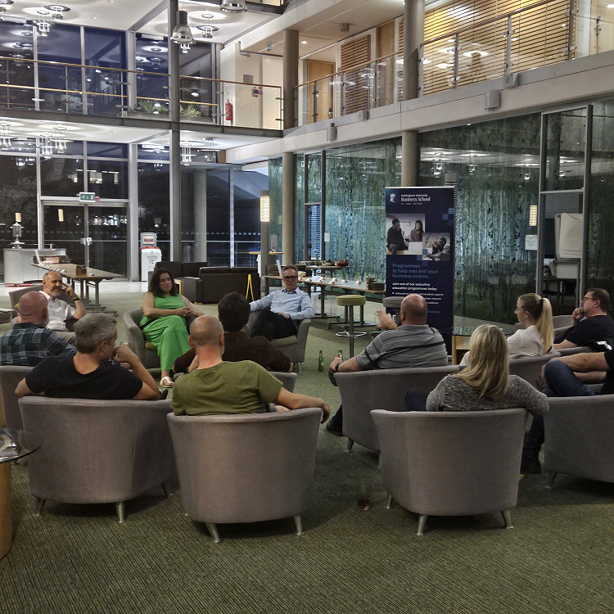
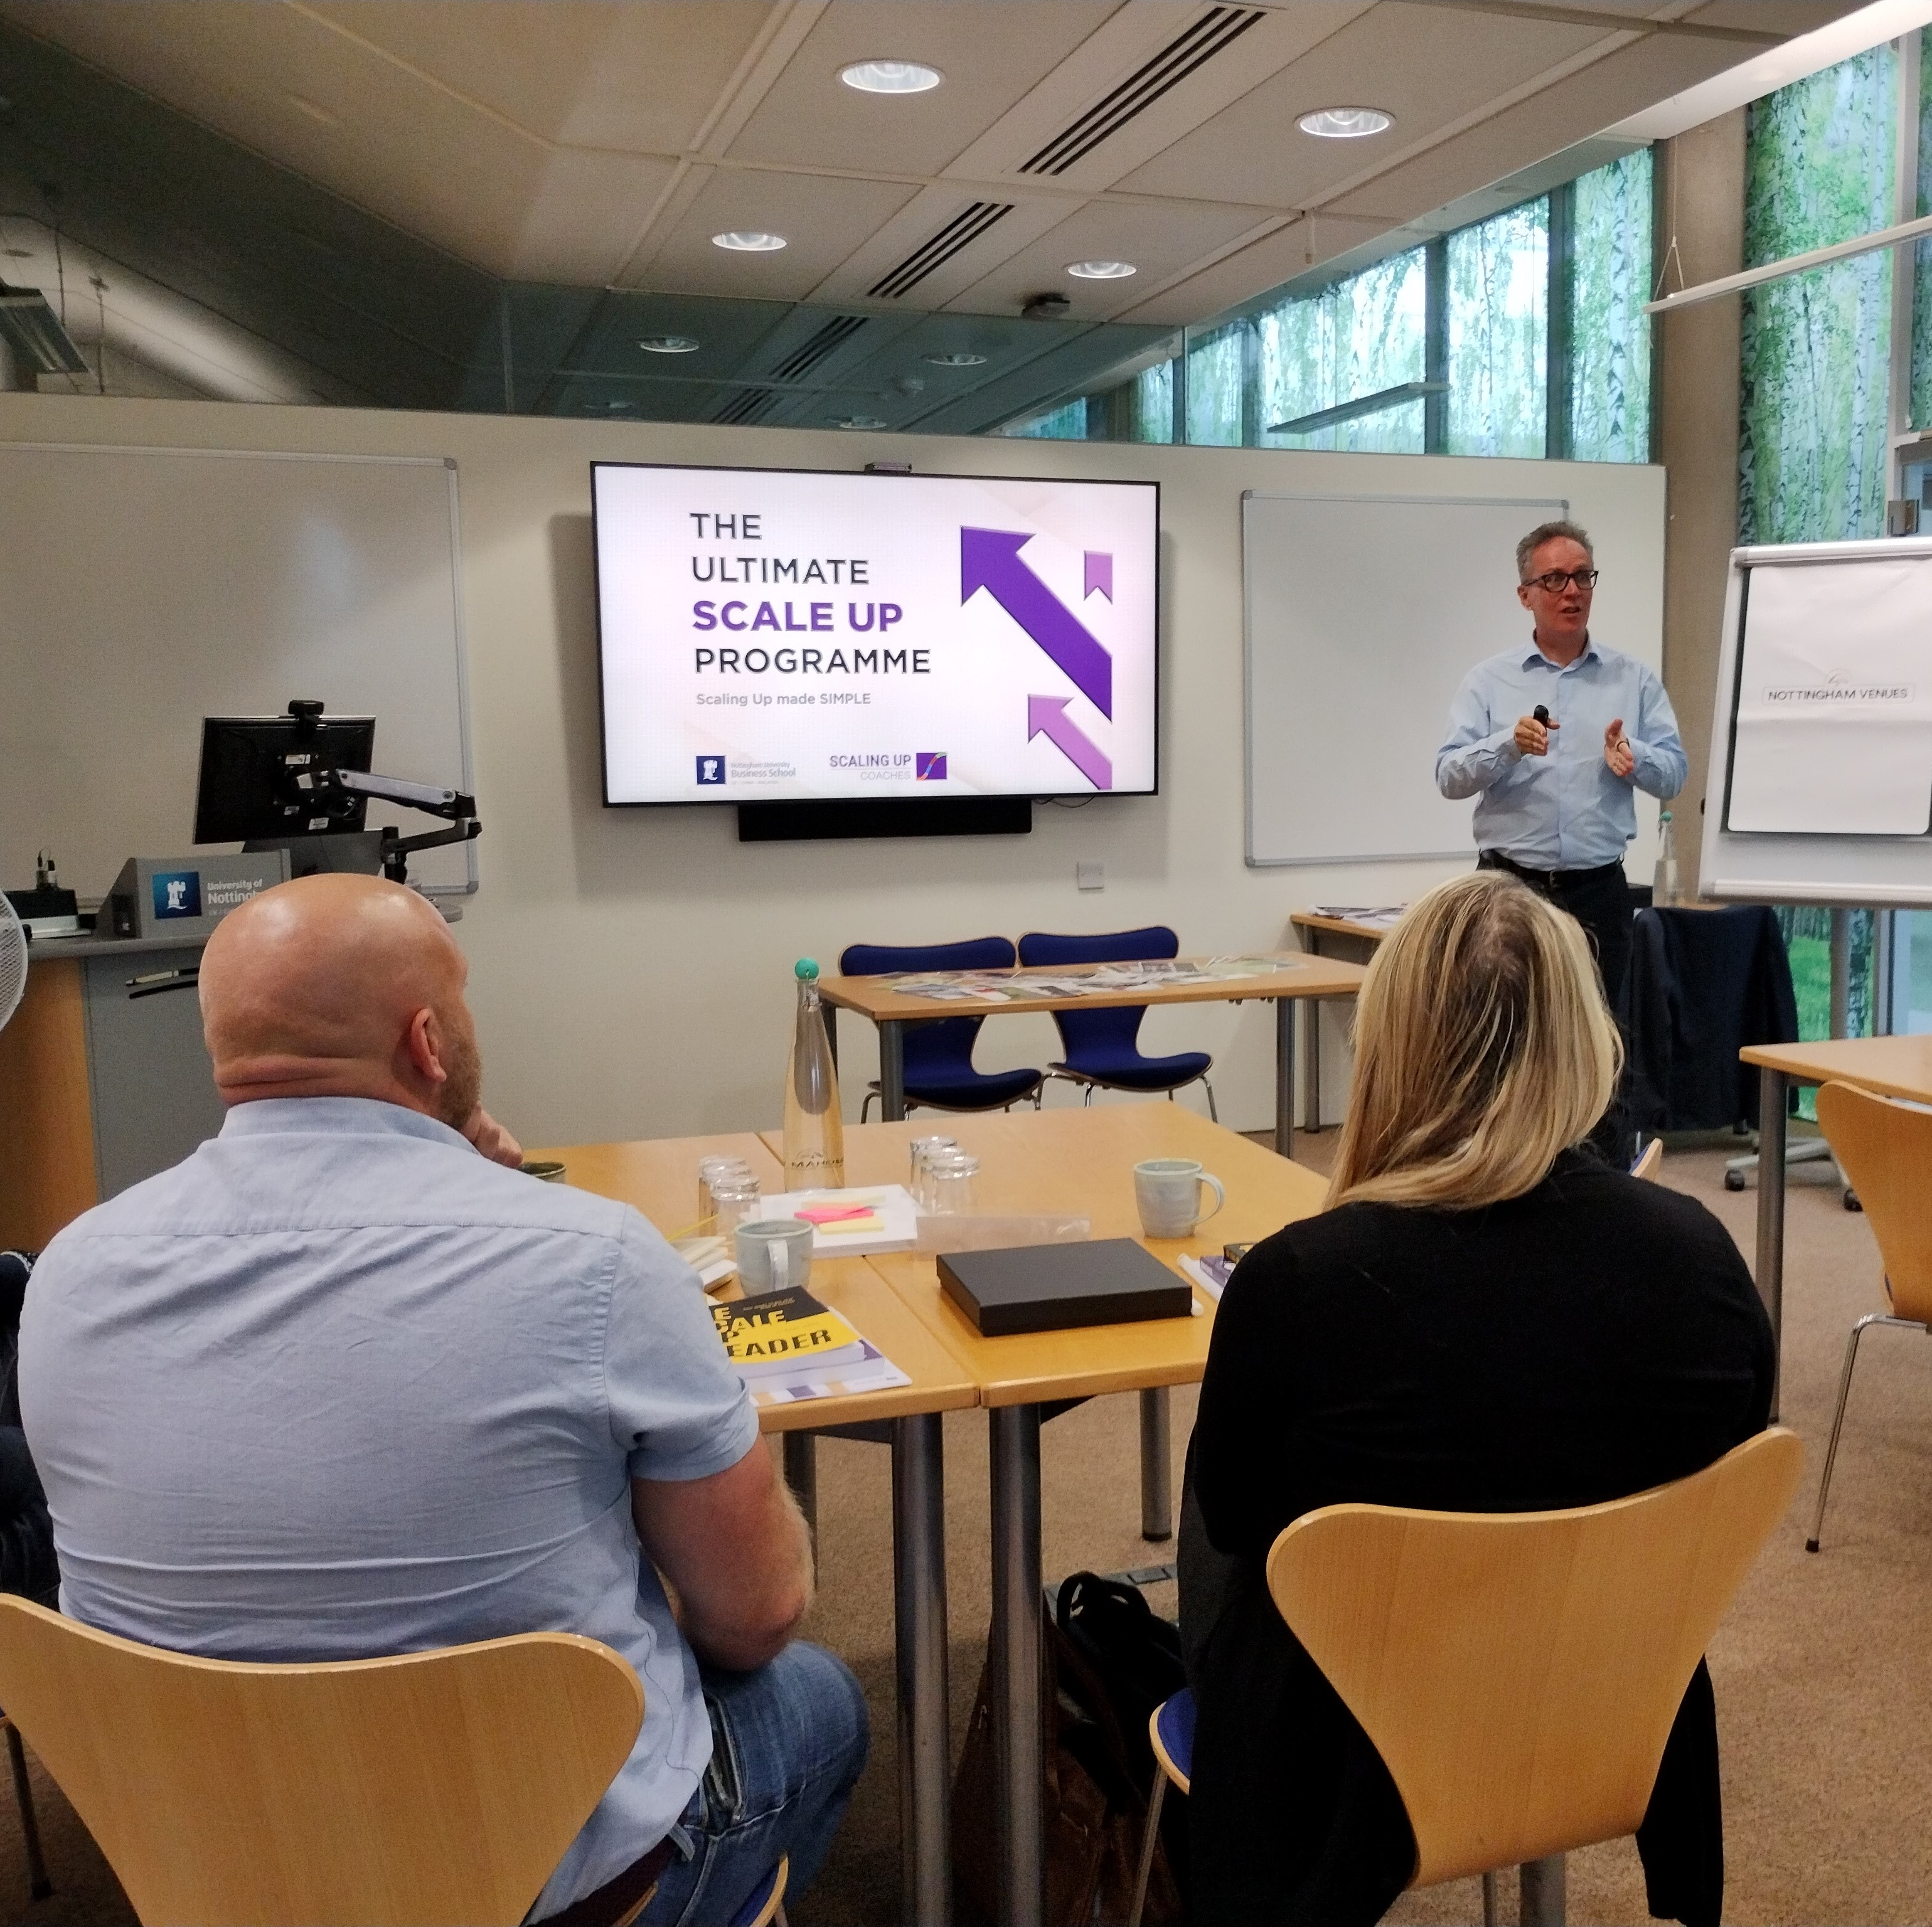
Title page – Ultimate Scale Up programme brochure
The Ultimate Scale Up programme
Equips you and your team with the skills, discipline and entrepreneurial passion to grow.

Slide 2
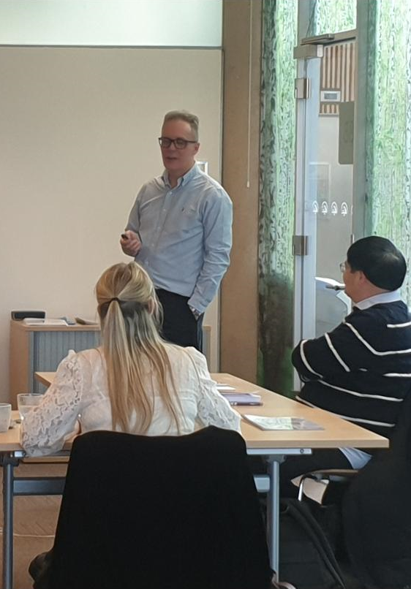
Programme overview
          We provide the very best business education and coaching support to ambitious scale up companies.
This programme puts together hands-on experience and the latest cutting-edge management tools, as well as peer-to-peer and individual one-to-one support, to equip high-potential companies with the skills, instruments, and entrepreneurial passion to grow.
Many courses or programmes about scaling complicate things. In most cases, the ultimate efficiency hack is the Pareto effect – 20% of efforts yield 80% of results. We are committed to identifying the 20% and doing it in the most efficient way.
We are not consultants or pure academics. We are entrepreneurs at heart. Between your Scaling Up Coaches and experts from Nottingham University Business School, we have started, managed and advised thousands of businesses internationally. We are passionate about what we do, and we treat your business as if it were ours.
“A real inspirational few days with lots of useful information for me to take away and implement into my company.”
Mathew Pallet, CoMech Metrology
(Cohort 1)

Slide 3
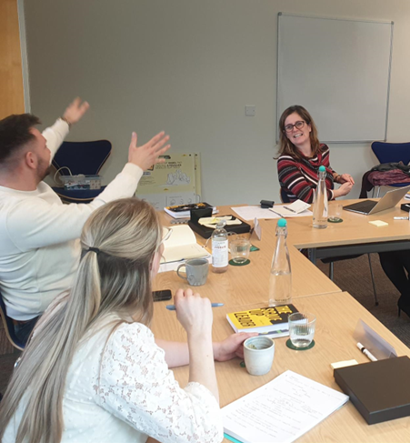
Who is it for?
            This course is designed for those with a growth mindset who recognise that, to achieve success, they must be growing faster than their competitors.
It is aimed at CEOs and managing directors of ambitious businesses (not start ups) who are committed to the growth of themselves as leaders, their teams, and their businesses.
The programme is open to all industry sectors. There are limited places available, each for a different business.
            If you believe that real life is the best classroom, we are keen to welcome you into the programme. We will create a relaxed environment for you to explore your business challenges and we will work together to increase the value of your business.
“Stuart led this programme with energy and enthusiasm. He established a bond between members of the cohort which led to an extremely constructive and supportive learning environment.”
Sam Bowles, Stencil UK (Cohort 1)

Slide 4
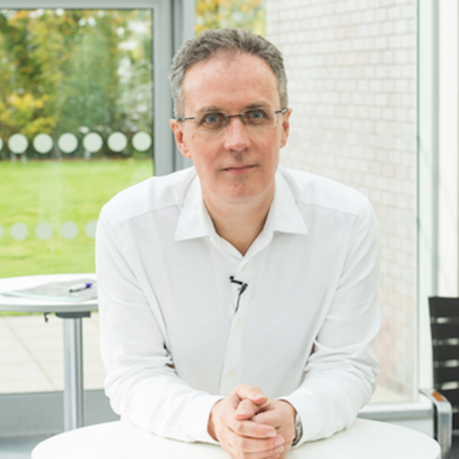
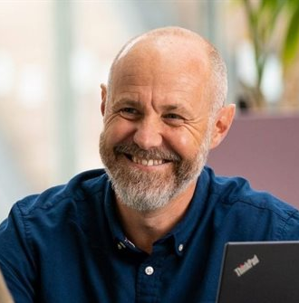
Delivery team
          Stuart Ross,
          High Growth
With more than thirty years of experience in marketing, starting new businesses, business development and scaling businesses, Stuart is an experienced director, strategist, business coach, author and non-executive director.
Stuart is CEO of High Growth one of the UK’s leading business coaching practices with an amazing track record of delivering to clients, through coaching and training (offline and online), substantial business growth and performance improvements easily and rapidly. Stuart is also Goldman Sachs 10K Growth Expert and international best-selling author.
          Professor Simon Mosey,
          Nottingham University
          Business School
Simon’s research addresses technology entrepreneurship and building a culture of innovation. He is co-author of the popular books, Ingenuity and Building an Entrepreneurial Organisation and has published his research within leading academic journals and periodicals such as the Washington Post and the Financial Times. He is chair of YES and Ingenuity that have developed the entrepreneurial skills of over 9000 student, academic and community entrepreneurs. Simon has led research projects, executive education and community events within the areas of impact led entrepreneurship and social, organisational and environmental innovation. He is also Visiting Professor at Ghent University and editor of the Journal of Technology Transfer.
*Speakers subject to change

Slide 5
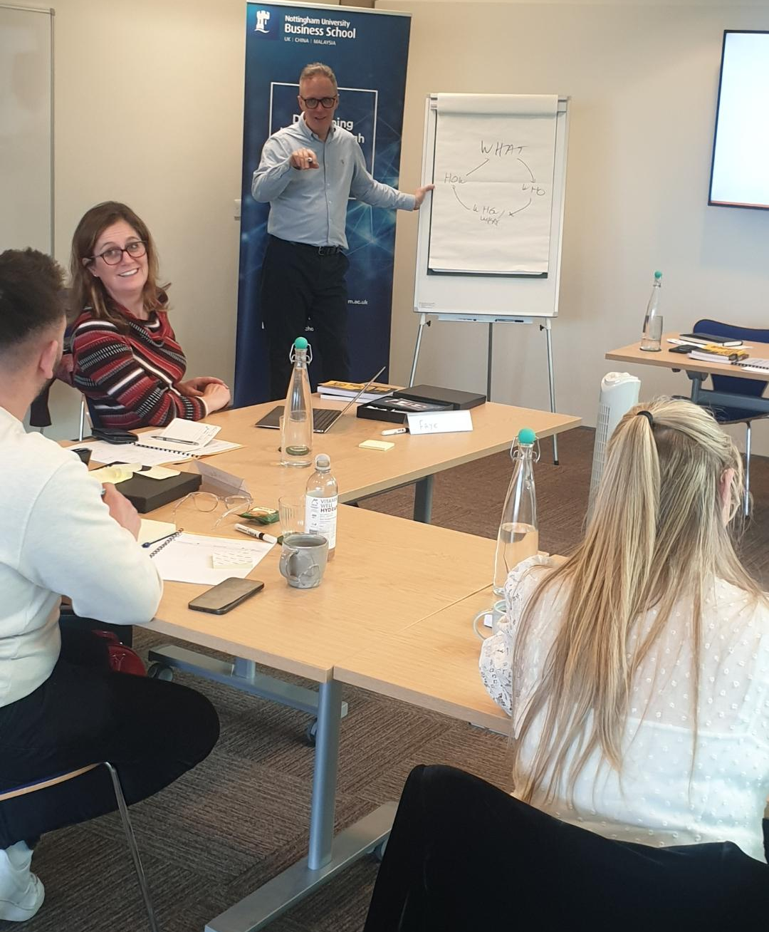
Programme aims
  By completing this programme, you will:
            Gain an understanding of the driving forces and future scenarios of your industry
            Discover future growth opportunities and set clear targets
            Define a clear strategy
            Develop business resilience to an uncertain market
            Design organisational structures and processes to enable fast and efficient strategy execution
            Establish habits and routines to enhance personal and team efficiency and execution capabilities
            Receive a guide to enjoy the quest of Scale Up
“An incredibly intensive three days, but extremely well spent. So pleased I put the time aside for it. Arrived questioning much of what I do, leaving with direction & focus.”
Nikki Newcombe, Bliss of London (Cohort 1)

Slide 6
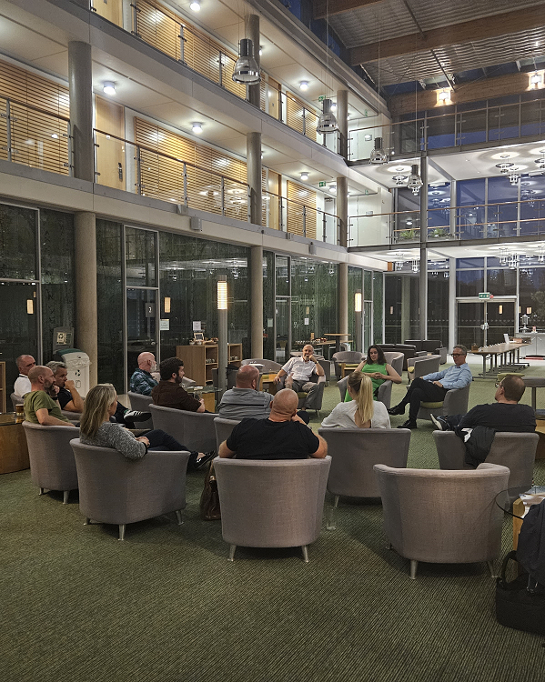
Programme outcomes
            Outcomes:
            The executive team is healthy and aligned.
            Everyone is aligned with the number one goal for the year and the quarter.
            Communication rhythm is established, and information moves throughout the organisation fast.
            Every facet of your business has a person assigned with accountability, and goals are met.
            Ongoing employee feedback is collected to identify obstacles and opportunities.
            Reporting and analysis of customer feedback is frequent and accurate.
            Core values and purpose are alive in your business.
            Employees can clearly articulate the company strategy, including long-term goals, core customer profiles, and brand promise.
            Everyone has priorities and Key Performance Indicators (KPIs).
            The company plans and performance are transparent and visible to everyone.
“This has been an exceptional out of the box experience. It has led me through a forest of confusion to show a clear path that I can now believe is achievable.”
Faye Murch, Kingsgate Nutrition (Cohort 2)

Slide 7
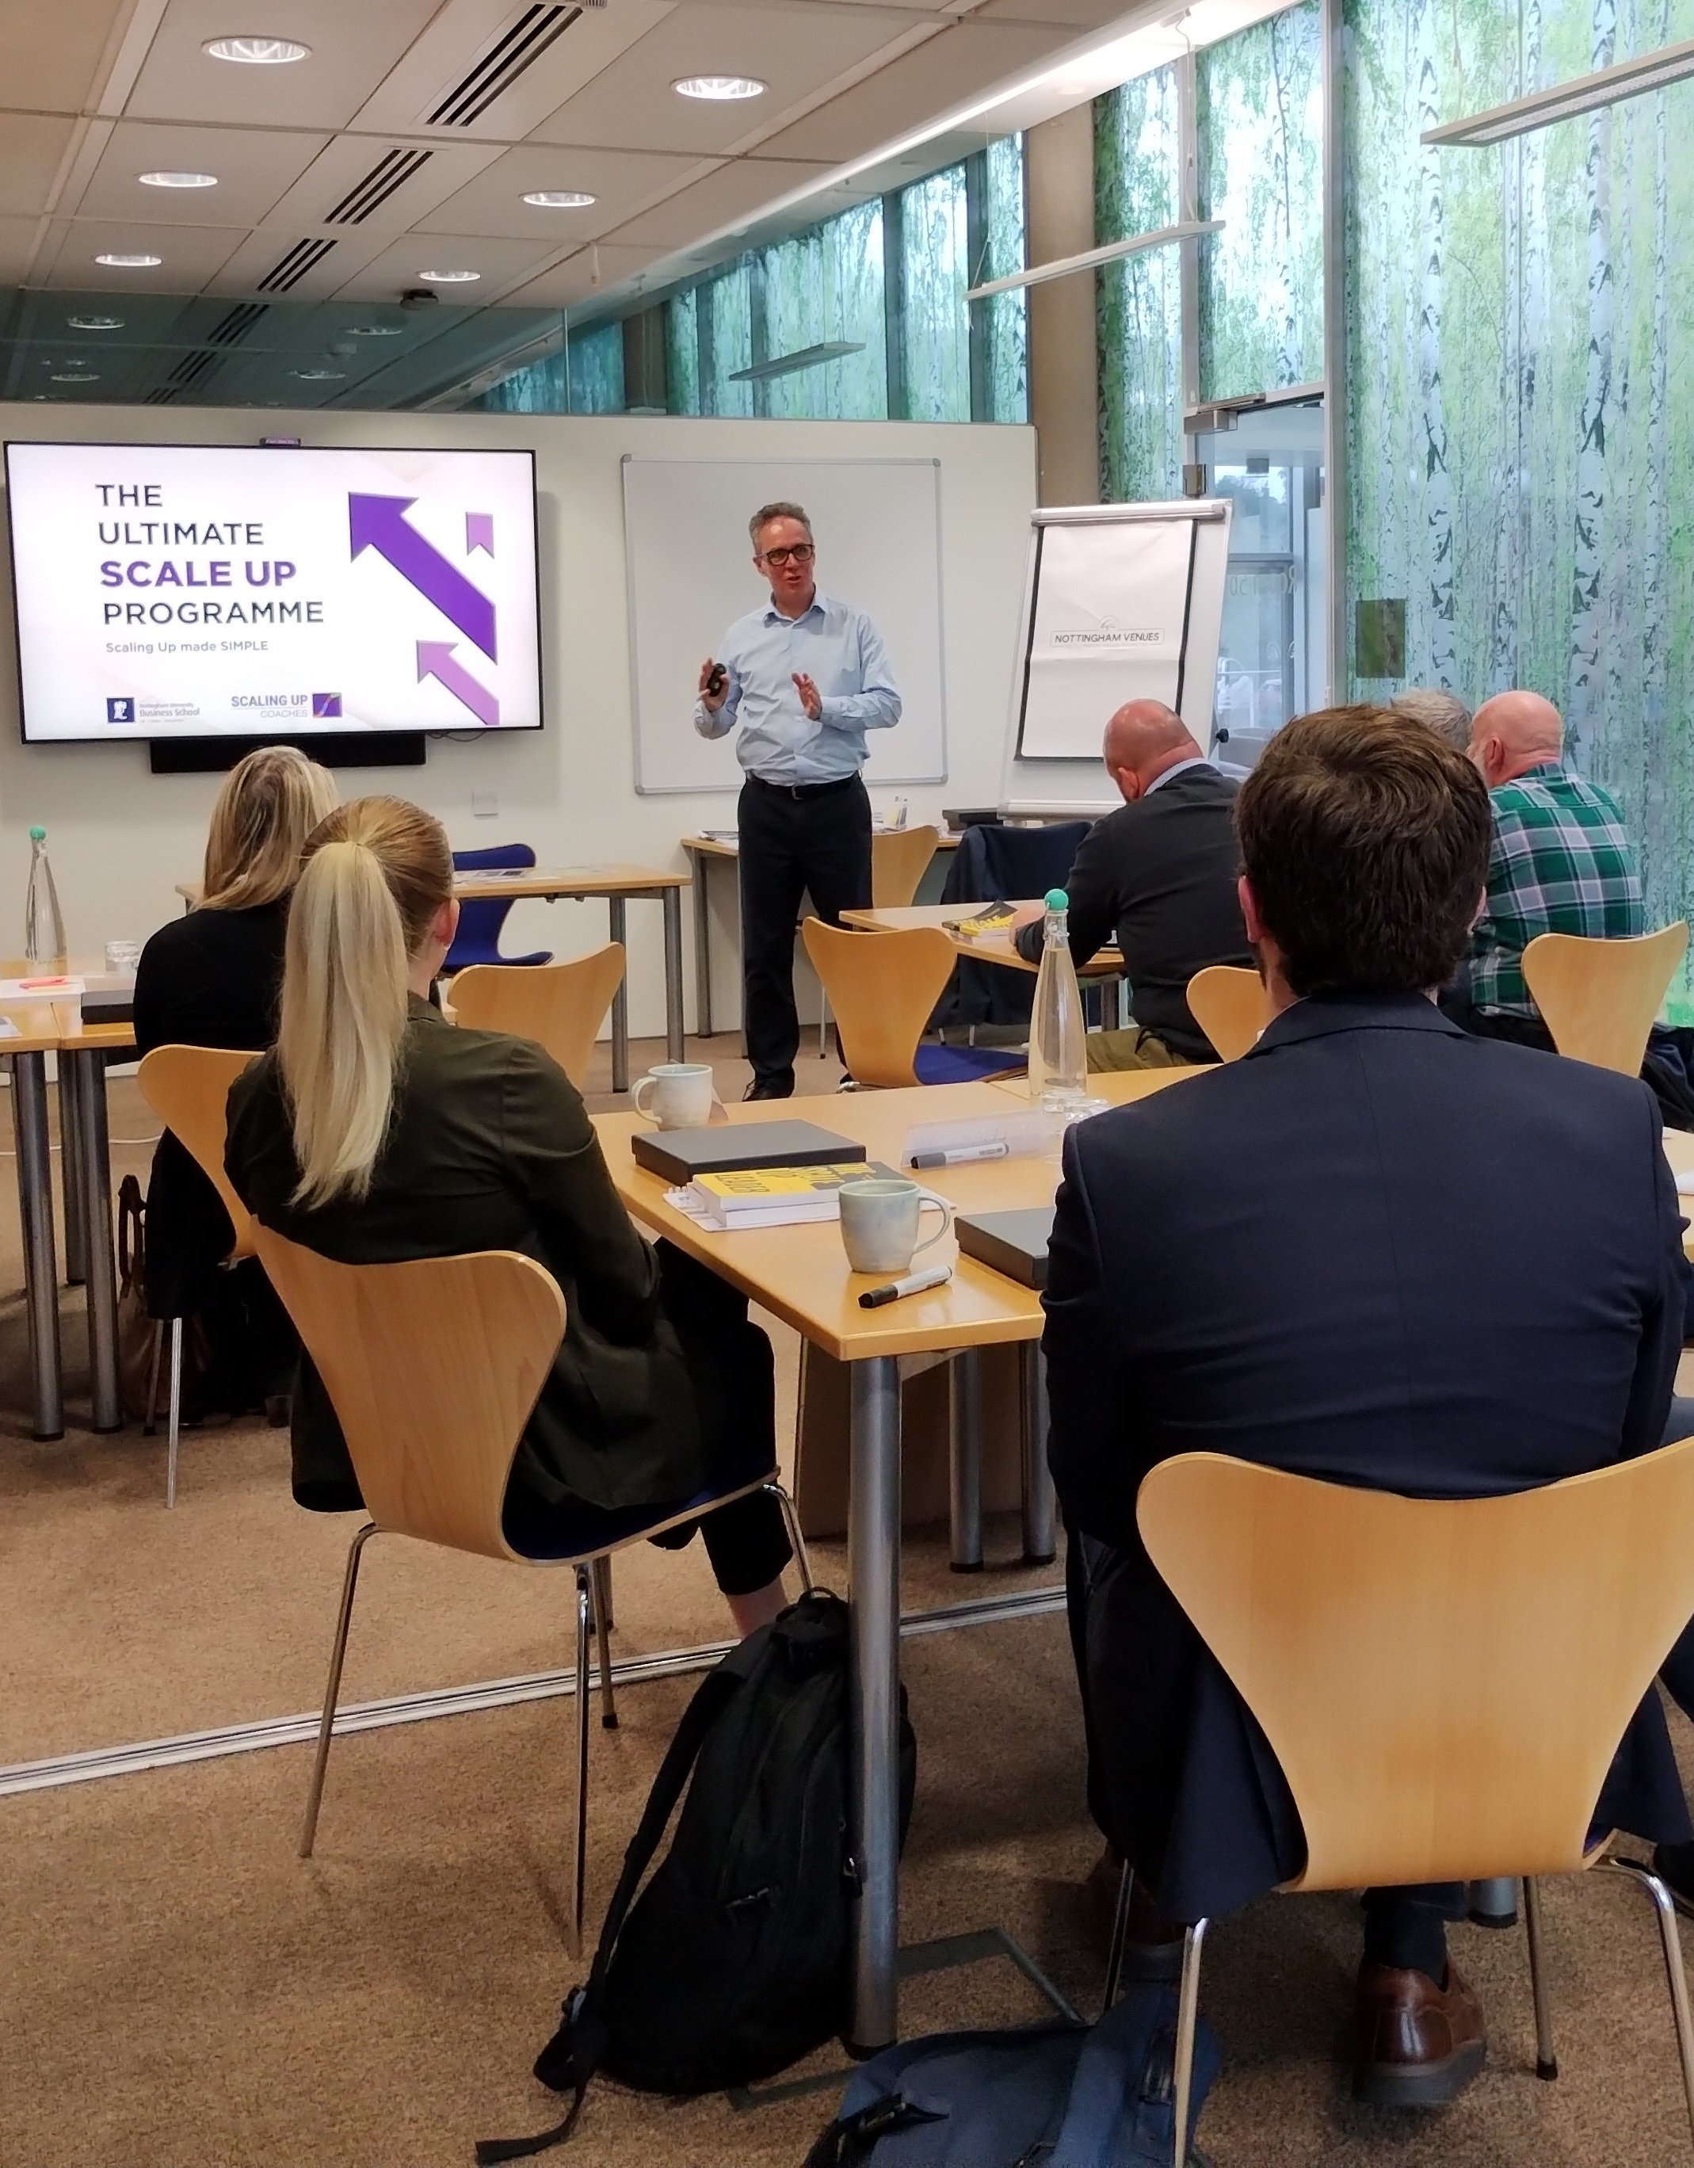
Areas to be covered - Leadership
            Some of the areas that will be covered:
            Leadership
            People
            Strategy
            Execution
            Cash
            Starting position
            Key personal drivers, definition of success
            Right habits
            Energy management, time management, the right mindset
            Communication challenge
            Being a storyteller, mastering meetings, the communication cycle
            Being an extraordinary leader
            Multiplier vs diminisher, situational leadership, leading through change
            Building a high-performance team
            Culture, top grading, 20-mile march

Slide 8
Areas to be covered - People
            Some of the areas that will be covered:
            Leadership
            People
            Strategy
            Execution
            Cash
            Starting position
            Roles and responsibilities, key performance indicators
            Right people
            ABC analyses, talent magnet programme, recruitment and retention strategy
            Growing and developing the team
            Creating a high-performance culture, a player development programme, employee net promoter score
            Right people in the right seats
            Organisational structure, core processes, core capabilities functional accountability chart.
            Right people in the right seats doing the right things
            Leadership, prediction, delegation, reputation

Slide 9
Areas to be covered - Strategy
            Some of the areas that will be covered:
            Leadership
            People
            Strategy
            Execution
            Cash
            Starting position
            Industry analyses: Driving forces, scenarios, sales and profit pools
            The core
            Core purpose, core values, core competencies
            The sandbox
            Core customer: Segmentation, core customer selection, customer analysis, quality and quantity
            Targets
            Goal-setting, three- to five-year thrusts, one-year targets
            The value proposition
            Brand promise, main products and services, price strategy, distribution strategy, value proposition design
            The plan
            Seven strata of strategy, one-page strategic plan

Slide 10
Areas to be covered - Execution
            Some of the areas that will be covered:
            Leadership
            People
            Strategy
            Execution
            Cash
            Starting position
            Company diagnostic: Strategic clarity, execution capabilities, Rockefeller habits checklist
            Corporate identity
            Bringing the core to life, cool and non-cool behaviours
            Doing the right thing in the right way
            Establishing a strict meeting rhythm, daily huddles, key meeting agendas
            Keep the main thing the main thing
            Priorities, quarterly themes, celebration and reward
            Metrics everywhere
            Company and department KPIs, company dashboard, individual performance programme

Slide 11
Areas to be covered - Cash
            Some of the areas that will be covered:
            Leadership
            People
            Strategy
            Execution
            Cash
            Starting position
            The importance of knowing your numbers, why growth sucks cash
            Accelerating cashflow
            Cash conversion strategies, the customer funded business, four drivers of cashflow
            The power of one
            The seven levers, implementing the power of one
            Critical Numbers
            Measuring financial success, improving profitability, financial dashboard chart
            Board pack
            Management board pack

Slide 12
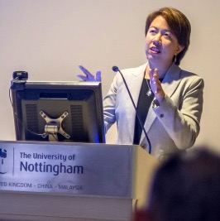



Programme components - 1
This three-month accelerated programme is hosted by Nottingham University Business School and will be split into three components. These include a face-to-face residential, as well as one-to-one coaching and Scale Up forums which are delivered online.
1) Face-to-face programme with residential
A 2-day residential (including 1-night stay) and 1 standalone day
A masterminding session will follow the evening meal of the residential
These will be held at Jubilee Campus, University of Nottingham.
  2) One-to-one coaching
Three one-to-one coaching sessions from a certified Scale Up Coach.
Each virtual coaching session will be one hour and will cover:
Accountability
Leadership coaching addressing the key barriers of success

Slide 13



Programme components - 2
  3) Scale Up forums
For three months following the residential, Scale Up Forums will bring together the attendees to maintain momentum. Each of the three virtual sessions will be three hours and will cover:
Accountability
Masterminding – addressing key challenges of members
Learning – additional insights to accelerate success
  Additional benefits of joining the programme
Invited to monthly webinars
Receive a monthly newsletter
Scale Up assessment
Access to online resources
Access to the Scale Up book club
Free books

Slide 14






About Nottingham University Business School
  Among an elite group of business schools
  Ingenuity Lab
  Location
The programme will be partially hosted at the Jubilee Conference Centre, located on our award-winning Jubilee Campus, and at the new Executive Education suite at our Castle Meadow Campus in Nottingham City Centre.
Nottingham University Business School is among an elite group of business schools worldwide that hold ‘triple crown’ accreditation from the three most influential accrediting organisations: AACSB, AMBA, and EQUIS. Employers recognise the accolade as a mark of high standards, quality, and reputation.
The Ingenuity Lab is a bespoke incubator and accelerator which is situated on the Jubilee Campus. It is home to over 300 start-ups and 70 Entrepreneurs-in-residence and hosts regular networking and KX events related to entrepreneurship.
  Small Business Charter Award
  World top 100* university
The School also holds a Small Business Charter (SBC) Award in recognition of its role in engaging with the needs of the regional business community and its leadership in providing enterprise skills development.
The University of Nottingham is ranked in the global top 100 in the 2024 QS World University Rankings. It has award-winning campuses in the UK, China and Malaysia and hosts a global academic community in all three countries.
* QS World University Rankings 2024

Slide 15

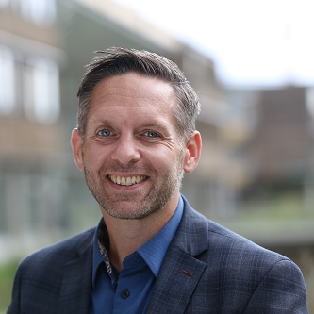


How to apply
  Apply now
  To find out more information about the programme, and to book your place on our next cohort, please visit our website (below) and follow the link to ‘Book your place’.
  Accessibility
We believe that all delegates should be able to participate in Executive Education programmes and we aim to make them accessible. We commit to ensuring this as far as possible and we will work with you to accommodate any adjustments that you require.
    Fee
The programme fee will be announced in early 2025.
This will include study materials, meals refreshments, and accommodation for the residential.
    Alumni discount
All University of Nottingham alumni are entitled to a 20% fee reduction. Please provide details on registration.
For an informal discussion about the programme, please contact our Senior Operations Manager, Nick Proverbs.
Email: Nick.Proverbs@nottingham.ac.uk
Phone: 07739039858
Website: nott.ac/UltimateScaleUp ExecutiveEducation@Nottingham.ac.uk

