Slide 1
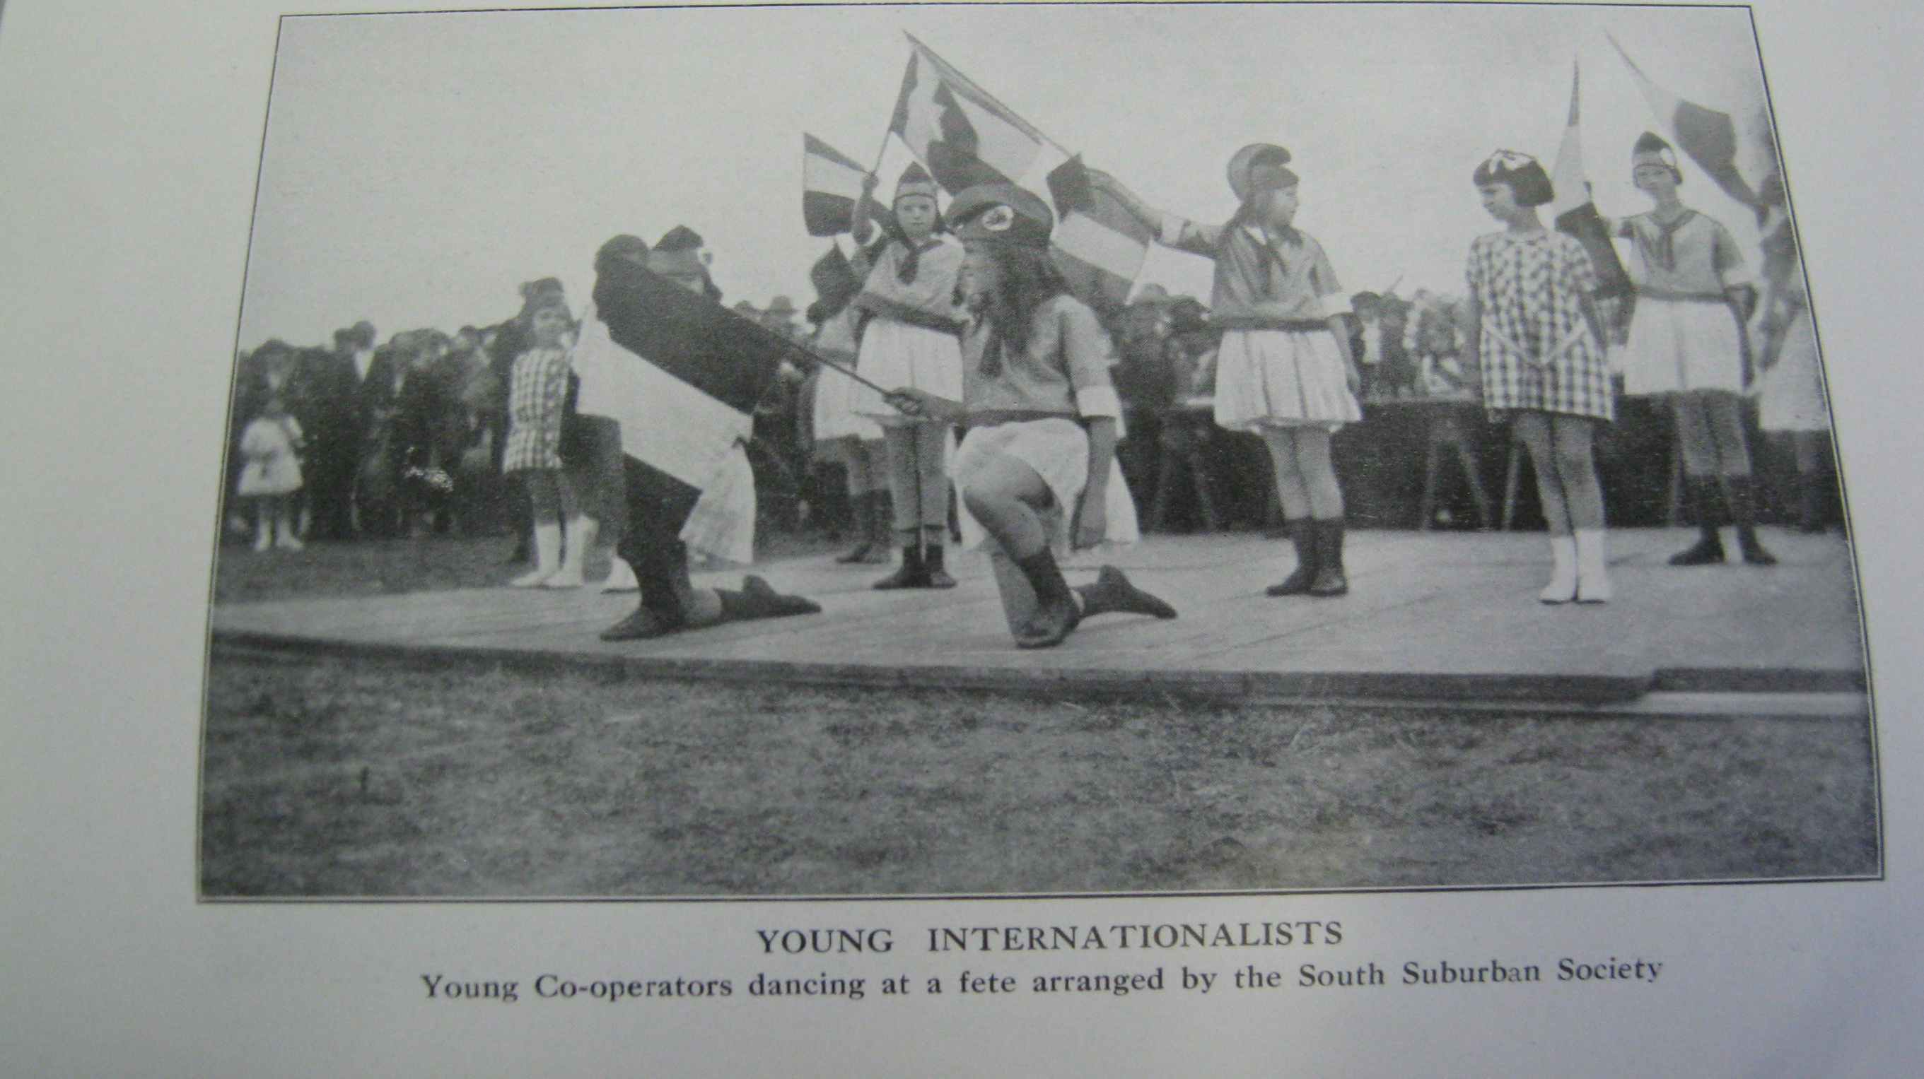
Education, culture and co-operation
Tom Woodin

Slide 2
Co-operative movement
Owenism and co-operation
Rochdale Pioneers 1844
Gradual then dramatic growth as a basis for co-operative visions
Turn c20 – 1500 independent co-operative societies
Membership 1914 3m; 1939 8m
National spread eg North West and industrial areas to London and South East
‘We want to put the profits of trade into the pockets of the people… Co-operators want to use the best means to get the entire wealth of this country, land and everything else, into the possession of the entire body politic.’ In S. Yeo, Who was JTW Mitchell

Slide 3
C20 challenges
Intensification of capitalist competition – profiteering, trusts and attacks on co-operation
Other forms of mutuality and co-partnership: WH Lever, John Speedan Lewis
State and welfare state undermines mutuality
Commercial forms of organised leisure
Polarisation of politics – fascism, growth labour movement
Democracy and membership as key co-operative values

Slide 5
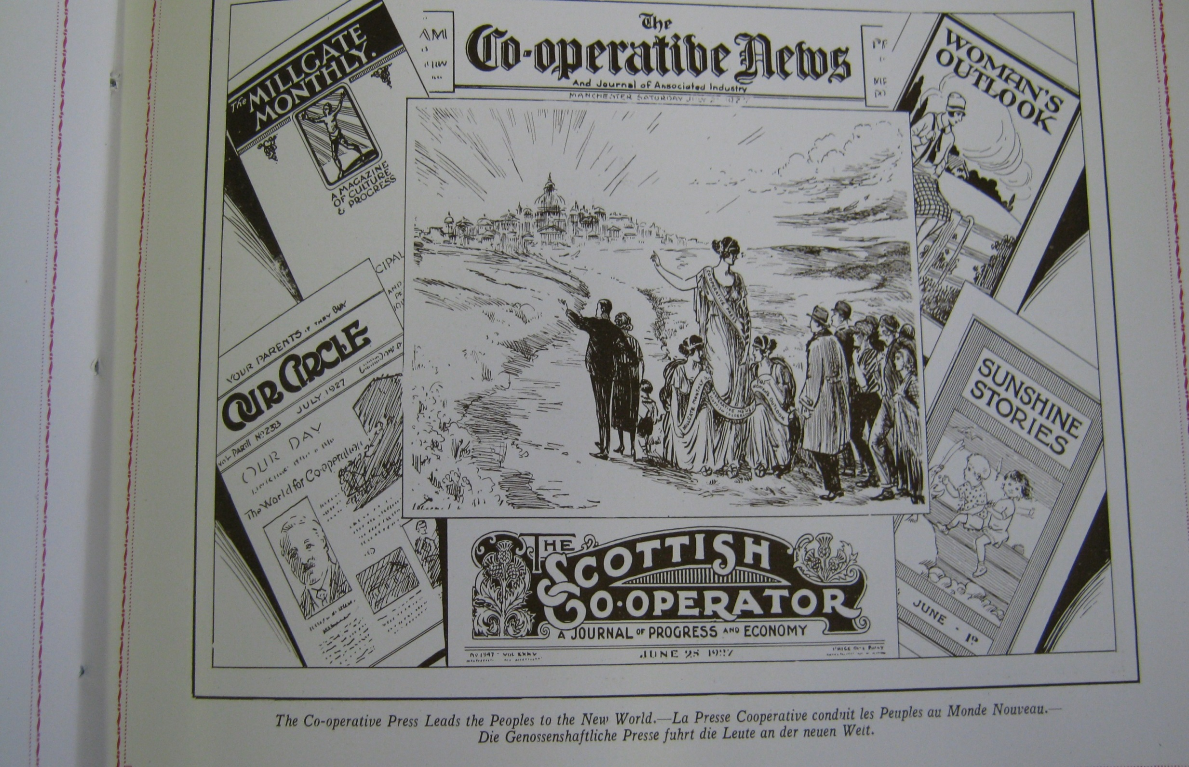

Slide 7
Brislington Clothing Factory Discussion Group

Slide 8
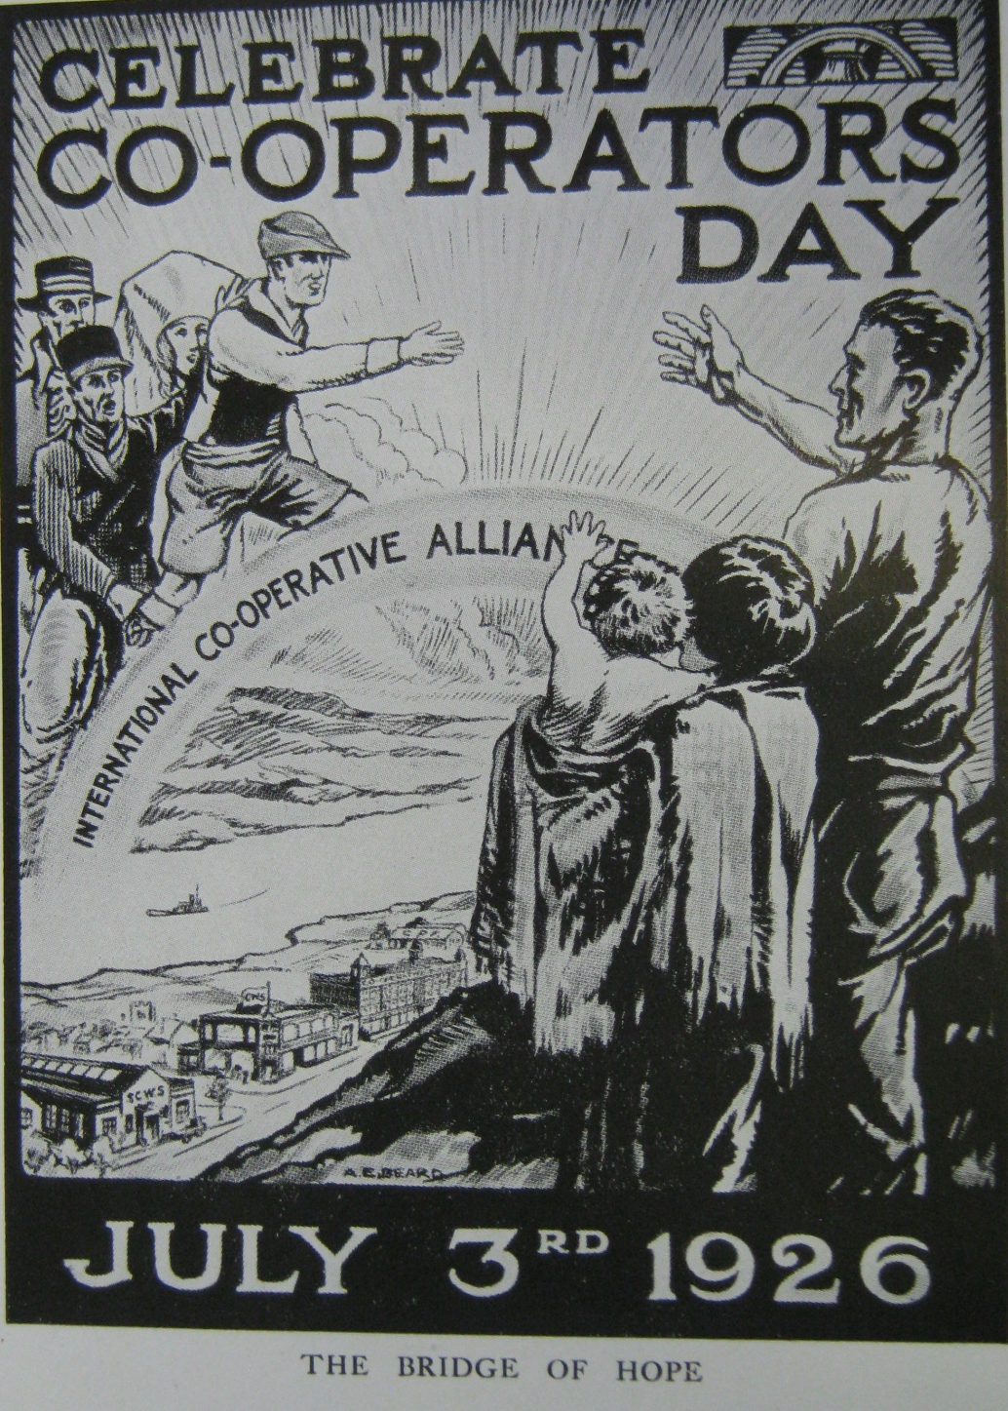

Slide 9
Education and culture – a state within a state?
The main aim of co-operative education was defined as ‘primarily the formation of co-operative character and opinion, and secondarily, though not necessarily of less import, the training of men and women to take part in industrial and social reforms and municipal life generally.’
Alternative – co-operative, labour movement, anti war, internationalist outlook
Size and range of activity: classes, reading rooms, libraries, lectures, social activities and entertainment, propaganda and press, literature, auxilliaries, children’s groups, cultural provision. Sport, cultural (drama, choirs, pageants etc), classes, examinations
50k students; 100,000s in guilds and auxiliaries
Tensions and contradictions

Slide 10
State and alternatives
Libraries, reading rooms, social and economic classes all taken over by the (local) state. Freed up resources but loss of identity
Politics: ‘intensive education’ for a ‘co-operative consciousness… He weakens his influence when he applies co-operation to his meal tables and lets capitalism run amuck through his house, garden and workshop.’ WH Brown 1919
‘the nationalisation movement, the municipalisation movement, and the co-operative movement… are all tending in the same directions’ (Alf Barnes, chair LCS and later MP)
‘That the workers have to develop their own culture no sympathetic observer can possibly deny, and the more they use the educational funds of the State for the purpose of developing their own system of education, the greater will be their chances of building a new system of society.’ Joseph Reeves, RACS, 1918
Concentration upon co-operation ‘has… a tendency to restrict the place given to Co-operation in other educational institutions of the workers’ movement, and so to separate Co-operation and its problems from the rest of the Labour movement’
It is curious that in Great Britain co-operation has no recognised place in the public educational system, though Paris and Brussels Universities have their Chairs of Co-operation provided and maintained by Co-operative Societies, and in several countries Co-operation forms a subject in the curriculum of certain types of schools’ Honora Enfield

Slide 11
Democracy, participation and structure
Growth led to problems of democracy, participation and loyalty
Education could be isolated. Education committees stepping stones, dumping grounds, limited power
Collective force of ‘working class culture’ (Williams 1958) but lost out to other organisations
‘Vast funds of enthusiasm, which are ours by right, are secured by other bodies… [classes] should not exhaust the missionary spirit’.
Problems with capturing zeal and interest of individuals but led to further structural innovations. Co-operators’ Educational Fellowship

Slide 12
Co-operative College
‘Evolutionary method’ 1919
College label was a challenge
One takes it for granted that the college would be established in some country district, where the work could be carried on under the best conditions.’ Fred Hall 1914
‘The presence of the College in Manchester has had certain advantages, such as proximity to the warehouses and many factories of the C.W.S., and contact with the day-by-day life of co-operators and co-operative societies. These advantages are much appreciated by the students, particularly by employee-students, who are attending the College in order to increase their knowledge of the trade, and the technical subjects bearing upon it.’ Fred Hall 1928
‘the nearest thing to a rural area enjoyed by the present college is the green area of the Manchester racecourse, in the Irwell valley below the College Hostel! Is it better to study in the thick of co-operative headquarter activities, or far away in some parkland…?’ Percy Redfern 1939

Slide 13
Amateurs and professionals
‘Drama… implies very practical co-operation between different groups of people – dramatists, actors, producers and stage craftsmen. Drama originally belonged to the people… at the market place or in the churchyard, and the whole community attended…
If drama is worth organising on a co-operative basis through amateur societies then it is worth organising properly, and co-operative societies should see to it that drama is presented at its best.’ April 1936
Occupying theatres – and centres; Wembley Pageant 1938

Slide 14
Business response and new technology
Co-opera: ‘one society’s educational committee… made a considerable financial gain by transferring it show from a school room to a super cinema’
Technology – investment and scale eg film, radio
Technical issues and local variation vs representation in film
Appealing to a ‘vast middle class public… on grounds of commercial merit… not… social revolution’

Slide 15
Culture and experience
‘co-operators were too apt to accept the fruit without inquiring into the growth of the tree.’ He wanted lecture lists and classes ‘but you prefer the tea, buns and funny men.’ WR Rae, 1903
Elocution, jazz
Classes on co-operation 1920-21: 21,366 junior students enrolled, 2,716 intermediate: 8,300 exam entries, 3026 certificates of merit, 5505 attendance certificates issued.
Internal cultural judgements eg Choirs
Debate on beauty (Pevsner)

Slide 16
Children’s writing: exposure and aspiration
‘By “co-operation” is meant the action of “working together,” from the Latin co, meaning “with” or “together,” and opera, meaning “I work,” while the word “Nature,” in its fullest sense, signifies the universe. Therefore, “Co-operation in Nature” means “working together in the whole of the universe.”’

Slide 17
the “Fisher Girls”… was acted very well indeed. The girls… were dressed in costumes to represent the fisher folk… They sang very nicely, and accomplished their work remarkably well.’
‘“Urchins We” was a little sketch performed by a number of boys, who were the cause of much merriment. They were dressed in rags, with many a large patch sewn here and there on their clothes. They had no boots or stockings on, and were not at all clean-looking.’
Nellie Dawson, Abbey Wood Junior Guild

Slide 18
Co-operative Women’s Guild – practice and experience
‘the kind of education which these adult women need is not of an intensive, neutral, and university type. It should proceed from what is concrete and affecting their everyday-life as married women, co-operators, trade-unionists, and political citizens. It should only be abstract in so far as general ideas and principles are needed as a background for giving the power to make intelligent judgements and criticisms on the problems of working class life. It must be frankly biased in favour of a society organised on a basis of fellowship, and it should be severely practical… [the Guild’s] members are at once Co-operators pledged to Co-operative ideals, and married working women whose experiences and spheres are those of mothers and housewives, and in these two capacities they desire to secure reforms and to take part in administrative work, co-operative and national.’ Margaret Llewelyn Davies to Board of Education, 1922
Campaigns and conferences, personal experience, radical commitment
Danger of emphasising the concrete, containing and limiting

Slide 19
Progressivism and differentiation
Play, drawing etc, ‘new methods of teaching juniors through action… Singing, dancing, drawing, modelling, and other activities are employed, so that the children may play themselves into knowledge.’ Fred Hall, 1918
I would put all children, rich or poor, through a form of elementary school, and let those of all classes who have the ability to proceed together to higher schools and the university. Brains and not cash should be the determining factor as to which pursuit in life persons should be employed’ Thomas Killon 1918 Congress
Following Hadow Reports 1926-33, all children, not just a selected few, ‘may receive an education suited to their age and special needs, practical in the broadest sense, and so organised as to allow of classification and differentiation between pupils of different types of capacities and different aptitudes... The significance of this new and revolutionary educational development lies in the fact that this second stage in the education of the child will be organised as a single whole within which there will be a great variety of types of schools, including modern, central, technical, and secondary.’ Joseph Reeves

Slide 20
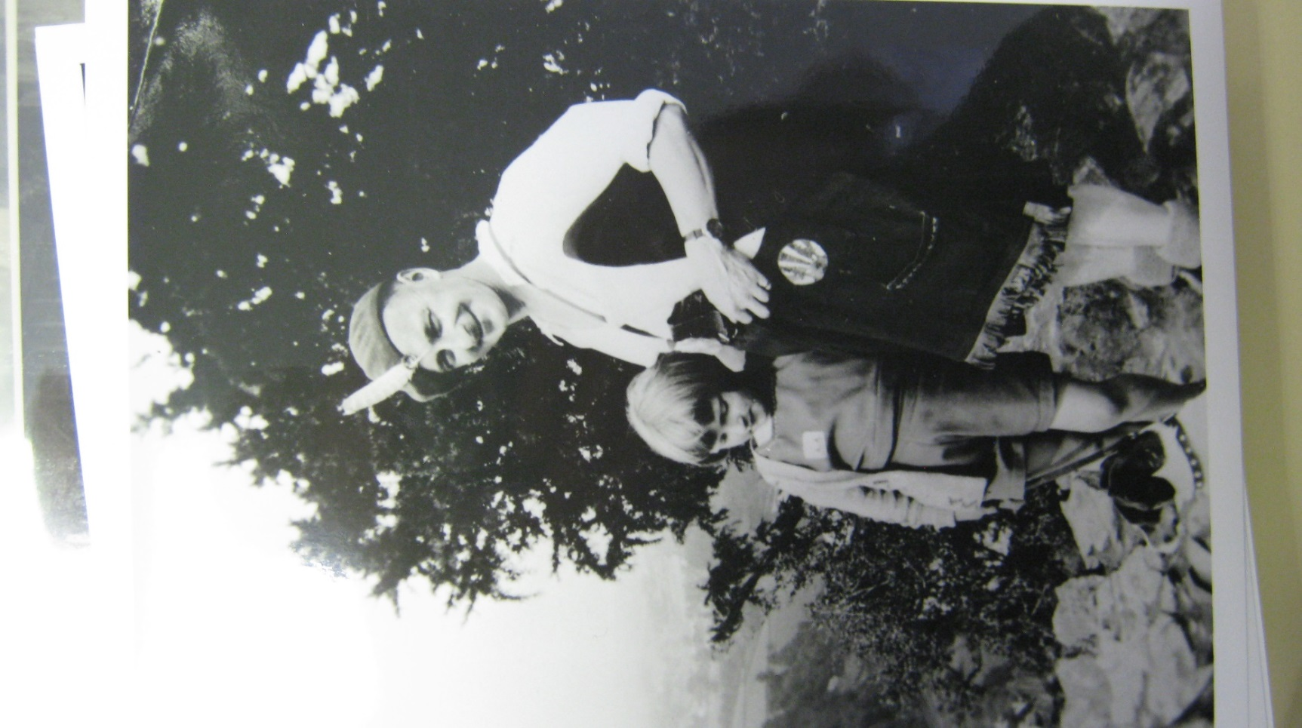
Evolution, progress and progressivism
a broad humanistic system of education for the children, so helping to rectify the narrow and utilitarian methods now adopted in our elementary schools… inculcating knowledge of human progress… We should not set too much store on whether the child knows where and when Robert Owen was born, but upon the interest the child takes in the beauty of a noble life.
Co-operation was tied to evolutionary ideas: ‘the altruistic dynamic at the heart of nature, which will ultimately transcend the mere selfish desire for personal gratification’
Woodcraft: The theory being that as we as individuals in our pre-natal life express the various stages of development through which life has travelled, so boys and girls express the gradual development of mankind from savagery to civilisation. In other words, individual life is a recapitulation of racial life.

Slide 21
Conclusions
Alternatives reproduced and changed elements of mainstream practices
Educational activities were for minority but involved large numbers
Unique elements incorporating co-operative history, business, resources of the movement
Tension between internal provision and external involvement/representation
Class and space helped to define activities. Blurring into lower middle class? Or a different social classification required?

