Slide 1
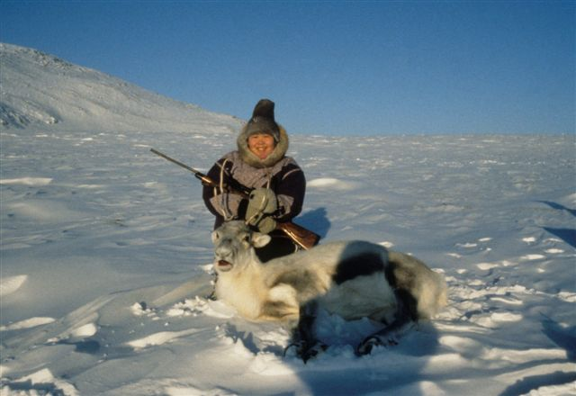
Power of Place in Indigenous Learning
Jim Sharpe
Mount Saint Vincent University
Halifax, Nova Scotia, Canada

Slide 2
Canadian Residential Adult Education
Antigonish Movement: People’s School
Religious and community conference centres
Residential training centres
Summer retreat, camping or canoeing adventure
University programs: summer institutes

Slide 3
Indigenous Education
Recovery from Residential Schools: Truth and Reconciliation Commission
Policy of “Cultural Genocide” to take the Indian out of the child
Resurgence based on survival of spiritual and cultural practices
Grass-roots, decentralized, cultural response:
Idle No More

Slide 4
Theorists of Indigenous Renaissance
Glen Coulthard, “Red Skins, White Masks”
Margaret Kovacs, “Indigenous Research Methods”
Marie Battiste, “Decolonizing Education: Nourishing the Learning Spirit”
All call for pedagogy of decolonization

Slide 5
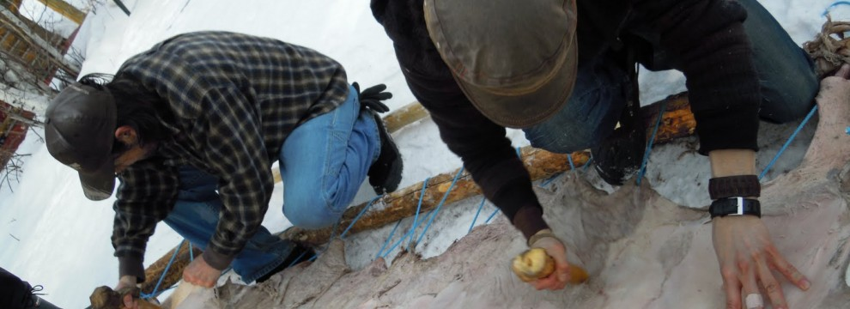
Duchinta Bush University

Slide 6
Duchinta=Learning from the Bush
Located 20 minutes by plane from Yellowknife on Blatchford Lake in Akaitcho territory
Offers both semester long programs and shorter professional development for teachers
Accredited by University of Alberta and other universities
All courses involve learning from the land

Slide 7
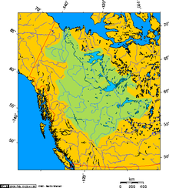
Location

Slide 8
Founder
Erin Ballantyne: first Rhodes scholar from NWT
Way of moving decolonization theory into practice
Learning from the Elders and the land
“Reciprocity with the land results in the crumbling of settler capitalism”

Slide 9
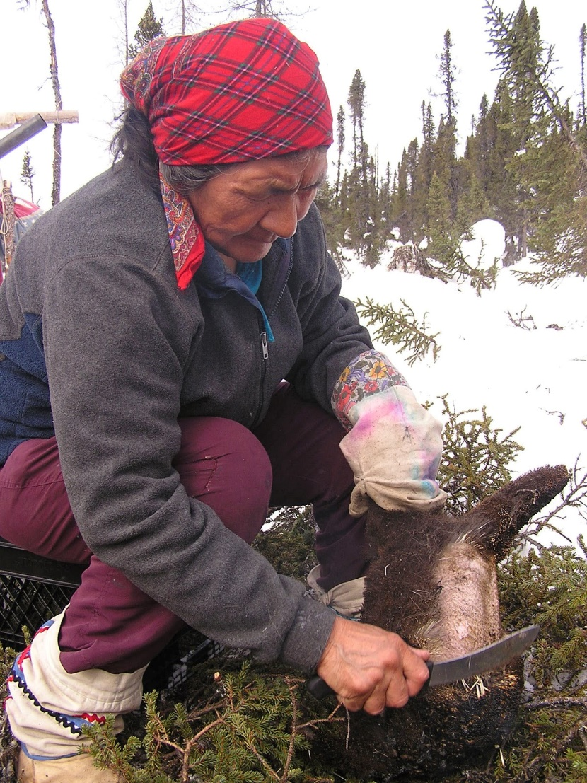
Elizabeth “Tshaukuesh” Penashue’s Walks

Slide 10
Late winter walks

Slide 11
Black Kettle Films
Short film (22 minutes) by US filmmaker Andrew Madge on 2009 walk
Available on Elizabeth’s blog http://elizabethpenashue.blogspot.ca/
Shows the purpose of the walk is to teach natural way of life
Special interest in involving children with the language of the land

Slide 12
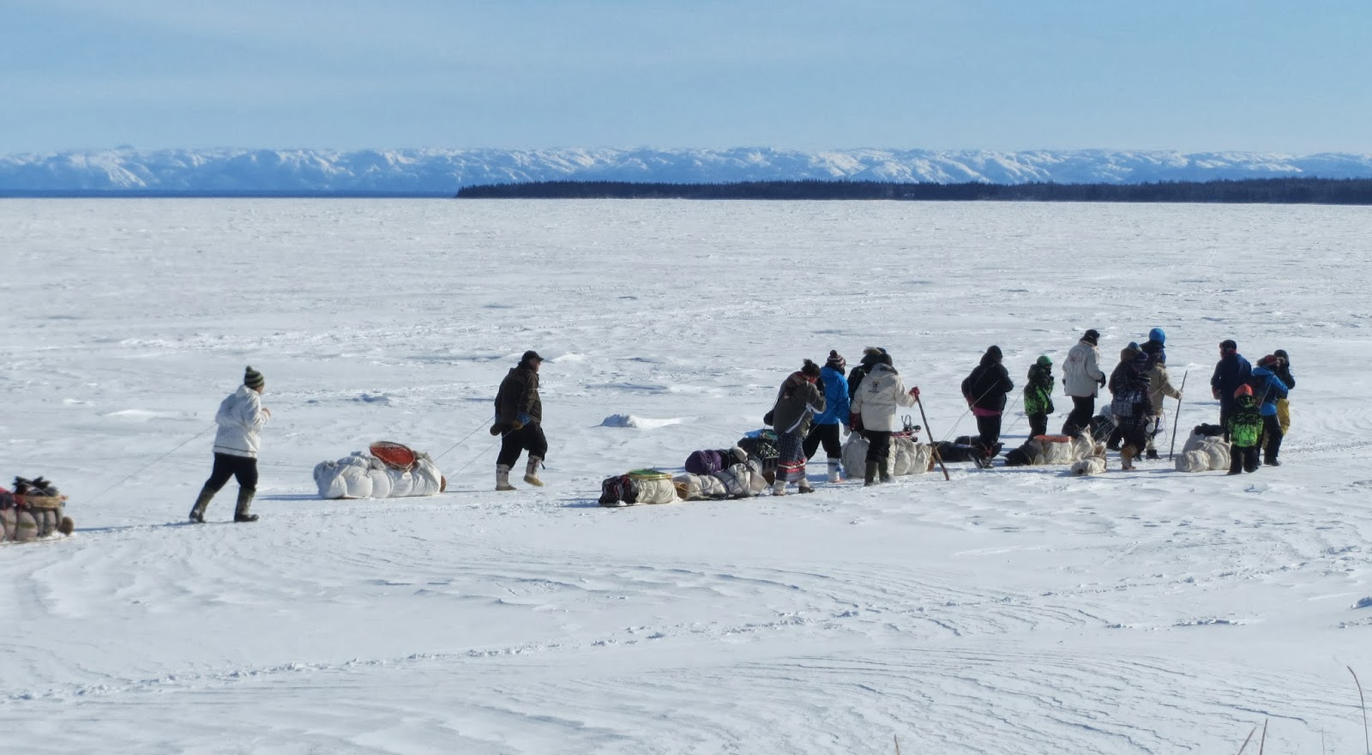
Images from the walk

Slide 13
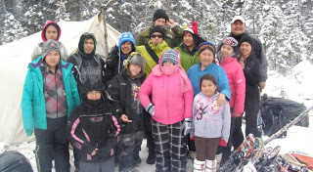
Family/Group Photo

Slide 14
Winter walks and summer canoe trips
Opportunity to learn from the land
Protest the development of the lower Churchill Falls Dam and power station
Long tradition of protests, including camping on runway to protest low-level flying training for NATO

Slide 15
Elispogtog Anti-Fracking Protest
Ten years of opposition to fracking in southern New Brunswick
In Fall of 2013 Government pushing fracking as the economic salvation for the province
Elispogtog, largest First Nation in New Brunswick, calls for stop of fracking on traditional territory
Occupation of Company equipment site.

Slide 16
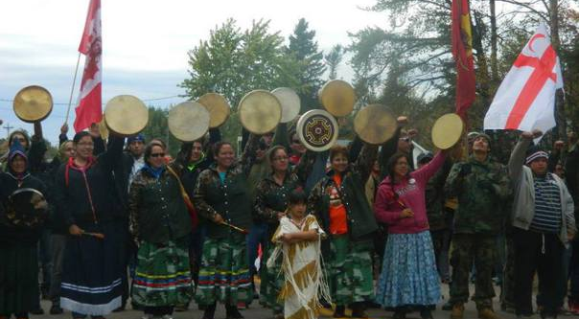
Started as Peaceful Protest

Slide 17
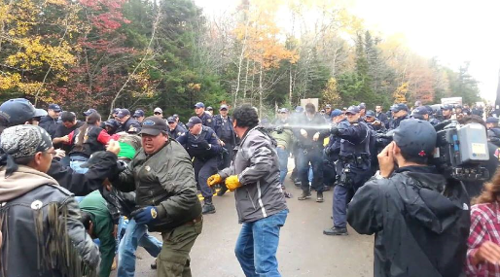
Then RCMP moved in

Slide 18
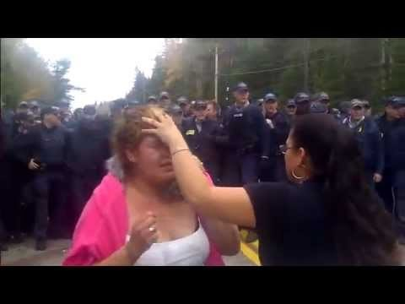
Showdown at Highway 134

Slide 19
Result of the Protest
South West Resources left and did not return
Election the next year defeated government that supported fracking
New government place moratorium on fracking recently extended
Ongoing court cases against protesters
Ongoing court challenge from Elispogtog on ownership and development of resource

Slide 20
Conclusion: Learning from the land
Great need for recovery of language of the land
Land based graduate degrees in education at University of Saskatchewan
Learning through collective action to both interact with the land and protect the land
Learning is dynamic, involves protest and builds community.

