Slide 1
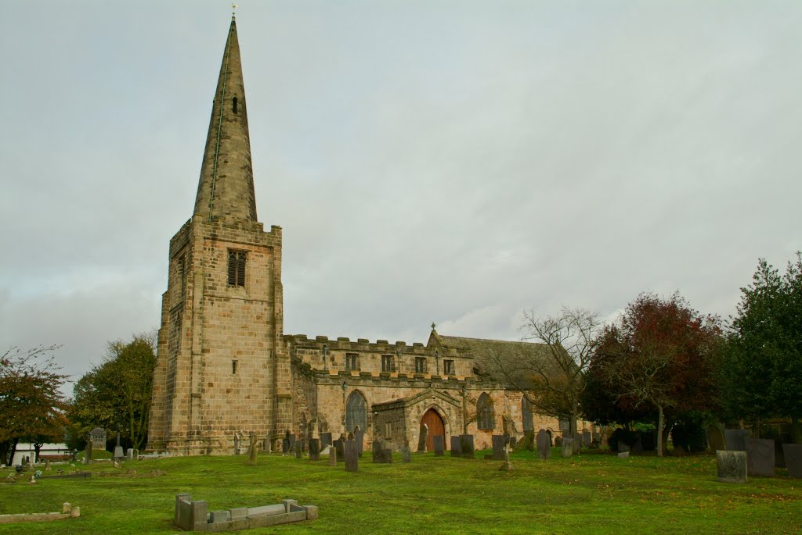
History and Spirituality in the House of God
The experience of running local history courses for adults using the church building

Slide 2
John Tomlinson
Born and brought up in Shropshire
BA in History and Welsh History (University of Wales, Aberystwyth)
Dissertation on the development of vernacular timber-framed buildings in Shropshire 1550-1620
MA in Social and Pastoral Theology (University of Manchester)
Dissertation on the theology of the church building
PhD (University of Birmingham)
Development of church within communities in Staffordshire, 1830-1960
At present vicar of Carrington, Nottingham and associate lecturer in theology at Bishop Grosseteste University, Lincoln
Observations and feedback from creating, developing and leading history courses for adults in four different church buildings over twenty years.

Slide 3
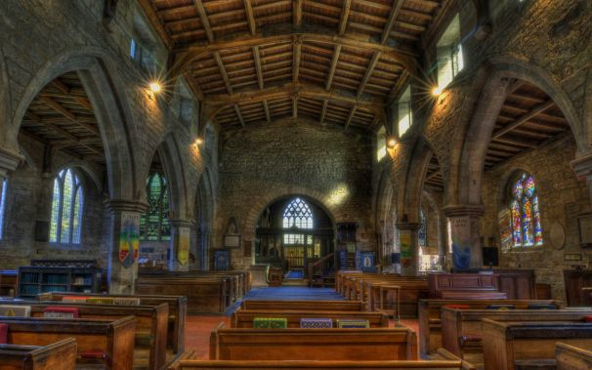
All Saints, Sawley, Derbyshire
Saxon foundation, 11th century parish church, extensively restored in 19th century

Slide 4
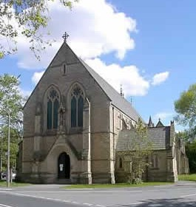
St Chrysostom, Victoria Park, Manchester
Late 19th century, rebuilt after fire in early 20th century

Slide 5
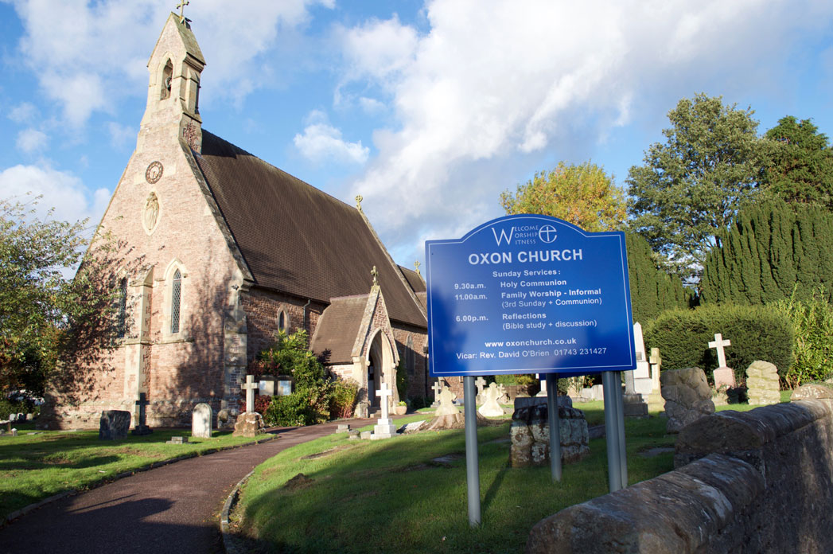
Christchurch, Oxon, Shrewsbury
Mid-19th century small country church, substantially unaltered

Slide 6
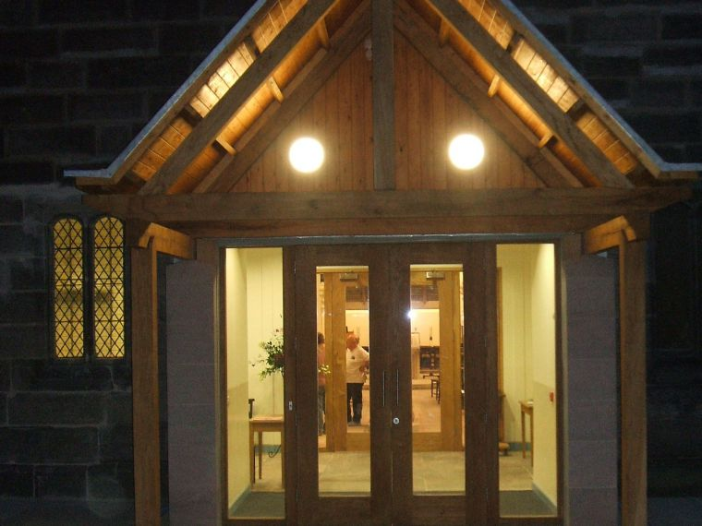
St John, Carrington, Nottingham
Mid-19th century, extended in 1920s and extensively re-ordered in 2009

Slide 7
Resources
www.christianityandculture.org.uk/churches
www.churchcare.co.uk
www.arthurrankcentre.org.uk
www.engagingplaces.org.uk
www.buildinghistory.org/buildings/churches
www.lookingatbuildings.org.uk
www.open.ac.uk/Arts/building-on-history-project
www.nottsopenchurches.org.uk

Slide 8
Practical Issues
Access
Funding
Ownership
Context

Slide 9
Benefits
Availability
Scope
Variety and longevity
Physicality

Slide 10
Challenges
Partial
Static
Nostalgic
Spiritual

Slide 11
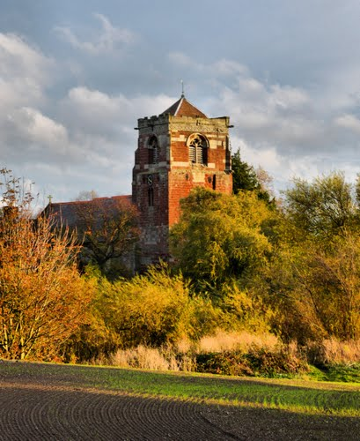
Adult education in church buildings
depends on a developed historiography of sacred space

