Slide 1

Creating space for the public domain through adult education: - a workshop
Kevin Walker – Plymouth University UK

Slide 2
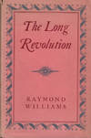
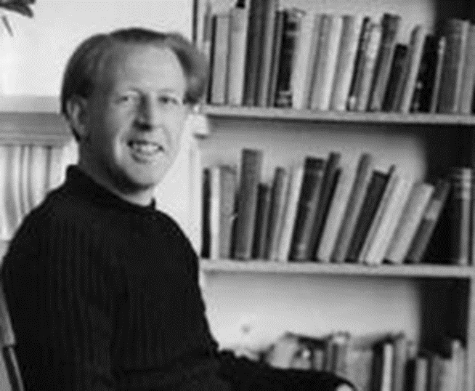
Educational Cultures in England.
The Industrial Trainers
education for industry – needs appropriate skills
The Old Humanists
education as transmission of enlightenment culture
The Public Educators
education as conscious political action, linked with the development of universal franchise.
Raymond Williams 1961

Slide 3
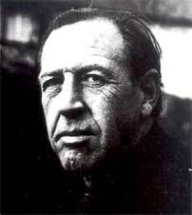
From the introduction to ‘The Long Revolution’. 1961
It seems to me that we are living through a long revolution, which our best descriptions only in part interpret. It is a genuine revolution, transforming men and institutions; continually and variously opposed by explicit reaction and by the pressure of habitual forms and ideas.
… it is impossible to mistake the rising determination , almost everywhere, that people should govern themselves, and make their own decisions, without concession of this right to any particular group, nationality or class.
… Yet the demand has been and is being very powerfully resisted, not only by the weight of other traditions, but by violence and fraud. … it is evident that the democratic revolution is still at a very early stage.

Slide 4
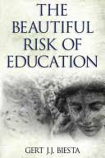
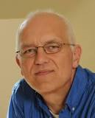
functional domains of education
Qualification
acquisition of knowledge, skills, values & dispositions.
Socialization
becoming part of existing traditions and ways of doing & being.
Subjectification
the recognition of subject-ness in those we educate,
- emancipation, freedom and responsibility.
Biesta G (2013:4)

Slide 5
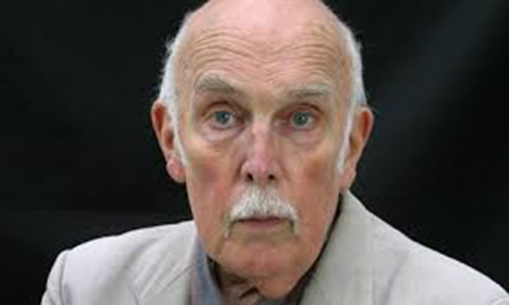
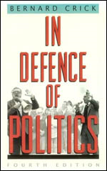
Forms of Citizenship
Sir Bernard Crick
An Informed Citizen
acquisition of knowledge, skills, values & dispositions.
A Participating Citizen
becoming part of society, a good citizen.
An Active Citizen
exercises critical judgement and takes responsible action.

Slide 6
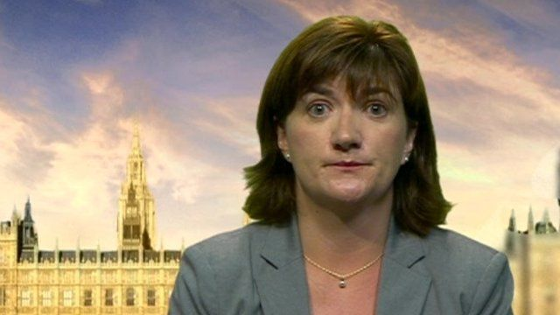
- … our priorities for 2016 which include: ...supporting schools to develop pupils into well-rounded, confident, happy and resilient individuals to boost their academic attainment, employability and ability to engage in society as active citizens.
Nicky Morgan, Secretary of state for Education

Slide 7
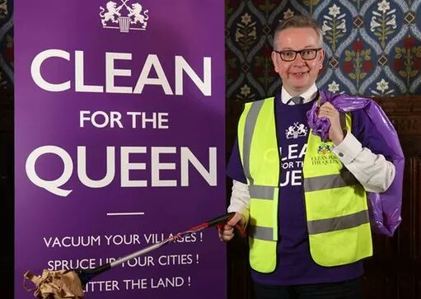

Active Citizens?

Slide 8

education with a social purpose?
Which is?
A better world – equal, democratic and just; through adult education the WEA challenges and inspires individuals, communities and society.*
How?
By Inspiring students, teachers and members to become active citizens.*
Using active learning and a student centred approach in which teachers and students work as equals.*
So why you are here?
*Extracts from http://www.wea.org.uk/about/vision

Slide 9
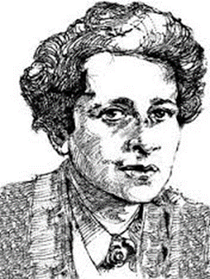
On the Public, Private & Social Realms
“The distinction between a private and a public sphere of life corresponds to the household and the political realms, which have existed as distinct, separate entities at least since the rise of the ancient city-state; but the emergence of the social realm, which is neither private nor public, strictly speaking, is a relatively new phenomenon whose origin coincided with the emergence of the modern age and which found its political form in the nation-state.”
From The Human Condition

Slide 10
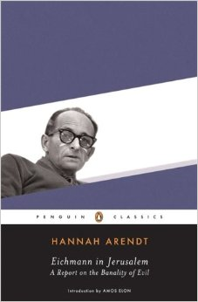
Eichmann in Jerusalem a report on the Banality of Evil
[That] an average, “normal” person, neither feeble-minded nor indoctrinated nor cynical, could be perfectly incapable of telling right from wrong.

Slide 11
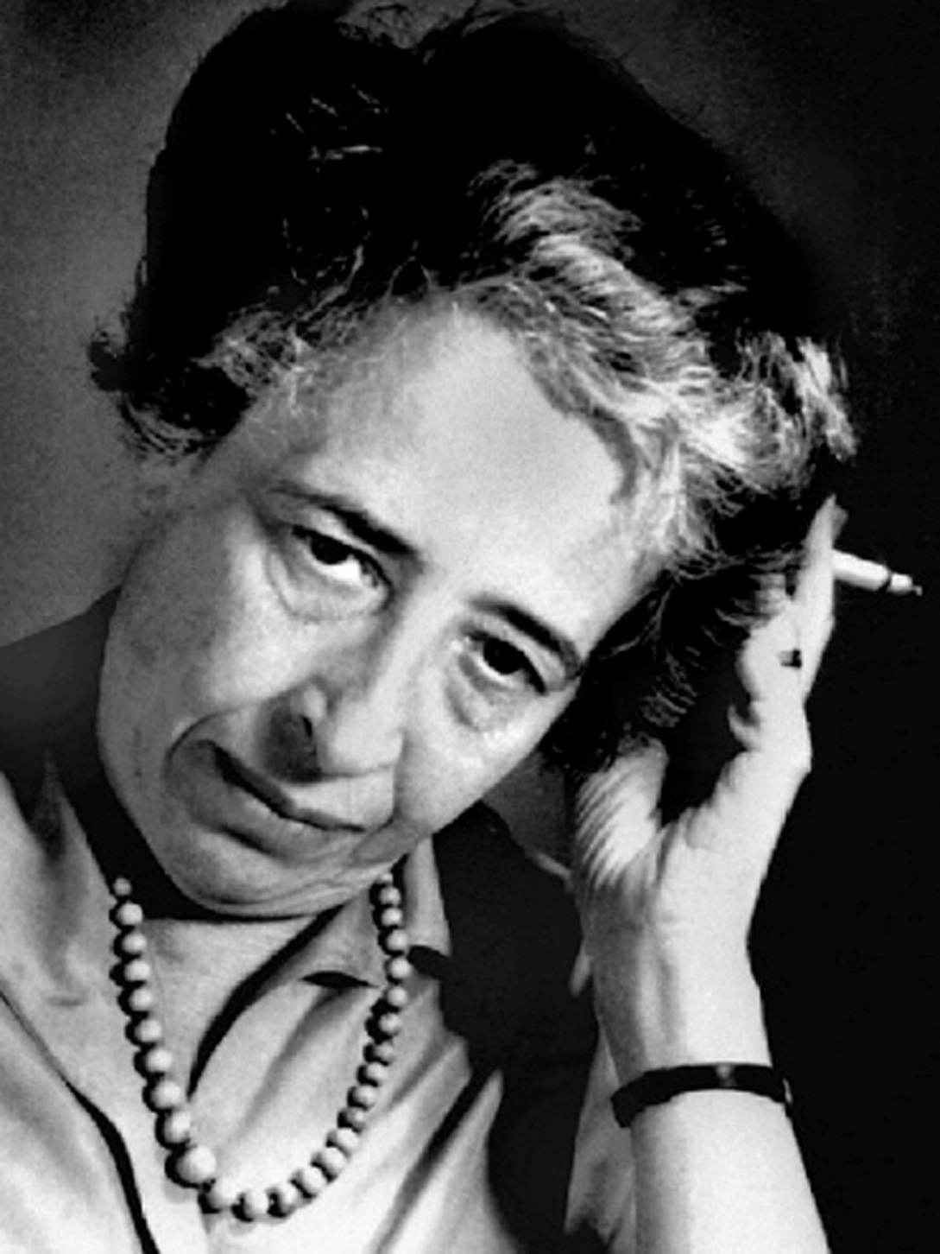
“What I propose in the following is a reconsideration of the human condition from the vantage point of our newest experiences and our most recent fears.
This, obviously, is a matter of thought, and thoughtlessness – the heedless restlessness or hopeless confusion or complacent repetition of “truths” which have become trivial and empty – seems to me among the outstanding characteristics of our time. What I propose, therefore, is very simple: it is nothing more than to think what we are doing. “
(Human Condition, p. 5)

Slide 12
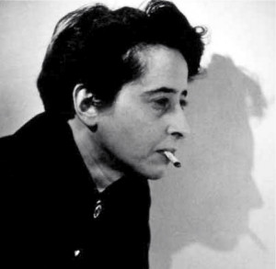
Hannah Arendt
Education is the point at which we decide whether we love the world enough to assume responsibility for it and by the same token save it from the ruin which, except for renewal, except for the coming of the new and the young, would be inevitable. And education, too, is where we decide whether we love our children enough not to expel them from our world and leave them to their own devices, nor to strike from their hands their chance of undertaking something new, something unforeseen by us, but to prepare them in advance for the task of renewing a common world.
(Arendt 1954:196)

Slide 13
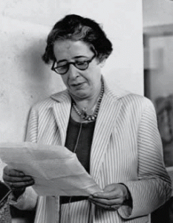
“The presupposition for this kind of judging is not a highly developed intelligence or sophistication in moral matters, but merely the habit of living together explicitly with oneself, that is, of being engaged in that silent dialogue between me and myself which since Socrates and Plato we usually call thinking.
This kind of thought, though at the root of all philosophical thinking, is not technical and does not concern theoretical problems.”
“Personal Responsibility under Dictatorship,” The Listener, August 6, 1964.

Slide 14
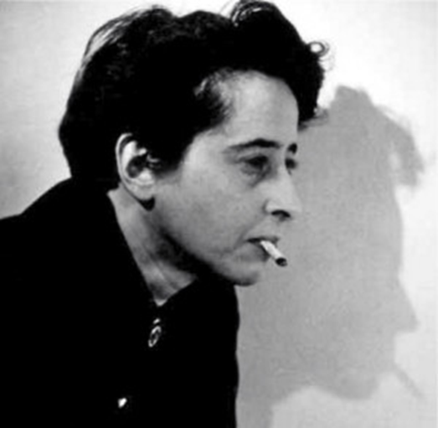
“Thinking deals with invisibles, with representations of things that are absent; judging always concerns particulars and things close at hand. But the two are interrelated in a way similar to the way consciousness and conscience are interconnected.
If thinking, the two-in-one of the soundless dialogue, actualizes the difference within our identity as given in consciousness and thereby results in conscience as its by-product, then judging, the by-product of the liberating effect of thinking, realizes thinking, makes it manifest in the world of appearances, where I am never alone and always much too busy to be able to think.
The manifestation of the wind of thought is no knowledge; it is the ability to tell right from wrong, beautiful from ugly. And this indeed may prevent catastrophes, at least for myself, in the rare moments when the chips are down.”
Hannah Arendt
“Thinking and Moral Considerations: A Lecture,” Social Research 38/3 (Fall 1971): 417–446.

Slide 15
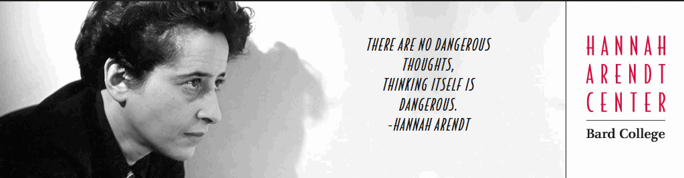
Final word?

Slide 16
References
Arendt H (1958) The Human Condition. Chicago: University of Chicago Press
Arendt H (1963) Eichman and the Holocaust. New York: Penguin
Arendt H (1970) On Violence. New York: Harvest Books.
Arendt H (1977) Life of the Mind. New York: Hardcourt.
Biesta G (2013) The Beautiful Risk of Education. Paradigm.
Bolton G (2001) Reflective Practice: writing & professional development. Sage.
Crotty, M. (1998) The Foundations of Social Research: Meaning and Perspective in the Research Process. London: Sage
Crick B (2005) In Defence of Politics, Continuum.
Williams R (1961) The Long Revolution, Penguin.

