Slide 1
‘PLACE DETECTIVES’ - PLACE, MEMORY AND WELLBEING
“I noticed new things today”
Dr Sarah Holland
University of Nottingham and WEA
@DrSarahHolland

Slide 2
Relationship between adult learning and health and wellbeing
John Field:
“participation in adult learning has both a direct and indirect influence on attitudes and behaviours that affect mental wellbeing”
“we know relatively little about the differential impacts of different types of adult learning”

Slide 3
PLACE DETECTIVES

Slide 4
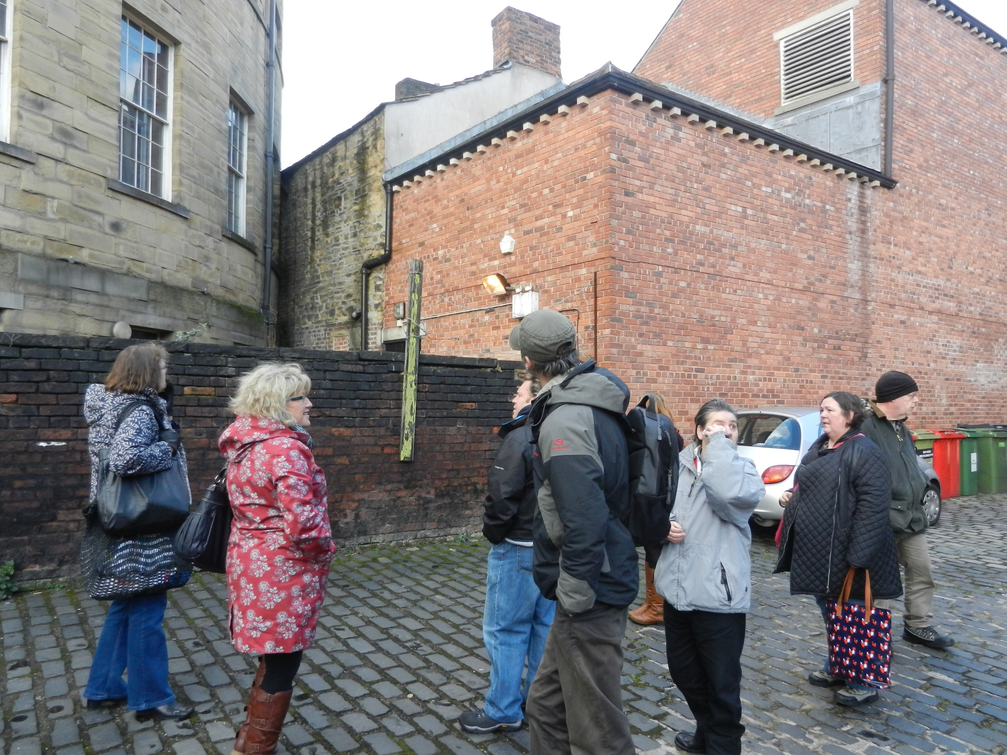

Slide 5
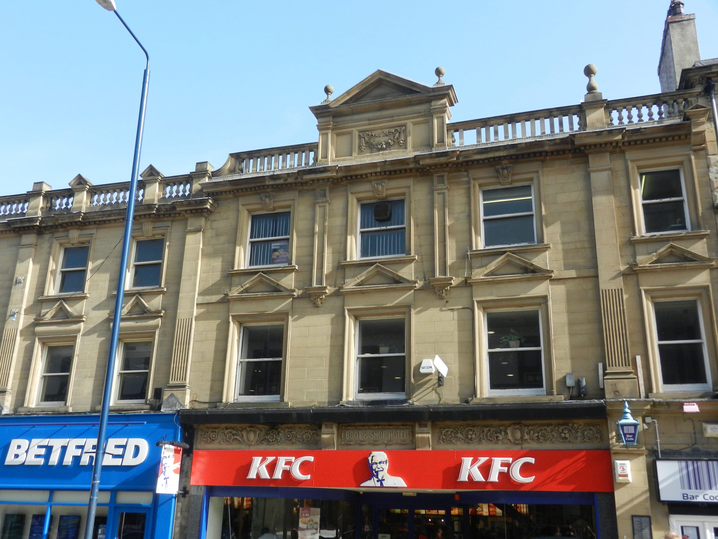

Slide 6
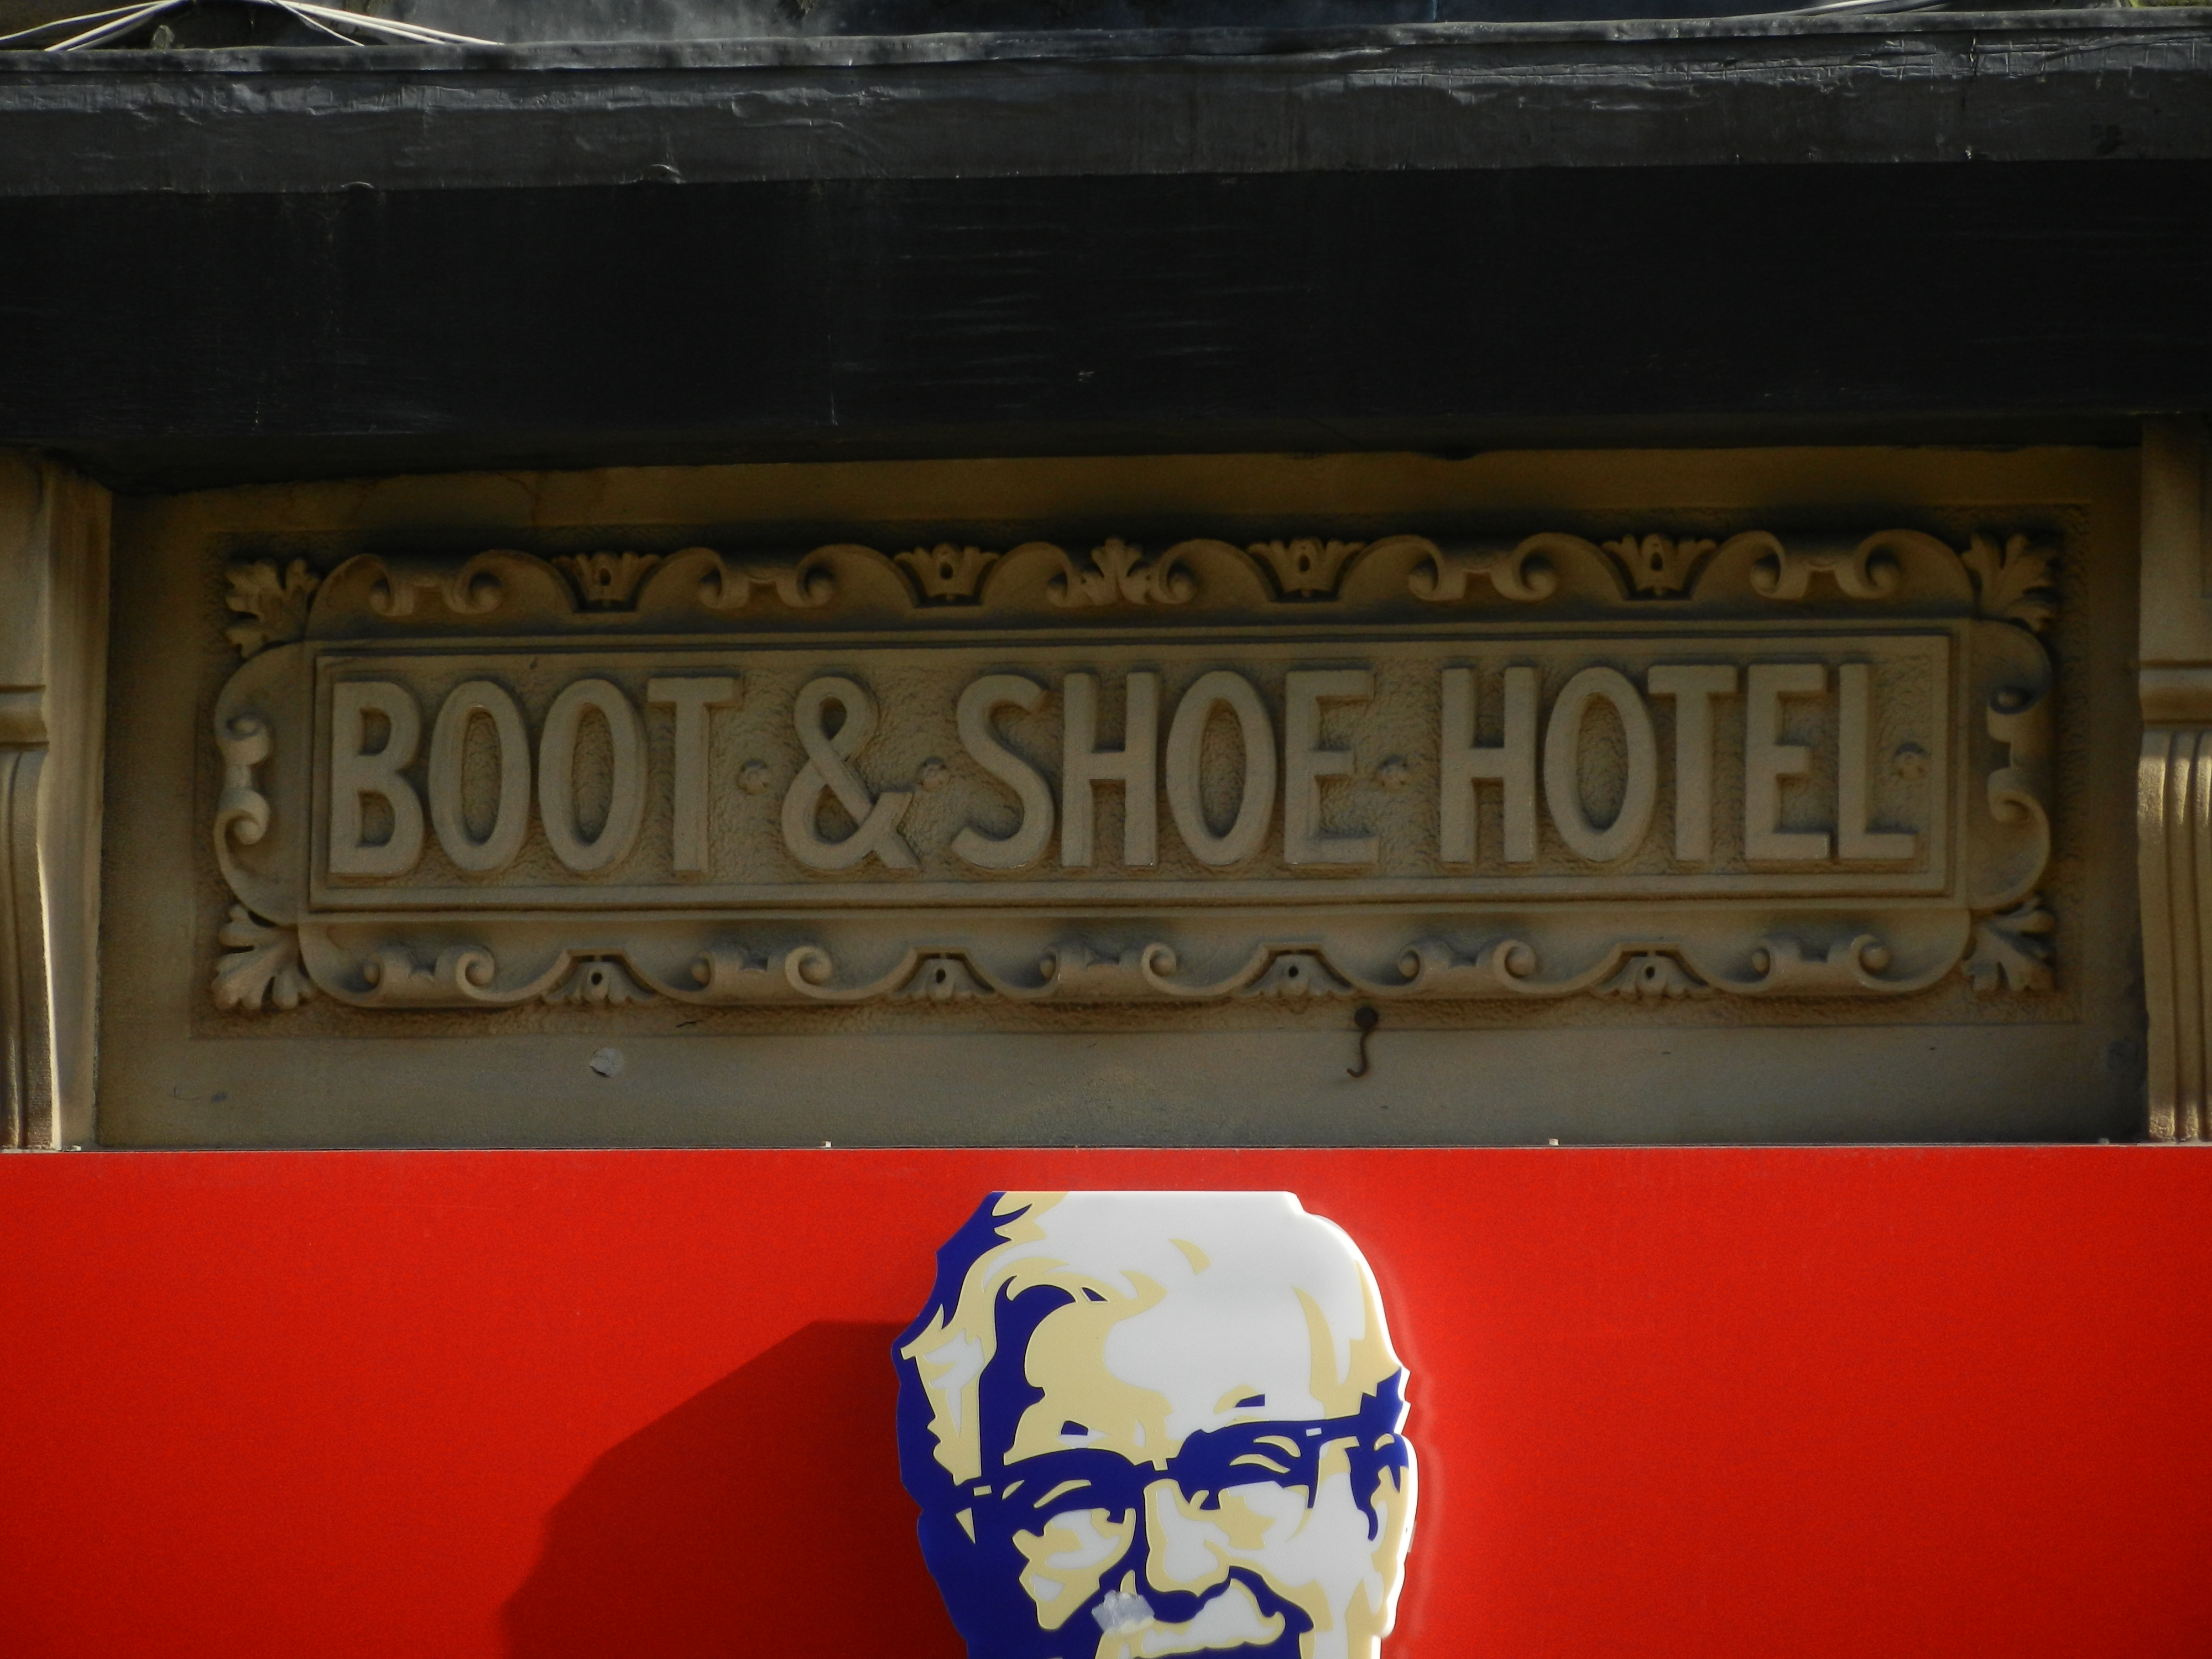

Slide 7
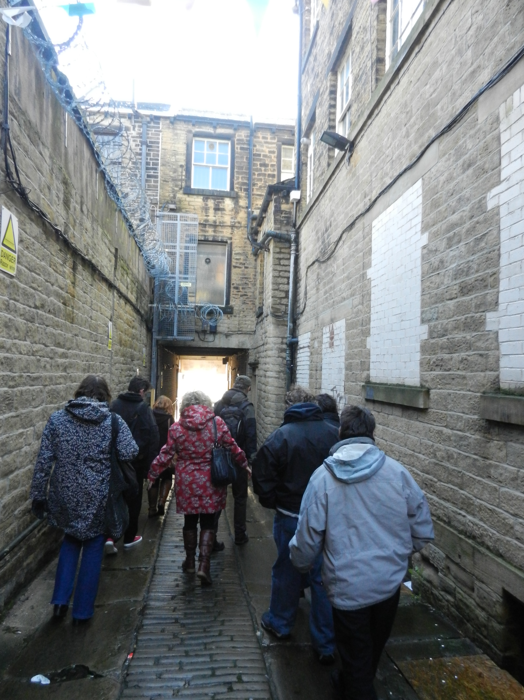

Slide 8
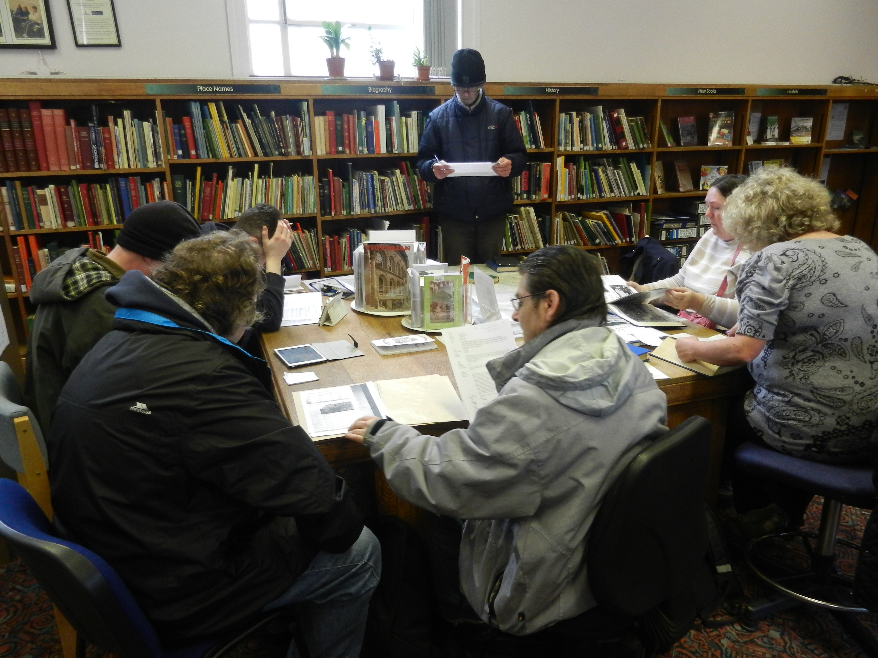

Slide 9
