Slide 1

From place to space: an adult education journey through a Nottingham lens
Sarah Speight,
Notes:
Me as a practitioners of adult ed for c. 20 years – liberal arts tradition, but also field studies, much of this residential. My own career has moved through the 3 phases

Slide 2
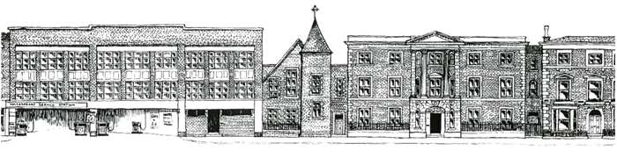
Phase 1: Community learning - boarding schools and country houses (c.1920 to 1945) Phase 2: Place-based learning - field schools and study tours (c. 1945 to 2008) Phase 3: Social and self-help learning - online education and MOOCs (c.2008 to present)
Notes:
Nottingham establishes its Department of Extra-Mural Studies/Adult Education in 1920 and appoints Robert Peers as its first director and then professor (reference to John)
Early programme of ‘liberal adult education’ focuses upon the 3-year tutorial class and the residential summer school
Curriculum including Literature, History, Economics, Psychology, Natural History, Trade Union Studies, Music
Major programmes for Miners’ Welfare Committee, H.M.Forces
How my own career connects – mention Shakespeare Street

Slide 3
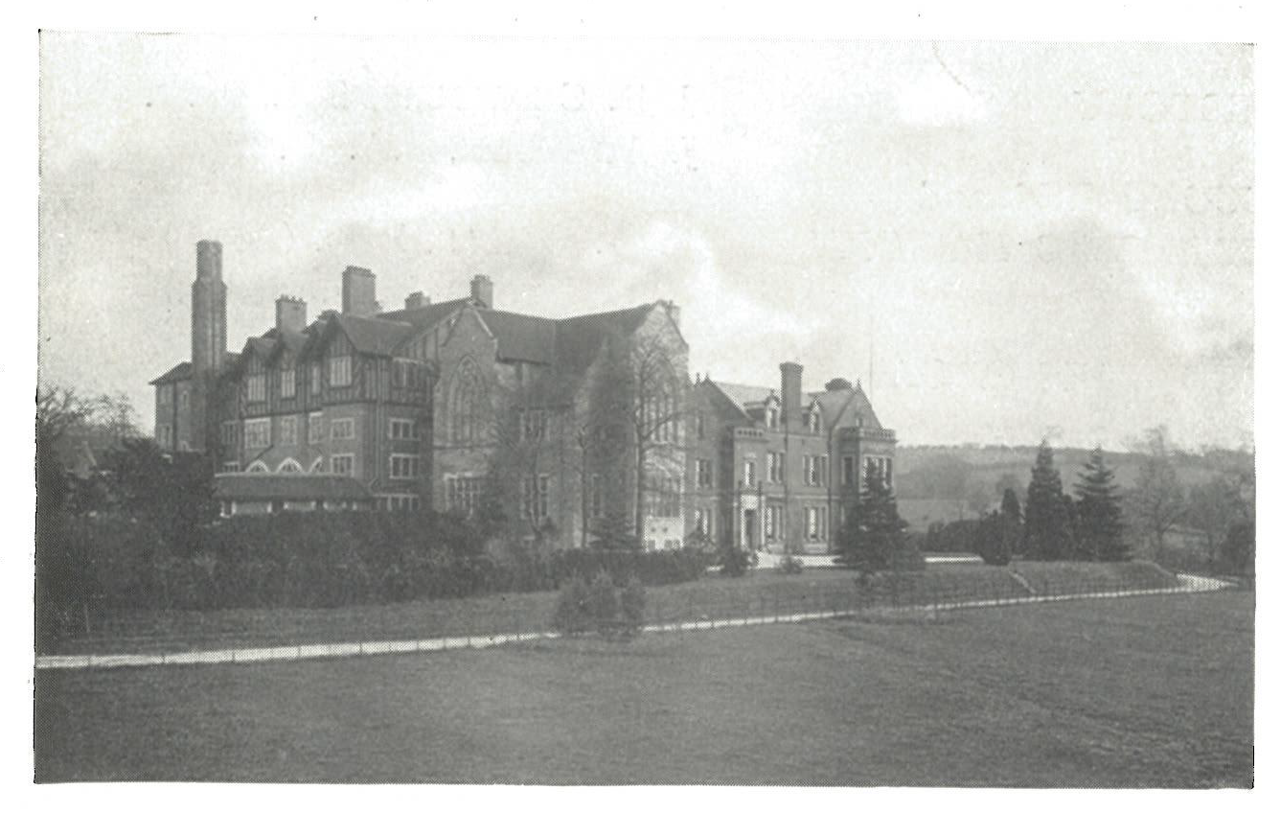
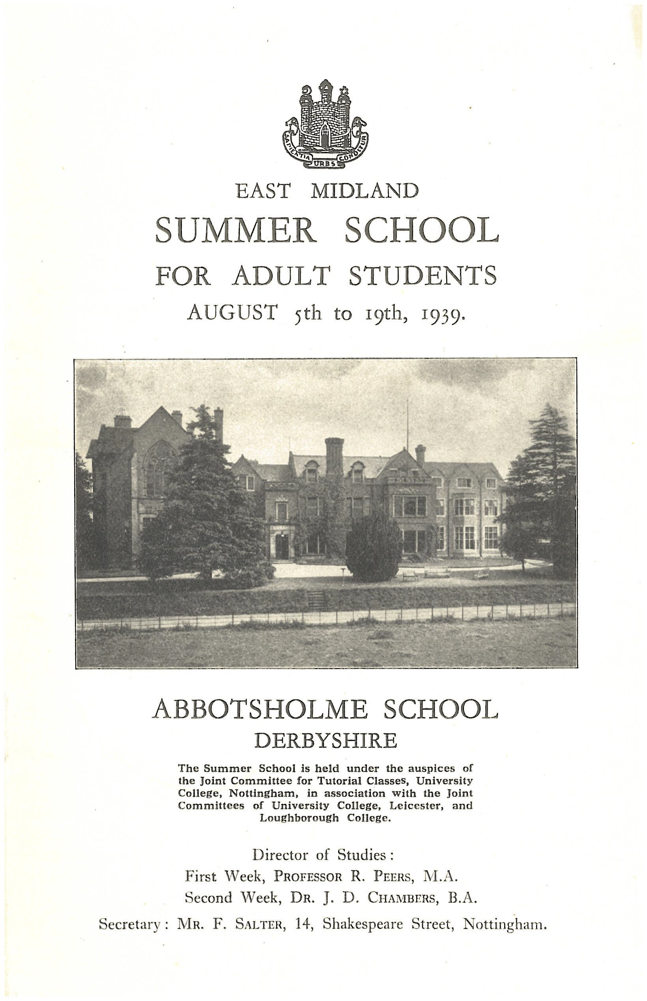
Phase 1: A rarified community?
Abbotsholme, 1880s
Stoke Hall, 1840s,
Notes:
Abbotsholme, (Staffs/Derbys border – near Rocester) school for boys founded by Dr Cecil Reddie, progressive educationalist – physical exercise and manual labour, modern languages, science, non-Christian religions, sex education, informal uniform. Still a school
Stoke Hall, nr Grantham – Victorian country mansion, taken over for education after WW2, still owned by NUT, now a hotel and conference venue

Slide 4
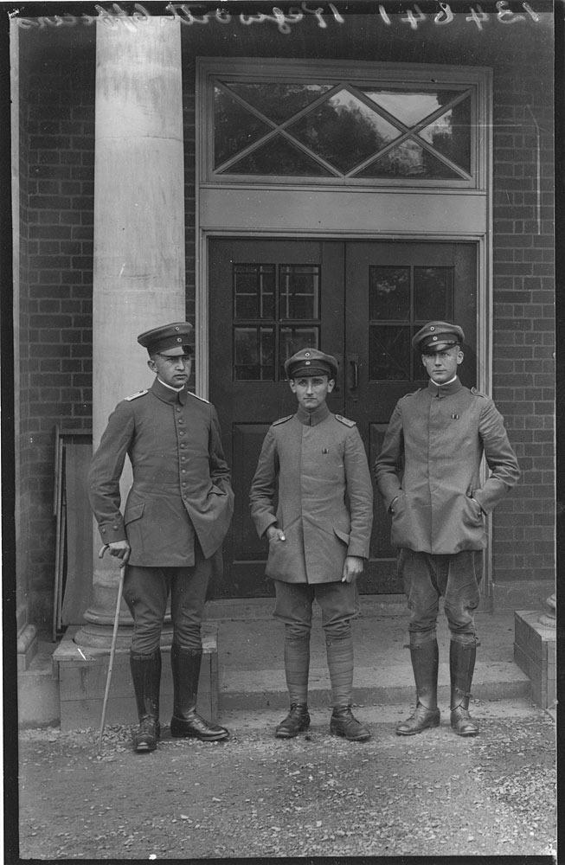
Themes of East Midland University Summer Schools
1935 The Problem of International Understanding
1945 The Post-World War
1947 The Prospects of International Understanding
1948 The Character and Possibilities of Democratic Society
1949 Town and Country in English Civilization
(1941 Summer sees record recruitment ‘partly due to the lack of normal holiday facilities’)
POWs at SB, 1915

Slide 5
3 key variables of residential AE:
isolation from daily cares,
continuity of learning
group support via student and tutor interaction.
These variables reinforce student motivation + result in higher levels of informal learning
Lacognata, AA (1961) ‘A comparison of the effectiveness of adult residential and non-residential learning situations’, Centre for the Study of Liberal Education for Adults Research Report.
Notes:
Romantic view of residential
Robert Peers, 1934 – “The work already covered in class provides a basis upon which progress, through the personal tuition received, becomes surprisingly rapid. Moreover, the atmosphere of intellectual alertness, and the constant opportunity for discussion with other students and with tutors, are extraordinarily stimulating, particularly to those who may be enjoying these conditions for the first time in their lives, so that students come away mentally invigorated”. (Peers, 1934, p 162)
Guy Hunter, 1953 - ‘The essential virtue of the resident course is not in putting over techniques, which the technical teacher can do; it is not in the methodological acquisition of some branch of ‘humane’ knowledge, which the Tutorial can do. It is in the impact on attitudes, in the revaluation of social, political and personal philosophy which is not only at the bottom of ‘citizenship’ but of all cultural life.’
(Guy Hunter, Warden of Urchfont Manor, Wiltshire, 1953)

Slide 6
Reliance upon goodwill and financial support of employers
residential colleges and Oxbridge summer schools creating unreal environment: problems of readjustment on return to home and work
Views of long-term residential colleges: ‘Many members of working-class organizations regarded them as institutes for the political perversion of the proletariat’ (Iphofen, R (1996) ‘Aspiration and inspiration: Student motives in adult residential colleges’, Studies in the Education of Adults, vol 28)
block teaching criticised for its lack of ‘reflective’ and preparatory time between sessions - lessening of academic achievement
Notes:
1924 Sutton Bonington prospectus: ‘It offers to students an opportunity to combine the highest academic work, under conditions of college life, with a delightful holiday in pleasant, healthful surroundings.’

Slide 7
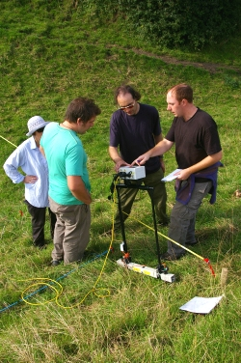
Phase 2: The power of place
Notes:
The impact of war? Nottingham sees summer school numbers initially drop and then rise – reaching a record number in 1944-5: “It would be foolish to pretend that love of learning was the only motive bringing students to the Summer School, or that the difficulty of securing other holiday accommodation was not an important factor governing their choice. It is nevertheless certain that such war-time experiences will result in a greater awareness of the place and importance of residential courses in the general provision of adult education.” (universities Extra-Mural Consultative Committee 1947, report from Nottingham)
But not all about escapism – about practical responses to emerging agendas – for example in local history and archaeology due to the concern about war-time damage and irreversible loss of heritage -
1957 Tutor’s Conference report: the bond of living in a particular place has in the past twenty years been exploited more and more keenly by the organisers of adult classes, as the other bonds seemed to fail. Thus local studies, and particularly local history, now occupy a major place in the programme, and the old-fashioned attitude that local studies were unworthy of a group which ought rather to be studying trade unionism or economics, has disappeared or been reduced to silence.

Slide 8
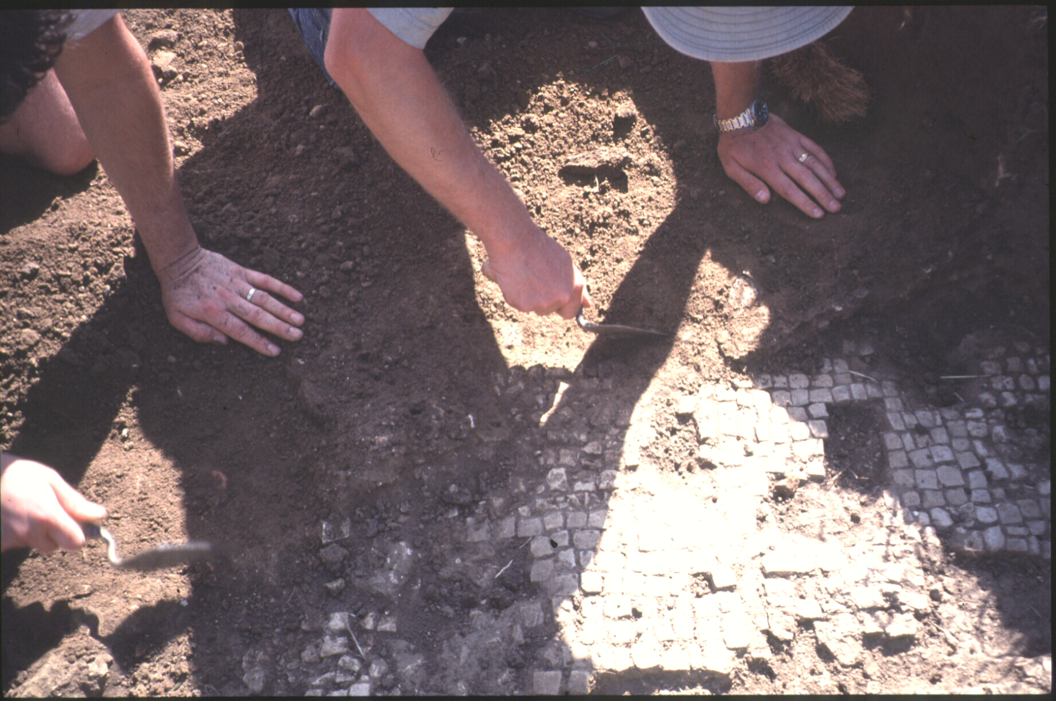
Maurice Barley to Harold Wiltshire, 1948:
‘I wish very much that we could make some definite plans for a summer school in Archaeology next year.........we should be filling a real national need.’
Archaeology does not appear as a subsidiary course for Undergraduates until 1962

Slide 9
1940: London Blitz. Foundation of National Buildings Record. South sheet of OS Map of Monastic Britain published (but stock destroyed in air raid on Southampton)
1947: Town & Country Planning Act
1948: Launch of the CBA
1949: National Parks + Access to the Countryside Act
1949: HMSO publishes ‘War and Archaeology in Britain’
1951: The Countryside Code issued by the National Parks Commission
1950s/1960s: formation of regional committees to deal with specific threats to landscapes (e.g. gravel extraction in Trent Valley)
1950s/60s: recognition of Motorway danger. M5 corridor full of RB sites
1960 RCME report, ‘A Matter of Time’ – the 1st warning that the archaeological resource was a diminishing asset
1971 RESCUE

Slide 10
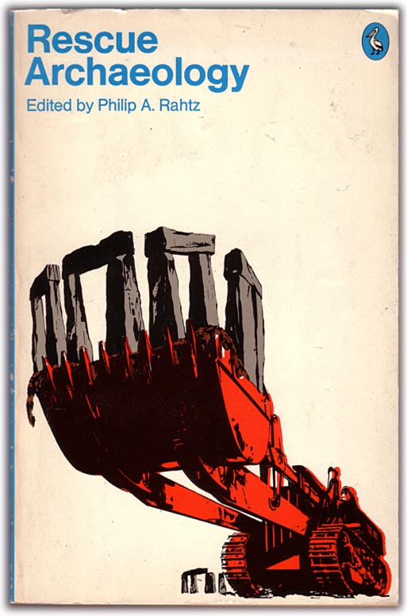
Phase 2:
HMI report, 1972: ‘adult students today….will recognise and respond to, courses which have specific objectives related to their needs and interests…..they will prefer them – to the extent of exclusiveness in a growing number of instances – to more general and less demanding courses’
The ‘motive of personal culture’

Slide 11
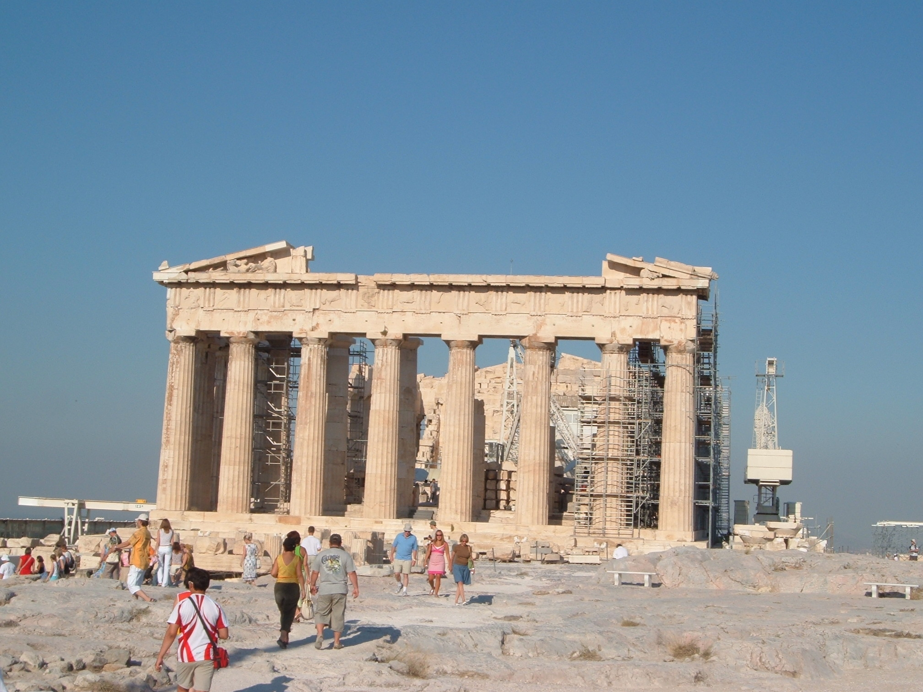

Phase 2: Divergence
In the 1950s Maurice Barley could suggest that residential recruitment was threatened not by too little money, but by too much as potential recruits travelled abroad instead.
Differentiation between ‘field courses’ and ‘summer schools’ and ‘study tours’
Notes:
Opening up of leisure time – car ownership, YHA, ramblers,
Moral geography, citizens outdoors

Slide 12
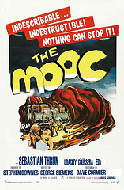
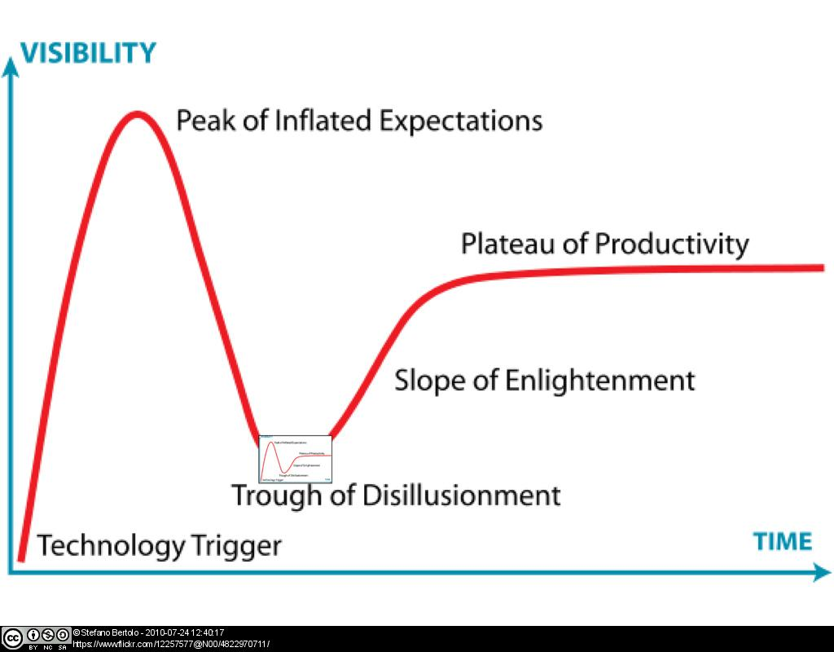
Phase 3 Learning in the cloud
Notes:
We’ve always looked beyond the hype – we’ve treated MOOCs and NOOCs as ‘skunkworks’ initiatives – experiments, trials, in low-risk spaces – not messing with people’s degrees

Slide 13









Massive Open Online Courses (MOOCs) Nottingham Open Online Courses (NOOCs)
Notes:
What they are, how they are proliferating

Slide 14
The spectrum of learning modes
100% Face to Face
Blended
Online Plus
100% Online
^{[i}
Diminishing physical presence on campus, interaction moves online

Slide 15

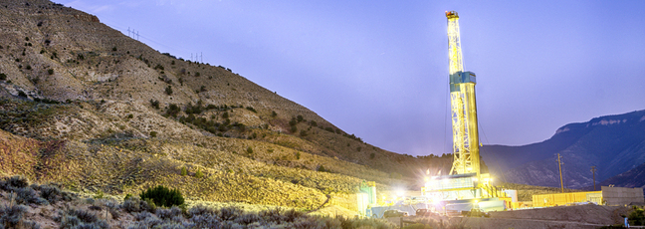



Nottingham MOOCs
Experiments in pedagogy
Courses (in own right; as tasters)
Research conversations
Data collection tools

Slide 16
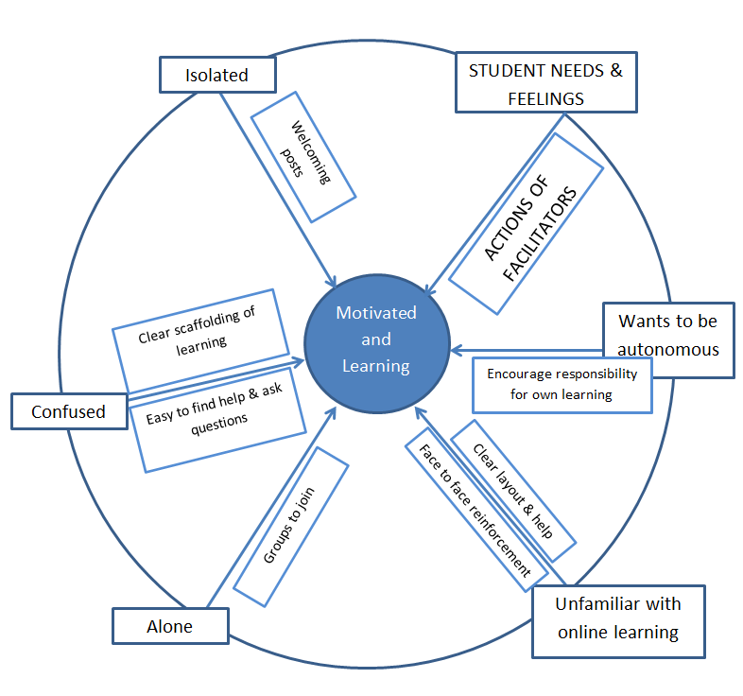

A model for UoN Online Learning

Slide 17

Case Study – RPA Rights and Justice
There are 45.8 million slaves alive today. How do we achieve a slavery-free world and what can we learn from past antislavery?
MOOC -’ Ending Slavery: Strategies for Contemporary Global Abolition’
Part-funded from AHRC - The Antislavery Usable Past
‘Online Plus’ MA Slavery and Liberation
Vision to turn world-leading research into an intervention for NGOs blending theory and practice

Slide 18
Phase 1: Community learning - boarding schools and country houses (c.1920 to 1945) Phase 2: Place-based learning - field schools and study tours (c. 1945 to 2008) Phase 3: Social and self-help learning - online education and MOOCs (c.2008 to present)
Notes:
Nottingham establishes its Department of Extra-Mural Studies/Adult Education in 1920 and appoints Robert Peers as its first director and then professor (reference to John)
Early programme of ‘liberal adult education’ focuses upon the 3-year tutorial class and the residential summer school
Curriculum including Literature, History, Economics, Psychology, Natural History, Trade Union Studies, Music
Major programmes for Miners’ Welfare Committee, H.M.Forces
How my own career connects – mention Shakespeare Street

Slide 19
Thank you
Sarah.speight@nottingham.ac.uk
Notes:
Intro to who we are
Brief explanation of MOOCs and NOOCs

