Slide 1
‘Let’s be clear about EDI’ campaign January – April 2021 Conversation Aid

Slide 2
Read me first!
There is no obligation for you to use this slide pack – it aims to provide resources and information should you feel they are helpful for you
It has been put together to provide a conversation aid which you can use as you want and personalise if you’d like to
Feel free to pick and choose any parts that are most helpful or that you think will help generate the best discussions
Save this master version as a new file and make adjustments as you want to, or just hide any slides you don’t want to present. They aim to be prompts and can be adapted
If you haven’t covered the stage 1 conversations, or used the conversation guide, you can start with this if you wish. Start at the place that will work best for your team
Hidden slides provide guidance and notes for you as a presenter
Notes underneath slides provide explanations to the slides – it’s up you whether you use these slides or not; you can also add to the notes with your own narrative or prompts
Some of the resources are located on the LMA Hub on Moodle. Staff will need a Moodle account to access these. This can be requested from the IT Service Desk: 0115 95 16677 itservicedesk@nottingham.ac.uk

Slide 3
What is ‘Let’s be clear about EDI’ about?
1
A campaign focusing on fundamental Equality, Diversity and Inclusion (EDI) messages
So we are all clear on the basics
2
A reminder about what protected characteristics are
And what they mean in terms of how we treat one another
3
An opportunity to have a University wide conversation at a local level
So we can understand what EDI means to us, and to others
4
A reminder that we have an EDI Strategic Delivery Plan
Which needs to be owned and acted on by everyone
5
A call for individual awareness, ownership and action
As EDI relates to everyone and is part of everyone’s responsibility
6
Another building block on our journey towards an inclusive culture
Which is a priority for the University of Nottingham
Notes:
This provides an overview of why we are doing this campaign and what the campaign is about.

Slide 4
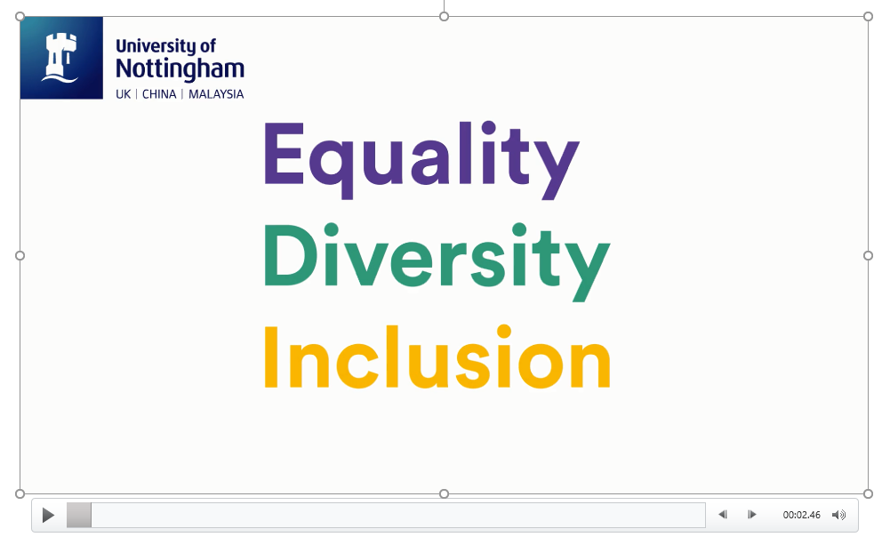
So, Let’s be clear about EDI….
Notes:
Play this video if you haven’t watched it already – it’s the one that was shared in October so some teams may have seen it, others might not

Slide 5
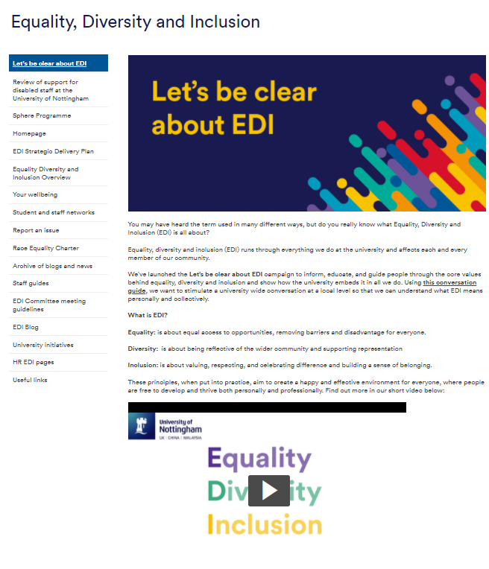
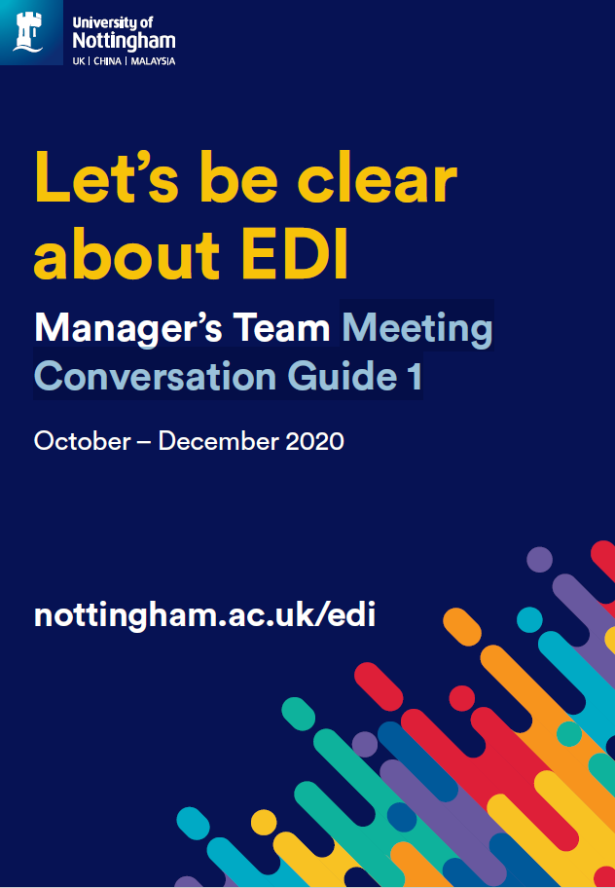
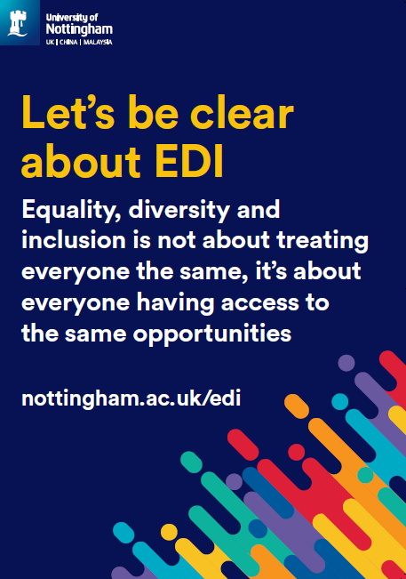
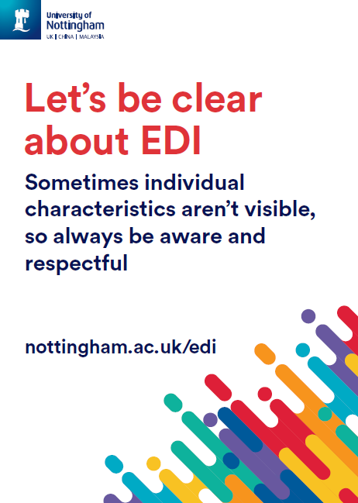
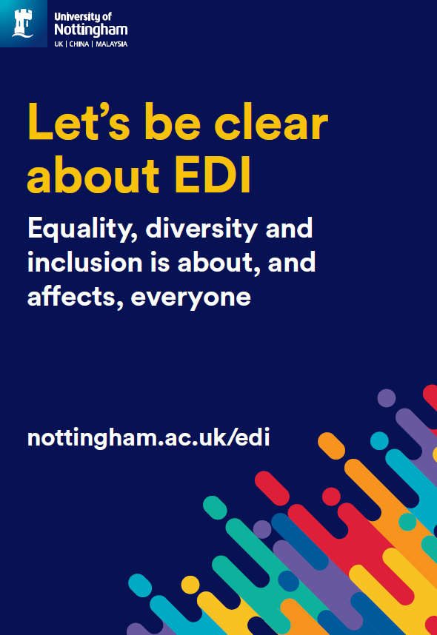
Campaign stages and elements
Stage 1
October – December 2020
Level 1 messages
Stage 2
January – April 2021
Level 2 messages
New campaign web page which includes a short animation for all staff to view
Posters to display or use as a conversation starter
Team conversation cascade in October, November and December, with a supporting Conversation Guide
Different conversations for January, February and March supported with a Conversation Aid
Webinar series engaging representatives from all staff networks
Blogs
University wide and local communications channels
Notes:
This provides an overview of the different stages of the campaign and resources available

Slide 6
Campaign messages
Stage 1
October – December 2020
Level 1 messages
Stage 2
January – April 2021
Level 2 messages
EDI stands for Equality, Diversity and Inclusion
EDI relates to everyone and is part of everyone’s responsibility - achieving equality, diversity and inclusion is everyone's responsibility and a priority for the University of Nottingham
EDI is about fairness and respect - our University strategy values fairness, inclusivity, and respect
EDI is about ensuring everyone has access to appropriate services, appreciates each other and feels included - we need to work together to remove the barriers many staff and students experience at the University
There is information and support for all - we want to nurture, support and empower all staff and students to do their very best
EDI is about everyone, not just specific groups – sometimes individual characteristics aren’t visible - the Equality Act 2010 details nine protected characteristics and it is illegal to discriminate against anyone, directly or indirectly based on these characteristics
EDI is part of everyone’s responsibility, and strengthening diversity and inclusion makes us more effective - be an authentic ally: talk to people about their experiences, educate yourself, take-action and hold others accountable
EDI is about fairness and respect, although it’s not about treating everyone the same - we want staff and students to have access to the same opportunities so we can continue to nurture the growth of our University
There is information and support for everyone so we can all work to ensure staff and students achieve their potential - we will provide training and support for all staff so we can develop anti-racist and inclusive practices, empowering everyone to challenge inequality
Notes:
Here are the different messages that we have been exploring – don’t worry if you haven’t looked at everything, just starting a conversation where you feel most comfortable is fine

Slide 7
Let’s talk about EDI

Slide 8
Supporting information for facilitators
By using this aid, you will be able to support a team conversation cascade
By adding ‘EDI conversation’ to meeting agendas between January and April, you will be encouraging honest conversations about EDI matters
As a guide you should allow 20-30 minutes for these conversations
Set up a separate team catch up if you need to, if that fits better with your timing
A list of suggested questions, prompts and information is provided in the followings slides to support discussion around the core messages; focus on one slide per month
You may need to adapt your approach slightly dependent on the level of prior knowledge around EDI matters within your team
The core messages have been specifically chosen as it is recognised that they can sometimes be taken for granted, and not everyone will be familiar with them
Be assured, you are not expected to be the expert on EDI, just to help facilitate conversations, and steer the discussion to ensure key messages are understood, whilst being part of the learning process yourself

Slide 9
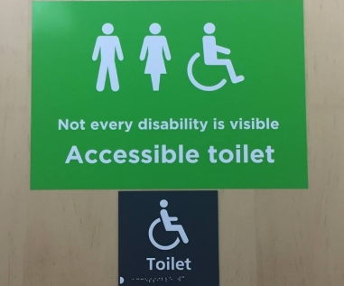
EDI core message 1 (January)
EDI is about everyone, not just specific groups
Sometimes individual characteristics aren’t visible - the Equality Act 2010 details nine protected characteristics and it is illegal to discriminate against anyone, directly or indirectly based on these characteristics
Discussion points
Can you name the nine protected characteristics?
Does everyone belong to a protected group?
Can protected characteristics change?
Why is this sign important? What does this tell us about why it’s
important not to make assumptions about someone’s identity?
What other characteristics aren’t always obvious or visible?
Notes:
Age (all ages are protected)
Disability
Gender reassignment* (or Trans)
Marriage and civil partnership
Pregnancy and Maternity
Race
Religion or belief (this includes no belief of religion)
Sex (the law focuses on a binary definition of legal sex, men and women are both protected under the equality act)
Sexual orientation
*At the University, you will see the term trans being used rather than gender reassignment. We recognise that trans people hold a variety of identities, some of which may not be related to gender reassignment, and that some people may identify as neither male nor female. Trans is used at the University as an inclusive ‘umbrella’ term for anyone whose gender identity and/or gender expression differs from the sex they were assigned at birth
Everyone belongs to a protected group, everyone has an age, a legal sex, a sexual orientation, a belief or no belief, an ethnicity
This sign helps us to understand that disabilities can be hidden but still require someone to use an accessible toilet.
It’s important not to assume we know everything about someone’s identity just by looking at them. People will have aspects of their identity that we can’t see but that may require adjustments or for things to be done differently in order for them to have equal access.
UoN also recognises some specific additional elements of someone's identity that may need to be considered to avoid someone experiencing disadvantage, these are socio-economic background, temporary impairment, caring responsibilities and neurodiversity.

Slide 10
Ideas for holding conversation 1 (January)
Preparing yourself for this conversation
You might want to read the Essentials for EDI: Our Approach which will give you a grounded context for why EDI matters in the context of our university
Facilitating the conversation
Watch an EDI story on why this matters if this helps to set the context
First question: invite responses in the chat
Second or third question: use a poll (Polly / MS Forms / Polleverwhere)
Use breakout groups to stimulate smaller group discussions if in a large group
Invite individuals to reflect on their own situation, personal characteristics and identity, discussing this if they feel able to
You might wish to challenge some of the myths around EDI
Take-away
You might all like to read the fact sheet on uniqueness and difference before the next conversation

Slide 11
EDI core message 2 (February)
EDI is part of everyone’s responsibility, and strengthening diversity and inclusion makes us more effective
We can all fulfil this responsibility by becoming an authentic ally
Discussion points
What does it mean to be an authentic ally?
What could you start doing now to be an authentic ally? Be specific!
What support might you need?
Take a look at the resources developed by MHFA England, and another on Non-Optical Allyship , developed to tackle racism and containing lots of ideas on how to become a more visible authentic ally.
Notes:
Being an authentic ally might include: talking to people about their experiences, educating yourself, taking action and hold others accountable
You are looking for practical examples to show people have thought about what they could do more, less or differently for their allyship to be visible. How will they educate themselves? Where might they start? Consider looking at reading lists developed by the library in support of LGBT History Month, Black History month etc. Seek out news articles. Talk to others and learn about their experiences.

Slide 12

EDI core message 2 cont’d (February)
An important aspect of being an authentic ally involves sensitively challenging words or actions that could be harmful or exclude people
Discussion points
Why can it be difficult to sensitively challenge other people?
How could these difficulties be overcome?
Notes:
Below are some suggested thoughts and phrases which address some of the common barriers. Share some of these with the group after the discussion.
Why can it be hard to challenge?
1 - Confrontation makes me anxious.
Even allies need allies sometimes!
Nudge the person next to you. "Did you see that? Do you think that was a bit off? Shall we say something?"
Using "We..." deflects attention away from you as an individual and widens the discussion. It also means that others in the room who agree with you are likely to back you up.
"We wanted to pick up on the language you just used. That feels really uncomfortable and quite offensive."
2 – I was shocked and didn’t have time to think.
Come up with a few stock phrases you can pull out to buy yourself time to think. Even something as simple as, "Can you repeat that please?" can be really effective. Or:
"Does anyone else find that uncomfortable?"
"What did you mean when you said..?"
Having a chat with them at a later time is also an option, when you've thought about what you want to say.
Even if you don't address it in the moment, checking in with the affected person afterwards will give them reassurance and support.
3- I don’t want to end up the target
It's tough to be the one to speak out, especially if it's your peers that you want to challenge.
Remember that many microaggressions are unintentional. Even intentional 'banter' rarely involves us stopping to think about the impact on others. Your role isn't to police your friends; it's to educate them.
"Mate, have you actually thought about how Xxx feels when you say/do that?"
If it's someone in a position of power, then that comes with its own challenges. Remain objective. State what you observed.
"Xxxx has had their hand up for ages. They haven't been asked to contribute for the last 3 seminars."
"You're still calling them Xxxxx. Their name is Yyyyyy."
4 - I don't want to patronise people by speaking on their behalf.
There is a difference between speaking on someone's behalf and speaking up for - or in solidarity with - an oppressed group. So long as you speak from your own perspective rather than someone else's, you'll be fine.
Eg: "I find that phrase dismissive of disabled people."
Not: "Disabled people find that phrase dismissive."

Slide 13
Ideas for holding conversation 2 (February)
Preparing yourself for this conversation
You might want to watch Melinda Epler’s TED talk on ‘Be an ally’
Facilitating the conversation
Here’s a short TED talk providing 5 Tips for Being an Ally by comedian and activist Franchesca Ramsey, also known as Chescaleigh, which you might like to watch together
If you are working in a large group, create breakouts and go through the discussion points to come up with practical actions you can take
Use the chat, or a whiteboard, or Padlet to list the types of words or actions that you might not want to see/hear and that you should all be prepared to challenge
Take-away
You might all like to read the fact sheet on What can I do? reflecting on practical actions you can take collectively and personally

Slide 14
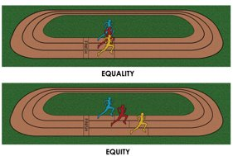
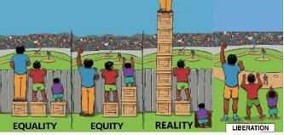
EDI core message 3 (March)
EDI is about fairness and respect, although it’s not about treating everyone the same
We want staff and students to have access to the same opportunities so we can continue to nurture the growth of our University, although often systemic inequalities, behaviours and attitudes can make this difficult
Discussion points
What does fairness and respect look, feel and sound like at UoN?
Are there inequalities that you experience at work, and how respected do you feel?
What inequalities are brought to our workplace setting? It might help you to think about those around you and any privilege or disadvantage that others bring. Or you can think about yourself and your own situation.
How can we develop our workplace diversity, including our own personal understanding and awareness, to incorporate those who may not have similar experiences of privilege?
Notes:
Put simply, fairness means that when we design out facilities, teaching, and services we have in mind the diversity of our student and staff community.
This would include, considering the different needs of all our staff and students and particularly giving consideration to how protected characteristics may need to be taken into account and doing things differently if we need to.

Slide 15
Ideas for holding conversation 3 (March)
Preparing yourself for this conversation
You might want to read the blog by Charlotte Caimino, Eszter Porter and Stephanie Pearson on Inclusivity in the Workplace. This could provide a prompt for a starting point to your discussion
Facilitating the conversation
Invite an open conversation about the discussion points
Think about examples in your local work setting as well as wider across the University
Talk about the concept of privilege using this document on privilege as a guide
Identify areas of practice that could be improved, including in terms of behaviours, attitudes, decision making and actions
Commit to taking individual and collective action on these improvements
Take-away
You might all like to complete the Inclusive Mindset module on the LMA Hub (request a Moodle login if you need one)

Slide 16
EDI core message 4 (April)
There is information and support for everyone so we can all work to ensure staff and students achieve their potential
It’s our personal responsibility to take ownership for our learning and make sure we take time to understand experiences from other perspectives
Discussion point
How will you continue to develop your understanding of EDI matters on an on-going basis?
LMA EDI Resources
EDI Webpages
EDI blogs
EDI Resource Bank (launching Jan 2021)
Inclusive mindset online module
Unconscious bias online training
EDI free webinars
Reverse mentoring insights
Local EDI Leads and EDI groups
Staff Networks
EDI Coordinators
Notes:
Most of the above are link to webpages for further info.
Find out who your local EDI Lead is and if you have any local EDI groups. Share their contact details on this slide before presenting. If you’re not sure contact the EDI Coordinators who can advise by emailing BR-EDICoordinators@exmail.nottingham.ac.uk

Slide 17
Your call to action
Keep the conversation about EDI going, formally and informally. That way you will learn more about what this means
Conversation:
Review the information about EDI for yourself and reflect on your own awareness, understanding, behaviours and actions. Make changes where you need to
Reflection:
Be consciously aware of those around you and challenge behaviours and actions which are not part of our inclusive culture. Let people see that it’s not OK
Challenge:
Action:
Take actions based on your learning and reflections. Make sure you consider own language, actions and reactions and how inclusive you are being in practice
Notes:
Use this as a prompt to remind people of their personal obligations to take action for themselves. Understanding EDI matters is each of our responsibility, and if all us makes one change to encourage inclusivity and challenge inappropriate behaviours, then together we will move further forward towards being an inclusive University

Slide 18
Ideas for holding conversation 4 (April)
Preparing yourself for this conversation
Have a look through the different resources so you know what is available
Facilitating the conversation
Invite discussion and ideas on what people might already be doing to improve their knowledge about EDI matters
Encourage individuals to consider any impact their behaviours might be having on others that they may wish to change
Consider the university’s value of Inclusivity (pg 5) and the expectation on our behaviour to be Always Inclusive (pg 8) – is this something being considered in 1:1 and ADC conversations on an on-going basis?
Take-away
Individually, and as a team, make at least one commitment to continue your EDI conversations, learning and action

Slide 19

Thank you!

