Slide 1
‘Let’s be clear about EDI’ campaign April 2021 Conversation Aid Conversation Starter Slides

Slide 2
What is ‘Let’s be clear about EDI’ about?
1
A campaign focusing on fundamental Equality, Diversity and Inclusion (EDI) messages
So we are all clear on the basics
2
A reminder about what protected characteristics are
And what they mean in terms of how we treat one another
3
An opportunity to have a University wide conversation at a local level
So we can understand what EDI means to us, and to others
4
A reminder that we have an EDI Strategic Delivery Plan
Which needs to be owned and acted on by everyone
5
A call for individual awareness, ownership and action
As EDI relates to everyone and is part of everyone’s responsibility
6
Another building block on our journey towards an inclusive culture
Which is a priority for the University of Nottingham
Notes:
This provides an overview of why we are doing this campaign and what the campaign is about.

Slide 3
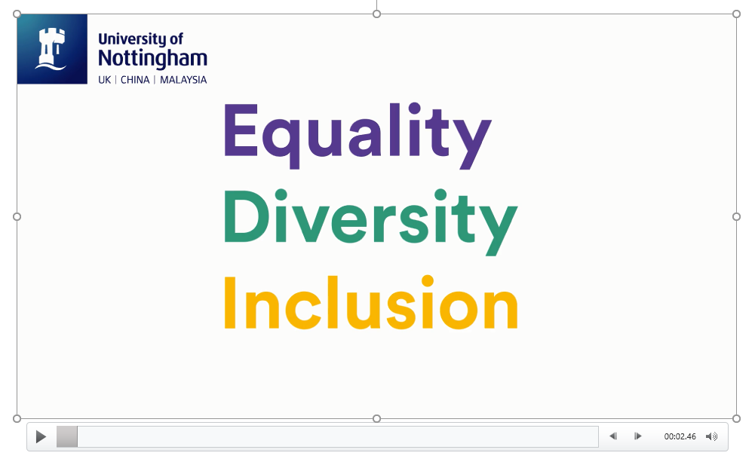
So, Let’s be clear about EDI….
Notes:
Play this video if you haven’t watched it already – it’s the one that was shared in October so some teams may have seen it, others might not

Slide 4
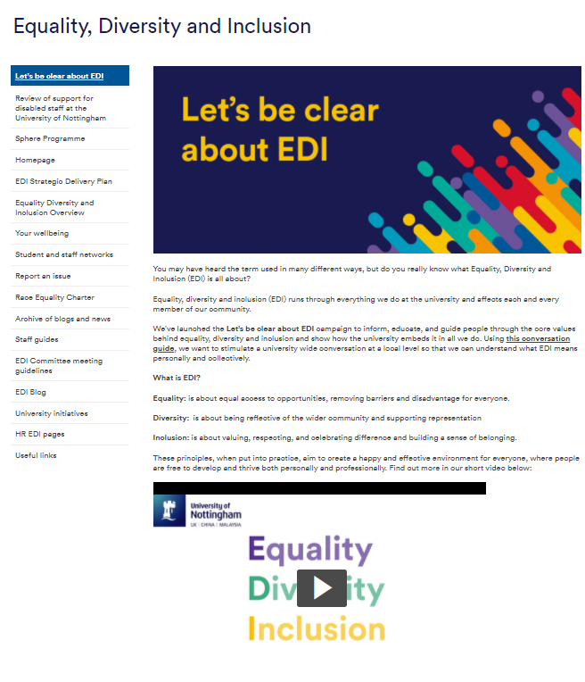
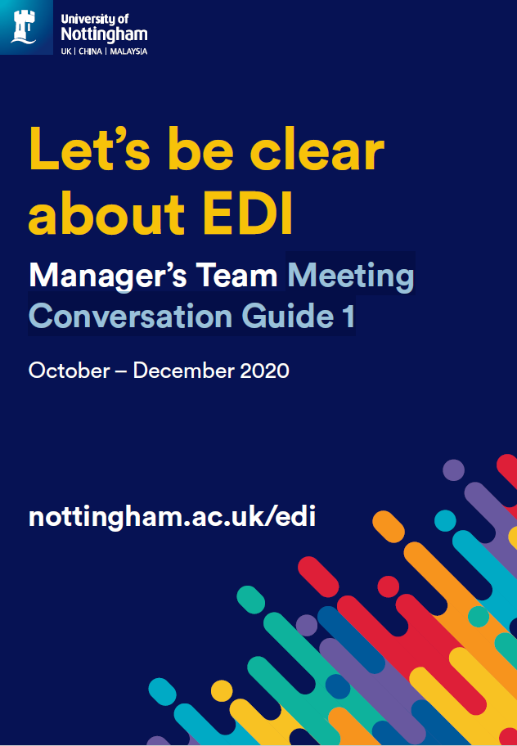
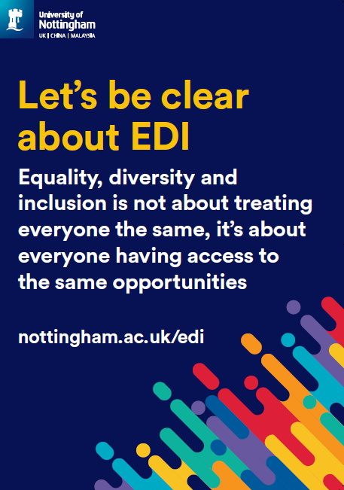
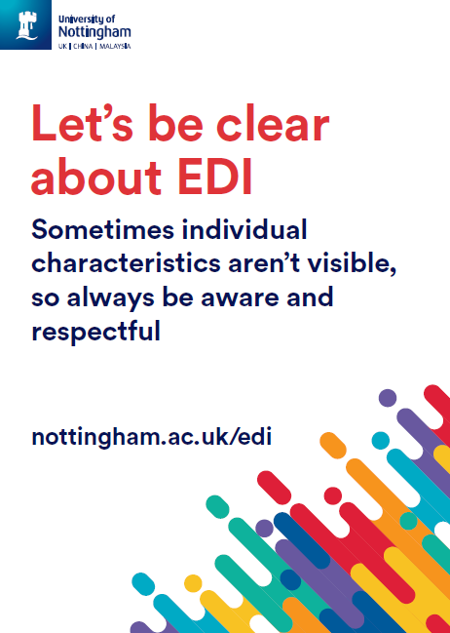
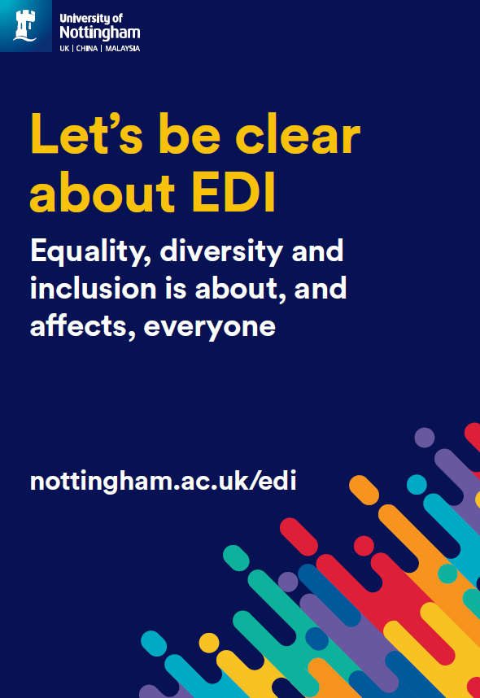
Campaign stages and elements
Stage 1
October – December 2020
Level 1 messages
Stage 2
January – April 2021
Level 2 messages
New campaign web page which includes a short animation for all staff to view
Posters to display or use as a conversation starter
Team conversation cascade in October, November and December, with a supporting Conversation Guide
Different conversations for January, February and March supported with a Conversation Aid
Webinar series engaging representatives from all staff networks
Blogs
University wide and local communications channels
Notes:
This provides an overview of the different stages of the campaign and resources available

Slide 5
Campaign messages
Stage 1
October – December 2020
Level 1 messages
Stage 2
January – April 2021
Level 2 messages
EDI stands for Equality, Diversity and Inclusion
EDI relates to everyone and is part of everyone’s responsibility - achieving equality, diversity and inclusion is everyone's responsibility and a priority for the University of Nottingham
EDI is about fairness and respect - our University strategy values fairness, inclusivity, and respect
EDI is about ensuring everyone has access to appropriate services, appreciates each other and feels included - we need to work together to remove the barriers many staff and students experience at the University
There is information and support for all - we want to nurture, support and empower all staff and students to do their very best
EDI is about everyone, not just specific groups – sometimes individual characteristics aren’t visible - the Equality Act 2010 details nine protected characteristics and it is illegal to discriminate against anyone, directly or indirectly based on these characteristics
EDI is part of everyone’s responsibility, and strengthening diversity and inclusion makes us more effective - be an authentic ally: talk to people about their experiences, educate yourself, take-action and hold others accountable
EDI is about fairness and respect, although it’s not about treating everyone the same - we want staff and students to have access to the same opportunities so we can continue to nurture the growth of our University
There is information and support for everyone so we can all work to ensure staff and students achieve their potential - we will provide training and support for all staff so we can develop anti-racist and inclusive practices, empowering everyone to challenge inequality
Notes:
Here are the different messages that we have been exploring – don’t worry if you haven’t looked at everything, just starting a conversation where you feel most comfortable is fine

Slide 6
Let’s talk about EDI

Slide 7
EDI core message 4 (April)
There is information and support for everyone so we can all work to ensure staff and students achieve their potential
It’s our personal responsibility to take ownership for our learning and make sure we take time to understand experiences from other perspectives
Discussion point
How will you continue to develop your understanding of EDI matters on an on-going basis?
LMA EDI Resources
EDI Webpages
EDI blogs
EDI Resource Bank (launching Jan 2021)
Inclusive mindset online module
Unconscious bias online training
EDI free webinars
Reverse mentoring insights
Local EDI Leads and EDI groups
Staff Networks
EDI Coordinators
Notes:
Most of the above are link to webpages for further info.
Find out who your local EDI Lead is and if you have any local EDI groups. Share their contact details on this slide before presenting. If you’re not sure contact the EDI Coordinators who can advise by emailing BR-EDICoordinators@exmail.nottingham.ac.uk

Slide 8
Your call to action
Keep the conversation about EDI going, formally and informally. That way you will learn more about what this means
Conversation:
Review the information about EDI for yourself and reflect on your own awareness, understanding, behaviours and actions. Make changes where you need to
Reflection:
Be consciously aware of those around you and challenge behaviours and actions which are not part of our inclusive culture. Let people see that it’s not OK
Challenge:
Action:
Take actions based on your learning and reflections. Make sure you consider own language, actions and reactions and how inclusive you are being in practice
Notes:
Use this as a prompt to remind people of their personal obligations to take action for themselves. Understanding EDI matters is each of our responsibility, and if all us makes one change to encourage inclusivity and challenge inappropriate behaviours, then together we will move further forward towards being an inclusive University

Slide 9

Thank you!

