Slide 1
‘Let’s be clear about EDI’ campaign
January 2021
Conversation Aid
Conversation Starter Slides

Slide 2
What is ‘Let’s be clear about EDI’ about?
1
A campaign focusing on fundamental Equality, Diversity and Inclusion (EDI) messages
So we are all clear on the basics
2
A reminder about what protected characteristics are
And what they mean in terms of how we treat one another
3
An opportunity to have a University wide conversation at a local level
So we can understand what EDI means to us, and to others
4
A reminder that we have an EDI Strategic Delivery Plan
Which needs to be owned and acted on by everyone
5
A call for individual awareness, ownership and action
As EDI relates to everyone and is part of everyone’s responsibility
6
Another building block on our journey towards an inclusive culture
Which is a priority for the University of Nottingham
Notes:
This provides an overview of why we are doing this campaign and what the campaign is about.

Slide 3
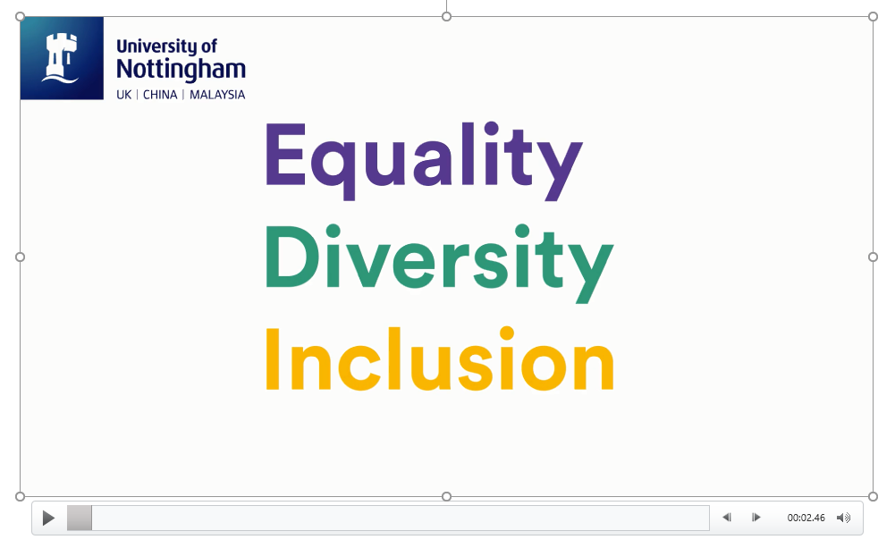
So, Let’s be clear about EDI….
Notes:
Play this video if you haven’t watched it already – it’s the one that was shared in October so some teams may have seen it, others might not

Slide 4
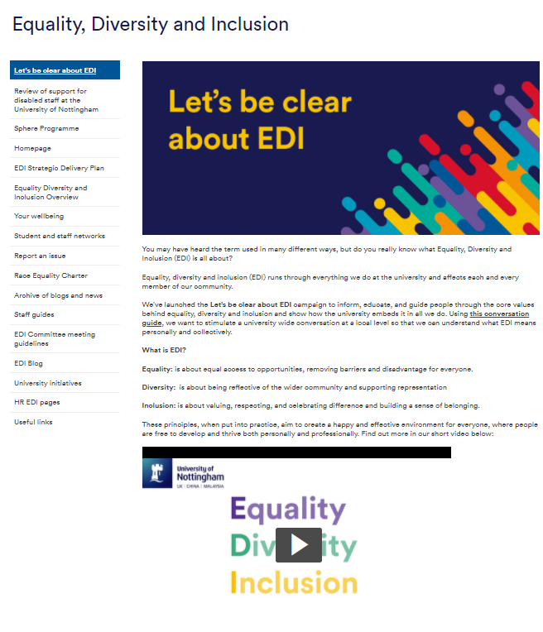
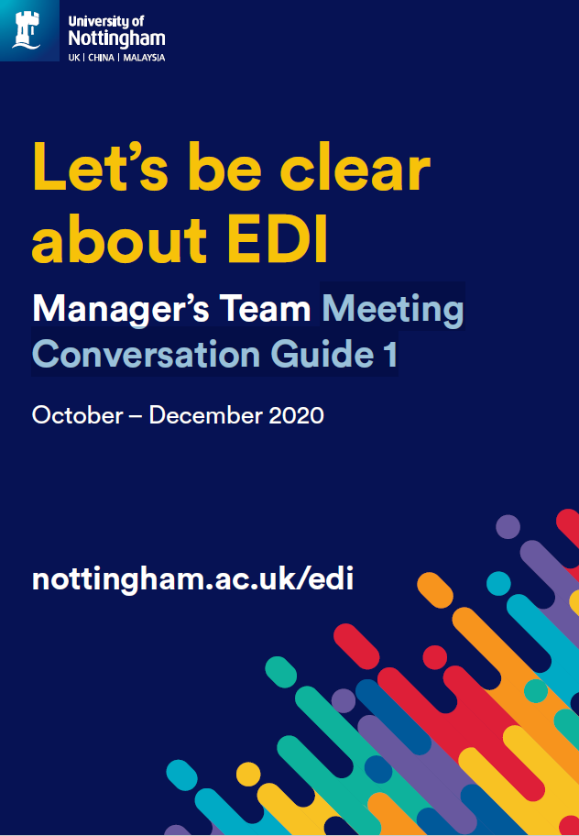
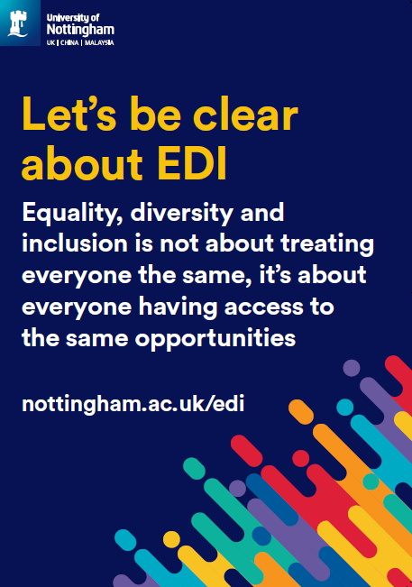
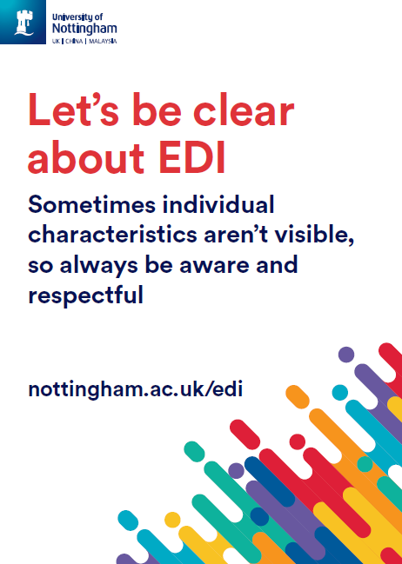
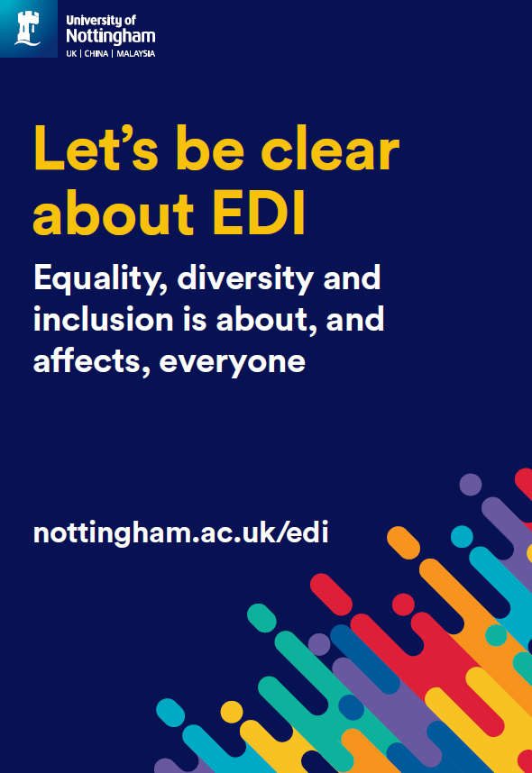
Campaign stages and elements
Stage 1
October – December 2020
Level 1 messages
Stage 2
January – April 2021
Level 2 messages
New campaign web page which includes a short animation for all staff to view
Posters to display or use as a conversation starter
Team conversation cascade in October, November and December, with a supporting Conversation Guide
Different conversations for January, February and March supported with a Conversation Aid
Webinar series engaging representatives from all staff networks
Blogs
University wide and local communications channels
Notes:
This provides an overview of the different stages of the campaign and resources available

Slide 5
Campaign messages
Stage 1
October – December 2020
Level 1 messages
Stage 2
January – April 2021
Level 2 messages
EDI stands for Equality, Diversity and Inclusion
EDI relates to everyone and is part of everyone’s responsibility - achieving equality, diversity and inclusion is everyone's responsibility and a priority for the University of Nottingham
EDI is about fairness and respect - our University strategy values fairness, inclusivity, and respect
EDI is about ensuring everyone has access to appropriate services, appreciates each other and feels included - we need to work together to remove the barriers many staff and students experience at the University
There is information and support for all - we want to nurture, support and empower all staff and students to do their very best
EDI is about everyone, not just specific groups – sometimes individual characteristics aren’t visible - the Equality Act 2010 details nine protected characteristics and it is illegal to discriminate against anyone, directly or indirectly based on these characteristics
EDI is part of everyone’s responsibility, and strengthening diversity and inclusion makes us more effective - be an authentic ally: talk to people about their experiences, educate yourself, take-action and hold others accountable
EDI is about fairness and respect, although it’s not about treating everyone the same - we want staff and students to have access to the same opportunities so we can continue to nurture the growth of our University
There is information and support for everyone so we can all work to ensure staff and students achieve their potential - we will provide training and support for all staff so we can develop anti-racist and inclusive practices, empowering everyone to challenge inequality
Notes:
Here are the different messages that we have been exploring – don’t worry if you haven’t looked at everything, just starting a conversation where you feel most comfortable is fine

Slide 6
Let’s talk about EDI

Slide 7
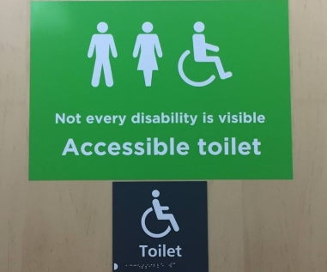
EDI core message 1 (January)
EDI is about everyone, not just specific groups
Sometimes individual characteristics aren’t visible - the Equality Act 2010 details nine protected characteristics and it is illegal to discriminate against anyone, directly or indirectly based on these characteristics
Discussion points
Can you name the nine protected characteristics?
Does everyone belong to a protected group?
Can protected characteristics change?
Why is this sign important? What does this tell us about why it’s
important not to make assumptions about someone’s identity?
What other characteristics aren’t always obvious or visible?
Notes:
Age (all ages are protected)
Disability
Gender reassignment* (or Trans)
Marriage and civil partnership
Pregnancy and Maternity
Race
Religion or belief (this includes no belief of religion)
Sex (the law focuses on a binary definition of legal sex, men and women are both protected under the equality act)
Sexual orientation
*At the University, you will see the term trans being used rather than gender reassignment. We recognise that trans people hold a variety of identities, some of which may not be related to gender reassignment, and that some people may identify as neither male nor female. Trans is used at the University as an inclusive ‘umbrella’ term for anyone whose gender identity and/or gender expression differs from the sex they were assigned at birth
Everyone belongs to a protected group, everyone has an age, a legal sex, a sexual orientation, a belief or no belief, an ethnicity
This sign helps us to understand that disabilities can be hidden but still require someone to use an accessible toilet.
It’s important not to assume we know everything about someone’s identity just by looking at them. People will have aspects of their identity that we can’t see but that may require adjustments or for things to be done differently in order for them to have equal access.
UoN also recognises some specific additional elements of someone's identity that may need to be considered to avoid someone experiencing disadvantage, these are socio-economic background, temporary impairment, caring responsibilities and neurodiversity.

Slide 8
Your call to action
Keep the conversation about EDI going, formally and informally. That way you will learn more about what this means
Conversation:
Review the information about EDI for yourself and reflect on your own awareness, understanding, behaviours and actions. Make changes where you need to
Reflection:
Be consciously aware of those around you and challenge behaviours and actions which are not part of our inclusive culture. Let people see that it’s not OK
Challenge:
Action:
Take actions based on your learning and reflections. Make sure you consider own language, actions and reactions and how inclusive you are being in practice
Notes:
Use this as a prompt to remind people of their personal obligations to take action for themselves. Understanding EDI matters is each of our responsibility, and if all us makes one change to encourage inclusivity and challenge inappropriate behaviours, then together we will move further forward towards being an inclusive University

Slide 9

Thank you!

