Slide 1


UNIVERSITY OF NOTTINGHAM PENSIONS DAY
25 FEBRUARY 2025
The content of this presentation is for information only. It does not explain all situations or eventualities. It is not, and should not be taken as, advice. You should not rely on, or take or fail to take any action based upon this presentation. We recommend that members and employers, or any other person that views, or otherwise comes into possession of the content of this presentation, take their own advice on which they can rely. The content in this presentation is based on the current scheme rules, as amended, including the change in contribution rate from 1 January 2024. The further benefit changes anticipated from 1 April 2025 are referred to at certain points in this presentation but have not yet become effective. If there is any difference between this presentation and the USS trust deed and rules the latter shall prevail. Please check the USS website for the latest information regarding the scheme and any changes that may have occurred to its rules and benefits.

Slide 2

The value of USS membership

Slide 3


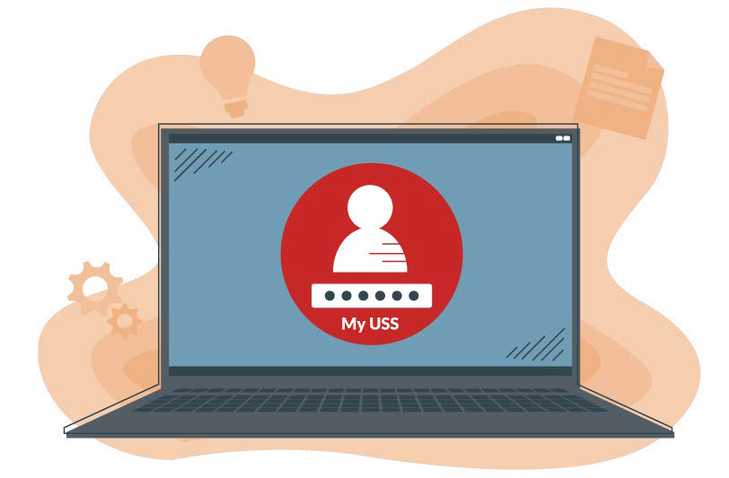
What you pay
What goes into your pension
You pay in 6.1% of your salary each month.
You get tax relief on your contributions, so some of the money that you normally pay towards tax goes into your pension instead.
Your employer pays in 14.5% of your salary each month towards your benefits and running USS.
You can also pay additional contributions to the investment builder to save more.
What happens next?
We invest your contributions so we can pay you the pension you’ve earned in the future.
You can manage your membership online in My USS, keeping on top of your benefits and savings and up to date on how much you’ve saved.
We’ll support you along your savings journey with relevant updates, free webinars, and useful information.

Slide 4




Four Benefits of saving into your USS pension
It’s a tax-efficient way of saving
When you build a pension, your contributions are taken from your pay before tax. This means you only pay tax on the salary you take home, which doesn’t include your pension contributions. So you’re getting tax relief on what you pay in.
Please visit the USS website and watch our short video for an Overview of Pension Tax.
It’s a flexible way to save
You’ll get a guaranteed income with the Retirement Income Builder and a flexible savings pot with the Investment Builder (if you earn above the salary threshold, choose to pay additional contributions or transfer other pension savings in). It’s your opportunity to increase your income from the state pension.
Please visit the USS website to see how your pension works for more information on the two parts of USS.
Your employer contributes too
On top of your monthly contribution of 6.1% of your salary, your employer pays in 14.5% each month. Their contributions help to fund the benefits you’ll get at retirement and go towards the costs of running the scheme.
And if you earn over the salary threshold, you and your employer will save into the Investment Builder too.
Choose how and where to invest
With the Investment Builder, you can either let our team of investment experts make the investment decisions for you, or you can take control and make your own investment choices.
This means you can tailor how your savings pot is invested based on your risk tolerance, or maybe even your ethical or religious beliefs.

Slide 5



As a USS member you’ll get
Life cover
to support your family if you die whilst paying in
A guaranteed income
for life once you retire with the Retirement Income Builder
A spouse or civil partner’s pension
and in some cases a dependant’s pension, giving peace of mind that they’ll be looked after
Ill health benefits
if you’re eligible and unable to work long-term

Slide 6

How the Hybrid Scheme Works

Slide 7


Threshold
Benefits in USS
DB
Defined Benefit
DC
Defined Contribution
Retirement Income
Builder
Investment
Builder
Salary

Slide 8

Retirement Income Builder (DB)

Slide 9
Retirement Income Builder
USS – April 2022 to March 2024
1
85
th pension
Salary to £41,004
3
85
th cash sum
USS – Post April 2024
1
75
th pension
Salary to £70,296
3
75
th cash sum

Slide 10


Annual Increases
Blocks of Pension
Each block attracts annual increases
Tax Free Cash
In addition to your Pension

Slide 11

USS Retirement Income Builder
Taking your benefits- DB
Maximum pension
Take the whole of the benefit you have built up as a pension
Maximum tax-free cash
Take a smaller pension plus the maximum possible tax-free cash sum
Something in-between
Choose a pension and lump sum, within the above parameters, to suit your needs
Example: A £20k p.a. pension with £60k lump sum could be converted to the following:
Maximum pension = £22k per annum + no lump sum
OR
Max lump sum = £115k + reduced annual pension of £17k p.a.
OR
Something in-between

Slide 12

Investment Builder (DC)

Slide 13

20% DC
contribution
Investment Builder
USS – April 2022 to March 2024
Over £41,004
USS – From April 2024
20% DC
contribution
Over £70,296

Slide 14

Savings into Investment Builder
Earnings over Salary Threshold
Make additional contributions
Transfers in from other schemes

Slide 15
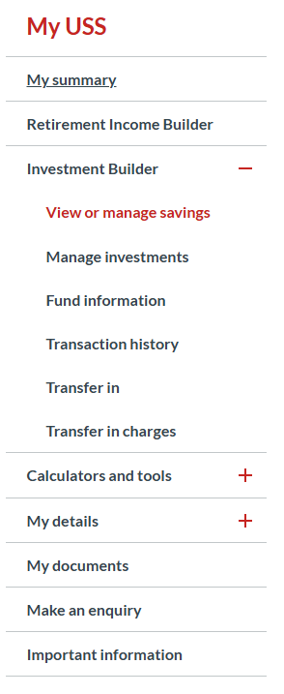
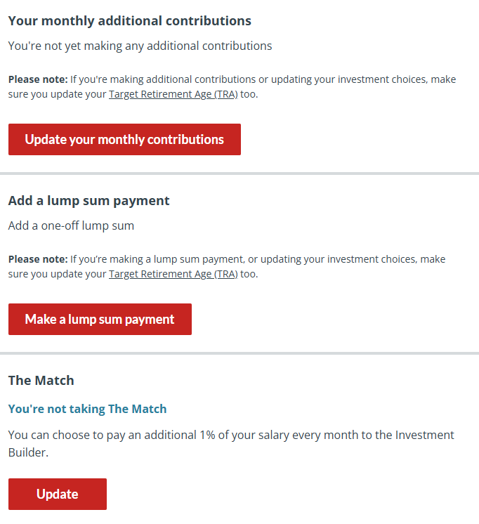
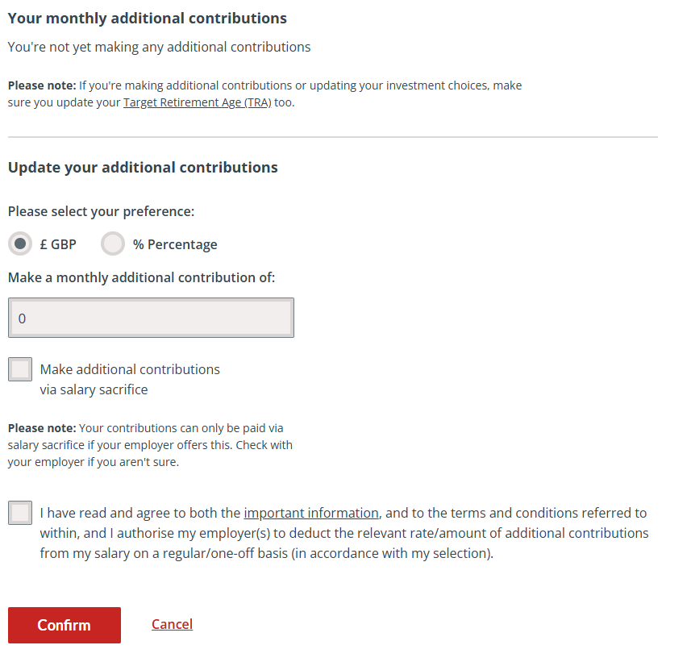
How to Make Additional Contributions

Slide 16
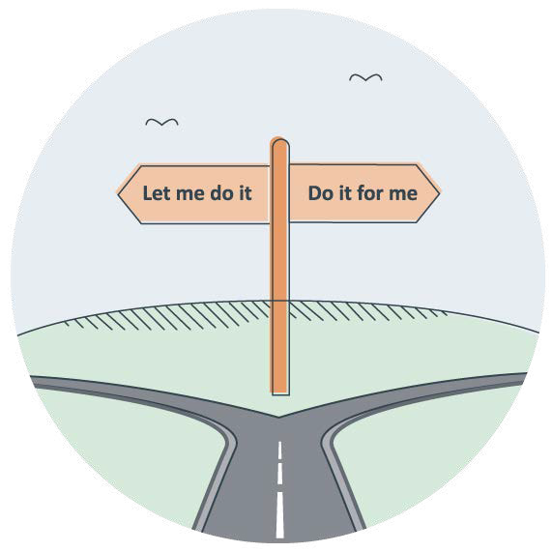
Investment Choices in Investment Builder
Do it for me
or
Let me do it

Slide 17

USS Investment Builder
Taking your benefits- DC
In most cases you can start accessing your pot from age 55, increasing to 57 from April 2028.
You don’t have to take your USS Investment Builder pot at the same time as you take your USS Retirement Income Builder benefits
Leave invested and make
withdrawals
Take as cash lump sum
Transfer

Slide 18

Death Benefits

Slide 19
Death in Service
What happens if you die
Death in Retirement
Death after leaving
Lump Sum
3 x Annual Salary
Remainder of pension payments if within 5 years
3 x pension on leaving
from retirement
And
Survivors Pension
Enhanced for future
service which would have been completed
Half Pension
Half Pension
13

Slide 20
What happens if you leave USS

Slide 21
What happens if you leave
Under 3 months | 3 months to 2 years | Over 2 years
Refund of Contributions | Refund of Contributions | Deferred Benefit
Or | Or | Or
Deferred Benefit | Deferred Benefit | Transfer Out
Or | Or
Transfer Out | Transfer Out
14

Slide 22

Support and Resources

Slide 23
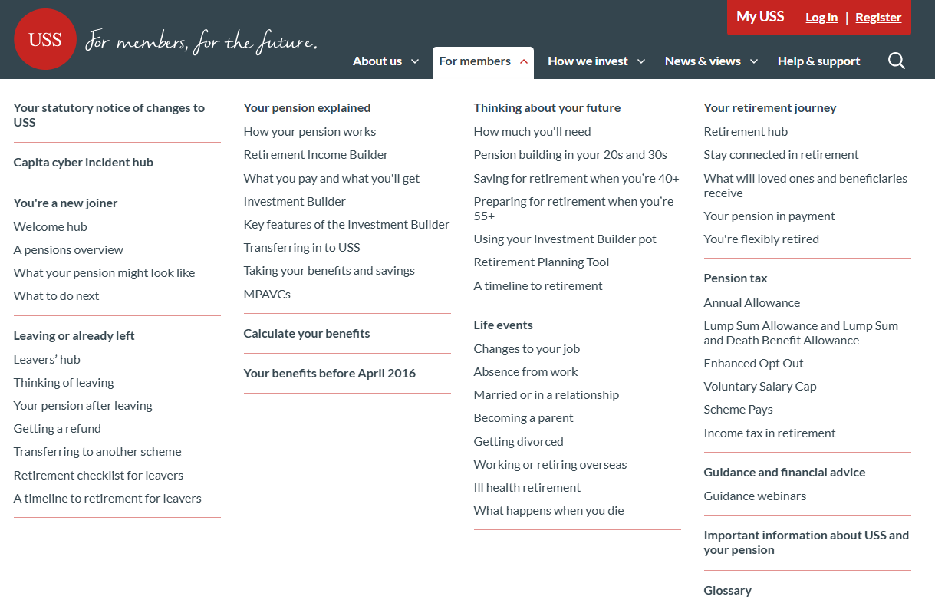
Sources of Support

Slide 24
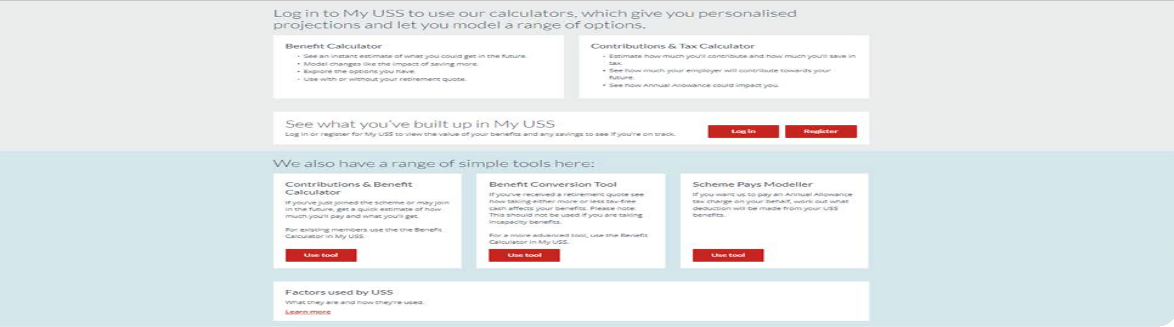
Sources of Support – For members

Slide 25
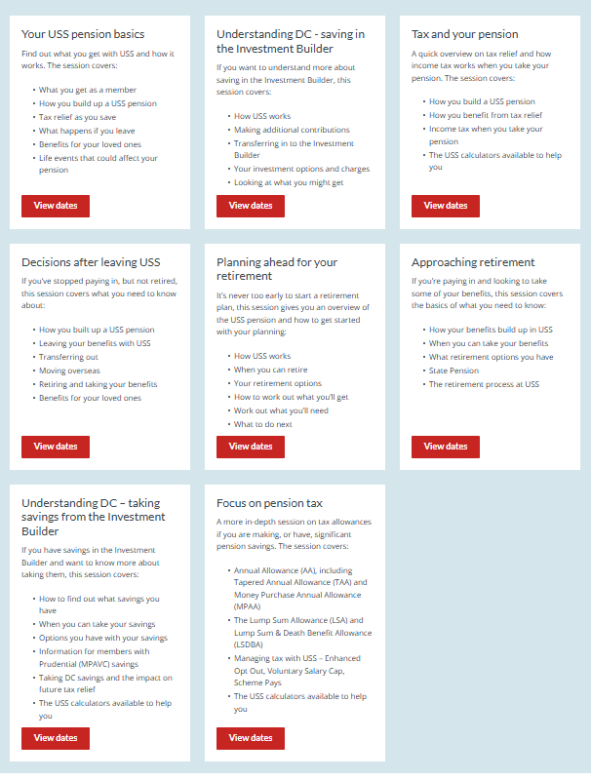
Sources of Support- Webinars

Slide 26
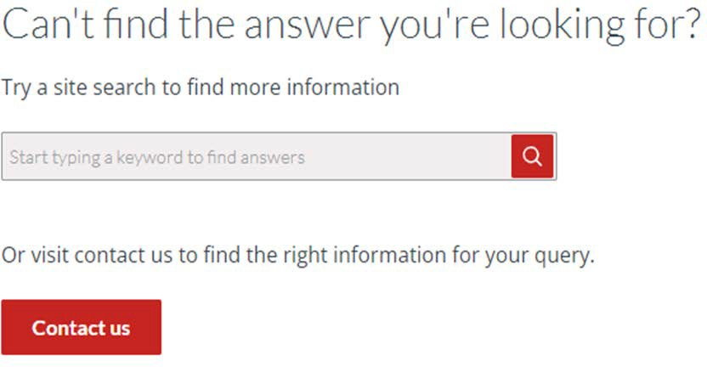
Sources of Support- Webinars

Slide 27
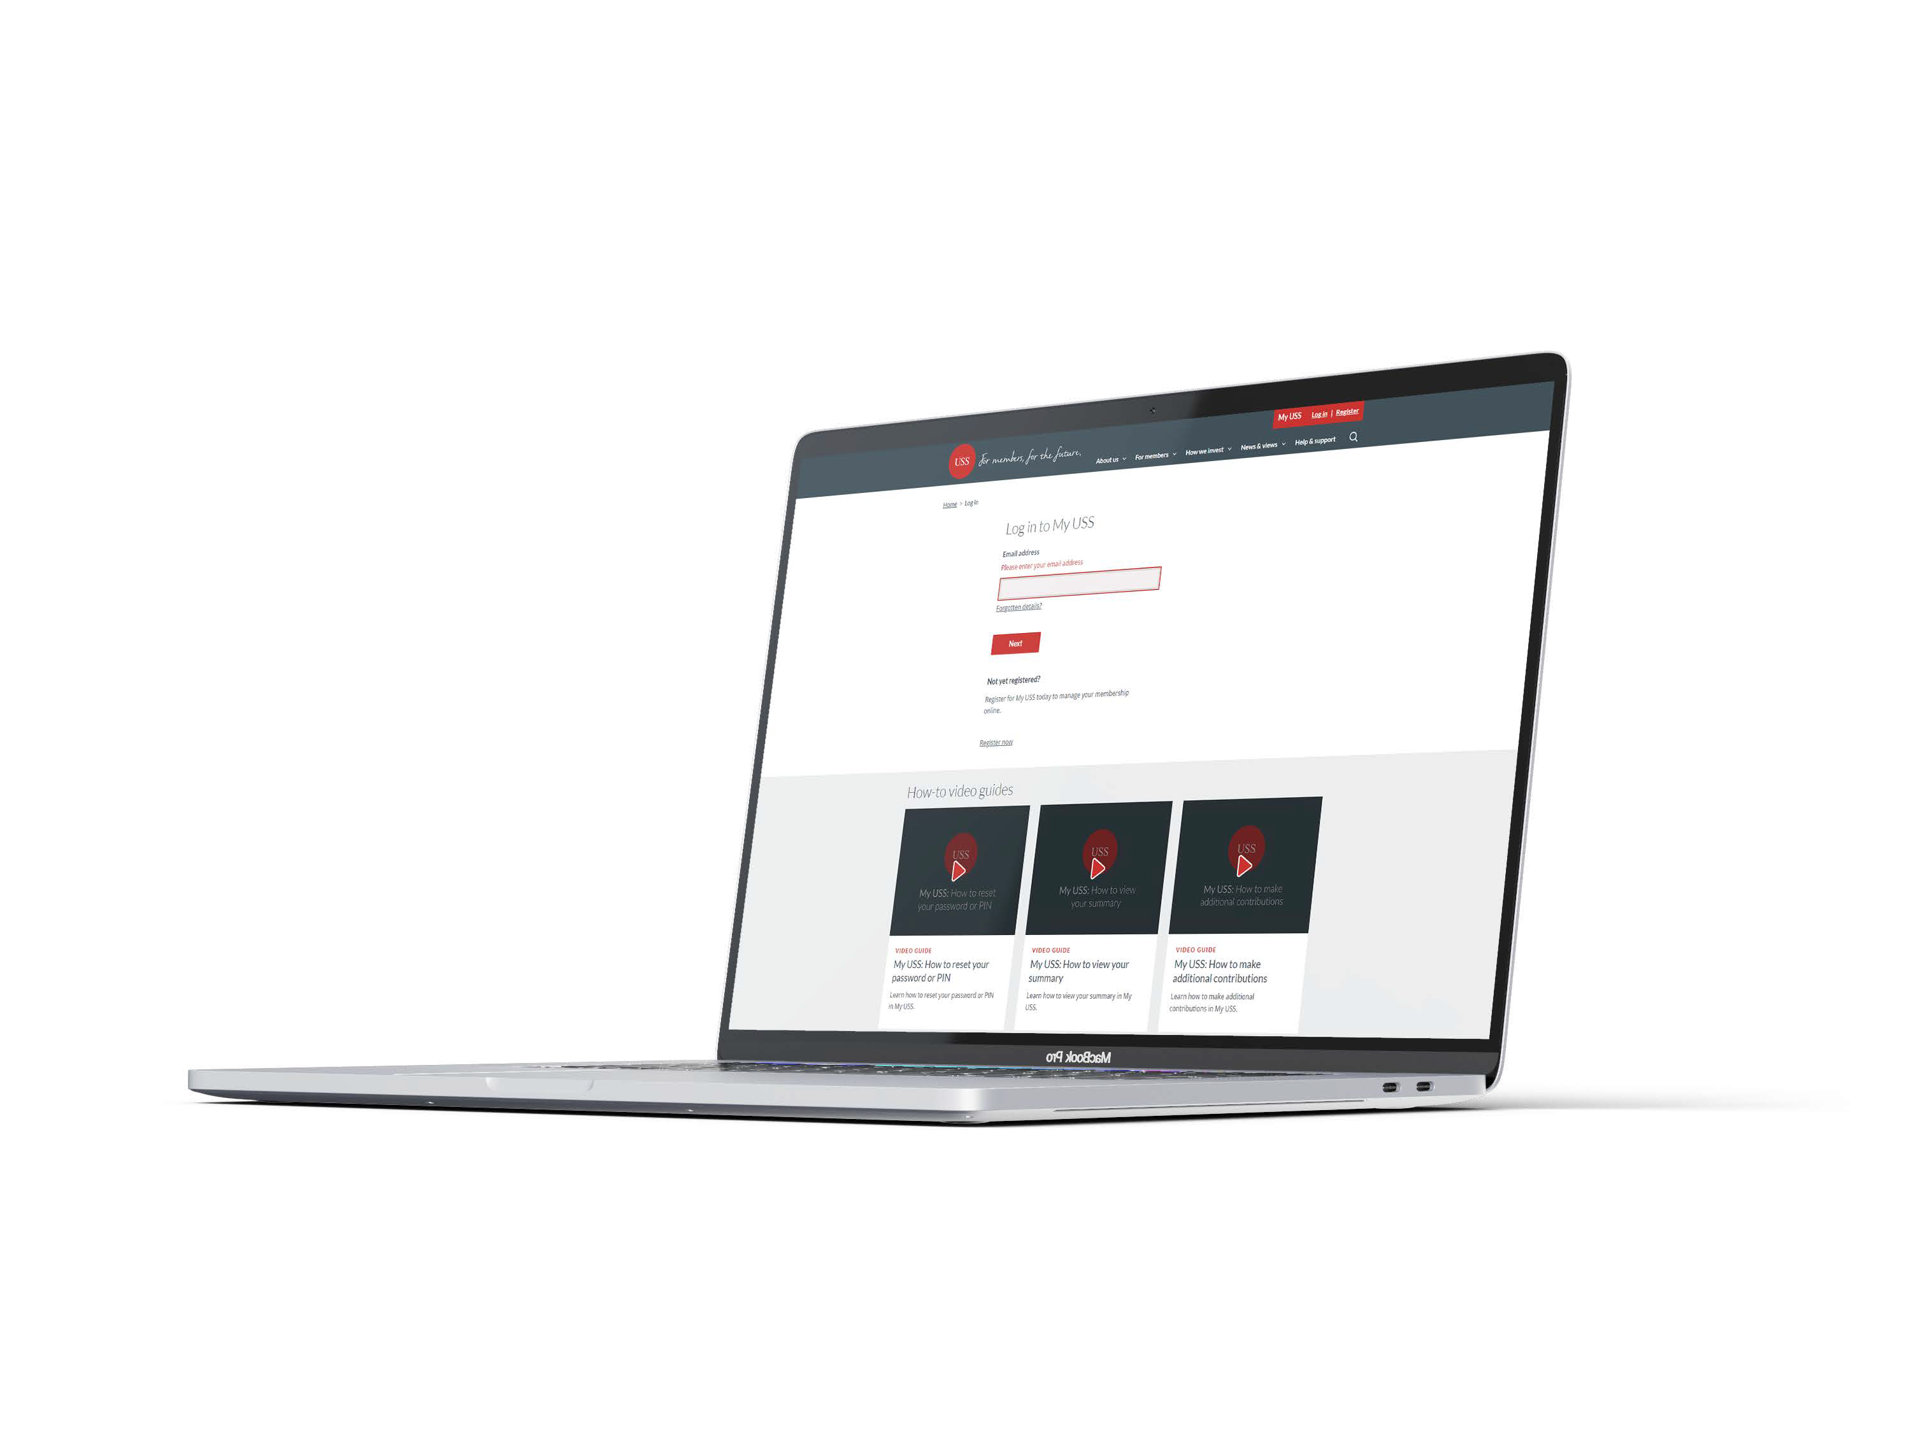
My USS

Slide 28
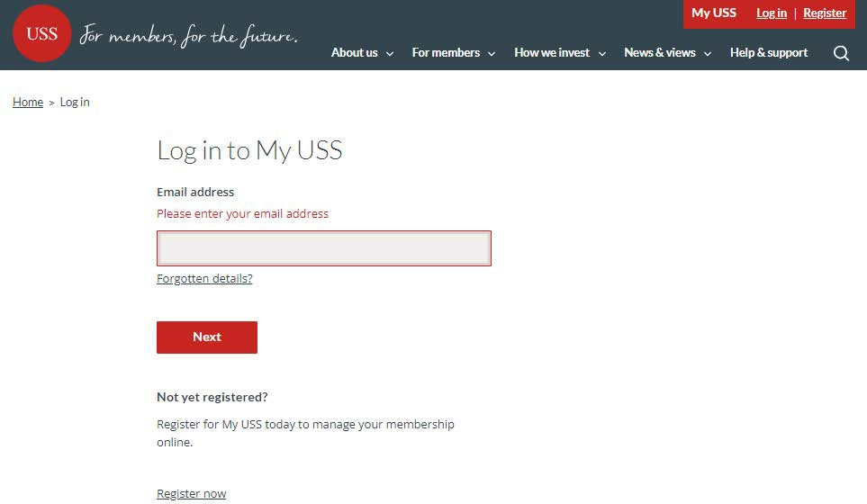

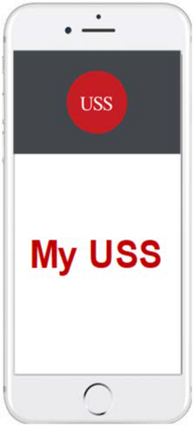

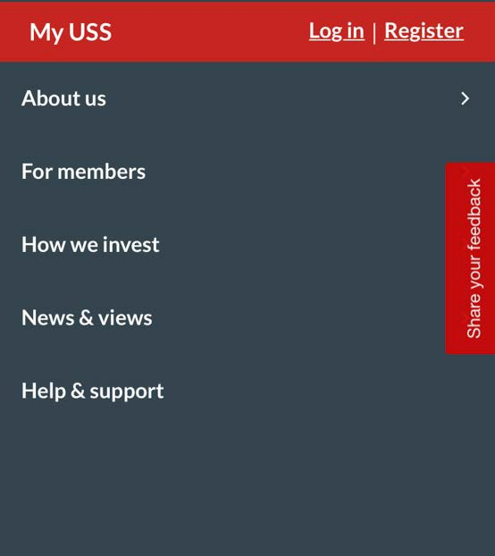
Sources of Support – My USS

Slide 29
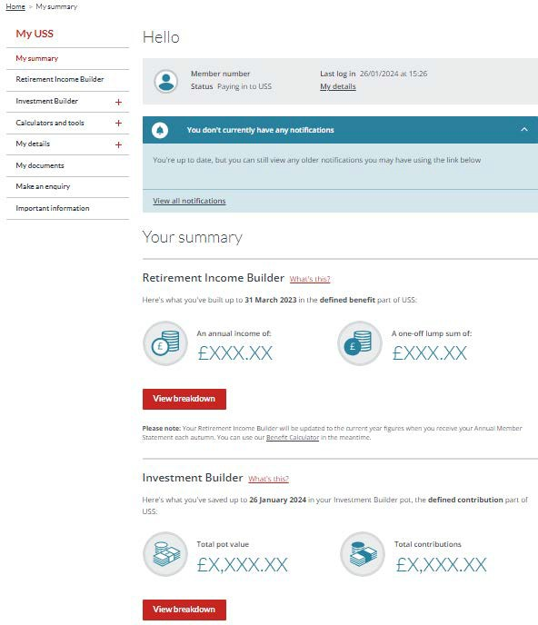
Sources of Support – My USS

Slide 30

Any questions?

Slide 31

Thank you
The content of this presentation is for information only. It does not explain all situations or eventualities. It is not, and should not be taken as, advice. You should not rely on, or take or fail to take any action based upon this presentation. We recommend that employers, or any other person that views, or otherwise comes into possession of the content of this presentation, take their own advice on which they can rely. If there is any difference between this presentation and the USS trust deed and rules the latter shall prevail. Please check the USS website for the latest information regarding the scheme and any changes that may have occurred to its rules and benefits.

