Slide 1
Digital Learning Development: Stepping out of the comfort zone
Richard Windle

Slide 2
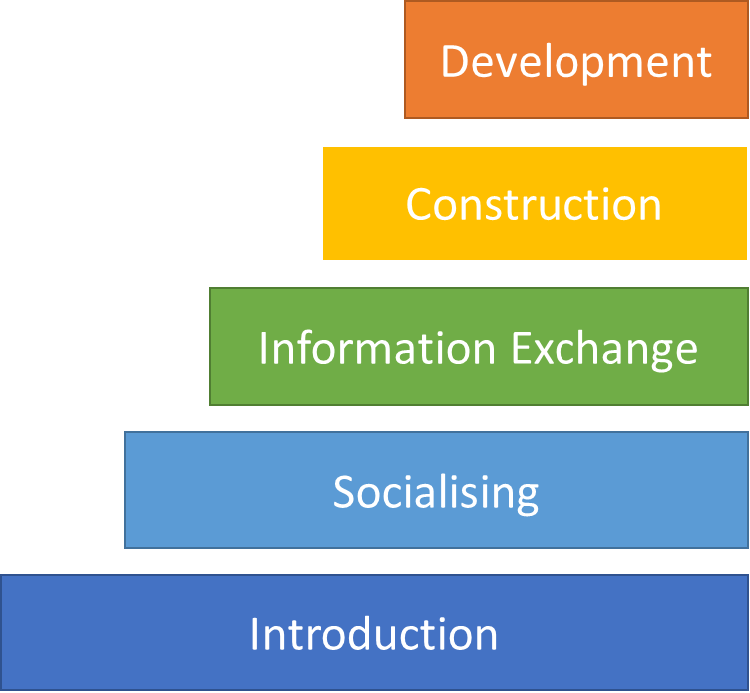


Digital Learning Experts?
“If anyone introduces themselves to you as a elearning expert, don’t believe them. There’s no such thing, we are all learning together”
Gilly Salmon

Slide 3

Technical Expert?

Slide 4
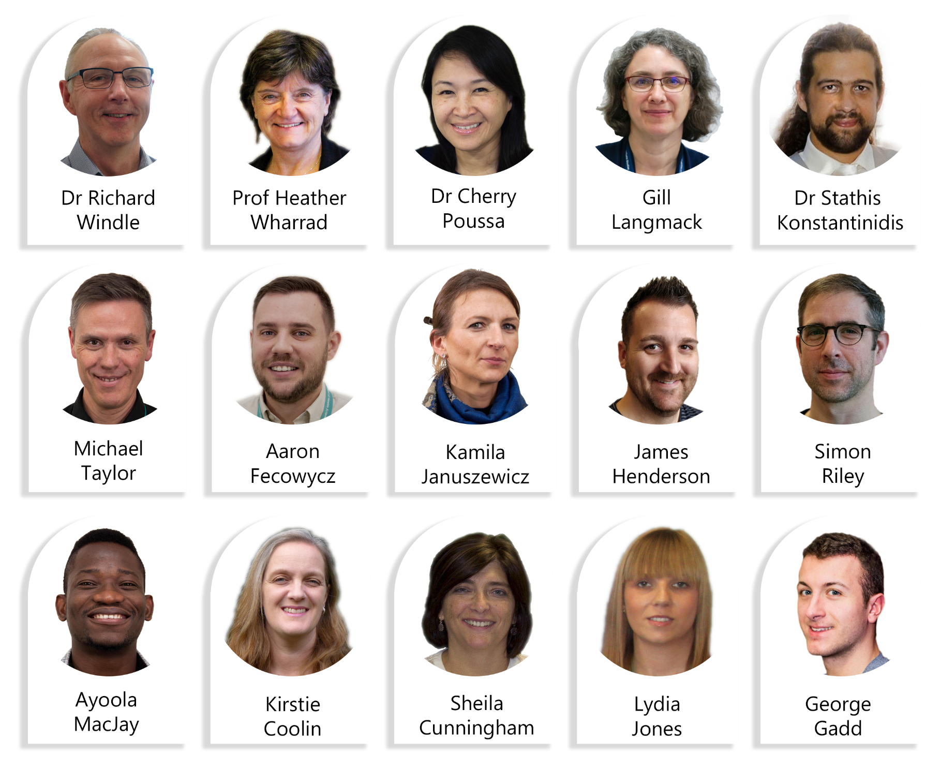
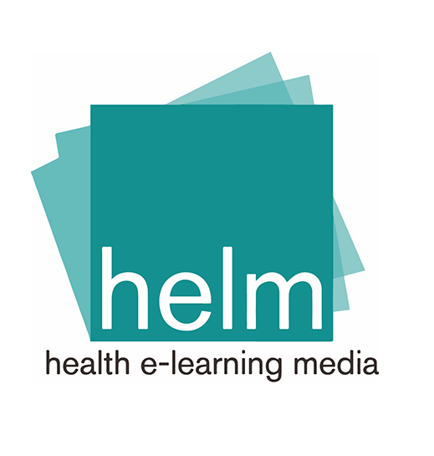
HELM team:

Slide 5
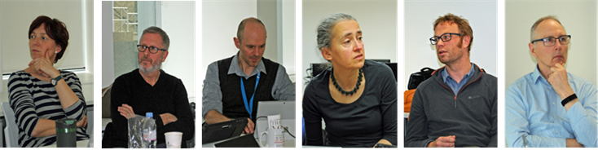
DLD team:
Teaching and Learning Board
Digital Strategy
Board
FACULTY BOARD
APVC T&L
University
APVC T&L
Professional
Services
Faculty Colleagues

Slide 6

DLD Vision
The University will nurture a culture of excellence in digitally-enhanced teaching and learning

Slide 7
The University will nurture a culture of excellence in digitally-enhanced teaching and learning that:
Is guided by sound pedagogic values and principles
Is shaped by voices from across the university community as a whole
Is informed by and fosters innovation and creativity
Promotes equity, inclusivity and values diversity
Inspires and unlocks the potentials of our learning community
Is user centred, not technology led
Engages with and informs the wider education technology community
Enhances the experience of learners and those who teach and support them

Slide 8
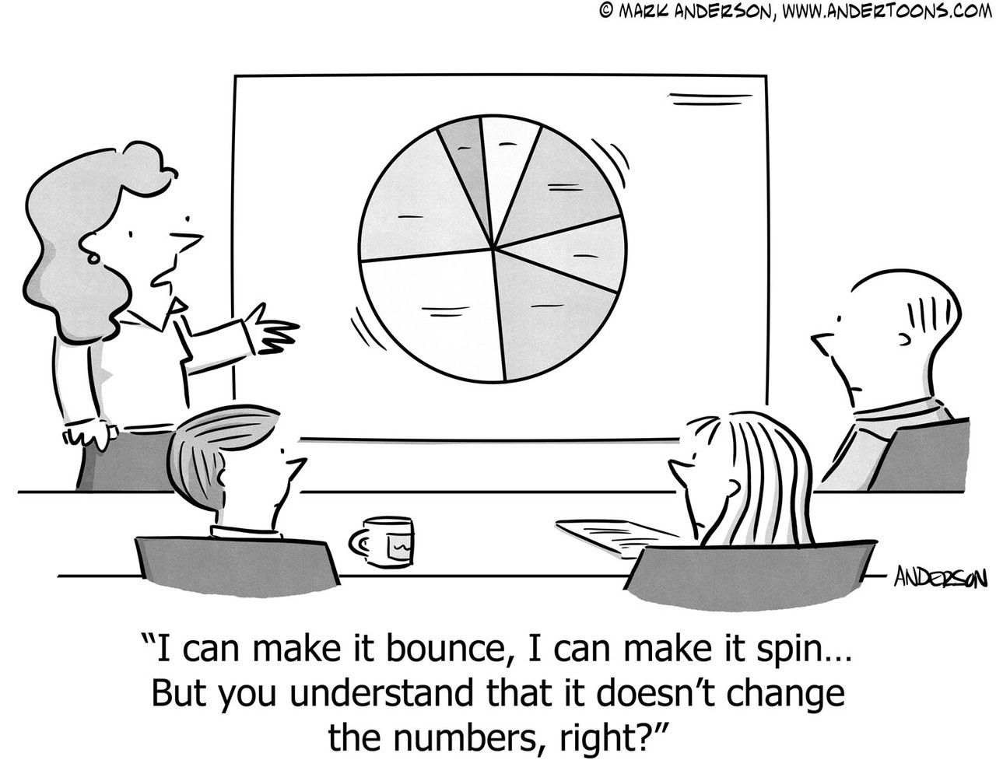
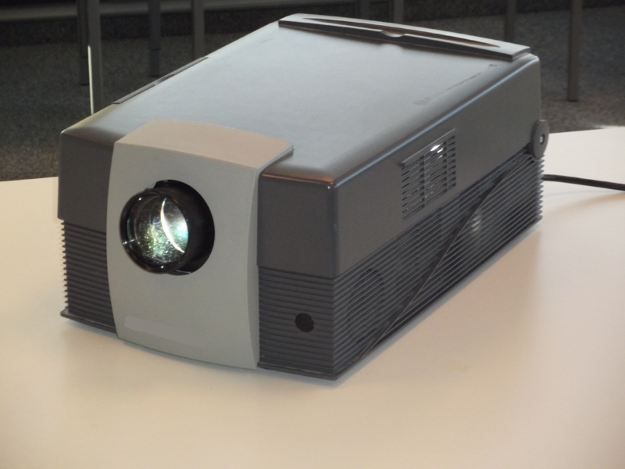
The Early Days
Notes:
.

Slide 9
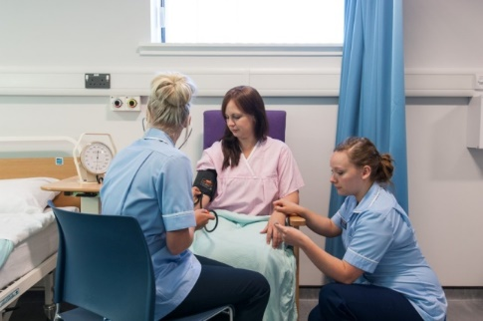
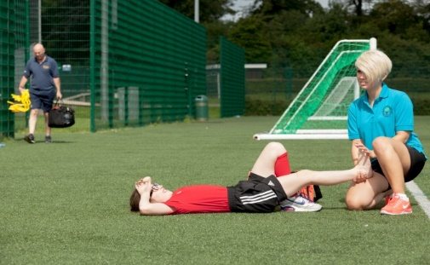
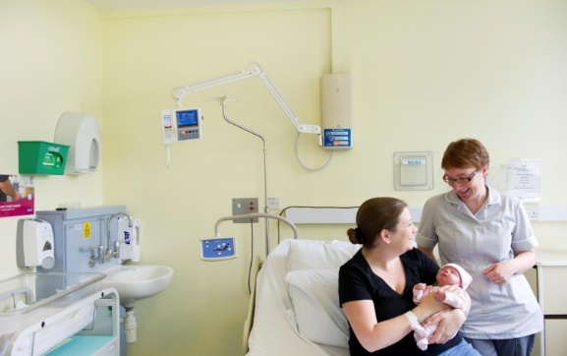

Drivers for Digital Development
Digital content: Context
Student/learner needs
Vocational subjects/ Theory-Practice Gap
Complex courses/ biology difficult subject
Need for re-usable, flexible, portable, quality (healthcare) resources

Slide 10


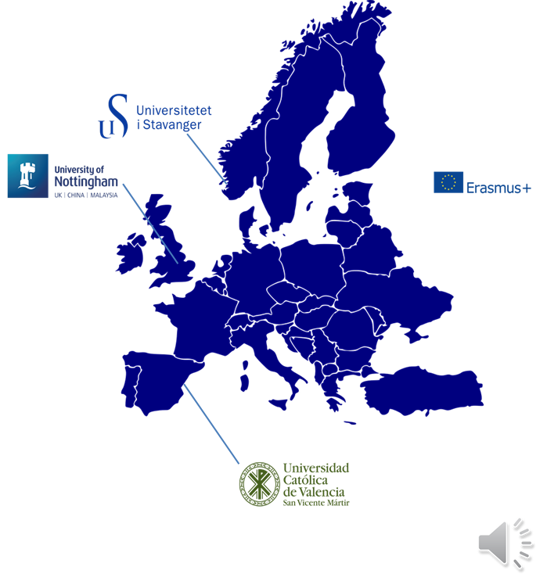


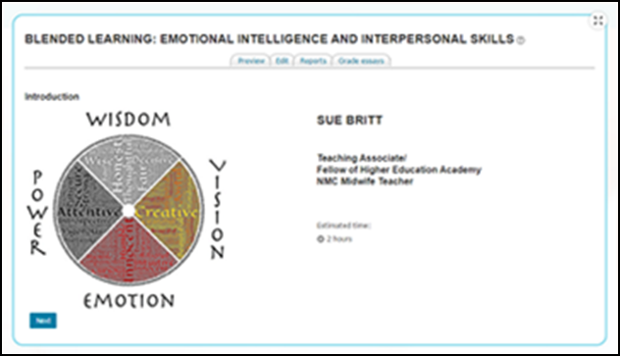


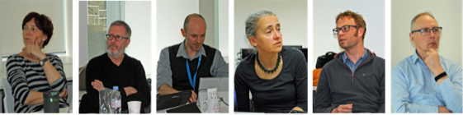


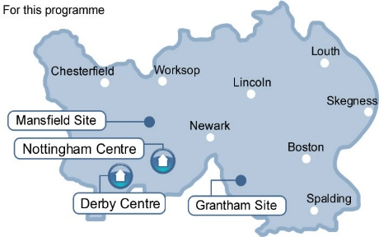


Milestones
Journey to open
Web development
Discussion boards
Web CT
First RLOs
PGCAP
SCORE FELLOWSHIP
Ed-tech PhD students
PRINCIPAL HEA FELLOWSHIP

Slide 11
HELM team:

Slide 12
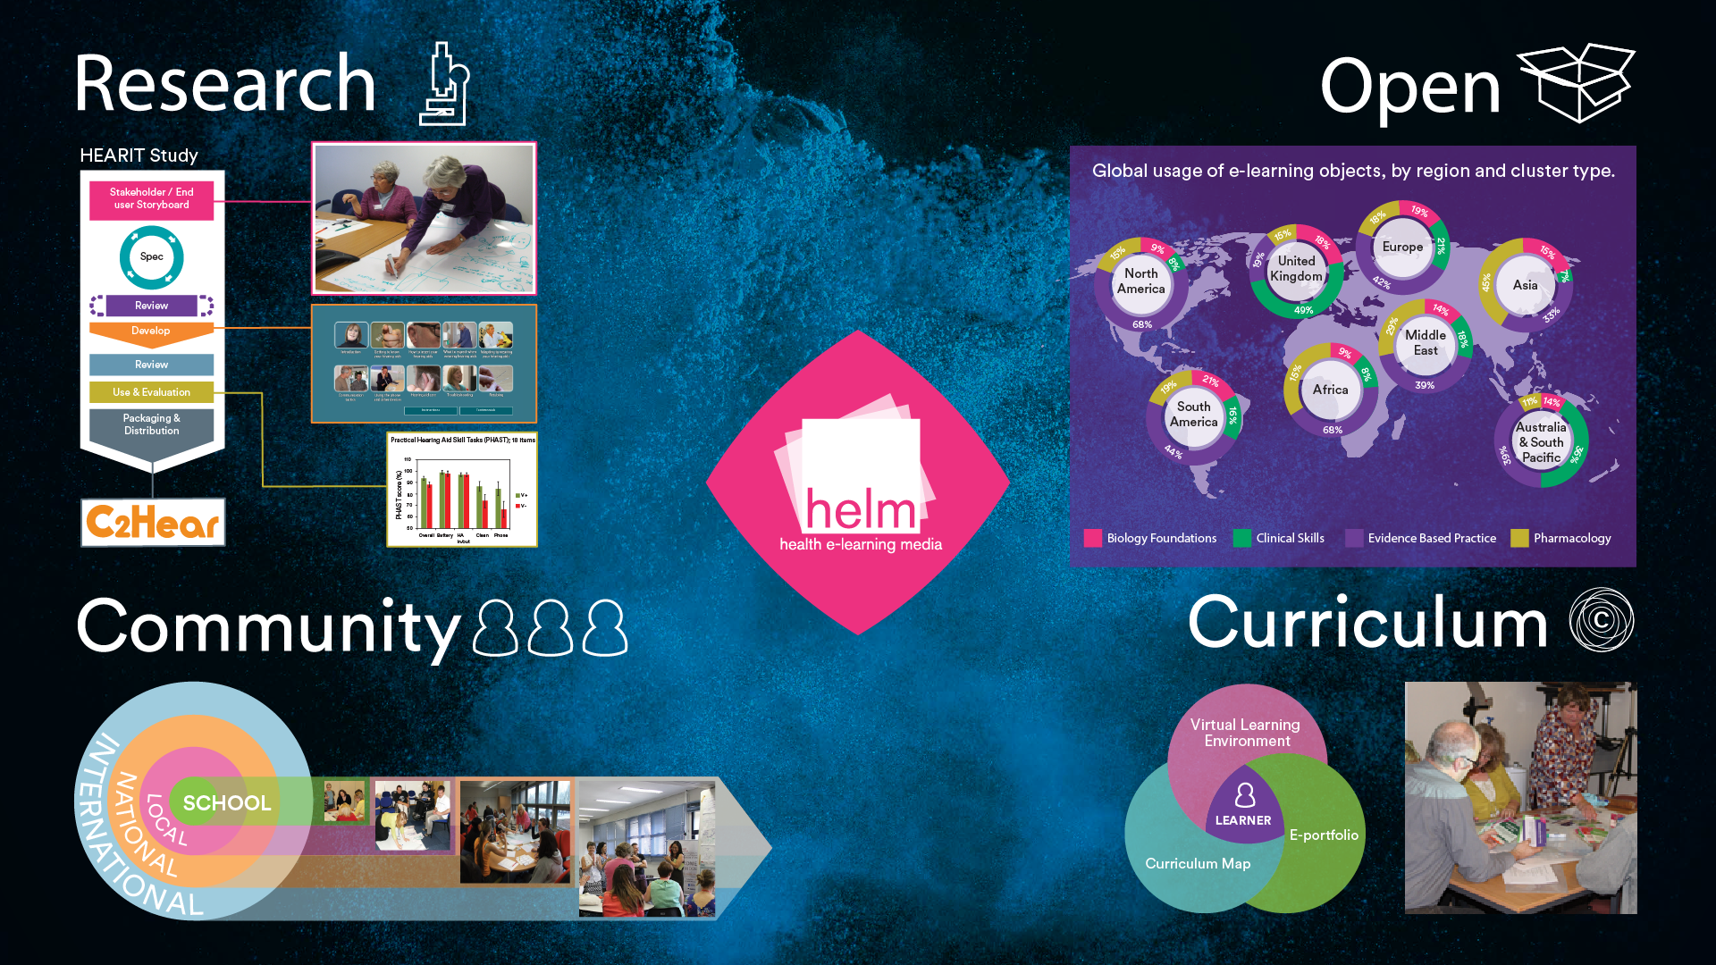

Slide 13
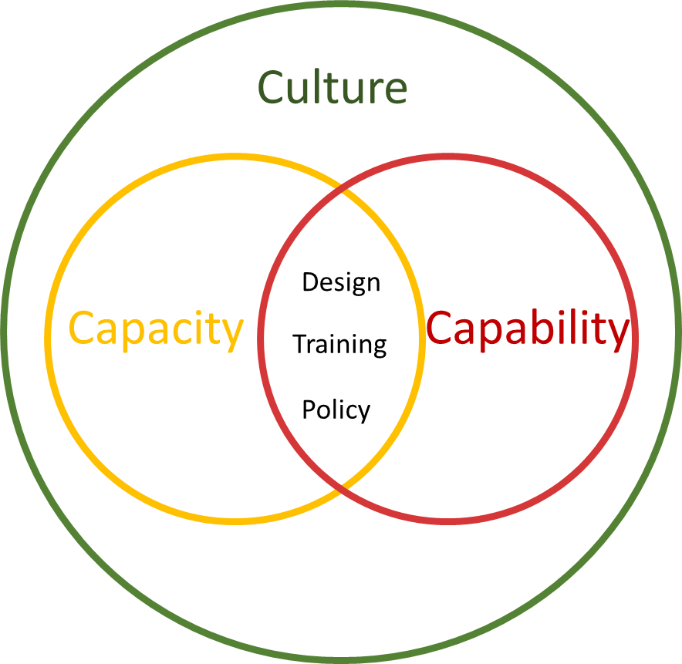
Digital Strategy :
Training
Showcasing
Physical Spaces
Curriculum Design
Online spaces

Slide 14

Comfort Zones:
Technology
Control
Pedagogy
Constraints

Slide 15
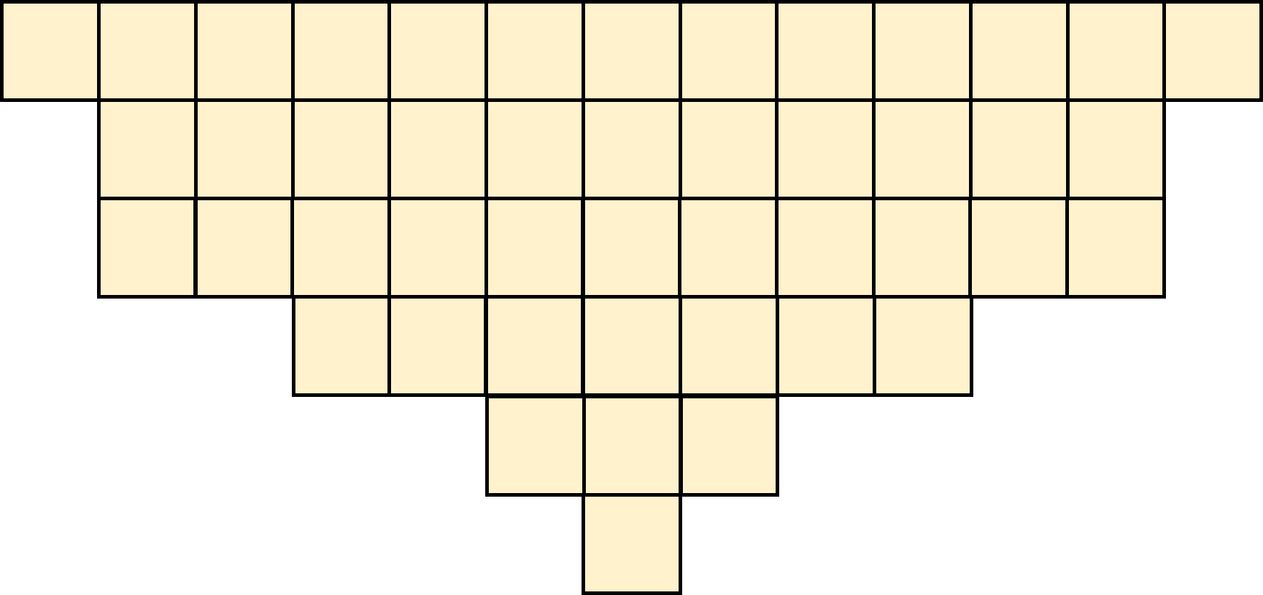
Technology
Disagree
Agree
D
Technology
Improves my
teaching

Slide 16
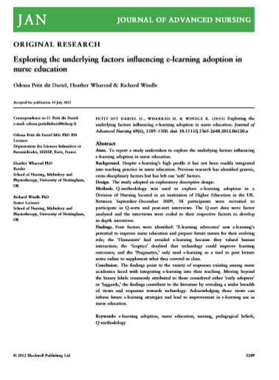
Technology
Enthusiasts
Pragmatists
Technology
Humanists
Sceptics
Educational Change

Slide 17
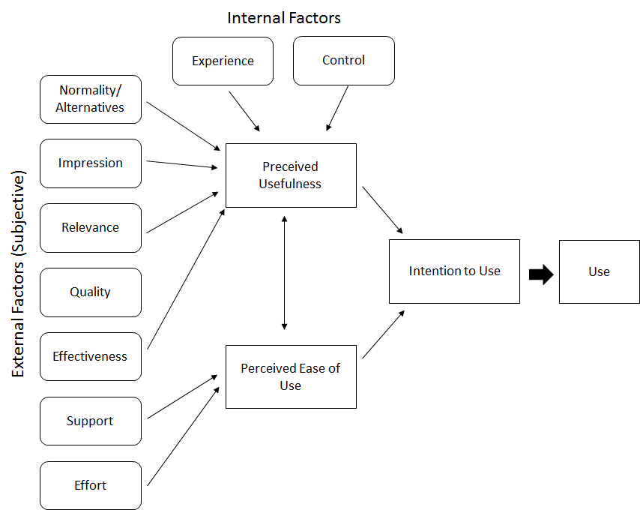
Technology
Unified theory of acceptance and use of technology.

Slide 18
Comfort Zones:
Technology
Control
Pedagogy
Constraints

Slide 19
Why Digital?
Enable
Allow you to do something that you couldn’t do by other methods of delivery
Enhance
Allows you to improve a learning instance
Expectation
Meets the requirements or expectations of students
Empower
Provides the learner with key skills that prepare them for the workplace or life in a digital world
-

Slide 20
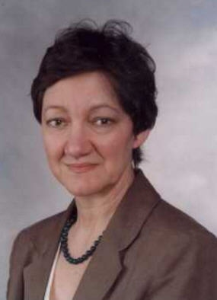
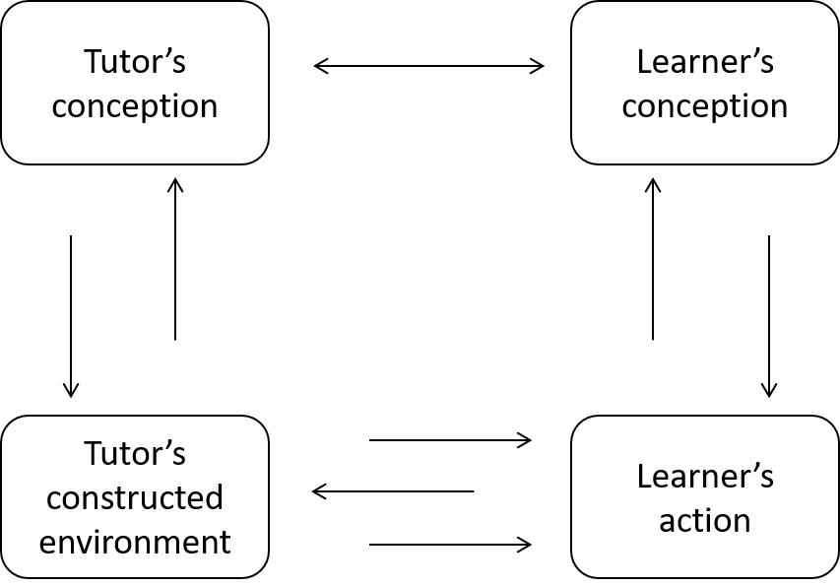
Conversational Framework
Laurillard

Slide 21
Salmon’s 5 stage model
SELF DIRECTED
Development
Testing, expanding, linking, applying, reflecting feedback, “assessment”
Construction
Creating, developing, critiquing, social learning, teamwork, feedback,
Information Exchange
Knowledge transfer, facilitating, learning materials, searching,
Socialising
Familiarising, simple interactions, content-neutral, trialling, bridging
Introduction
Welcoming, encouraging, setting up,
Explaining, contextualising

Slide 22
Comfort Zones:
Technology
Control
Pedagogy
Constraints

Slide 23
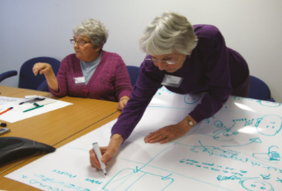

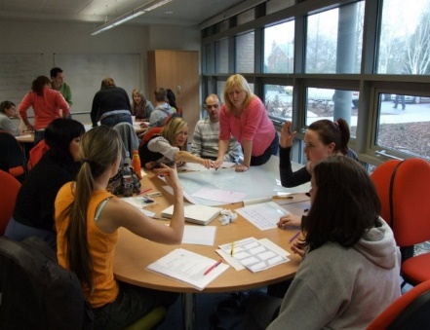
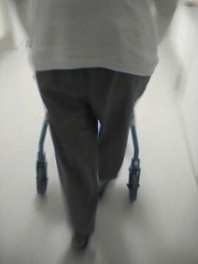
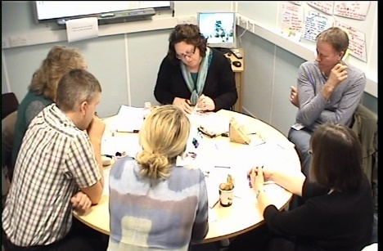
Who is the expert?

Slide 24
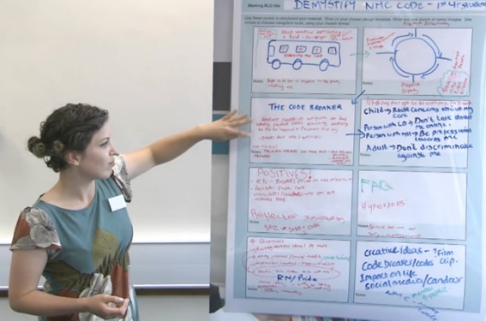

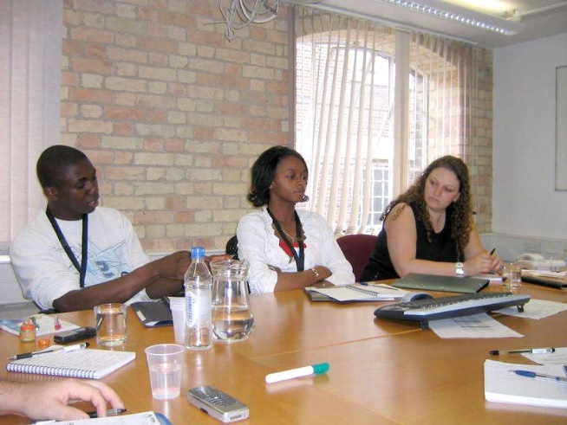
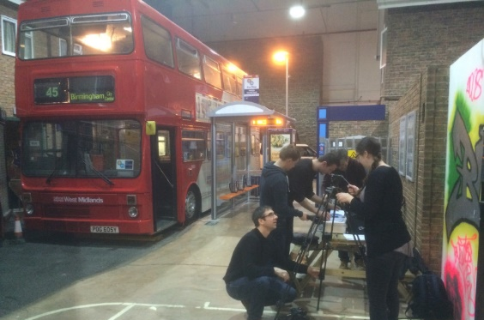
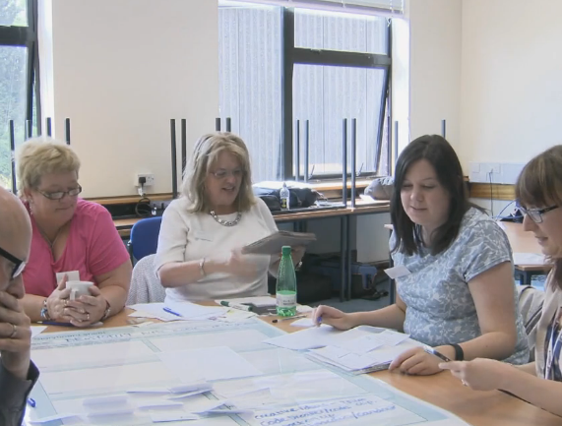
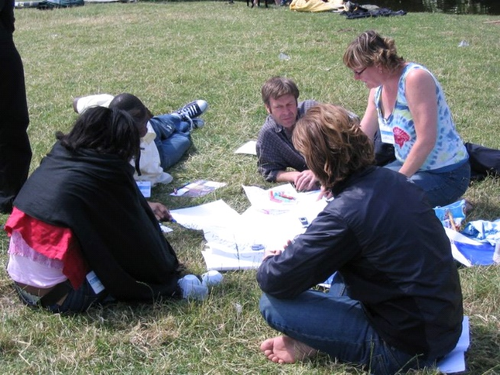
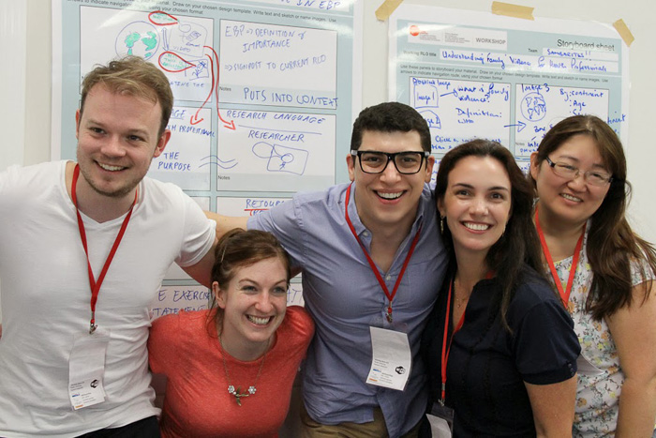
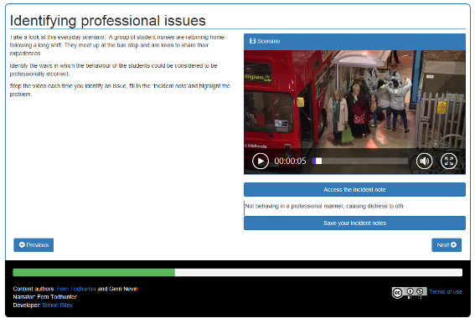
Participatory Design

Slide 25
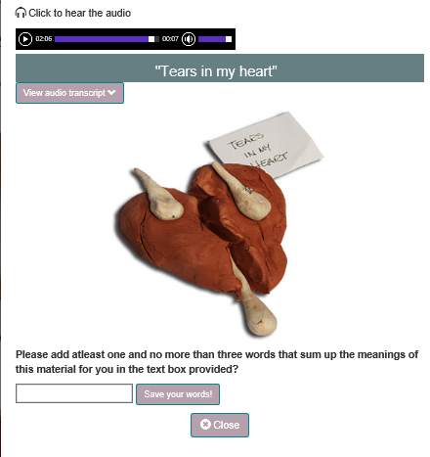
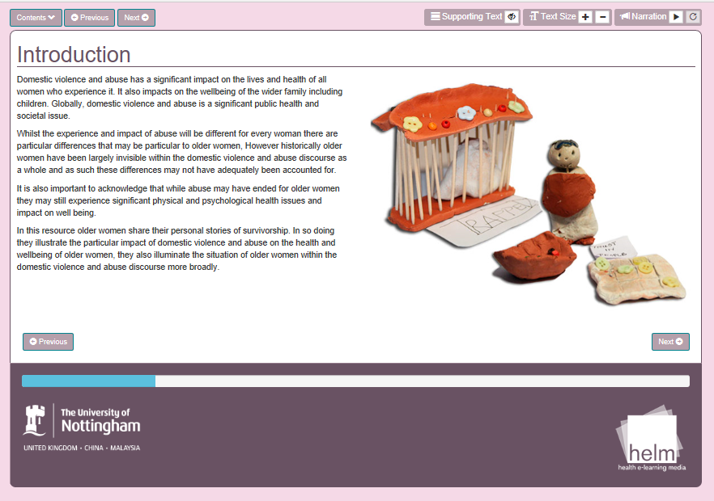
Stakeholders:
Power of User Generated Content:

Slide 26

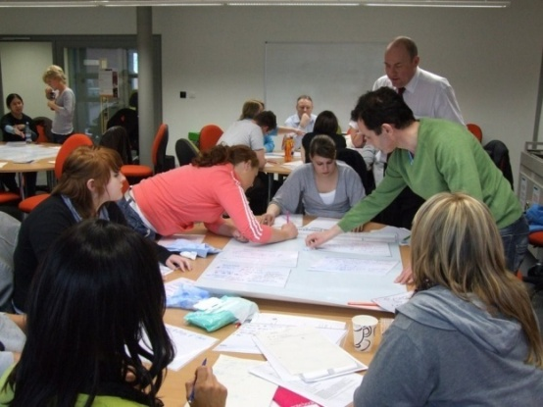
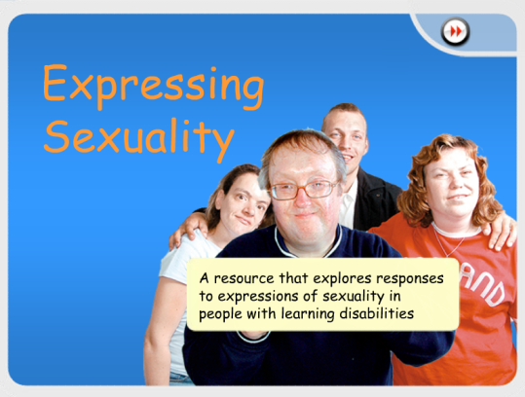
Students as co-producers
Project 2: SHOULD
“ We think as if we’re in the persons’
shoes”
“ I think tutors would probably
have gone over the top.. too much into depth”

Slide 27

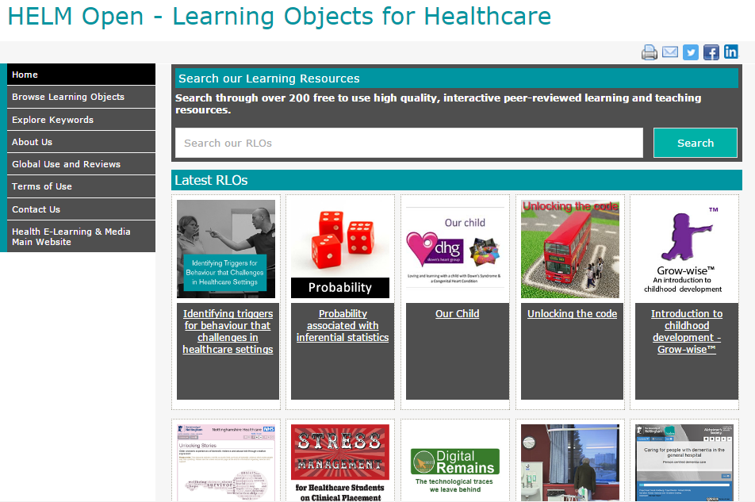
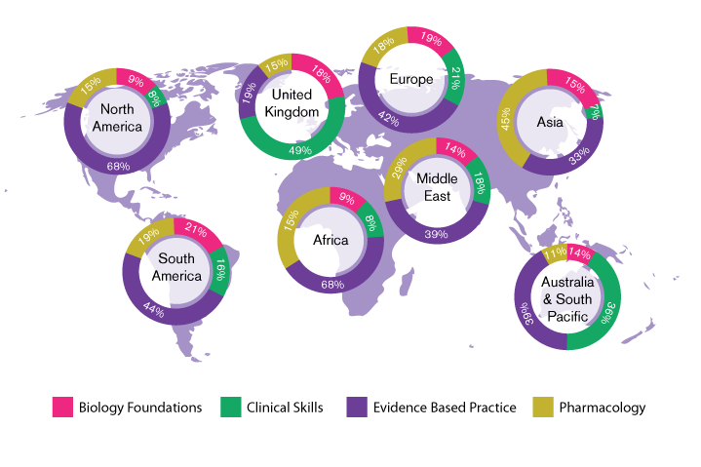
Open for Education
HELM Open

Slide 28
Comfort Zones:
Technology
Control
Pedagogy
Constraints

Slide 29
Technology
Institutional Factors
Unified theory of acceptance and use of technology.

Slide 30

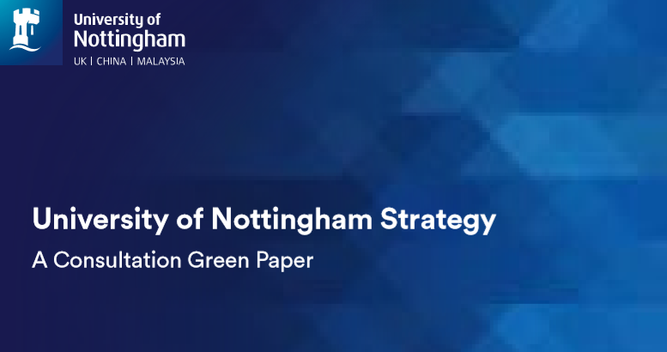
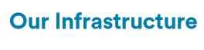
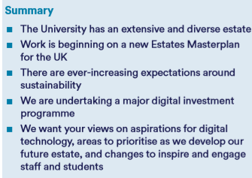
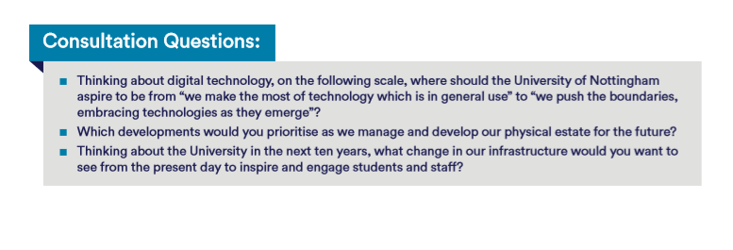

Slide 31

Thanks

