Slide 1
Meeting the teaching and learning challenges in 21st Century Higher Education
Pauline Kneale
@pekneale
pauline.kneale@plymouth.ac.uk
#UoNTLC2019

Slide 2
Looking back
Peering forward

Slide 3
Defining the Challenges
Active learning tasks to promote students feelings of competence and autonomy
Assessment and feedback that promote student learning
Blending in expertise from professionals elsewhere within and beyond the university – an integrated curriculum
Enabling students to choose IT that promotes autonomy and professional development
Curriculum conceptualisation so the programme team has common goals and understandings- one team
De-metricise the meanings and criteria for teaching excellence
Decolonise the curriculum for genuine internationalisation
Giving individual students the attention they deserve
Inclusive learning
Incorporating climate change / sustainability action in all disciplines
Long-term confident researchers
Meaningful understanding of ‘diversity’ in T&L - T&L that promotes diversity
Student well being and mental health
Staff mental health and workload - wellbeing for staff

Slide 4
Improvements since ….?
Most universities train new staff to teach
Clearer targets in university mission and value statements
Staff-student partnerships – Student Charters – Student Voice
Graduate attributes – linking employability
Recognition that most students will NOT have academic careers
Skills – Enterprise – Sustainability agendas
Some appreciation that auditing practice can be helpful (in some areas!)
Student prizes for staff performance
What else?

Slide 5
Sector Shifts
1992 Further and Higher Education Act Polys → Unis
1996 The Dearing report
1998 Labour, David Blunkett, introduces tuition fees
2009-10 Fee cap set at £9000
2010s New (new) universities
2015 Cap off student numbers
2017 Higher Education and Research Act 2017
Closure of FE colleges
Expansion of size of universities – classes
Increasing live-at home students
Business Options
Elite university
Mass university
Niche university
Local university
Distance Learning university
Anchor university
International university

Slide 6
Changing shape of the sector
Christensen 2011 ‘as many as half of American universities would close or go bankrupt within 10 to 15 years’
2017 Christensen specifically predicted "50 percent of the 4,000 colleges and universities in the U.S. will be bankrupt in 10 to 15 years."
Number of small US colleges closed per year and closure rate as a percentage of the total number of private, not-for-profit colleges in the US, 2002–2019. Source: Moody’s

Slide 7
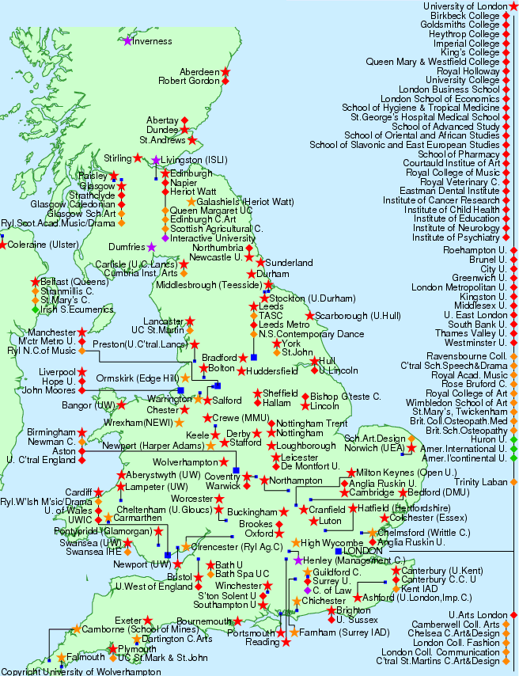
Universities and
Colleges
2017

Slide 8
Universities and Colleges
White
Rose University
Mersey University
King’s University
Birmingham
University of Wales
Cambridge
Oxford
Bristol
Royal University South East
University of the South West
2025-30?

Slide 9
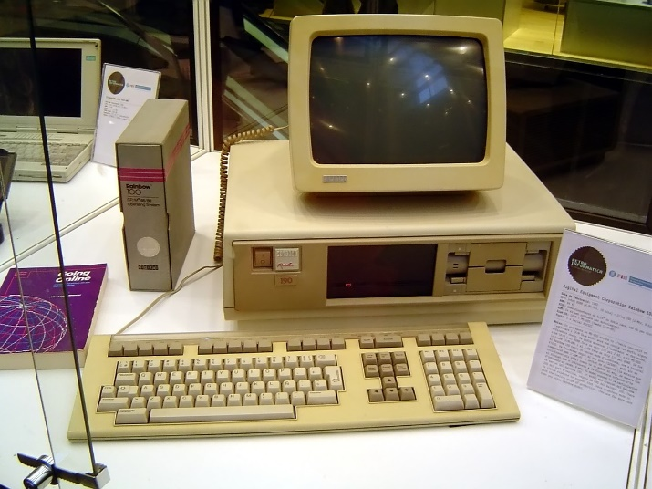
Technology - milestones
1975 Desk top computer
1983 Researchers began to assemble the ‘network of networks’
1980s Internet established
1990 Sir Tim Berners-Lee invents the World Wide Web
1990s email becomes a practical alternative to the post
1993 Browsers
1998 Google search engine

Slide 10
1974-1993 Change
1974 SPSS, Fortran - punch cards mainframe
1976 Programmable calculator
1978 ZX spectrum
1979 Commodore PET
1980 BBC micro
1981 BMDP
1985 Microtab SPSS X
1990 Minitab
1992 MATLAB
1993 SPSS X

Slide 11
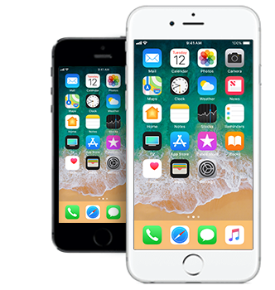
Contemporary reality 2005→
Computers are furniture

Slide 12
Next ten years - more automation
Graduate jobs taken over by machine processing – finance / accounting …
Trawling huge data sets – data mining
Simulation on a new scale
Raspberry Pi generation

Slide 13
Change meets academic resistance?
I don’t believe the evidence… That won’t work here… This is how we do it here…
“ …. students don’t know what good teaching is, so my 30 year-old notes are still OK”
Sadly not - students have 14+ years of dull ⬄ brilliant learning experiences. They know boring and disengaging in an instant.
Phillips and Joseph (2015: 526) student quotes: “Don't read from PowerPoint ... I zoned out before the second slide.”
“… relate the material to the real world or explain how it would be applied to actual tasks. …engage students in the material by answering questions, rather than consistent lecturing.”
‘Unfortunately, most scientists’ beliefs about [higher] education are rarely based on objective evidence but rather on what they imagine to be true. While personal experience in the classroom can give valuable insights, it is not data’. (Cooper and Stowe, 2018)

Slide 14
Pre-1990
Teacher-centred approaches dominate
Focus on a lecturer’s performance and presentation of material; essentially transferring information to the class

Slide 15
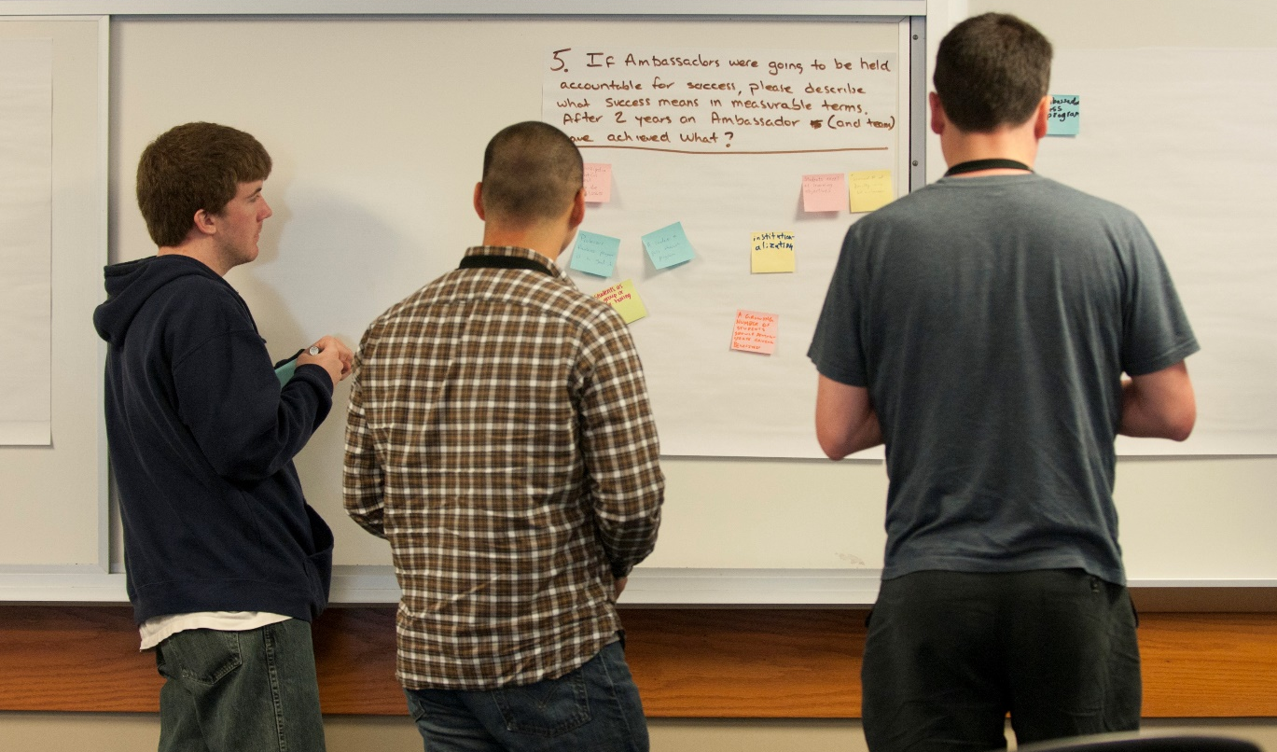
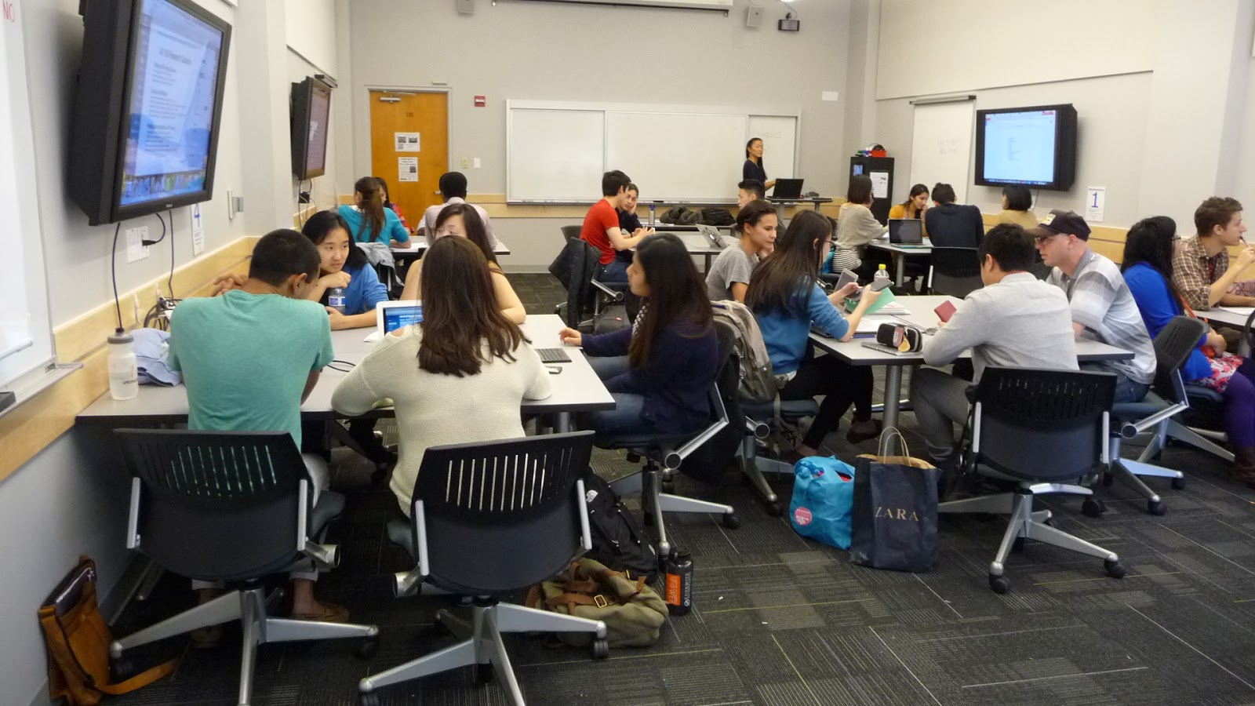
2019
How close is your class to student-centred learning?
Information transfer part of the picture; Students involved;
Students doing;
Active and experiential learning pedagogies prioritised and supported (Scheyvens et al., 2008);
Assessment is authentic;
Delivery is inclusive, supporting learners with diverse backgrounds and learning needs to develop autonomy.
(Biggs and Tang, 2007; Gibbs and Simpson, 2005)

Slide 16
Reaching the Millennial student
Understanding how today’s students learn successfully is essential
for effective curriculum design:
“… educators need to change their methods in order to reach today’s
millennial student.” Ebert (2016)
“Millennials are the most diverse generation we have had to teach, thus our approaches to teaching must be diverse … Millennials expect to be engaged in their learning, they do not do well being passive learners”. NIU (2014)
These students embrace technology, lose interest during lectures, and enjoy the challenges and experience of taking part in interactive learning activities. - Stevens and Nies (2018)
‘Selfie-taking yet unselfish, connected yet lonely, anxious yet pragmatic, risk-averse yet entrepreneurial, Generation K is a distinct cadre, a generation very different from those that preceded them’. Hertz (2016)

Slide 17
Live at home / Commuter students
Older students are coping better than under 21s
Younger students are doing less well, but hidden in class
Group work on trains
Skype / webcast tutorials – office hours
But I do think in a way we have missed out cos it’s part of uni isn’t it, being social, … but partly because we just don’t have the time to come in just to go out.
PLYMOUTH
It would be great to have affordable, occasional accommodation, bookable for single nights, to allow engagement in social events , reduce the pressure of travelling for exams and early teaching sessions.
Travelling for 5 hours for the sake of one lecture does not make the best use of time and resources, and has an environmental impact.

Slide 18
Creating inclusive communities?
It’s not hard to find friends; it’s hard to find British friends.
I played a card game with my flatmates but I just can’t play because they give like the particular name of the political figures or stars but I have no clue about who they are.
We don’t actually watch the same cartoons as you growing up, we don’t watch the same TV programmes so actually we still have too much difference.
sometimes they [home students] may think you are stupid
… feel embarrassed, so I tend to go along with other international students.
Wenger (2010, p. 180) regards, ‘the person as a social participant, as a meaning-making entity for whom the social world is a resource for constituting an identity.’ University is a new social world
The communities international students make do not include home students, (despite their best efforts)
Research suggests a need for organisational ownership of the situation – with lecturers and professional staff creating academic and co-curricular opportunities for home-international encounters

Slide 19
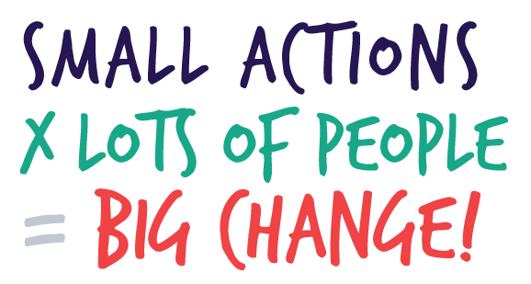
Building curriculum to support the team-based Future and Workplace
Team working/building and leadership
Inter-personal skills
Negotiation
Decision making
Handling conflict
Sharing
Communication skills
Presentation, explaining, questioning
Networking
Managing projects and meetings
Evaluation, judgement, appraisal
Entrepreneurship, ‘intrapreneurship’ and social enterprise

Slide 20
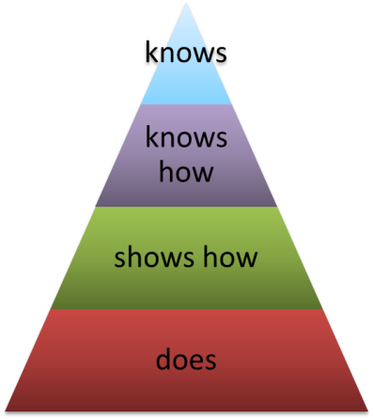
Skills / Capabilities?
Be creative & think outside the box
Self aware
Know how to learn
Able to identify underlying principles
Confidence
Self-efficacy
Working effectively with others
Comfortable with not-knowing and uncertainty
Knows limits
Knows when to ask for help
Adapt to unexpected and changing circumstances and settings
Integrate
A CAPABILITY
FRAMEWORK
After Neve & Hanks 2016

Slide 21
Understanding yourself and your way of teaching -learning?
Your comfort zone?

Slide 22
In summary
HE students need different (not pre-internet) approaches
The modern educator is facilitator, coordinator and guide
Teaching Isn’t about giving information. Information is already out there. The task is to present it to the students effectively letting them use it to research for themselves.
How should / could the curriculum change to best support our students? 2019 - 2050
Students who are:
Confident researchers
Professional in approach
Familiar with workplaces
Flexible and discerning in moving between technologies
??
Your top 4 actions for the next few years?

Slide 23
Levelling the playing field?

Slide 24
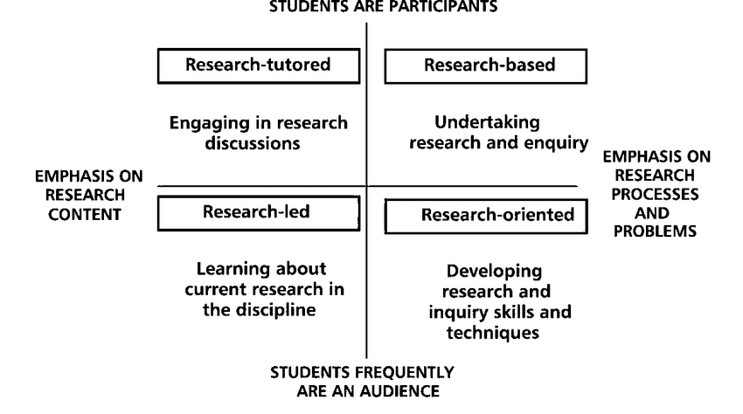
Inclusive Teaching, Learning & Assessment
‘Good teaching and learning is inclusive’ (Thomas et al, 2005; Hockings, 2010)
‘Teaching which engages students in learning that is meaningful, relevant and accessible to all, embracing the view of individual difference as a source of diversity that can enrich the lives and learning of others’ (adapted from Hockings 2010)

Slide 25
Doing
My Project
Our poster
Fun
My film
Hard work
It’s what you expect
Boring Just listening
It’s OK when they tell you WHY you are doing an experiment
It’s OK, but it’s all in the book
Sometimes he’s quite funny
Is he a really important person?

Slide 26
Student-led
Exploring and acquiring existing disciplinary knowledge
Participating in building disciplinary knowledge
Staff-led
Levy and Petrulis, (2007, 3)

Slide 27
Student researchers
Tame Problems - complicated but resolvable, they are likely to have
occurred before, have a limited degree of uncertainty. There is an answer.
Wicked Problems are difficult ←→ impossible to solve. Typically characterised by incomplete information, contradictory and changing circumstances and requirements that are often difficult to recognize. They are complex, not just complicated. No clear relationship between cause and effect. Solving one aspect of a wicked problem may reveal or create other problems.

Slide 28
Co-researching with partners.
Employer / charity / organisation - defined work to resolve contemporary life and workplace issues.
Projects that align to the university / department mission exploring technical, policy and society issues.
Topics that inspire dedicated enjoyment and deep engagement.
‘Products’ are professional standard, work-relevant, authentic in all aspects.
Fee-paying students are more engaged in co-creation activities in comparison to non-fee-paying students. Maxwell et al. (2018: 1401)
Owen and Hill, 2011; NCCPE, 2019

Slide 29
Being brave: Research only final year
Two modules
All year
Teams of 4-10 people depending on the challenge
Group reporting with project milestone reports and updates
- (staff-led) academic topic
- external / workplace / international / ??? Topic

Slide 30
Design Thinking - Story telling How are we telling stories to our students and taking them with us?
Where do students tell stories to us?
Roth, B. (2015)

Slide 31
Social constructionist perspective
‘Knowledge’ becomes locally situated in the cultural and social milieu in which it is created and what is important is what happens ‘in between’ people, in the discursive social context’ (Burr, 2015).
Meaning is created through interactions in the social context. The SC approach recognises that the individual is indivisible from their social context.
Where are the conversation spaces in curriculum?
…. science and engineering staff and students too

Slide 32
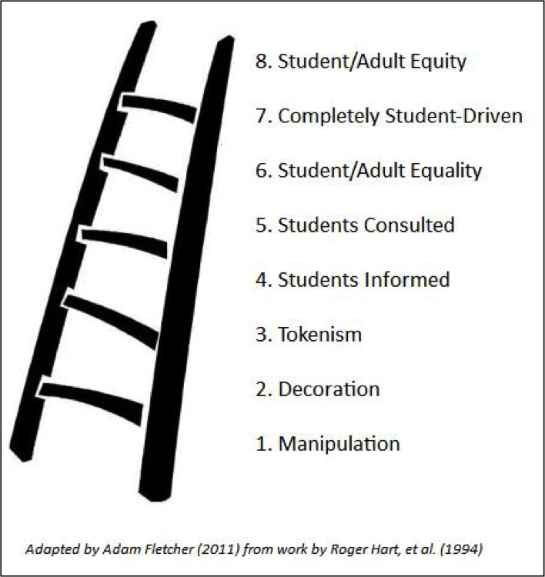
Co-creation

Slide 33
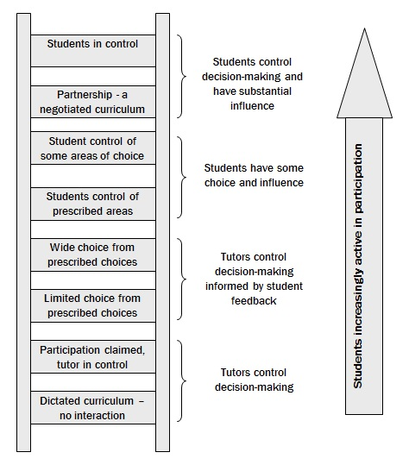
Co-creation
Programme design team member
Fieldwork task decisions
Select assessment from a list: essay, web page or presentation
Module feedback collected
Bovill, C. and Bulley, C.J. (2011)

Slide 34
TEF
Enabling students to learn excellently
Creating leaders for the future
Every student needs to be exposed to research at all stages of their degree
Students really feel they are part of the research group – in all years, they contribute usefully
Bovill, C. and Bulley, C.J. (2011)

Slide 35
A Model of Learning
Inputs Surface Deep Transfer Outputs
Skill
Skill
Surface Acquiring
Transfer
Surface Consolidating
Will
Will
Knowing Success
Deep Acquiring
Deep Consolidating
Thrill
Thrill
Environment
Hattie and Donoghue (2016)

Slide 36
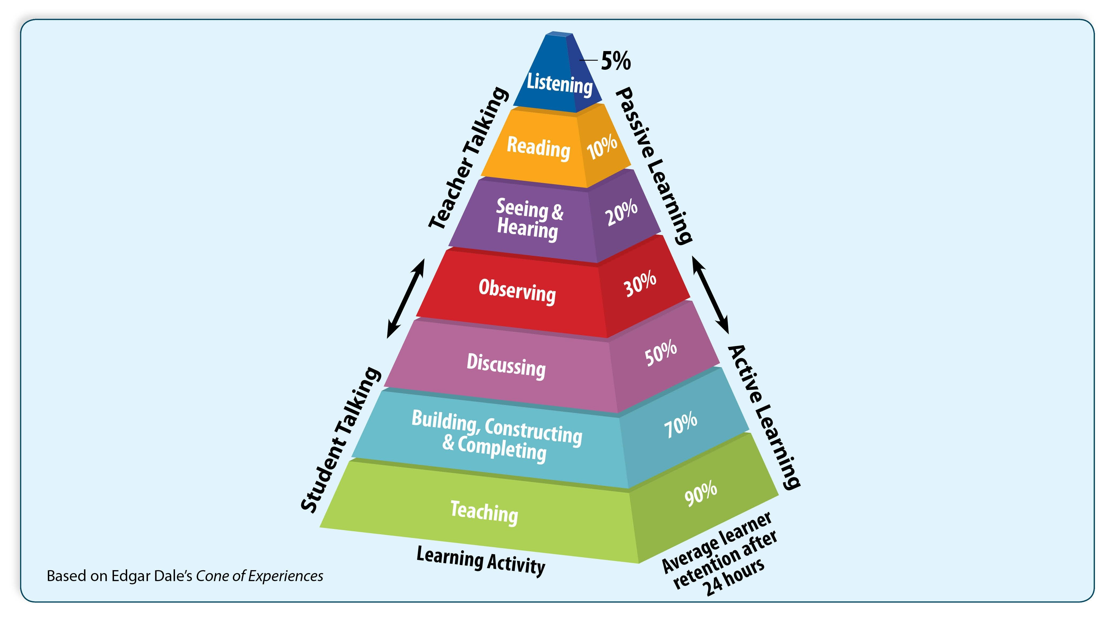
Explain pedagogic approaches to students Share pedagogic research evidence with students
This is why I don’t waste my time and your time by lecturing
Teaching each other

Slide 37
The challenge for higher education
Self-authorship: the ability to know oneself, to know what one knows, to reflect upon it and to base judgements on it (Baxter Magolda, 2004)
Three zones / levels:
epistemological, concerning the nature and certainty of knowledge;
intra-personal, concerning an individual’s sense of who they are and what they believe;
inter-personal, concerning the construction of relationships.
The challenge is to create effective spaces for undergraduate students to develop these three areas of experience (and for academics to know what they are doing?)

Slide 38
Developing self-authorship - requires disruption
Key dimensions:
skills of critical analysis and evaluation;
development of mature working relationships, embracing and valuing of diversity;
consideration of multiple perspectives.
Students move towards self-authorship when they are able to balance their understanding of the contextual and partial nature of their knowledge with personally grounded goals, beliefs and values, defined by relating to a multiplicity of others.
Undergraduates need program and extra curricular opportunities with sufficiently novel spaces and encounters that compel them to reconsider and subsequently fashion new conceptions of self and personally-referenced ways of knowing (Baxter Magolda, 2004).

Slide 39
Defining disruption and the borderland
The borderland is a metaphor for the condition of living between spaces and cultural norms, existing in the interstices between traditional arenas and/or practices of pedagogy (Elenes, 1997).
In higher education these spaces can be defined as the unfamiliar physical or metaphorical territories where their novelty and ambiguity provides a challenge which seems daunting to students and faculty.
Borderland spaces are liminal, foregrounding a sense of becoming and ambiguity (Turner, 1974). When entering a liminal space, participants become ‘neither here nor there, betwixt and between all fixed points of classification’ (Turner, 1974: 232). The expected norm is disrupted so transitions are not easy.
Challenge – to create disruption in the curriculum and co-curriculum.

Slide 40
Unfamiliar…Ambiguous…Daunting spaces
Independent Undergraduate Research
Teaching yourself - Independent learning (Lynda.com)
The ‘unfinished’ assignment
Undergraduate Research Conference
Volunteering Project Work
??
‘every university graduate should understand that no idea is fully formed until it can be communicated … Dissemination of results is an essential and integral part of the research process.’ (Boyer Commission, 1988:24)
Transformative learning (Mezirow, 2000; Meyer and Land, 2006)

Slide 41
Teach yourself - independence
Flipping the learning
Let students find their own way through the technology - deeper learning, more rewarding
Multiple IT backgrounds - use any system you like to run your statistics or create a podcast. Use the system you are familiar with
Wholly aligns to Digital Literacy goals:
‘ability to use digital technology, communication tools or networks to locate, evaluate, use and create information. The ability to understand and use information in multiple formats from a wide range of sources via computers’
Lynda.com: An online learning platform that helps anyone learn business, software, technology and creative skills to achieve personal and professional goals

Slide 42
The ‘unfinished’ authentic assignment
Assignments should mirror real life, real research (authenticity)
Most research papers report a story in progress
Deep learning needs scaffolding / support / challenge - avoiding over-prescription / handholding / …
The challenge is to present authentic problems, for individual or group research, in a timeframe that enables students to tackle enough of a problem to achieve some mastery while appreciating the unfinished nature of the job
For many students this is uncomfortable / challenging / disconcerting / … but real

Slide 43
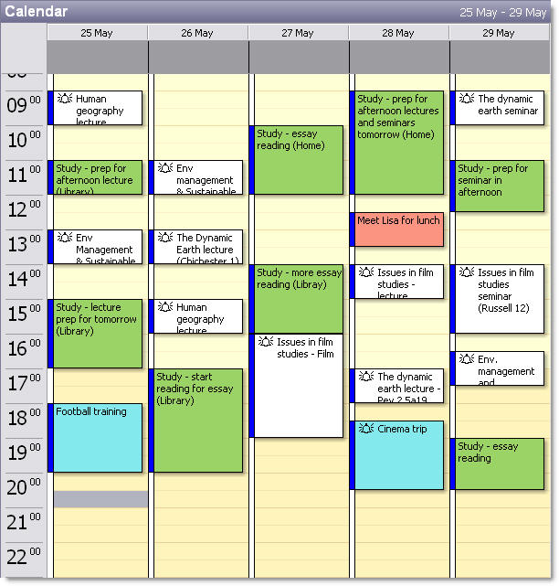
Scaffolding student learning
Energy – focus – interest – stimulation - engagement
The Module timetable sets expectations:
Detailed taught sessions and indicates out of class activities (reading / group work / language classes, writing café, ...)
Managed student expectations
Introducing ‘good study’ habits
Identified / Dedicated time for group work
Managed anxiety:
“Working in groups enabled us to discuss our worries about the assessment”
Notes:
Structure of the timetable
Students were presented with a structured timetable (running from 9-6) which mapped out the teaching and learning activities related to this module. The timetable not only included details of the taught (workshops) sessions, but also indicated when students could undertake course related reading, study tasks and meet as a group. The module leader demonstrated a clear rationale behind structuring the timetable in this way; firstly, they highlighted the value of this to map out their expectations of the students when planning the course. But more importantly the module leader felt this gave a clear indication to students of what was expected of them and how they could manage their time in order to meet the requirements of this module. At the end of the module a number of students recognized the value of this in the focus group discussions and felt it had be a useful approach to assist them in planning what they did when.
But, the students appreciated the opportunity to be ‘thrown in at the deep end’ and felt that the experience would be of benefit to them throughout the duration of their programme and into employment.

Slide 44
Learning Spaces as Disrupters
In and Out of the classroom
Physical spaces Virtual spaces

Slide 45
Physical spaces | Traditional use | Example use as borderland space
Lecture theatres, seminar rooms, classrooms | Transmissive faculty-led presentations, seminars and workshops | Flipped classroom - student-led break-out discussion/critique; use of collaborative technology (e.g. clickers, smart devices); student-led, faculty-facilitated collaborative debate and critique; group role play and other experiential learning
Laboratories and studios | Directed experiments and exercises, performance, dance; faculty demonstrate equipment/techniques | Student-directed/informed experiments, productions, dance, theatre, exercises and small group explorations
Libraries, resources rooms | Faculty directed study | Collaborative, dialogic self-directed meaning-making; student research-led reading and learning
Field, campus spaces | Faculty-led tours; small group inquiries and exercises following stipulated techniques | Students generate new knowledge through research (using relevant technologies); student field presentations and interpretations

Slide 46
Physical spaces | Traditional use | Example use as borderland space
Transit spaces: cars, trains and buses | Directed reading and thinking; informal conversations | Individual and small-group sharing and reflection; group learning via smart devices
Communal campus spaces: auditoria, corridors, refectories, student accommodation | Directed reading, watching audio and video podcasts; informal conversations | ‘Think stops’ for peer sharing and group learning face-to-face and via smart devices
Exhibition and conference spaces | Transmissive presentation of faculty directed student materials | Faculty-student-employer multi-way dialogue enabling critical interaction with student research; networking
Classroom and corridor walls | Passive displays of materials | Interactive critique of materials

Slide 47
Physical spaces | Traditional use | Example use as borderland space
Collaboratories: pods for break-out sessions | Faculty-initiated group inquiries | Student-led problem-solving and critical reflection via dialogue
Faculty offices | Formal tutorials; faculty-led feedback | Formative discussions between faculty and students, directed by the latter
Peer mentoring spaces (PAL) | Revision of faculty-delivered material by PAL leader | Student-led participative inquiry and shared meaning- and identity-making
Off-campus informal spaces: coffee bars, cafes, student accommodation, libraries, museums, galleries, parks, theatres, malls | Directed personal reading and watching audio and video podcasts; performances; informal conversations | ‘Think stops’ for peer sharing; small group exploration and discovery

Slide 48
Virtual spaces | Traditional use | Example use as borderland space
VLEs: synchronous (chatrooms, virtual worlds) or asynchronous (discussion boards, blogs, wikis, emails) | Faculty communicating with individual students and groups; resource repositories | Peer production of knowledge, resources and meaning; peer questioning and answering in class/ field/studio/immersive environment;
Online undergraduate research journals | Student reading and authorship | Student video reflections on personal research; reflective blogs
Social media (e.g. Twitter, Facebook, Instagram) | Faculty communicating with students and student groups | Two way iterative developmental dialogue between faculty-students and students-students
Personal (head) space | Thinking within comfort zone | Thinking ‘outside of the box’

Slide 49
Inclusive, Active, Authentic student journey
Admissions -realistic (fitness to study/practice issue)
Early identification, communication about students support needs, reasonable adjustments
Consistent & effective personal tutoring
Effective teaching and post session support
Inclusive assessment and feedback
Active learning - field trips / off campus activities, laboratory and practical work accessible to all.

Slide 50
Consistent Support
RASE (Resources, Activities, Support and Evaluation) pedagogical support for all modules
UNSW 2025 &
Graduate Capabilities
Program Learning Outcomes (PLO)
Content + Tools enabling students to learn
Resources
Course Learning
Outcomes (CLO)
Work on tasks (individual + peer) to achieve LOs
Activities
Courses & Course Components
Peer/Tutor/Technical/online - resolve emerging difficulties
Support
Assessment
Structured, formative ways to identify and improve student progress
Evaluation
Evaluation
Shared institution-wide frameworks
(Churchill, King and Fox, 2014; UNSW, 2017).

Slide 51
Being brave: Re-imaging Exams Inclusive Typed
Open book
Seen
Take-Home: same day
Take-Home: extended 3 days – 3 months
Multiple choice questions (MCQ)
Problem or case based scenarios – individual or team solutions
Practical examinations
Computer Aided Assessment (CAA)
Observed laboratory and field activities - Group and team
Group presentations
Observed Structured Clinical Examinations (OSCEs) individual and team
Integrated Structured Clinical Examinations (ISCEs) individual and team
‘Assessment needs to be rigorous but not exclusive, to be authentic yet reliable, to be exacting while also being fair and equitable, to adhere to long-established standards but to reﬂect and adapt to contemporary needs’. (Hounsell, Xu and Tai, 2007)

Slide 52
Current Assessment Practice
Assessment Options - Flexibility both ways
Staff choice - Student choice - Co-design
Simple or MAP free assessments
Group plan, report and presentation Report of data analysis Encyclopaedia entry Wiki Website Group discussion Debate Research proposal | Report on cause and effect Research bid Field work report Decision makers template Case study analysis Oral presentation to a small group, or on camera Laboratory practical report Court of enquiry | Analysis of a problem Action plan Group or individual poster Simulation exercise Report and presentation MCQs (no time pressure) Story boards Mooting Press conference
Notes:
This work is not new 2006 in SPACE identified the need
MAPs – bust the jargon - no room to put it in full

Slide 53
What would really impact students learning?
Suppose Total Focus …… 2019-2025 on …..
Eliminating the traditional lecture and handwritten timed exam.
Research only in final year – two big worthwhile projects
Getting there means promoting the alternatives in every forum at all times
Managing up, down and out to employers, government, professional bodies, parents, alumni, …..

Slide 54
References
Balint, P.J., Stewart, R.E., Desai, A. and Walters, L.C. (2011) Wicked Environmental Problems: Managing Uncertainty and Conflict, Washington: Island Press.
Barnett, R. 2014 Conditions of Flexibility: Securing a more responsive higher education system,
Biggs, J. & C. Tang (2007). Teaching for quality learning at university. Maidenhead: Open University Press.
Bovill, C. and Bulley, C.J. (2011) A model of active student participation in curriculum design: exploring desirability and possibility. In Rust, C. Improving Student Learning (18) Oxford: The Oxford Centre for Staff and Educational Development, pp176-188.
Christensen, C. 2011The Innovative University
Conklin, R. J. (2003) Dialog Mapping: An Approach for Wicked Problems. CogNexus Institute. http://cognexus.org/dmforwp2.pdf
Cooper MM and Stowe RL 2018, Chemistry Education Research—From Personal Empiricism to Evidence, Theory, and Informed Practice Chem. Rev. 2018, 118, 12, 6053-6087
Cotton, D., Nash, P. and Kneale P.E. 2017 Supporting the retention of non-traditional students in Higher Education using a resilience framework, European Educational Research Journal, Special Issue, Vol. 16(1) 62–79 http://journals.sagepub.com/doi/pdf/10.1177/1474904116652629

Slide 55
Ebert, K. (2016). Teaching techniques. Classroom strategies for millennial learners. Radiation Therapist, 25(2), 201–204
Gibbs, G. and Simpson, C. (2005) Conditions Under Which Assessment Supports Students’ Learning. Learning and Teaching in Higher Education, 1, 3-31
Griffith, A. and Burns, M. (2014) Teaching Backwards, Outstanding Teaching Series.
Grint, K. (2008) Wicked Problems and Clumsy Solutions: the Role of Leadership. http://leadershipforchange.org.uk/wp-content/uploads/Keith-Grint-Wicked-Problems-handout.pdf
Hattie, J.A.C. and Donoghue, G.M. (2016) Learning strategies: a synthesis and conceptual model, npj Science of Learning, 1, 16013 https://www.nature.com/articles/npjscilearn201613#f1
Healey, M. (2005). Linking research and teaching: exploring disciplinary spaces and the role of inquiry-based learning, in Barnett, R. (ed). Reshaping the university: new relationships between research, scholarship and teaching. Maidenhead: McGraw-Hill/Open University Press, pp.67-78.
Hertz NA 2016 Think millennials have it tough? For ‘Generation K’, life is even harsher, http://noreena.com/think-millennials-have-it-tough-for-generation-k-life-is-even-harsher/

Slide 56
Hill, J., Walkington, H. & Kneale, P. (2019) Borderland spaces: moving towards self-authorship. In T. Bilham, C. Hamshire, M. Hartog and M. Doolan (eds) Reframing Space for Learning: Empowering Excellence and Innovation in University Teaching and Learning. London: UCL/IoE Press (in print).
Kneale, P.E. 2018 Where might pedagogic research focus to support students’ education in a REF-TEF world. Journal of Geography in Higher Education 42, 4, 487-497
Kneale, P.E. 2019 Exploring pedagogic tensions in final year program design, in Hill, J. Walkington Drewey, S. (Eds) Handbook for Learning and Teaching in Geography. Edward Elgar Publishing
Kneale, P.E. Context Case Studies, http://www.geog.leeds.ac.uk/courses/other/casestudies/
Knight, P.T. and Page, A. (2007) The assessment of ‘wicked’ competences. Report to the Practice-based Professional Learning Centre for excellence in teaching and learning in the Open University (The Open University).
Levy, P. and Petrulis, R. (2007). Towards transformation? First year students, inquiry-based learning and the research/teaching nexus. In: Proceedings of the Annual Conference of SRHE, 11-13 December 2007, Brighton, UK.
Neve and Hanks 2016 The transition from competence to capability. https://www.plymouth.ac.uk/uploads/production/document/path/10/10114/Sally_Hanks_-_The_transition_from_competence_to_capability.pdf

Slide 57
NIU (2014) Millennials: our newest generation in higher education, Northern Illinois University, Faculty Development and Instructional Design Center, https://www.niu.edu/facdev/_pdf/guide/students/millennials_our_newest_generation_in_higher_education.pdf
Phillips, C.R. and Joseph E. (2015) Millennial students and the flipped classroom, Proceedings of ASBBS Annual Conference: Las Vegas, 21, (1) 519-530. http://asbbs.org/files/ASBBS2014/PDF/P/Phillips_Trainor(P519-530).pdf
Roth, B. (2015) The Achievement Habit. New York: HarperCollins Publishers; https://www.youtube.com/watch?v=8bYIQDlWj34
Scheyvens, R., Griffin, A.L., Jocoy, C.L., Liu, Y. and Bradford, M. (2008) Experimenting with Active Learning in Geography: Dispelling the Myths that Perpetuate Resistance, Journal of Geography in Higher Education, 32(1) 51-69.
Sadler, D.R. (2010) ‘Beyond feedback: Developing student capability in complex appraisal’, Assessment & Evaluation in Higher Education, 35: 5, 535–50
Stevens, K.P. and Nies, M.A. (2018) Transforming nursing education in a 140-character world: The efficacy of becoming social, Journal of Professional Nursing, 34, 31-34.
Turner, R., Morrison, D., Cotton, D., Child, S., Stevens, S., Nash, P. and Kneale P.E 2017 Easing the transition of first year undergraduates through an immersive induction module, Teaching in Higher Education http://www.tandfonline.com/doi/full/10.1080/13562517.2017.1301906

Slide 58
Commuter student references
Browitt, A. and N. Croll (2015). Enhancing engagement of local ‘commuter’ students at induction to support transition and promote student retention and success. Enhancement and Innovation in Higher Education. University of Glasgow.
Clayton, J., et al. (2009). "Home and away: Risk, familiarity and the multiple geographies of the higher education experience." International Studies in Sociology of Education 19: 157-174.
Graham, P. A., et al. (2016). Living on Campus: Does it still make a difference? Bloomington, Indiana University.
Helsen, E. (2013). The Role of Student Services and Support in Attaining Commuter Students. Amosshe: The Student Services Organisation, Kingston University.
Holton, M. (2015). "‘I Already Know the City, I Don't Have to Explore it’: Adjustments to ‘Sense of Place’ for ‘Local’ UK University Students." Population, Space and Place 21(8): 820-831.
Khambhaita, P. and K. Bhopal (2015). "Home or away? The significance of ethnicity, class and attainment in the housing choices of female university students." Race Ethnicity and Education 18(4): 535-566.
NUS (2015). Reaching home: Policy and practice for students living in the parental home. https://www.nus.org.uk/PageFiles/12238/Reaching%20Home.pdf

Slide 59
Pokorny, H., et al. (2017). "Commuting, transitions and belonging: the experiences of students living at home in their first year at university." Higher Education 74(3): 543-558.
University of Essex (2017) Commuters https://www1.essex.ac.uk/students/groups/commuters.aspx
University of Birmingham (2017) Commuting student testimoials https://www.birmingham.ac.uk/welcome/before-you-start/connect-with-other-students/Local-and-commuting-students/a-week-in-the-life-of-local-students.aspx
University of Manchester Students' Union (2017). "Living at home students." https://manchesterstudentsunion.com/livingathome
University of Sheffield (2017) Living at Home https://www.sheffield.ac.uk/ssid/local-students/living-at-home
University of St Andrews (2017) Commuter students, https://www.st-andrews.ac.uk/study/support/commuter-students/
University of York (2017). "Local and commuting students."https://www.york.ac.uk/students/support/off-campus-students/
Whalen, J., Clarke, C.and Laber V., (2016) Our Sector: Understanding Commuter Students, ChangeSU Report for Liverpool John Moores University. http://www.changesu.org/?p=608

Slide 60
Assessment Resources
DfE: ( 2017) Inclusive teaching and learning in Higher Education as a Route to Excellence. https://www.gov.uk/government/publications/inclusive-teaching-and-learning-in-higher-education
HEA(2012) A Marked Improvement; transforming Assessment in higher Education. https://www.heacademy.ac.uk/system/files/a_marked_improvement.pdf
Waterfield,J., & West,B.,(2006) Inclusive Assessment in Higher Education: A Resource for Change. Plymouth University. https://www.plymouth.ac.uk/uploads/production/document/path/3/3026/Space_toolkit.pdf
University of Plymouth – Inclusive Teaching, Learning & Assessment https://www.plymouth.ac.uk/your-university/teaching-and-learning/inclusivity

Slide 61
Inclusive learning
Healey, M., Bradley, A., Fuller, M. and Hall, T. (2006) Listening to students: the experiences of disabled students of learning at university. In Adams, M and Brown, S.(eds) Towards Inclusive Learning in Higher Education: developing curricula for disabled students. Abingdon. Routledge.
Hockings. C. (2010) Inclusive learning and teaching in higher education: a synthesis of research. EvidenceNet. HEA York
Hughes,B and Paterson,K. (1997) The Social Model of Disability and the Disappearing Body: Towards a sociology of impairment. Disability& Society, 12, 3.
May, H. and Bridger, K. (2010) Developing and embedding inclusive policy and practice in higher education. HEA
Thomas, L; May, H; Harrop, H; Houston, M; Knox, H; Lee, M, F; Osborne, M; Pudner, H, and Trotman, C (2005).From the Margins to the Mainstream: Embedding Widening Participation in Higher Education. Disability & Society. 12, 3.
Swain,J and French,S. (2000) Towards an affirmation model of disability. Disability & Society, 15, 4.

