Slide 1
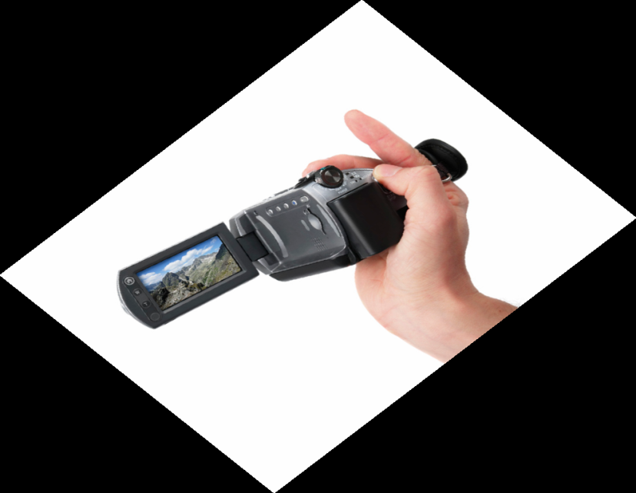
The ASSET Project: Can Video Enhance the Feedback Experience for Students and Staff?
Dr Anne Crook

Slide 2
Objectives
Provide a brief overview of feedback issues at the UoR
Outline the case for using video feedback
Illustrate the ‘ASSET’ pilot resource
Show the results of the video feedback pilot study
Discuss project approaches

Slide 3
“Why bother, they’re only interested in the grade”
“They don’t ever read it or listen to what I’m saying”
“I don’t get feedback in time”
“What does it mean?”
“They expect feedback the next day!”
“It’s just so time consuming”
“It’s not very helpful”
“I wish they’d ask me if they don’t understand”
“I can’t even read the handwriting”
“I’m always saying the same things…”
“I wish they’d see beyond the grade”

Slide 4
Feedback Challenges
Getting staff to provide consistently high quality feedback
FEED-FORWARD
Improving timeliness of feedback
Student engagement with feedback
Recognise the range of feedback
www.rdg.ac.uk/engageinfeedback

Slide 5
The ASSET Project
Explore & evaluate the use of video for providing timely, quality feedback: Web 2.0 resource, ‘ASSET’
Encourage deeper engagement with ‘feed-forward’
Enhance the feedback experience for staff & students
Pilot with generic feedback
Longer-term sustainability: embed within VLE
Notes:
AC
JISC-funded, 18-month project; UoR led with Staffs, Plymouth and HEA Bioscience as partners.
Pedagogic project and NOT a technical project per se.
ASSET was used for the first time this academic year; used proprietary software to explore the use of video as a medium for providing, in the first instance, generic feedback to students.
Law, Fine Art, Applied Language Studies, Chemistry, Food Bioscience & Pharmacy, International Foundation Programme, Real Estate and Planning
Working closely with RUSU

Slide 6
Our Rationale for Using Video Feedback
Support rapid feedback to students (esp. generic to large gps)
Motivate students: expression & tone (distance learners)
Encourage dialogue
Accommodate different learning styles
Can say a lot within a short space of time
Overcome common issues, e.g. illegible handwriting
Feedback can be accessed anytime, anywhere and replayed

Slide 7
Why Use Video for Feedback?
Professor Stephen Gomez (University of Plymouth)
Sorry, the video is not available
7
Notes:
7

Slide 8
Methodology
Review of appropriate technologies: pedagogic focus
Pre-use staff & student questionnaires
Access to ASSET resource
Staff given ‘free-reign’
Complement existing feedback methods
Generic feedback as initial focus
Web cams, ‘Flip’ videos and camcorder
Post-use staff & student questionnaires, interviews and focus groups

Slide 9
‘ASSET’ in Practice
Staff set assignment
Staff record brief video to support assignment
Students view video & can store it in their own playlist
Students hand in assignment
Staff record video with feedback on assignment (feed forward)
Students view feedback video & can share their comments online with peers & staff

Slide 11
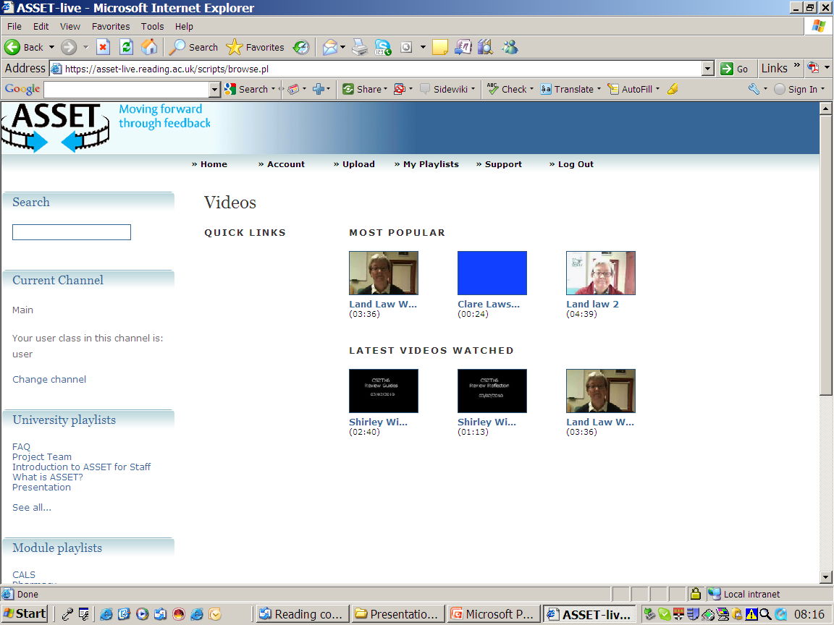

Slide 12
Evaluating The Use of Video Feedback
How did staff make use of video to provide feedback?
Did video have an impact on staff time (efficiency) and ability to provide timely feedback to students?
Did video impact on the quality of feedback?
Any evidence that the use of video changed students’ levels of engagement with feedback?

Slide 13
Results: Staff
Pre-ASSET
58% (N=27) spend 10-30% week providing feedback
Written feedback the most common method
Student engagement seen as the biggest challenge
No prior experience of video feedback
Hopes
More creative and engaging
New way to articulate assessment criteria
Make feedback clearer and more accessible
Exciting supplement to other feedback

Slide 14
Results: Staff
Post-ASSET
Most used “talking head” or screen-capture videos
Useful for focussing on assessment criteria & ‘feed-forward’
<30 mins/video and no longer than previous feedback methods
87% believed students took more notice of video feedback
Likes & Dislikes
Added value: stress key points; more informal; overcomes issues with written feedback; 24/7 accessibility; large groups
Not time-saving (esp. at start)
Still have to encourage students to view videos

Slide 15
Dr Orla Kennedy Sorry, the video is not available

Slide 16
Results: Staff
“Opened up my mind to alternative forms of feedback”
“Made me think about the piece of work in detail before recording the feedback”
“I have probably given more detailed feedback this year”

Slide 17
Results: Students
Pre-ASSET
91% (N=287) only experienced “traditional” feedback
50% mostly/always have assessment criteria
61% stated feedback helps work more effectively
49% students said feedback makes it clear how to improve
Preference for 1:1 feedback
82% liked the idea of receiving video feedback

Slide 18
Results: Students
Post-ASSET
72% (N=105) liked the feedback videos
60% students said it encouraged them to take more notice of the feedback: more engaging, informative & clearer
61% watched the videos more than once
80% would like staff to continue using video feedback
Likes & Dislikes
More detailed feedback, accessibility, clarity, more engaging, re-playable
Impersonal: couldn’t ask questions

Slide 19
Student Results
“It was easier to gauge the reaction and emphasis of a lecturer by watching a video than it was through written feedback”
“Watching and listening to someone speak says more that reading feedback ”
“Would much prefer to receive feedback in person. Video feedback seems impersonal”
“One-to-one feedback is easier if you have questions, you can get answers straight away”

Slide 20
Sustainability
Proprietary software (‘CORE’) initially used to pilot the use of video for feedback: not sustainable
Created ‘video drop box’ facility within the University’s VLE, Blackboard (http://www.reading.ac.uk/videofeedback/VideoDrop-box/asset-VideoDropbox.aspx)

Slide 21
Our Experience
Need to identify and work to encourage effective ‘champions’
Support at the highest levels: PVC T&L, Head of IT etc.
Video streaming not always straightforward
Don’t bombard staff with technical jargon/“video regulations”
Consider sustainability issues at the start

Slide 22
Publications
The use of video technology for providing feedback to students: Can it enhance the feedback experience for staff and students? Computers in Education Vo. 58(1): 386-396 (2012)
http://www.sciencedirect.com/science/article/pii/S036013151100203X
Moving feedback forward: theory to practice. Assessment and Evaluation in Higher Education (in press).
Notes:
Computers in Education vol. 58(1): 386-396 (January 2012).
Assessment and Evaluation in HE: feedback issues, importance of staff/student feedback dialogue and a framework for putting feedback theory into practice (GOALS: Grasping the objectives or purpose for learning; Orientate the student to ‘self’; Actions required to provide dialogue opportunities and enhance self-regulation; Learning evaluation opportunities; Strategies for moving on).

Slide 23
Project Website www.reading.ac.uk/videofeedback
Media-enhanced case studies

Slide 24
Engage for Learning
Interactive resources for students and staff
The three new ‘Engage’ resources were produced by the University of Reading's Centre for Excellence in Teaching and Learning in Applied Undergraduate Research Skills (CETL-AURS) and their Centre for the Development of Teaching and Learning. The aim was to create resources for staff and students that would be :
Comprehensive
Practical
Interactive
Evidence-based
Peer-reviewed
Open access
The Engage Resources
Engage in Research
Interactive resource for life science students
Designed to engage undergraduate life science students in developing their research skills
Provides advice and assistance on the most important aspects of scientific research
Includes comprehensive links and references covering different aspects of scientific research
Offers step-by-step guidance from scientific writing to data analysis
Includes worked examples, formative case studies, help sheets and quick quizzes
Available now:
Engage in Feedback
Improving feedback provision
to students
Designed for staff to enhance feedback provision to students
Includes strategies and methods to enhance the effectiveness of feedback/feed-forward
Showcases good practice using different feedback approaches
Includes evidence-based case studies and quick tips
Downloadable tools available, including a customisable ‘Feedback Audit Tool’
Available now:
Engage in Assessment
Enhancing approaches to assessment
Supports staff in enhancing practices from assessment design to implementation
Showcases a wide range of assessment types and approaches
Offers generic and subject-specific resources across a range of assessment topics
Includes video and audio files of staff sharing their assessment experiences and advice
Provides practical support and troubleshooting tips
Available October 2011:
www.engageinresearch.ac.uk
www.reading.ac.uk/engageinfeedback
www.reading.ac.uk/engageinassessment
Contact information: Centre for the Development of Teaching and Learning, University of Reading, Whiteknights, Reading, RG6 6AB.
Email: Professor Julian Park j.r.park@reading.ac.uk Dr Anne Crook a.c.crook@reading.ac.uk

Slide 25
Contacts and Links
Dr Anne Crook a.c.crook@rdg.ac.uk
Prof. Julian Park j.r.park@rdg.ac.uk
Video Feedback www.reading.ac.uk/videofeedback
Engage in Feedback www.reading.ac.uk/engageinfeedback
Engage in Assessment www.reading.ac.uk/engageinassessment
(launch date Autumn Term 2011)

