Slide 1
Could the UK government go bust?
Dr John Gathergood
School of Economics
University of Nottingham

Slide 2
This Lecture
UK confronted by global economic crisis
New financial pressures on the economy
  Households face unemployment, falling wages, lack of access to credit
  Firms face lower demand, higher cost of debt
  Government faces lower tax revenues, higher welfare bills

Slide 3
This Lecture
Pressure may be too much to bear
Some economic agents ‘go bust’
  Households who cannot pay their debts may suffer personal insolvency (bankruptcy, IVA etc..)
  Firms who cannot pay their debts may go into administration and liquidation
  Why can’t governments who can’t pay their debts go bust as well?

Slide 4




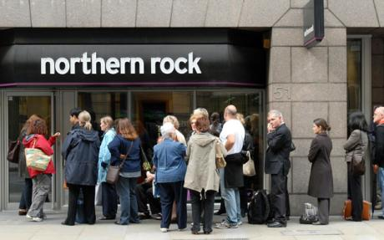

Slide 5


Slide 6


Slide 7


Slide 8
The Problem
Governments, like households or firms have unsustainable debts
Struggling under burden of interest costs and difficulty financing their debt
Greece: bailed-out by EU / IMF
UK: arguably in a worse position than Greece
  Could the UK Government go bust?

Slide 9
Theory I
Governments have a budget:
  They have a source of income (e.g. tax revenue)
  They spend this on services for the country (e.g. on the NHS) and transfers (e.g. benefits)
  i.e. Income = Expenditure
  In this model, there is no government borrowing
Tax Revenue = Government Spending + Government Transfers

Slide 10
Theory II
Governments can get into debt:
  If they want expenditure > income, can borrow
  This isn’t free: debt has to be paid back and interest has to be paid on outstanding debt
Tax Revenue = Government Spending + Government Transfers
Tax Revenue + Net Saving / Borrowing = Government Spending + Government Transfers + Interest on Debt

Slide 11
Theory III
If government expenditure is more than income, it is running a deficit
Outstanding money owed by government is known as government debt
DEFICIT
DEBT
Tax Revenue + Net Saving / Borrowing = Government Spending + Government Transfers + Interest on Debt

Slide 12
The Financial Crisis I
Before the crisis, most Western Nations were running a deficit
  Governments spending more than their income
  In U.K., used to increase spending on NHS, education, welfare benefits
Plus most nations had positive outstanding debt
  U.K. approximately 40% GDP (i.e. Income)

Slide 13
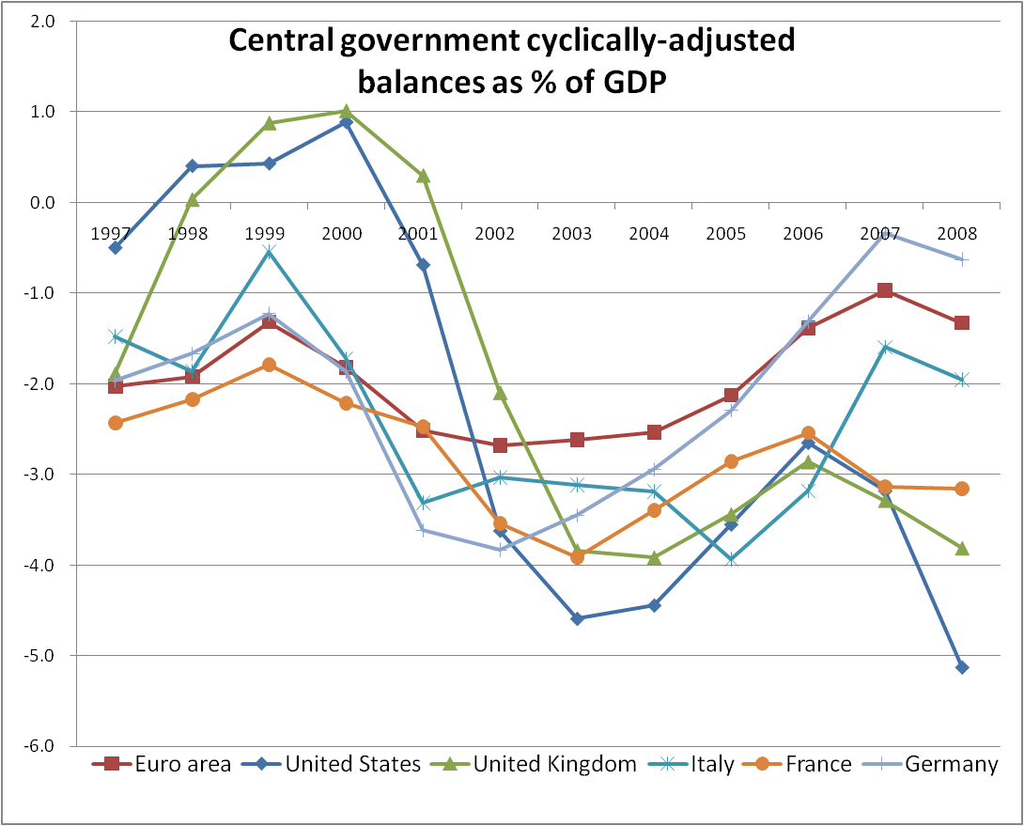
Central Government Budget Balances
as % of GDP, 1997 - 2008

Slide 14
The Financial Crisis II
Financial Crisis and Great Recession
  Government tax revenues fell – e.g. rising unemployment means fewer people pay tax
  Government spending increased – e.g. cost of bank bailouts (RBS, Northern Rock etc..), cost of welfare benefits, such as unemployment benefit
  Government DEFICIT increases, adding more DEBT, how much debt is too much?

Slide 15
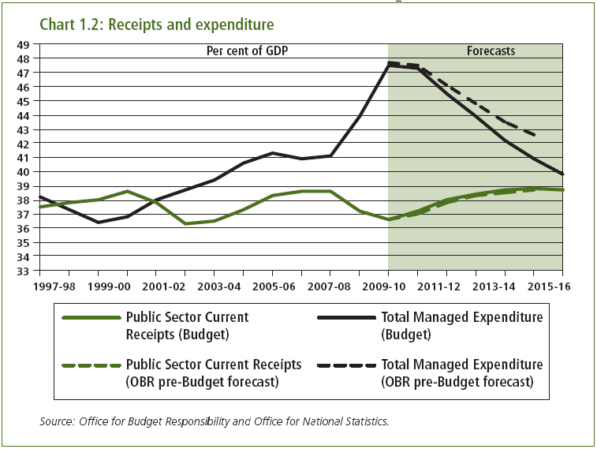

Slide 16
Change in Government Budget Balance, 2008 - 2010

Slide 18
Too Much Debt
At some point, government debt becomes unsustainable
  So much debt that interest costs are more than the government can afford
  Investors lose confidence that government will be able to repay
  Refuse to buy government debt / demand very high interest rates (this hasn’t happened, yet)

Slide 19
Cost of Servicing U.K. Government Debt, 1975 - 2015

Slide 20
Government Debt Crisis
If government cannot afford interest payments / sell new debt, drastic action
  Tax increases to raise government income
  Spending cuts to reduce expenditure
U.K. Emergency Budget June 2010
  Tax increases (V.A.T. increased, National Insurance raised, 50p tax rate)
  Spending cuts (25% reduction in spending in non-health / foreign aid budgets)

Slide 22
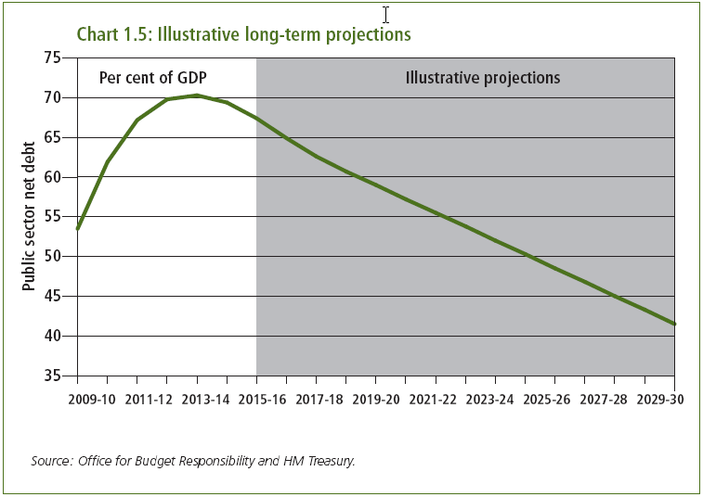

Slide 23
Worst Case Scenario
U.K. looks set to avoid ‘debt default’
  Unable to pay interest / unable to sell new debt
In worst case ‘default’ scenario would have to:
  Massively cut spending / increase taxation
  Seek loan from another county (e.g. EU, IMF, U.S.)
  Sell assets owned by the U.K. government

Slide 24
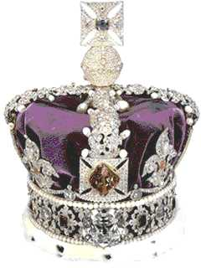

Gibraltar, £100bn?
Crown Jewels, £20bn?

Slide 25
Is This Likely?
U.K.’s credit rating (creditworthiness) is strong:
  Remains ‘AAA’, best possible: Spain ‘AA’, Italy ‘A+’, Portugal ‘A-’
Cost of insuring U.K. debt low (CDS margin):
  the UK’s premium has fluctuated: in Feb 2009 it was 164 basis points but today is 80bp
  Greece & Ireland 280bp, Italy 180bp, UK is bracketed with Spain, Austria, Portugal. By comparison, France is 60bp, Germany 50bp.

Slide 26
Could the U.K. Government go bust?
Yes, technically it could
  In much the same way as households or firms become insolvent
Financial crisis stressing government finances
  Highest-ever post-war debt
  But interest costs are low
  And new budget should reduce deficit / debt
  U.K. government could go bust, but not this time

Slide 27
