Slide 1
Leverhulme Centre Schools Conference 2010
Trade and the Environment
Dr. Tim Lloyd
Associate Professor
School of Economics

Slide 2
Introduction
We are in a critical time in history
Growth vs. Environment
Not a case of one or the other . . . we must have both
Far from being ‘agent of disaster’ . . . international trade holds the key

Slide 3
In today’s lecture . . .
The Growth vs Environment debate
Trade is a powerful force
The scenarios : Growth & Environment
Global Warming

Slide 4
In today’s lecture . . .
Audience Response technology
You press buttons on keepad
It graphs results in real time
It’s your last response that counts

Slide 5
Is this your first visit to a university?
Yes
No
0

Slide 6
Are you . . . .
Male
Female
0

Slide 7
What school are you from?
Nottingham High School
Ecclesbourne School
Oakham School
KE VII, Melton Mowbray
Arnold Hill School
QEGS, Lincs
0

Slide 8
Trade & Economic Growth
Most economists agree . . .
trade is ‘good’ and free trade is better.
Consumption higher than without trade
Both trading parties benefit

Slide 9
Trade & Economic Growth
Some environmentalists retort . . .
trade is bad for the environment and free trade is even worse.
Trade encourages greater pollution
Resource exploitation
Destruction of wildlife & habitats
Global warming

Slide 10
Trade & Economic Growth
The debate is one of the most contentious issues of our time
Polarisation of views
Resolution needs understanding of the problems and opportunities

Slide 11
Economists can play a role
We understand the ‘trade-offs’
Growth vs environment
We understand Markets
Market failure
We understand property rights
Consequences of lack of ownership

Slide 12
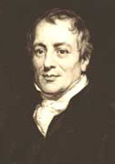
Why does trade make us richer?
‘Comparative advantage’
‘Engine of trade’
Logic underlying all exchange
Individuals . . firms . . Countries
David Ricardo (1817)
England (wool) Portugal (wine)
Forces are everywhere and awesome
. . . even in some unexpected places

Slide 13

Where did all the Neanderthals go?
Neanderthal
Existed for 250,000 years
Became extinct ~35,000 BC
Wars/disease not responsible
Perpetrator none other than . . .

Slide 14
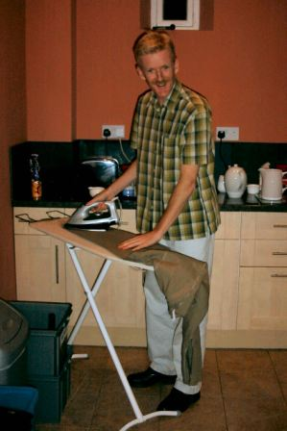
Where did all the Neanderthals go?
Neanderthal
Modern Man
Grrrrrr!

Slide 15
Where did all the Neanderthals go?
Homo Sapiens had a special weapon . . .
social interaction
This gave them the evolutionary edge
Homo Sapiens were weaker but by specialisation and trade their calorific intake & fertility was higher
Survival of smartest
Modern Man

Slide 16
But what of today’s humans (us)?
Will the same forces lead to:
Resource exploitation
Environmental degradation
Eventual ecological catastrophe
Is the ‘Doomsday scenario’ inevitable ?

Slide 17
The Doomsday Scenario
End of the World
Pollution
Per capita
Economic growth causes
environmental degradation
Economic Activity per capita

Slide 18
But why do we go on polluting ?
Because no one owns the environment
No one has ‘property rights’ over it
It is free to everyone
Thus used as if it’s price is zero
Over-use/degradation of environment
Is there anything we can do?

Slide 19
An Alternative Scenario . . .
Pollution
Per capita
End of
the World
Industrialisation
Services
Demand for
environmental quality
Poverty
alleviation
Tougher standards
Green technologies
Economic Activity per capita

Slide 20
Environmental Kuznets Curve
EKC Hypothesis:
“as per capita incomes rise , pollution will initially rise, reach a turning point and then fall”
‘n’ shaped (‘Kuznets’) relationship
So-called after the famous economist who found same ‘n’ shaped relationship between income and income inequality

Slide 21
Empirical Evidence of EKC?
Turning point varies by pollutant
Air quality ~$11,000/capita
Water quality ~$15,000/capita

Slide 22
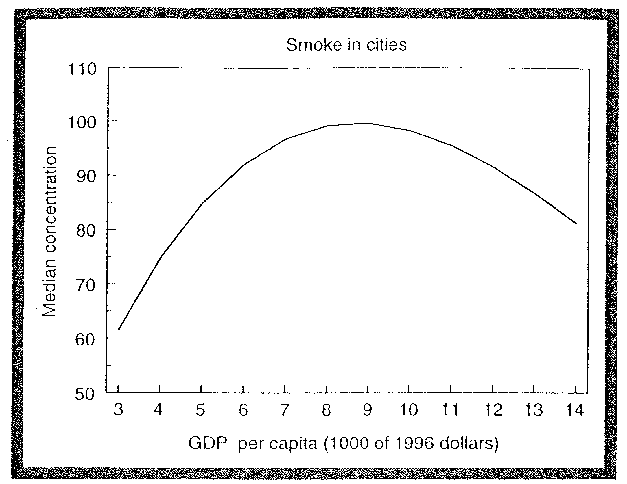
The EKC for US Air Quality
Turning point
$9,000

Slide 23
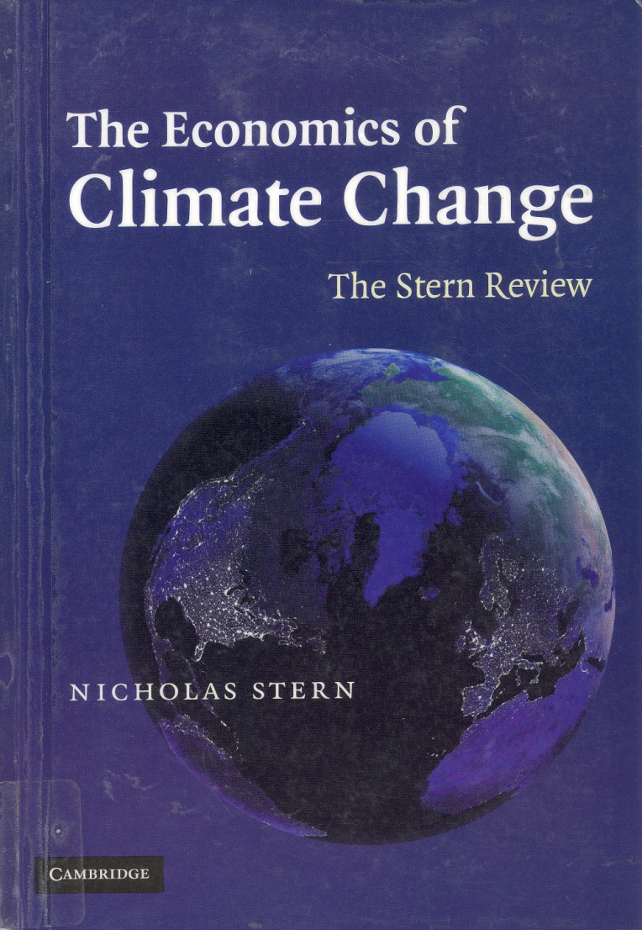
And what of Global Warming?
Stern Review (2006) stark warning
CO₂ turning point ~$50,000/capita
Turning point will not be reached until 2050

Slide 24
An Invisible Threat
Current trends: 2-3 ºc rise by 2050
200m people displaced
Rising sea levels
Aridity
Threat of resource wars (water)
<40% species extinction
Malnutrition, disease

Slide 25
Sleep walking in to Catastrophe
Why aren’t we abating CO₂ more?
CO₂
Only recognised as pollutant 1980s
Long lag between cause & effect
‘Non-point pollutant’
Initial uncertainty about human cause
Nobody ‘owns’ the environment
Hence no ‘sellers’ and the market fails to emerge

Slide 26
How can we stop it?
Not easy to assign ‘ownership’ of environment (to who?)
But we can create markets
Pollution permits are traded
Carbon taxes are levied
Raises the price of using environment
To reflect its value to us and future generations
Who better to do this than . . .
World Trade Organisation (WTO)

Slide 27
Four Important Messages
Growth need not be harmful to environment
Global warming - a new kind of threat
Trade & its governance offer mechanism for sustainable growth
Co-ordinated action required (carbon taxes, pollution permits)
World Trade Organisation
Economist have a role to play . . . and can make a difference

Slide 28
When Was David Ricardo born?
1772
1790
1823
0

Slide 29
When did Neanderthals become extinct?
250,000 BC
50,000 BC
35,000 BC
0

Slide 30
Team Scores: Half time
160 | Ecclesbourne School
140 | QEGS, Lincs
120 | KE VII, Melton Mowbray
96.67 | Nottingham High School
86.13 | Oakham School
77.78 | Arnold Hill School

Slide 31
What shape is the Environmental Kuznets Curve?
‘s’ shaped
‘L’ Shaped
‘n’ shaped
0

Slide 32
What is the rise in temperature predicted by the Stern Review by 2050?
1-2 °c
2-3 °c
3-4 °c
0

Slide 33
Team Scores: Final Results
346.19 | Ecclesbourne School
340 | QEGS, Lincs
320 | KE VII, Melton Mowbray
277.92 | Nottingham High School
263.59 | Oakham School
233.33 | Arnold Hill School

Slide 34
And finally . . .
Thanks for taking part!

Slide 35
Further reading
Horan, R., E. Bulte and J. Shrogen (2005) ‘How Trade Saved Humanity from Biological Exclusion: An Economic Theory of Neanderthal Extinction’ Journal of Economic Behaviour and Organisation, 58:1-29.
Copeland, B.R. and S.M. Taylor (2003) Trade, Growth and the Environment: Theory and Evidence. Princeton, NJ, Princeton University Press.
Grossman, G. and A. Krueger (1995) ‘Economic Growth and the Environment’, Quarterly Journal of Economics, 110: 353-377.

