Slide 1
Entrepreneurship and Tax Policy
Richard Kneller
University of Nottingham
Financial support from the ESRC under project no. RES-194-23-0003 is gratefully acknowledged.

Slide 2
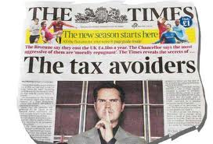
Jimmy Carr is not a tax dodger
Richard Kneller
University of Nottingham
Financial support from the ESRC under project no. RES-194-23-0003 is gratefully acknowledged.

Slide 3

What sort of entrepreneur are you?
The Apprentice

Slide 4
Every Dot represent one firm
Every year some of the firms will die and be replaced by new coloured firms
Pick a dot
How long does your firm survive?
Industry A

Slide 21
Industry B

Slide 38
Which do you prefer?
Industry A
Industry B

Slide 39
Which scenario do you prefer?
Case 1
  5% chance of earning £1,00,000
  95% chance of earning £20,000
Case 2
  50% chance of earning £40,000
  50% chance of earning £98,000
  In both cases on average you could expect to earn £69,000

Slide 40
Which do you prefer?
Case 1
Case 2

Slide 41
What sort of entrepreneur are you?
Entrepreneur #1 Industry A Case 1 | Entrepreneur #2 Industry A Case 2
Entrepreneur #3 Industry B Case 1 | Entrepreneur #4 Industry B Case 2

Slide 42
What sort of entrepreneur are you?
Industry A and Case 1 (5% chance of £1million, 95% chance of £20,000)
  Lots of entry & exit - low start up costs
  Large variance of returns- high growth emerging market

Slide 43
Entrepreneurship across UK industries
Average entry rate=10.6%
Average exit rate = 10.6%
45⁰
Net exit
High entry/exit
Net entry
Positive Correlation
Low entry/exit

Slide 44
What sort of entrepreneur are you?
Industry A and Case 1 (5% chance of £1million, 95% chance of £20,000)
  Lots of entry & exit - low start up costs
  Large variance of returns- high growth emerging market

Slide 46

What sort of entrepreneur are you?
Industry A and Case 1 (5% chance of £1million, 95% chance of £20,000)
  Lots of entry & exit - low start up costs
  Large variance of returns- high growth emerging market
Angry birds

Slide 47
What sort of entrepreneur are you?
Industry A and Case 2 (50% chance of £40,000, 50% chance of £98,000)
  Lots of entry & exit - low start up costs
  Low variance of returns- mature market

Slide 49
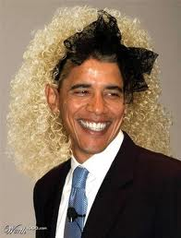
What sort of entrepreneur are you?
Industry A and Case 2 (50% chance of £40,000, 50% chance of £98,000)
  Lots of entry & exit - low start up costs
  Low variance of returns- mature market
Perms’r’us

Slide 50
What sort of entrepreneur are you?
Industry B and Case 1 (5% chance of £1million, 95% chance of £20,000)
  Little entry & exit - high start up costs
  Large variance of returns- high growth emerging market

Slide 52
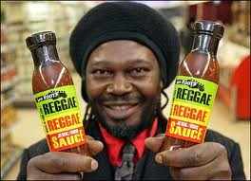
What sort of entrepreneur are you?
Industry B and Case 1 (5% chance of £1million, 95% chance of £20,000)
  Little entry & exit - high start up costs
  Large variance of returns- high growth emerging market
Reggae
Reggae

Slide 53
What sort of entrepreneur are you?
Industry B and Case 2 (50% chance of £40,000, 50% chance of £98,000)
  Little entry & exit - high start up costs
  Low variance of returns- mature market

Slide 55
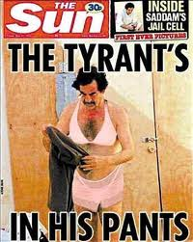
What sort of entrepreneur are you?
Industry B and Case 2 (50% chance of £40,000, 50% chance of £98,000)
  Little entry & exit - high start up costs
  Low variance of returns- mature market
Pants

Slide 56
Can governments affect entrepreneurship?
Consider the role of tax policy (income taxes)
  Can taxes make you entrepreneurial?
  What happens when tax rates change?

Slide 57
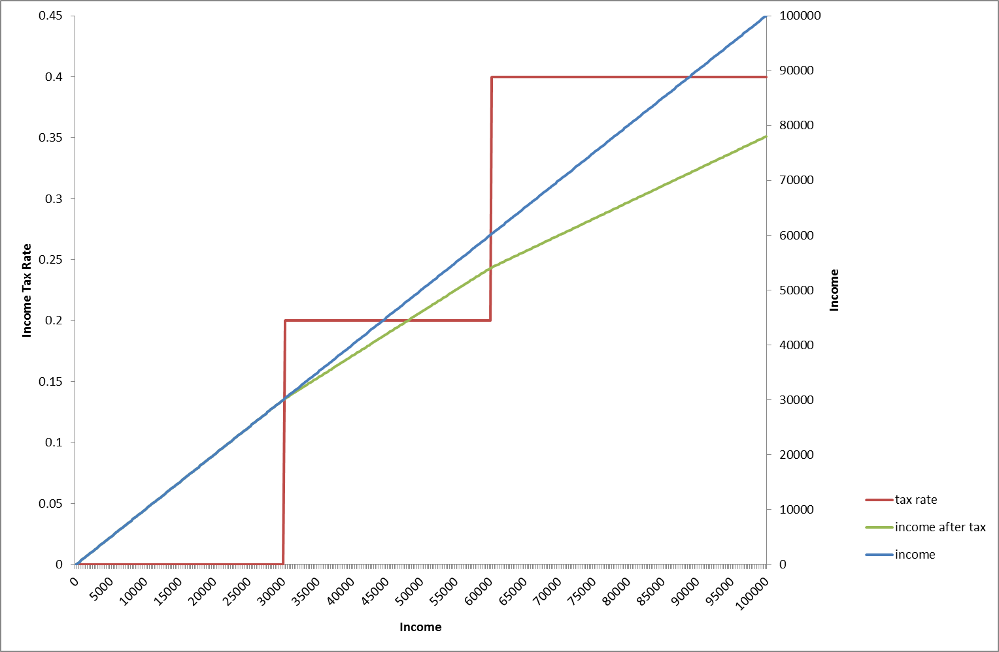
Income and Income Taxation

Slide 58
Employment or self-employment?
 | employment | self-employment
probability | 1 | 0.5 | 0.5
income | £45,000 | 20,000 | 70,000 | £45,000
50% chance of £20,000 and 50% chance of £70,000
Expected income the same

Slide 59
Employment or self-employment?
 | employment | self-employment
probability | 1 | 0.5 | 0.5
income | £45,000 | 20,000 | 70,000 | £45,000
Income after tax | £42,000 | 20,000 | 60,000 | £40,000
Expected income different

Slide 60
Employment or self-employment?
If top tax rate was 60% (instead of 40%)
 | employment | self-employment
probability | 1 | 0.5 | 0.5
income | £45,000 | 20,000 | 70,000 | £45,000
Income after tax | £42,000 | 20,000 | 58,000 | £39,000
UK more entrepreneurial than Belgium because top tax rates are lower

Slide 61
UK more entrepreneurial than Belgium

Slide 62
Can governments affect entrepreneurship?
Consider the role of tax policy (income taxes)
  Can taxes make you entrepreneurial?
  What happens when tax rates change?

Slide 63
Employment or self-employment?
What happens when taxes increase?
 | employment | self-employment
probability | 1 | 0.5 | 0.5
income | £45,000 | 20,000 | 70,000 | £45,000
Income after tax | £42,000 | 20,000 | 60,000 | £40,000

Slide 64
Employment or self-employment?
If top tax rate increases to 60% (from 40%)
 | employment | self-employment
probability | 1 | 0.5 | 0.5
income | £45,000 | 20,000 | 70,000 | £45,000
Income after tax | £42,000 | 20,000 | 58,000 | £39,000
If top tax rate increases then prefer employment (entrepreneurship goes down)

Slide 65
Employment or self-employment?
 | employment | self-employment
probability | 1 | 0.5 | 0.5
income | £45,000 | 20,000 | 70,000 | £45,000
Income after tax | £42,000 | 20,000 | 60,000 | £40,000
Self-employment provides an opportunity to affect tax rate through legal (tax allowances) and illegal means

Slide 66
Employment or self-employment?
 | employment | self-employment
probability | 1 | 0.5 | 0.5
income | £45,000 | 20,000 | 70,000 | £45,000
Declared income | £45,000 | 20,000 | 50,000
Income after paying tax | £42,000 | 20,000 | 68,000 | £44,000
High tax rates are an incentive to under-declare income. So as taxes go up so should entrepreneurship

Slide 67
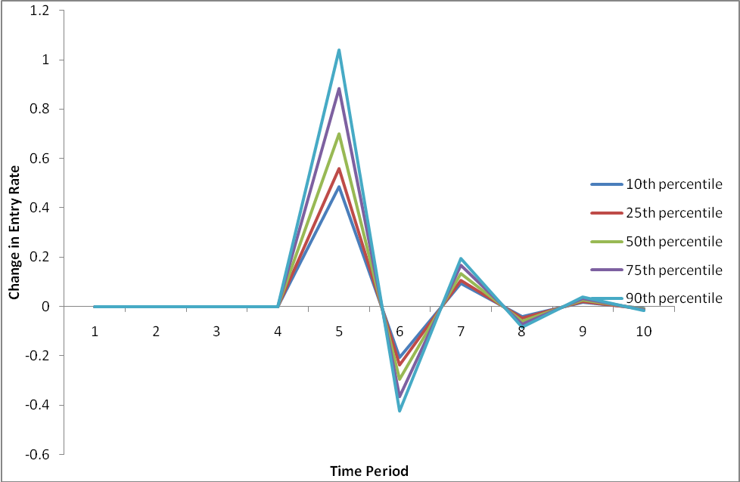
Increase in top personal income tax rate
More choose to become entrepreneurs
The effect lasts for 2-3 years
Means few thousand extra firms (out of 1.5 million)
Change of -2.4% in p. income tax rate

Slide 68
Summary
Entrepreneurship is an alternative to unemployment and helps improve economic growth
Entry and exit are a measure of entrepreneurship
There are large differences in entry-exit rates across sectors
The decision to become an entrepreneur is affected by tax policy
Individuals respond to the incentives presented to them
Jimmy Carr is not a tax dodger
……he’s an entrepreneur

Slide 69
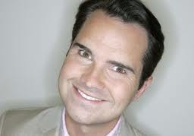
The End

Slide 70
Across time entry/exit is quite stable
Hotels and Restaurants

Slide 71
Across time entry/exit is quite stable

