Slide 1
David Greenaway’s Contribution to International Economics
Peter Egger (ETH Zurich)
Chris Milner (University of Nottingham)

Slide 2
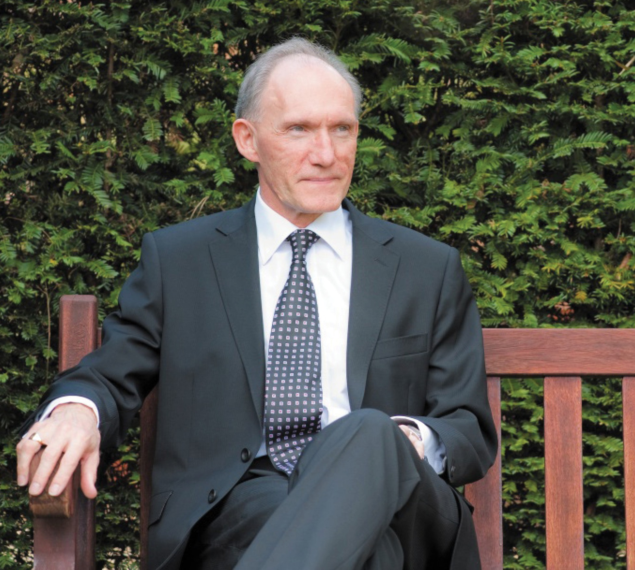

Slide 3
Academic Career
Started in 1975
Professor of Economics at University of Nottingham since 1987
Head of School, Director of CREDIT and GEP, Dean, Pro-Vice Chancellor on route to Vice-Chancellor at Nottingham
Numerous editorial and scientific advisory appointments, including Associate Editor (Economic Journal) and Managing Editor (The World Economy)

Slide 5
Research : Some Numbers
Authored or co-authored over 150 papers in leading peer-reviewed journals
Authored, co-authored or edited over 40 books
Contributed about 70 papers to edited volumes
Individually or jointly involved in the generation of over £7 million of research income
Supervised and externally examined large numbers of research students

Slide 6
Areas of Contribution
Intra-industry trade
Trade and growth/development
Costs of protection
Firm exporting and productivity
FDI and knowledge spillovers
Globalisation and labour market adjustment

Slide 7
Citations
Over 16,000 total citations recorded in Google Scholar (as of May, 2015)
Including over 50 papers with over 100 citations
An overall h-index of 59, and 38 since 2009 (up to October, 2014)
Top 20 cited papers include papers in the Economic Journal, Journal of International Economics, Journal of Development Economics, Review of International Economics, World Bank Research Observer, and European Economic Review

Slide 8
Service to Economics Profession
Member of:
3 UK Research Assessment (RAE) Panels, twice as Chair
UK’s Economic and Social Research Council (ESRC) Council
Council and Executive of the Royal Economic Society
UK’s Technology Foresight Panel

Slide 9
Policy Advice
Economic advisor and consultant to:
a range of international agencies, including World Bank, WTO, OECD, UNCTAD, UNIDO and Commonwealth Secretariat
a number of national governments in Asia, Africa and the Caribbean
Report to Secretary of State for Transport on Uninsured Drivers (2006)
Recently appointed to lead a major review of UK postgraduate medical education and training

Slide 10
Wider Public Service
UK’s Armed Forces Pay Review Body
member (1998-2004)
Chair (2004-10)
UK’s Senior Salaries Review Body (2004-10)
Member of Government’s Asia Task Force (2004-14)
Currently Chair of CASE Europe
Board Member of:
Nottingham Health Authority (1994-98)
Nottingham University Hospital Trust (2001-4)

Slide 11
Overall Assessment
Fantastic energy and enterprise
Quick to spot research opportunities
Excellent expositional skills and ability to sell ideas
Competitive, but also a great collaborator and mentor of research
Enjoys economics and working with economists

