Slide 1


ICT and Exporting
The effects of broadband on the extensive margin of business service exports
Richard Kneller and Jonathan Timmis
GEP, University of Nottingham

Slide 2
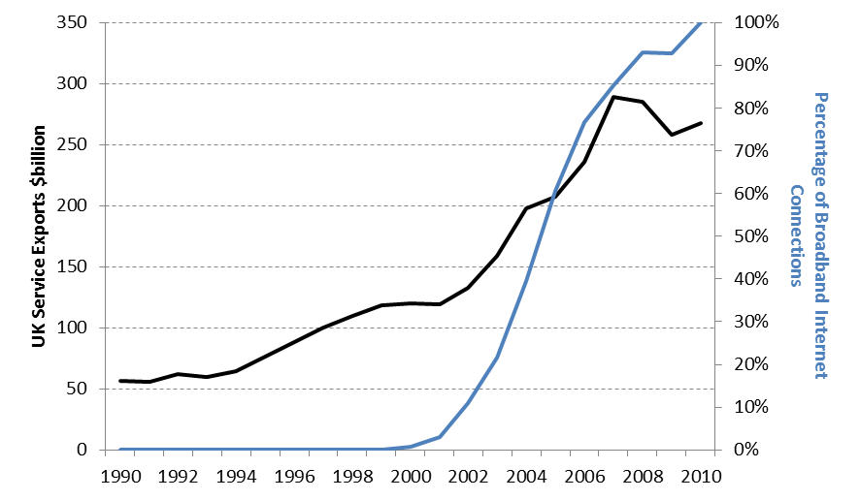
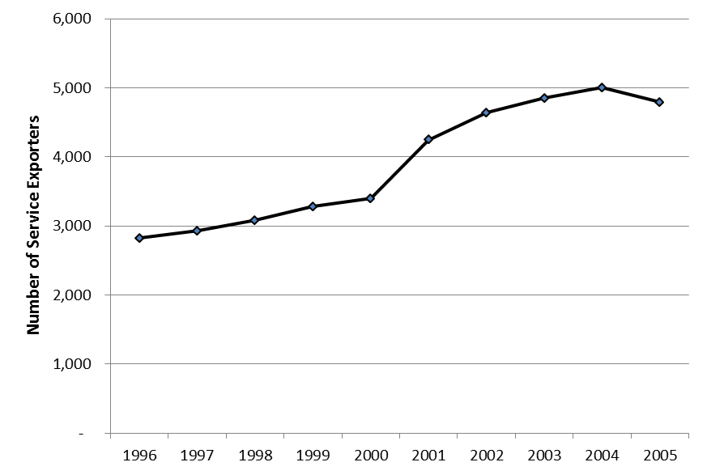
Introduction
UK service exports grew 156% to $228bn in decade to 2008
This coincides with advances in information and communication technologies
Broadband allows for faster & more comprehensive information transmission
Easier to collaborate & coordinate at a distance and therefore purchase and consume many service functions
Likely to be strongest for information intensive services
Can broadband explain the growth of UK service exports trade along its extensive margin?
Trade in Services data used by Breinlich & Criscuolo (2011) combined with other ONS data – ARD, E-commerce

Slide 3
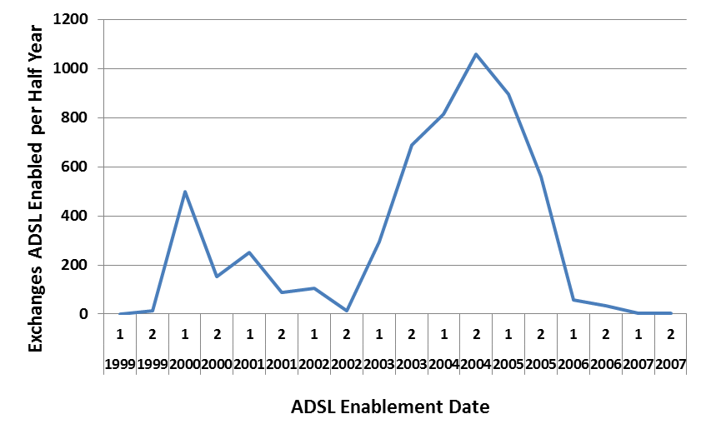
Concerned by endogeneity bias
Develop instruments based on telephone network infrastructure
5,630 Telephone exchange in UK
Data on day & location each TE was ADSL enabled & cable distance to the customer
Instrument 1: 0/1 indicator of TE if ADSL enabled if enabled in wave 1
Instrument 2: Local Loop Distance
Sample Restriction
ADSL rollout began 1999 and ended 2007
Pause at end-2002 due to low take-up (call these phase 1 and 2)
Up to this point enablement constrained by availability of BT engineers
20% of TEs enabled by end of 2002
UK telephone network
UK ADSL rollout across time

Slide 4
TEs Enabled by the end of 2002
Exchanges Enabled by the end of 2000
Notes:
EVA530371195

Slide 5
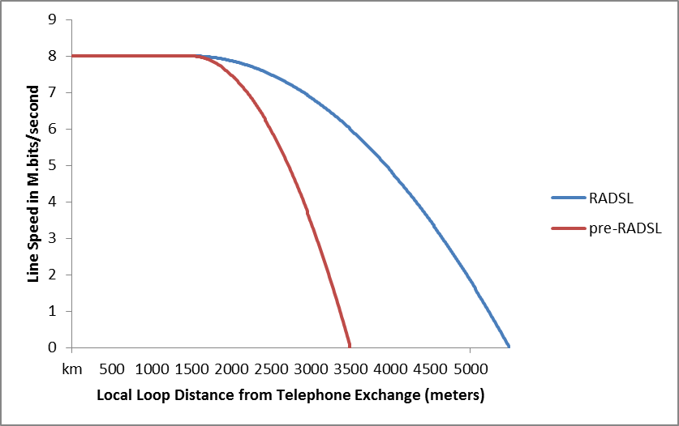
Effect of cable distance on ADSL & RADSL
ADSL is distant dependent
Connection speeds deteriorate for cable-distances >2km.
Maximum distance of 3.5km.
Telephone quality okay up to 16km.
Mid-2001 BT introduces RADSL technology
Boosts connection speed and increases qualifying distance to 5.5km.
Local loop (cable) distances by postcode from PointTopic
Median (25%, 75%, 99%) distance 2.81km (1.93km, 4.05km, 5.89km)
Location of TEs in Nottingham

Slide 6
Do Instruments Matter for Internet Connections?
First stage regressions for broadband use (3787 firm-observations 2000-2002) who were connected to TEs enabled before end-2002
Attached to ADSL enabled TE increases probability by 15%
A firm median cable distance reduces this by 8.5%
Dependent variable: Type of Internet Connection
Internet Technology | Broadband |  | Broadband |  | Narrowband
Sample | Wave 1 Exchanges |  | ADSL Enabled Wave 1 Exchanges |  | Wave 1 Exchanges
ADSL Enabled | 0.173*** | 0.152*** |  |  | -0.165***
 | (0.047) | (0.050) |  |  | -(0.047)
ADSL Enabled *Cable Distance | -0.074*** | -0.083*** | -0.075*** | -0.080*** | 0.091*** | 0.088***
 | (0.024) | (0.026) | (0.024) | (0.027) | -(0.025) | -(0.025)
Firm Controls | Y | Y | Y | Y | Y | Y
Region FE |  | Y |  | Y | Y | Y
2-digit Industry FE |  | Y |  | Y | Y | Y
Year FE | Y | Y | Y | Y | Y | Y
Observations | 3,787 | 3,362 | 3,549 | 3,138 | 3,362 | 3,138

Slide 7
Instrument Validity
Objections to the instrument
  Local loops are not randomly assigned
  Other confounding factors are correlated with service exports other than through broadband adoption
Arguably unobserved geographic & firm factors may be important
Provide evidence for
  Narrowband
  Introduction of RADSL
  Pre-ADSL firm characteristics (data from 1998)
  control for region dummies, no. households, no. businesses
  Add employment as a control variable
  Anticipation Effects
Dependent variable: probability of enablement
Years | 2000 | 2001 | 2002 | 2003 | 2004 | 2005
Dependent Variable | Probability of Firm Exporting
ADSL Enabled *Cable Distance | -0.041 | -0.084** | -0.075** | -0.062*** | -0.027* | -0.001
 | (0.062) | (0.033) | (0.032) | (0.023) | (0.016) | (0.010)
Observations | 501 | 1,650 | 1,398 | 2,264 | 2,627 | 2,662

Slide 8
Main Results: Probability of Exporting
Estimation Method: Sample | OLS: Wave 1 Exchanges |  |  | IV: Wave 1 Exchanges |  |  | IV: Wave 1 Enabled Exchanges
Export Data | ITIS: Total Service Exports | ARD | ITIS: Business Service Exports | ITIS: Total Service Exports | ARD | ITIS: Business Service Exports | ITIS: Total Service Exports | ARD | ITIS: Business Service Exports
Second stage:
Broadband | 0.098*** | 0.072*** | 0.044*** | 0.508* | 0.266 | 0.635** | 0.438 | 0.282 | 0.658**
 | (0.016) | (0.011) | (0.013) | (0.279) | (0.188) | (0.251) | (0.302) | (0.229) | (0.287)
Firm Controls | Y | Y | Y | Y | Y | Y | Y | Y | Y
Reg. & Ind. FE | Y | Y | Y | - | - | - | - | - | -
Year FE | Y | Y | Y | Y | Y | Y | Y | Y | Y
C-D F-stat. |  |  |  | 9.13 | 11.82 | 9.13 | 14.51 | 15.70 | 14.51
K-P F-stat. |  |  |  | 8.03 | 10.21 | 8.03 | 12.42 | 13.23 | 12.42
J Test |  |  |  | 0.55 | 0.92 | 0.94
Observations | 3,362 | 5,146 | 3,362 | 3,362 | 5,140 | 3,362 | 3,138 | 4,720 | 3,138

Slide 9
Robustness: Probability of Exporting
Estimation Method: Sample | IV: Wave 1 Enabled Exchanges
Second Stage:
Broadband | 0.551** | 0.660** | 0.585** | 0.755** | 0.075**
 | (0.251) | (0.331) | (0.271) | (0.343) | (0.03)
No. of Households in Exchange Area |  | -0.004
 |  | (0.015)
No. of Businesses in Exchange Area |  |  | 0.035***
 |  |  | (0.009)
Ln(employment) |  |  |  | -0.046**
 |  |  |  | (0.021)
Cragg-Donald F-statistic | 16.83 | 10.78 | 15.06 | 11.47 | 2442.16
Kleinbergn Paap F-statistic | 14.18 | 9.36 | 12.89 | 9.79 | 10.58
Observations | 3,138 | 3,128 | 3,128 | 3,137 | 725,522

Slide 10
Extension: Firm Intensive Margin
Sample | Wave 1 Exchanges |  | Wave 1 Enabled Exchanges | Wave 1 Exchanges |  | Wave 1 Enabled Exchanges
Estimation Method | OLS | IV |  | OLS | IV
Export Measure | ITIS: Total Service Exports |  |  | ITIS: Business Services Exports
Second Stage:
Broadband | 0.788*** | 13.031** | 8.893** | 0.987*** | 10.762 | 1.425
 | (0.213) | (5.835) | (4.122) | (0.272) | (13.451) | (2.589)
Firm Controls | Y | Y | Y | Y | Y | Y
Region & Ind FE | Y | - | - | Y | - | -
Year FE | Y | Y | Y | Y | Y | Y
C-D F-stat. |  | 4.56 | 7.45 |  | 4.65 | 7.79
K P F-stat. |  | 4.20 | 6.74 |  | 4.43 | 7.20
J Test |  | 0.29 |  |  | 0.10
Observations | 895 | 895 | 825 | 488 | 488 | 450

Slide 11
Discussion & Conclusions
Broadband infrastructure investment a key priority for many governments
This paper considers whether this technology can help to explain the growth of UK service exports
We use an IV approach that uses infrastructure
Find that instruments behave as expected and pass standard tests for instrument validity
Find a strong effect on compliers for the extensive margin of business service exports
Suggests a causal effect in the range of £1.0-£1.4 billion on exports between 2000-2002.

Slide 12
References
Acknowledgements
This work was based on data from the Annual Respondent Database, the E-Commerce and ITIS Database, produced by the Office for National Statistics (ONS) and supplied by the Secure Data Service at the UK Data Archive. The data are Crown Copyright and reproduced with the permission of the controller of HMSO and Queen's Printer for Scotland. The use of the data in this work does not imply the endorsement of ONS or the Secure Data Service at the UK Data Archive in relation to the interpretation or analysis of the data. This work uses research datasets which may not exactly reproduce National Statistics aggregates. In addition this research used data from them ICT Capital Stock Dataset provided by the VML.

