Slide 1
Festschrift Conference in Honour of Professor Sir David Greenaway
Global Engagement and the Occupational Structure of Firms
Carl Davidson, Fredrik Heyman, Steven Matusz, Fredrik Sjöholm, and Susan Chun Zhu
Nottingham Centre for Research on Globalisation and Economic Policy
June 25, 2015

Slide 2
The Question
“[t]he productivity of the firm remains largely a black box and we still have relatively little understanding of the separate roles played by production technology, management practice, firm organization and product attributes towards variation in revenues across firms”
Marc J. Melitz and Stephen J. Redding (2013), Handbook of International Economics

Slide 3
The Question
Exporters differ systematically from non-exporters (bigger, more productive, pay higher wages, more capital intensive)—Bernard and Jensen (JIE 1997) and many others.
Are there also systematic differences in the mix of occupations employed by globally-engaged firms relative to strictly domestic firms?
If so, are there systematic differences between (e.g.) MNEs and exporters?

Slide 4
What We Find
More globalized firms tend to be intensive in the use of more skilled occupations (e.g., managers, scientists, engineers)
One implication is that increased globalization could change relative demand for different occupations, therefore impacting the wage structure

Slide 5
Related Work
Matsuyama (ReStud 2007) Production for export requires “white-collar workers, particularly those with language skills, international business experiences and/or specialists in export finance and maritime insurance.”
Implication: an increase in the world supply of skilled labor will therefore increase the degree of globalization.

Slide 6
Related Work
Caliendo and Rossi-Hansberg (QJE 2012) Firms are hierarchical. Adding a layer increases fixed cost, but reduces marginal cost. Global engagement expands markets, making it worthwhile to add layers.
Guadulupe and Wulf (AEJ Applied 2010) find evidence to the contrary. Trade liberalization associated with flattening of firms.
Our work deals with occupations, not layers. E.g., “manager” is an occupation that can appear in several layers of the firm.

Slide 7
Data
Swedish matched employer-employee data (1997 – 2005) combined with regional labor market statistics
Detailed information on all Swedish firms and about half the Swedish labor force
Includes data on education, demographics, full-time equivalent wages, and occupation (3-digit ISCO-88)
Swedish Foreign Trade Statistics contain firm-level information on imports, exports, and offshoring

Slide 8
Occupation Detail
More than 100 identifiable occupations (International Standard Classification of Occupations—1988)
Some categories have few observations, so merged with others
Result in 100 occupations

Slide 9
Occupation Detail
Rank by skill level in three ways:
Mean occupational wage in 1997.
Mean occupational wage in 1997 excluding wages paid by MNEs.
Mincer regression: regress individual wages against standard independent variables and occupation dummy. Use coefficient of occupation dummy adjusted for median education in that occupation.

Slide 10
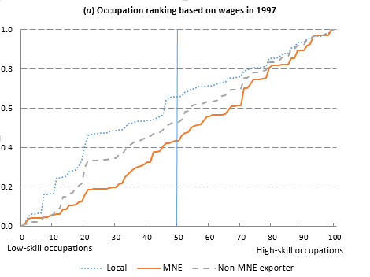
Cumulative Distribution of Employment

Slide 11
Helpman, Melitz, and Yeaple (2004 AER)
Profit
Domestic
Firm-Specific Productivity

Slide 12
Helpman, Melitz, and Yeaple (2004 AER)
Profit
Exporter
Domestic
Firm-Specific Productivity

Slide 13
Helpman, Melitz, and Yeaple (2004 AER)
Profit
MNE
Exporter
Domestic
Firm-Specific Productivity

Slide 14
Helpman, Melitz, and Yeaple (2004 AER)
Profit
MNE
Exporter
Domestic
Firm-Specific Productivity

Slide 15
Fixed and Variable Employment
Employment
Domestic
Exporter
MNE
Variable
Variable
Fixed
Variable
Fixed
40%
Fixed
50%
60%
Firm-Specific Productivity

Slide 16
More Skilled and Less Skilled Occupations
Employment
Domestic
Exporter
MNE
S
U
S
U
S
U
S
U
S
U
40%
S
U
50%
60%
Firm-Specific Productivity

Slide 17
Occupational Shares: Notation
$$λ^{k}\left(q,x\right): occupation k as share of firm^{′}s total employment$$
𝜆^𝑘 (𝑞,𝒙): 𝑜𝑐𝑐𝑢𝑝𝑎𝑡𝑖𝑜𝑛 𝑘 𝑎𝑠 𝑠ℎ𝑎𝑟𝑒 𝑜𝑓 𝑓𝑖𝑟𝑚^′ 𝑠 𝑡𝑜𝑡𝑎𝑙 𝑒𝑚𝑝𝑙𝑜𝑦𝑚𝑒𝑛𝑡
$$λ_{f}^{k}\left(x\right): occupation k as share of fixed employment$$
𝜆_𝑓^𝑘 (𝒙): 𝑜𝑐𝑐𝑢𝑝𝑎𝑡𝑖𝑜𝑛 𝑘 𝑎𝑠 𝑠ℎ𝑎𝑟𝑒 𝑜𝑓 𝑓𝑖𝑥𝑒𝑑 𝑒𝑚𝑝𝑙𝑜𝑦𝑚𝑒𝑛𝑡
$$λ_{v}^{k}\left(x\right): occupation k as share of variable employment$$
𝜆_𝑣^𝑘 (𝒙): 𝑜𝑐𝑐𝑢𝑝𝑎𝑡𝑖𝑜𝑛 𝑘 𝑎𝑠 𝑠ℎ𝑎𝑟𝑒 𝑜𝑓 𝑣𝑎𝑟𝑖𝑎𝑏𝑙𝑒 𝑒𝑚𝑝𝑙𝑜𝑦𝑚𝑒𝑛𝑡
$$Λ_{f}\left(q,x\right): fixed employment as share of total employment$$
Λ_𝑓 (𝑞,𝒙): 𝑓𝑖𝑥𝑒𝑑 𝑒𝑚𝑝𝑙𝑜𝑦𝑚𝑒𝑛𝑡 𝑎𝑠 𝑠ℎ𝑎𝑟𝑒 𝑜𝑓 𝑡𝑜𝑡𝑎𝑙 𝑒𝑚𝑝𝑙𝑜𝑦𝑚𝑒𝑛𝑡

Slide 18
Occupational Shares: Accounting
$$λ^{k}\left(q,x\right)=Λ_{f}\left(q,x\right)λ_{f}^{k}\left(x\right)+\left(1−Λ_{f}\left(q,x\right)\right)λ_{v}^{k}\left(x\right)$$
𝜆^𝑘 (𝑞,𝒙)=Λ_𝑓 (𝑞,𝒙) 𝜆_𝑓^𝑘 (𝒙)+(1−Λ_𝑓 (𝑞,𝒙)) 𝜆_𝑣^𝑘 (𝒙)

Slide 19
Occupational Shares: Accounting
$$λ^{k}\left(q,x\right)=Λ_{f}\left(q,x\right)λ_{f}^{k}\left(x\right)+\left(1−Λ_{f}\left(q,x\right)\right)λ_{v}^{k}\left(x\right)$$
𝜆^𝑘 (𝑞,𝒙)=Λ_𝑓 (𝑞,𝒙) 𝜆_𝑓^𝑘 (𝒙)+(1−Λ_𝑓 (𝑞,𝒙)) 𝜆_𝑣^𝑘 (𝒙)
$$Sign λ^{k}\left(q^{j′},x^{j′}\right)−λ^{k}\left(q^{j},x^{j}\right) for firm j′≠j$$
𝑆𝑖𝑔𝑛 𝜆^𝑘 (𝑞^𝑗′,𝒙^𝑗′ )−𝜆^𝑘 (𝑞^𝑗,𝒙^𝑗 ) 𝑓𝑜𝑟 𝑓𝑖𝑟𝑚 𝑗′≠𝑗

Slide 20
Within and Between Effects
Within: International engagement affects occupational mix within fixed and within variable employment
Between: International engagement affects share of fixed versus variable employment

Slide 21
Assumptions
Fixed employment weakly intensive in use of skilled occupations compared with variable employment

Slide 22
Assumptions
Fixed employment weakly intensive in use of skilled occupations compared with variable employment
All else constant, fixed employment share is highest for multinationals and lowest for strictly domestic firms

Slide 23
Assumptions
Fixed employment weakly intensive in use of skilled occupations compared with variable employment
All else constant, fixed employment share is highest for multinationals and lowest for strictly domestic firms
Within fixed and variable employment, share of more skilled occupations weakly increases with degree of int’l engagement

Slide 24
Assumptions
Productivity differences between firms only affects variable employment, not fixed employment

Slide 25
Assumptions
Productivity differences between firms only affects variable employment, not fixed employment
The share of higher-skilled occupations within fixed and variable employment is weakly increasing in productivity

Slide 26
Key Predictions
Occupational mix increases in skill intensity as firms become more globally engaged
Occupational mix increases in skill intensity as firms become more productive
Occupational mix decreases in skill intensity as firms become larger

Slide 27
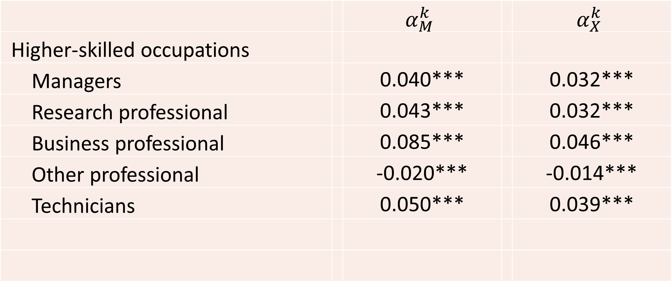
$$λ_{jt}^{k}=α_{M}^{k}M_{jt}+α_{X}^{k}E_{jt}+Z_{jt}γ^{k}+D_{i}^{k}+D_{t}^{k}+ε_{jt}^{k}$$
𝜆_𝑗𝑡^𝑘=𝛼_𝑀^𝑘 𝑀_𝑗𝑡+𝛼_𝑋^𝑘 𝐸_𝑗𝑡+𝑍_𝑗𝑡 𝛾^𝑘+𝐷_𝑖^𝑘+𝐷_𝑡^𝑘+𝜀_𝑗𝑡^𝑘
 |  | $$α_{M}^{k}$$ |  | $$α_{X}^{k}$$
Higher-skilled occupations
Managers |  | 0.040*** |  | 0.032***
Research professional |  | 0.043*** |  | 0.032***
Business professional |  | 0.085*** |  | 0.046***
Other professional |  | -0.020*** |  | -0.014***
Technicians |  | 0.050*** |  | 0.039***

Slide 28
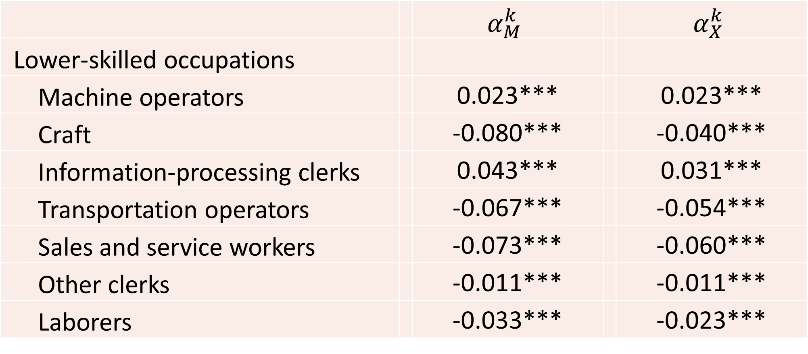
$$λ_{jt}^{k}=α_{M}^{k}M_{jt}+α_{X}^{k}E_{jt}+Z_{jt}γ^{k}+D_{i}^{k}+D_{t}^{k}+ε_{jt}^{k}$$
𝜆_𝑗𝑡^𝑘=𝛼_𝑀^𝑘 𝑀_𝑗𝑡+𝛼_𝑋^𝑘 𝐸_𝑗𝑡+𝑍_𝑗𝑡 𝛾^𝑘+𝐷_𝑖^𝑘+𝐷_𝑡^𝑘+𝜀_𝑗𝑡^𝑘
 |  | $$α_{M}^{k}$$ |  | $$α_{X}^{k}$$
Lower-skilled occupations
Machine operators |  | 0.023*** |  | 0.023***
Craft |  | -0.080*** |  | -0.040***
Information-processing clerks |  | 0.043*** |  | 0.031***
Transportation operators |  | -0.067*** |  | -0.054***
Sales and service workers |  | -0.073*** |  | -0.060***
Other clerks |  | -0.011*** |  | -0.011***
Laborers |  | -0.033*** |  | -0.023***

Slide 29
$$S_{jt}=δ_{M}M_{jt}+δ_{X}E_{jt}+Z_{jt}γ+D_{i}+D_{t}+μ_{jt}$$
𝑆_𝑗𝑡=𝛿_𝑀 𝑀_𝑗𝑡+𝛿_𝑋 𝐸_𝑗𝑡+𝑍_𝑗𝑡 𝛾+𝐷_𝑖+𝐷_𝑡+𝜇_𝑗𝑡
 | Beta ranking | Wage ranking | Non-MNE wage ranking
MNE | 0.106*** | 0.112*** | 0.099***
 | (0.006) | (0.006) | (0.006)
Exporter | 0.079*** | 0.086*** | 0.077***
 | (0.005) | (0.005) | (0.005)
Log firm size | -0.004** | -0.007*** | -0.006***
 | (0.002) | (0.002) | (0.002)

Slide 30
$$S_{jt}=δ_{M}M_{jt}+δ_{X}E_{jt}+Z_{jt}γ+D_{i}+D_{t}+μ_{jt}$$
𝑆_𝑗𝑡=𝛿_𝑀 𝑀_𝑗𝑡+𝛿_𝑋 𝐸_𝑗𝑡+𝑍_𝑗𝑡 𝛾+𝐷_𝑖+𝐷_𝑡+𝜇_𝑗𝑡
 | Beta ranking | Wage ranking | Non-MNE wage ranking
Capital-labor ratio | -0.005*** | -0.004*** | -0.004***
 | (0.001) | (0.001) | (0.001)
VA/employee | 0.043*** | 0.046*** | 0.044***
 | (0.007) | (0.007) | (0.007)
Observations | 25,871 | 25,871 | 25,871
R-squared | 0.359 | 0.402 | 0.395

Slide 31
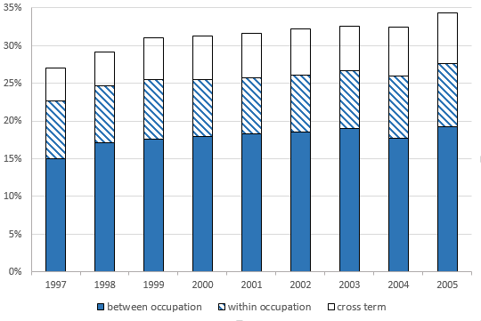
Wage Dispersion and Occupational Mix

Slide 32
Conclusion
Compelling evidence that skill intensity of occupational mix positively related to degree of firm’s global engagement
More skill-intensive occupational mix when exporting to distant markets (not shown in current presentation…see paper)
Cross-firm difference in occupational mix and higher share of skilled workers in high-wage firms account for ≈ 20% overall dispersion

