Slide 1
Wine: IIT in a Globalized Industry
Kym Anderson Wine Economics Research Centre University of Adelaide | Joe Francois World Trade Institute University of Bern
Doug Nelson Murphy Institute Tulane University | Glyn Wittwer Centre for Policy Studies Victoria University

Slide 2
We all know that David has written (a lot) about intra-industry trade
Theory
  Greenaway (1982). “Identifying the Gains from Pure Intra‐Industry Exchange.” Journal of Economic Studies, V.9-#3, 40-54.
  Greenaway, (1985). “Trade in Differentiated Goods and Commercial Policy,” in D. Greenaway ed Current Issues in International Trade Theory and Policy. London: Macmillan, 81-98.
  Greenaway & Milner (1988). “Intra Industry Trade and the Shifting of Protection across Sectors.” European Economic Review, V.32-#4, 927-45.
  Egger, Egger and Greenaway. (2007). “Intra-Industry Trade with Multinational Firms.” European Economic Review, V.51-#8, 1959-84.
  Falvey, Greenaway and Yu. (2011). “Catching up or Pulling Away: Intra-Industry Trade, Productivity Gaps and Heterogeneous Firms.” Open Economies Review, V.22-#1, 17-38.

Slide 3
We all know that David has written (a lot) about intra-industry trade
Methods
  Greenaway & Milner (1981). “Trade Imbalance Effects in the Measurement of Intra-Industry Trade.” Weltwirtschaftliches Archiv, V.117-#4, 756-62.
  Greenaway & Milner (1983). “On the Measurement of Intra-Industry Trade.” The Economic Journal, V.93-#372, 900-08.
  Greenaway (1984). “The Measurement of Product Differentiation in Empirical Studies of Trade Flows,” in H. Kierzkowski ed Monopolistic Competition in International Trade. Oxford: Oxford University Pres, 230-50.
  Greenaway, Hine, Milner & Elliott (1994). “Adjustment and the Measurement of Marginal Intra-Industry Trade.” Weltwirtschaftliches Archiv, V.130-#2, 418-27.
  Greenaway & Milner (2001). “Intra-Industry Foreign Direct Investment and Trade Flows: New Measures of Global Competition,” in L. Cheng and H. Kierzkowski eds, Global Trade and Production in East Asia. Dordrecht: Kluwer, 111-28.

Slide 4
We all know that David has written (a lot) about intra-industry trade
Applications
  Greenaway (1983). “Intra-Industry and Inter-Industry Trade in Switzerland.” Weltwirtschaftliches Archiv, V.119-#1, 109-21.
  Greenaway (1983). “Patterns of Intra-Industry Trade in the UK,” in P. K. M. Tharakan ed Intra-Industry Trade: Empirical and Methodological Issues. Amsterdam: North-Holland, 141-60.
  Drabek & Greenaway (1984). “Economic Integration and Intra-Industry Trade: The EEC and CMEA Compared.” Kyklos, V.37-#3, 444-69.
  (1984). “A Cross Section Analysis of Intra-Industry Trade in the U.K.” European Economic Review, V.25-#3, 319-44.

Slide 5
We all know that David has written (a lot) about intra-industry trade
  Greenaway (1987). “Intra-Industry Trade, Intra-Firm Trade and European Integration: Evidence, Gains and Policy Aspects.” Journal of Common Market Studies, V.26-#2, 153-72.
  Greenaway (1989). “Regional Trading Arrangements and Intra-Industry Trade: Evidence and Policy Issues,” in D. Greenaway, T. Hycak and R. Thornton eds, Economic Aspects of Regional Trading Arrangements. Wheatsheaf Books, 31-42.
  Greenaway & Milner (1989). “The Extent and Consequences of Intra-Industry Trade,” in J. Black and A. I. MacBean eds, The Changing Structure of World Trade. Basil Blackwell, 60-88.
  Cooper, Greenaway & Rayner (1993). “Intra-Industry Trade and Limited Producer Horizons: An Empirical Investigation.” Weltwirtschaftliches Archiv, V.129-#2, 345-66.

Slide 6
We all know that David has written (a lot) about intra-industry trade
  Greenaway & Hine (1991). “Intra-Industry Specialization, Trade Expansion and Adjustment in the European Economic Space.” Journal of Common Market Studies, V.29-#6, 603-22.
  Greenaway, Hine & Milner (1994). “Country-Specific Factors and the Pattern of Horizontal and Vertical Intra-Industry Trade in the UK.” Weltwirtschaftliches Archiv, V.130-#1, 77-100.
  Greenaway, Hine & Milner (1995). “Vertical and Horizontal Intra-Industry Trade: A Cross Industry Analysis for the United Kingdom.” The Economic Journal, V.105-#433, 1505-18.
  Greenaway, Hine & Milner (1998). “Vertical and Horizontal Intra-Industry Trade: An Analysis of Country-and Industry-Specific Determinants,” in M. Brulhart and R. Hine eds, Intra-Industry Trade and Adjustment: The European Experience. London: Macmillan, 70-97.

Slide 7
We all know that David has written (a lot) about intra-industry trade
  Menon, Greenaway & Milner (1999). “Industrial Structure and Australia–UK Intra-Industry Trade.” Economic Record, V.75-#1, 19-27.
  Greenaway, Milner & Elliott (1999). “UK Intra-Industry Trade with the EU North and South.” Oxford Bulletin of Economics and Statistics, V.61-#3, 365-84.
  Greenaway & Torstensson (2000). “Economic Geography, Comparative Advantage and Trade within Industries: Evidence from the OECD.” Journal of Economic Integration, V.15-#2, 260-80.
  Greenaway, Haynes & Milner. (2002). “Adjustment, Employment Characteristics and Intra-Industry Trade.” Weltwirtschaftliches Archiv, V.138-#2, 254-76.

Slide 8
We all know that David has written (a lot) about intra-industry trade
Surveys
  Greenaway & Milner (1986). The Economics of Intra-Industry Trade. Oxford: Basil Blackwell.
  Greenaway (1987). “The New Theories of Intra-Industry Trade.” Bulletin of Economic Research, V.39-#2, 95-120.
  Greenaway & Milner (1987). “Intra-Industry Trade: Current Perspectives and Unresolved Issues.” Weltwirtschaftliches Archiv, V.123-#1, 39-57.
  Greenaway & Milner (1987b). “Theories of Intra-Industry Trade: A Review of the State of the Art,” in Nordic Studies on Intra-Industry Trade. Åbo, Finland: Abo Academy Press, 11-34.

Slide 9
We all know that David has written (a lot) about intra-industry trade
  Greenaway & Milner (2005). “What Have We Learned from a Generation's Research on Intra-Industry Trade?,” in S. Jayasuriya ed Trade Theory, Analytical Models and Development: Essays in Honor of P.J. Lloyd. Cheltenham: Edward Elgar, 147-60.
  Greenaway & Torstensson (1997). (1997). “Back to the Future: Taking Stock on Intra-Industry Trade.” Weltwirtschaftliches Archiv, V.133-#2, 249-69.

Slide 10

We also know that David, shall we say, enjoys a glass of wine
It looks like Sue is driving.
Probably an Australian chardonnay.

Slide 11
So, of course, We Need A Paper on IIT in Wine!
Provide an overview, with projections, of the global wine industry.
Provide some details on intra-industry trade in the global wine industry.

Slide 12
The Global Wine Industry
Who are the main wine producers

Slide 13
Source: Anderson & Nelgen (2009). Global Wine Markets, 1961-2009.

Slide 15
The Global Wine Industry
Who are the main wine consumers

Slide 17
!

Slide 23
The Global Wine Industry
Wine consumption is declining in much of the world; and
Wine’s share of the booze market is declining

Slide 27
The Global Wine Industry
Wine’s share of the booze market is declining
Wine consumption is declining, but
Not everywhere, and not in the UK

Slide 29
The Global Wine Industry
Wine’s share of the booze market is declining
Wine consumption is declining, but
Not everywhere, and not in the UK
Definitely not in China

Slide 34
World Wine Market
For this presentation, I’m going to focus on the largest producers

Slide 35
 | 1969 | 1979 | 1989 | 1999 | 2009 | 2013
ITA | 6,896 | 7,128 | 6,747 | 5,615 | 4,823 | 4,490
ESP | 2,597 | 3,262 | 3,255 | 2,951 | 3,576 | 4,473
FRA | 6,272 | 6,661 | 6,609 | 5,759 | 4,777 | 4,202
USA | 799 | 1,557 | 1,736 | 2,065 | 2,501 | 2,200
ARG | 2,092 | 2,436 | 1,918 | 1,424 | 1,450 | 1,498
CHL | 453 | 540 | 401 | 436 | 847 | 1,280
AUS | 171 | 353 | 439 | 677 | 1,250 | 1,246
CHN | 0 | 0 | 33 | 739 | 686 | 1,170
ZAF | 456 | 581 | 815 | 795 | 967 | 1,097
DEU | 558 | 871 | 954 | 972 | 957 | 830
PRT | 1,080 | 922 | 813 | 673 | 648 | 674
ROM | 631 | 818 | 806 | 636 | 492 | 428
GRC | 421 | 528 | 454 | 418 | 394 | 370
RUS |  |  |  | 227 | 494 | 361
BRA | 135 | 250 | 310 | 271 | 323 | 273
Top 15 producers by 2013 volume

Slide 36
 | Market share in production volumes of top 11 producers from 2009
 |  | 1969 | 1979 | 1989 | 1999 | 2009 | 2013
1 | ITA | 24.8 | 22.3 | 22.3 | 21.1 | 17.9 | 16.1
2 | FRA | 22.6 | 20.9 | 21.9 | 21.6 | 17.8 | 15.1
3 | ESP | 9.3 | 10.2 | 10.8 | 11.1 | 13.3 | 16.1
4 | USA | 2.9 | 4.9 | 5.7 | 7.7 | 9.3 | 7.9
5 | ARG | 7.5 | 7.6 | 6.3 | 5.3 | 5.4 | 5.4
6 | AUS | 0.6 | 1.1 | 1.5 | 2.5 | 4.6 | 4.5
7 | ZAF | 1.6 | 1.8 | 2.7 | 3.0 | 3.6 | 3.9
8 | DEU | 2.0 | 2.7 | 3.2 | 3.6 | 3.6 | 3.0
9 | CHL | 1.6 | 1.7 | 1.3 | 1.6 | 3.1 | 4.6
10 | CHN | 0.0 | 0.0 | 0.1 | 2.8 | 2.5 | 4.2
11 | PRT | 3.9 | 2.9 | 2.7 | 2.5 | 2.4 | 2.4
 | SUM | 76.9 | 76.1 | 78.5 | 82.9 | 83.5 | 83.1
 | Hirfindahl (for top 11) | 1,303.3 | 1,143.3 | 1,195.3 | 1,166.0 | 997.5 | 925.2

Slide 49
Recall that this is the ratio of a country’s wine exports to total exports
divided by the same ratio for the world as a whole. An RCA > 1 implies
that the country has a comparative advantage.

Slide 51
Top 25 importers of 2009 ranked by value, by decade
 | 2009 | 1999 | 1989 | 1979 | 1969
1 | GBR | GBR | GBR | USA | FRA
2 | USA | USA | DEU | DEU | DEU
3 | DEU | DEU | USA | GBR | USA
4 | CAN | JPN | CHE | FRA | GBR
5 | BLX | BLX | BLX | BLX | CHE
6 | NLD | CHE | NLD | CHE | BLX
7 | JPN | NLD | FRA | NLD | NLD
8 | CHE | CAN | JPN | CAN | CAN
9 | SWE | FRA | CAN | DNK | ITA
10 | DNK | DNK | ITA | ITA | SWE
11 | FRA | SWE | DNK | SWE | DNK
12 | RUS | ITA | SWE | JPN | AUT
13 | HKG | IRL | PRT | IRL | FIN
14 | CHN | PRT | AUS | AUS | AUS
15 | AUS | RUS | AUT | AUT | HKG
16 | ITA | AUT | IRL | PRT | SGP
17 | SGP | SGP | ESP | BRA | BRA
18 | IRL | ESP | HKG | MEX | JPN
19 | FIN | FIN | FIN | HKG | ESP
20 | AUT | BRA | BRA | FIN | MEX
21 | BRA | AUS | MEX | SGP | IRL
22 | ESP | HKG | SGP | ESP | PRT
23 | MEX | MEX | KOR | KOR | CHN
24 | KOR | CHN | CHN | CHN | KOR
25 | PRT | KOR | RUS | RUS | RUS
Top 25 exporters of 2009 ranked by value, by decade
 | 2009 | 1999 | 1989 | 1979 | 1969
1 | FRA | FRA | FRA | FRA | FRA
2 | ITA | ITA | ITA | ITA | ITA
3 | ESP | ESP | ESP | ESP | PRT
4 | AUS | AUS | DEU | DEU | ESP
5 | CHL | PRT | PRT | PRT | DEU
6 | DEU | CHL | USA | AUT | GRC
7 | USA | USA | AUS | HUN | ZAF
8 | PRT | DEU | ROM | GRC | HUN
9 | ZAF | ZAF | GRC | BLX | BLX
10 | NZL | ARG | CHL | CHL | AUS
11 | ARG | BLX | BGR | USA | AUT
12 | BLX | BGR | BLX | BGR | CHL
13 | AUT | NZL | HUN | ROM | BGR
14 | CHE | HUN | ARG | ARG | ROM
15 | HUN | GRC | CHE | AUS | CHE
16 | GRC | CHE | AUT | ZAF | USA
17 | BGR | AUT | NZL | CHE | ARG
18 | UKR | ROM | ZAF | BRA | TUR
19 | GEO | GEO | BRA | TUR | CAN
20 | ROM | UKR | TUR | CHN | CHN
21 | CAN | HRV | CHN | NZL | NZL
22 | HRV | TUR | CAN | CAN | BRA
23 | BRA | CAN | GEO | GEO | GEO
24 | TUR | CHN | UKR | UKR | UKR
25 | CHN | BRA | HRV | HRV | HRV
BLX = Belgium/Lux; HRV = Croatia; SGP = Singapore; ZAF = S. Africa

Slide 57
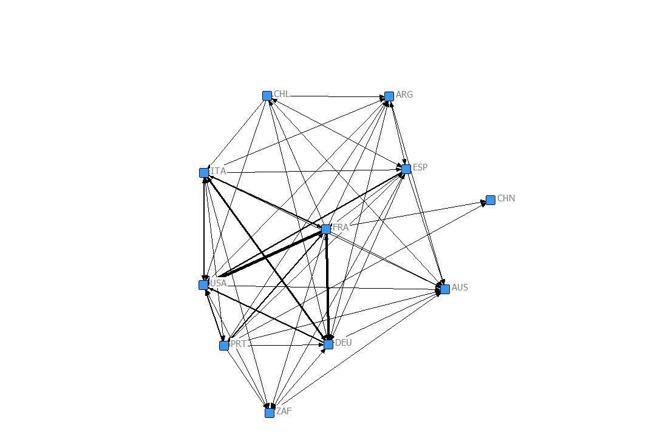
Trade Among Top 11 Wine Producers, 1969

Slide 58
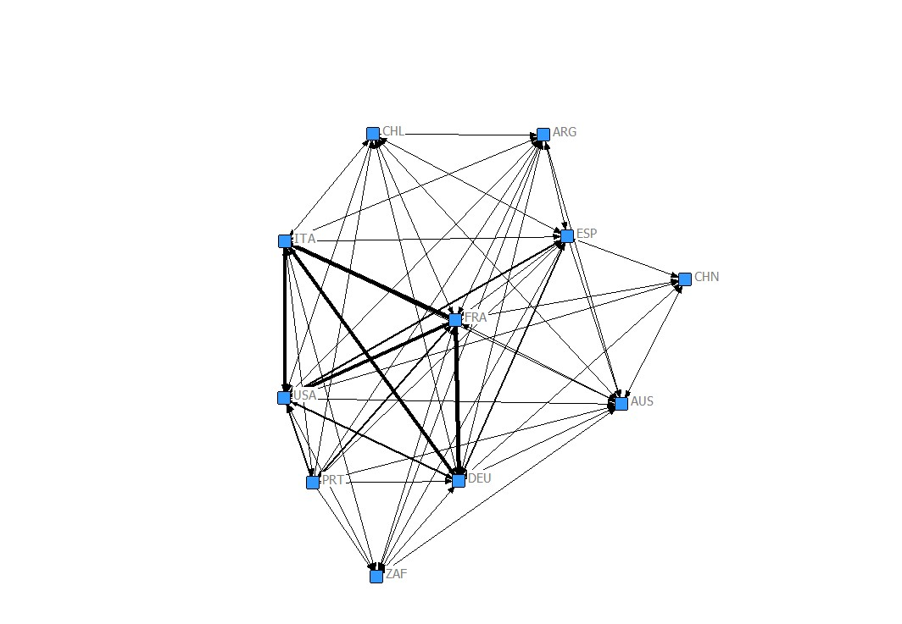
Trade Among Top 11 Wine Producers, 1979

Slide 59
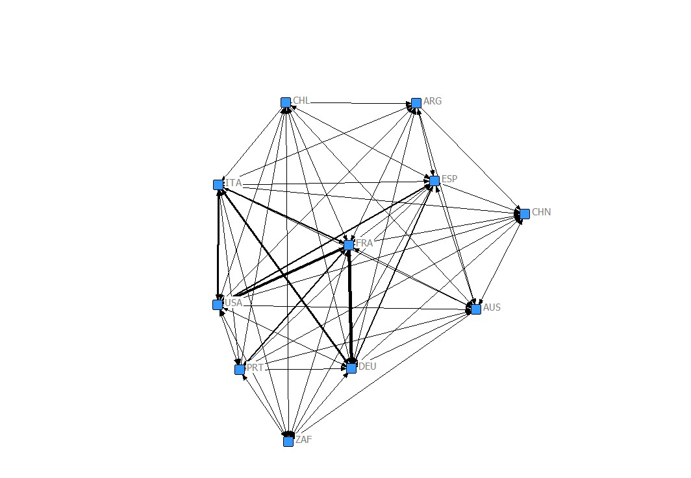
Trade Among Top 11 Wine Producers, 1989

Slide 60
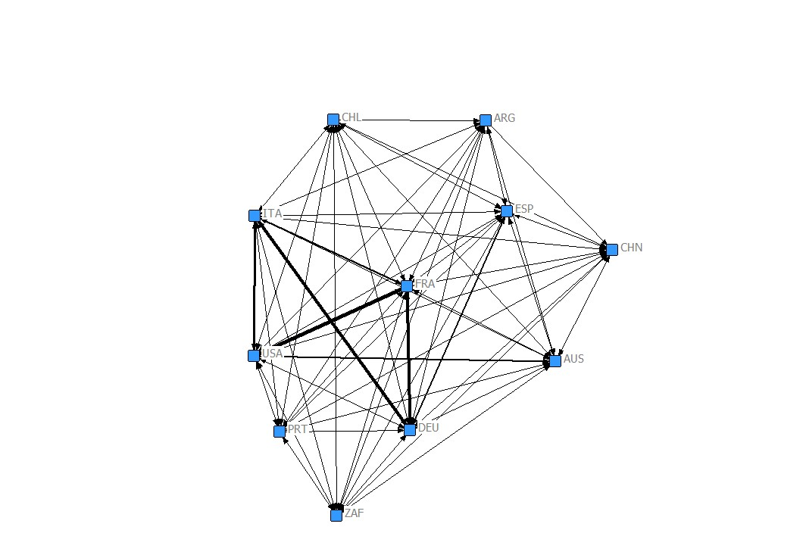
Trade Among Top 11 Wine Producers, 1999

Slide 61
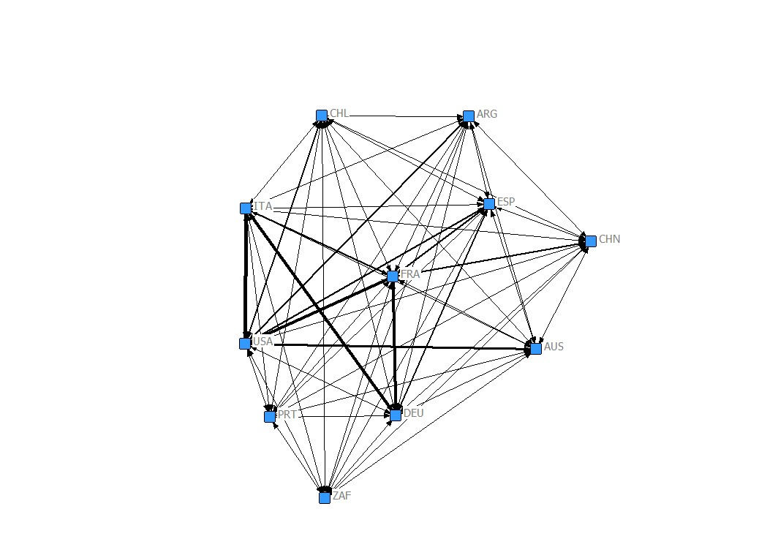
Trade Among Top 11 Wine Producers, 2009

Slide 62
Intra-Industry Trade in Wine
Quick reminder on calculating IIT
  IIT is just
  The Grubel-Lloyd index is
    X_{j} = M_{j} → GL_{j} = 1, all trade is IIT;
    X_{j} or M_{j} = 0 → GL_{j} = 0, all trade is inter-industry.

Slide 63
Intra-Industry Trade in Wine
While production techniques vary systematically across countries, IIT in wine would seem to be driven primarily by a preference for variety.
Loosely speaking, with a few exceptions (e.g. Great Britain), demand for wine and local production grow together, followed by increasing demand for other varieties.
  This is clearest, in more recent times, for the case of new world producers; also
  Even more recently, the case of China

Slide 64
Intra-Industry Trade in Wine
GBR’s role in the global wine trade is very interesting.
  Never a major producer, but for a very long time a major consumer.
  As Nye (2007, War, Wine & Taxes) shows, British demand for wine has played a major role in the development of the French (and Portugese) wine industry back to the 15th century.
  Then, in the mid-1980s, the government permitted grocery shops to sell wine, this led to a massive boom in imports from Australia and New Zealand.

Slide 65
Intra-Industry Trade in Wine
What we want to do is look at the way the elements of the IIT measure (X_{wine}, M_{wine}, Y_{wine}), along with national consumption, evolve, especially in the core producing countries.
Unfortunately, the data made its way to me yesterday. So, right now, I’ll show you some basic IIT measures in wine.

Slide 66
IIT Indexes (volume and value) top producing countries
 | 69 vol | 69 val | 79 vol | 79 val | 89 vol | 89 val | 99 vol | 99 val | 09 vol | 09 val
Argentina | 0.14 | 0.16 | 0.11 | 0.12 | 0.05 | 0.09 | 0.14 | 0.13 | 0.05 | 0.07
Australia | 0.02 | 0.01 | 0.09 | 0.14 | 0.12 | 0.14 | 0.07 | 0.06 | 0.09 | 0.06
Chile | 0.02 | 0.13 | 0.05 | 0.07 | 0.01 | 0.04 | 0.02 | 0.04 | 0.02 | 0.02
China | 0.00 | 0.00 | 0.08 | 0.09 | 0.07 | 0.08 | 0.05 | 0.05 | 0.11 | 0.11
France | 0.08 | 0.07 | 0.07 | 0.07 | 0.05 | 0.09 | 0.14 | 0.14 | 0.12 | 0.13
Germany | 0.08 | 0.08 | 0.06 | 0.08 | 0.09 | 0.16 | 0.15 | 0.18 | 0.16 | 0.19
Italy | 0.03 | 0.01 | 0.06 | 0.04 | 0.07 | 0.06 | 0.07 | 0.08 | 0.08 | 0.08
New Zealand | 0.00 | 0.00 | 0.00 | 0.01 | 0.05 | 0.03 | 0.02 | 0.05 | 0.07 | 0.09
Portugal | 0.11 | 0.09 | 0.08 | 0.07 | 0.11 | 0.07 | 0.08 | 0.11 | 0.04 | 0.10
South Africa | 0.13 | 0.09 | 0.17 | 0.17 | 0.14 | 0.18 | 0.11 | 0.14 | 0.19 | 0.20
Spain | 0.04 | 0.06 | 0.04 | 0.08 | 0.04 | 0.06 | 0.16 | 0.13 | 0.17 | 0.18
USA | 0.01 | 0.03 | 0.02 | 0.03 | 0.03 | 0.05 | 0.03 | 0.07 | 0.11 | 0.14

Slide 67
Core IIT Indexes (volume and value) top producing countries
 | 69 vol | 69 val | 79 vol | 79 val | 89 vol | 89 val | 99 vol | 99 val | 09 vol | 09 val
Argentina | 0.16 | 0.15 | 0.16 | 0.15 | 0.13 | 0.22 | 0.31 | 0.26 | 0.18 | 0.23
Australia | 0.04 | 0.03 | 0.18 | 0.22 | 0.13 | 0.16 | 0.23 | 0.17 | 0.21 | 0.10
Chile | 0.03 | 0.17 | 0.13 | 0.16 | 0.03 | 0.10 | 0.05 | 0.14 | 0.07 | 0.07
China | 0.00 | 0.00 | 0.21 | 0.17 | 0.22 | 0.20 | 0.10 | 0.10 | 0.01 | 0.01
France | 0.11 | 0.12 | 0.03 | 0.07 | 0.19 | 0.32 | 0.22 | 0.38 | 0.22 | 0.32
Germany | 0.02 | 0.07 | 0.08 | 0.19 | 0.06 | 0.08 | 0.23 | 0.21 | 0.10 | 0.11
Italy | 0.14 | 0.07 | 0.03 | 0.07 | 0.12 | 0.24 | 0.15 | 0.24 | 0.31 | 0.29
New Zealand | 0.06 | 0.02 | 0.13 | 0.08 | 0.14 | 0.13 | 0.10 | 0.10 | 0.17 | 0.13
Portugal | 0.01 | 0.01 | 0.00 | 0.01 | 0.15 | 0.01 | 0.05 | 0.18 | 0.11 | 0.18
South Africa | 0.04 | 0.10 | 0.10 | 0.08 | 0.22 | 0.13 | 0.22 | 0.23 | 0.14 | 0.29
Spain | 0.05 | 0.13 | 0.03 | 0.05 | 0.09 | 0.17 | 0.08 | 0.18 | 0.30 | 0.29
USA | 0.09 | 0.05 | 0.14 | 0.16 | 0.16 | 0.15 | 0.11 | 0.10 | 0.13 | 0.09

