Slide 1
Immigration and the UK economy
Jonathan Portes
October 2012 www.niesr.ac.uk
Twitter: @jdportes
Blog: http://notthetreasuryview.blogspot.com

Slide 2
Outline and motivation
some personal history
the economic and political debate about immigration in the 2000s
where next for research and policy?
Notes:
₂

Slide 3
Migration policy and analysis in the late 90s
Not a big political issue from late 70s to 1997
when it was, it was about race and social issues not the economy
Few or no economists working in the field then. Almost no quantitative economic analysis.
Notes:
₃

Slide 4
Migration: an economic and social analysis
PIU /Home Office report 2000-01
First comprehensive analysis of impact of migration on economic and social outcomes not seen through “race relations” frame
Necessarily descriptive rather than quantitative, but led to significant policy change:
“[the government] comprehensively changed policy and marked a decisive break with the previous policy model’ [Somerville, 2007]
Notes:
₄

Slide 5
2000s: rapid policy development
Reform and liberalisation of the work permit system
Highly Skilled Migrant Programme
Post-Study Work Route
Labour market access for A8 nationals
Notes:
₅

Slide 6
Impact of policy change significant: work permits issued doubled 1999-2001

Slide 7
But what did we know about impacts?
View of the benefits of economic migration based largely on theory and anecdote..
Dustmann (2003) first serious econometric analysis of labour market impacts
Found no significant negative impacts: became “conventional wisdom” in government
Sadly, no programme evaluation of WP, HSMP, PSWR
Notes:
₇

Slide 8
Labour market access for the A8
Myth that decision was based on Dustmann (2003) “forecast”. 3 key drivers:
Political/foreign policy
Administrative/practical
Economic/labour market
But undeniable that flows were much larger than anticipated by government
Notes:
₈

Slide 9
Sudden upsurge in research on labour market impacts..
Dustmann, Frattini and Preston (LPC, 2007)
Portes and Lemos (2006, 2008)
Manning, Manacorda and Wadsworth (2006)
Nickell and Salahadeen (2008)
Reed and Latorre (2008)
MAC (2012)
Lucchino, Portes and Rosazza-Bondibene (2012)
Notes:
₉

Slide 10
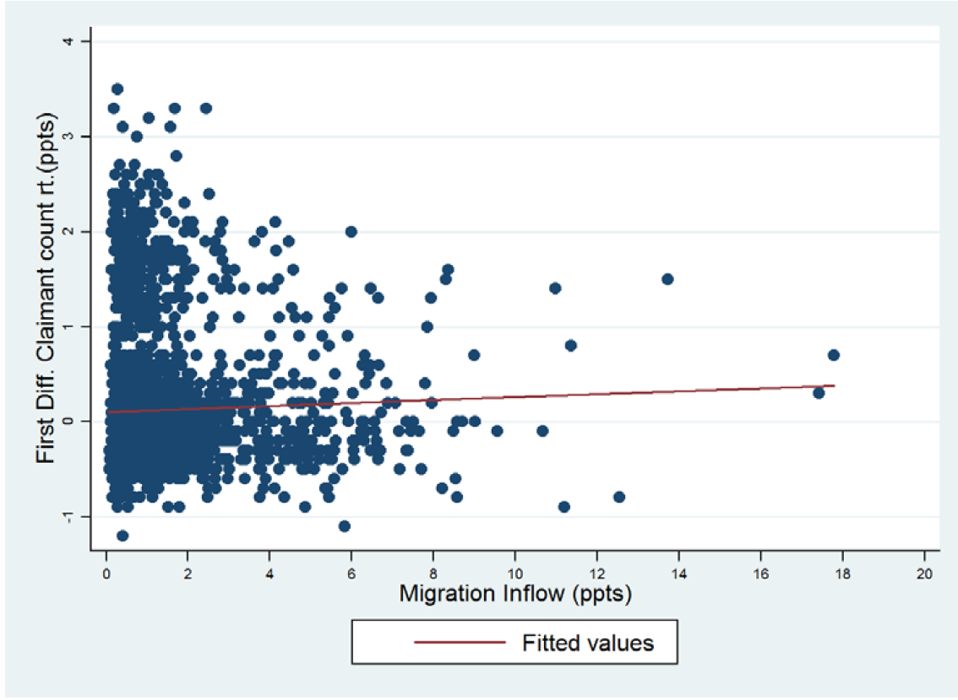
Summing it up with one chart..
Notes:
Migration has raised the Irish population by about 4%, Spanish – by 1.9%; Italian – by 1.4% and the UK - by 1.1%; elsewhere - inflows have been small

Slide 11
So where do we stand?
Considerable consensus among labour market economists (Wadsworth, 2010)
Little or no impact on unemployment
Probably some relatively small negative impact on wages at the bottom of the distribution
Notes:
₁₁

Slide 12
The “So what?” question has framed the political debate
“The overall conclusion from existing evidence is that immigration has very small impacts on GDP per capita, whether these impacts are positive or negative. This conclusion is in line with findings of studies of the economic impacts of immigration in other countries including the US.”
House of Lords (2008)
Conclusion might be migration is a political not economic issue..
I want to argue that is fundamentally wrong..
Notes:
₁₂

Slide 13
Triangles are small!
Costs and benefits of migration in a static model are small, one off and short term
But the same is true for trade..
And economists don’t really believe that..
Notes:
₁₃

Slide 14
Are there other channels and other models? Yes
Increased competition
Human capital spillovers
Transnational networks
Complementarities (O-ring effects)
Segmented labour markets (may be negative..)
Impact on innovation, patents, start-ups etc
Notes:
₁₄

Slide 15
Virtually no research in the UK on these issues..
Ottoviano and Peri, Jennifer Hunt in US
Max Nathan (LSE and NIESR) in UK (patents, management diversity, “super-diversity”)
Challenging research agenda that will require more than just econometrics – but necessary to reframe debate
Notes:
₁₅

Slide 16
Immigration and the UK economy
Jonathan Portes
October 2012

Slide 17
Key references..
“The Economic Impact of Immigration”, House of Lords Economic Affairs Committee, 2008.
“Migration, An Economic and Social Analysis”, Home Office/Performance and Innovation Unit, 2001.
“The Impact of Immigration on the UK Labour Market", Dustmann, Fabri and Preston, Economic Journal, 115, F324-F341.
“The Effect of Immigration along the Distribution of Wages”, Dustmann, T. Frattini and I. Preston, 2008, Review of Economic Studies, May 2012.
“The Impact of EU Enlargement on Migration Flows.” Dustmann, C., M. Casanova, I. Preston, M. Fertig, and C. M. Schmidt Home Office Online Report 25/03, 2003.
“The Economic Impacts of Migration on the UK Labour Market”, Maria Latorre and Howard Reed IPPR, 2009.
“The Impact of Immigration on Occupational Wages: Evidence from Britain”, Steve Nickell and Jumana Salaheen, 2008.
“New Labour? The impact of migration from Central and Eastern European Countries on the UK Labour Market”, Sara Lemos and Jonathan Portes, IZA Discussion Paper no 3756, October 2008
“Labour and Epistemic Communities: The Case of Managed Migration”, Alex Balch, British Journal of Politics and International Relations, 2009
“The Impact of Immigration on the Structure of Male Wages: Theory and Evidence from Britain”, Marco Manacorda, Alan Manning and. Jonathan Wadsworth, CEP, 2006
"Immigration to the UK: The Evidence from Economic Research“, Jonathan Wadsworth, CEP, 2010.
“ Examining the relationship between immigration and unemployment using National Insurance Data”, Lucchino, Portes and Rosazza Bondibene, NIESR, 2012
“Analysis of the Impacts of Migration”, Migration Advisory Committee, 2012
“Skilled immigration and strategically important skills in the UK economy”, Anitha George, Mumtaz Lalani, Geoff Mason, Heather Rolfe and Chiara Rosazza Bondibene, Migration Advisory Committee, 2012
“Ethnic Inventors, Diversity and Innovation in the UK: Evidence from Patents Microdata”, Max Nathan, October 2011
“Does Cultural Diversity Help Innovation in Cities: Evidence from London Firms”, Neil Lee, Max Nathan, February 2011
“The Economics of Super-Diversity: Findings from British Cities, 2001-2006”, Max Nathan, February 2011
Notes:
₁₇

