Slide 1
Africa: the Next Growth Miracle? Nottingham Globalization Lecture
Stefan Dercon
Oxford University
DFID
November 2012
Notes:
Slides for illustration not definitive. For full analysis and sources refer to SU Horizon Scans.

Slide 2
Outline
The miracle described
Why may this fail?
Opportunities and challenges for success
Epilogue

Slide 3
Part 1
The Miracle Described

Slide 4
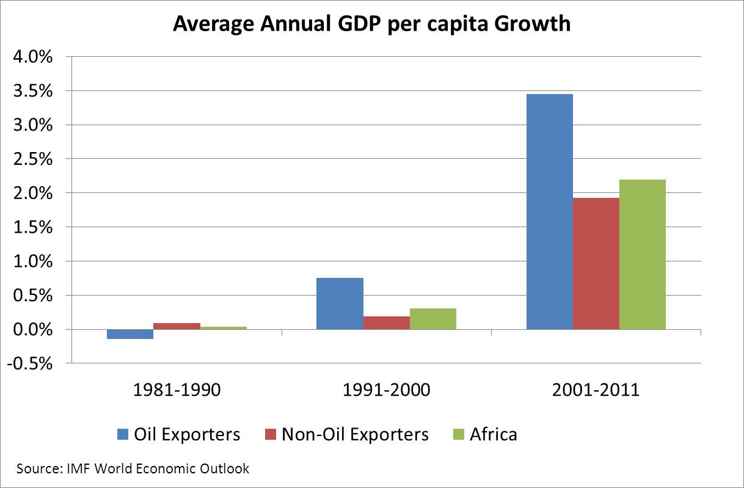

Slide 5
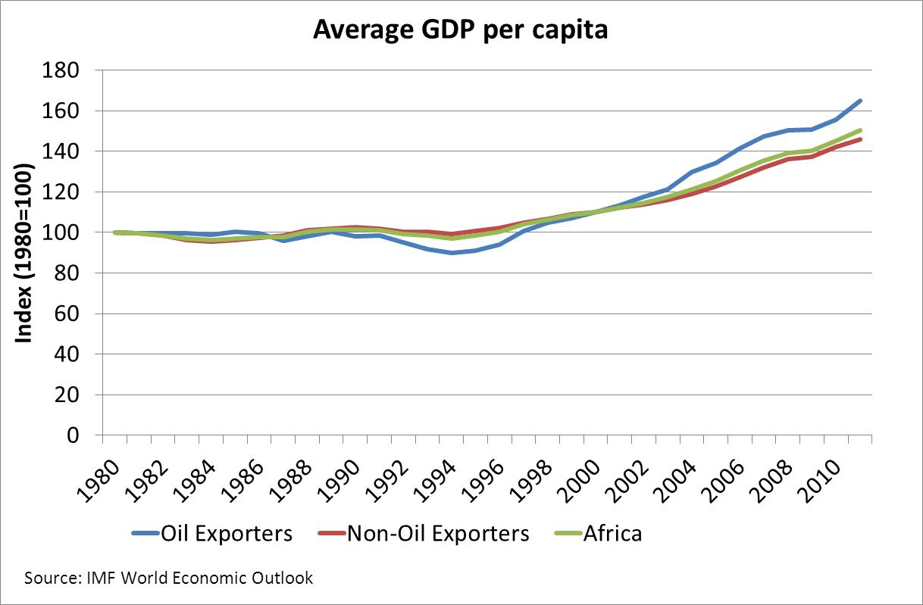

Slide 6
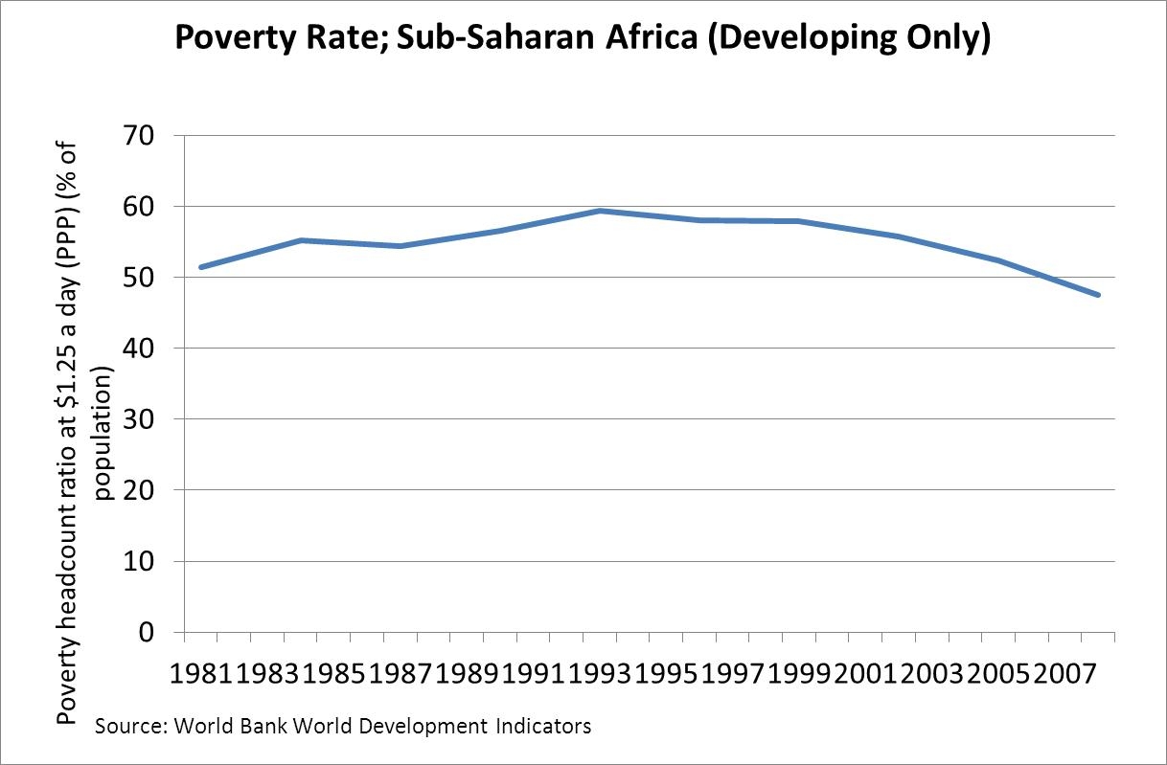

Slide 7
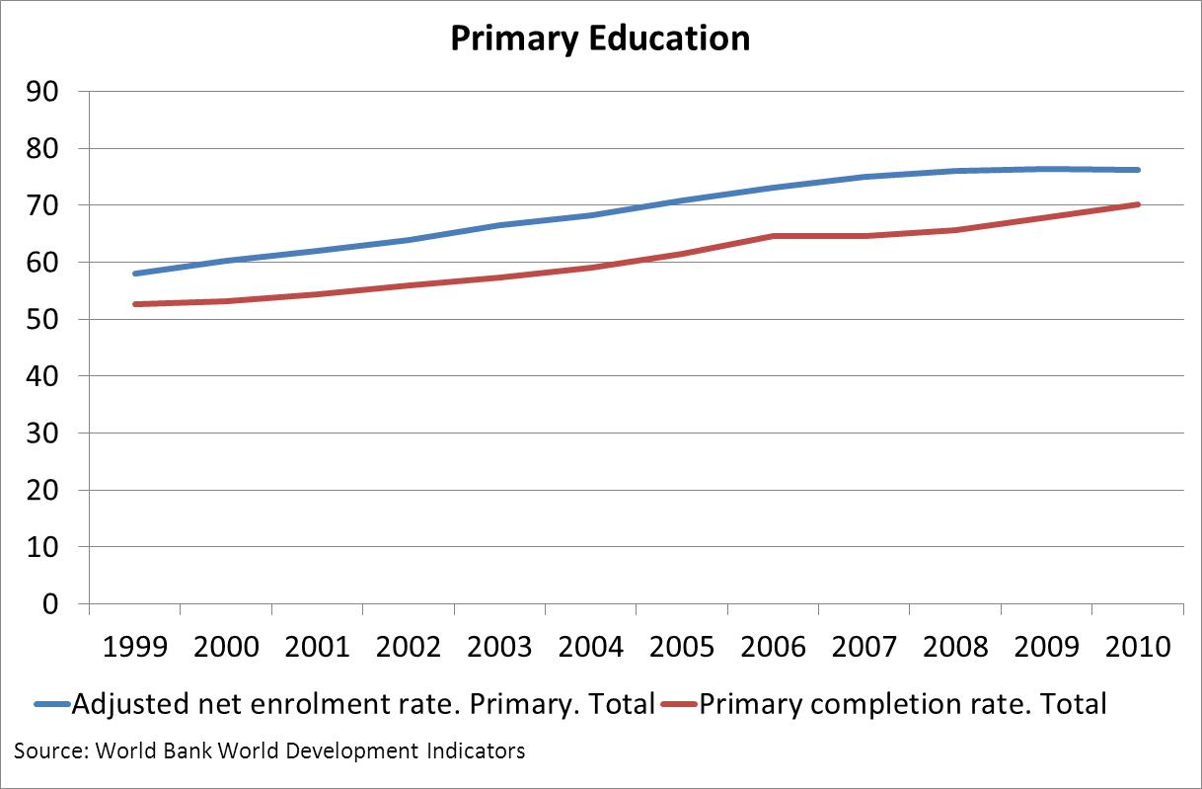

Slide 8
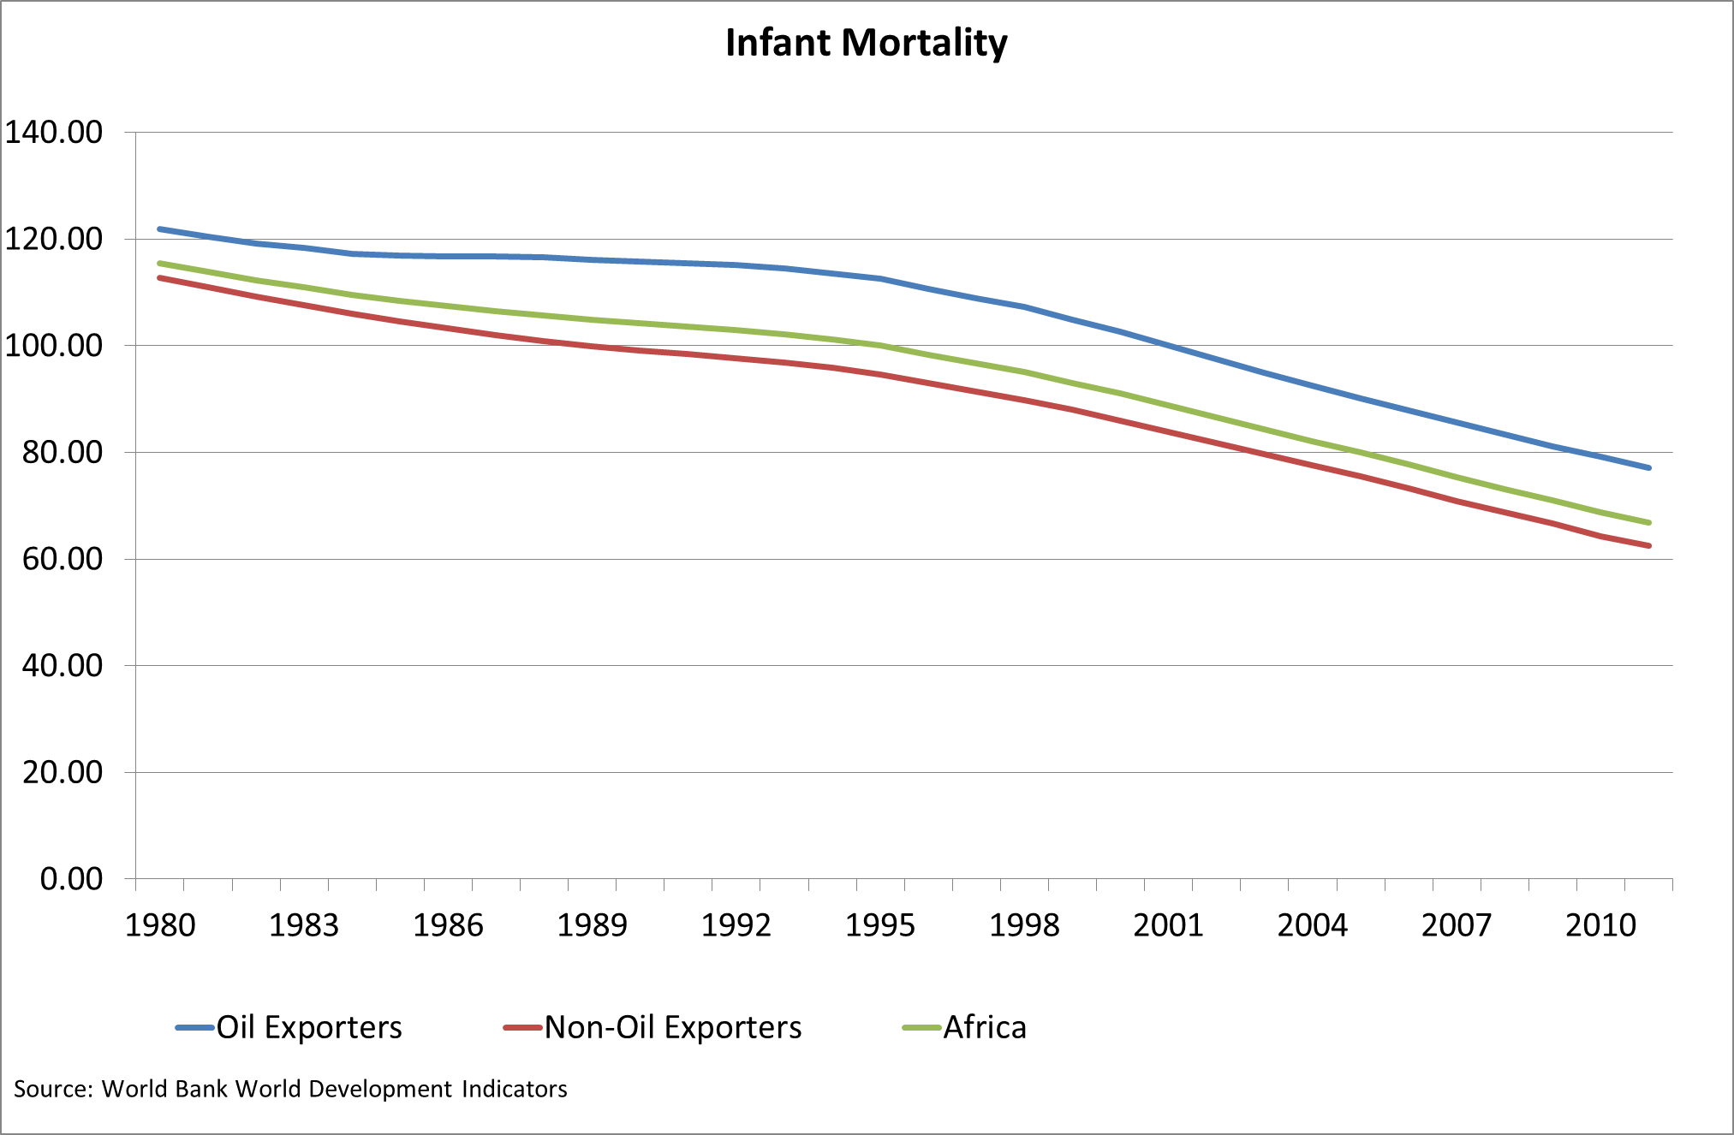

Slide 9
In sum
There is growth
Not just in oil exporters
And improvement in human development outcomes
But with clear heterogeneity. E.g. consider Radelet’s emerging economies

Slide 10
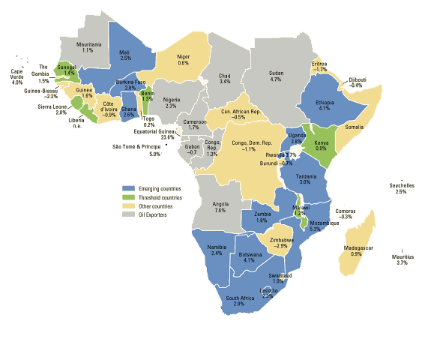

Source: ‘Emerging Africa; How 17 Countries are Leading the Way’,
Steven Radelet, Centre for Global Development, 2010

Slide 11
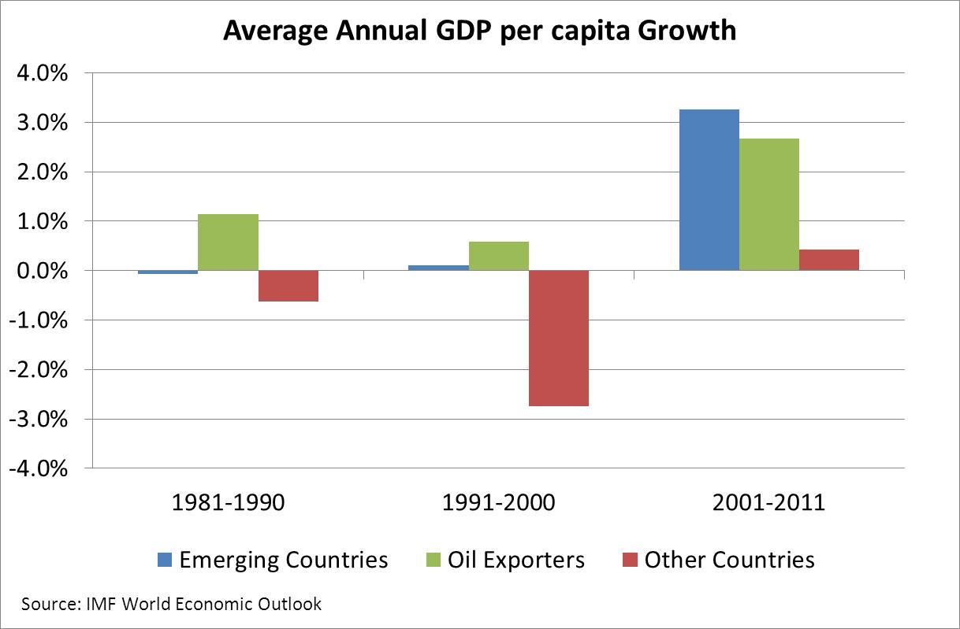

Slide 12
Why did it happen?

Slide 13
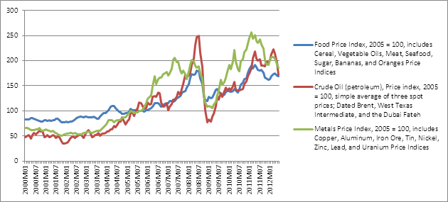
More than a little help from commodity prices…

Slide 14
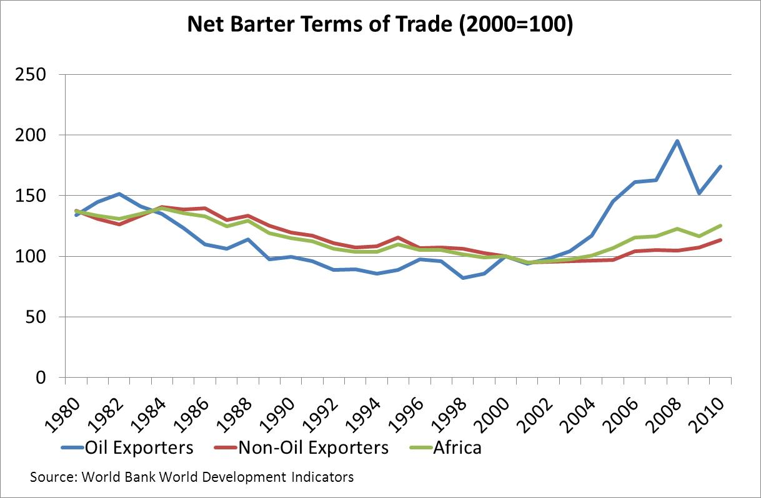

Slide 15
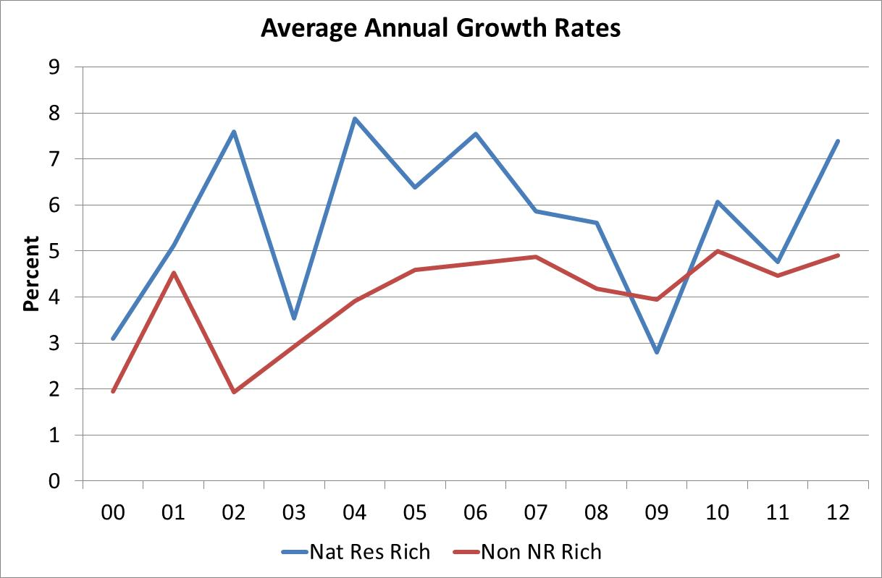

Slide 16
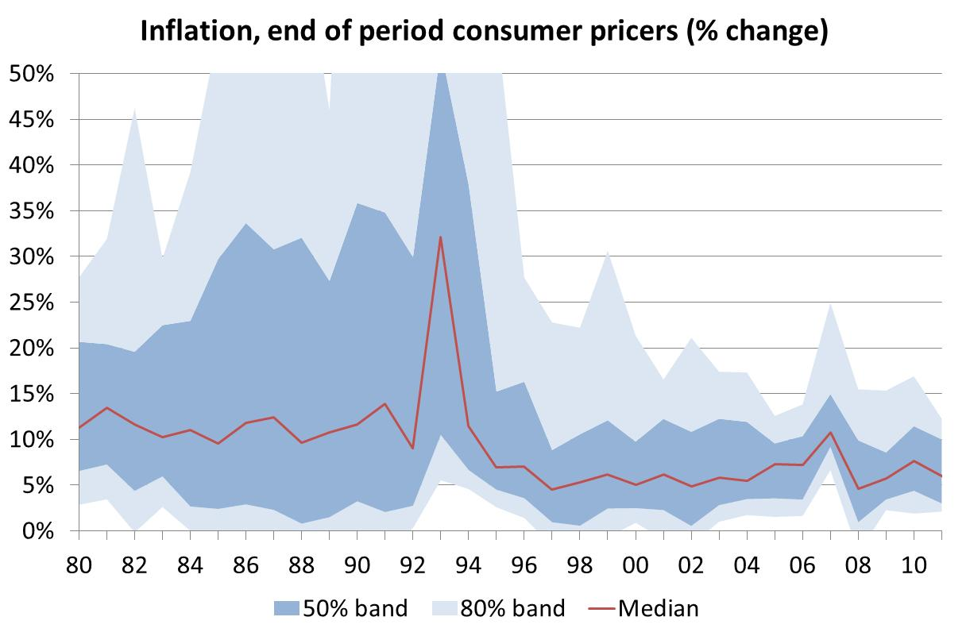

Slide 17
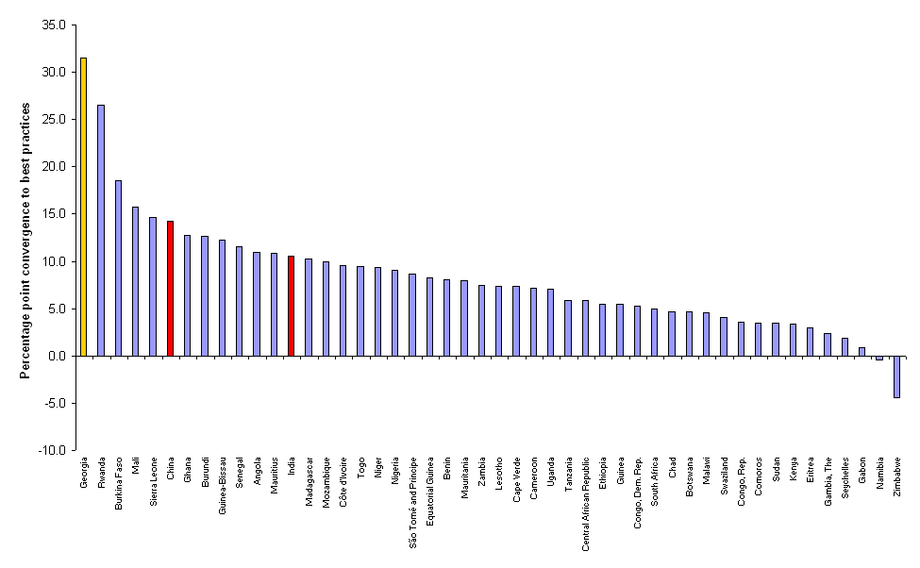
Rate of convergence to the best practice frontier for Doing Business, 2005-2012
Georgia – Best performer
China and India
Source: Data provided by the World Bank, produced for Doing Business Survey 2012

Slide 18
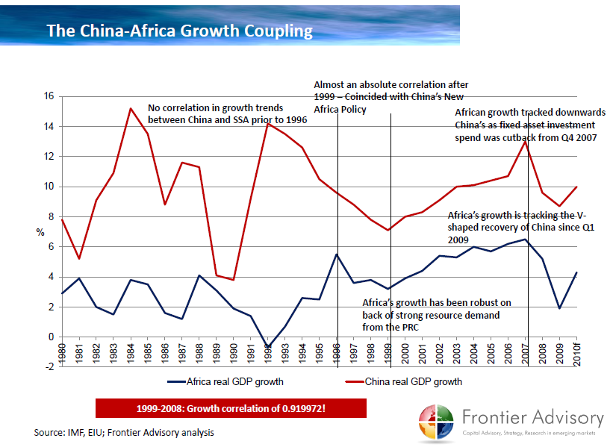

Slide 19
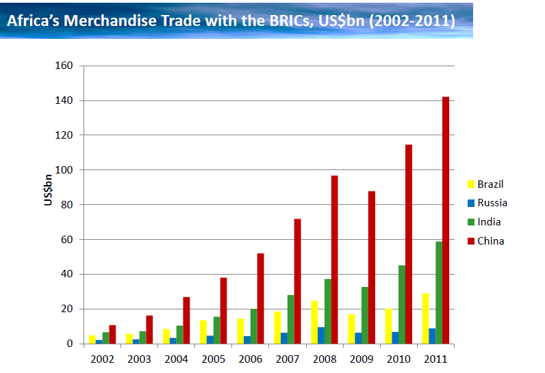

Slide 20
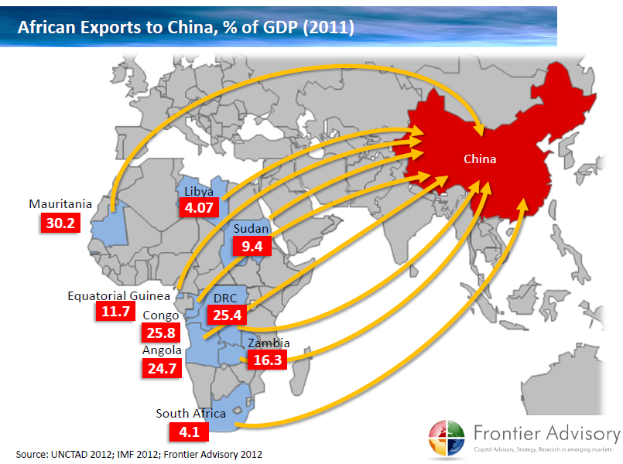

Slide 21
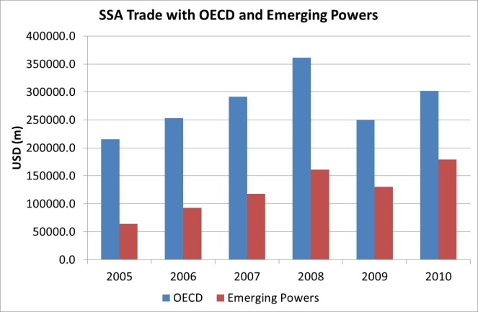

Slide 22
Why did it happen?
Commodity prices
Much better investment environment due to macroeconomic stability and general stability
Rise of trade and involvement of emerging powers, not least China
Highest growth in natural resource rich economies, not just relative price effect but also extraction climate ‘better’

Slide 23
Part 2
Why may this fail?

Slide 24
How sustainable is the success…
First, round up the usual suspects
Then identify the actual risks and challenges…

Slide 25
Population bomb…

Slide 26
Rapid population growth will take place in Asia and Africa …
Occupied Palestinian
Territories
10m
Sierra
Leone
11m
Occupied Palestinian
Territories
4m
Sudan
91m
Yemen
61m
Nigeria
390m
Sierra
Leone
6m
Ethiopia
145m
Liberia
10m
Sudan
44m
Yemen
24m
Liberia
4m
Ethiopia
83m
Nigeria
158m
Uganda
94m
Somalia
28m
Ghana
49m
Kenya
97m
2050 population
DRC
149m
Ghana
24m
DRC
66m
Somalia
9m
2010 population
Uganda
33m
Tanzania
138m
Kenya
41m
Zambia
45m
Malawi
50m
Tanzania
45m
Rwanda
10m
But it will peak near that time…
Zambia
13m
Rwanda
26m
Malawi
15m
South Africa
57m
South Africa
50m
Mozambique
50m
Zimbabwe
21m
Mozambique
23m
Zimbabwe
13m
Source: World Population Prospects 2012
Notes:
26
Diagram shows change in population in DFID partner countries between now and 2050 when viewed as slide show. Many of DFID’s BAR countries are set to see high rates of growth, with the highest seen in sub-Saharan Africa
Asia will add another billion people by the middle of the century (up from four to five billion), whilst Africa’s population will double, from one to just over two billion people.
. In eleven of the poorest countries – Afghanistan, Angola, Burundi, Chad, DRC, Equatorial Guinea, Guinea-Bissau, Liberia, Mali, Niger and Uganda – half the population will still be aged 23 or younger in 2050.

Slide 27
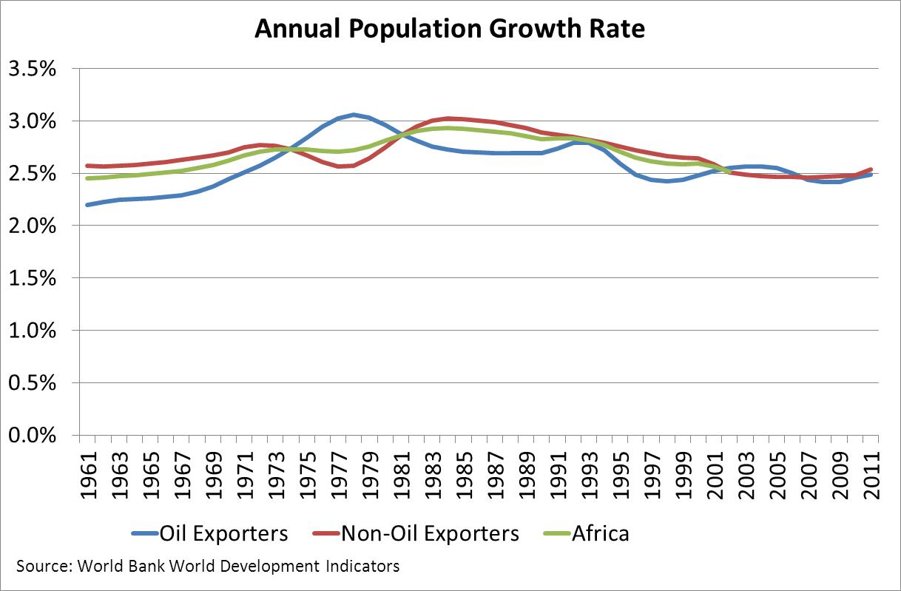

Slide 28
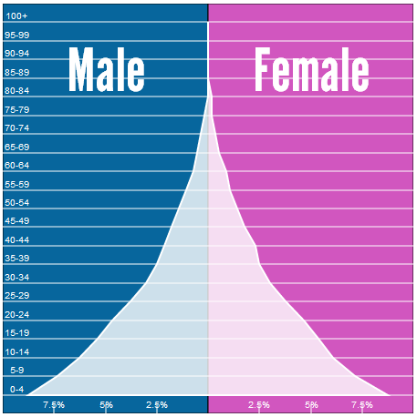
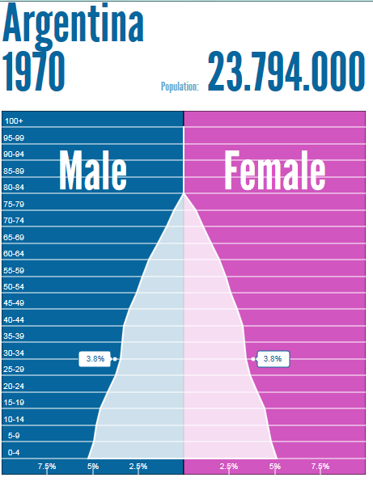
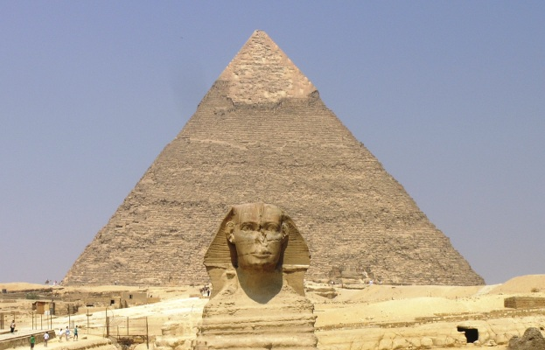

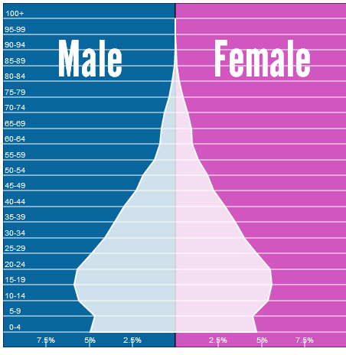
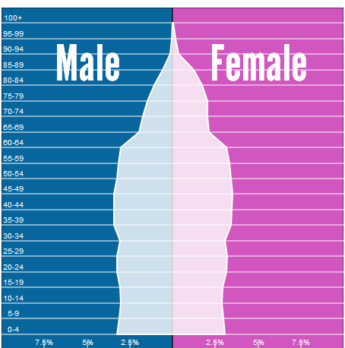
… but the path to modern population structure comes with a golden opportunity of low dependency ratios….
Stage 1:
High death rates, high births, high dependency
Stage 2:
Falling death rates, high births, high dependency
Many African countries entering into stage 3
Stage 3:
Low death rates, falling births, low dependency
Stage 4:
Low death rates, low births, high dependency
Source: Populationpyramids.net, note that this slide borrows ideas from Hans Rosling’s TED talk and publically available demographic transition presentations
Notes:
Demographic transition from high birth and death rates to low birth and death rates is a one off opportunity as countries see a large increase in population, and a youth bulge, until birth rates fall and the population ages. Countries of Africa and South Asia are still passing through the transition, some still in the early stages, others almost at the end.
A “demographic dividend” is possible during this transition while falling birth rates reduce the number of dependent children relative to people of working age. It can leave a lasting legacy of relative prosperity. Such a dividend has been credited as accounting for a third of East Asian growth between 1965 and 1990.

Slide 29
Many countries will experience a golden opportunity of low dependency ratios…
Source: World Population Prospects 2012
Notes:
29
Demographic transition from high birth and death rates to low birth and death rates is a one off opportunity as countries see a large increase in population, and a youth bulge, until birth rates fall and the population ages. Countries of Africa and South Asia are still passing through the transition, some still in the early stages, others almost at the end.
A “demographic dividend” is possible during this transition while falling birth rates reduce the number of dependent children relative to people of working age. It can leave a lasting legacy of relative prosperity. Such a dividend has been credited as accounting for a third of East Asian growth between 1965 and 1990.

Slide 31
Population bomb… may actually be part of a more immediate opportunity… of the lowest dependency ratio and largest working age population ever… healthier and better educated than ever…

Slide 32
Climate Change Bomb…

Slide 33
Climate effects are harshest in developing countries (1)
Map of likely future water scarcities
Western Europe and most of North America will be largely unaffected by water scarcity
But Africa and Western and Southern Asia will be hit by either physical or ‘economic’ water scarcity – the inability to access available water.

Slide 34
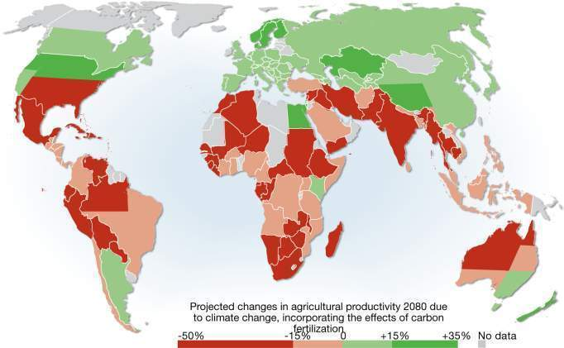
Climate effects are harshest in developing countries (2)
Climate effects on agricultural productivity are hardest in developing countries (including Latin America and South-East Asia) though also affecting North America and Australia
Notes:
34

Slide 35
Climate Change Bomb…
is real, but will hit after 2030, not likely much earlier….
and an important force for resilience will be development….
so making development more urgent…

Slide 36
It can’t be sustained as growth did not come from agriculture?
Perceived wisdom that it should start from agriculture… for those working on agriculture…
Or WDR 2008
But much of this perceived wisdom is from closed economy thinking
Even though no doubt an excellent source of poverty reduction if there is growth

Slide 37
But there is a failing economic transformation….
E.g. share of employment in agriculture
SS Africa 68% versus Asia 53%

Slide 38
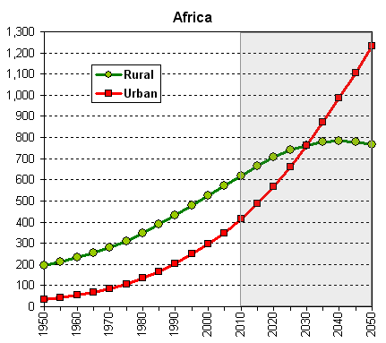
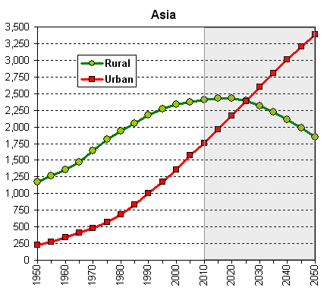
And an early acceleration of African urbanization without growth …
By 2030 more people in both Africa and Asia are projected to live in urban than rural areas.
Source: World Urbanisation Prospects 2009
Notes:
38
In Africa the urban population is set to outstrip the rural by 2030; in Asia the tipping point comes a little earlier (2025). By 2050, Africa’s urban population is predicted to be just over 1.2 billion people and Asia’s around 3.3 billion.

Slide 39
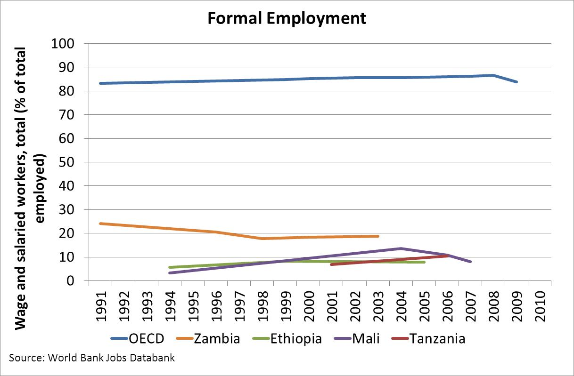

Slide 40
… waged jobs are not keeping pace
Job creation in Ghana 1998-2006
Lowest paying jobs are expanding fastest, including farming – the default option. Well paid jobs are growing more slowly than population
Moderately paid jobs also lagging behind population
Source: Nsowah-Nuamah, Teal, Awoonor-Williams (2010)

Slide 41
So real issue is growth without transformation - key risk 1: jobless growth
Fast growth
Partly driven by natural resources
In relatively urbanising settings
No growth in manufacturing or sectors with formal job creation
Risking to turn demographic dividend into trouble…

Slide 42
Natural resource curse?
Is it a problem that the growth today has a strong component from extraction of natural resources?
It is relatively jobless
It has incentives to perpetuate this
Dutch Disease?
Incentives for governance and emergence of non-extractive institutions

Slide 43
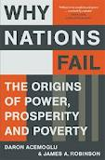

The Dominance of Institutions
The X-factor is institutions, the hard to measure, “set of economic and political rules, created and enforced by state and citizens, which determine economic, social and political incentives, which in turn determine economic and other development outcomes” (Daron Acemoglu and Jim Robinson, “Why do Nations Fail”)

Slide 44
The Dominance of Institutions
Inclusive political institutions (with sufficient centrality of power but with clear constraints on this power) lead to inclusive economic institutions that promote growth and are sustainable
Extractive political institutions (with power in small elite with few constraints) lead to economic institutions with no or unsustainable growth and development.
In resource rich environments: no incentive to build up state capacity or tax-raising powers, no process that requires inclusion to keep power

Slide 45
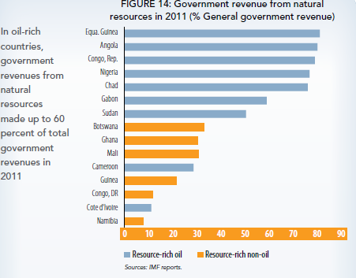
Government revenue form natural resources 2011

Slide 46
Any progress?
Some say: YES.
from 4 to 24 democracies in Africa (Radelet – using Polity IV and Freedom House index)
progress everywhere on doing business
Other say: no
Above interprets institutions are rules and not the enforcement of rules
Pritchett: when limited contract enforcement, deals environment, not rules

Slide 47

In poor ‘institutional’ settings, deals dominate….
Open versus closed deals (identity of agents matter or not)
Ordered versus unordered deals (predictable, once deal is done it stays done versus not)
 | OPEN | CLOSED
ORDERED | Functioning economy, with much petty corruption | Oligarchs, Cronyism
UNORDERED | Informal sector | Fragile states

Slide 48
Natural resource deals … ... relatively easy even in fragile environment
Natural resource extraction: high return in short run, limited capital, no lags, heavily localised, high value per tonne, limited skills of labour force – easily protected
Compared to
manufacturing: capital intensity, scale matters, lags, long horizon, labour force skills
Commercial agriculture: scale matters, lags, long horizon, low value per tonne

Slide 49
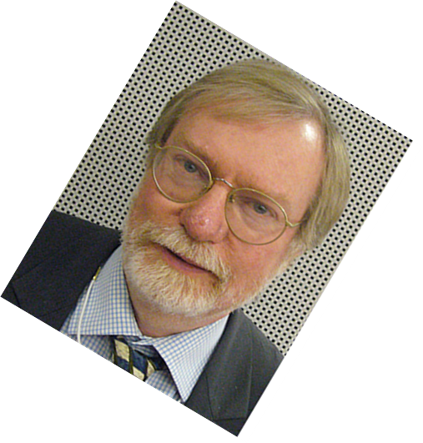
Key risk 2: institutional incentives
Natural resources offer few incentives for state to build up its capacity
While even in fragility it can thrive
How to change horizon from short-run to long-run?
… is more than just saving large part of natural resource rents
… is also about what to do with it today
…. Collier: investing in investing

Slide 50


How to do this? … there is the rub…
Policy makers that need to act against their own incentives
Using aid to support this process, with aid suffering from the same incentives
Leading to isomorphic mimicry:
Building institutions and organizations
that look like the real thing
But just look like the real thing
and no more…

Slide 51
Part 3
Opportunities and Challenges

Slide 52
The two key risks are also massive opportunities
Jobless growth but also
demographic dividend, and
gradual rise of education and skill levels in Africa
Natural resources curse
but also unique historical opportunity for Africa

Slide 53
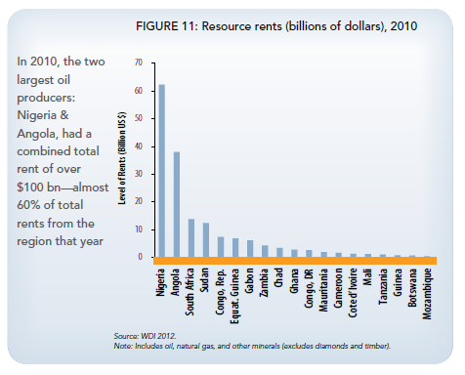
Huge natural resource rents on offer…

Slide 54
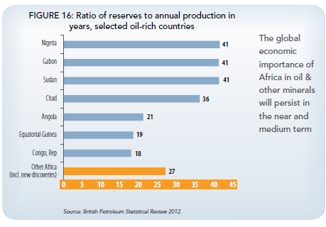
Massive reserves….

Slide 55

Expectation on continuing discoveries….
Recent discoveries in e.g. Ghana (oil), Tanzania (natural gas), Uganda (oil), Ethiopia (diamonds), Mozambique (natural gas)
Under-surveyed continent…

Slide 56
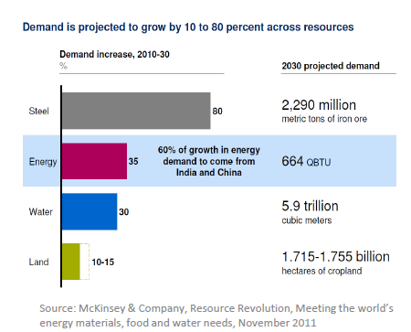
With large increases in demand offering hope and expectation
for unprecedented rents…
Managed well, increased global demand is a positive for resource-rich countries
Tax revenues can be collected, and domestic accountability strengthened
Revenues can be reinvested and used to diversify growth and create jobs
Public services, infrastructure, can all be improved

Slide 57
With large increases in demand offering hope and expectation
for unprecedented rents…
Managed poorly, wasted resources,
Incentives for poor governance and conflict
Booming underemployed youth
Borrowing against future returns that won’t materialize
…

Slide 58
The other main present and future opportunity

Slide 59



The future is:
The opportunities offered by new technologies and communications

Slide 60
The future is:
The opportunities offered by new technologies and communications

Slide 61

The future is:
Mandarin…

Slide 62
China in Africa is viewed with suspicion
It goes for ‘deals’, not following rules
It has clear self-interest, not aid in mind
Upsets the donor-recipient relationship
Is exploitative…

Slide 63
China in Africa needs to be understood from China
State-interest is commercial interest and vice-versa
Aid is commercial as there is no other interest than Chinese development
Aid size to Africa?
Consistent with commercial interest in fuelling its growth
Tied aid
The fact that it does not follow our rules does not mean it ‘vicious’
More used to ‘fragile’ institutional environments…

Slide 64
China in Africa needs to be understood from China (2)
It is also looking for FDI opportunities to balance its own restructuring away from labour-intensity
Workers’ paradise built on workers’ exploitation
Labour as a natural resource (Lewis model)
That is getting exhausted (“middle income trap”)
Incentives against labour-intensity of production
Encouragement of movement out of S-Eastern China into West, other Asian countries and Africa
CADF – $5 billion, managed by CDB – tied credit/ equity stakes

Slide 65
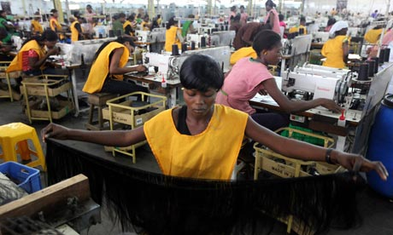
The prize for Africa: job creating growth
Is Africa ready to grab that opportunity?
Notes:
65
Source: UN World Population Prospects, 2010 revision
The most recent UN figures show that the global population is likely to begin to level off at around 10 billion by the end of this century. However, small variations in the underpinning fertility assumptions [1] could alter these figures significantly, leading to as many as 16 billion (high variant) or as few as 6 billion (low variant) people on the planet by 2100.
[1] A difference from the median projection of just half a child more or less per woman.

Slide 66
The pieces that need to get into place
the demographic dividend (education, health, ….)
natural resource rents for transformative infrastructure, social protection, absolute poverty alleviation, etc
an investment climate that will make Chinese, other foreign and local investors willing to part with their cash for the long-run
basic costs structures to make investment profitable

Slide 67
Due in part to cost-disadvantages: against China, for example
Source: World Bank Jobs Databank (2012)

Slide 68
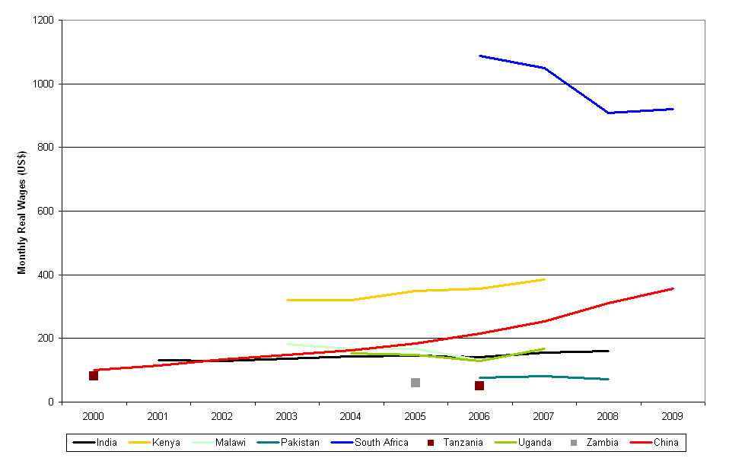
Opportunity: Cost-profiles are changing …
Real wages in China are rising fast
But in most DFID LICs they are more stable
Real Wages 2000-2009, Selected Economies
South Africa
Kenya
China
Malawi
Pakistan
Source: ILO, Key Indicators of the Labour Market database (2012); converted to US$
Data also suggests that since the 1990s, wages are growing faster than productivity in China – meaning that it is becoming more expensive to produce labour-intensive goods there

Slide 69
Rate of convergence to the best practice frontier for Doing Business, 2005-2012
Georgia – Best performer
China and India
Source: Data provided by the World Bank, produced for Doing Business Survey 2012

Slide 70
And Chinese business are looking
FDI projects, Ethiopia
FDI projects,Ghana
Ethiopia
Country | Total Number
China | 93
India | 39
S-Arabia | 27
Britain | 18
US | 12
Ghana
Country | Total new Number
China | 167
India | 129
Nigeria | 91
UK | 57
US | 40
South Africa | 17

Slide 71
The pieces that need to get into place
the demographic dividend (education, health, ….) yes, contribution from aid undeniable
natural resource rents for transformative infrastructure, social protection, absolute poverty alleviation, etc not quite
Basic costs structures to make investment profitable hopeful signs
The investment climate that will make Chinese, other foreign and local investors willing to part with their cash for the long-run some signs
And
China’s and other EP businesses
as the key investors with
jobs to relocate
to create jobs in Africa

Slide 72
Part 4
What does this mean for aid?

Slide 73

Notes:
73
Source: UN World Population Prospects, 2010 revision
The most recent UN figures show that the global population is likely to begin to level off at around 10 billion by the end of this century. However, small variations in the underpinning fertility assumptions [1] could alter these figures significantly, leading to as many as 16 billion (high variant) or as few as 6 billion (low variant) people on the planet by 2100.
[1] A difference from the median projection of just half a child more or less per woman.

Slide 74
Aid is becoming increasingly irrelevant….
% of GNI
Source: IMF World Economic Outlook 2009

Slide 75
Where and How we offer it, What For is much more important
Notes:
75
Source: UN World Population Prospects, 2010 revision
The most recent UN figures show that the global population is likely to begin to level off at around 10 billion by the end of this century. However, small variations in the underpinning fertility assumptions [1] could alter these figures significantly, leading to as many as 16 billion (high variant) or as few as 6 billion (low variant) people on the planet by 2100.
[1] A difference from the median projection of just half a child more or less per woman.

Slide 76
The Role of Aid?
the demographic dividend (education, health, ….) yes, contribution from aid undeniable
natural resource rents for transformative infrastructure, social protection, absolute poverty alleviation, etc not quite
Basic costs structures to make investment profitable hopeful signs
The investment climate that will make Chinese, other foreign and local investors willing to part with their cash for the long-run some signs

Slide 77
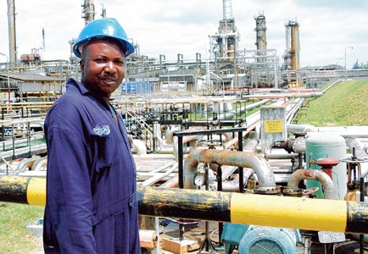
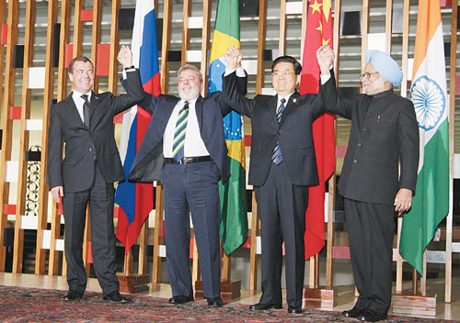
The Motors: Resource wealth, trade and investment
Notes:
77
better handling of the complex linkages, overlaps and feedback loops between food and energy prices, water scarcity and competition for land.

Slide 78
Huge challenges
An economic agenda with potentially huge benefits for Africa
Requiring work on global system to make it work
Huge benefits for economic rivals
Can we allow Chinese firm to gain via Africa from AGOA?
A political institutional agenda with few levers and fraught with bad experiences
How much do we know what works? Can we? Should we?

Slide 79
Part 4
Epilogue

Slide 80
So what do we have?
a global crisis in the OECD
huge liquidity outside OECD with much investment in non-productive sectors in Africa
Africa booming fuelled by commodities
huge liquidity outside OECD with much investment in non-productive sectors in Africa
exciting signs of progress on human development
a developmental state with rhetoric on poverty

Slide 81
Are back in
1977

Slide 82

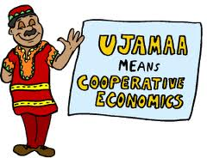
A warning from history… Haven’t we been here?
Ujamaa Tanzania
Hotel Intercontinental
Cote d’Ivoire

Slide 83
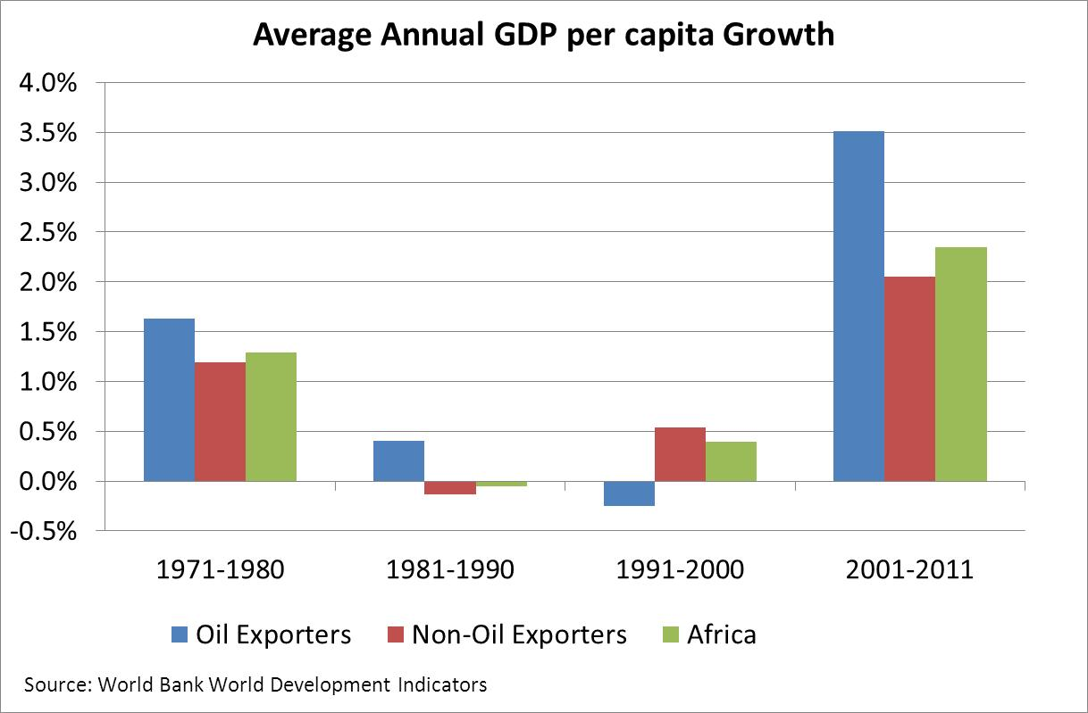

Slide 84
Are we back in
1979

Slide 85
Unique historical opportunities are … unique
Africa and the world can waste its natural resources or allow it to be wasted
We can waste the demographic dividend
We can waste the opportunity to grab part of the world’s production
Cost would be huge:
Macroeconomic collapse, fragility, debt

Slide 86
Let us not go back to
1986

