Slide 1
Have we fixed the financial system? Martin Wolf, Associate Editor & Chief Economics Commentator, Financial Times
Nottingham University
January 29th 2014
Nottingham

Slide 2
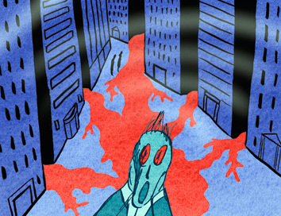
Have we fixed the financial system?

Slide 3
Have we fixed the financial system?
Legacy of the crisis
Fragility of finance
Reform agenda
Critique of the agenda
Future of finance

Slide 4
1. Legacy of the crisis
The high-income countries have been stuck in a “contained depression” for six years.
What are the symptoms?
The answer is the combination of:
Weak economies, and
aggressive monetary and (to a lesser degree) fiscal policies;
This is not just due to the fragility of the financial system. But it is a big part of the explanation.

Slide 5
1. Legacy of the crisis
THE LONG SLUMP

Slide 6
1. Legacy of the crisis
THE LONG SLUMP

Slide 7
1. Legacy of the crisis
THE LONG SLUMP

Slide 8
1. Legacy of the crisis
CREDIT ENGINE REVERSED

Slide 9
2. Fragility of finance
When the “Minsky moment” came in 2007-08, the results were:
A huge financial crisis;
State-backing of the core financial system; and
The hyper-aggressive monetary and fiscal policies.
The crisis is the result of a complex interaction between two forces:
A global saving glut; and
A fragile financial system.

Slide 10
2. Fragility of finance
The banks were huge and unable to withstand severe shocks – thin equity, debt not loss-absorbent
Financial system was highly interconnected – both within and between systemically important banks
Governments were unable to let whole financial system fail, so were forced into providing unprecedented levels of support
Even so, the disruption in economic activity is having a huge and lasting effect on economic growth and the public finances

Slide 11
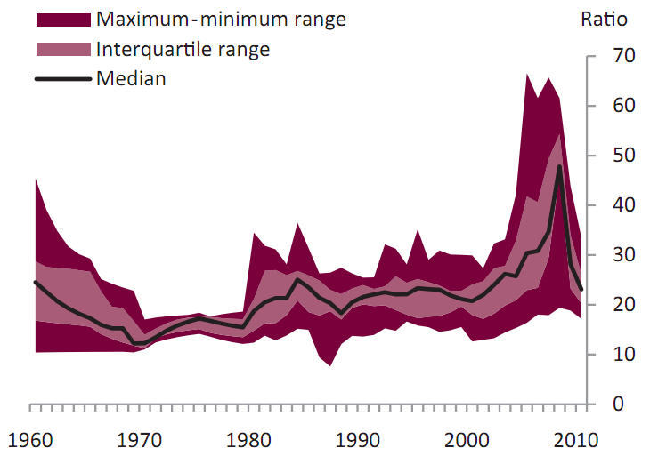
2. Fragility of finance - leverage
LEVERAGE IN PRE-CRISIS UK BANKING

Slide 12
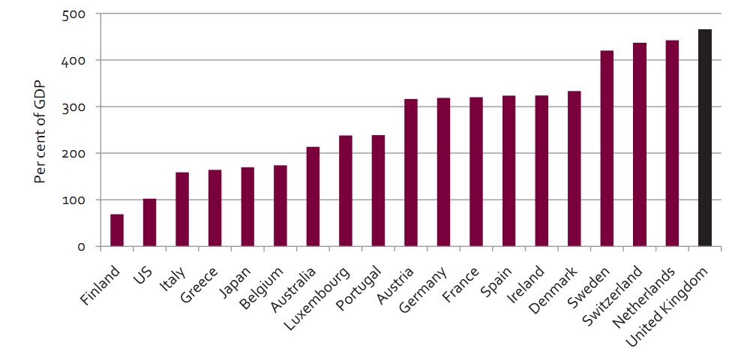
2. Fragility of finance - size

Slide 13
2. Fragility of finance - irrelevance

Slide 14
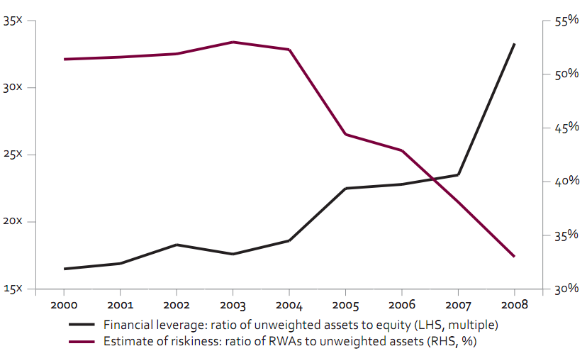
2. Fragility of finance – risk-weights

Slide 15
3. The reform agenda - the new orthodoxy
Basel III
Resolution
Incentives
Structural Reform
Regulatory reform

Slide 16
3. The reform agenda – Basel III
Basel III - capital:
Tier 1 capital raised to 6 per cent of risk-weighted assets;
2 per cent of RWAs in “tier 2” capital;
2.5 per cent of RWAs in “capital conservation buffer”;
2.5 per cent of RWAs in “countercyclical buffer”;
1-2.5 per cent of RWAs in countercyclical buffer for global systemically important banks (G-SIBs);
A total of 15.5 per cent in good times for G-SIBs; plus a leverage ratio of 3 per cent.
Tightening up on risk-weights; and
Macroprudential regulation.

Slide 17
3. The reform agenda – Basel III
Basel III - Markets:
Integrated management of market and counterparty risk;
Capital requirements lifted for counterparty exposures; and
Movement of trading in over-the-counter derivatives towards centralised clearing houses.
National jurisdictions:
“Swiss finish”: 19 per cent of risk-weighted assets, with 9 per cent in contingent convertible bonds; and
UK Independent Commission on Banking: minimum loss-absorbing capacity of 17-20 per cent of RWAs.

Slide 18
3. The reform agenda - resolution
Resolution:
The aim of orderly resolution is universally accepted;
The important principle is to maintain the business as a going concern;
The instrument is orderly conversion of debt into equity;
The Federal Deposit Insurance Corporation and the Bank of England are co-operating on a “single-point-of-entry” (SPOE) approach to bank holding companies.
The holding company would need sufficient bail-in-able debt to recapitalise any part of the business that needs it.
This would tackle “too big to fail”. It should also stop host countries from ring-fencing subsidiaries of failing firms.

Slide 19
3. The reform agenda - incentives
Incentives:
In 2010, the Committee of European Banking Supervisors required 40-60 per cent of variable pay to be deferred for three to five years and at least 50 per cent to be paid in shares;
In 2013, the EU imposed a maximum one-to-one ratio of bonus to salary;
The UK’s Parliamentary Commission on Banking Standards has recommended: that “a criminal offence . . . be established applying to Senior Persons carrying out their professional responsibilities in a reckless manner, which may carry a prison sentence”.

Slide 20
3. The reform agenda - incentives
Incentives:
In 2010, the Committee of European Banking Supervisors required 40-60 per cent of variable pay to be deferred for three to five years and at least 50 per cent to be paid in shares;
In 2013, the EU imposed a maximum one-to-one ratio of bonus to salary;
The UK’s Parliamentary Commission on Banking Standards has recommended: that “a criminal offence . . . be established applying to Senior Persons carrying out their professional responsibilities in a reckless manner, which may carry a prison sentence”.

Slide 21
3. The reform agenda - resolution
Resolution:
The aim of orderly resolution is universally accepted;
The important principle is to maintain the business as a going concern;
The instrument is orderly conversion of debt into equity;
The Federal Deposit Insurance Corporation and the Bank of England are co-operating on a “single-point-of-entry” (SPOE) approach to bank holding companies.
The holding company would need sufficient bail-in-able debt to recapitalise any part of the business that needs it.
This would tackle “too big to fail”. It should also stop host countries from ring-fencing subsidiaries of failing firms.

Slide 22
3. The reform agenda – ICB structural reforms
Structural reform: The Independent Commission on Banking
The main recommendations were:
Ring-fencing retail banking; and
Increasing the loss-absorbing capacity of banks
The aims were essentially two-fold:
To make it easier to resolve retail banks, without government money, while preserving continuity of service;
To reduce, if not eliminate, the implicit taxpayer subsidy to investment banking divisions of UK banks.

Slide 23
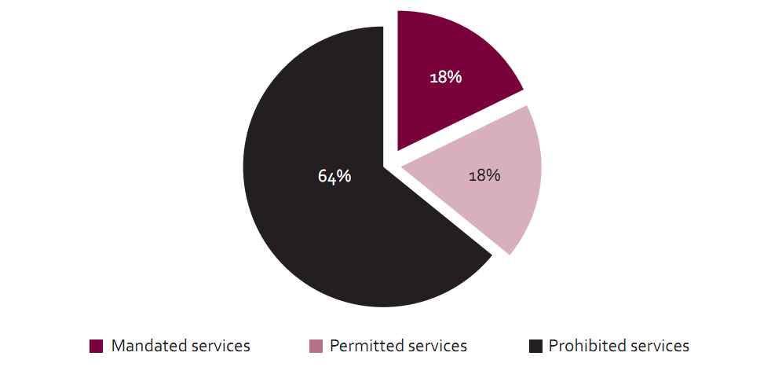
3. The reform agenda – ICB structural reforms
PROPOSED UK SPLIT

Slide 24
3. The reform agenda – Liikanen structural reforms
High-level EU expert group reported in October 2012.
Recommended separating trading from the deposit bank.
Plus powers to require further separation if needed for resolvability.
Banks should build up a sufficient layer of bail-in-able debt.
Need for more robust risk weights.
Need to augment existing corporate governance reforms.
Notes:
24

Slide 25
3.The reform agenda – Vickers vs Liikanen
Remarkably similar on structural reform – strong but flexible separation; don’t try to sub-divide trading; structured universal banking, not full split
On retail ‘versus’ trading separation, note that fence around the deer park to protect them from the lions = fence to keep the lions away from the deer
UK reform goes further than (baseline) Liikanen in some ways, but Liikanen proposes powers to require wider separation if needed for resolvability
Beware one-size-fits-all and note special features of UK banking
Notes:
25

Slide 26
4. Critique of the agenda
Complexity;
Resolution;
Capital;
Structure; and
Macroprudential regulation.
Notes:
26

Slide 27
4. Critique of the agenda - complexity
Glass-Steagall was 37 pages; Dodd-Frank was 848 pages; and it will require 400 pieces of detailed rule-making;
“If we want everything to stay the same, everything must change”:
The system will still be global;
it will continue to rely on the interaction of vast institutions with free-wheeling capital markets;
it will remain highly leveraged;
and it will continue to rely on managing maturity and risk mismatches.
Yet the new structure of regulatory oversight and rules displays the breakdown of trust between authorities and finance.
That is why the regulatory outcome has become so complex and prescriptive.
Notes:
27

Slide 28
4. Critique of the agenda - resolution
Resolution should work when the failure is idiosyncratic.
It is not clear that it will work in a systemic crisis:
It might exacerbate panic;
It is likely to be particularly difficult for the G-SIBs;
But the effect of the crisis has been to increase concentration in the global banking system.
It will certainly only work if (a) the debt is genuinely loss absorbing; (b) conversion is large enough to remove doubts about ongoing solvency; and (c) triggers are automatic, not discretionary.
More capital would surely be better.
Notes:
28

Slide 29
4. Critique of the agenda - capital
Higher capital requirements are, in my view, a social benefit, not a cost. I would like to see much higher capital ratios than now agreed in Basel, a minimum of 10 per cent true equity. Risk-weighting is so bad that a leverage ratio is also essential
One of the arguments for more capital is that resolution is not necessarily going to work.
Another is that this increases the stake of shareholders, in whose names the bank is notionally run.
It also removes the incentives to “go for broke”.
A situation in which taxpayers underpin banks, while bankers make private fortunes, is intolerable.
Notes:
29

Slide 30
4. Critique of the agenda - capital
The costs of more capital are usually exaggerated. Take an example:
Suppose one raised the equity ratio from 3 per cent to 10 per cent, that the cost of equity was 15 per cent a year and the cost of junior debt was 8 per cent a year.
The additional cost of funds would then be 49 basis points.
But this includes the effect of two subsidies on borrowing costs: tax benefits of debt and risk-bearing by taxpayers. Also the costs of junior debt would rise if it were loss absorbing.
The true social cost of extra capital would be close to zero, while benefits of reducing risk of a systemic crisis are huge.

Slide 31
4. Critique of the agenda - structure
Ring-fencing is needed if capital does not rise radically.
But why not separate retail from investment banking completely?
Ring-fencing retains many of the synergies of a broad banking group, while providing insulation for vital economic functions;
With ring-fencing the parent group could still rescue a failing retail bank;
A full split would create undiversified, correlated, stand-alone UK retail banking sector – stability risk;
So we favoured structured universal banking, not ending universal banking – more robust than unstructured universal banking.
Notes:
31

Slide 32
4. Critique of the agenda - macroprudential
A key role in future will be played by macro-prudential regulation.
This raises big issues:
Potential conflicts with monetary policy
Potential fragmentation of integrated financial markets inside the eurozone or the EU.
Notes:
32

Slide 33
4. Critique of the agenda - transition
We seem to want the balance sheets of the financial system to be larger in the short run and smaller in the longer run.
That creates a big dilemma for current policy.
The only solution is to get more capital into the financial system.
That will allow bad assets to be written down or written off, while expanding profitable lending.
Notes:
33

Slide 34
5. Future of finance
Here are five big questions:
Should we eliminate the creation of private debt-backed money?
Should we lower leverage in the economy and if so how far?
Should we reduce the leverage of financial institutions further?
Should we reduce the globalisation of the financial system?
Should we rely more on capital markets?
Notes:
34

Slide 35
6. Conclusion
The collapse of the western financial system contributed to a disaster from which we have not recovered.
The collapse was due to extreme fragility.
The reform effort has sought to make the current system more resilient.
But it is not clear it has gone far enough.
We face a long-lasting transition problem to what remains an uncertain destination.
Notes:
35

