Slide 1
David Smith
David Smith
Sunday Times
September 2011
Copyright © 2011 CIL Ltd. All rights reserved.

Slide 2
After the crisis
How Britain’s adjusted - and how it has not

Slide 3
Seven years after the worst storm in a century

Slide 4
It’s taken a long time to get over it

Slide 5
Particularly in the eurozone

Slide 6
Are we still in an age of instability?

Slide 7
How has Britain adjusted?

Slide 8
Five aspects of adjustment
Growth
The labour market
Fiscal adjustment/deficit reduction
Rebalancing
Monetary policy/normalization

Slide 9
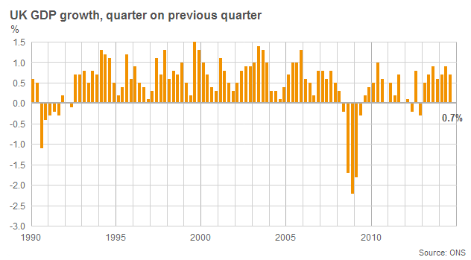
1. Growth: It has been a stop-start recovery

Slide 10
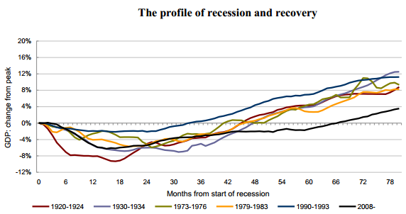
And weak by past standards

Slide 11
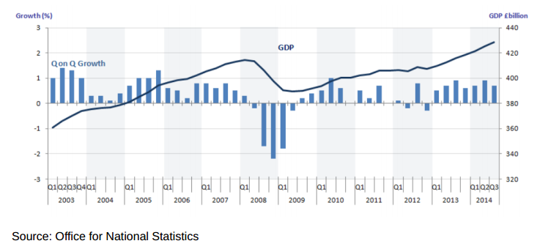
Though it has strengthened recently

Slide 12
Much to George Osborne’s relief
Early 2013 – Britain seemingly faced a triple-dip and George ‘playing with fire’ Osborne huge pressure to change policy.
Deficit reduction appeared to be going into reverse.
Growth came just in time.
The budget deficit is still falling, albeit slowly.

Slide 13
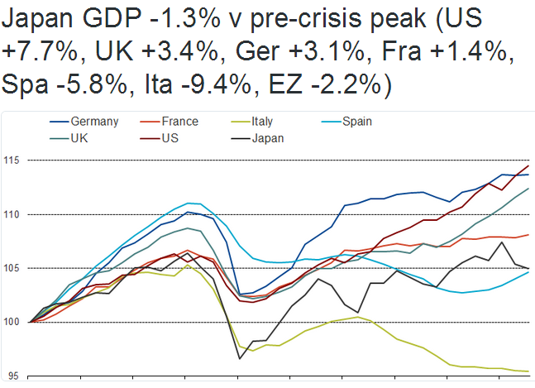
And now looks better internationally

Slide 14
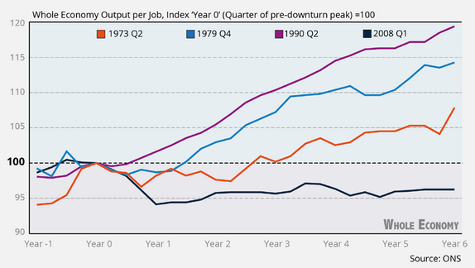
Despite weak productivity growth

Slide 15
Why has productivity been so weak?
Some sectoral factors – e.g. financial services, North Sea
Some productivity successes – e.g. manufacturing
Some measurement issues
But overall a story of substituting (cheap) labour for capital & the growth of low productivity jobs, mainly in services

Slide 16
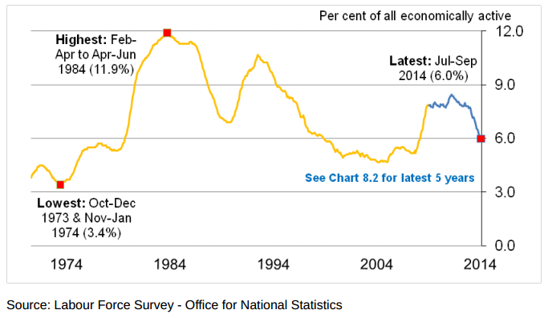
2. Labour market: rise & fall of unemployment

Slide 17
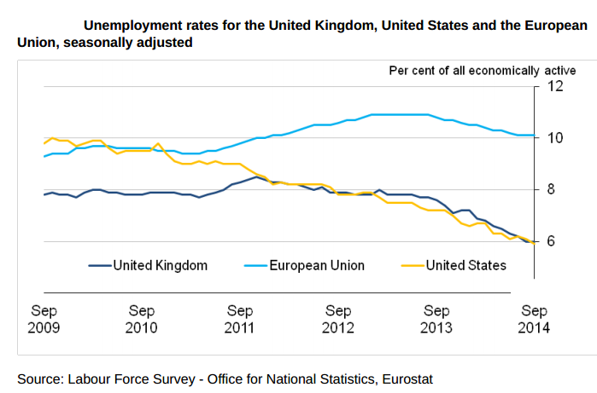
Much better than European average

Slide 18
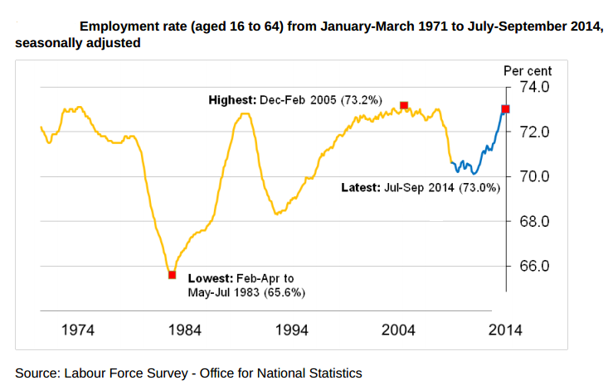
Strong employment growth

Slide 19
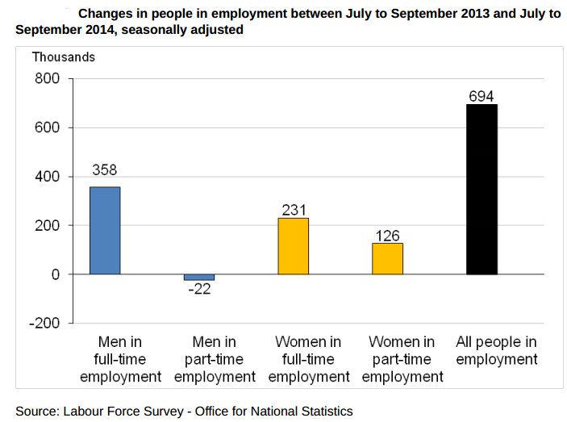
And much stronger recently

Slide 20
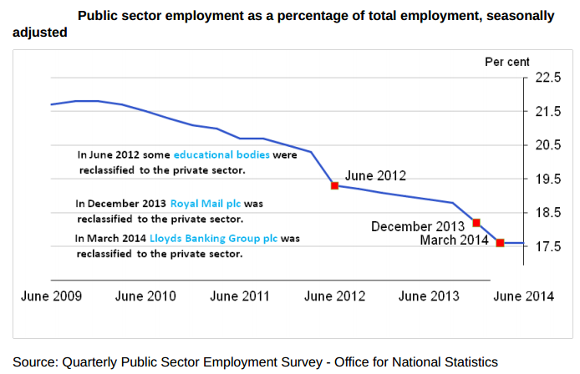
Despite a shrinking public sector

Slide 21
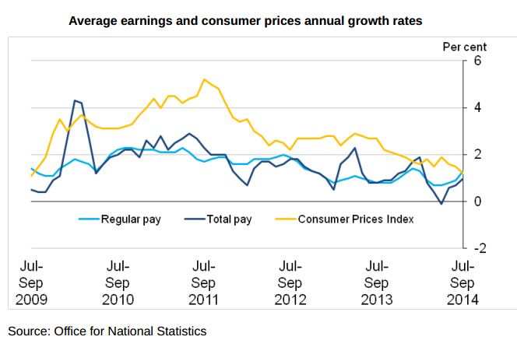
But wages have remained surprisingly weak

Slide 22
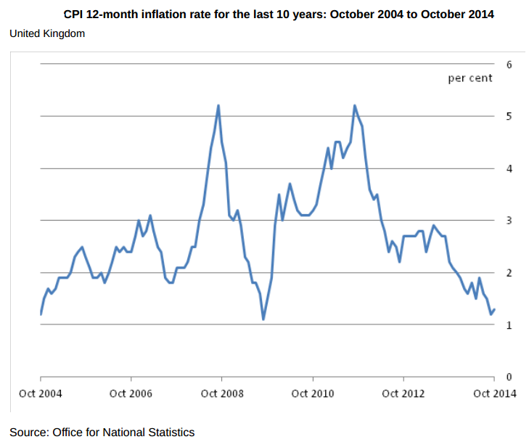
Falling inflation has eased the squeeze

Slide 23
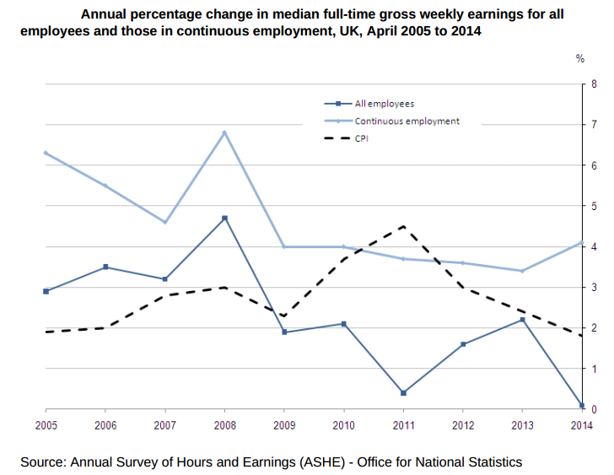
And a puzzling pay breakdown

Slide 24
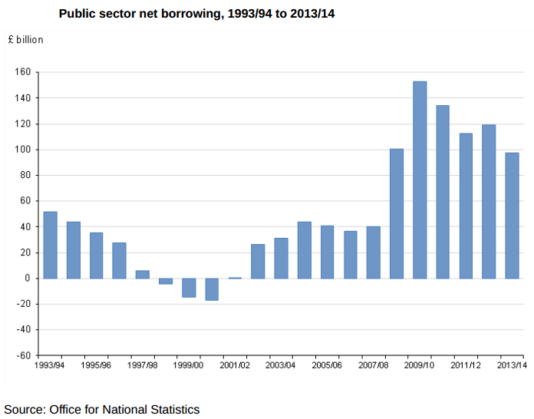
3. Fiscal adjustment going slowly

Slide 25
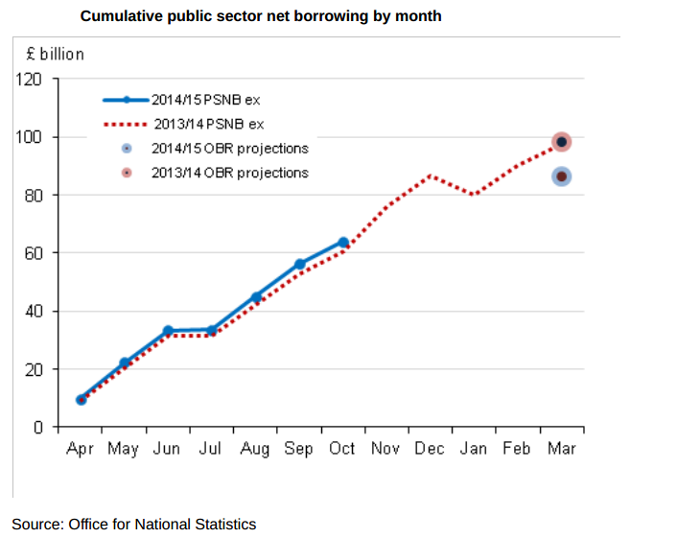
And may be going backwards

Slide 26
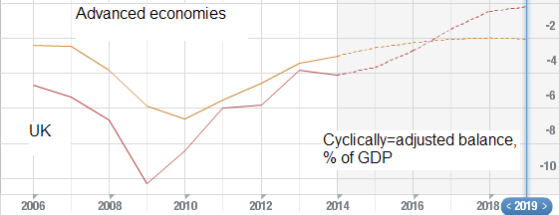
Underlying picture somewhat better

Slide 27
But the UK has a tax problem
Spending targets have been achieved, with some compositional caveats: public spending lower than set out in June 2010 ‘emergency’ budget.
Tax revenues weak – partly loss of some revenues e.g. from the City
Mainly generalised weakness in income tax and National Insurance
Reflects interaction of weak pay growth and the £10,000 personal allowance

Slide 28
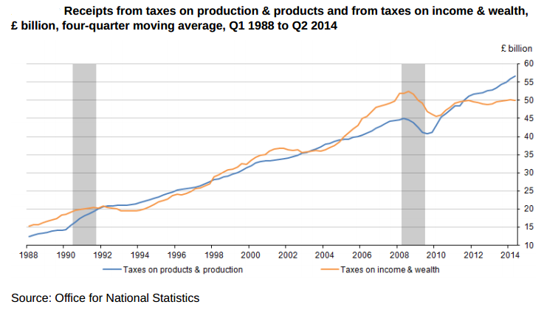
A break in the trend for income taxes

Slide 29
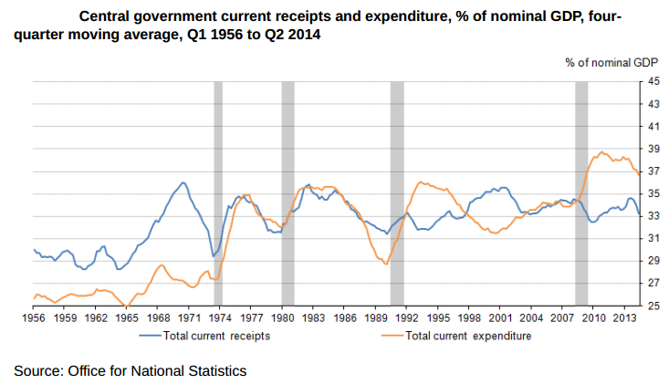
Leaving a big gap to fill

Slide 30
And more austerity
Deficit reduction was intended to be completed by May 2015 – current budget deficit eliminated.
Slow growth, OBR increase in structural deficit and tougher target means longer austerity
By end of this parliament: 55% of deficit reduction completed, 45% still to do

Slide 31
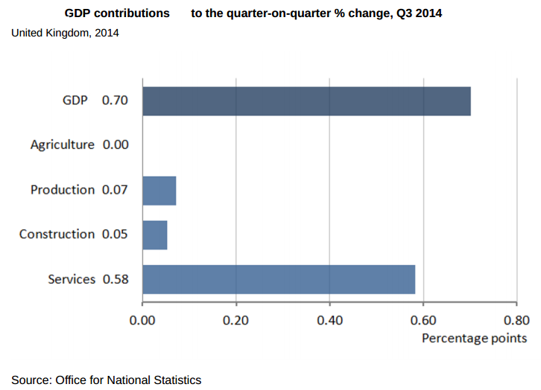
4. Rebalancing – all sectors are growing

Slide 32
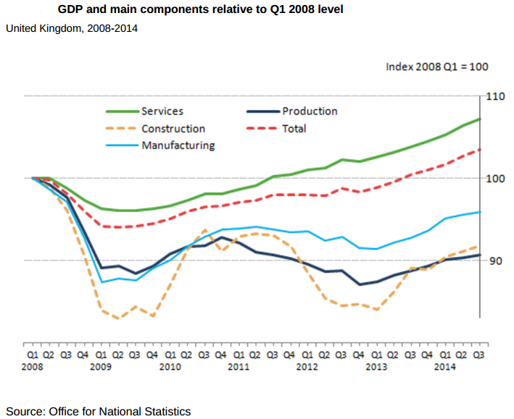
But only services above pre-crisis levels

Slide 33
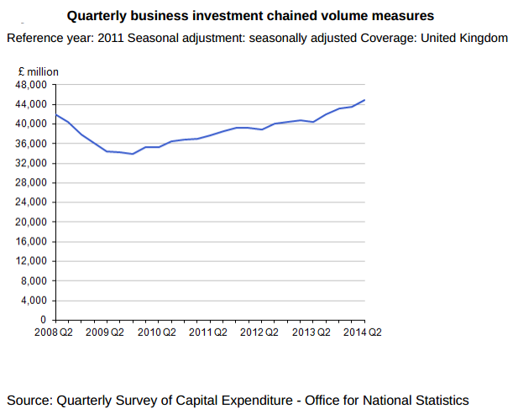
Investment is now recovering well

Slide 34
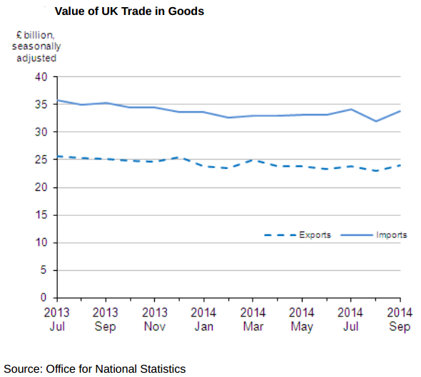
Exports have consistently disappointed

Slide 35
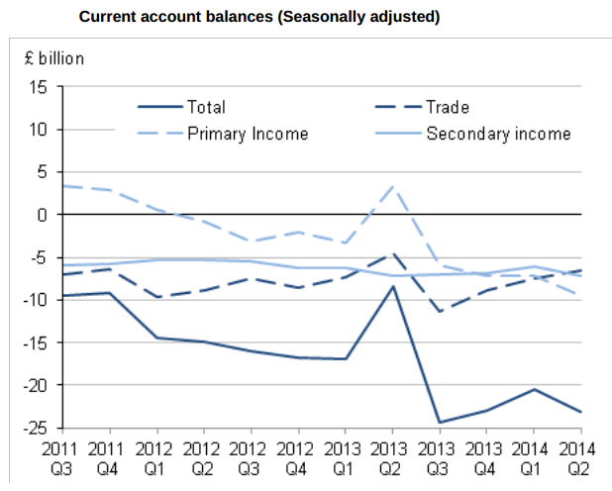
And a record current account deficit

Slide 36
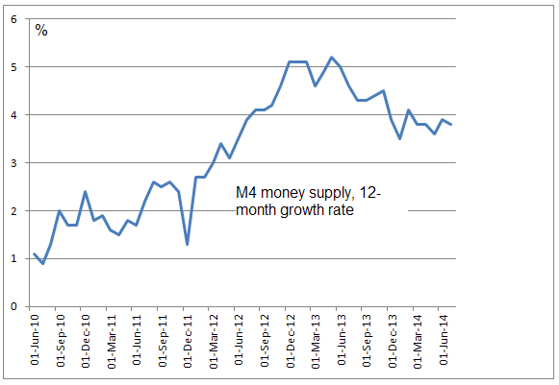
5. Monetary policy is working

Slide 37
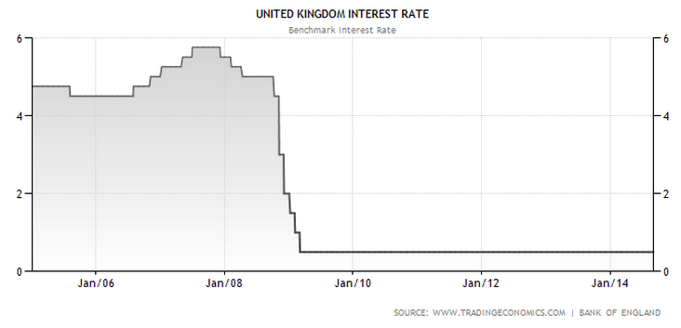
But remains exceptionally loose

Slide 38
Exceptional monetary policy
Lowest Bank Rate in history
Longest period of unchanged rates since shortly after WW2
Unconventional monetary policy too: mainly £375bn of QE
No meaningful QE reversal for some time.

Slide 39
Rates will eventually rise
Bank of England may hike at some stage next year
Federal Reserve should also start hiking in 2015
But any rate rise by the European Central Bank very distant
Japan stuck with zero interest rates

Slide 40
But will be much lower than in the past
Bank of England emphasising a ‘new normal’ for interest rates.
When rates rise they will do so gradually and to a much lower level than in the past.
2.5% or 3% rates could be the new norm – manageable for most borrowers.

Slide 41
QE may never be fully unwound
Bank of England will reinvest maturing gilts until rates begin to rise
Will only actively sell back gilts when interest rates can be ‘materially cut’
May permanently hold more assets - an expanded balance sheet – compared with the past

Slide 42
The Adjustment Scorecard
Growth slow at first, better recently, relatively good internationally.
Labour market – employment strong, wages productivity weak, but probably better than the alternative.
Fiscal consolidation has been achieved but a lot still needed: slow progress.
Rebalancing towards investment and growth across all sectors but exports weak and current account a worry.
A very long way from monetary normalization.

