Slide 1
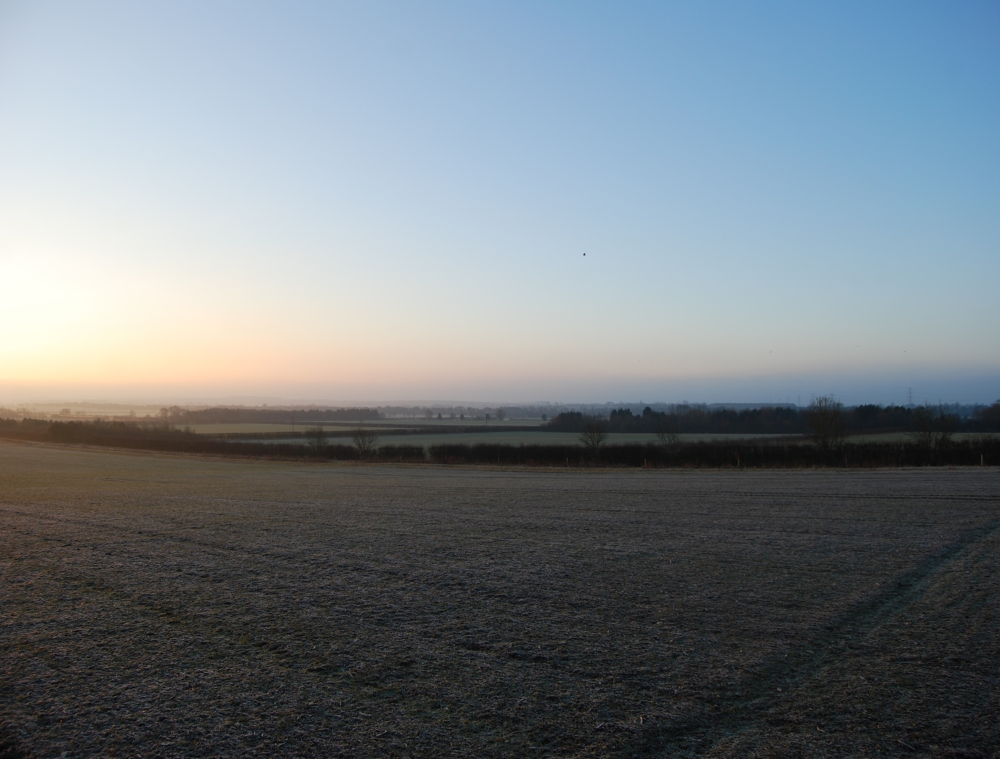
Agriculture; a sunrise industry!
Peter Kendall
Nottingham University 23rd March 2015

Slide 2
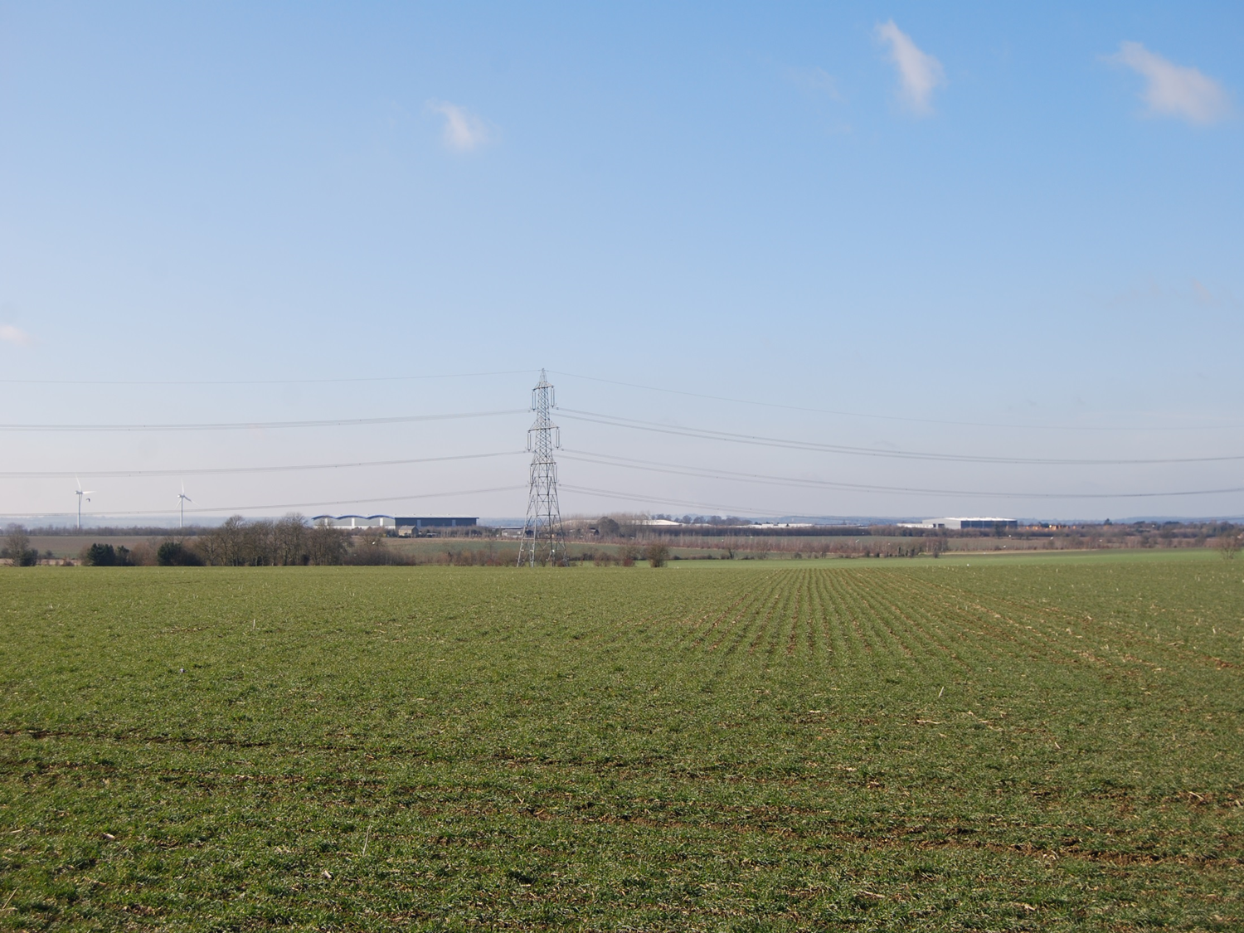

Slide 4
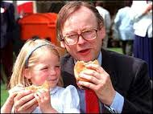
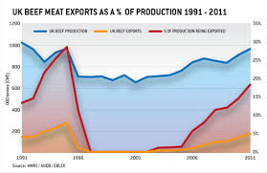
BSE
The worldwide ban on the export of British beef imposed by the European Union following the outbreak of BSE has had far-reaching consequences

Slide 5
Countryside closed for business; election postponed!

Slide 7
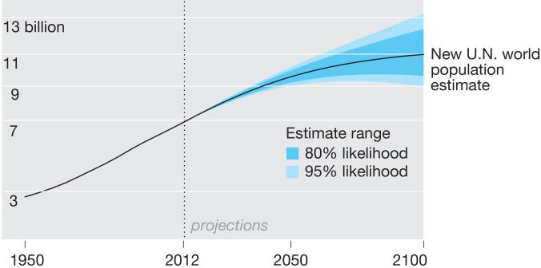
A World With 11 Billion People? New Population Projections Shatter Earlier Estimates

Slide 8
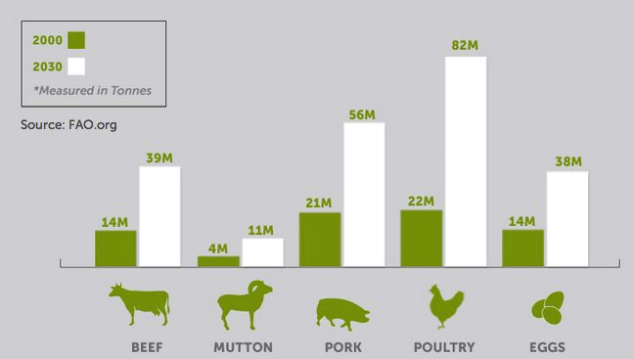

Slide 9
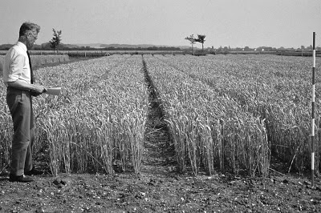
Research establishments closed
How Margaret Thatcher destroyed public sector science. The case of Plant Breeding Institute at Cambridge.
The erstwhile Plant Breeding Institute at Cambridge (UK)
Margaret Thatcher, 87, died yesterday. She is being hailed as the Iron Lady who transformed Britain

Slide 10
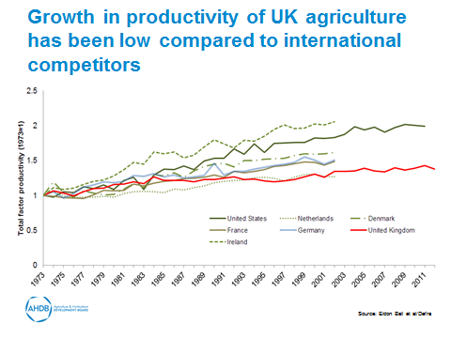

Slide 12
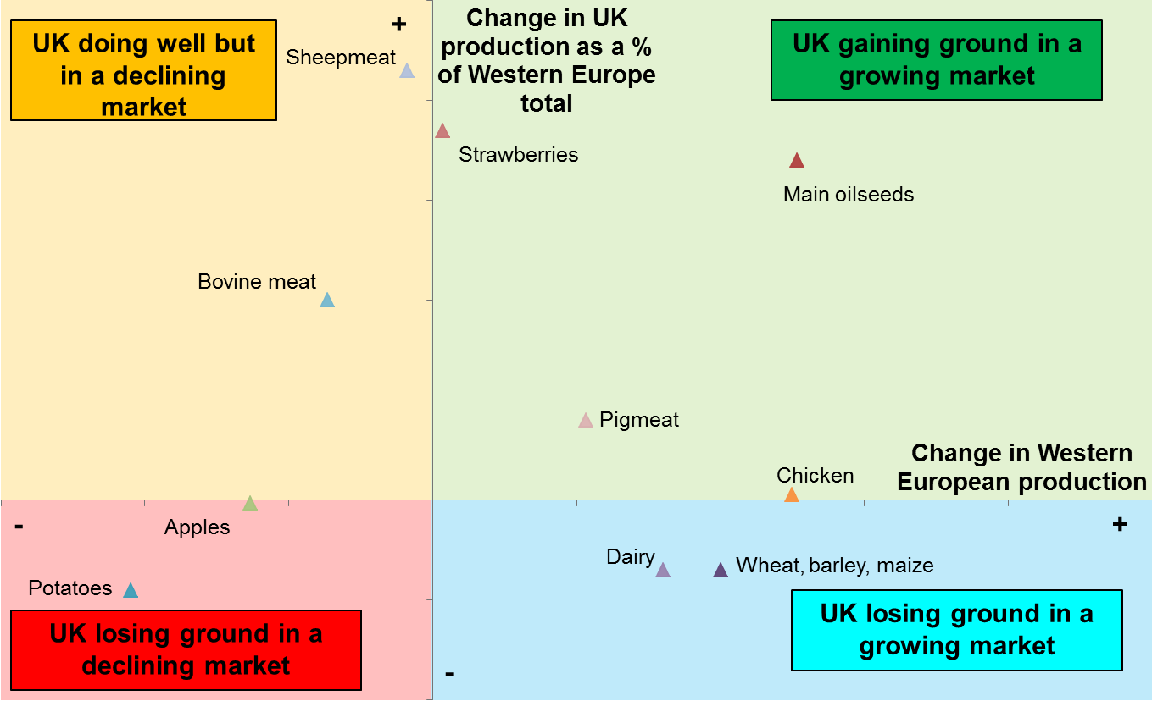
Sector Analysis
Source: Medium term changes in production based on official data e.g. Eurostat
Western Europe defined as UK, France, Germany, Denmark, Netherlands, Ireland, Italy, Spain, Portugal, Belgium and Luxembourg. Strawberries excludes Portugal, Denmark and Ireland. Apples excludes Denmark and Ireland

Slide 13
AHDB
Central to reversing this trend
Farmers contributing as well as Government
Key functions; R&D, KT, Market development, Market intelligence.

Slide 14
Investment in Agricultural Research

Slide 15
Precision Farming and The Internet of Things

Slide 16
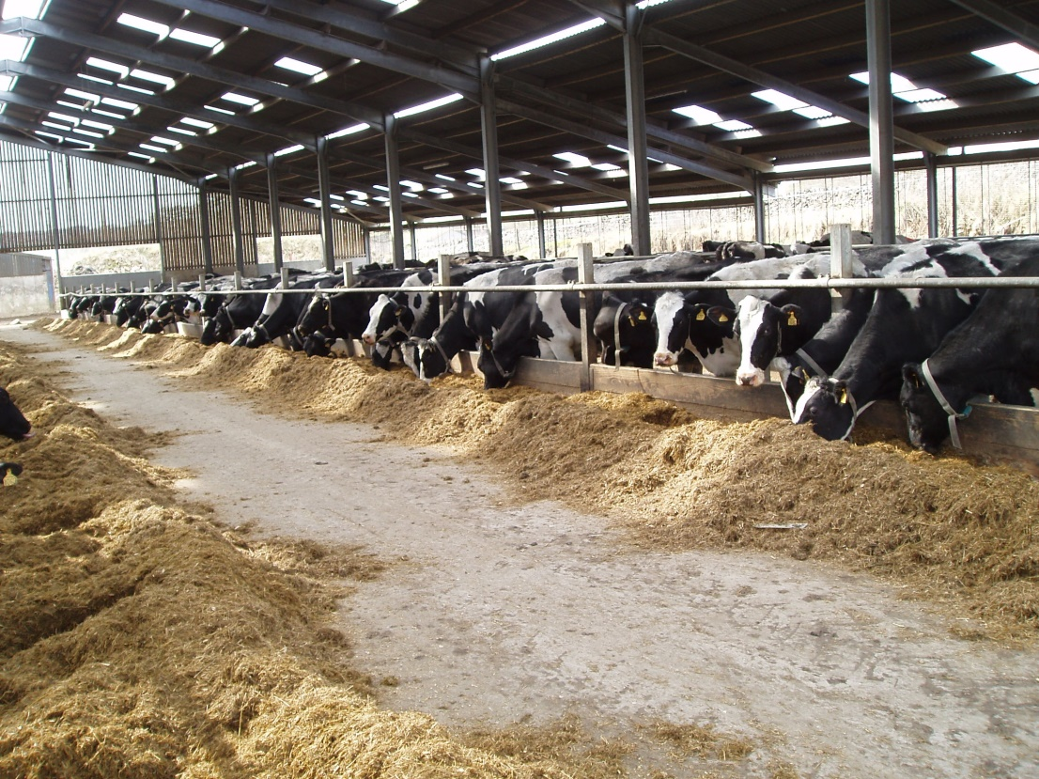
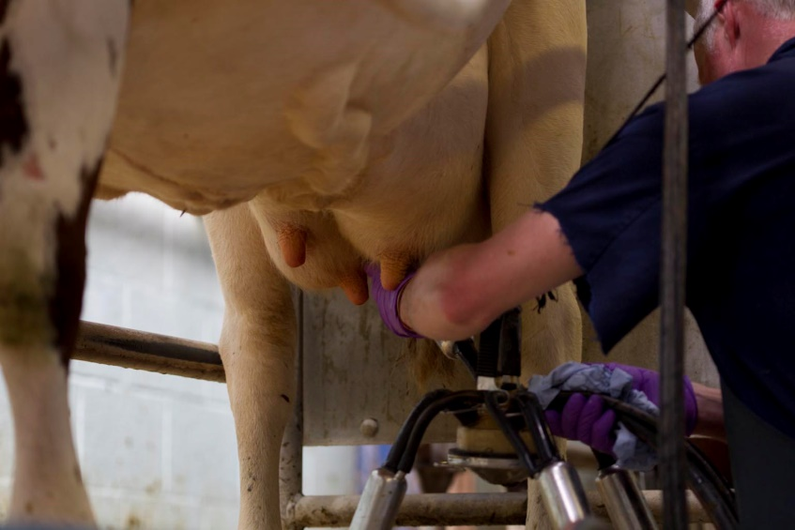
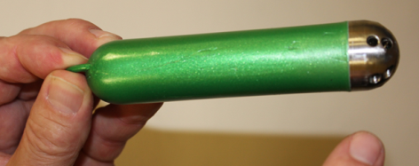
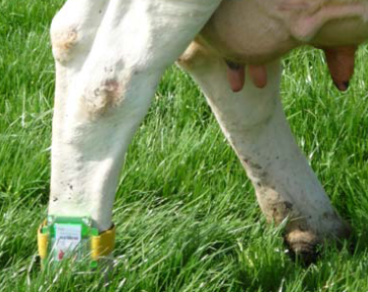
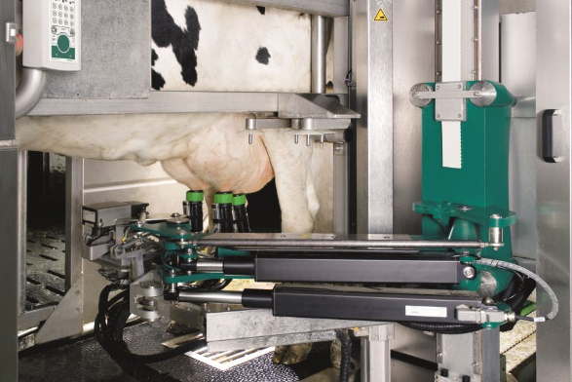
The appliance of innovation in dairy
Indoor housing system
Milking parlour
Bolous
pedometer
Robotic Milking
Identification tags

