Slide 1
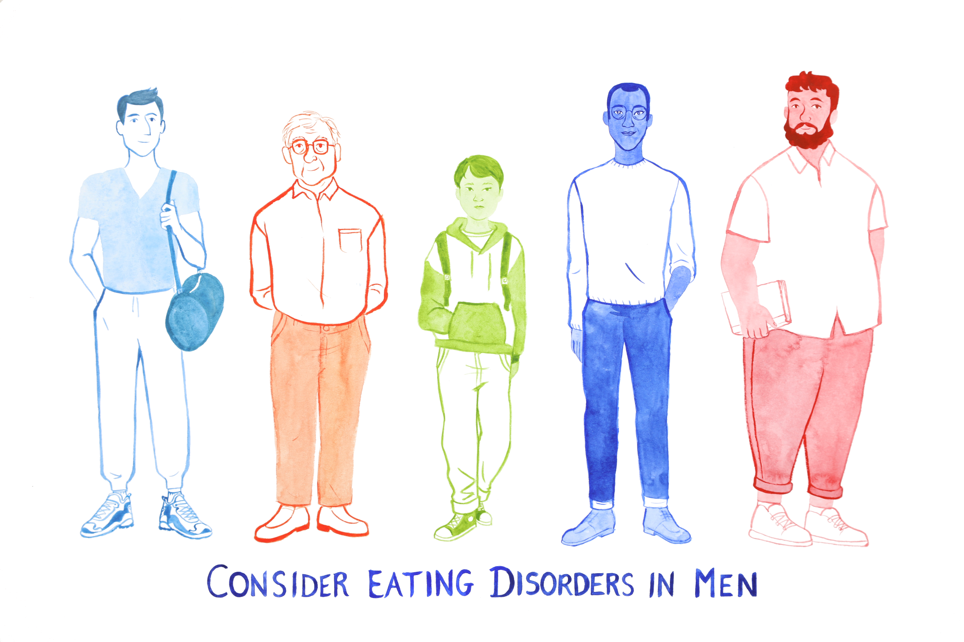
Consider Eating Disorders in Men
An animated training tool for GPs providing key information and help for daily practice
Developed by Heike Bartel (University of Nottingham) & Una Foye (King’s College London)
with
Dominique Thompson (GP, student mental health expert & NICE Eating Disorders Guidelines Committee 2017, RCGP Clinical Champion) &
Liz England (GP, RCGP Mental Health Champion)
https://www.nottingham.ac.uk/research/groups/hungry-for-words/consider-eating-disorders-in-men.aspx

Slide 2
An animated training tool to inform about eating disorders (EDs) in men* aged 18+, improve understanding of and care for this patient group, reflect upon aspects of primary care and make everyday practice easier.
At the centre of this training is a 3.5 mins animation, illustrating men’s personal experiences of seeing a GP to seek help for an ED. All contributors to the project were adults and talk about their experiences as adults and young adults (16 – 52). The training tool has ethics approval from The University of Nottingham (contact jennifer.birks@nottingham.ac.uk).
Before the animation you will be asked five questions about your confidence and experience supporting men with EDs and obtaining information about this topic. This will take approximately 3 minutes.
The animation itself will last 3.5 minutes.
Ten points with key information and additional resources will follow the animation. You can access them in your own time (we suggest: 30-45 mins)
At the end you will be asked to reflect on what you have learned and how it might affect your practice. This will take approximately 10 minutes. You will be able to print out your personal reflections (e.g. for professional appraisals).
The full training ‘Consider Eating Disorders in Men’ may take approx. 60 mins = suggested 1 CPD point.
* Please note that the terms ‘men/male patient’ includes all individuals identifying as male.

Slide 3
Results from this JISC survey will be fed back automatically and anonymously to the research leader, heike.bartel@nottingham.ac.uk at The University of Nottingham, for evaluation as part of a project on eating disorders.
All data will be stored securely. Results may be used for research purposes on the topic of eating disorders treatment and support in health care with special focus on men.
Ethics approval from The University of Nottingham, contact: jennifer.birks@nottingham.ac.uk
I confirm that: (a) I am over 16, (b) I have understood the potential research purpose of this survey , (c) that all data are anonymous (d) that there are no known risks or hazards associated participating in this study. By submitting the questionnaire contained in this survey I agree that my answers, which I have given voluntarily, can be used anonymously for research purposes.
◻ Yes ◻ No

Slide 4
Part 1: Questions before training
Please tell us how you currently feel about the following statements.
Your answers will be submitted anonymously as part of the survey.
 | Strongly agree | Agree | Somewhat agree | Neither agree nor disagree | Somewhat disagree | Disagree | Strongly disagree
I feel confident to spot the signs of an eating disorder in a man*.
I feel confident to start a conversation with a male patient* about his eating and relationship with food.
I feel confident about when to refer a male patient to eating disorder services.
Generic resources on eating disorders are easily accessible to me.
*The term ‘men/male patient’ includes all individuals identifying as male.
This training focuses on men aged 18+.

Slide 5
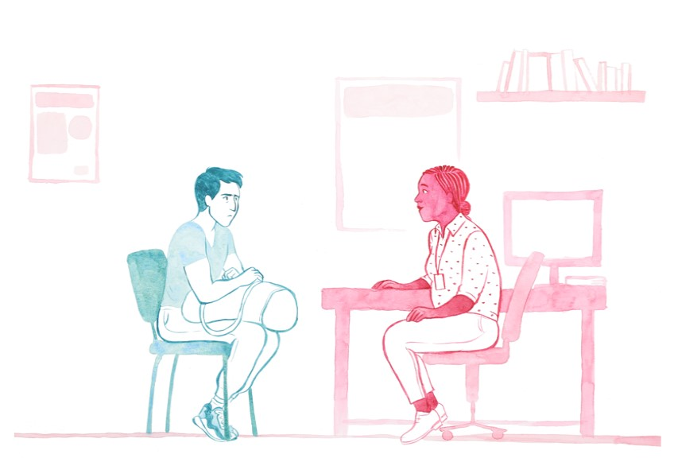
Questions before training
Your answer will be submitted anonymously as part of the survey.
Are there any specialised resources* on the topic of eating disorders in males that you have used to inform your everyday practice?
Yes | No | Don’t know
* Please note that this training contains such specialised resources for you to access and recommend in your future practice.

Slide 6
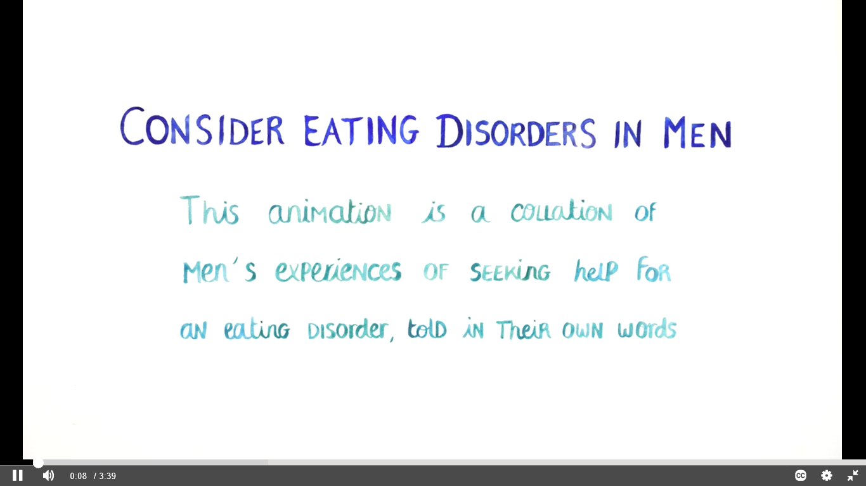
Part 2: Animation
The following animation lasts 3.5 minutes. It voices men's own experiences of seeing a GP about their ED.
After the animation you can read 10 pieces of key information on the topic.
https://youtu.be/Sbbdee4N4yA
.

Slide 7
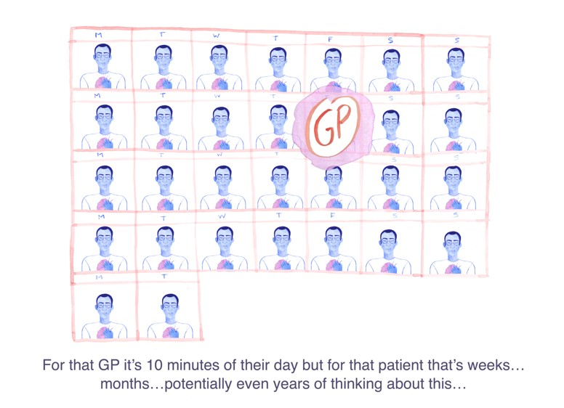
Part 3: Key information
Here you can access 10 points of key information and some further resources to:
learn more about eating disorders (EDs) in men
improve understanding and care
make your everyday practice easier.
Some facts about EDs
Facts & Figures about EDs in men
How to start an appropriate conversation
Symptoms and Red Flags
Examination and Risk Assessment
Making a Referral
EDs Services
Muscle Dysmorphia
Why do some people get EDs
Supporting Family and Carers
Further Resources

Slide 8
There are many different types of eating disorders (EDs) including Anorexia Nervosa (commonly associated with restricting eating and low weight) and Bulimia Nervosa (characterized by periods of binging or overeating, followed by fasting and/ or purging).
Less commonly known EDs include Binge Eating Disorder (where people experience a loss of control and binge eat similarly to bulimia without purging, often associated with extreme feelings of distress) and Other Specified Feeding or Eating Disorders (OSFED) which was previously known as Eating Disorder Not Otherwise Specified (EDNOS) (a category that encompasses those individuals who did not meet strict diagnostic criteria for anorexia or bulimia but still had a significant eating disorder).
Only about 10% of people with an ED fit into the category of anorexia, 20% bulimia, 20% Binge Eating Disorder, and up to 50% OSFED.
An estimated 1.25 million people in the UK have an ED. However, studies suggest that just 23% of individuals with diagnosable EDs seek treatment specific to EDs meaning that many people are not accounted for within these official statistics.
Anyone can go through the kinds of stresses and worries that might lead to them developing an ED – things like work or academic stress, bereavement, difficulties in an important relationship, struggles with body image, these are not unique to one gender or one sexual orientation. EDs can affect any age group, children, adolescents, adults and those in later life, people of any ethnicity and individuals with learning disabilities.
Animation: “It’s a complicated process … there’s no easy fix … and no two people are the same…”
1. Some facts about eating disorders
New classification DSM 5
Anorexia, Bulimia, BED, OSFED, Pica/Rumination Disorder, ARFID (Avoidant Restrictive Food Intake Disorder)
Notes:
Sources: Hay, P., Girosi, F. & Mond, J. Prevalence and sociodemographic correlates of DSM-5 eating disorders in the Australian population. J Eat Disord 3, 19 (2015) doi:10.1186/s40337-015-0056-0
https://www.beateatingdisorders.org.uk/media-centre/eating-disorder-statistics
Hart, L. M., Granillo, M. T., Jorm, A. F., & Paxton, S. J., 2011: https://www.sciencedirect.com/science/article/pii/S0272735811000523?via%3Dihub

Slide 9
2. Facts and figures about eating disorders in men
Animation: “We don’t all fit into one box”
Official statistics suggest that men and boys make up 10% of these patients however recent research suggests males account for around 25% of those with an ED
Males account for approximately one-third of all bulimia cases, and binge eating seems to be the most common ED in males.
NHS figures released in November 2018 show that the prevalence of EDs in young men in hospital have increased by 98% between 2010 and 2018, growing at a faster rate for boys than girls.
LGBTQ+ groups and transgender individuals can be disproportionally affected. Previous studies on men with EDs have focused on the experiences of gay or bisexual men finding higher levels of disordered eating. However, more recent work has found that heterosexual men are experiencing increased levels of body dissatisfaction and disordered eating.
Due to perceived stigma attached to EDs, men may find it much harder to seek help.
“One of the reasons why I was reluctant to seek help was because I thought I'd be judged...”
Notes:
Hudson, J. I., Hiripi, E., Pope, H. G., Jr, & Kessler, R. C. (2007). The prevalence and correlates of eating disorders in the National Comorbidity Survey Replication. Biological psychiatry, 61(3), 348–358. doi:10.1016/j.biopsych.2006.03.040
Lavender, Brown & Murray, 2017
Mitchison & Mond, 2015.
NHS Digital, 2018: https://www.england.nhs.uk/mental-health/cyp/eating-disorders/
Frederick, D. A., & Essayli, J. H. (2016). Male body image: The roles of sexual orientation and body mass index across five national US Studies. Psychology of Men & Masculinity, 17(4), 336–351. doi:10.1037/men0000031

Slide 10
3. How to start an appropriate conversation

Slide 11
3. How to start an appropriate conversation
Animation:
“It can be very frightening to expose the thing you might be very ashamed of…”
Starting a conversation can be a powerful way to support your patient. They may be attending to address their eating disorder (ED), or because of a physical health complaint such as gastrointestinal problems, or because of an aspect of their mental health such as depression. It is important that if you are concerned that they might have an ED that you speak to them about this.
Often people with EDs deny or do not realize there is a problem. EDs are often kept secret. Many people who are in recovery agree that breaking the silence in a sensitive way is the right thing to do, even if they did not feel that way at the first consultation and needed to be given more time.
Because of the stigma commonly attached to EDs as a ‘girls’ illness’ men might find it hard to speak about their problems with eating.
The sooner someone can get treatment, the greater their chance of a full and sustained recovery, but if you don’t start the conversation, you may not find out.
“One of the reasons why I was reluctant to seek help was because I thought I'd be judged… I guess society had made it a … a feminine illness.’”

Slide 12
3. How to start an appropriate conversation
Animation:
“I want first and foremost to be listened to…somebody to just hold the space…”
Conversation starters … are as individual as any patient and healthcare professional
Suggestions are:
“You seem to be worried/ struggling with your eating…”
“Is your eating pattern a worry for you?”
“I’m here to help as much as I can…” ; “I’m here to listen…”
“In my experience depression can throw out obstacles and have other underlying causes… I think your eating might be adding to that…”.
Further questions:
Do you worry a lot about your weight and/or body shape? Maybe too much?
Do you spend a lot of time thinking about your weight/shape and what you eat?
Does your weight/shape affect the way you feel about yourself?
Have you lost control over what you eat/ do you eat in secret/ make yourself sick?
Individual questions that may possibly rule out an ED:
Does your weight/shape affect the way you feel about yourself? -no
Are you satisfied with your eating patterns? - yes

Slide 13

Further tips
Provide information, avoiding ‘scare tactics’.
Positively reinforce steps taken so far. E.g. “Good that you mention this today” and validate anxiety and ambivalence.
Avoid expressing your own assumptions but try to elicit change talk – the more you can help your patient to verbally state their own reasons for considering change, the better the chance of them making changes. E.g. “What has led you to mention this at this time? How is this affecting your life? What problems is it causing? What does it get in the way of?”
Animation: “My GP was like .. ‘oh, you'll be fine’.”
Try to understand what has made them seek help and also what makes the man unsure about seeking treatment (e.g. not knowing what the cause of behaviour is / (self)stigma of having a ‘girls’ illness’/ low confidence in success / fear of failure / anxiety about change / shame / worry about control being taken away / fear of weight gain / loss of shape / worries about ability to cope without the eating disorder… are all common).
Help those expressing readiness to attempt change to make small, manageable and achievable goals. Behavioural change is a positive predictor of outcome.
Help the person to feel in control, e.g. by providing information about the referral to Eating Disorder Services: It is an opportunity for a discussion, focusing on the current situation with food. An eating disorder specialist can offer advice or follow-up.
Provide other information and resources. For local support groups and self-help: http://helpfinder.b-eat.co.uk/join-helpfinder/helpfinder-listings/
“My GP was great ... she really knew the local charities, and was like ‘In the meantime, whilst you’re waiting on a referral, here’s some groups that can help you’.”
3. How to start an appropriate conversation

Slide 14
4. Symptoms and Red flags
Eating disorders (EDs) are complex and can present with a range of physical and psychological symptoms. Patients rarely present with eating issues as the problem. They may have a physical health complaint or come in for another mental health problem, having not considered an ED, or they may not want to talk about/ address their eating problems. EDs are serious mental illnesses with severe medical impact. It is important to look at the physical as well as the mental health symptoms facing patients, and to avoid potential diagnostic overshadowing.
Below are a range of symptoms and red flags that may help identify if a patient is at risk. This is not an exhaustive list …
Behavioural signs:
Emotional:
Physical symptoms:
Dieting, missing meals or avoidance of food, but there may be a denial of this
Stating a need to eat less than others or eating very small portions. Avoiding eating with others and opting out of meal times
Secrecy around food and eating
Increased interest in preparing food, reading recipes, watching food based TV programmes
Wearing baggy clothes, or more clothes to conceal weight loss
Increased sensitivity about body shape
Increased interest in or avoidance of weighing and checking in mirrors
Reluctance to participate in activities where the body will be viewed by others i.e. swimming , sports
Concerns about use of anabolic steroids
Increase in exercise, both overt and exercising in secret
Spending increased time in the bathroom after meals
Increased obsessiveness in certain behaviours and perfectionism
Mood changes – particularly depressive symptoms
Low self-esteem
Feeling suicidal
Increased substance misuse
Increased anxiety
Social withdrawal, particularly from situations that involve food
Distorted body image
Other mental health diagnoses (e.g. anxiety, depression, OCD, substance misuse, self-injury, etc)
Generic symptoms:
  Headaches
  Fainting / Dizziness
  Fatigue / Lethargy
  Palpitations
  Cold intolerance
  Dry Skin
  Bloating
  Abdominal Pain / Constipation
Bulimia: Gastroesophageal Reflux Disease, peptic ulcers, electrolyte imbalances, sore throat (from vomiting), and possibly dental enamel erosion
Anorexia: Brittle bones, muscle loss, cardiac symptoms, hair loss, erectile dysfunction
Binge eating disorder: High blood pressure, high cholesterol, type 2 diabetes, gallbladder disease
Animation: “My eating was a total mess. I was beginning to have severe gastrointestinal problems… I was having heart palpitations…but…I looked bloody fabulous.”

Slide 15
Muscle dysmorphia is more common in males than in females: a condition whereby the sufferer is preoccupied with thoughts of wanting to look more muscular and perceives themselves to be skinny, regardless of their actual physical size. This has led to the condition being dubbed 'Bigorexia' or 'Reverse-Anorexia', a reference to it being the opposite of anorexia in a sense. Muscle Dysmorphia in the DSM-5 as a variant of Body Dysmorphic Disorder.
Common recognisable symptoms of Muscle Dysmorphia include:
Preoccupation with body image, in particular the wish to look muscular
Intense fear of losing weight and 'withering away’
Excessive exercise with the aim of 'bulking-up'
Planning and often neglecting other life activities around exercise
Adhering to unconventional diets to help achieve the 'ideal' body shape
Use of steroids or dietary supplements aimed at increasing muscle mass
Avoidance of situations where the individual's body could be exposed due to feelings of inadequacy
Animation:
“If somebody’s doing a lot of exercise … consider it could be an eating disorder”
5. Muscle Dysmorphia
Notes:
Morgan J. The invisible man: A self-help guide for men with EDs, compulsive exercise, and bigorexia. New York, NY: Routledge; 2008

Slide 16
6.Examination and risk assessment
For people with eating disorders (EDs) presenting in primary care, GPs should undertake the initial assessment and the initial co-ordination of care. This includes the determination of the need for emergency medical or psychiatric assessment and referral to EDs services.
Although weight and body mass index (BMI) are important indicators of physical risk they should not be considered the sole indicators of risks (as on their own they are unreliable).
It is important that you consider BOTH mental and physical health checks as equally important and to avoid the potential of diagnostic overshadowing.
Professionals in primary and secondary mental health or acute settings should assess the following in people with a suspected eating disorder (NICE, 1.2.9):
physical health, including checking for any physical effects of malnutrition or compensatory behaviours such as vomiting (note: bloods may present as normal.)
the presence of mental health problems commonly associated with EDs, including depression, anxiety, self-harm and obsessive compulsive disorder; the possibility of alcohol or substance misuse
the need for emergency care in people whose physical health is compromised or who have a suicide risk
Animation:
“Depression’s what I went in for…”
  DO NOT FORGET TO ASSESS FOR OTHER
  MENTAL HEALTH SYMPTOMS.
  Consider looking at the possible interrelated mental health issues that patients may be presenting with such as depression and anxiety that may impact on their well-being and affect recovery.

Slide 17
6.Examination and risk assessment
When to refer more urgently:
An urgent referral to the EDs service reflects the level of risk and severity of problems associated with the ED. Provide acute medical care (including emergency admission) for people with an ED who have severe electrolyte imbalance, severe malnutrition, severe dehydration or signs of incipient organ failure (NICE 1.10.3). When considering urgent referrals take the following into account (NICE 1.11.3 ):
The person's BMI or weight, and whether these can be safely managed in a day patient service or whether the rate of weight loss (for example more than 1 kg a week) means they need inpatient care.
Whether inpatient care is needed to actively monitor medical risk parameters such as blood tests, physical observations and ECG (for example bradycardia below 40 beats per minute or a prolonged QT interval) that have values or rates of change in the concern or alert ranges.
The person's current physical health and whether this is significantly declining.
Whether the parents or carers of children and young people can support them and keep them from significant harm as a day patient.
If a person's physical health is at serious risk due to their ED, they do not consent to treatment, and they can only be treated safely in an inpatient setting, follow the legal framework for compulsory treatment in the Mental Health Act 1983.
You do not need to be 100% sure of the specific type of ED to urgently refer.
For more info visit: https://www.kcl.ac.uk/ioppn/depts/pm/research/eatingdisorders/resources/GUIDETOMEDICALRISKASSESSMENT.pdf

Slide 18
6.Examination and risk assessment
Looking for in blood tests:*
Low K from vomiting or laxative abuse
High bicarb from vomiting
Low bicarb from laxative abuse
Low Mg from diarrhoea
Low PO4 from malnourishment
Low Hb 90-120
Low WCC 2-4
High ALT/ ALKP
Low Gluc
Low Na
Comorbidities
Psychological; treat e.g. anxiety, depression and OCD also
Medication; consider compliance & risks e.g. side effects of weight gain, or cardiac effects e.g. K+, bradycardia, QT interval
Diabetes; collaboration key, between diabetes and ED team and GP. Misuse of insulin high risk. Specific advice in NICE guidance
Osteoporosis (local guidelines from rheumatologists re DEXA)
[Puberty/ growth failure; refer specialist endocrinology]
Animation:
‘My GP said:
“I'm worried about you’.”
To people with anorexia nervosa who are not receiving ongoing treatment for their ED, GPs should offer a physical and mental health review at least annually, to include: weight or BMI; blood pressure; relevant blood tests; any problems with daily functioning; assessment of risk (related to both physical and mental health); an ECG, a discussion of treatment options. (NICE, 1.10.10)
Tip: consider doing an audit for your appraisal / CPD
Notes:
* Source: https://www.kcl.ac.uk/ioppn/depts/pm/research/eatingdisorders/resources/GUIDETOMEDICALRISKASSESSMENT.pdf

Slide 19
7. Making a referral
If you suspect an eating disorder (ED) after an initial assessment and there is no immediate risk refer to a community-based ED Service for further assessment or treatment.
NICE guidelines suggest considering a range of factors when deciding whether to refer someone for treatment (NICE Rec. 1.2.6): Do not wait for low weight. EDs are complex mental illnesses, and no single measure (i.e. weight) should be used to determine whether to offer treatment (NICE Rec. 1.2.8).
Because of the highly specialised level of care required for people with EDs, NICE recommends immediate referral for specialist assessment (NICE Rec. 1.2.10). Ensure you enter “eating disorder” into SNOMED CT / READ code.
For further information visit the NICE guidelines (NG69, May 2017) at: https://www.nice.org.uk/guidance/ng69
Consider whether liaison with specialist services elsewhere is required if your patient is moving areas (e.g. for university, work). Patients are at risk of being lost within the system during these transition periods (e.g. from home to university or from CAMHs to AMHs). Your role is key in coordinating this, supporting the patient, and ensuring they don’t fall through the gaps.
Students may find it difficult to access care if they are registered with a GP practice as temporary residents, e.g. when they are at home from university. Under the current NHS guidance, students should have access to appropriate healthcare services at university and at home, this may require liaison with their regular GP. You can find more information on transition issues from NHS guidance: Commissioning Development Directorate, NHS England. Who Pays? Determining responsibility for payments to providers. (2013). Many universities have their own specialist eating disorder support and services.

Slide 20
Animation: “My GP was great ... she really knew the local charities, and was like ‘In the meantime, whilst you’re waiting on a referral, here’s some groups that can help you’.”
Throughout the UK there are regional variations in the services that are offered and available to individuals with eating disorders (EDs). This means that the type of treatment available in your area may be different to other areas based on services, their specialist knowledge, resources and the way that they work.
This is particularly important across Scotland, Wales and Northern Ireland where the policies and frameworks that inform services can be very different from those used in England. Services will also vary widely depending on availability across England.
For information about self-help and support groups in your area you can use the B-eat helpfinder for England, Scotland and Wales: http://helpfinder.b-eat.co.uk/join-helpfinder/helpfinder-listings/, for details of organisations in Northern Ireland visit: https://www.eatingdisordersni.co.uk/.
Many of these services also provide support to family, friends and carers.
If you are unsure about local services for EDs for adults your local adult psychiatric service will also be able to provide guidance and signpost to the appropriate service.
8. Eating Disorders Services

Slide 21
9. Why do some people get eating disorders?
There is no single reason why a person develops an eating disorder (ED). For some people, males and females, it may be about controlling something when everything else in their lives feels out of control, for others it is about having that security and “body armour” (animation). It is important to be open to hearing the person’s circumstances and not to assume why they are experiencing this mental health problem.
Animation: “It’s a complicated process … there’s no easy fix … and no two people are the same…”
Though the exact causes of EDs are unknown, it is generally believed that a combination of biological, psychological, and/or environmental abnormalities contribute to the development of these illnesses.
Examples of biological factors include:
Genetics / family history
Neurobiological factors
Neurochemical factors
Examples of psychological factors include:
Negative body image
Poor self-esteem
Examples of environmental factors include:
Aesthetically oriented sports, where an emphasis is placed on maintaining a lean body for enhanced performance.
Childhood trauma
Sociocultural factors
Stressful transitions or life changes (e.g. transitioning due to university or work)

Slide 22
10. Supporting family and carers
Experiencing that someone close has an eating disorder (ED) is often difficult and distressing for parents, siblings, other family members, partners, friends or co-workers. They may feel responsible or guilty and unsure of how to help them get better. They might need:
  emotional and social support
  practical support, including discussing care plans and what to do if emergency care is needed.
Being involved
A patient of 18+ with an ED might find it comforting to have family members, a partner or trusted friends involved in their recovery process. But if the patient prefers not to have family involved, that wish needs to be respected too.
After referral, ED services may offer family member involvement. In addition, there are many local and national support services for family/ carers, available via
http://helpfinder.b-eat.co.uk/join-helpfinder/helpfinder-listings/;
Additional services: e.g.: https://www.beateatingdisorders.org.uk/someone-else/support-for-carers
https://firststepsed.co.uk/parents-and-carers/
Animation:
“I think giving hope helps … saying we can give you … your love of life back … your relationship with yourself … with others …”

Slide 23
11. Further resources
For further information about assessment and treatment of eating disorders please visit the NICE guidelines (NG69, May 2017) at: https://www.nice.org.uk/guidance/ng69
Beat the national eating disorders charity have lots of information and online support groups and helpline services: https://www.beateatingdisorders.org.uk/
Anorexia, Bulimia Care (ABC) provide on-going care, emotional support and practical guidance for anyone affected by eating disorders, those struggling personally and parents, families and friends http://www.anorexiabulimiacare.org.uk/
Male Voice ED is a charity which recognises and values the lived experience of males who have experienced, or are experiencing, eating disorders, disordered eating and associated co-morbid conditions, providing a range of support groups across the UK: https://www.malevoiced.com/
For information about support groups in your area you can use the B-eat help-finder for England, Scotland and Wales: http://helpfinder.b-eat.co.uk/join-helpfinder/helpfinder-listings/, First Steps provide support for individuals and their families in the midlands https://firststepsed.co.uk/, visit Eating Disorders Association for details of organisations in Northern Ireland: https://www.eatingdisordersni.co.uk/
Animation: “A GP once said to me ‘I’m not exactly sure who we should be referring you to… I’m gonna have to go ask one of my colleagues, and I can get back to you…’”

Slide 24
Part 4: Questions after training
Please tell us how you feel now, after the training, about the following statements Your answers will be submitted anonymously as part of the survey.
 | Strongly agree | Agree | Somewhat agree | Neither agree nor disagree | Somewhat disagree | Disagree | Strongly disagree
Now, after the training, I feel more confident to spot the signs of an eating disorder in a man*.
Now I feel more confident to start a conversation with a male patient* about his eating and relationship with food.
Now I feel more confident about when to refer a male patient to eating disorder services.
The training helped me to reflect on the challenges of looking after men with eating disorders.
* The terms ‘men/male patient’ include all individuals identifying as male.
This training focuses on men aged 18+.

Slide 25
Final page
Your answers will be submitted anonymously as part of the survey.
Please reflect in a few words on how this training tool might influence your practice. What single change will you make? Please print out this page for your records and appraisal purposes. The full training ‘Consider Eating Disorders in Men’ should have taken approx. 60 mins = 1 CPD point
If you have any feedback or questions about the research behind this training tool, please contact Dr Heike Bartel at: heike.bartel@nottingham.ac.uk or visit https://www.nottingham.ac.uk/research/groups/hungry-for-words/

