Slide 1







Religion & Worldviews in Religious Studies
Training Pack for Secondary Schools
Notes:
Welcome to the “Adopting a Religion & Worldviews approach in RS” training for secondary school teachers.
Before delivering the training, we recommend that trainers print this slide deck using the “notes pages” option (> click on “print” and in “settings” change from “full page slides” to “notes pages”). This will enable you to see all the trainer’s guidance under each slide, which will be useful to help you deliver the training. We also recommend that trainers get familiar with the training package and guidance notes prior to the training, as the aim is not for the trainer to read the guidance notes to the teachers – instead they have been added to this training to help you prepare what to say for each slide.
This pack has been designed in such a way that it can be delivered as a whole day training – in which case you will want to go through sessions 1, 2, and 3 or 2, 3 and 4 depending on your audience – or as a series of twilight sessions.
You might find it useful to conduct a short audit prior to the training, to understand where teachers are at when it comes to Religion and Worldviews (R&W). Here are some questions you could put on an online form (such as Microsoft Form) to capture attitudes:
How confident do you feel delivering RE classes in general? 1-5 (1: not at all confident; 5: very confident)
How confident do you feel about adopting a Religion and Worldviews (R&W) approach in the RE? (1: not at all confident; 5: very confident)
How confidently would you be able to explain to colleagues the challenge of defining “religion” and the implications of this challenge for teaching RE? Scale 1-5 (1: not at all confident; 5: very confident)
How confidently would you be able to explain to colleagues the problems with the World Religions approach? Scale 1-5 (1: not at all confident; 5: very confident)
How confidently would you be able to explain to colleagues the concept of worldview and why this may change the way you teach RE? (1: not at all confident; 5: very confident)
How confidently would you be able to explain what a personal worldview is? (1: not at all confident; 5: very confident)
How confidently would you be able to explain what an organised worldview is? (1: not at all confident; 5: very confident)
The same questions should be asked after the training has been delivered - this will enable you to capture the impact of the training, and whether there are areas where more work will be needed in the future.

Slide 2


How do you organise worldviews?
Session 3
Notes:
Welcome to Session 3

Slide 3

Learning Objectives
To understand that a religion and worldviews (R&W) approach encourages us to think about lived experiences within religion and nonreligion.
To reflect on the interplay between the different levels within religious and nonreligious traditions, and the power dynamics involved.
To understand the importance of balancing personal and organised worldviews in RS, and how a R&W approach lends itself to addressing the sometimes missing and marginalised voices in the study of RS.

Slide 4
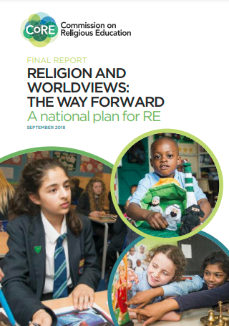
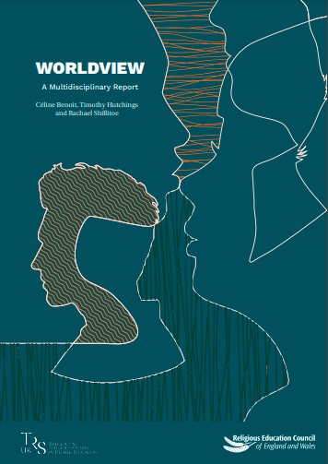
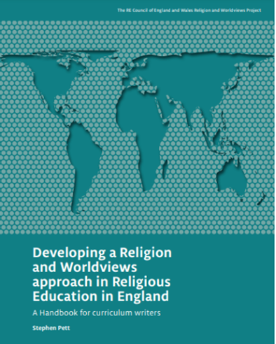
R&W: Context
Click on the pictures to access the resources hosted by the Religious Education Council for England and Wales
Notes:
[Ignore this slide if used previously].
Why the phrase “religion and worldviews”?
Use this slide to provide some context to colleagues.
Explain to colleagues that the concept of Religion and Worldviews (R&W) was first introduced in 2018 in the CoRE report (Commission on Religious Education). Trainers and teachers do not need to read the report to understand a R&W approach - this is only shared by way of context (though if this is something you and/or colleagues are interested in, the document can be accessed either by clicking on the photo on the slide, or by copying/pasting this link: https://religiouseducationcouncil.org.uk/rec/wp-content/uploads/2017/05/Final-Report-of-the-Commission-on-RE.pdf).
You can summarise the main takeaways from the CoRE report that are relevant for this training, which are that:
RS is an important subject, that can equip students with the tools to navigate an increasingly diverse world.
RS can provide students the opportunity to reflect on their own worldviews (e.g., by being able to understand how they may or may not relate to religion and nonreligious traditions).
Ruth Flanagan (2021) calls this ‘worldview consciousness’ – this is up to the trainer to decide whether to introduce that concept, or not.
Good quality RS is needed, and a R&W approach can enable teachers to move away from traditional RS in which we may have had a tendency to represent “world religions” as if they could all be contained in neat boxes. This “new” approach aims to be more inclusive and representative of the diversity within and between religious and nonreligious traditions.
The recommendation to rename RE/RS ‘Religion & Worldviews’ does not stand anymore. While this was one of the recommendations back in 2018, there has been significant change on this topic, and it is up to schools to choose what to call their subject, RE remaining a preferred option in most primary schools. This point can either be ignored altogether during the training, or acknowledged if you feel that colleagues may be aware of such proposals.
Again, only by way of context, you may wish to explain that following the CoRE report, the Religious Education Council for England and Wales (also called the REC or RE Council) commissioned 3 university academics to look into the concept of “worldview” – as this sparked a lot of discussion at the time. The reason you may want to mention this document is because it will be referenced by the speakers in the videos in this training later, since the speakers in the videos also are the authors of this report. There is no expectation to engage with the report. However, should anyone want to access it, the report is entitled “Worldviews: A Multidisciplinary Report”, and can be accessed by clicking on the picture on the slide, or copying/pasting this link: https://religiouseducationcouncil.org.uk/rec/wp-content/uploads/2021/01/REC-Worldview-Report-A4-v2.pdf
The authors (Céline Benoit, Tim Hutchings and Rachael Shillitoe) are the speakers in the videos that will be used in this training.
At this point, you may want to inform teachers that there may be more relevant resources that are available to them - as indicated on their Teacher Handout - which include:
The Handbook for Curriculum Writers (pictured here)
The (draft) National Content Standard for Religious Education in England pp. 6-11 (NB: only refer to this document if based in England).

Slide 5

Summary of previous session(s) (1/2)
The Religion and Worldviews (R&W) approach may seem new, but it builds on existing good practice in RS – you may already be adopting a R&W approach to an extent!
We need to be mindful about the language and examples we use:
  To avoid framing ‘world religions’ through Western Christian lenses,
  To avoid representing religious/nonreligious communities as un-diverse; instead acknowledging diversity within and across religion/nonreligion
Notes:
Go through the bullet points with colleagues. Check understanding after this slide before moving onto the next one.
Only use this slide if you have had a few week’s break between sessions 1 /2 and this one.

Slide 6
Summary of previous session(s) (2/2)
This is a pedagogical shift: i.e., it’s about how you teach RS, not about adding/removing content.
Different disciplinary lenses can be useful to investigate worldviews.
It is important to acknowledge the body and the emotions as well as the cognitive (i.e., beliefs and sets of ideas).
Notes:
Go through the bullet points with colleagues. Check understanding after this slide before moving onto the next one.
You can ask teachers if they have already made changes to their RS classroom as a result of previous sessions.

Slide 7

A note about language: personal vs organised
This training talks about two levels of worldviews: personal vs. organised.
This is the idea that everyone has/inhabits a personal worldview, which is their own way of understanding, experiencing and responding to the world.
These worldviews are sometimes organised, shared with others or embedded in institutions (like religions).
Notes:
Go over the bullet points with colleagues and explain that this may become clearer after the video and activities.
Reassure teachers that they will not be expected to engage in debates about terminology with their students – this is something for them to be aware of as they engage with resources and material that use a R&W approach.
Note to support the trainer – there is no need to mention any of the below to teachers at this stage but this may be useful should teachers still have questions after the video and activities in this slide deck:
What’s the difference between personal and organised worldviews?
See the glossary in the teacher handout.
Organised worldviews are ‘more or less coherent and established system[s] with certain (written and unwritten) sources, traditions, values, rituals, ideals, or dogmas. An organised worldview has a group of believers who adhere to this view of life’ (van der Kooij et al., 2013: 212).
Personal worldviews may or may not be informed by organised worldview(s), and can be (though not necessarily) based on or inspired by (non)religious organised worldviews on life. While the video here focuses on the concept of ‘personal’ worldview, some teachers may prefer using ‘individual’ worldview if they wish to make a distinction between the student’s (personal) worldview, and the individual’s worldview who is the subject of study in the classroom (see the glossary for more information).
For example, if someone calls themselves a Catholic, their personal worldview could be more or less based on the organised worldview of the catechism of Catholicism. But often, people adapt, accept, and/or reject certain aspects of the organised worldview. Here our focus is on understanding how (non)religion is lived, from a personal perspective. It is also interesting to reflect on the power dynamics at play: who gets to define Catholicism? The Pope? Or Catholic communities? This raises important ethical questions: whose voices are foregrounded and legitimised? Are certain voices silenced?
Note that the adjectives ‘organised’ and ‘institutional’ are often used interchangeably – though they can imply different kinds of social arrangement (as explained below).
Context regarding the language being used: It is important to note that since the CoRE report in 2018 the language has kept evolving (and will very likely keep on changing!). Teachers may hear about ‘organised’, ‘communal’, ‘institutional’ (or more rarely ‘systemic’) worldviews. These terms are sometimes used interchangeably. Generally speaking, ‘organised worldviews’ is preferred to ‘institutional worldviews’ as not all organised worldviews have institutions that represent them. On the other hand, in the videos you will hear speakers use the term ‘institutional worldviews’ when referring to the Catholic Church, because this is an institution.
If you further dig into the R&W literature, you may see that some prefer using the term ‘systemic worldviews’ instead of ‘organised/institutional worldviews’ because they think ‘organised’ implies the existence of an organisation, and some religious/nonreligious worldviews might not be represented by an organisation. This remains an uncommon terminology in RS/R&W. Here, we recommend that teachers use the term ‘organised worldviews’, which seems more common within the RS community. The word ‘organised’ is flexible and can refer to anything that has been put in order, as well as anything arranged by a formal group, so we can include both the systemic and the institutional within it.

Slide 8
A note about language: individual vs personal
The new Handbook for Curriculum Writers (2024) suggests adding a new term: individual worldview.
In RS, we study other people’s individual worldviews and organised worldviews, and this helps us to reflect on our own personal worldview.
This change is meant to avoid a misunderstanding about the purpose of RS. It reassures pupils (and parents) that we are not trying to study them or change them. That would be Religious Instruction, not RS!
Do you think this distinction between personal and individual worldviews is helpful for your teaching?
Notes:
The aim of this slide is to explain a change in language that has been proposed since the R&W approach has been introduced.
Only include this slide if you think it will be helpful and not confusing!
The new Handbook (page 36) recommends talking about the INDIVIDUAL worldviews of the people we study and distinguishing this from the PERSONAL worldviews of pupils. There is no conceptual difference here – everyone has their own worldview, whether or not they are a pupil. The purpose of the distinction is to reassure pupils, parents and other stakeholders that RE teachers don’t want to indoctrinate children or force them to change their worldviews.
For example, some might find it helpful to use INDIVIDUAL worldview to connect this with the worldview of any visitor(s) to the RS classroom. Teachers may then feel that they approach the pupils’ own PERSONAL worldviews in a different way. It is up to you and colleagues to decide whether you would like to introduce such a distinction in your RS curriculum.
We have continued to use “personal” worldview in this training, because we think there is an advantage to using a smaller number of terms with clearer conceptual definitions. However, if you think that pupils and parents in your schools are anxious about the purpose of RS, please feel free to introduce the distinction between individual and personal worldviews. If so, you may wish to edit some of the other slides to use the word “individual” instead of “personal” throughout.
Reassure teachers that they will not be expected to engage in debates about terminology with their students. This is something for them to be aware of as they engage with resources and material that use a R&W approach.
You might also want to direct teachers to the glossary in the teacher handout.

Slide 9
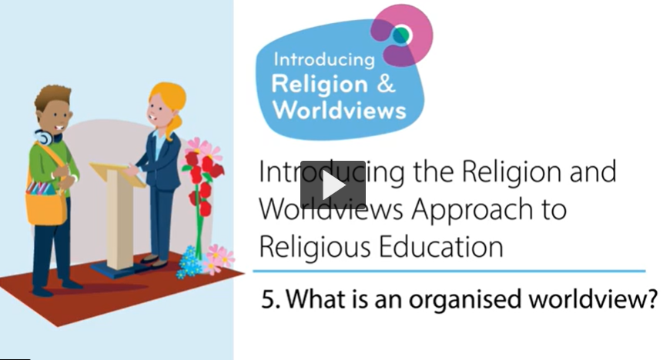
What is an organised worldview?
Notes:
[Twilight training: You may want to skip this slide if teachers have already watched the video ahead of the training session.]
Watch the video with colleagues. Ask if they have any questions at the end of the video. You may not necessarily want to answer them then if you know they’ll be answered in the slides below, but this may help you gauge where there you need to spend more/less time when recapping the key points of the video

Slide 10

What is an organised worldview? Key points (1/4)
An organised worldview is the formal expression of a way of understanding and engaging with the world. It may be the official position of a worldview community. It may be announced by a leader, or it may emerge as a consensus or compromise within the community, reached after a long process of discussions, debates and decisions.
For example, the official website of Humanists UK publishes statements explaining Humanist values, Humanist beliefs and Humanist ways of thinking.
Notes:
Go through the bullet points with colleagues. Check understanding after this slide before moving onto the next one.

Slide 11
What is an organised worldview? Key points (2/4)
Organised worldviews can inform and shape personal worldviews.
We are not neat as human beings. Our worldviews can be quite diverse, and we often pick values and beliefs from different spaces and places.
Notes:
Go through the bullet points with colleagues. Check understanding after this slide before moving onto the next one.

Slide 12

What is an organised worldview? Key points (3/4)
There could be gaps between personal and organised worldviews. Individuals do not always agree with the official positions of their community.
Organised worldviews are also not fixed – they can change. However, any change is likely to be controversial within the community.
Notes:
Go through the bullet points with colleagues. Check understanding after this slide before moving onto the next one.

Slide 13
What is an organised worldview? Key points (4/4)
For example: the Church of England’s position towards same-sex relationships is still evolving.
Some Christian churches agreed to change their rules about Eucharist/Communion during COVID19 pandemic to allow online celebrations.
The way Hajj is performed has also changed due to increasing population and environmental concerns.
Notes:
Go through the bullet points with colleagues. Check understanding after this slide before moving onto the next one.

Slide 14

Activity
Notes:
Break out into small groups and reflect on the questions below:
What is an organised worldview?
10 mins, ask teachers to write answers down on flipchart papers, and then to go and compare what other groups have written down.
Do you already teach about religious and nonreligious worldviews?
Which ones do you include?
Which ones do you not include yet, but would like to explore further in the future? What’s been holding you back?
Are you using the term ‘organised’ (non)religious worldviews? Could this term be useful moving forward?
15 mins, as a group discussion
Do you tend to present organised worldviews as ‘fixed’ or as evolving over time?
Which approach do you think is more suitable to the W&R approach?
How can you acknowledge that organised worldviews might shift over time, and why this happens?
10 mins, as a group discussion

Slide 15

What is a personal worldview?
Notes:
[Twilight training: You may want to skip this slide if teachers have already watched the video ahead of the training session. Make sure you tell them to stop the video after 5’25]
Watch the video with colleagues. Ask if they have any questions at the end of the video. You may not necessarily want to answer them then if you know they’ll be answered in the slides below, but this may help you gauge where there you need to spend more/less time when recapping the key points of the video.
Remember that you may want to amend the slides from here onwards to read ‘individual worldview’ if you would like to make a distinction between personal and individual.

Slide 16
What is a personal worldview? Key Points (1/3)
Everyone has a personal worldview that may be implicit or explicit, and affects choices and way of living.
A person's values, beliefs and stances form part of their worldview.
This includes feelings and emotions and how these inform our lives.
Worldviews can include what a person does not stand for, or feel is important.
Notes:
Go through the bullet points with colleagues. Check understanding after this slide before moving onto the next one.

Slide 17
What is a personal worldview? Key Points (2/3)
A worldview is not always something that a person is aware of. They may only reflect on it in certain circumstances, for example when experiencing big life events.
A personal worldview may or may not be influenced by organised worldviews.
Personal worldviews can change over time.
Notes:
Go through the bullet points with colleagues. Check understanding after this slide before moving onto the next one.

Slide 18
Key Points (continued)
One advantage of the R&W approach is that it provides the opportunity for consideration of individual perspectives as well as organised worldviews.
Another advantage of the R&W approach is that it provides teachers and children with the space to reflect on their own positionality.
This links back to the video from session 1 - Nobody Stands Nowhere.
Do you know where you stand and why?
Notes:
Go through the bullet points with colleagues. Check understanding after this slide before moving onto the next one.
Link to the video: https://www.youtube.com/watch?v=AFRxKF-Jdos

Slide 19
Activity 1
Notes:
After the video, break out into small groups and reflect on the questions below:
What is a personal worldview?
10 mins, ask teachers to write answers down on flip chart papers, and then to go and compare what other groups have written down.
Who is currently represented in your curriculum? Whose voices are heard - those representing organised worldviews? Those who have lived experiences? Both?
e.g. If you cover Catholicism, do you do so by focusing on ‘elite’ understandings of Catholicism (i.e. what the Pope and the Church say)? Or do you also include the voices of those who identify as Catholics, even if their lived experiences differ from the dominant doctrines?
Who gets more visibility / more power in your current curriculum? Who is invisible / unheard?
If there’s an imbalance of representation between organised and personal worldviews, why do you think that happened? What can be done to fix it (if needed)? If you feel you have balanced perspectives throughout your curriculum, can you share examples of good practice, and how students respond to them?
20 mins, as a group discussion
Ask teachers to reflect on the discussions they have had. Are there any elements from today’s conversation they would like to take away and adapt to use in teaching?
Did they have a debate about how organised (non)religious traditions are fixed or not? How could they adopt this in the classroom?):
Based on the discussions you have just had, what changes are you thinking of making to your curriculum to ensure you and your students have the opportunity to (further) uncover the interplay between organised and personal worldviews?
10 mins, Jot down ideas and possible timelines

Slide 20
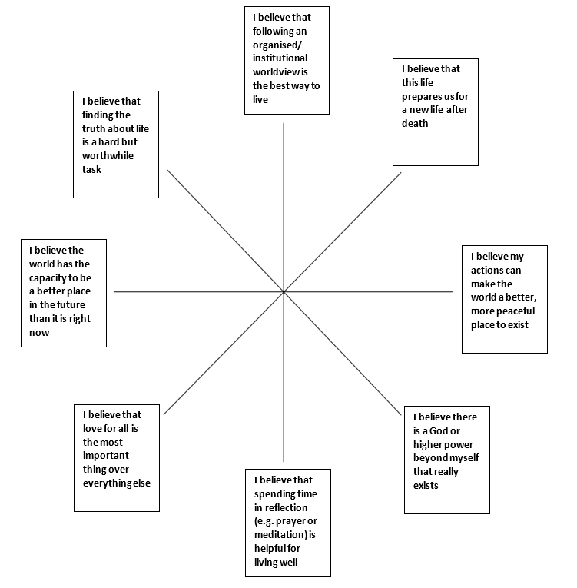
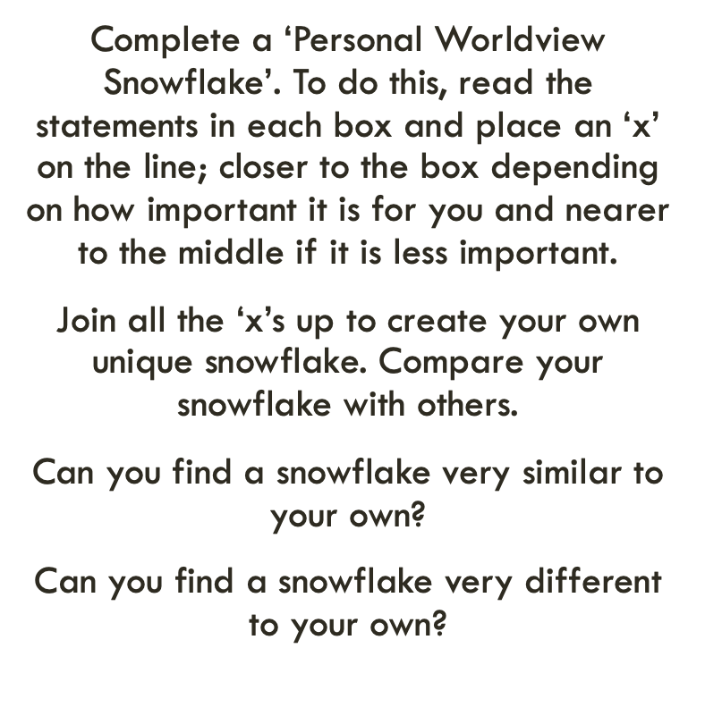
Activity 2
Thanks to the Coventry & Warwickshire REC / local Agreed Syllabus writing team, led by Jennifer Jenkins, for sharing this material. The snowflake exercise builds on a strategy originally developed by Sarah Northall, formerly head of RE.
Notes:
Invite teachers to complete their personal worldview snowflake (see instructions on the slide). Once completed, ask teachers to compare their snowflake with others in their group – what are the differences/similarities? See how their can be differences within one tradition, and similarities across traditions. Examples of reflection might include:
Everybody’s snowflake is unique because we are all unique.
You could have different snowflakes from people who follow the same religion.
You could have different snowflakes from people who all identify as nonreligious.
You could end up with more similar looking snowflakes from people across different religions.
Tell teachers that the snowflake activity can be done with children too (not just teachers!).
This is one activity some teachers like to do at the start of each academic year because it shows how our worldviews are unique to us and our worldviews are always evolving.
The snowflake exercise is also described in the REC’s Handbook for Curriculum Writers, p.55 (see: https://religiouseducationcouncil.org.uk/rec/wp-content/uploads/2024/04/24-25698-REC-Handbook-A4-DIGITAL-PAGES.pdf)
Thanks to the Coventry & Warwickshire REC / local Agreed Syllabus writing team, led by Jennifer Jenkins, for sharing this material. The snowflake strategy was originally developed by Sarah Northall, formerly Head of RE at Chipping Norton Secondary School. See it in basic form in More than 101 Great Ideas ed. Rosemary Rivett, and applied to ideas of God using the discipline of psychology in Investigating God, ed. Fiona Moss for primary and Studying God for secondary.

Slide 21
Activity 3 - Reflect
Notes:
Follow-up activity, if time allows (see instructions below):
Ask teachers to reflect on someone’s life journey (their own but not necessarily) and identify how their relationship with (non)religion may have evolved. For example, someone may have been born in a nominal Catholic family, been baptised and gone to Sunday school and had their communion but then stopped attending church in adolescence. Later in life, they attended CofE services to become eligible to marry in the parish church. After 18 months, they again stopped attending church, until they had a child and decided to attend the local church to secure a school place in the Roman Catholic school as it has a good Ofsted rating. This example demonstrate how one person’s engagement with (non)religion can fluctuate, depending on circumstances and their surroundings.
Give teachers the opportunity to look back at their snowflakes and think how similar/different their responses might have been 5 years ago, or when they were a teenager, and how these answers may change in 20 years’ time. This can be a silent reflection – only invite teachers to share their views should they want to.
This task can be adapted to suit your group, e.g.
Silent reflection, including writing down reflections
Discuss as a whole group

Slide 22
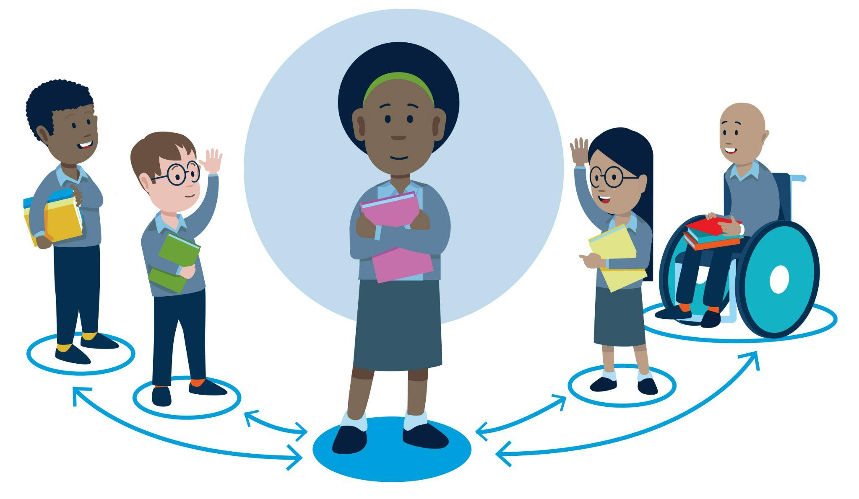
Beyond the individual and the organised
Communal worldviews
Many argue that it’s not just the individual and the organised that shape personal worldviews, but that there is another level: the communal.
This can be used to refer to a local community, a local place of worship, family, friends, digital online spaces, etc.). There is no video for this concept, but you will need to mention it to teachers – the next slides can help.
Notes:
It's important to note that while the videos focus on the personal and organised (because this was in response to the CoRE report, which dates back to 2018), many have since argued that there are other worldview levels missing, and which need including. For example: the community or membership group.
For further guidance about the differences between individual and personal worldviews, please refer to the REC’s Handbook, p.36: https://religiouseducationcouncil.org.uk/rec/wp-content/uploads/2024/04/24-25698-REC-Handbook-A4-DIGITAL-PAGES.pdf.
Similarly, p. 37 of the REC’s Handbook (please refer to the REC’s Handbook (https://religiouseducationcouncil.org.uk/rec/wp-content/uploads/2024/04/24-25698-REC-Handbook-A4-DIGITAL-PAGES.pdf) offers a detailed description of the differences between organised and institutional worldviews. Again, there is no need for teachers to necessarily know these - they can stick to organised worldviews instead.
The message you will want to pass onto teachers from the next slide onwards is that the videos have so far referred to personal and organised worldviews but that communal is often considered another important aspect to take into consideration when exploring lived experiences of religion and nonreligion.
One other level that is often introduced is the communal level, to acknowledge the influence of local communities, local places of worship, family, friends, digital online spaces, etc.

Slide 23
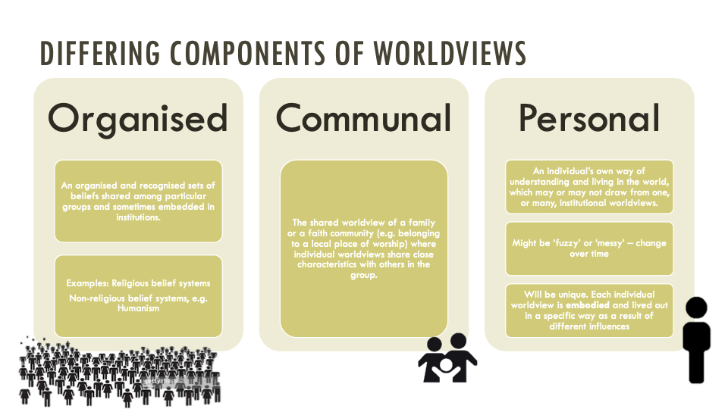
Copyright RE Today Services: www.retoday.org.uk
Notes:
Copyright RE Today Services: www.retoday.org.uk

Slide 24
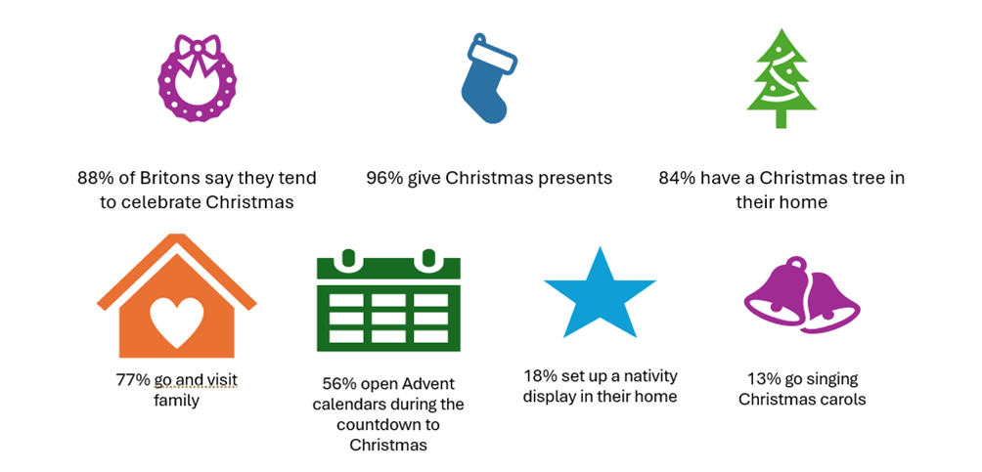
Source: adapted from YouGov Plc, 2023, © All rights reserved
How does the celebration of Christmas reflect
organised, communal or personal worldviews?
Notes:
Useful links:
YouGov poll, Christmas practices, 2023: https://ygo-assets-websites-editorial-emea.yougov.net/documents/YouGov_-_Christmas_practices_2023.pdf
YouGov article, How do Britons celebrate Christmas, 2023: https://yougov.co.uk/society/articles/48208-how-do-britons-celebrate-christmas
The aim of this slide is to apply these three concepts to a familiar case study. For example, you might use these statistics to argue that the popularity of Christmas doesn’t reflect much engagement with the organised worldviews of Christianity or with a personal Christian worldview. Instead, most people see this as an opportunity to exchange gifts and spend time with family. These are elements of a communal worldview about Christmas that is very popular in modern Britain and has a big influence on the personal worldviews of many British people.
The aim of this slide is to apply these three concepts to a familiar case study. For example, you might use these statistics to argue that the popularity of Christmas doesn’t reflect much engagement with the organised worldviews of Christianity or with a personal Christian worldview. Instead, most people see this as an opportunity to exchange gifts and spend time with family. These are elements of a communal worldview about Christmas that is very popular in modern Britain and has a big influence on the personal worldviews of many British people.

Slide 25
Activity – Reflection
How do you experience Christmas?
  Think about organised worldviews: which ones have shaped your personal worldview? Which ones have inspired you?
  Think about communal worldviews – how have your local community (religious or nonreligious), your family, your friends, etc. shaped your personal worldview of Christmas?
Notes:
This task can be adapted to suit your group, e.g.
Silent reflection, including writing down reflections
Two groups – one group takes the first statement and set of questions, and the other group the other statement and set of questions. Discuss for 5-10 mins and feedback to the other group
Discuss as a whole group
Make sure this activity is introduced in a way that includes teachers who are not Christian, or who identify with religions other than Christianity. Their experience of Christmas is also valid and useful for this activity. Also remember that an experience of Christmas could be positive or negative.

Slide 26
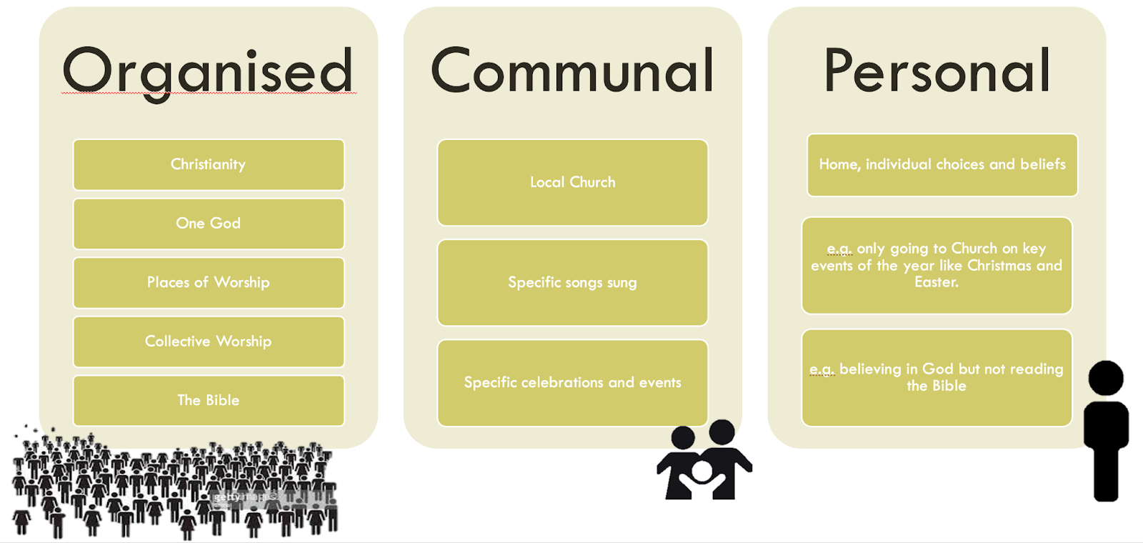
Copyright RE Today Services: www.retoday.org.uk
Notes:
Copyright RE Today Services: www.retoday.org.uk

Slide 27
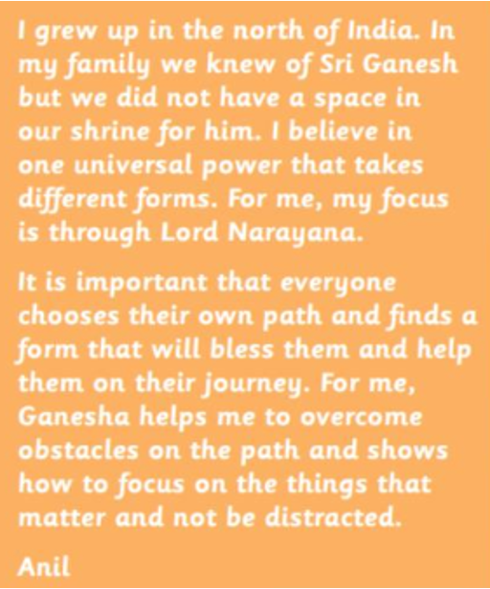
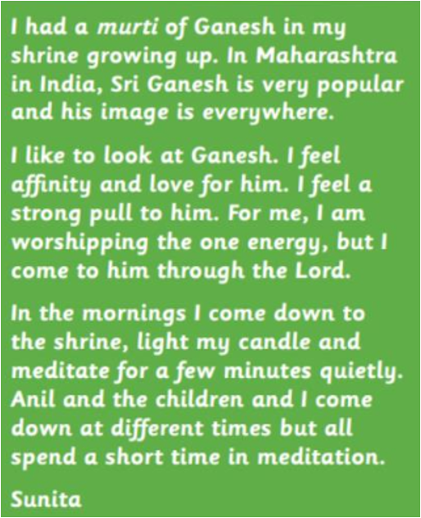
Copyright RE Today Services: www.retoday.org.uk
Notes:
Copyright RE Today Services: www.retoday.org.uk

Slide 28
Summary: Why does it matter for RS?
It provides students with the opportunity to reflect on their own worldviews, and how they might be influenced by individual, communal, and/or organised worldviews.
It enables teachers and students to study how organised worldviews are not fixed, but evolve over time.
It is about acknowledging that worldviews are not just about the cognitive (i.e., beliefs or a set of ideas), but it is also about the body and emotions.
It makes the RS classroom more representative, more inclusive and more relevant for our pupils
Notes:
Go through the bullet points with colleagues. Check understanding after this slide before moving onto the next one.
The aims of this slide are to:
Clarify the importance of being aware of the traditional power asymmetries in RS. In the past, only religious leaders/religious institutions were allowed to define their religion/faith and considered worthy of study. Now we also view people’s lived experiences of religion as valid.
Explain that such an approach is more inclusive. RS becomes relevant to everyone and does not alienate those who do not fit within the neat boxes of ‘world religions’ (as may have been traditionally taught, when using a World Religions Paradigm)

Slide 29
Take-Away Activity
Notes:
You may want to invite teachers to consider their own scheme of work and identify where organised, communal, and personal (or individual) worldviews come up. How does this help frame the way they teach about religion/nonreligion? Are there examples of good practice they would be willing to share? Have they identified gaps? What is their action plan moving forward?

Slide 30

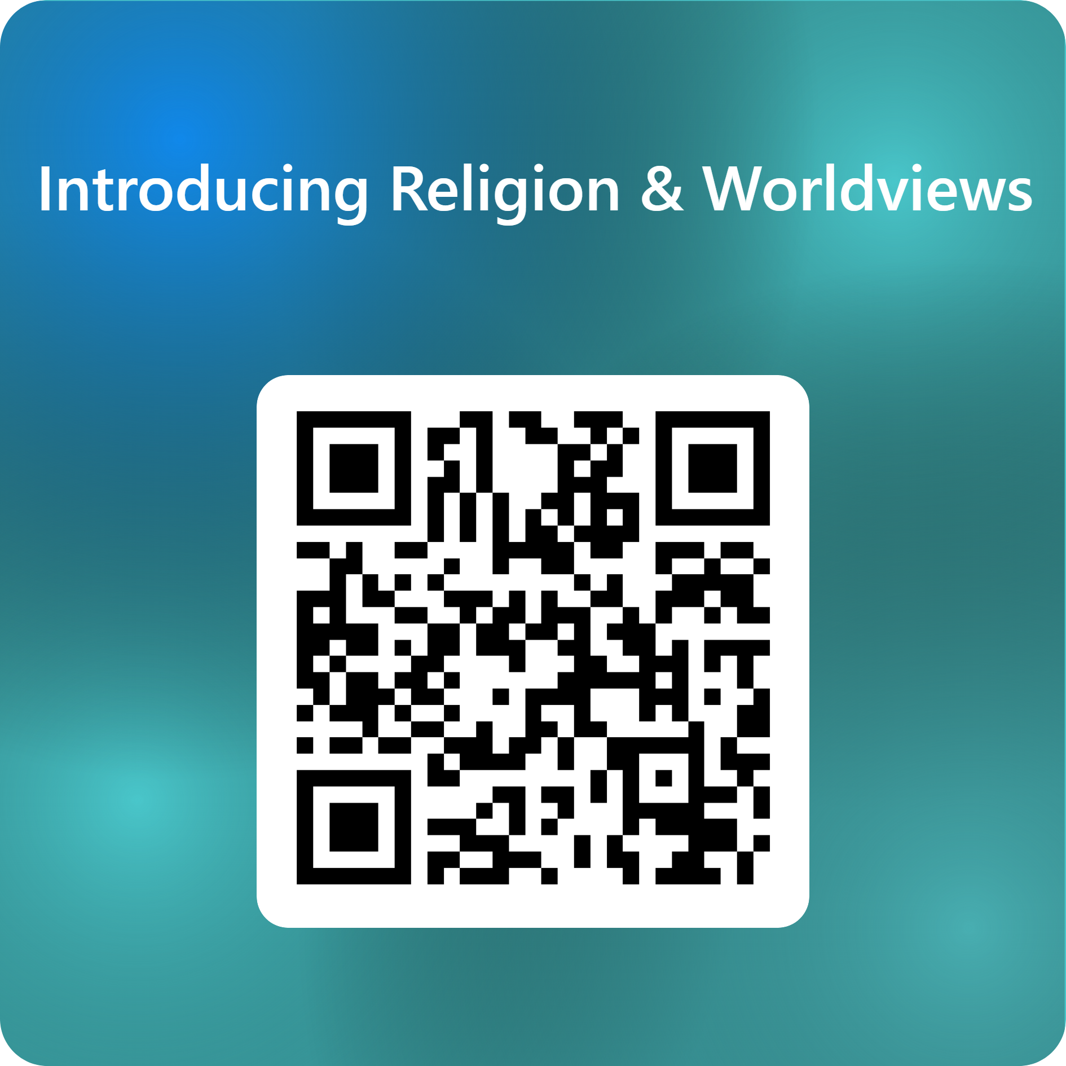
End of session 3
© Introducing Religion & Worldviews (2025)
Notes:
For feedback and comments about these resources, please scan the QR code or copy/paste this URL into your browser: https://forms.office.com/e/iLKDeRHMYL
To contact the lead author, please email Dr Céline Benoit: Celine.Benoit@nottingham.ac.uk

