Slide 1







Religion & Worldviews in Religious Studies
Training Pack for Secondary Schools
Notes:
Welcome to the “Adopting a Religion & Worldviews approach in RS” training for secondary school teachers.

Slide 2


How do you organise worldviews?
Session 3
Notes:
Welcome to Session 3

Slide 3

Learning Objectives
To understand that a religion and worldviews (R&W) approach encourages us to think about lived experiences within religion and nonreligion.
To reflect on the interplay between the different levels within religious and nonreligious traditions, and the power dynamics involved.
To understand the importance of balancing personal and organised worldviews in RS, and how a R&W approach lends itself to addressing the sometimes missing and marginalised voices in the study of RS.

Slide 4
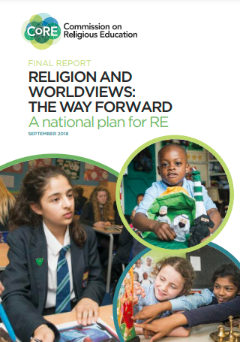
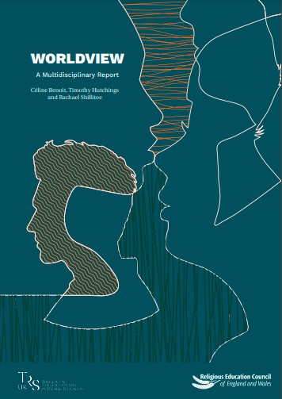
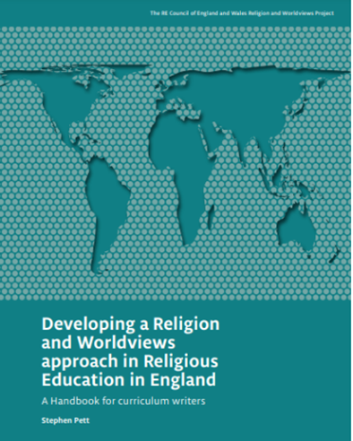
R&W: Context
Click on the pictures to access the resources hosted by the Religious Education Council for England and Wales
Notes:
The Handbook for Curriculum Writers (pictured here)
The (draft) National Content Standard for Religious Education in England pp. 6-11 (NB: only refer to this document if based in England).

Slide 5

Summary of previous session(s) (1/2)
The Religion and Worldviews (R&W) approach may seem new, but it builds on existing good practice in RS – you may already be adopting a R&W approach to an extent!
We need to be mindful about the language and examples we use:
To avoid framing ‘world religions’ through Western Christian lenses,
To avoid representing religious/nonreligious communities as un-diverse; instead acknowledging diversity within and across religion/nonreligion

Slide 6
Summary of previous session(s) (2/2)
This is a pedagogical shift: i.e., it’s about how you teach RS, not about adding/removing content.
Different disciplinary lenses can be useful to investigate worldviews.
It is important to acknowledge the body and the emotions as well as the cognitive (i.e., beliefs and sets of ideas).

Slide 7

A note about language: personal vs organised
This training talks about two levels of worldviews: personal vs. organised. This is the idea that everyone has/inhabits a personal worldview, which is their own way of understanding, experiencing and responding to the world.
These worldviews are sometimes organised, shared with others or embedded in institutions (like religions).

Slide 8
A note about language: individual vs personal
The new Handbook for Curriculum Writers (2024) suggests adding a new term: individual worldview.
In RS, we study other people’s individual worldviews and organised worldviews, and this helps us to reflect on our own personal worldview.
This change is meant to avoid a misunderstanding about the purpose of RS. It reassures pupils (and parents) that we are not trying to study them or change them. That would be Religious Instruction, not RS!
Do you think this distinction between personal and individual worldviews is helpful for your teaching?

Slide 9
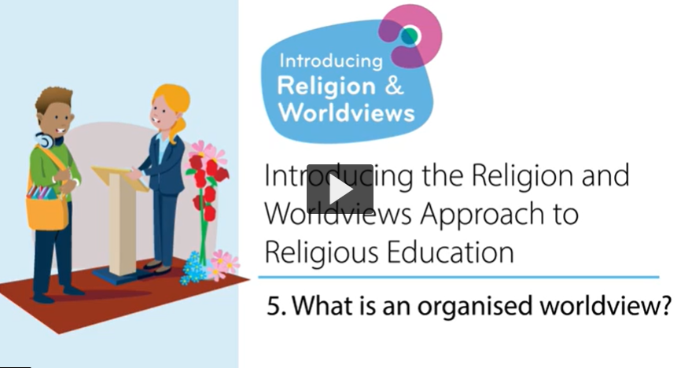
What is an organised worldview?

Slide 10

What is an organised worldview? Key points (1/4)
An organised worldview is the formal expression of a way of understanding and engaging with the world. It may be the official position of a worldview community. It may be announced by a leader, or it may emerge as a consensus or compromise within the community, reached after a long process of discussions, debates and decisions.
For example, the official website of Humanists UK publishes statements explaining Humanist values, Humanist beliefs and Humanist ways of thinking.

Slide 11
What is an organised worldview? Key points (2/4)
Organised worldviews can inform and shape personal worldviews.
We are not neat as human beings. Our worldviews can be quite diverse, and we often pick values and beliefs from different spaces and places.

Slide 12

What is an organised worldview? Key points (3/4)
There could be gaps between personal and organised worldviews. Individuals do not always agree with the official positions of their community.
Organised worldviews are also not fixed – they can change. However, any change is likely to be controversial within the community.

Slide 13
What is an organised worldview? Key points (4/4)
For example: the Church of England’s position towards same-sex relationships is still evolving.
Some Christian churches agreed to change their rules about Eucharist/Communion during COVID19 pandemic to allow online celebrations.
The way Hajj is performed has also changed due to increasing population and environmental concerns.

Slide 14

Activity

Slide 15

What is a personal worldview?

Slide 16
What is a personal worldview? Key Points (1/3)
Everyone has a personal worldview that may be implicit or explicit, and affects choices and way of living.
A person's values, beliefs and stances form part of their worldview.
This includes feelings and emotions and how these inform our lives.
Worldviews can include what a person does not stand for, or feel is important.

Slide 17
What is a personal worldview? Key Points (2/3)
A worldview is not always something that a person is aware of. They may only reflect on it in certain circumstances, for example when experiencing big life events.
A personal worldview may or may not be influenced by organised worldviews.
Personal worldviews can change over time.

Slide 18
Key Points (continued)
One advantage of the R&W approach is that it provides the opportunity for consideration of individual perspectives as well as organised worldviews.
Another advantage of the R&W approach is that it provides teachers and children with the space to reflect on their own positionality.
This links back to the video from session 1 - Nobody Stands Nowhere. Do you know where you stand and why?
Notes:
Link to the video: https://www.youtube.com/watch?v=AFRxKF-Jdos

Slide 19
Activity 1

Slide 20
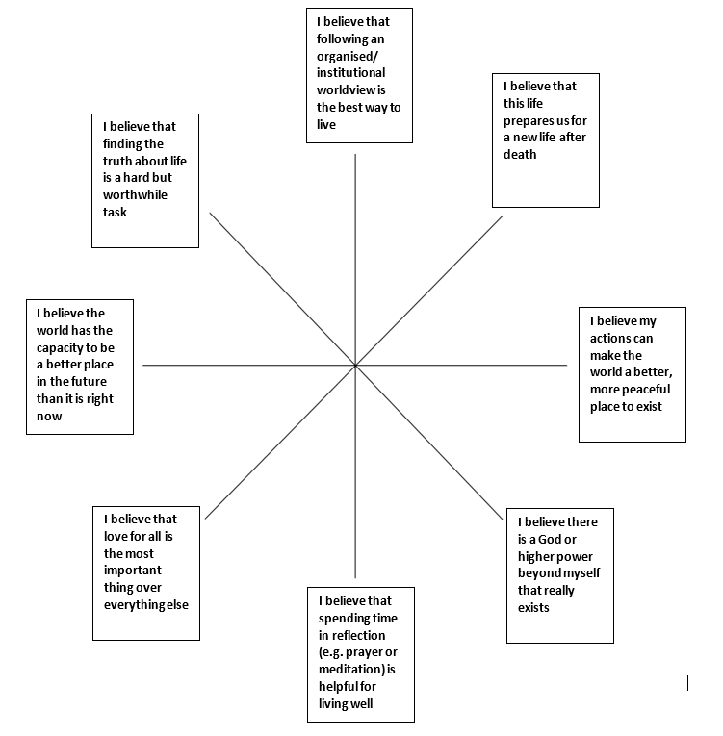
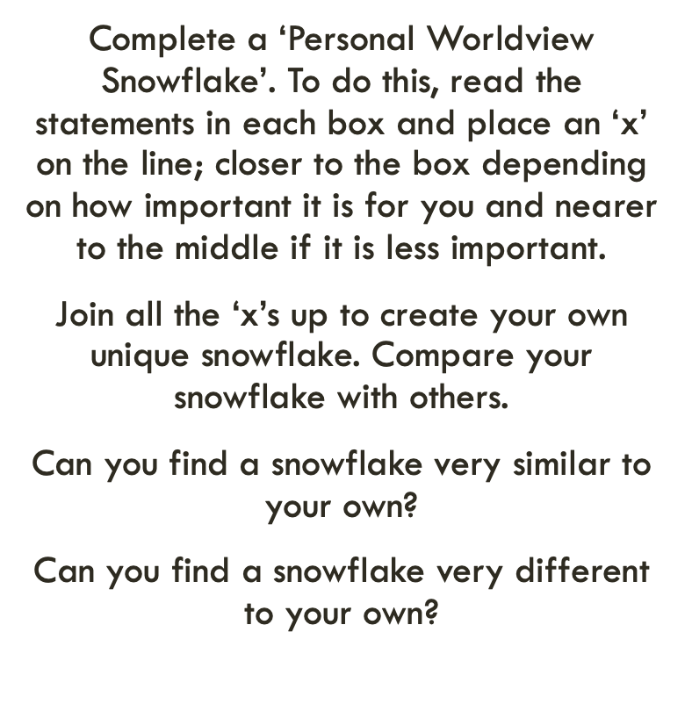
Activity 2
Thanks to the Coventry & Warwickshire REC / local Agreed Syllabus writing team, led by Jennifer Jenkins, for sharing this material. The snowflake exercise builds on a strategy originally developed by Sarah Northall, formerly head of RE.
Notes:
The snowflake activity can be done with students too (not just teachers!).
The snowflake exercise is also described in the REC’s Handbook for Curriculum Writers, p.55 (see: https://religiouseducationcouncil.org.uk/rec/wp-content/uploads/2024/04/24-25698-REC-Handbook-A4-DIGITAL-PAGES.pdf)
Thanks to the Coventry & Warwickshire REC / local Agreed Syllabus writing team, led by Jennifer Jenkins, for sharing this material. The snowflake strategy was originally developed by Sarah Northall, formerly Head of RE at Chipping Norton Secondary School. See it in basic form in More than 101 Great Ideas ed. Rosemary Rivett, and applied to ideas of God using the discipline of psychology in Investigating God, ed. Fiona Moss for primary and Studying God for secondary.

Slide 21
Activity 3 - Reflect

Slide 22
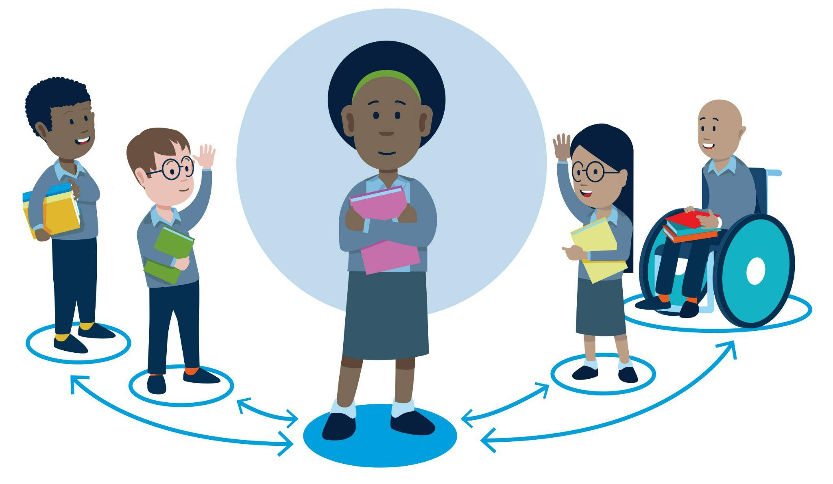
Beyond the individual and the organised
Communal worldviews
Many argue that it’s not just the individual and the organised that shape personal worldviews, but that there is another level: the communal.
This can be used to refer to a local community, a local place of worship, family, friends, digital online spaces, etc.). There is no video for this concept, but you will need to mention it to teachers – the next slides can help.

Slide 23
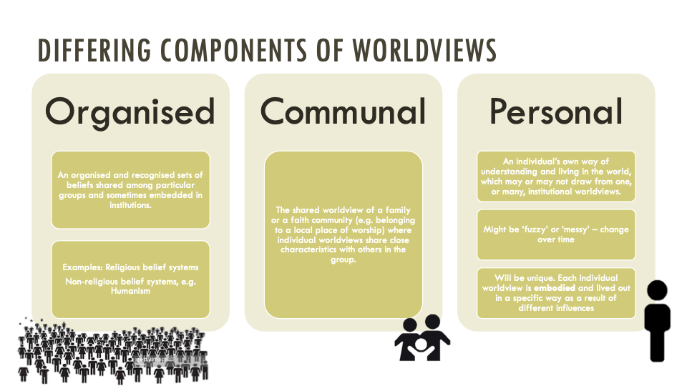
Copyright RE Today Services: www.retoday.org.uk
Notes:
Copyright RE Today Services: www.retoday.org.uk

Slide 24
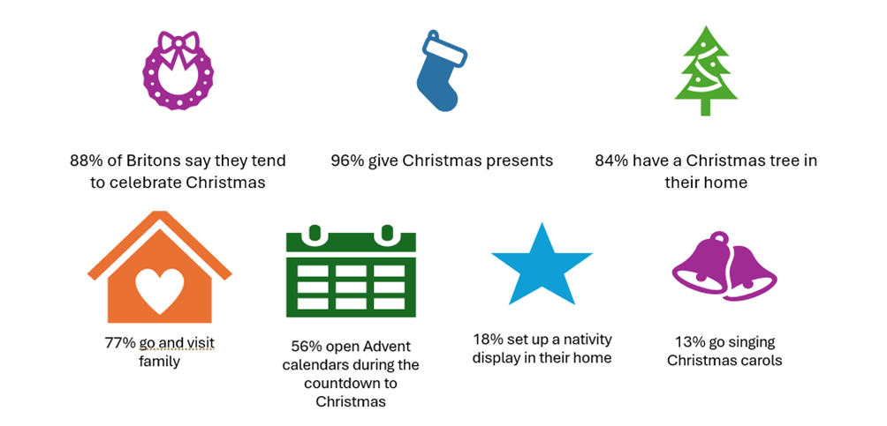
Source: adapted from YouGov Plc, 2023, © All rights reserved
How does the celebration of Christmas reflect
organised, communal or personal worldviews?
Notes:
Useful links:
YouGov poll, Christmas practices, 2023: https://ygo-assets-websites-editorial-emea.yougov.net/documents/YouGov_-_Christmas_practices_2023.pdf
YouGov article, How do Britons celebrate Christmas, 2023: https://yougov.co.uk/society/articles/48208-how-do-britons-celebrate-christmas

Slide 25
Activity – Reflection
How do you experience Christmas?
Think about organised worldviews: which ones have shaped your personal worldview? Which ones have inspired you?
Think about communal worldviews – how have your local community (religious or nonreligious), your family, your friends, etc. shaped your personal worldview of Christmas?
Notes:
This task can be adapted to suit your group, e.g.
Silent reflection, including writing down reflections
Two groups – one group takes the first statement and set of questions, and the other group the other statement and set of questions. Discuss for 5-10 mins and feedback to the other group
Discuss as a whole group
Make sure this activity is introduced in a way that includes teachers who are not Christian, or who identify with religions other than Christianity. Their experience of Christmas is also valid and useful for this activity. Also remember that an experience of Christmas could be positive or negative.

Slide 26
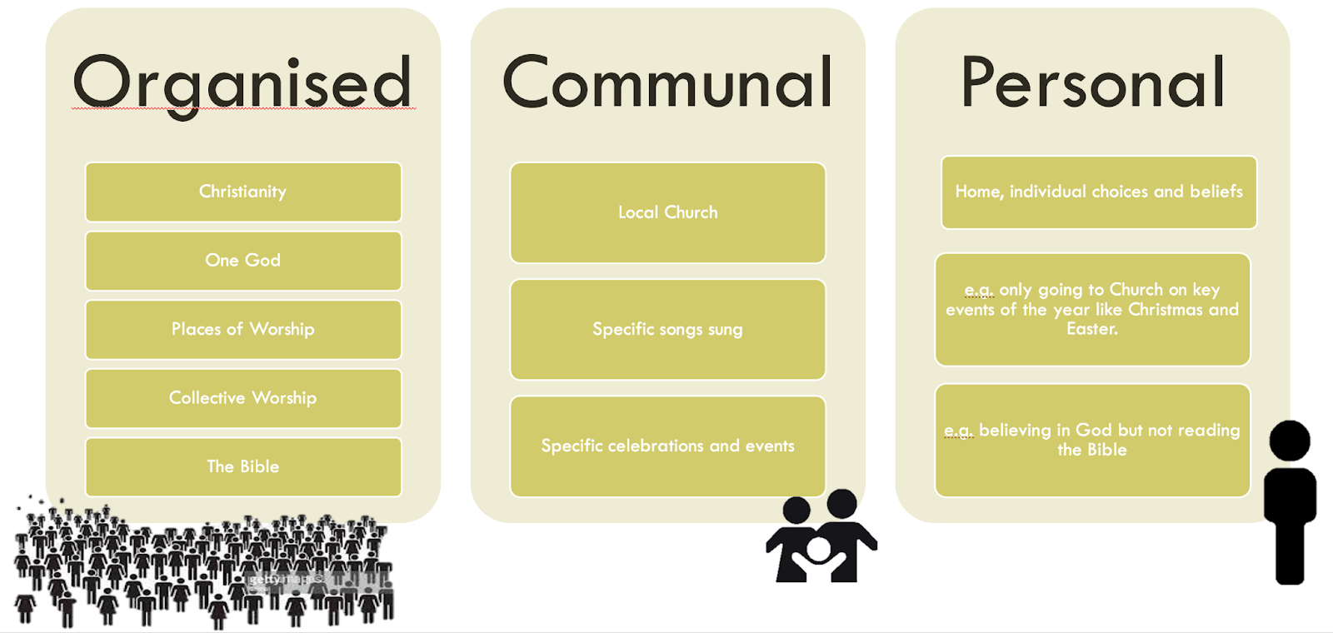
Copyright RE Today Services: www.retoday.org.uk
Notes:
Copyright RE Today Services: www.retoday.org.uk

Slide 27
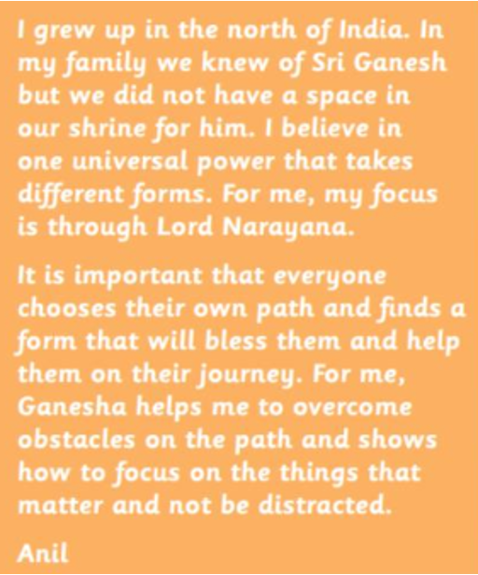
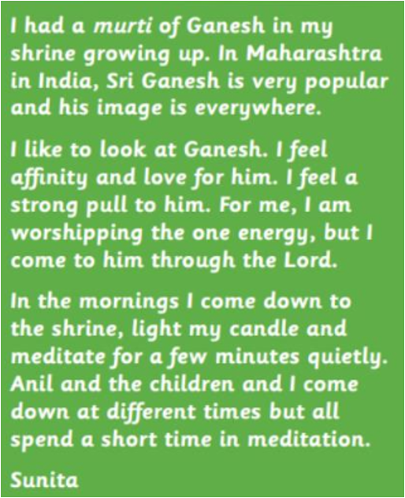
Copyright RE Today Services: www.retoday.org.uk
Notes:
Copyright RE Today Services: www.retoday.org.uk

Slide 28
Summary: Why does it matter for RS?
It provides students with the opportunity to reflect on their own worldviews, and how they might be influenced by individual, communal, and/or organised worldviews.
It enables teachers and students to study how organised worldviews are not fixed, but evolve over time.
It is about acknowledging that worldviews are not just about the cognitive (i.e., beliefs or a set of ideas), but it is also about the body and emotions.
It makes the RS classroom more representative, more inclusive and more relevant for our pupils

Slide 29
Take-Away Activity
Notes:
You may want to consider their own scheme of work and identify where organised, communal, and personal (or individual) worldviews come up. How does this help frame the way you teach about religion/nonreligion? Are there examples of good practice you would be willing to share? Have you identified gaps? What is your action plan moving forward?

Slide 30

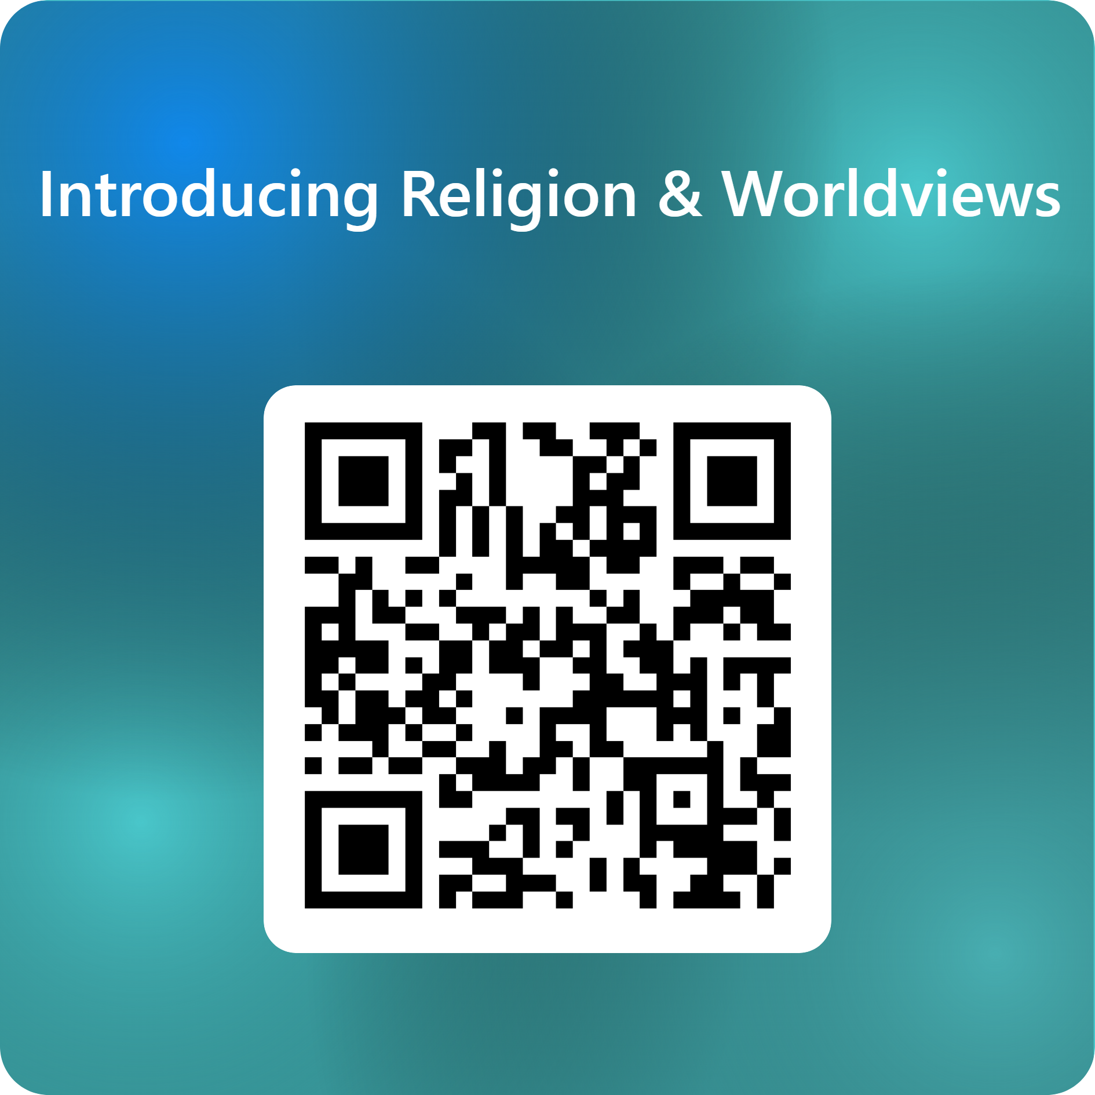
End of session 3
© Introducing Religion & Worldviews (2025)
Notes:
For feedback and comments about these resources, please scan the QR code or copy/paste this URL into your browser: https://forms.office.com/e/iLKDeRHMYL
To contact the lead author, please email Dr Céline Benoit: Celine.Benoit@nottingham.ac.uk

