Slide 1







Religion & Worldviews in Religious Education
Training Pack for Primary Schools
Notes:
Welcome to the “Adopting a Religion & Worldviews approach in RE” training for primary school teachers.
Before delivering the training, we recommend that trainers print this slide deck using the “notes pages” option (> click on “print” and in “settings” change from “full page slides” to “notes pages”). This will enable you to see all the trainer’s guidance under each slide, which will be useful to help you deliver the training. We also recommend that trainers get familiar with the training package and guidance notes prior to the training, as the aim is not for the trainer to read the guidance notes to the teachers – instead they have been added to this training to help you prepare what to say for each slide.
This pack has been designed in such a way that it can be delivered as a whole day training – in which case you will want to go through the slide decks for Sessions 1, 2, and 3 in one day – or as a series of twilight sessions (up to 3, dedicating each twilight session to one of the sessions).
Prior to delivering the training, you might find it useful to conduct a short audit to understand where teachers are at when it comes to RE and Religion and Worldviews. Here are some questions you could put on an online form (such as Microsoft Form) to capture attitudes. Feel free to adapt as you see fit:
How confident do you feel delivering RE classes in general? 1-5 (1: not at all confident; 5: very confident)
How confident do you feel about adopting a Religion and Worldviews (R&W) approach in the RE? (1: not at all confident; 5: very confident)
How confidently would you be able to explain to colleagues the challenge of defining “religion” and the implications of this challenge for teaching RE? Scale 1-5 (1: not at all confident; 5: very confident)
How confidently would you be able to explain to colleagues the problems with the World Religions approach? Scale 1-5 (1: not at all confident; 5: very confident)
How confidently would you be able to explain to colleagues the concept of worldview and why this may change the way you teach RE? (1: not at all confident; 5: very confident)
How confidently would you be able to explain what a personal worldview is? (1: not at all confident; 5: very confident)
How confidently would you be able to explain what an organised worldview is? (1: not at all confident; 5: very confident)
The same questions should be asked after the training has been delivered - this will enable you to capture the impact of the training, and whether there are areas where more work will be needed in the future.

Slide 2


Introducing Religion & Worldviews
Session 1
Notes:
If this session (Session 1) is delivered as a stand-alone twilight session, we recommend asking teachers to view all 3 videos prior to attending the training given the length of the training session. If so, you may want to send colleagues a few reminders to watch the videos ahead of the training.
If Session 1 is delivered as part of a whole day training, we recommend viewing the videos during the training to help with pace and breaks between activities.
The aims of Session 1 are to:
Give teachers an opportunity to reflect on how they learnt about the concept of ‘religion’, and how that particular understanding may have shifted (e.g., moving from world religions being presented as neatly contained boxes, to acknowledging the fluidity within and between (non)religious traditions)
Give teachers an opportunity reflect on some of the limitations of the concept of religion, not necessarily to teach these limits to pupils, but to become more mindful in the RE practice (e.g., this may result in a change in language used, such as moving away from statements such as “Guru Granth Sahib is similar to the Bible, but for Sikhs,” which leads us to explore Sikhi through a Christian lens).
Give teachers an opportunity to engage with the concept of worldview, and how this can be a useful tool to acknowledge how we engage with religion and nonreligion in different ways throughout our life course.
Give teachers an opportunity to reflect on the notion of worldview, as not just a set of complex ideas we have in our heads, but also as how we respond to the world (i.e., emotions, feelings, body…), and how this can be reflected in the RE classroom.
This section should be delivered in 2 hours, but can be delivered in 90 mins if videos are watched at home, and if some of the activities are amended to be ‘take-away’ activities. We do not recommend shortening it to less than 90 minutes (unlike Sessions 2 and 3 which may be adapted and delivered in 60 minutes), as you need time to lay the foundations of R&W before further delving into what a R&W approach is, and how it can shape the RE curriculum.

Slide 3
Learning Objectives
Reflect on the concept of ‘religion’, and how its definition may have shifted over the years
Reflect on some of the limitations of the concept of religion, and what this means for the RE classroom
Engage with the concept of worldview, and how this can be a useful tool to acknowledge how people engage with religion and nonreligion in different ways throughout their life-course
Reflect on the notion of worldview, not just a set of complex ideas but also as how we respond to the world (i.e., emotions, feelings, body…), and how this can be reflected in the RE classroom.
Reflect on the importance of lived experiences of religion, and how to include these in the RE classroom
Notes:
Go through each statement one at a time, to help teachers know what this session will cover.

Slide 4
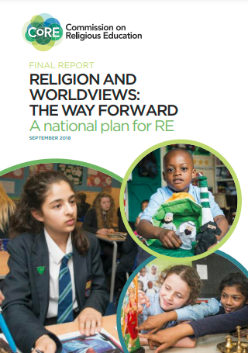


R&W: Context
Click on the pictures to access the resources hosted by the Religious Education Council for England and Wales
Notes:
Why the phrase “religion and worldviews”?
Use this slide to provide some context to colleagues.
Explain to colleagues that the concept of Religion and Worldviews (R&W) was first introduced in 2018 in the CoRE report (Commission on Religious Education). Trainers and teachers do not need to read the report to understand a R&W approach - this is only shared by way of context (though if this is something you and/or colleagues are interested in, the document can be accessed either by clicking on the photo on the slide, or by copying/pasting this link: https://religiouseducationcouncil.org.uk/rec/wp-content/uploads/2017/05/Final-Report-of-the-Commission-on-RE.pdf).
You can summarise the main takeaways from the CoRE report that are relevant for this training, which are that:
RE is an important subject, that can equip students with the tools to navigate an increasingly diverse world.
RE can provide students the opportunity to reflect on their own worldviews (e.g., by being able to understand how they may or may not relate to religion and nonreligious traditions).
Ruth Flanagan (2021) calls this ‘worldview consciousness’ – this is up to the trainer to decide whether to introduce that concept, or not.
Good quality RE is needed, and a R&W approach can enable teachers to move away from traditional RE in which we may have had a tendency to represent “world religions” as if they could all be contained in neat boxes. This “new” approach aims to be more inclusive and representative of the diversity within and between religious and nonreligious traditions.
The recommendation to rename RE ‘Religion & Worldviews’ does not stand anymore. While this was one of the recommendations back in 2018, there has been significant change on this topic, and it is up to schools to choose what to call their subject, RE remaining a preferred option in most primary schools. This point can either be ignored altogether during the training, or acknowledged if you feel that colleagues may be aware of such proposals.
Again, only by way of context, you may wish to explain that following the CoRE report, the Religious Education Council for England and Wales (also called the REC or RE Council) commissioned 3 university academics to look into the concept of “worldview” – as this sparked a lot of discussion at the time. The reason you may want to mention this document is because it will be referenced by the speakers in the videos in this training later, since the speakers in the videos also are the authors of this report. There is no expectation to engage with the report. However, should anyone want to access it, the report is entitled “Worldviews: A Multidisciplinary Report”, and can be accessed by clicking on the picture on the slide, or copying/pasting this link: https://religiouseducationcouncil.org.uk/rec/wp-content/uploads/2021/01/REC-Worldview-Report-A4-v2.pdf
The authors (Céline Benoit, Tim Hutchings and Rachael Shillitoe) are the speakers in the videos that will be used in this training.
At this point, you may want to inform teachers that there may be more relevant resources that are available to them - as indicated on their Teacher Handout - which include:
The Handbook for Curriculum Writers (pictured here)
The (draft) National Content Standard for Religious Education in England pp. 6-11 (NB: only refer to this document if based in England).

Slide 5

Activity
What comes to mind when you hear the word “religion”?
Notes:
We recommend starting the training with an interactive activity. We suggest inviting teachers to create a mind map. You may want to take flipchart papers and markers, or post-its to attach on a wall. Teachers are given not more than 3 minutes to jot down what they think about when they hear the word ‘religion’. Take a step back and look at the mind map that’s been created and discuss.
Day training: tell teachers we will now watch a video, and that after the video they’ll be invited to reflect on whether they want to add to the mind map, or make any changes.
Twilight training: if teachers have already watched the video ahead of the training, ask them to reflect on how their answers have been informed (or not!) by the video they watched ahead of the training session.

Slide 6
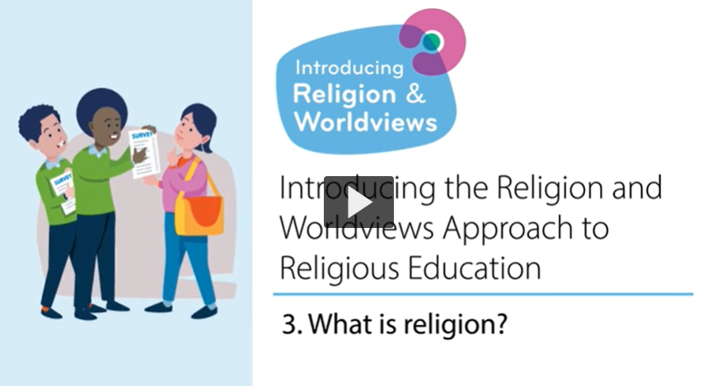
What is ‘religion’?
Notes:
[Twilight training: You may want to skip this slide if teachers have already watched the video ahead of the training session.]
Watch the video with colleagues. Ask if they have any questions at the end of the video. You may not necessarily want to answer them at this stage if you know they’ll be answered in the slides below, but this may help you gauge where there you need to spend more/less time when recapping the key points of the video

Slide 7

What is ‘religion’? – Key Points (1/3)
It’s hard to define the term ‘religion’.
You could say it’s a group of people who have a set of values, a set of beliefs in something like a God, follow a sacred text, have a form of priesthood, have beliefs about life after death.
But…. a definition can be a barrier to understanding traditions, cultures, and beliefs outside of the Western Christian context.
Notes:
Go through the bullet points with colleagues. Check understanding after this slide before moving onto the next one.

Slide 8

What is a ‘religion’? – Key Points (2/3)
Remember the concept of religion derives from Western countries, and was then applied to traditions and beliefs outside that area… but the framework used did not always apply neatly!
The way we use the term ‘religion’ does not always fully embrace the lived experiences of religion (i.e. people’s lived realities of what it means to be religious or nonreligious)
Notes:
Go through the bullet points with colleagues. Check understanding after this slide before moving onto the next one.

Slide 9
What is a ‘religion’? – Key Points (3/3)
There are lots of groups in Britain who are perhaps on the edge of religion or nonreligion:
E.g. Judaism - some see themselves as Jewish in terms of identity and community but it’s not their religion.
E.g. Paganism - some Pagan groups see themselves as religious and some Pagan groups see themselves as nonreligious.
E.g. A belief in ghosts. The category of religion as previously understood doesn’t fit with this - with ghosts there is not a sacred text or a priesthood.
Notes:
Go through the bullet points with colleagues. Check understanding after this slide before moving onto the next one.
If teacher feel comfortable, you could ask them to share any of their own experiences of not being sure if they are religious or not (e.g. “I believe in God but I don't attend a place of worship or ever pray”).

Slide 10

Why does this matter for RE? (1/4)
This is helpful to realise that the concept of ‘religion’ as we were taught it may not have done justice to the concept, and/or to what we may have called ‘world religions’.
It is not necessary for primary teachers to engage in such discussions with pupils. Rather, it is about providing teachers an understanding of the challenges that can come up when we define ‘religion’ and ‘world religions’, and how this may affect the language and/or the case studies we use in the classroom.
Notes:
Go through the bullet points with colleagues. Check understanding after this slide before moving onto the next one.
You may want to make sure there are no misunderstandings following this discussion: we are not saying we should not use the word ‘religion’, as it remains a really useful term to make sense of the world. It’s about being aware of its boundaries and its limitations.
You may want to refer teachers to the example activities in the teacher handout to help illustrate the change, and reassure them that small changes can have a huge impact!
This slide will lead you onto the next one, which explains how such a Western Christian framing has been prominent in RE because of what we call the “World Religions Paradigm” (which is explained in the next slide, and also in the Teacher Handout > Glossary).

Slide 11
Why does this matter for RE? (2/4)
Being aware of the term’s colonial baggage (i.e. that the word as we know it has been shaped by Western Christianity) help helps us:
Understand why we should not compare ‘other’ religious and nonreligious tradition to Christianity in RE classes.
Understand that why ‘religion’ is so hard to define and why there can be disagreements about it.
Notes:
Go through the bullet points with colleagues. Check understanding after this slide before moving onto the next one.
The aims of this slide and the next two ones are to understand that using Christianity as a reference point in RE can be problematic as it reinforces power asymmetries (in other words, it perpetuates the idea that Christianity is the norm or the reference point against which other religious and nonreligious traditions can be compared, which gives it more status than other religion and worldviews).
A R&W approach is therefore useful for those who are seeking to decolonise the RE curriculum, since it invites teachers to think about the way in which things are framed - rather than about adding/taking out content (see Teacher Handout > glossary if help is needed to understand ‘decolonising’).

Slide 12

Why does this matter for RE? (3/4)
As such, you may want to be mindful of the language or comparisons you draw in class.
While in the past we may have heard/said things like ““Guru Granth Sahib is similar to the Bible, but for Sikhs.”
Or
“A Gurdwara is like a church, but for Sikhs”, you’re now aware that by doing so you’re restricting Sikhi by trying to make sense of it through Christianity (and as such through a Western Christian lens).
Notes:
Go through the bullet points with colleagues. Check understanding after this slide before moving onto the next one.

Slide 13

Why does this matter for RE? (4/4)
Making sense of religious and nonreligious worldviews through Christianity (and as such, through a Western Christian lens) can do them a real disservice (e.g. Indic/Dharmic traditions).
E.g.: Making sense of Sanatan Dharma* by using Christianity (and as such a Western Christian lens) to make sense of it can often mean using categories such as ‘sacred text’, ‘place of worship’, and ‘God’-creating’.
This is not only an unhelpful framing but also a colonial one.
Notes:
Go through the bullet points with colleagues. Check understanding after this slide before moving onto the next one.
* Acknowledge that most teachers will talk about Hinduism. Sanatan Dharma is often used instead when wanting to reframe it outside a Christian lens.
If you and/or colleagues would like to read more about what happens when religion(s) are framed through Christianity, they can read Benoit’s (2021) paper, which looks at how teachers may accidently invalidate children’s experiences of religious belonging: https://www.tandfonline.com/doi/full/10.1080/13537903.2021.1958493 .

Slide 14

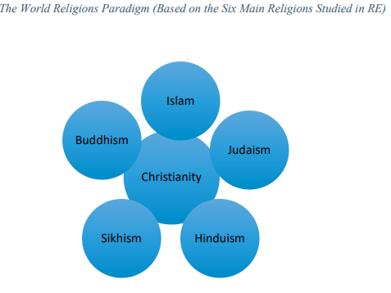
Moving away from the ‘World Religions Paradigm’ (WRP)
We cannot fit religions neatly into boxes (e.g. Islam is …, Muslims do …),
nor ignore lived experiences of religion and nonreligion
Source: Benoit, 2020
Notes:
Here, take the time to explain that traditionally RE has been taught through what we call the ‘World Religion Paradigm’ (WRP). This was the idea that the ‘main’ religions - usually the ‘big six’: Buddhism, Christianity, Hinduism, Islam, Judaism, and Sikhi(sm) – were the ones taught in school. These would usually be framed as if they could fit into neat boxes (e.g., ‘Islam is….; Muslims do…”).
The criticism is that the WRP was perpetuating the notion that this traditions can all be understood through a Christian lens, especially as we framed all world religions as sharing common aspects with Christianity, and focusing on aspects such as scriptures, a church-like organisational structure, religious leaders organised in ways that are similar to priesthood, and a belief in one (or more) divine power(s).
But as we’ve seen in the previous slides, by making sense of ‘world religions’ through Christianity, we are failing to do justice to the diverse religious and nonreligious traditions present in our society. In other words, we are essentialising ‘world religions’ (refer to the Teacher Handout > Glossary to unpack the concept of (de-)essentialising if useful).
Instead, a ‘Religion and Worldviews’ (R&W) approach will aim to de-essentialise RE by capturing, and where appropriate, foregrounding lived experiences of religion and nonreligion.
If you/colleagues want to read more about the WRP, please see pp.7-8 of the Multidisciplinary Report: https://religiouseducationcouncil.org.uk/rec/wp-content/uploads/2021/01/REC-Worldview-Report-A4-v2.pdf

Slide 15
Reflect
Mrs Taylor says that Muslims pray five times a day. But in my family . . . my dad says that, if I pray only once a day, it’s ok. So I’m not sure. I’d definitely say I’m a Muslim. But I don’t know if that’s the right word ‘cos I don’t pray five times a day. . . But I’d say it is...
(Benoit, 2021)
Imagine a Muslim child sitting in an RE classroom and thinking they do not recognise their own faith because they do not pray five times a day. Why is this happening? Why is this an issue? Why does this need to change?
In the video, the speakers explain that people cannot agree on whether Paganism (or other traditions like Scientology) is a religion or not. What does this reveal about the concept of ‘religion’? Why is this important to know if you teach RE?
Notes:
This task can be adapted to suit your group, e.g.
Silent reflection, including writing down reflections
Two groups – one group takes the first statement and set of questions, and the other group the other statement and set of questions. Discuss for 5-10 mins and feedback to the other group
Discuss as a whole group
Use these discussions to explain that ‘worldview’ is considered as possible tool to move away from these issues, which should help you make the transition to the next video.
If you/colleagues are interested in further exploring misrepresentation in the RE classroom, or looking at other examples where pupils felt alienated in RE, you may want to read Benoit’s (2021) paper “I’m Just British - normal British” pp. 315-322.
NB: We expect the training to have taken approx. 60 mins to reach this point. If this session will last longer than 90 mins, it may be a good place to stop and have a quick break.

Slide 16

What is a worldview? (1/6)
Notes:
To introduce the concept of worldview, we recommend watching this video all together – even for twilight sessions
Link to ‘Nobody Stands Nowhere’ video: https://www.youtube.com/watch?v=AFRxKF-Jdos&ab_channel=TheosThinkTank

Slide 17
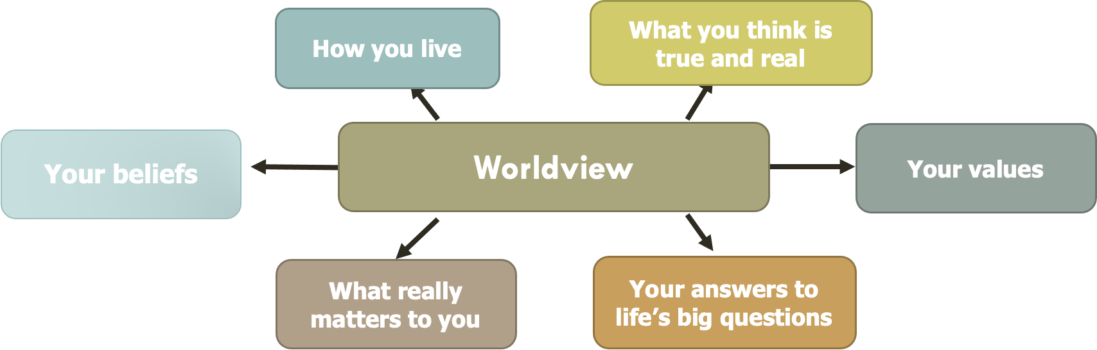
What is a worldview? (2/6)
Your worldview might include….
Thanks to the Coventry & Warwickshire REC / local Agreed Syllabus writing team, led by Jennifer Jenkins, for sharing this material
Notes:
Show this slide to teachers and explain that this is how the Coventry and Warwickshire SACRE and locally agreed syllabus team made sense of ‘worldview’.
Ask teachers:
1/ What do they think about this figure?
2/ Do they think anything is missing and might needed to be added?
3/ [optional]: How does this understanding of ‘worldview’ might change the way they approach RE? (e.g. do they feel that some of these are relevant/irrelevant?) NB: this isn’t a platform to provide answers but to raise questions, which you will then respond to with the next few slides, so if there are queries and disagreement at this stage, they do not need to be resolved yet. You can skip this question if more appropriate to your setting and/or if time is an issue.
Thanks to the Coventry & Warwickshire REC / local Agreed Syllabus writing team, led by Jennifer Jenkins, for sharing this material.

Slide 18
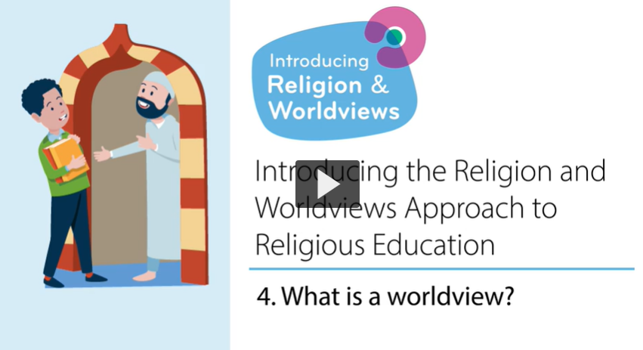
What is a worldview? OPTIONAL VIDEO
Notes:
NOTE: This video is optional. We recommend it is only showed should teachers show an interest to go beyond the discussions held during the training or if your school is already well-versed in the R&W approach.
We have left it in the trainer’s pack for further guidance, not for showing to teachers.

Slide 19

What is a worldview? (3/6)
The word ‘Worldview’ describes the way in which a person encounters, interprets, understands and engages with the world.
Everyone has/inhabits a worldview, even if it’s not easily explained. This is why we all need RE.
Notes:
The aims are to go over the key points in this slide and the following two slides to ensure that teachers are given the chance to reflect on the concept of worldview and how this might help address some of the issues discussed earlier. Go through the bullet points with colleagues. Check understanding after this slide before moving onto the next one.

Slide 20
What is a worldview? (4/6)
Worldviews might draw on religious and nonreligious influences, which is one of the things we investigate in the RE classroom.
Worldviews as a concept allows us not to just focus on a set of ideas we have in our heads, it also acknowledges the lived experiences and considers the body and emotions too.
Notes:
Go through the bullet points with colleagues. Check understanding after this slide before moving onto the next one.

Slide 21

What is a worldview? (5/6)
Worldviews are not fixed – they can change over a life-course, - e.g. from early childhood to adolescence to adulthood.
Different disciplinary knowledge and skills can help us make sense of religion and worldviews; using a multidisciplinary approach, not just Theology, might be useful to the RE curriculum.
Notes:
Go through the bullet points with colleagues. Check understanding after this slide before moving onto the next one.
Regarding the last bullet point (i.e., that different disciplines can help us make sense of religion and nonreligion), at this stage just flag this up to teachers and tell them that they will have the opportunity to explore what that means in more detail towards the end of Session 1.

Slide 22
What is a worldview? (6/6)
Worldviews are not fixed – they can change over a life-course, - e.g. from early childhood to adolescence to adulthood.
A worldview is your approach to life. It might draw on religious and/or nonreligious aspects. It might be personal to you; it might be shared with other people.
Notes:
Go through the bullet points with colleagues. Check understanding after this slide before moving onto the next one.

Slide 23
Why does this matter for RE?
The concept of worldview enables us to approach our RE curriculum differently. It helps us acknowledge that religious and nonreligious traditions are fluid, diverse, and can change over time (and so can our attitudes towards them).
The concept of worldview can help us make RE classrooms more inclusive.
As such, you may want to ensure the language you use is inclusive (e.g., do not say “All Muslims pray 5 times a day”, but “many Muslims pray 5 times a day”, or “Christians go to church for Easter”, but “some Christians might go to church for Easter”). Similarly, you may want to ensure you include emotions and the body, not just beliefs as you discuss (non)religion.
Can you think of other examples where knowing about ‘religion’ can inform the choices you’ll make in RE?
Notes:
Go through the bullet points with colleagues. Check understanding after this slide before moving onto the next one.
You may, once again, want to make sure there are no misunderstandings following the discussion: we are not saying we should replace the word ‘religion’ with the word ‘worldview’. Remember: ‘religion’ remains a really useful term to make sense of the world!
Examples of the final bullet point may include things like: the language you use, the images or books you use, reflecting a more diverse view of the lived experience of religion and nonreligion.
Also, ensure a range of images are used to show different examples, e.g. groups of Muslim women with some wearing hijab and others not, to show the diversity of lived religion/nonreligion.

Slide 24

Discussion
Does your RE classroom/curriculum currently capture…
  People’s lived experiences of religion and nonreligion?
  Diversity within religious and nonreligious traditions?
  How worldviews might be informed by religion AND nonreligion (rather than either/or)?
  That our relationship with religion/nonreligion is not fixed and will evolve over our life course?

Slide 25
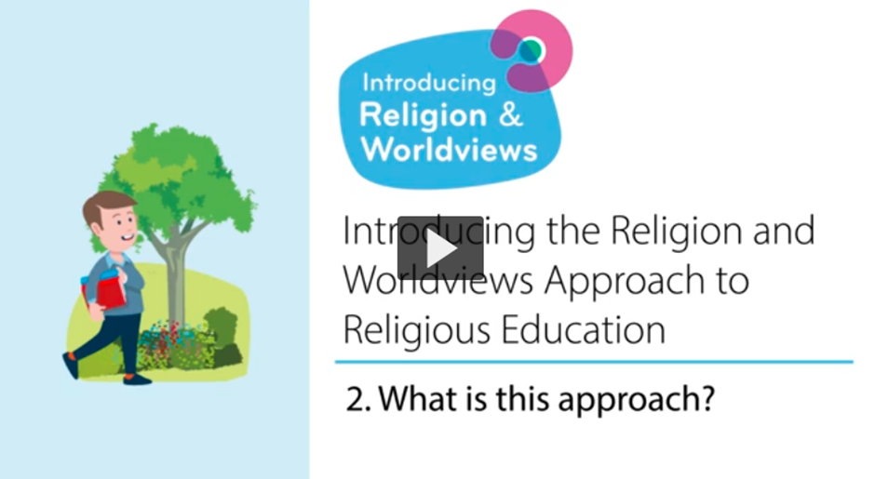
What is the R&W approach?
Notes:
[Twilight training: You may want to skip this slide if teachers have already watched the video ahead of the training session.]
Watch the video with colleagues. Ask if they have any questions at the end of the video. You may not necessarily want to answer them then if you know they’ll be answered in the slides below, but this may help you gauge where there you need to spend more/less time when recapping the key points of the video.
NB! Please reassure teachers by explaining that in this video the speakers make reference to ‘individual/personal worldviews’ and ‘organised/institutional worldviews’, the differences between the different levels will be explained in Session 2 – and at this stage there is no need to focus on this yet.

Slide 26

From WRP to R&W (1/4)
It’s a change in the way we teach (a pedagogical shift).
It’s not so much about the content we teach, it’s about how we teach thar content
World Religions Paradigm
Religion & Worldviews Approach
The idea that there are six major world religions, and lots of minor ones, and that they have a comparable set of core beliefs and practices that we can neatly package up and present in lessons. This approach is seen as distorting by imposing a particular model onto diverse traditions.
The idea that religion and beliefs are constantly changing and dynamic and each person will experience these differently.
Thanks to the Coventry & Warwickshire REC / local Agreed Syllabus writing team, led by Jennifer Jenkins, for sharing this material
Notes:
Please reassure teachers: while RE classes will provide us with opportunities to start making sense of our diverse world, as well as our own worldview, we do not expect teachers to be able to fully articulate what their own worldviews are, nor what their pupils’ worldviews are.
RE becomes the space where this is investigated.
Thanks to the Coventry & Warwickshire REC / local Agreed Syllabus writing team, led by Jennifer Jenkins, for sharing this material.

Slide 27
From WRP to R&W (2/4)
Adopting a R&W approach:
is not simply adding more content.
is not merely adding in non-religious worldviews.
This approach is about reflecting the ever increasing and diverse society in which we live.
This approach will recognise plurality within religion and nonreligion.
There is a focus on people: a R&W approach starts with people.
There is a focus on learning as an interpretive endeavour.
It involves examining one’s own beliefs, attitudes, motives and reactions and those of other people.
Notes:
This should help make the RE classroom an inclusive space.

Slide 28
From WRP to R&W (3/4)
Adopting a R&W approach:
is not simply adding more content.
is not merely adding in non-religious worldviews.
A R&W approach is about reflecting the ever increasing and diverse society in which we live.
A R&W approach recognises plurality within religious and nonreligious traditions.
Notes:
This should help make the RE classroom an inclusive space.

Slide 29
From WRP to R&W (4/4)
A R&W approach should help make the RE classroom an inclusive space.
There is a focus on people: a R&W approach can start with people.
A R&W approach involves examining one’s own beliefs, attitudes, motives and reactions and those of other people.
There is a focus on learning as an interpretive endeavour.
Notes:
If you need guidance about what is meant by an interpretive approach to RE: the intention is to enable learners to formulate their own views and to relate these to their previous learning and understanding.
Jackson wrote a useful paper on the interpretive approach in the RE classroom: https://theewc.org/content/uploads/2020/02/Studying-Religions-The-Interpretive-Approach-in-Brief.pdf

Slide 30
A pedagogical shift - Example
Take a concept like Karma:
A R&W approach means starting with where your children are at, and then moving on to consider the worldviews of others.
A R&W approach also means starting with the particular, then expanding to the more general.
Start by investigating what the concept of Karma means to children / families in the school and local community.
Then consider what Karma means to two different Hindu families. Through these two case studies you may recognise some diversity of beliefs / practices within a religion.
Then branch out to investigate what Karma might mean to Hindus more generally.
End with children reflecting again about what they have learnt and if this has changed or informed their own worldview.
Notes:
Go through this classroom example with teachers to illustrate what a R&W could look like in the classroom.

Slide 31

R&W and disciplinary lenses (1/2)
Worldview is a concept that has a long history in a few different academic disciplines including philosophy, theology, sociology and anthropology. We find it in Religious Education too.
Tapping into different disciplines can be also be really useful in the RE classroom.
Good RE is informed by different disciplines, which is what is called a ‘Multidisciplinary Approach’
Notes:
Go through the bullet points with colleagues. Check understanding after this slide before moving onto the next one.
Reassure teachers it’s not about becoming experts in lots of different disciplines; instead it’s about acknowledging that sometimes we may talk about sacred texts (Theology), sometimes we may investigate how people live their religion and nonreligion (Sociology/Social Sciences), and other times we may want to ponder on how they interpret some of the big questions in life (philosophy). It’s important to note that while these are the main disciplines (or disciplinary lenses as we like to call them in RE!), there are more disciplines that can inform RE (e.g. History…) and this is not an exhaustive list.

Slide 32
R&W and disciplinary lenses (2/2)
There are lots of different disciplines (or disciplinary lenses) you can bring to the RE classroom to try and make sense of how people understand the world around them.
Examples include: Theology, History, Philosophy, Social Sciences, Sociology…
The RE classroom draws on different disciplinary lenses to teach pupils the different skills for studying texts, people, objects and buildings.
Notes:
In the next slides, you will be able to look at examples of how different disciplinary lenses are used in EYFS, KS1, and KS2.
Before you show the next slides, please make it clear to teachers that:
We often use the different disciplines throughout RE and during different lessons; this reflects the messiness of worldviews and lived experiences of religion and nonreligion. As such, although the next slides suggest a clean split between the different disciplines please make it clear to teachers that this is not how it will look in the RE classroom.
Please acknowledge that these are examples in which the disciplines can be understood in the context of the RE classroom - they are not meant to be exhaustive understanding of what each different discipline entails.

Slide 33

We are Theologians - EYFS
We listen carefully to sacred stories and make links with what people do and believe.
We look for clues to try and to back-up our thinking.
We ask questions about what we read and discuss what it might mean.
We think deeply about what sacred texts mean to us. personally and what they might mean to others.
We look carefully at religious art to discover what it might be telling us about the artist’s worldview, beliefs and ideas.
Thanks to the Coventry & Warwickshire REC / local Agreed Syllabus writing team, led by Jennifer Jenkins, for sharing this material
Notes:
It is up to you as the trainer whether you would like to show the next few slides (“we are Theologians”, “we are Social Scientists” and “We are Philosophers”) as these are also covered in Session 3. Some trainers like introducing these early and using session 3 as a reminder, while others prefer bringing up the concept of disciplinary lenses at this stage and delving into further details later on. Choose what is most appropriate for you.
If time is an issue - you can ask teachers to read the 3-4 slides that are relevant to their own KS instead of going over EYFS, KS1 and KS2 with everyone - or to use these slides as a take-away activity - and move straight to the last two slides of this training session. Tell teachers there will be more time in Session 3 to engage with the concept of disciplinary lenses.
Thanks to the Coventry & Warwickshire REC / local Agreed Syllabus writing team, led by Jennifer Jenkins, for sharing this material.

Slide 34

We are Philosophers - EYFS
We think about our own opinions and ideas.
We explain our opinions and ideas.
We ask brave questions of our own and attempt to answer the questions of others.
We try to help people understand our point of view through what we say.
We think carefully about what we have learned to decide what is true and what might not be true.
We think about issues of right and wrong, good and bad.
Thanks to the Coventry & Warwickshire REC / local Agreed Syllabus writing team, led by Jennifer Jenkins, for sharing this material
Notes:
Thanks to the Coventry & Warwickshire REC / local Agreed Syllabus writing team, led by Jennifer Jenkins, for sharing this material.

Slide 35

We are Human and Social Scientists - EYFS
We look for similarities and differences in the way people live together.
We think about the reasons why people might choose to wear specific things, behave in certain ways or do particular things.
We study diversity and lived experiences of religion using interviews, examples and observations.
We listen carefully and think hard about what we have heard to try to understand the worldviews of others, both personal and organised, alongside our own.
We meet real people from different religious traditions and those of no faith/religion.
We think about issues of belonging and how we express ourselves.
Thanks to the Coventry & Warwickshire REC / local Agreed Syllabus writing team, led by Jennifer Jenkins, for sharing this material
Notes:
Thanks to the Coventry & Warwickshire REC / local Agreed Syllabus writing team, led by Jennifer Jenkins, for sharing this material.

Slide 36
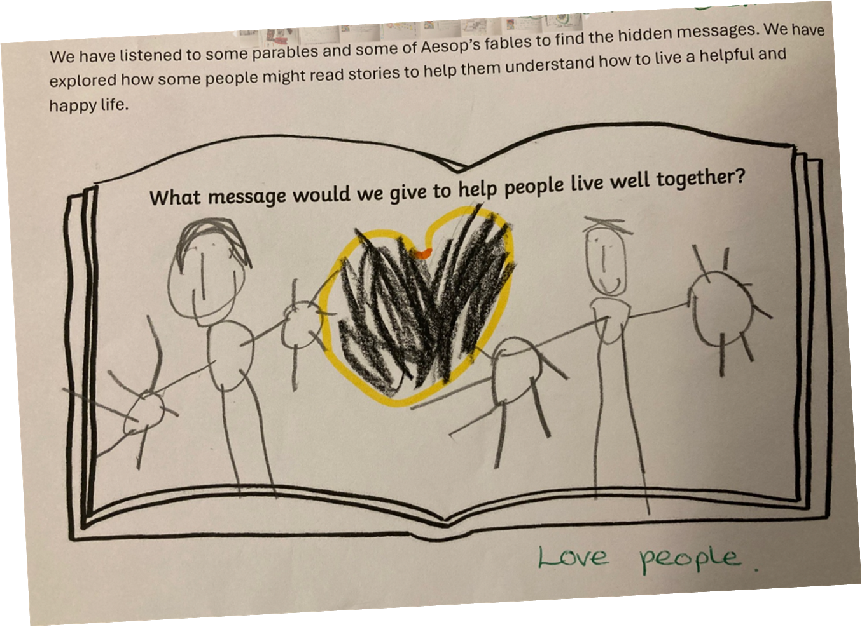
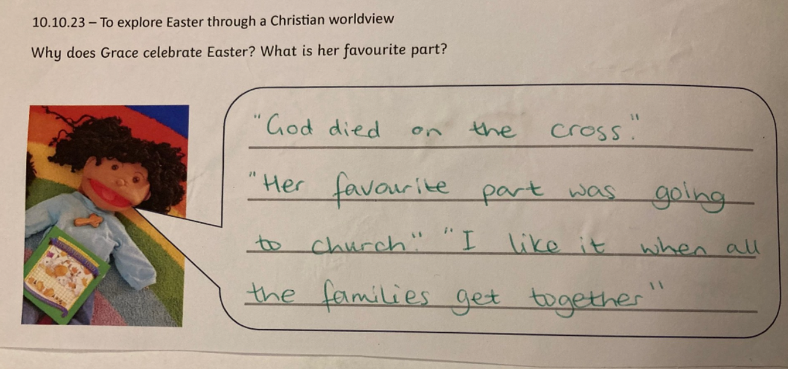
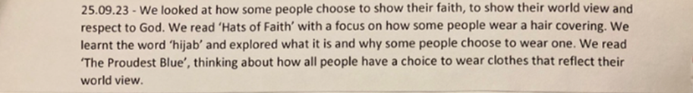
EYFS: Examples of work

Slide 37
We are Theologians - KS1
We listen carefully to sacred stories and make links with what people do and believe.
We look for clues to try and to back-up our thinking.
We ask questions about what we read and discuss what it might mean.
We think deeply about what sacred texts mean to us personally and what they might mean to others.
We look carefully at religious art to discover what it might be telling us about the artist’s worldview, beliefs and ideas.
Thanks to the Coventry & Warwickshire REC / local Agreed Syllabus writing team, led by Jennifer Jenkins, for sharing this material
Notes:
Thanks to the Coventry & Warwickshire REC / local Agreed Syllabus writing team, led by Jennifer Jenkins, for sharing this material.

Slide 38
We are Philosophers - KS1
We think about our own opinions and ideas.
We explain our opinions and ideas.
We ask brave questions of our own and attempt to answer the questions of others.
We try to help people understand our point of view through what we say.
We think carefully about what we have learned to decide what is true and what might not be true.
We think about issues of right and wrong, good and bad.
Thanks to the Coventry & Warwickshire REC / local Agreed Syllabus writing team, led by Jennifer Jenkins, for sharing this material
Notes:
Thanks to the Coventry & Warwickshire REC / local Agreed Syllabus writing team, led by Jennifer Jenkins, for sharing this material.

Slide 39
We are Human and Social Scientists - KS1
• We look for similarities and differences in the way people live together.
• We think about the reasons why people might choose to wear specific things, behave in certain ways or do particular things.
• We study diversity and lived experiences of religion using interviews, examples and observations.
• We listen carefully and think hard about what we have heard to try to understand the worldviews of others, both personal and organised, alongside our own.
• We meet real people from different religious traditions and those of no faith/religion.
• We think about issues of belonging and how we express ourselves.
Thanks to the Coventry & Warwickshire REC / local Agreed Syllabus writing team, led by Jennifer Jenkins, for sharing this material
Notes:
Thanks to the Coventry & Warwickshire REC / local Agreed Syllabus writing team, led by Jennifer Jenkins, for sharing this material.

Slide 40
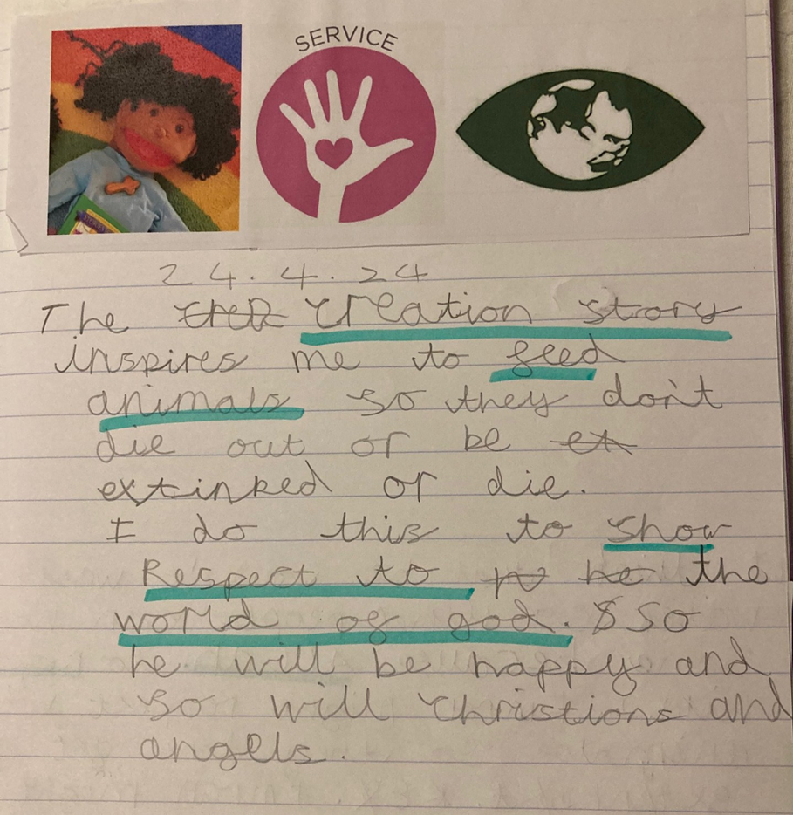
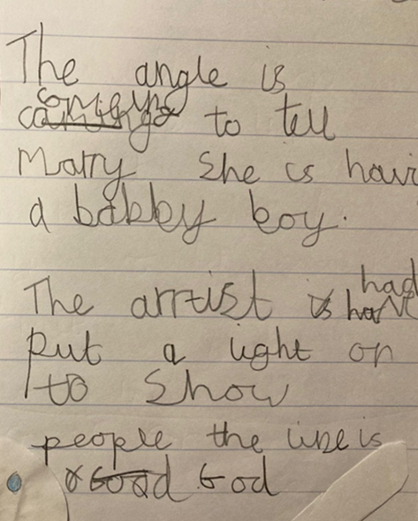
KS1: Examples of work

Slide 41
We are Theologians - KS2
We analyse sacred texts and make links with practices and beliefs.
We look for evidence to back up our thinking.
We make judgements based on our reading.
We make interpretations and identify our hermeneutical lenses.
We ask questions about what we read and discuss its meaning.
We consider authorship and authority and the context in which sacred texts were written.
We reflect on what sacred texts mean to us personally and what they mean to others.
We consider what religious art might be telling us about the artist’s worldview and wider beliefs and ideas.
Thanks to the Coventry & Warwickshire REC / local Agreed Syllabus writing team, led by Jennifer Jenkins, for sharing this material
Notes:
Thanks to the Coventry & Warwickshire REC / local Agreed Syllabus writing team, led by Jennifer Jenkins, for sharing this material.

Slide 42
We are Philosophers - KS2
We explore different methods of knowing and different methods of reasoning.
We use the ideas and thoughts of others to generate discussion and formulate our own opinions.
We justify our opinions and ideas with evidence and examples.
We challenge the ideas and opinions of others, known to us and not previously known.
We ask innovative questions of our own and attempt to answer the questions of others.
We try to be persuasive in our spoken language and in our writing.
We think critically using reason and evidence.
We think about why we are here and issues of right and wrong, good and bad.
Thanks to the Coventry & Warwickshire REC / local Agreed Syllabus writing team, led by Jennifer Jenkins, for sharing this material
Notes:
Thanks to the Coventry & Warwickshire REC / local Agreed Syllabus writing team, led by Jennifer Jenkins, for sharing this material.

Slide 43
We are Human and Social Scientists - KS2
We question assumptions about worldviews and religion/nonreligion.
We analyse how things change in society.
We consider the reasons for human behaviour and practices.
We consider what behaviour and practices tell us about belief and ways of seeing the world.
We study diversity and lived experiences of religion using interviews, case studies and observations.
We analyse and try to understand the worldviews of others, both personal and organised, alongside our own.
We encounter real people from different religious traditions and those of no faith/religion.
We think about issues of belonging and identity and the interactions between these ideas.
Thanks to the Coventry & Warwickshire REC / local Agreed Syllabus writing team, led by Jennifer Jenkins, for sharing this material
Notes:
Thanks to the Coventry & Warwickshire REC / local Agreed Syllabus writing team, led by Jennifer Jenkins, for sharing this material.

Slide 44
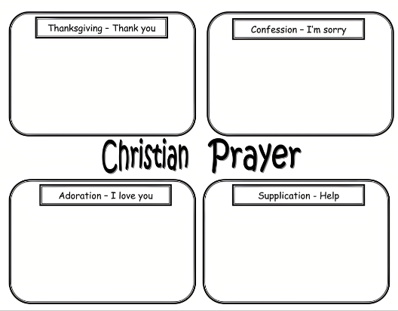
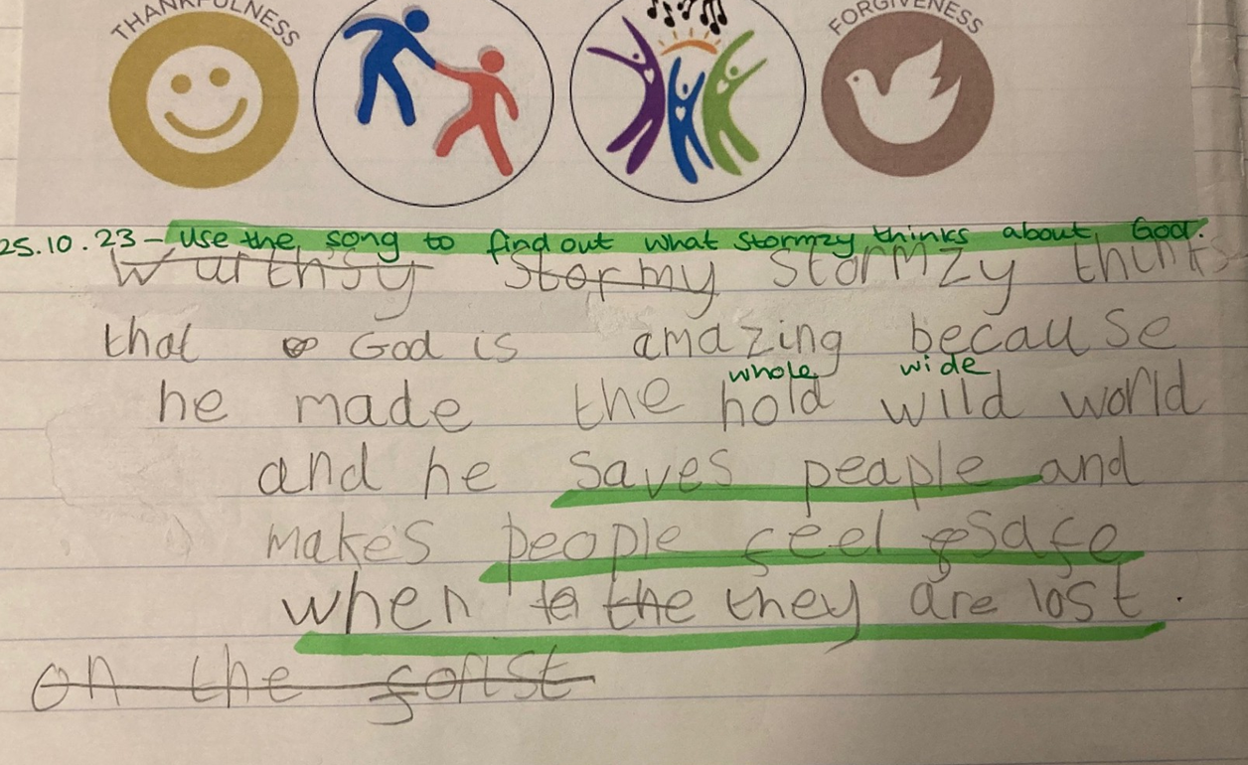
R&W - Investigate Stormzy’s worldview. Read the lyrics of “Blinded by Your Grace” and find examples of what he thinks about God.
What are the differences between a WRP and a R&W approach?
WRP - Give an example of when Christians use each type of prayer.
2. Reflect on Stormzy’s worldview.
KS2: Examples of work

Slide 45

Session 1: Summary (1/2)
The Religion and Worldviews (R&W) approach may seem new, but it builds on existing good practice in RE – you may already be adopting a R&W approach to an extent!
We need to be mindful about the language we use, as well as the images/pictures and examples we use in the classroom:
  To avoid framing ‘world religions’ through Western Christian lenses
  To avoid homogenising groups, instead acknowledging diversity within and across (non)religion

Slide 46
Session 1: Summary (2/2)
This is a pedagogical shift: it’s about how you teach RE, not about adding/removing content
Different disciplinary lenses can be useful to investigate worldviews
It is important to acknowledge the body and the emotions as well as the cognitive

Slide 47


End of session 1
© Introducing Religion & Worldviews (2025)
Notes:
If this is a day-long training, please make sure everyone has time for a break before moving on to session 2.
For feedback and comments about these resources, please scan the QR code or copy/paste this URL into your browser: https://forms.office.com/e/iLKDeRHMYL
To contact the lead author, please email Celine.Benoit@nottingham.ac.uk

