Slide 1







Religion & Worldviews in Religious Education
Training Pack for Primary Schools
Notes:
Welcome to the “Adopting a Religion & Worldviews approach in RE” training for primary school teachers.

Slide 2


Introducing Religion & Worldviews
Session 1

Slide 3
Learning Objectives
Reflect on the concept of ‘religion’, and how its definition may have shifted over the years
Reflect on some of the limitations of the concept of religion, and what this means for the RE classroom
Engage with the concept of worldview, and how this can be a useful tool to acknowledge how people engage with religion and nonreligion in different ways throughout their life-course
Reflect on the notion of worldview, not just a set of complex ideas but also as how we respond to the world (i.e., emotions, feelings, body…), and how this can be reflected in the RE classroom.
Reflect on the importance of lived experiences of religion, and how to include these in the RE classroom

Slide 4
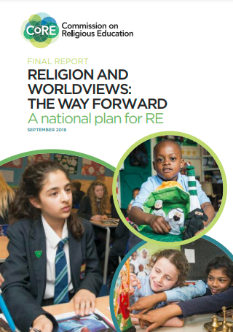
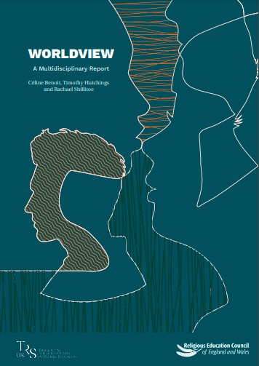
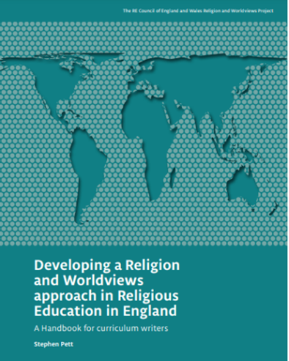
R&W: Context
Click on the pictures to access the resources hosted by the Religious Education Council for England and Wales
Notes:
The Handbook for Curriculum Writers (pictured here)
The (draft) National Content Standard for Religious Education in England pp. 6-11 (NB: only refer to this document if based in England).

Slide 5

Activity
What comes to mind when you hear the word “religion”?

Slide 6
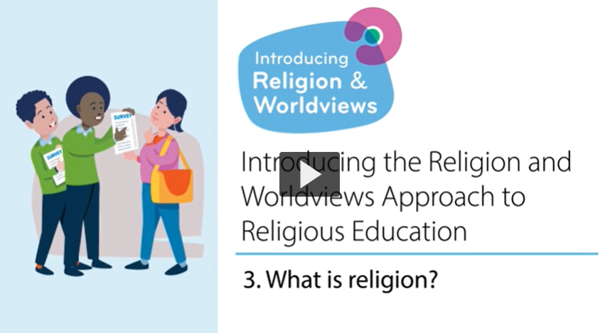
What is ‘religion’?

Slide 7

What is ‘religion’? – Key Points (1/3)
It’s hard to define the term ‘religion’.
You could say it’s a group of people who have a set of values, a set of beliefs in something like a God, follow a sacred text, have a form of priesthood, have beliefs about life after death.
But…. a definition can be a barrier to understanding traditions, cultures, and beliefs outside of the Western Christian context.

Slide 8

What is a ‘religion’? – Key Points (2/3)
Remember the concept of religion derives from Western countries, and was then applied to traditions and beliefs outside that area… but the framework used did not always apply neatly!
The way we use the term ‘religion’ does not always fully embrace the lived experiences of religion (i.e. people’s lived realities of what it means to be religious or nonreligious)

Slide 9
What is a ‘religion’? – Key Points (3/3)
There are lots of groups in Britain who are perhaps on the edge of religion or nonreligion:
E.g. Judaism - some see themselves as Jewish in terms of identity and community but it’s not their religion.
E.g. Paganism - some Pagan groups see themselves as religious and some Pagan groups see themselves as nonreligious.
E.g. A belief in ghosts. The category of religion as previously understood doesn’t fit with this - with ghosts there is not a sacred text or a priesthood.

Slide 10

Why does this matter for RE? (1/4)
This is helpful to realise that the concept of ‘religion’ as we were taught it may not have done justice to the concept, and/or to what we may have called ‘world religions’.
It is not necessary for primary teachers to engage in such discussions with pupils. Rather, it is about providing teachers an understanding of the challenges that can come up when we define ‘religion’ and ‘world religions’, and how this may affect the language and/or the case studies we use in the classroom.

Slide 11
Why does this matter for RE? (2/4)
Being aware of the term’s colonial baggage (i.e. that the word as we know it has been shaped by Western Christianity) help helps us:
Understand why we should not compare ‘other’ religious and nonreligious tradition to Christianity in RE classes.
Understand that why ‘religion’ is so hard to define and why there can be disagreements about it.

Slide 12

Why does this matter for RE? (3/4)
As such, you may want to be mindful of the language or comparisons you draw in class.
While in the past we may have heard/said things like ““Guru Granth Sahib is similar to the Bible, but for Sikhs.”
Or
“A Gurdwara is like a church, but for Sikhs”, you’re now aware that by doing so you’re restricting Sikhi by trying to make sense of it through Christianity (and as such through a Western Christian lens).

Slide 13

Why does this matter for RE? (4/4)
Making sense of religious and nonreligious worldviews through Christianity (and as such, through a Western Christian lens) can do them a real disservice (e.g. Indic/Dharmic traditions).
E.g.: Making sense of Sanatan Dharma* by using Christianity (and as such a Western Christian lens) to make sense of it can often mean using categories such as ‘sacred text’, ‘place of worship’, and ‘God’-creating’.
This is not only an unhelpful framing but also a colonial one.
Notes:
* Most teachers will talk about Hinduism. Sanatan Dharma is often used instead when wanting to reframe it outside a Christian lens.
If you would like to read more about what happens when religion(s) are framed through Christianity, you can read Benoit’s (2021) paper, which looks at how teachers may accidently invalidate children’s experiences of religious belonging: https://www.tandfonline.com/doi/full/10.1080/13537903.2021.1958493 .

Slide 14

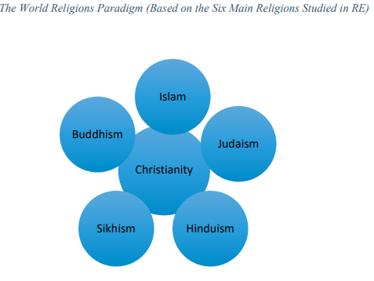
Moving away from the ‘World Religions Paradigm’ (WRP)
We cannot fit religions neatly into boxes (e.g. Islam is …, Muslims do …),
nor ignore lived experiences of religion and nonreligion
Source: Benoit, 2020
Notes:
If you want to read more about the WRP, please see pp.7-8 of the Multidisciplinary Report: https://religiouseducationcouncil.org.uk/rec/wp-content/uploads/2021/01/REC-Worldview-Report-A4-v2.pdf

Slide 15
Reflect
Mrs Taylor says that Muslims pray five times a day. But in my family . . . my dad says that, if I pray only once a day, it’s ok. So I’m not sure. I’d definitely say I’m a Muslim. But I don’t know if that’s the right word ‘cos I don’t pray five times a day. . . But I’d say it is...
(Benoit, 2021)
Imagine a Muslim child sitting in an RE classroom and thinking they do not recognise their own faith because they do not pray five times a day. Why is this happening? Why is this an issue? Why does this need to change?
In the video, the speakers explain that people cannot agree on whether Paganism (or other traditions like Scientology) is a religion or not. What does this reveal about the concept of ‘religion’? Why is this important to know if you teach RE?
Notes:
If you are interested in further exploring misrepresentation in the RE classroom, or looking at other examples where pupils felt alienated in RE, you may want to read Benoit’s (2021) paper “I’m Just British - normal British” pp. 315-322.

Slide 16

What is a worldview? (1/6)
Notes:
Link to ‘Nobody Stands Nowhere’ video: https://www.youtube.com/watch?v=AFRxKF-Jdos&ab_channel=TheosThinkTank

Slide 17
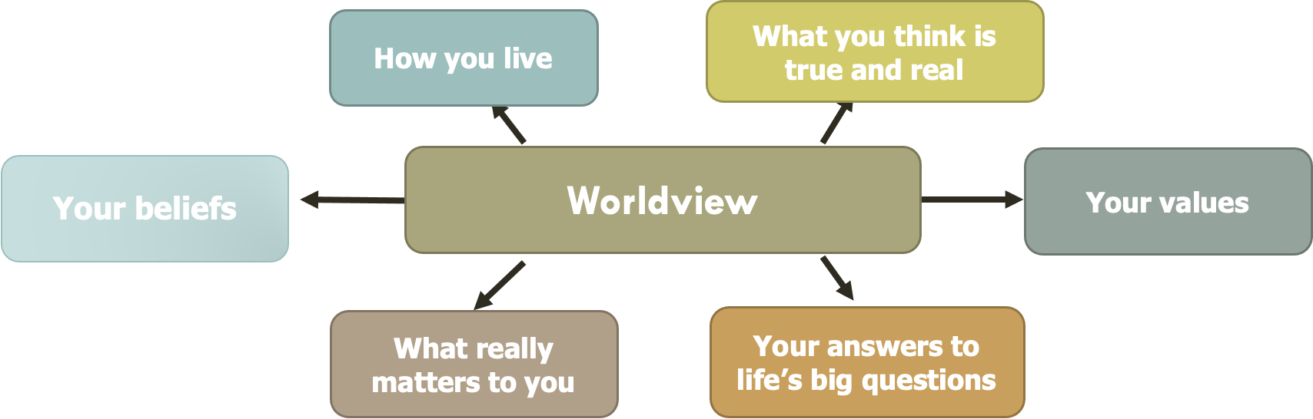
What is a worldview? (2/6)
Your worldview might include….
Thanks to the Coventry & Warwickshire REC / local Agreed Syllabus writing team, led by Jennifer Jenkins, for sharing this material
Notes:
Thanks to the Coventry & Warwickshire REC / local Agreed Syllabus writing team, led by Jennifer Jenkins, for sharing this material.

Slide 18

What is a worldview? (3/6)
The word ‘Worldview’ describes the way in which a person encounters, interprets, understands and engages with the world.
Everyone has/inhabits a worldview, even if it’s not easily explained. This is why we all need RE.

Slide 19
What is a worldview? (4/6)
Worldviews might draw on religious and nonreligious influences, which is one of the things we investigate in the RE classroom.
Worldviews as a concept allows us not to just focus on a set of ideas we have in our heads, it also acknowledges the lived experiences and considers the body and emotions too.

Slide 20

What is a worldview? (5/6)
Worldviews are not fixed – they can change over a life-course, - e.g. from early childhood to adolescence to adulthood.
Different disciplinary knowledge and skills can help us make sense of religion and worldviews; using a multidisciplinary approach, not just Theology, might be useful to the RE curriculum.

Slide 21
What is a worldview? (6/6)
Worldviews are not fixed – they can change over a life-course, - e.g. from early childhood to adolescence to adulthood.
A worldview is your approach to life. It might draw on religious and/or nonreligious aspects. It might be personal to you; it might be shared with other people.

Slide 22
Why does this matter for RE?
The concept of worldview enables us to approach our RE curriculum differently. It helps us acknowledge that religious and nonreligious traditions are fluid, diverse, and can change over time (and so can our attitudes towards them).
The concept of worldview can help us make RE classrooms more inclusive.
As such, you may want to ensure the language you use is inclusive (e.g., do not say “All Muslims pray 5 times a day”, but “many Muslims pray 5 times a day”, or “Christians go to church for Easter”, but “some Christians might go to church for Easter”). Similarly, you may want to ensure you include emotions and the body, not just beliefs as you discuss (non)religion.
Can you think of other examples where knowing about ‘religion’ can inform the choices you’ll make in RE?

Slide 23

Discussion
Does your RE classroom/curriculum currently capture…
  People’s lived experiences of religion and nonreligion?
  Diversity within religious and nonreligious traditions?
  How worldviews might be informed by religion AND nonreligion (rather than either/or)?
  That our relationship with religion/nonreligion is not fixed and will evolve over our life course?

Slide 24
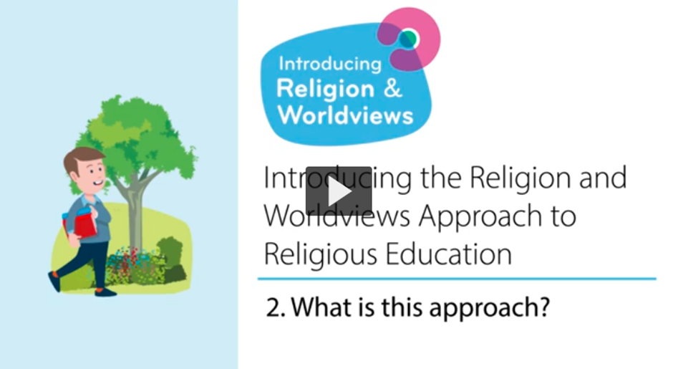
What is the R&W approach?

Slide 25

From WRP to R&W (1/4)
It’s a change in the way we teach (a pedagogical shift).
It’s not so much about the content we teach, it’s about how we teach thar content
World Religions Paradigm
Religion & Worldviews Approach
The idea that there are six major world religions, and lots of minor ones, and that they have a comparable set of core beliefs and practices that we can neatly package up and present in lessons. This approach is seen as distorting by imposing a particular model onto diverse traditions.
The idea that religion and beliefs are constantly changing and dynamic and each person will experience these differently.
Thanks to the Coventry & Warwickshire REC / local Agreed Syllabus writing team, led by Jennifer Jenkins, for sharing this material
Notes:
Thanks to the Coventry & Warwickshire REC / local Agreed Syllabus writing team, led by Jennifer Jenkins, for sharing this material.

Slide 26
From WRP to R&W (2/4)
Adopting a R&W approach:
is not simply adding more content.
is not merely adding in non-religious worldviews.
This approach is about reflecting the ever increasing and diverse society in which we live.
This approach will recognise plurality within religion and nonreligion.
There is a focus on people: a R&W approach starts with people.
There is a focus on learning as an interpretive endeavour.
It involves examining one’s own beliefs, attitudes, motives and reactions and those of other people.

Slide 27
From WRP to R&W (3/4)
Adopting a R&W approach:
is not simply adding more content.
is not merely adding in non-religious worldviews.
A R&W approach is about reflecting the ever increasing and diverse society in which we live.
A R&W approach recognises plurality within religious and nonreligious traditions.

Slide 28
From WRP to R&W (4/4)
A R&W approach should help make the RE classroom an inclusive space.
There is a focus on people: a R&W approach can start with people.
A R&W approach involves examining one’s own beliefs, attitudes, motives and reactions and those of other people.
There is a focus on learning as an interpretive endeavour.
Notes:
If you need guidance about what is meant by an interpretive approach to RE: the intention is to enable learners to formulate their own views and to relate these to their previous learning and understanding.
Jackson wrote a useful paper on the interpretive approach in the RE classroom: https://theewc.org/content/uploads/2020/02/Studying-Religions-The-Interpretive-Approach-in-Brief.pdf

Slide 29
A pedagogical shift - Example
Take a concept like Karma:
A R&W approach means starting with where your children are at, and then moving on to consider the worldviews of others.
A R&W approach also means starting with the particular, then expanding to the more general.
Start by investigating what the concept of Karma means to children / families in the school and local community.
Then consider what Karma means to two different Hindu families. Through these two case studies you may recognise some diversity of beliefs / practices within a religion.
Then branch out to investigate what Karma might mean to Hindus more generally.
End with children reflecting again about what they have learnt and if this has changed or informed their own worldview.

Slide 30

R&W and disciplinary lenses (1/2)
Worldview is a concept that has a long history in a few different academic disciplines including philosophy, theology, sociology and anthropology. We find it in Religious Education too.
Tapping into different disciplines can be also be really useful in the RE classroom.
Good RE is informed by different disciplines, which is what is called a ‘Multidisciplinary Approach’

Slide 31
R&W and disciplinary lenses (2/2)
There are lots of different disciplines (or disciplinary lenses) you can bring to the RE classroom to try and make sense of how people understand the world around them.
Examples include: Theology, History, Philosophy, Social Sciences, Sociology…
The RE classroom draws on different disciplinary lenses to teach pupils the different skills for studying texts, people, objects and buildings.

Slide 32

We are Theologians - EYFS
We listen carefully to sacred stories and make links with what people do and believe.
We look for clues to try and to back-up our thinking.
We ask questions about what we read and discuss what it might mean.
We think deeply about what sacred texts mean to us. personally and what they might mean to others.
We look carefully at religious art to discover what it might be telling us about the artist’s worldview, beliefs and ideas.
Thanks to the Coventry & Warwickshire REC / local Agreed Syllabus writing team, led by Jennifer Jenkins, for sharing this material
Notes:
Thanks to the Coventry & Warwickshire REC / local Agreed Syllabus writing team, led by Jennifer Jenkins, for sharing this material.

Slide 33

We are Philosophers - EYFS
We think about our own opinions and ideas.
We explain our opinions and ideas.
We ask brave questions of our own and attempt to answer the questions of others.
We try to help people understand our point of view through what we say.
We think carefully about what we have learned to decide what is true and what might not be true.
We think about issues of right and wrong, good and bad.
Thanks to the Coventry & Warwickshire REC / local Agreed Syllabus writing team, led by Jennifer Jenkins, for sharing this material
Notes:
Thanks to the Coventry & Warwickshire REC / local Agreed Syllabus writing team, led by Jennifer Jenkins, for sharing this material.

Slide 34

We are Human and Social Scientists - EYFS
We look for similarities and differences in the way people live together.
We think about the reasons why people might choose to wear specific things, behave in certain ways or do particular things.
We study diversity and lived experiences of religion using interviews, examples and observations.
We listen carefully and think hard about what we have heard to try to understand the worldviews of others, both personal and organised, alongside our own.
We meet real people from different religious traditions and those of no faith/religion.
We think about issues of belonging and how we express ourselves.
Thanks to the Coventry & Warwickshire REC / local Agreed Syllabus writing team, led by Jennifer Jenkins, for sharing this material
Notes:
Thanks to the Coventry & Warwickshire REC / local Agreed Syllabus writing team, led by Jennifer Jenkins, for sharing this material.

Slide 35
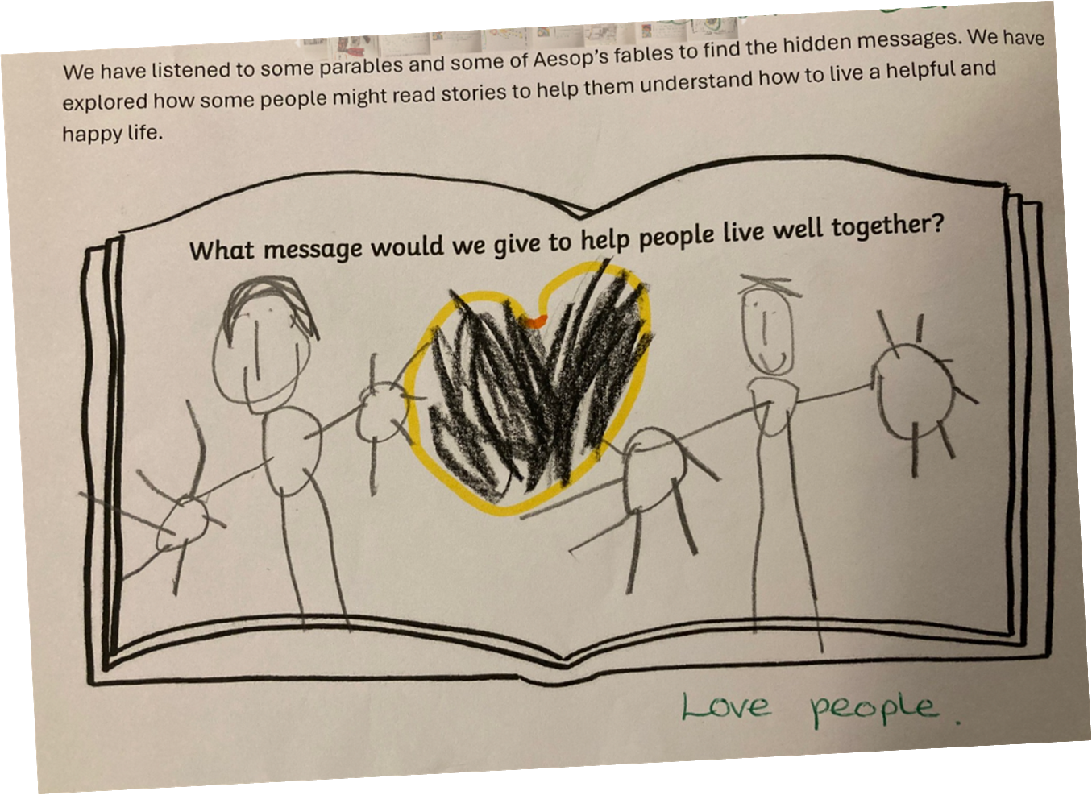
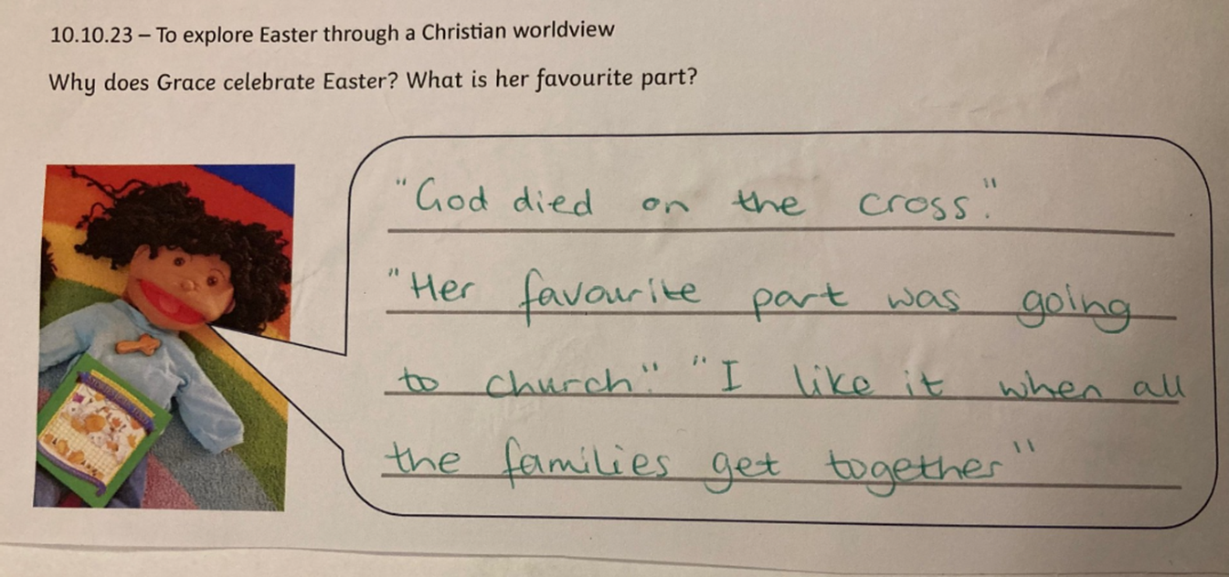
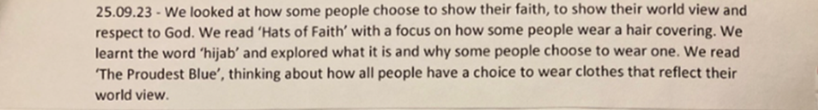
EYFS: Examples of work

Slide 36
We are Theologians - KS1
We listen carefully to sacred stories and make links with what people do and believe.
We look for clues to try and to back-up our thinking.
We ask questions about what we read and discuss what it might mean.
We think deeply about what sacred texts mean to us personally and what they might mean to others.
We look carefully at religious art to discover what it might be telling us about the artist’s worldview, beliefs and ideas.
Thanks to the Coventry & Warwickshire REC / local Agreed Syllabus writing team, led by Jennifer Jenkins, for sharing this material
Notes:
Thanks to the Coventry & Warwickshire REC / local Agreed Syllabus writing team, led by Jennifer Jenkins, for sharing this material.

Slide 37
We are Philosophers - KS1
We think about our own opinions and ideas.
We explain our opinions and ideas.
We ask brave questions of our own and attempt to answer the questions of others.
We try to help people understand our point of view through what we say.
We think carefully about what we have learned to decide what is true and what might not be true.
We think about issues of right and wrong, good and bad.
Thanks to the Coventry & Warwickshire REC / local Agreed Syllabus writing team, led by Jennifer Jenkins, for sharing this material
Notes:
Thanks to the Coventry & Warwickshire REC / local Agreed Syllabus writing team, led by Jennifer Jenkins, for sharing this material.

Slide 38
We are Human and Social Scientists - KS1
• We look for similarities and differences in the way people live together.
• We think about the reasons why people might choose to wear specific things, behave in certain ways or do particular things.
• We study diversity and lived experiences of religion using interviews, examples and observations.
• We listen carefully and think hard about what we have heard to try to understand the worldviews of others, both personal and organised, alongside our own.
• We meet real people from different religious traditions and those of no faith/religion.
• We think about issues of belonging and how we express ourselves.
Thanks to the Coventry & Warwickshire REC / local Agreed Syllabus writing team, led by Jennifer Jenkins, for sharing this material
Notes:
Thanks to the Coventry & Warwickshire REC / local Agreed Syllabus writing team, led by Jennifer Jenkins, for sharing this material.

Slide 39
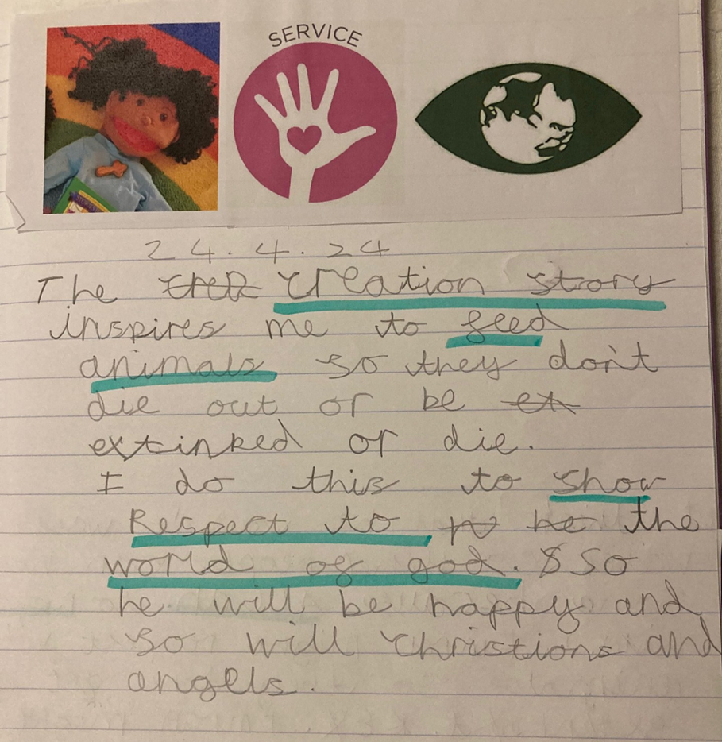
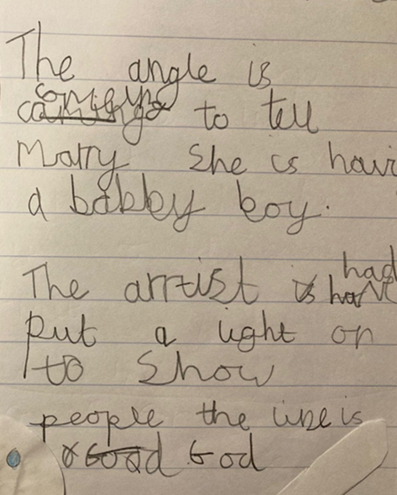
KS1: Examples of work

Slide 40
We are Theologians - KS2
We analyse sacred texts and make links with practices and beliefs.
We look for evidence to back up our thinking.
We make judgements based on our reading.
We make interpretations and identify our hermeneutical lenses.
We ask questions about what we read and discuss its meaning.
We consider authorship and authority and the context in which sacred texts were written.
We reflect on what sacred texts mean to us personally and what they mean to others.
We consider what religious art might be telling us about the artist’s worldview and wider beliefs and ideas.
Thanks to the Coventry & Warwickshire REC / local Agreed Syllabus writing team, led by Jennifer Jenkins, for sharing this material
Notes:
Thanks to the Coventry & Warwickshire REC / local Agreed Syllabus writing team, led by Jennifer Jenkins, for sharing this material.

Slide 41
We are Philosophers - KS2
We explore different methods of knowing and different methods of reasoning.
We use the ideas and thoughts of others to generate discussion and formulate our own opinions.
We justify our opinions and ideas with evidence and examples.
We challenge the ideas and opinions of others, known to us and not previously known.
We ask innovative questions of our own and attempt to answer the questions of others.
We try to be persuasive in our spoken language and in our writing.
We think critically using reason and evidence.
We think about why we are here and issues of right and wrong, good and bad.
Thanks to the Coventry & Warwickshire REC / local Agreed Syllabus writing team, led by Jennifer Jenkins, for sharing this material
Notes:
Thanks to the Coventry & Warwickshire REC / local Agreed Syllabus writing team, led by Jennifer Jenkins, for sharing this material.

Slide 42
We are Human and Social Scientists - KS2
We question assumptions about worldviews and religion/nonreligion.
We analyse how things change in society.
We consider the reasons for human behaviour and practices.
We consider what behaviour and practices tell us about belief and ways of seeing the world.
We study diversity and lived experiences of religion using interviews, case studies and observations.
We analyse and try to understand the worldviews of others, both personal and organised, alongside our own.
We encounter real people from different religious traditions and those of no faith/religion.
We think about issues of belonging and identity and the interactions between these ideas.
Thanks to the Coventry & Warwickshire REC / local Agreed Syllabus writing team, led by Jennifer Jenkins, for sharing this material
Notes:
Thanks to the Coventry & Warwickshire REC / local Agreed Syllabus writing team, led by Jennifer Jenkins, for sharing this material.

Slide 43
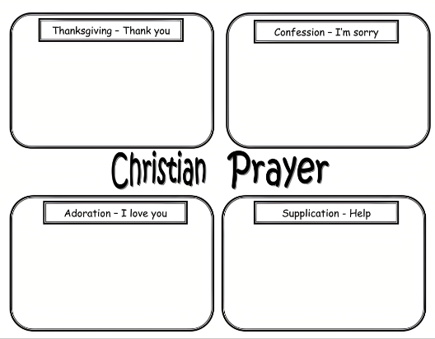
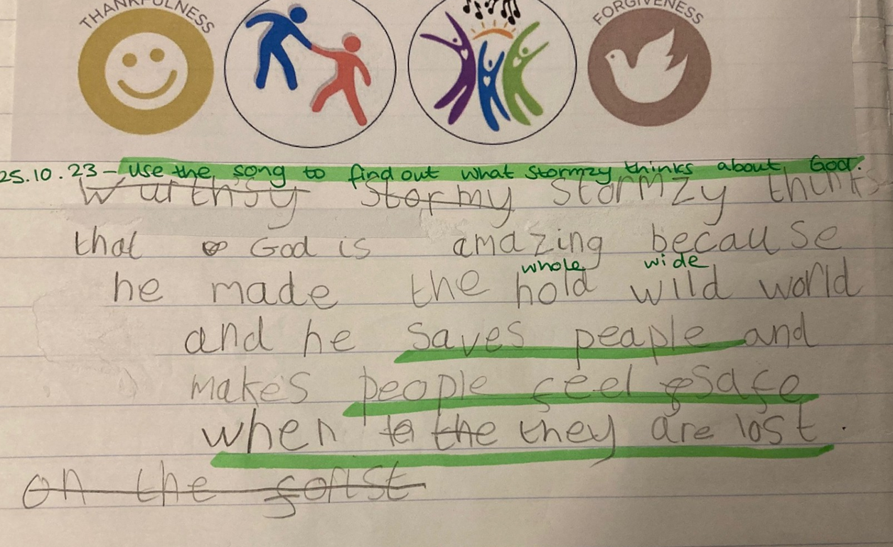
R&W - Investigate Stormzy’s worldview. Read the lyrics of “Blinded by Your Grace” and find examples of what he thinks about God.
What are the differences between a WRP and a R&W approach?
WRP - Give an example of when Christians use each type of prayer.
2. Reflect on Stormzy’s worldview.
KS2: Examples of work

Slide 44

Session 1: Summary (1/2)
The Religion and Worldviews (R&W) approach may seem new, but it builds on existing good practice in RE – you may already be adopting a R&W approach to an extent!
We need to be mindful about the language we use, as well as the images/pictures and examples we use in the classroom:
  To avoid framing ‘world religions’ through Western Christian lenses
  To avoid homogenising groups, instead acknowledging diversity within and across (non)religion

Slide 45
Session 1: Summary (2/2)
This is a pedagogical shift: it’s about how you teach RE, not about adding/removing content
Different disciplinary lenses can be useful to investigate worldviews
It is important to acknowledge the body and the emotions as well as the cognitive

Slide 46

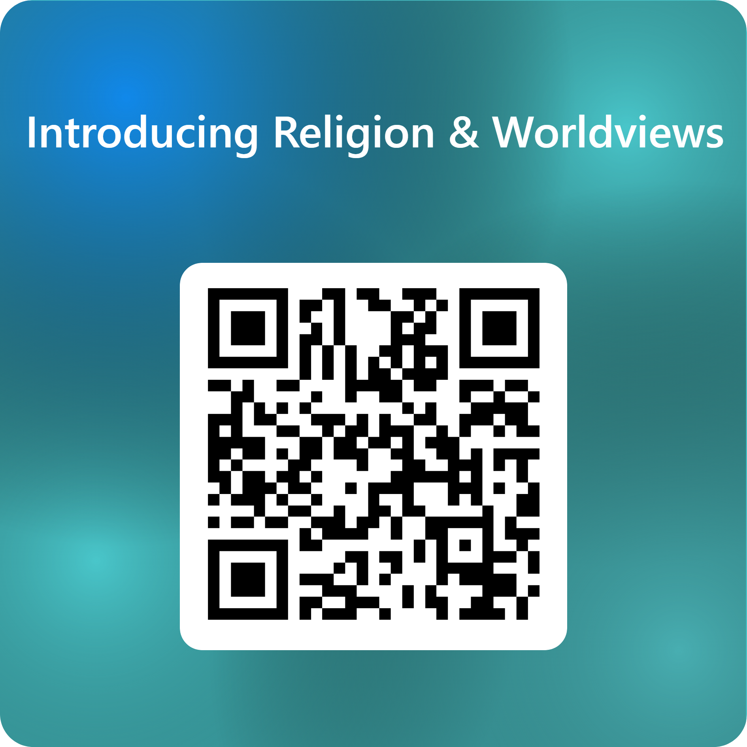
End of session 1
© Introducing Religion & Worldviews (2025)
Notes:
For feedback and comments about these resources, please scan the QR code or copy/paste this URL into your browser: https://forms.office.com/e/iLKDeRHMYL
To contact the lead author, please email Celine.Benoit@nottingham.ac.uk

