Slide 1







Adopting a R&W approach in RE
Training Pack for Primary Schools
Notes:
Welcome to the “Adopting a Religion & Worldviews approach in RE” training for primary school teachers – session 2.

Slide 2


Personal, Communal and Organised worldviews
Session 2

Slide 3
Learning Objectives
To understand that a religion and worldviews (R&W) approach encourages us to think about the lived experiences within religious and nonreligious traditions (with a specific focus on ‘personal’, ‘communal’ and ‘organised’ worldviews).
To reflect on the interplay between the lived experiences within religious and nonreligious traditions, and the power dynamics at stake.
To understand the importance of balancing personal and organised worldviews in RE and how a R&W approach lends itself to addressing the sometimes missing and marginalised voices in the study of RE.

Slide 4
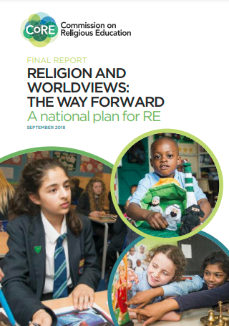
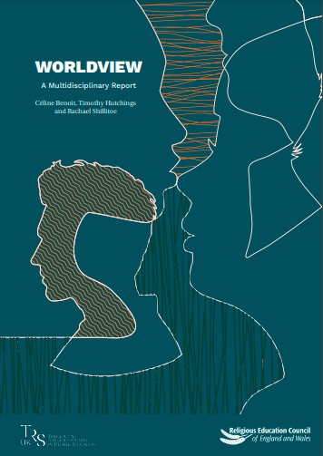
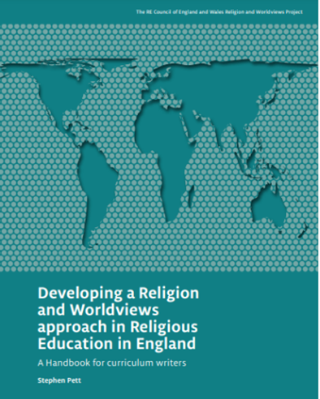
R&W: Context
Click on the pictures to access the resources hosted by the Religious Education Council for England and Wales
Notes:
The Handbook for Curriculum Writers (pictured here)
The (draft) National Content Standard for Religious Education in England pp. 6-11 (NB: only refer to this document if based in England).

Slide 5

Session 1: Summary (1/2)
The Religion and Worldviews (R&W) approach may seem new, but it builds on existing good practice in RE – you may already be adopting a R&W approach to an extent!
We need to be mindful about the language we use, as well as the images/pictures and examples we use in the classroom:
To avoid framing ‘world religions’ through Christianity (or Western Christian lenses)
To avoid representing groups as not diverse/homogeneous; instead, we acknowledge diversity within and across religious and nonreligious traditions.

Slide 6
Session 1: Summary (2/2)
This is a pedagogical shift: i.e., it’s about how you teach RE, not about adding/removing content
Different disciplinary lenses can be useful to investigate worldviews
It is important to acknowledge the body and the emotions as well as the cognitive (meaning: thoughts and beliefs).

Slide 7

A note about language: personal vs organised
This training talks about two levels of worldviews: personal vs. organised. This is the idea that everyone has/inhabits a personal worldview, which is their own way of understanding, experiencing and responding to the world.
These worldviews are sometimes organised, shared with others or embedded in institutions (like religions).

Slide 8
A note about language: individual vs personal
The new Handbook for Curriculum Writers (2024) suggests adding a new term: individual worldview.
In RE, we study other people’s individual worldviews and organised worldviews, and this helps us to reflect on our own personal worldview.
This change is meant to avoid a misunderstanding about the purpose of RE. It reassures pupils (and parents) that we are not trying to study them or change them. That would be Religious Instruction, not RE!
Do you think this distinction between personal and individual worldviews is helpful for your teaching?

Slide 9

What is a personal worldview?
Notes:
! Stop the video at 5’25 !

Slide 10

What is a personal worldview? Key Points (1/3)
Everyone has a personal worldview that may be implicit or explicit, and affects choices and way of living.
A person's values, beliefs and stances form part of their worldview.
Studying a personal worldview includes taking feelings and emotions into account, and reflecting on how these inform our lives.
A worldview can be what a person does or does not stand for, or feel is important.

Slide 11
What is a personal worldview? Key Points (2/3)
A worldview is not always something that a person is aware of, or may only reflect on it in certain circumstances or times - for example when experiencing big life events.
A personal worldview may or may not be influenced by organised worldviews to some extent.
Personal worldviews can change over time.

Slide 12
What is a personal worldview? Key Points (2/3)
One advantage of the R&W approach is that it provides the opportunity for consideration of individual perspectives as well as organised worldviews.
Another advantage of the R&W approach is that it provides teachers and children with the space to reflect on their own positionality. This links back to the video from session 1 - Nobody Stands Nowhere. Do you know where you stand and why?

Slide 13
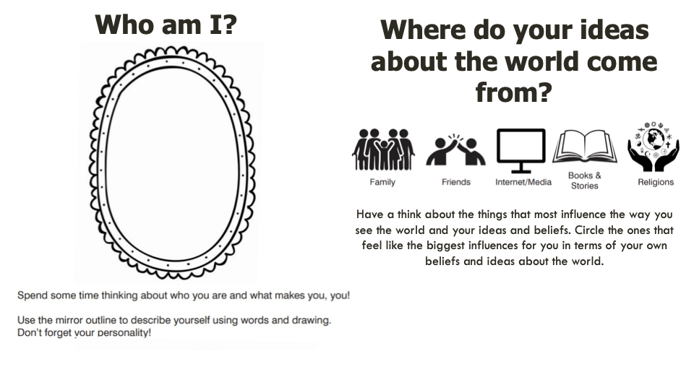
Activity 1
© Coventry City Council (2024), Locally Agreed Syllabus for Religious Education 2024-2029, p. 36.
Notes:
Thanks to the Coventry & Warwickshire REC / local Agreed Syllabus writing team, led by Jennifer Jenkins, for sharing this material.

Slide 14
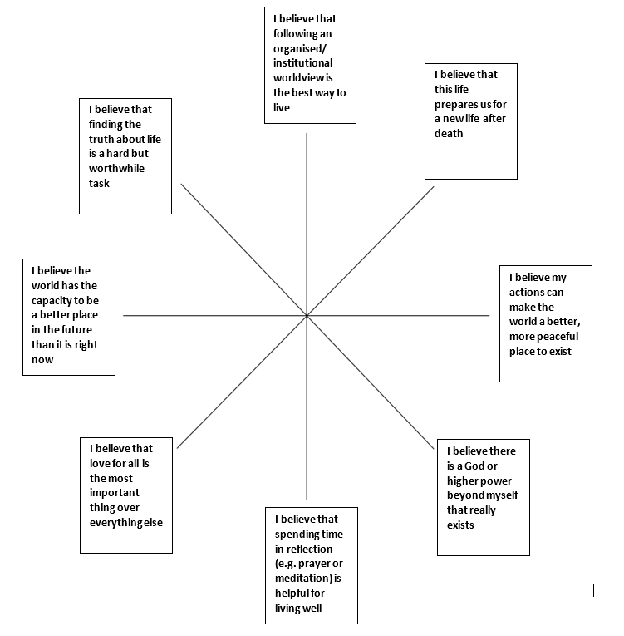
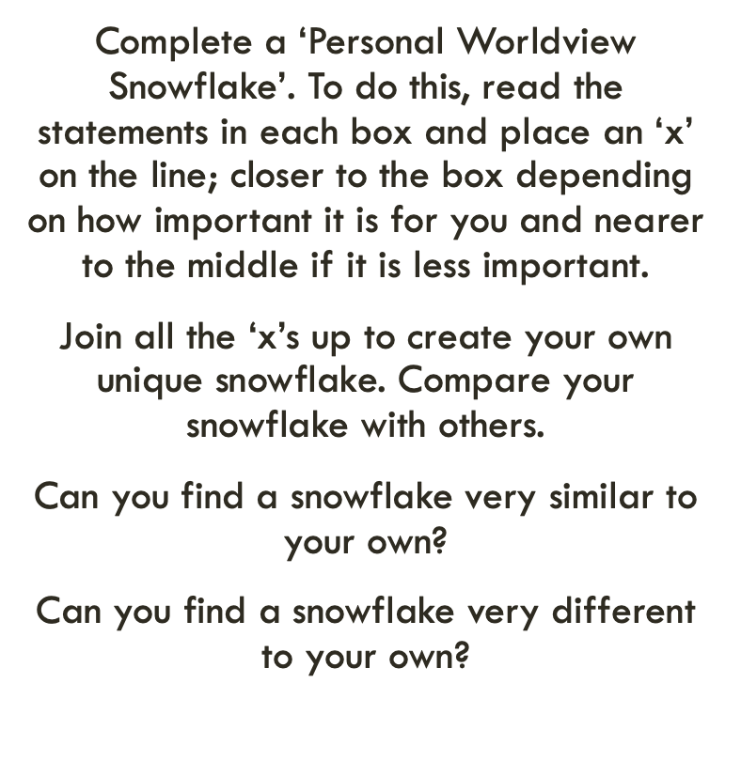
Activity 2
Thanks to the Coventry & Warwickshire REC / local Agreed Syllabus writing team, led by Jennifer Jenkins, for sharing this material. The snowflake exercise builds on a strategy originally developed by Sarah Northall, formerly head of RE.
Notes:
The snowflake exercise is also described in the REC’s Handbook for Curriculum Writers, p.55 (see: https://religiouseducationcouncil.org.uk/rec/wp-content/uploads/2024/04/24-25698-REC-Handbook-A4-DIGITAL-PAGES.pdf)
Thanks to the Coventry & Warwickshire REC / local Agreed Syllabus writing team, led by Jennifer Jenkins, for sharing this material. The snowflake strategy was originally developed by Sarah Northall, formerly Head of RE at Chipping Norton Secondary School. See it in basic form in More than 101 Great Ideas ed. Rosemary Rivett, and applied to ideas of God using the discipline of psychology in Investigating God, ed. Fiona Moss for primary and Studying God for secondary.

Slide 15
Activity 3
Reflect

Slide 16
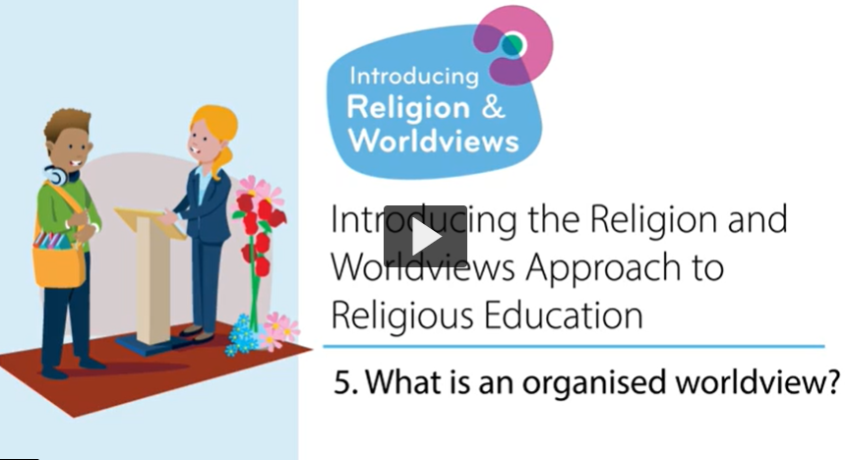
What is an organised worldview?

Slide 17

What is an organised worldview? Key Points (1/2)
Organised worldviews are when a particular set of worldviews has gone through a process, with discussions and decisions, it has been reflected on and then it had been placed somewhere (e.g. For Humanists-UK it can be their website which states what they stand for, what their values are, etc.)
Organised worldviews can inform personal worldviews.
We are not neat as human beings… Our worldviews can be quite diverse, and can traverse religious and nonreligious boundaries. We can pick different values and beliefs from different spaces and places.

Slide 18
What is an organised worldview? Key Points (2/2)
There could be gaps between personal and organised worldviews.
Organised worldviews are also not fixed – they can change (e.g., the Church of England’s position towards same-sex relationships changing; changes made to how the Eucharist was celebrated during the COVID19 pandemic to conform to sanitary regulations in place at the time, etc.; the way Hajj is performed due to increasing population and environmental concerns)

Slide 19
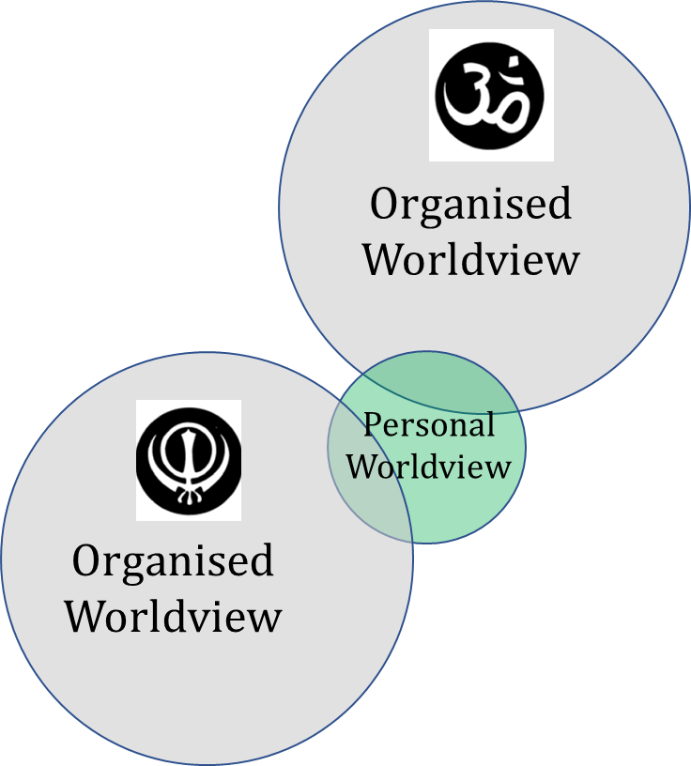
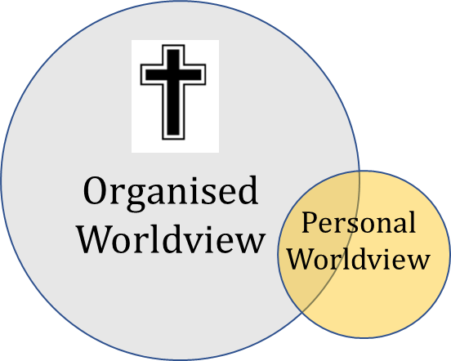
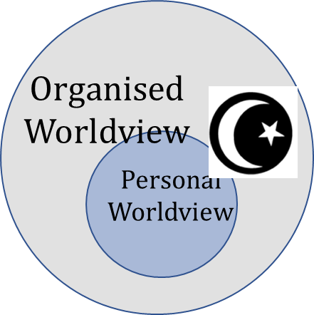

Ways in which personal and organised worldviews might intersect.
Are there circles here which represent you and your personal worldview and how it aligns to an organised worldview or worldviews? Or would you choose to create a new diagram to best represent yourself? What might this be?
Thanks to the Coventry & Warwickshire REC / local Agreed Syllabus writing team, led by Jennifer Jenkins, for sharing this material
Notes:
Thanks to the Coventry & Warwickshire REC / local Agreed Syllabus writing team, led by Jennifer Jenkins, for sharing this material.

Slide 20
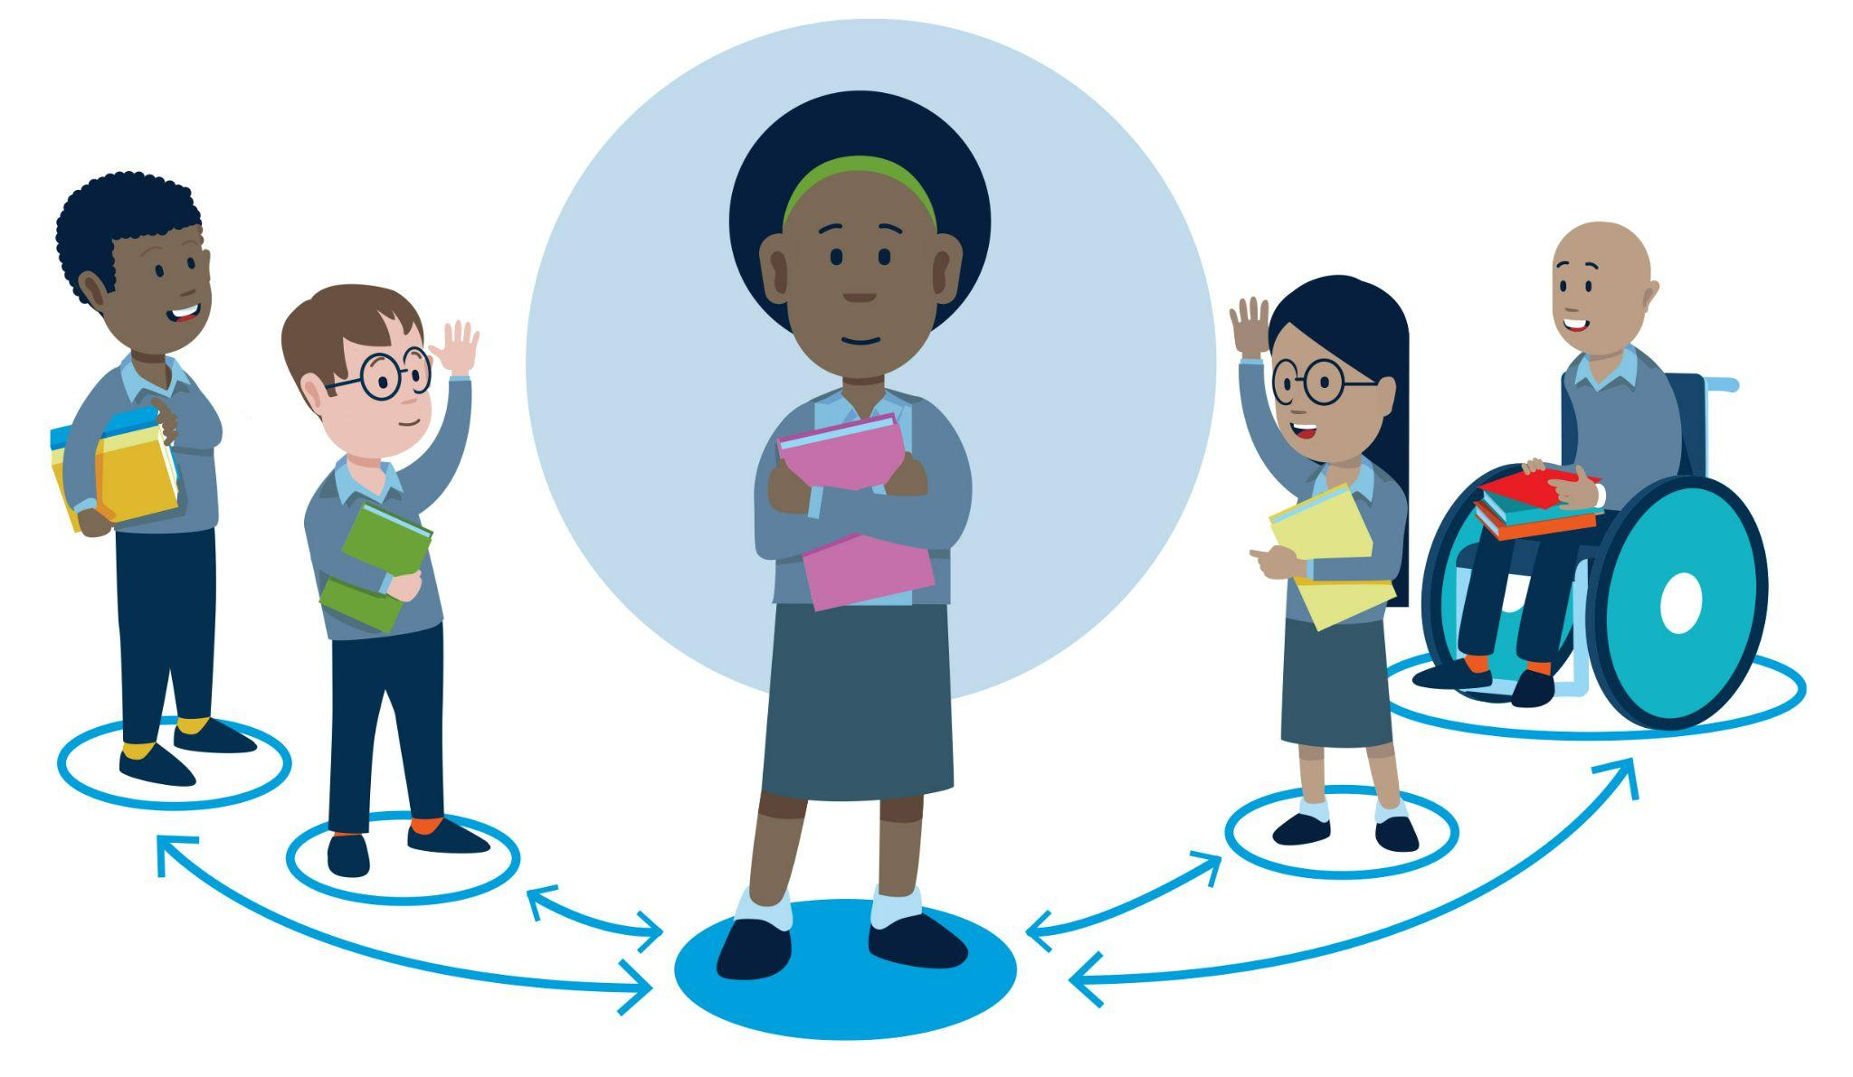
Beyond the individual and the organised
Communal worldviews
Many argue that it’s not just the individual and the organised that shape personal worldviews, but that there is another level: the communal.
This can be used to refer to a local community, a local place of worship, family, friends, digital online spaces, etc.). There is no video for this concept, but you will need to mention it to teachers – the next slides can help.
Notes:
For further guidance about the differences between individual and personal worldviews, please refer to the REC’s Handbook, p.36: https://religiouseducationcouncil.org.uk/rec/wp-content/uploads/2024/04/24-25698-REC-Handbook-A4-DIGITAL-PAGES.pdf.
Similarly, p. 37 of the REC’s Handbook (please refer to the REC’s Handbook (https://religiouseducationcouncil.org.uk/rec/wp-content/uploads/2024/04/24-25698-REC-Handbook-A4-DIGITAL-PAGES.pdf) offers a detailed description of the differences between organised and institutional worldviews. Again, there is no need for teachers to necessarily know these - they can stick to organised worldviews instead.
One other level that is often introduced is the communal level, to acknowledge the influence of local communities, local places of worship, family, friends, digital online spaces, etc.

Slide 21
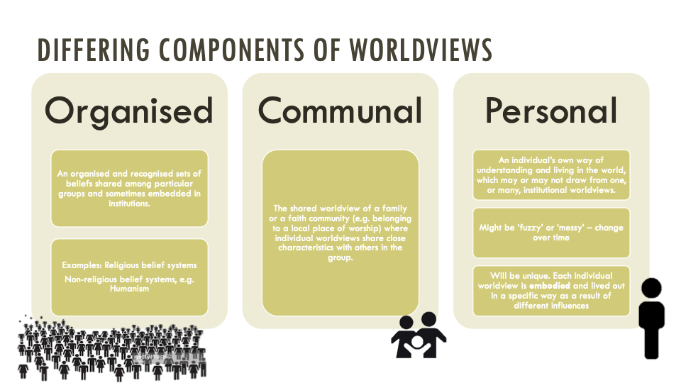
Copyright RE Today Services: www.retoday.org.uk
Notes:
Copyright RE Today Services: www.retoday.org.uk

Slide 22

Activity – School Values
Look at the school values
Were these informed by any organised worldviews?
Were these informed by a communal worldview such as that embraced by the school community? (e.g., teachers, governors…?)
Reflect: which one is more important to you personally?
How are these school values performed and lived in the school?

Slide 23
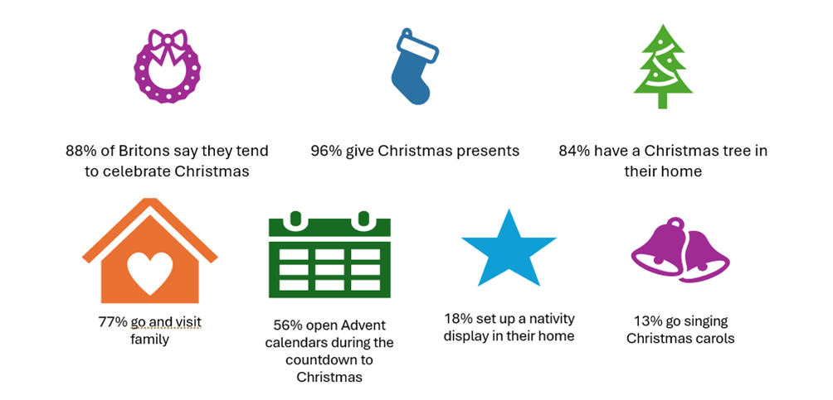
Source: adapted from YouGov Plc, 2023, © All rights reserved
How does the celebration of Christmas reflect
organised, communal, or personal worldviews?
Notes:
Useful links:
YouGov poll, Christmas practices, 2023: https://ygo-assets-websites-editorial-emea.yougov.net/documents/YouGov_-_Christmas_practices_2023.pdf
YouGov article, How do Britons celebrate Christmas, 2023: https://yougov.co.uk/society/articles/48208-how-do-britons-celebrate-christmas

Slide 24
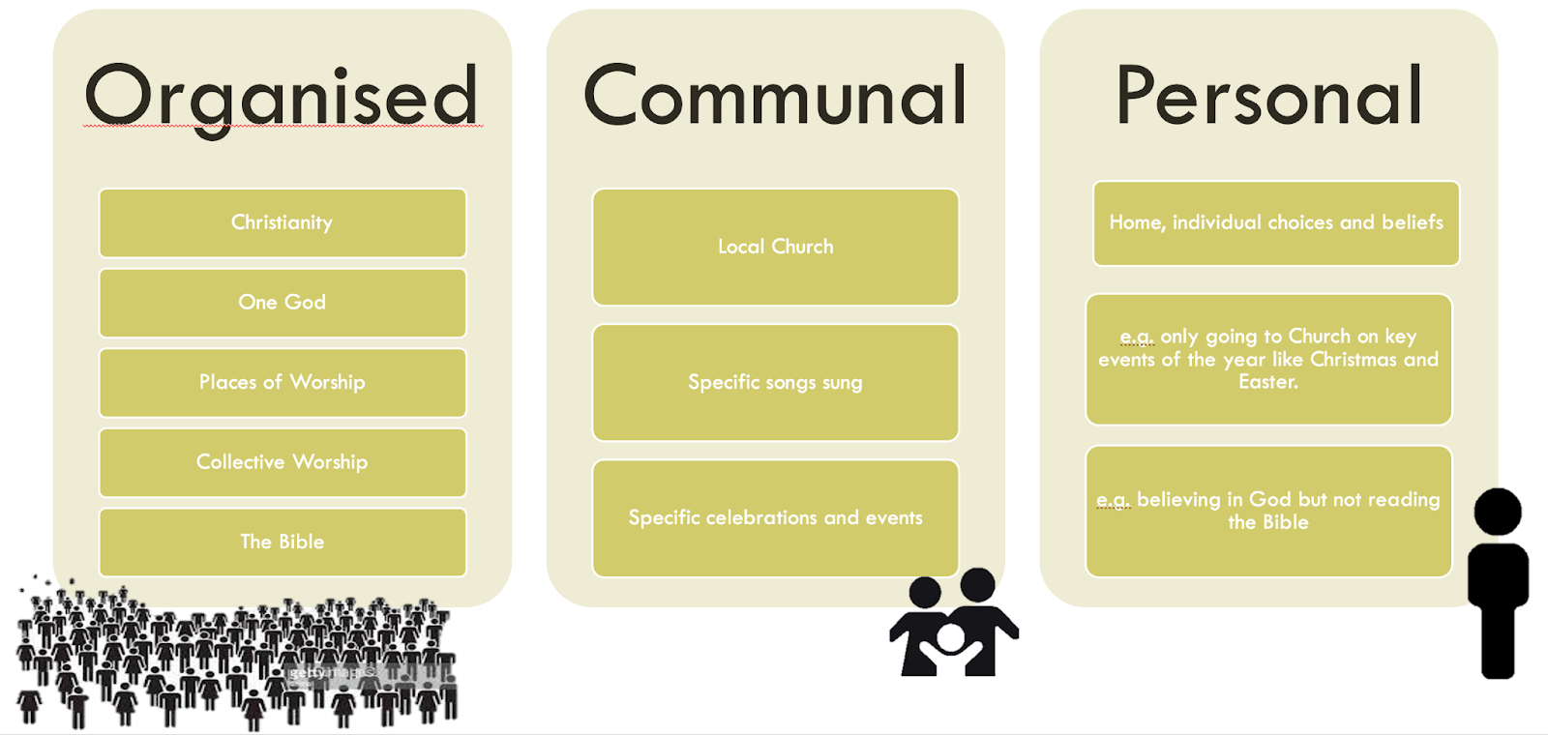
Copyright RE Today Services: www.retoday.org.uk
Notes:
Copyright RE Today Services: www.retoday.org.uk

Slide 25
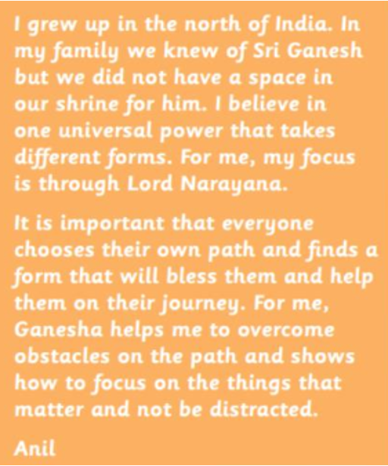
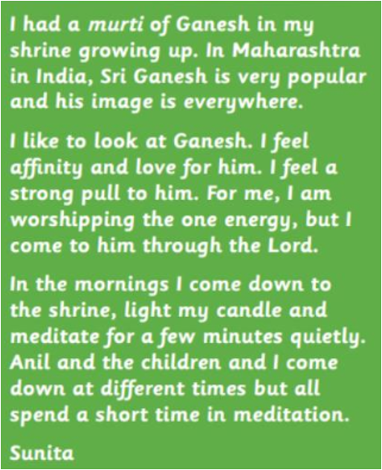
Copyright RE Today Services: www.retoday.org.uk
Notes:
Copyright RE Today Services: www.retoday.org.uk

Slide 26
Activity – Reflection
How do you experience Christmas?
Think about religious and nonreligious organised worldviews: which ones have shaped your personal worldviews?
Think about communal worldviews – how have your local community (incl. religious community if relevant), your family, your friends, etc. shaped your personal worldview?

Slide 27
Why do personal/communal/organised worldviews matter in RE?
It is about pupils being able to reflect on the tensions and interplay between the different levels
It provides pupils with the opportunity to reflect on their own worldviews, and how they might be influenced by communal, and/or organised (non)religious worldviews

Slide 28
Why do personal/communal/organised worldviews matter in RE?
The distinctions enable teachers and pupils to study how organised religious and nonreligious worldviews are not fixed, but evolve over time.
It is about acknowledging that worldviews are not just about the cognitive (i.e., a set of ideas; beliefs), but it is also about the body, feelings, and emotions.
It makes the RE classroom more representative, more inclusive and more relevant for our pupils

Slide 29
Example of classroom practice
Jesus is God’s son, born at Christmas. Christmas is important to me because it’s when I celebrate the birth of Jesus, who I believe came to show God’s love to the world.
I’m not totally sure what I believe, but based on the stories in the Bible about what Jesus did when he was alive, but I think it is worth celebrating Christmas as a way to remember to treat others well, show love and have hope.
I celebrate Christmas but don’t believe the Nativity story is true, I celebrate Christmas but don’t believe the Nativity story is true, it’s still important to me though as we have lots of fun family traditions and is a big part of life in Britain.
It’s still important to me though as we have lots of fun family traditions and is a big part of life in Britain.
When I was younger, Christmas was just about presents, food and fun. Now I reflect on what I am grateful for including that God gave his son, Jesus, so that I can be forgiven and have a relationship with God.
Notes:
These quotes have been used by teachers in a lesson exploring ‘Why is Christmas celebrated?’ Teachers ask pupils to read the quotes and ask:
Why do some people celebrate Christmas?
If you celebrate Christmas, why do you celebrate?
What’s most important about Christmas? For you, for the people in the quotes?
This example shows how teachers can go beyond just learning about the Bible and what it says, and study what some people actually think, believe, do, and feel.

Slide 30

Take-Away Activity
Look at an existing RE lesson plan and assess to what extent it is R&W-ready
What would you keep and why?
Identify areas of good practice
What would you do differently and why?
Identify what would need changing

Slide 31

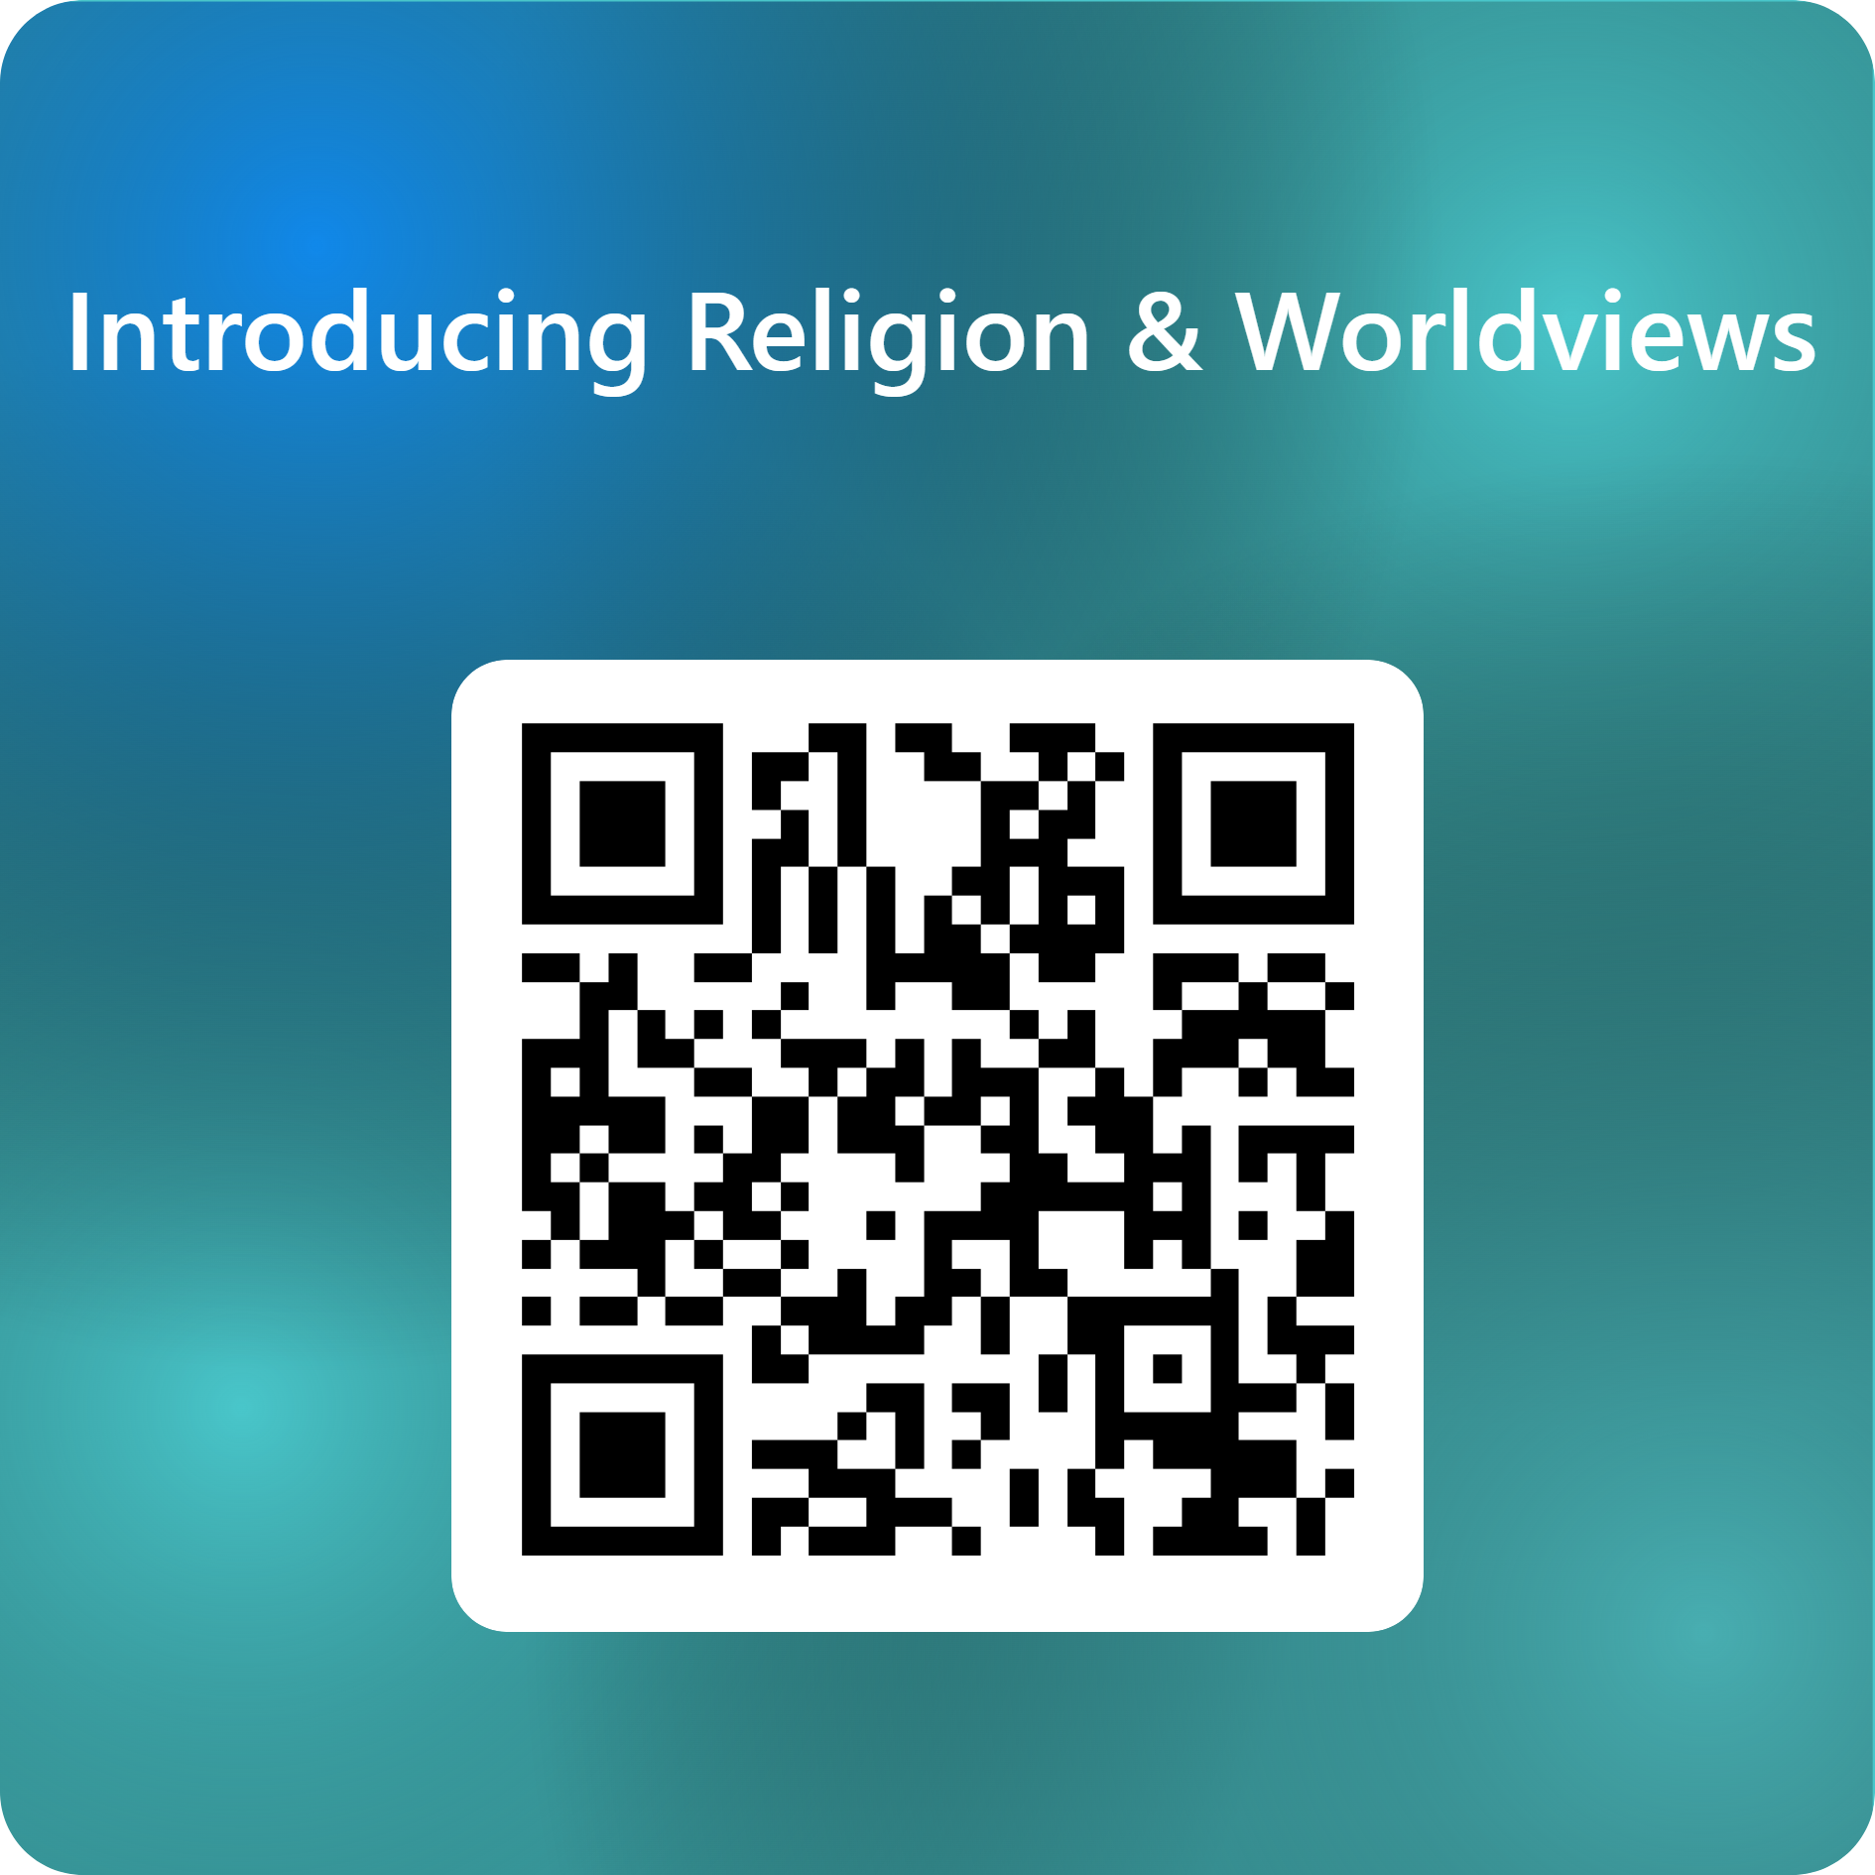
End of session 2
© Introducing Religion & Worldviews (2025)
Notes:
For feedback and comments about these resources, please scan the QR code or copy/paste this URL into your browser: https://forms.office.com/e/iLKDeRHMYL
To contact the lead author, please email Celine.Benoit@nottingham.ac.uk

