Slide 1







Adopting a R&W approach in RE
Training Pack for Primary Schools
Notes:
Welcome to the “Adopting a Religion & Worldviews approach in RE” training for primary school teachers – session 3.

Slide 2


What is a R&W approach?
Session 3
Notes:
If session 3 is delivered as a stand-alone twilight session, we recommend asking teachers to view both videos prior to attending the training.
If session 3 is delivered as part of a whole day training, we recommend viewing the videos during the training to help with pace and breaks between activities.
The aims of session 3 are to:
Summarise what a R&W approach is
Tackle some misconceptions when it comes to a R&W approach
Encourage teachers to think about their own practice and the changes they’d like to make to (further) adopt a R&W approach to RE

Slide 3

Learning Objectives
To clarify what a religion and worldviews (R&W) approach is (and is not).
To reflect on classroom practice and the existing RE curriculum - What changes will you bring to the RE classroom based on this training?

Slide 4
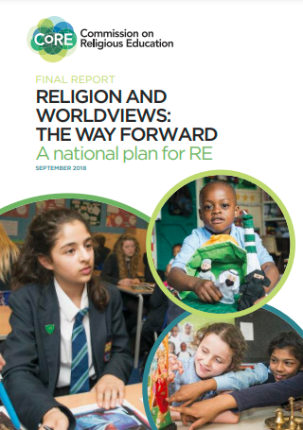
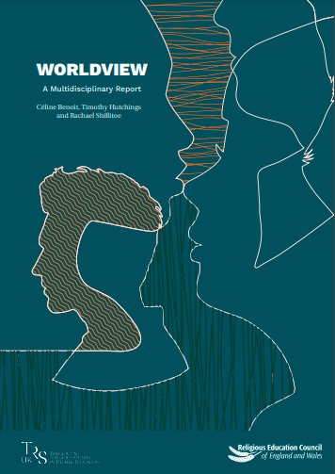
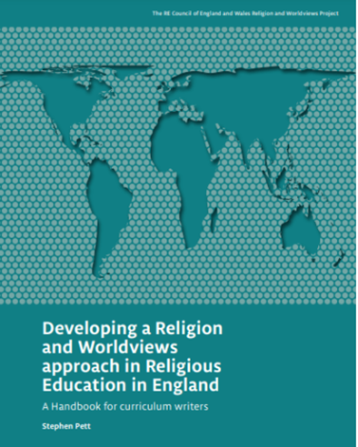
R&W: Context
Click on the pictures to access the resources hosted by the Religious Education Council for England and Wales
Notes:
The Handbook for Curriculum Writers (pictured here)
The (draft) National Content Standard for Religious Education in England pp. 6-11 (NB: only refer to this document if based in England).

Slide 5

Session 1: Summary (1/2)
The Religion and Worldviews (R&W) approach may seem new, but it builds on existing good practice in RE – you may already be adopting a R&W approach to an extent!
We need to be mindful about the language we use, as well as the images/pictures and examples we use in the classroom:
To avoid framing ‘world religions’ through Western Christian lenses
To avoid homogenising groups, instead acknowledging diversity within and across religion/nonreligion.

Slide 6
Session 1: Summary (2/2)
This is a pedagogical shift: it’s about how you teach RE, not about adding/removing content
Different disciplinary lenses can be useful to investigate worldviews
It is important to acknowledge the body and the emotions as well as the cognitive

Slide 7

Session 2 – Summary (1/2)
A R&W approach is about pupils being able to reflect on the tensions and interplay between the different levels
It provides pupils the opportunity to reflect on their own worldviews, and how they might be influenced by individual, communal, and/or organised (non)religious worldviews

Slide 8
Session 2 - Summary
It is about acknowledging that organised (non)religious worldviews are not fixed, but evolve over time.
It is about acknowledging that worldviews are not just about the cognitive (i.e., a set of ideas), but it is also about the body and the affect.
It makes the RE classroom more representative, more inclusive and more relevant for our pupils.

Slide 9

Exercise
Complete the following sentences:
All children at [our school] …​
Most children at [our school] …​
Some children at [our school] …​
A few children at [our school] …​
No children at [our school] …

Slide 10
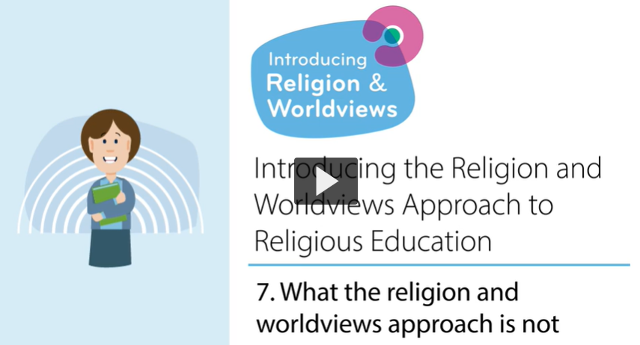
What the R&W approach is not

Slide 11

What the R&W approach is not - Key Points (1/2)
It is not about changing everything all at once! The R&W builds on good practice in RE and you may already do a lot of work that already aligns with a R&W approach.
It is not about adding extra content. It is about how we rethink, present, and communicate the RE content.
It is not about removing religion from RE. Instead, it’s about taking a more engaging approach that is more relevant to pupils.

Slide 12
What the R&W approach is not - Key Points (2/2)
A focus on personal worldviews does not mean that everyone’s worldview is valid.
It is not just about how we make sense of the world, it is also about feelings, experiences, embodiment…
The R&W approach is about making the subject more exciting, more inviting, and more inclusive than it already is.

Slide 13

Activity

Slide 14
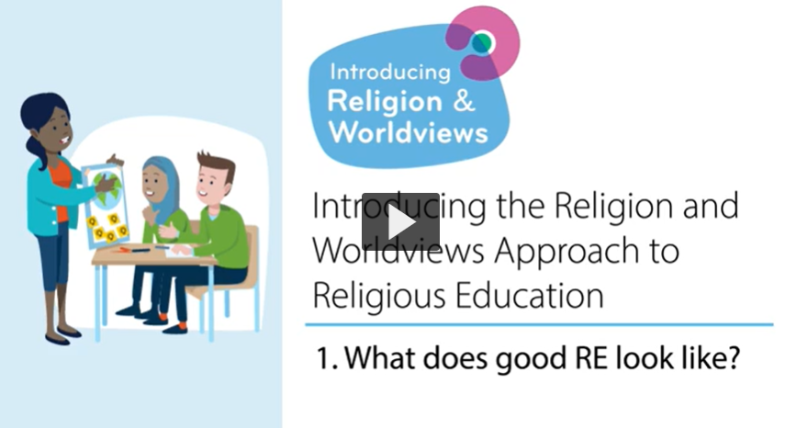
What does good RE look like?

Slide 15

What does good RE look like? - Key Points (1/2)
We teach RE to study people and how they make sense of the world. It’s about understanding the world.
Society is increasingly plural and diverse, and pupils need to be equipped with the tools to navigate it.
Good RE involves both the study of religious and nonreligious groups of people.

Slide 16
What does good RE look like? - Key Points (2/2)
Good RE involves studying worldviews at different levels: individual, communal and organised worldviews.
Good RE enables pupils to become familiar with their own personal worldviews too - knowing what their personal worldview is and how it has been influenced.
Reminder: Using different disciplinary lenses can be a useful tool to teach RE.

Slide 17

We are Theologians - EYFS
We listen carefully to sacred stories and make links with what people do and believe.
We look for clues to try and to back-up our thinking.
We ask questions about what we read and discuss what it might mean.
We think deeply about what sacred texts mean to us. personally and what they might mean to others.
We look carefully at religious art to discover what it might be telling us about the artist’s worldview, beliefs and ideas.
Thanks to the Coventry & Warwickshire REC / local Agreed Syllabus writing team, led by Jennifer Jenkins, for sharing this material
Notes:
It is up to you whether you would like to re-introduce these slides here again. The teachers who co-designed these resources suggested it may be a useful reminder if a few weeks have passed between the training sessions. Alternatively, you may want to skip the next few slides and go straight to slide 29.
Thanks to the Coventry & Warwickshire REC / local Agreed Syllabus writing team, led by Jennifer Jenkins, for sharing this material.

Slide 18
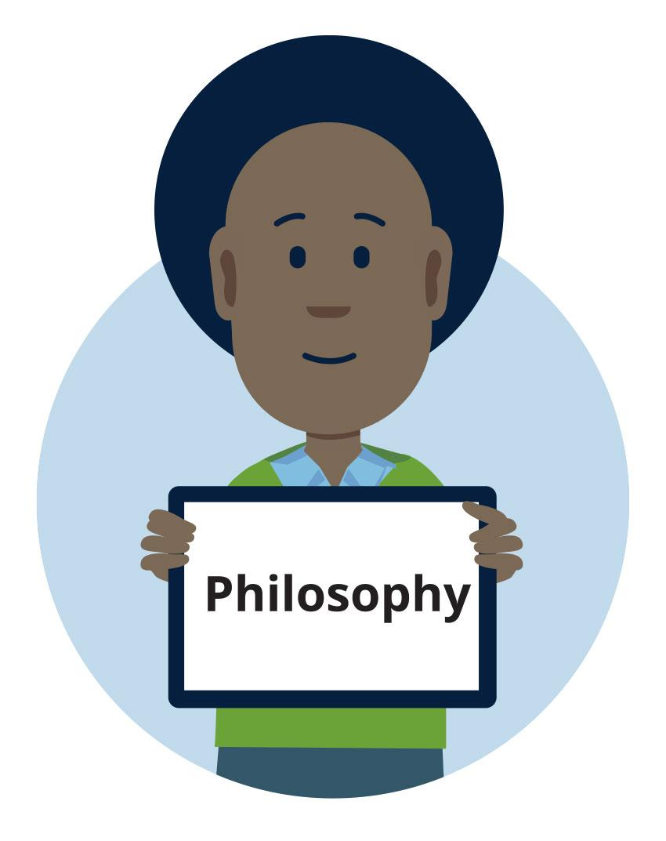
We are Philosophers - EYFS
We think about our own opinions and ideas.
We explain our opinions and ideas.
We ask brave questions of our own and attempt to answer the questions of others.
We try to help people understand our point of view through what we say.
We think carefully about what we have learned to decide what is true and what might not be true.
We think about issues of right and wrong, good and bad.
Thanks to the Coventry & Warwickshire REC / local Agreed Syllabus writing team, led by Jennifer Jenkins, for sharing this material
Notes:
Thanks to the Coventry & Warwickshire REC / local Agreed Syllabus writing team, led by Jennifer Jenkins, for sharing this material.

Slide 19

We are Human and Social Scientists - EYFS
We look for similarities and differences in the way people live together.
We think about the reasons why people might choose to wear specific things, behave in certain ways or do particular things.
We study diversity and lived experiences of religion using interviews, examples and observations.
We listen carefully and think hard about what we have heard to try to understand the worldviews of others, both personal and organised, alongside our own.
We meet real people from different religious traditions and those of no faith/religion.
We think about issues of belonging and how we express ourselves.
Thanks to the Coventry & Warwickshire REC / local Agreed Syllabus writing team, led by Jennifer Jenkins, for sharing this material
Notes:
Thanks to the Coventry & Warwickshire REC / local Agreed Syllabus writing team, led by Jennifer Jenkins, for sharing this material.

Slide 20
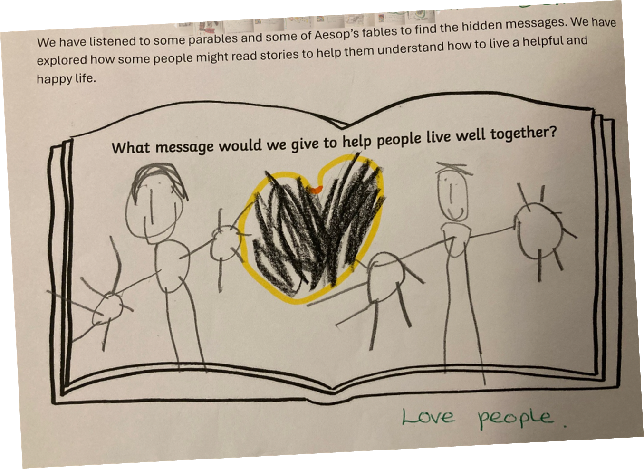
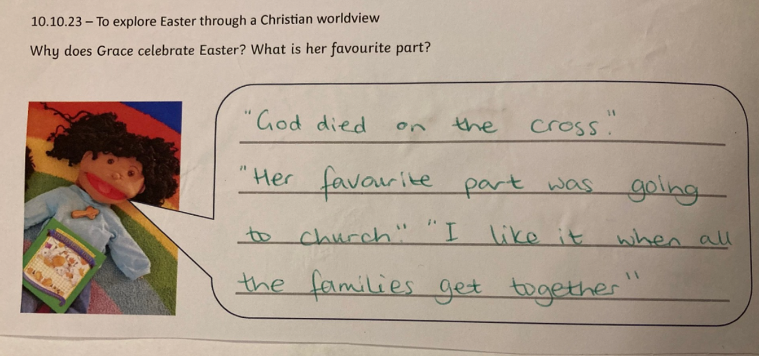
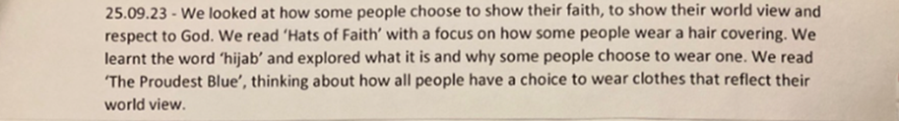
EYFS: Examples of work

Slide 21
We are Theologians - KS1
We listen carefully to sacred stories and make links with what people do and believe.
We look for clues to try and to back-up our thinking.
We ask questions about what we read and discuss what it might mean.
We think deeply about what sacred texts mean to us personally and what they might mean to others.
We look carefully at religious art to discover what it might be telling us about the artist’s worldview, beliefs and ideas.
Thanks to the Coventry & Warwickshire REC / local Agreed Syllabus writing team, led by Jennifer Jenkins, for sharing this material
Notes:
Thanks to the Coventry & Warwickshire REC / local Agreed Syllabus writing team, led by Jennifer Jenkins, for sharing this material.

Slide 22
We are Philosophers - KS1
We think about our own opinions and ideas.
We explain our opinions and ideas.
We ask brave questions of our own and attempt to answer the questions of others.
We try to help people understand our point of view through what we say.
We think carefully about what we have learned to decide what is true and what might not be true.
We think about issues of right and wrong, good and bad.
Thanks to the Coventry & Warwickshire REC / local Agreed Syllabus writing team, led by Jennifer Jenkins, for sharing this material
Notes:
Thanks to the Coventry & Warwickshire REC / local Agreed Syllabus writing team, led by Jennifer Jenkins, for sharing this material.

Slide 23
We are Human and Social Scientists - KS1
• We look for similarities and differences in the way people live together.
• We think about the reasons why people might choose to wear specific things, behave in certain ways or do particular things.
• We study diversity and lived experiences of religion using interviews, examples and observations.
• We listen carefully and think hard about what we have heard to try to understand the worldviews of others, both personal and organised, alongside our own.
• We meet real people from different religious traditions and those of no faith/religion.
• We think about issues of belonging and how we express ourselves.
Thanks to the Coventry & Warwickshire REC / local Agreed Syllabus writing team, led by Jennifer Jenkins, for sharing this material
Notes:
Thanks to the Coventry & Warwickshire REC / local Agreed Syllabus writing team, led by Jennifer Jenkins, for sharing this material.

Slide 24
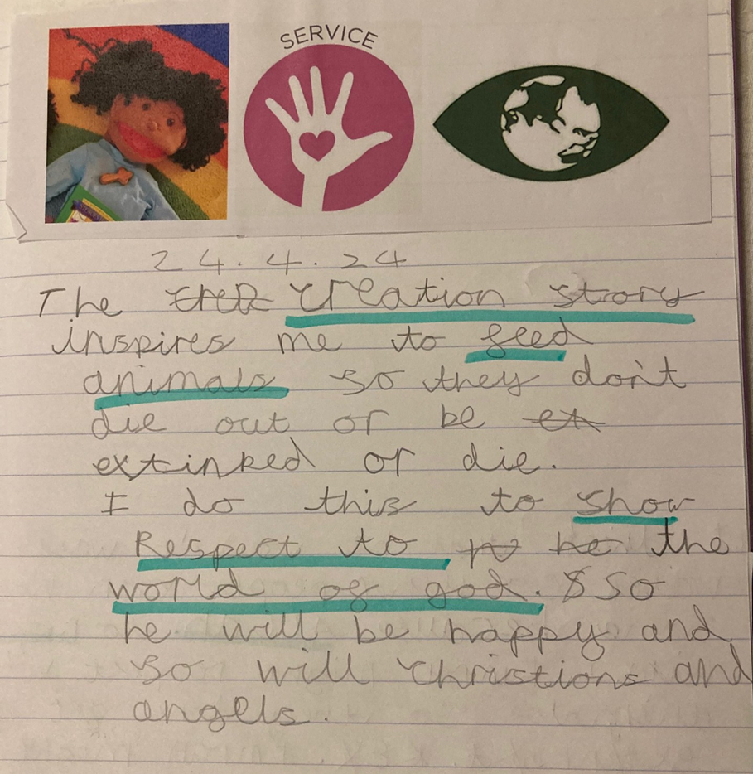
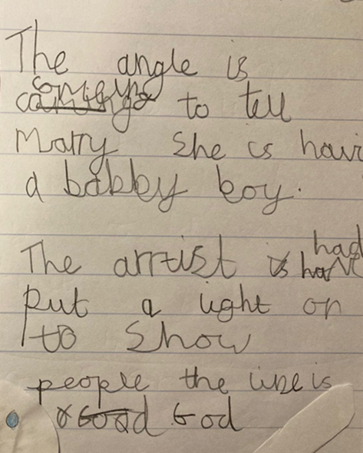
KS1: Examples of work

Slide 25
We are Theologians - KS2
We analyse sacred texts and make links with practices and beliefs.
We look for evidence to back up our thinking.
We make judgements based on our reading.
We make interpretations and identify our hermeneutical lenses.
We ask questions about what we read and discuss its meaning.
We consider authorship and authority and the context in which sacred texts were written.
We reflect on what sacred texts mean to us personally and what they mean to others.
We consider what religious art might be telling us about the artist’s worldview and wider beliefs and ideas.
Thanks to the Coventry & Warwickshire REC / local Agreed Syllabus writing team, led by Jennifer Jenkins, for sharing this material
Notes:
Thanks to the Coventry & Warwickshire REC / local Agreed Syllabus writing team, led by Jennifer Jenkins, for sharing this material.

Slide 26
We are Philosophers - KS2
We explore different methods of knowing and different methods of reasoning.
We use the ideas and thoughts of others to generate discussion and formulate our own opinions.
We justify our opinions and ideas with evidence and examples.
We challenge the ideas and opinions of others, known to us and not previously known.
We ask innovative questions of our own and attempt to answer the questions of others.
We try to be persuasive in our spoken language and in our writing.
We think critically using reason and evidence.
We think about why we are here and issues of right and wrong, good and bad.
Thanks to the Coventry & Warwickshire REC / local Agreed Syllabus writing team, led by Jennifer Jenkins, for sharing this material
Notes:
Thanks to the Coventry & Warwickshire REC / local Agreed Syllabus writing team, led by Jennifer Jenkins, for sharing this material.

Slide 27
We are Human and Social Scientists - KS2
We question assumptions about worldviews and religion/nonreligion.
We analyse how things change in society.
We consider the reasons for human behaviour and practices.
We consider what behaviour and practices tell us about belief and ways of seeing the world.
We study diversity and lived experiences of religion using interviews, case studies and observations.
We analyse and try to understand the worldviews of others, both personal and organised, alongside our own.
We encounter real people from different religious traditions and those of no faith/religion.
We think about issues of belonging and identity and the interactions between these ideas.
Thanks to the Coventry & Warwickshire REC / local Agreed Syllabus writing team, led by Jennifer Jenkins, for sharing this material
Notes:
Thanks to the Coventry & Warwickshire REC / local Agreed Syllabus writing team, led by Jennifer Jenkins, for sharing this material.

Slide 28
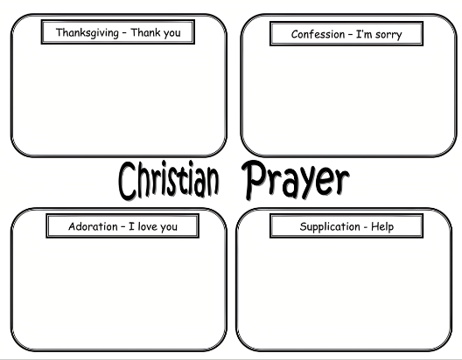
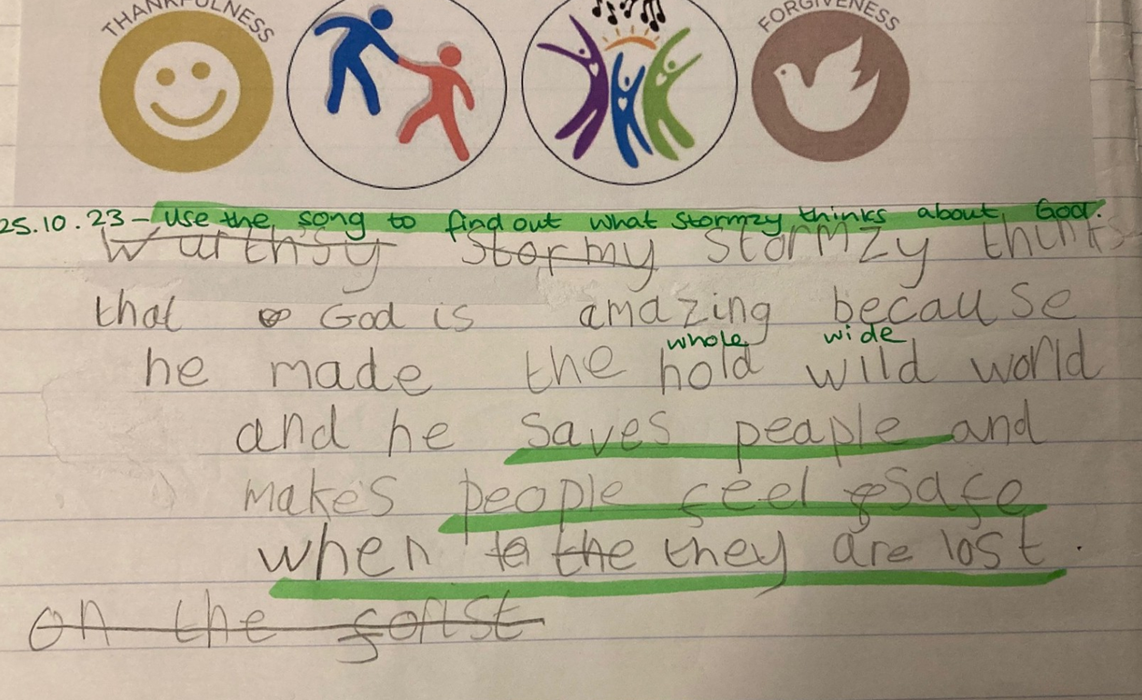
R&W - Investigate Stormzy’s worldview. Read the lyrics of “Blinded by Your Grace” and find examples of what he thinks about God.
What are the differences between a WRP and a R&W approach?
WRP - Give an example of when Christians use each type of prayer.
2. Reflect on Stormzy’s worldview.
KS2: Examples of work

Slide 29
Good vs. poor examples
What does R&W in RE look like?

Slide 30
Mosques | Good examples | Poor examples
Substantive knowledge | Pupils explore the underpinning spiritual purpose and function of a mosque in the lives of many with Islamic worldviews Or Pupils engage with the concept of Allah by exploring key features of a mosque and the ways in which it plays a role in the lives of different Muslims | Pupils draw a mosque Or Pupils label key features of a mosque (without making any connections with conceptual knowledge) Or Pupils make their own mosque out of craft materials without considering its significance as a place of worship
Disciplinary knowledge | Pupils visit a mosque/explore a case study (e.g. text, images, video) in their own locality and conduct simple ethnographic study, observing the uses of the mosque in action(e.g. for spiritual, social and religious purposes as well as unique ways the mosque serves its particular community) and interviewing several people with Muslim worldviews who are using the mosque for different purposes; they consider whether all Muslims engage with the mosque in the same way, exploring questions about how context might affect this | Pupils label the typical features of a mosque (as if all mosques are the same) Or Pupils learn factual information about mosques (treated entirely in general terms) and never engage with this information in any depth or by using scholarly questions and skills
Personal knowledge | Pupils consider their own experience of mosques [or sacred / special places], whether the mosque has personal significance in their own worldview and the role places of worship in general play within their own lives | Pupils rate the local mosque. Pupils express their opinion on the mosque without considering how their opinion might be reflective of their own worldview
Thanks to the Coventry & Warwickshire REC / local Agreed Syllabus writing team, led by Jennifer Jenkins, for sharing this material
Notes:
Thanks to the Coventry & Warwickshire REC / local Agreed Syllabus writing team, led by Jennifer Jenkins, for sharing this material (which has been adapted here).

Slide 31
The Ten Commandments | Good examples | Poor examples
Substantive knowledge | Connecting the Ten Commandments with an understanding of the Jewish belief in G-d, authority, covenant and the role of obedience in Jewish worldviews. | Rote learning the Ten Commandments and/or putting them in order.
Disciplinary knowledge | Interviewing a visitor (or several visitors) with a Jewish worldview to further understand the role the Ten Commandments might (or might not!) play in their lives. Or using selected video resources for the same goal. Focusing on addressing questions about how context might impact on a Jewish person’s understanding and living out of the Ten Commandments Applying skills of textual interpretation to the Ten Commandments, e.g. recognising that there are several versions within the Torah | Anything that uses language such as ‘All Jewish people believe and follow the Ten Commandments’ Or Pupils learn factual information about the Ten Commandments (treated entirely in general terms) and never engage with this information in any depth or by using scholarly questions and skills
Personal knowledge | Considering whether there are a set of ‘rules’ or specific guidelines that influence and impact upon their own ‘embodied’ worldview and way of living and what the sources of any such guidance might be (leading into consideration of positionality). | Writing their own 10 commandments.*
Thanks to the Coventry & Warwickshire REC / local Agreed Syllabus writing team, led by Jennifer Jenkins, for sharing this material
Notes:
*Acknowledging this might end up being a suitable task IF consideration of their significance for those with Jewish worldviews has been explored and the role of rules and guidance in their own lives has been considered.
Thanks to the Coventry & Warwickshire REC / local Agreed Syllabus writing team, led by Jennifer Jenkins, for sharing this material (which has been adapted here).

Slide 32
Sikh clothing/ headwear/symbols | Good examples | Poor examples
Substantive knowledge | Exploration of images and case studies that provide examples of different expressions of Sikh worldviews e.g. Khalsa affiliated Sikhs. | Typical 5Ks activities that assume all those with Sikh worldviews wear / carry the 5Ks
Disciplinary knowledge | Exploring the concept of ‘sewa’ (service’ through philosophical discussion and debate e.g. ‘All humans should engage in a form of service towards other humans’ and then connecting with common Sikh expressions of ‘sewa’ (such as through interviewing or surveying members of the local Sikh community). Pupils interview local people with Sikh worldviews to explore the way a concept (sewa) can be understood in different ways by those from different generations (e.g. younger Sikhs and those who are past pension age) | Simplifying ‘sewa’ to be only the Langar in a local gurdwara rather than appreciating the diversity with which the concept can be understood and lived out through embodied Sikh worldviews. Or Pupils learn factual information about the concept of sewa (treated entirely in general terms) and never engage with this information in any depth or by using scholarly questions and skills
Personal knowledge | Considering service from their own perspective and identifying examples of physical, mental and material service they might engage with (such as through groups such as Brownies, Cubs, etc). Considering how their own understanding of service might relate to their personal worldviews. Identifying the importance of any symbols within their own personal worldview. | Designing their own 5Ks equivalent.
Thanks to the Coventry & Warwickshire REC / local Agreed Syllabus writing team, led by Jennifer Jenkins, for sharing this material
Notes:
Thanks to the Coventry & Warwickshire REC / local Agreed Syllabus writing team, led by Jennifer Jenkins, for sharing this material (which has been adapted here).

Slide 33

Take-Away Activity
Look at an existing RE lesson plan and assess to what extent it is R&W-ready
What would you keep and why?
Identify areas of good practice
What would you do differently and why?
Identify what would need changing

Slide 34
What next?

Slide 35
Moving forward
Design an action plan: what changes do you need to make, by when?
For further reading, guidance and resources see the Teacher Handout + summary infographic
Complete the online questionnaire
Notes:
For further reading, guidance and resources, please see the teacher handout, and the infographic.

Slide 36


End of session 3
© Introducing Religion & Worldviews (2025)
Notes:
For feedback and comments about these resources, please scan the QR code or copy/paste this URL into your browser: https://forms.office.com/e/iLKDeRHMYL
To contact the lead author, please email Celine.Benoit@nottingham.ac.uk

