Slide 1







Religion & Worldviews in Religious Studies
Training Pack for Secondary Schools
Notes:
Welcome to the “Adopting a Religion & Worldviews approach in RS” training for secondary school teachers. This pack has been designed in such a way that it can be delivered as a whole day training – in which case you will want to go through sessions 1, 2, and 3 or 2, 3 and 4 depending on your audience – or as a series of twilight sessions.
Before delivering the training, we recommend that trainers print this slide deck using the “notes pages” option (> click on “print” and in “settings” change from “full page slides” to “notes pages”). This will enable you to see all the trainer’s guidance under each slide, which will be useful to help you deliver the training. We also recommend that trainers get familiar with the training package and guidance notes prior to the training, as the aim is not for the trainer to read the guidance notes to the teachers – instead they have been added to this training to help you prepare what to say for each slide.
You might find it useful to conduct a short audit prior to the training, to understand where teachers are at when it comes to Religion and Worldviews (R&W). Here are some questions you could put on an online form (such as Microsoft Form) to capture attitudes:
How confident do you feel delivering RE classes in general? 1-5 (1: not at all confident; 5: very confident)
How confident do you feel about adopting a Religion and Worldviews (R&W) approach in the RE? (1: not at all confident; 5: very confident)
How confidently would you be able to explain to colleagues the challenge of defining “religion” and the implications of this challenge for teaching RE? Scale 1-5 (1: not at all confident; 5: very confident)
How confidently would you be able to explain to colleagues the problems with the World Religions approach? Scale 1-5 (1: not at all confident; 5: very confident)
How confidently would you be able to explain to colleagues the concept of worldview and why this may change the way you teach RE? (1: not at all confident; 5: very confident)
How confidently would you be able to explain what a personal worldview is? (1: not at all confident; 5: very confident)
How confidently would you be able to explain what an organised worldview is? (1: not at all confident; 5: very confident)
The same questions should be asked after the training has been delivered - this will enable you to capture the impact of the training, and whether there are areas where more work will be needed in the future.

Slide 2


Introducing Religion & Worldviews
Session 1
Notes:
If session 1 is delivered as a stand-alone twilight session, we recommend asking teachers to view all 3 videos prior to attending the training.
If session 1 is delivered as part of a whole day training, we recommend viewing the videos during the training to help with pace and breaks between activities.
This section is aimed at teachers who are new to Religious Studies (RS), who are non-specialists of RS, or who are completely new to the Religion and Worldviews (R&W) approach.
If your group consists of RS specialists, who have some understanding of R&W, you may want to make this section shorter or skip it altogether.
The aims of session 1 are to:
Give teachers an opportunity to reflect on what RS is and why we need it in schools
Give teachers an opportunity to reflect on how they learnt about the concept of ‘religion’, and how that particular understanding may have shifted (e.g., moving from ‘world religions’ being presented as neatly contained boxes, to acknowledging the fluidity within and between (non)religious traditions)
Give teachers an opportunity reflect on some of the limitations of the concept of religion, not necessarily to teach these limits to students, but to become more mindful in the RS practice (e.g., this may result in a change in language used, such as moving away from statements such as “Guru Granth Sahib is similar to the Bible, but for Sikhs,” which leads us to explore Sikhi through a Christian lens).
Give teachers an opportunity to engage with the concept of worldview, and how this can be a useful tool to acknowledge how we engage with (non)religion in different ways throughout our life course
Give teachers an opportunity to reflect on the notion of worldview, not just a set of complex ideas you have in your heads, but also as how we respond to the world (i.e., emotions, feelings, body…), and how this can be reflected in the RS classroom.
This section can be delivered in 90 minutes. We do not recommend shortening it to 60 minutes (unlike sessions 2, 3 and 4 which can be shorter), as you may need time to lay the foundations before further delving into what a religion and worldviews approach is, and how it can shape the RS curriculum.

Slide 3

Learning Objectives
Reflect on the importance of RS as an academic subject.
Reflect on the concept of ‘religion’ and its limitations, and what that means for the RS classroom.
Start to think about the ‘World Religion Paradigm’ and Religion and Worldviews (R&W) as pedagogical shifts in RS.

Slide 4
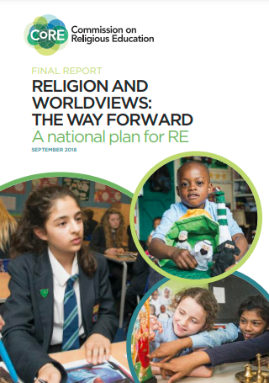
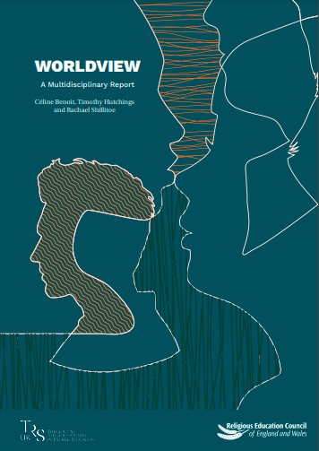

R&W: Context
Click on the pictures to access the resources hosted by the Religious Education Council for England and Wales
Notes:
Why the phrase “religion and worldviews”?
Use this slide to provide some context to colleagues.
Explain to colleagues that the concept of Religion and Worldviews (R&W) was first introduced in 2018 in the CoRE report (Commission on Religious Education). Trainers and teachers do not need to read the report to understand a R&W approach - this is only shared by way of context (though if this is something you and/or colleagues are interested in, the document can be accessed either by clicking on the photo on the slide, or by copying/pasting this link: https://religiouseducationcouncil.org.uk/rec/wp-content/uploads/2017/05/Final-Report-of-the-Commission-on-RE.pdf).
You can summarise the main takeaways from the CoRE report that are relevant for this training, which are that:
RS is an important subject, that can equip students with the tools to navigate an increasingly diverse world.
RS can provide students the opportunity to reflect on their own worldviews (e.g., by being able to understand how they may or may not relate to religion and nonreligious traditions). Ruth Flanagan (2021) calls this ‘worldview consciousness’ – this is up to the trainer to decide whether to introduce that concept, or not.
Good quality RS is needed, and a R&W approach can enable teachers to move away from traditional RS in which we may have had a tendency to represent “world religions” as if they could all be contained in neat boxes. This “new” approach aims to be more inclusive and representative of the diversity within and between religious and nonreligious traditions.
The recommendation to rename RE/RS ‘Religion & Worldviews’ does not stand anymore. While this was one of the recommendations back in 2018, there has been significant change on this topic, and it is up to schools to choose what to call their subject, RE remaining a preferred option in most primary schools. This point can either be ignored altogether during the training, or acknowledged if you feel that colleagues may be aware of such proposals.
Again, only by way of context, you may wish to explain that following the CoRE report, the Religious Education Council for England and Wales (also called the REC or RE Council) commissioned 3 university academics to look into the concept of “worldview” – as this sparked a lot of discussion at the time. The reason you may want to mention this document is because it will be referenced by the speakers in the videos in this training later, since the speakers in the videos also are the authors of this report. There is no expectation to engage with the report. However, should anyone want to access it, the report is entitled “Worldviews: A Multidisciplinary Report”, and can be accessed by clicking on the picture on the slide, or copying/pasting this link: https://religiouseducationcouncil.org.uk/rec/wp-content/uploads/2021/01/REC-Worldview-Report-A4-v2.pdf
The authors (Céline Benoit, Tim Hutchings and Rachael Shillitoe) are the speakers in the videos that will be used in this training.
At this point, you may want to inform teachers that there may be more relevant resources that are available to them - as indicated on their Teacher Handout - which include:
The Handbook for Curriculum Writers (pictured here)
The (draft) National Content Standard for Religious Education in England pp. 6-11 (NB: only refer to this document if based in England).

Slide 5

What does good RS look like?
Notes:
Reminder: You may need to explain to colleagues that the speakers are using the term ‘Religious Education’ instead of RS as this is the term used by the Commission on RE /CoRE report, but that throughout this training we refer to RS as this is more commonly used in secondary education (trainers are free to adapt the resources to use “RE” - or other - instead of “RS” if this feels more appropriate for their context - see guidance for trainers)
[Twilight training: You may want to skip this slide if teachers have already watched the video ahead of the training session.]
Watch the video with colleagues. Ask if they have any questions at the end of the video. You may not necessarily want to answer them at this stage if you know they’ll be answered in the slides below, but this may help you gauge where there you need to spend more/less time when recapping the key points of the video.

Slide 6

What does good RS look like? Key Points (1/2)
We teach RS to study people and how they make sense of the world. It’s about understanding the world.
Society is increasingly plural and diverse, and students need to be equipped with the tools to navigate it.
Notes:
Go through the bullet points with colleagues. Check understanding after this slide before moving onto the next one.
The main aim of slide is to explain what RS is to non-specialists and demonstrate that the subject is based on academic rigour. The purpose of is to ensure teachers are subject-secure before undertaking the rest of the training.

Slide 7
What does good RS look like? Key Points (2/2)
The RS classroom can provide students with the opportunity to reflect on their own worldviews, and how these may have been shaped by (non)religious traditions.
Using different disciplinary lenses can be a useful tool to teach RS.
Notes:
Go through the bullet points with colleagues. Check understanding after this slide before moving onto the next one.
When telling teachers that using different disciplinary lenses can be a useful tool to teach RS – feel free to tell them that this is something that will be explored in further detail in sessions 2 and 3 of this training, and that if they are unsure what this means at this stage, it’s ok.

Slide 8

Activity
Notes:
You can host a short discussion based on teachers’ own experiences of RE at primary school and/or RS at secondary.
Example of questions can include: “How was it like for you when you were in school?” “What seemed to work well and not so well?” “What misconceptions might you have held about RS as a result of these experiences?” “What do you currently do in RS?” “Why do you do what you do?”
This task can be adapted to suit your group, e.g.
Silent reflection, including writing down reflections
Two groups – one group takes the first statement and set of questions, and the other group the other statement and set of questions. Discuss for 5-10 mins and feedback to the other group
Discuss as a whole group.
Rationale for these activities/discussions: these may provide trainers with the opportunity to explain to teachers that RS is going through a transition, moving away from the World Religions Paradigm (WRP), towards a Religion and Worldviews (R&W) approach, which is what the next videos/activities focus on.

Slide 9

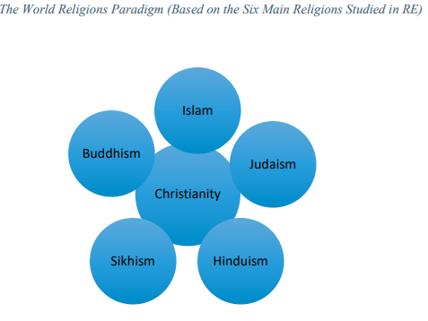
Moving away from the ‘World Religions Paradigm’ (WRP)
We cannot fit religions neatly into boxes (e.g. Islam is …, Muslims do …),
nor ignore lived experiences of religion and nonreligion
Source: Benoit, 2020
Notes:
Here, take the time to explain that traditionally RS has been taught through what we call the ‘World Religion Paradigm’ (WRP).
This was the idea that the ‘main’ religions - usually the ‘big six’: Buddhism, Christianity, Hinduism, Islam, Judaism, and Sikhi(sm) – were the ones taught in school. These would usually be framed as if they could fit into neat boxes (e.g., ‘Islam is….; Muslims do…”).
The criticism is that the WRP was perpetuating the notion that this traditions can all be understood through a Christian lens, because there is a tendency to frame all world religions as sharing common aspects with Christianity, and focusing on aspects such as scriptures, a church-like organisational structure, religious leaders organised in ways that are similar to priesthood, and a belief in one (or more) divine power(s).
By make sense of ‘world religions’ through Christianity, however, we are failing to do justice to the diverse religious and nonreligious traditions present in our society. We are trying to make them fit into a box, which was shaped by Christianity, but which does not fit.
As we put ‘world religions’ into neat boxes, not only we frame them through our understanding of Christianity, but we also ignore the diversity of beliefs and practices within each tradition. The latter is what we call essentialising ‘world religions’ (see Teacher Handout > glossary to unpack the concept of (de-)essentialising if useful).
Instead, a Religion and Worldviews (R&W) approach aims to de-essentialise RE by i) capturing and foregrounding individual’s lived experiences of religion and nonreligion (rather than solely relying on religious/nonreligious leaders telling us what religion is or isn’t), and ii) acknowledging the diversity of beliefs and practices within religious/nonreligious traditions.
Optional: If you/colleagues want to read more about the WRP, please see pp.7-8 of the Multidisciplinary Report: https://religiouseducationcouncil.org.uk/rec/wp-content/uploads/2021/01/REC-Worldview-Report-A4-v2.pdf

Slide 10
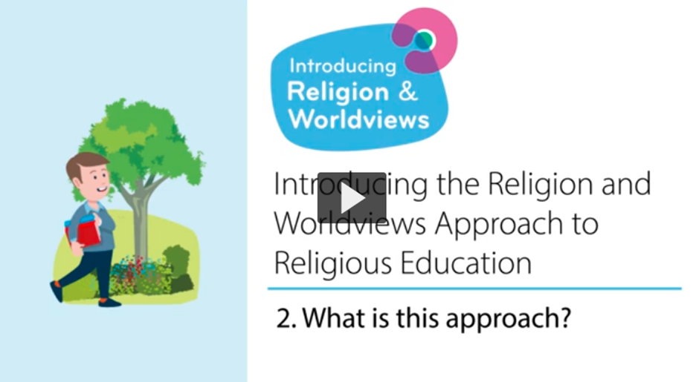
What is the R&W approach?
Notes:
[Twilight training: You may want to skip this slide if teachers have already watched the video ahead of the training session.]
Watch the video with colleagues. Ask if they have any questions at the end of the video. You may not necessarily want to answer them then if you know they’ll be answered in the slides below, but this may help you gauge where there you need to spend more/less time when recapping the key points of the video.
NB! Please reassure teachers by explaining that in this video the speakers make reference to ‘individual/personal worldviews’ and ‘organised/institutional worldviews’, the differences between the different levels will be explained in Session 2 – and at this stage there is no need to focus on these differences yet.

Slide 11

From WRP to R&W (1/4)
It’s a change in the way we teach (a pedagogical shift).
It’s not so much about the content we teach, it’s about how we teach thar content
World Religions Paradigm
Religion & Worldviews Approach
The idea that there are six major world religions, and lots of minor ones, and that they have a comparable set of core beliefs and practices that we can neatly package up and present in lessons. This approach is seen as distorting by imposing a particular model onto diverse traditions.
The idea that religion and beliefs are constantly changing and dynamic and each person will experience these differently.
Thanks to the Coventry & Warwickshire REC / local Agreed Syllabus writing team, led by Jennifer Jenkins, for sharing this material
Notes:
Please reassure teachers: while RS classes will provide us with opportunities to start making sense of our diverse world, as well as our own worldview, we do not expect teachers to be able to fully articulate what their own worldviews are, nor what their students’ worldviews are.
RS becomes the space where this is investigated.
Thanks to the Coventry & Warwickshire REC / local Agreed Syllabus writing team, led by Jennifer Jenkins, for sharing this material.

Slide 12
From WRP to RW (2/4)
Adopting a R&W approach:
is not simply adding more content.
is not merely adding in nonreligious worldviews.
This approach is about reflecting the ever increasing and diverse society in which we live.
This approach will recognise plurality within religion and nonreligion.
There is a focus on people: a R&W approach starts with people.
There is a focus on learning as an interpretive endeavour.
It involves examining one’s own beliefs, attitudes, motives and reactions and those of other people.
Notes:
Go through the bullet points with colleagues. Check understanding after this slide before moving onto the next one.
Explain how a R&W approach should help make the RS classroom an inclusive space.

Slide 13

From WRP to RW (3/4)
Adopting a R&W approach:
is not simply adding more content.
is not merely adding in non-religious worldviews.
A R&W approach is about reflecting the ever increasing and diverse society in which we live.
A R&W approach recognises plurality within religious and nonreligious traditions.
Notes:
Go through the bullet points with colleagues. Check understanding after this slide before moving onto the next one.

Slide 14
From WRP to RW (4/4)
A R&W approach should help make the RE classroom an inclusive space.
There is a focus on people: a R&W approach can start with people.
A R&W approach involves examining one’s own beliefs, attitudes, motives and reactions and those of other people.
There is a focus on learning as an interpretive endeavour.
Notes:
Go through the bullet points with colleagues. Check understanding after this slide before moving onto the next one.
If you need guidance about what is meant by an interpretive approach to RS: the intention is to enable learners to formulate their own views and to relate these to their previous learning and understanding.
Jackson wrote a useful paper on the interpretive approach in the RE classroom: https://theewc.org/content/uploads/2020/02/Studying-Religions-The-Interpretive-Approach-in-Brief.pdf

Slide 15
A pedagogical shift - Example
Take a concept like Karma:
A R&W approach means starting with where your children are at, and then moving on to consider the worldviews of others.
A R&W approach also means starting with the particular, then expanding to the more general.
Start by investigating what the concept of Karma means to children / families in the school and local community.
Then consider what Karma means to two different Hindu families. Through these two case studies you may recognise some diversity of beliefs / practices within a religion.
Then branch out to investigate what Karma might mean to Hindus more generally.
End with children reflecting again about what they have learnt and if this has changed or informed their own worldview.
Notes:
Go through this classroom example with teachers to illustrate what a R&W could look like in the classroom.

Slide 16

R&W and disciplinary lenses (1/2)
Worldview is a concept that has a long history in a few different academic disciplines including philosophy, theology, sociology and anthropology. We find it in Religious Education too.
Tapping into different disciplines can be also be really useful in the RS classroom.
Good RS is informed by different disciplines, which is what is called a ‘Multidisciplinary Approach’
Notes:
Go through the bullet points with colleagues. Check understanding after this slide before moving onto the next one.
Reassure teachers it’s not about becoming experts in lots of different disciplines; instead it’s about acknowledging that sometimes we may talk about sacred texts (Theology), sometimes we may investigate how people live their religion and nonreligion (Sociology/Social Sciences), and other times we may want to ponder on how they interpret some of the big questions in life (philosophy). It’s important to note that while these are the main disciplines (or disciplinary lenses as we like to call them in RS!), there are more disciplines that can inform RS (e.g. History…) and this is not an exhaustive list.

Slide 17
R&W and disciplinary lenses (2/2)
There are lots of different disciplines (or disciplinary lenses) you can bring to the RS classroom to try and make sense of how people understand the world around them.
Examples include: Theology, History, Philosophy, Social Sciences, Sociology…
The RS classroom draws on different disciplinary lenses to teach pupils the different skills for studying texts, people, objects and buildings.
Notes:
Go through the bullet points with colleagues. Check understanding after this slide before moving onto the next one.
In the next slides, you will be able to look at examples of how different disciplinary lenses are used in KS3. Before you show the next slides please make it clear to teachers that:
We often use the different disciplines throughout RS and during different lessons; this reflects the messiness of worldviews and lived experiences of religion and nonreligion. As such, although the next slides suggest a clean split between the different disciplines please make it clear to teachers that this is not how it will look in the RS classroom.
Please acknowledge that these are examples in which the disciplines can be understood in the context of the RS classroom - they are not meant to be exhaustive understanding of what each different discipline entails.

Slide 18

We are Theologians - KS3
• We analyse sacred texts and make links with practices and beliefs.
• We look for evidence to back up our thinking.
• We make judgements based on our reading.
• We make interpretations and identify our hermeneutical lenses.
• We ask questions about what we read and discuss its meaning.
• We consider authorship and authority and the context in which sacred texts were written.
• We reflect on what sacred texts mean to us personally and what they mean to others.
• We consider what religious art might be telling us about the artist’s worldview and wider beliefs and ideas.
Thanks to the Coventry & Warwickshire REC / local Agreed Syllabus writing team, led by Jennifer Jenkins, for sharing this material
Notes:
Thanks to the Coventry & Warwickshire REC / local Agreed Syllabus writing team, led by Jennifer Jenkins, for sharing this material.

Slide 19

We are Philosophers - KS3
• We explore different methods of knowing and different methods of reasoning.
• We use the ideas and thoughts of others to generate discussion and formulate our own opinions.
• We justify our opinions and ideas with evidence and examples.
• We challenge the ideas and opinions of others, known to us and not previously known.
• We ask innovative questions of our own and attempt to answer the questions of others.
• We try to be persuasive in our spoken language and in our writing.
• We think critically using reason and evidence.
• We think about why we are here and issues of right and wrong, good and bad.
Thanks to the Coventry & Warwickshire REC / local Agreed Syllabus writing team, led by Jennifer Jenkins, for sharing this material
Notes:
Thanks to the Coventry & Warwickshire REC / local Agreed Syllabus writing team, led by Jennifer Jenkins, for sharing this material.

Slide 20

We are Social Scientists - KS3
• We question assumptions about worldviews and religion.
• We analyse how things change in society.
• We consider the reasons for human behaviour and practices.
• We consider what behaviour and practices tell us about belief and ways of seeing the world.
• We study diversity and lived experiences of religion using interviews, case studies and observations.
• We analyse and try to understand the worldviews of others, both personal and organised, alongside our own.
• We encounter real people from different religious traditions and those of no faith/religion.
• We think about issues of belonging and identity and the interactions between these ideas.
Thanks to the Coventry & Warwickshire REC / local Agreed Syllabus writing team, led by Jennifer Jenkins, for sharing this material
Notes:
Thanks to the Coventry & Warwickshire REC / local Agreed Syllabus writing team, led by Jennifer Jenkins, for sharing this material.
This may be a good time to take a break, if times allows.

Slide 21

“Nobody stands nowhere”
Notes:
To introduce the concept of worldview, we recommend watching this video all together – even for twilight sessions.
This video can also be used in the RS classroom:
Link to ‘Nobody Stands Nowhere’ video: https://www.youtube.com/watch?v=AFRxKF-Jdos&ab_channel=TheosThinkTank

Slide 22

What is ‘religion’?
Notes:
[Twilight training: You may want to skip this slide if teachers have already watched the video ahead of the training session.]
Watch the video with colleagues. Ask if they have any questions at the end of the video. You may not necessarily want to answer them at this stage if you know they’ll be answered in the slides below, but this may help you gauge where there you need to spend more/less time when recapping the key points of the video

Slide 23

What is ‘religion’? – Key Points (1/3)
It’s hard to define the term ‘religion’.
You could say it’s a group of people who have a set of values, a set of beliefs in something like a God, follow a sacred text, have a form of priesthood, have beliefs about life after death.
But…. a definition can be a barrier to understanding traditions, cultures, and beliefs outside of the Western Christian context.
Notes:
Go through the bullet points with colleagues. Check understanding after this slide before moving onto the next one.

Slide 24
What is ‘religion’? – Key Points (2/3)
Remember the concept of religion derived from Western countries and it was then applied to traditions and beliefs outside that area, but the framework used did not always neatly apply.
The way we use the term does not fully embrace the lived experiences of religion.
Notes:
Go through the bullet points with colleagues. Check understanding after this slide before moving onto the next one.

Slide 25
What is a ‘religion’? – Key Points (3/3)
There are lots of groups in Britain who are perhaps on the edge of religion or nonreligion.
E.g. Judaism - some see themselves as Jewish in terms of identity and community but it’s not their religion.
E.g. Paganism - some Pagan groups see themselves as religious and some Pagan groups see themselves as nonreligious.
E.g. A belief in ghosts. The category of religion as previously understood doesn’t fit with this - with ghosts there is not a sacred text or a priesthood.
Notes:
Go through the bullet points with colleagues. Check understanding after this slide before moving onto the next one.
If teacher feel comfortable, you could ask them to share any of their own experiences of not being sure if they are religious or not (e.g. “I believe in God, but I don't attend a place of worship or ever pray”).

Slide 26
Why does this matter for RS? (1/2)
Being aware of the term’s colonial baggage (i.e. that it has been shaped by Western Christianity), it helps us understand why it’s important not to reproduce such discourses.
As such, you may want to be mindful of the language or comparisons you draw in class. While in the past we may have heard/said things like ““Guru Granth Sahib is similar to the Bible, but for Sikhs,” or “a Gurdwara is like a church, but for Sikhs”, you’re now aware that by doing so you’re restricting Sikhi by trying to make sense of it through a Western Christian lens.
Notes:
Go through the bullet points with colleagues. Check understanding after this slide before moving onto the next one.
The aims of this slide are to:
Make sure teachers have a sound understanding of the limitations of the concept of ‘religion’ so they can make informed choices when they teach RS to ensure they do not perpetuate the notion that all religious/nonreligious traditions can be understood through a Western Christian lens, but should be studied within their own rights.
Help teachers realise that they may have grown up with one understanding of ‘religion’, which may not have done justice to the concept and/or what they may have tended to call ‘world religions’.
Understand that using Christianity as a reference point in RS can be problematic as it reinforces power asymmetries.

Slide 27
Why does this matter for RS? (2/2)
Making sense of religious/nonreligious worldviews through Christianity (or more specifically, through what we call ‘a Western Christian lens’ can do them a real disservice (e.g. Indic/Dharmic traditions).
Making sense of Sanatan Dharma* by comparing it to Christianity, with categories such as ‘sacred text’, ‘place of worship’, and ‘God’-creating is not only an unhelpful framing but also a colonial one.
A R&W approach can help us decolonise the curriculum.
Notes:
Go through the bullet points with colleagues. Check understanding after this slide before moving onto the next one.
* Acknowledge that most teachers will talk about Hinduism. Sanatan Dharma is often used instead when wanting to reframe it outside a Christian lens.
A R&W approach is therefore useful for those who are seeking to decolonise the RS curriculum, since it invites teachers to think about the way in which things are framed - rather than about adding/taking out content (see Teacher Handout > glossary if help is needed to understand ‘decolonising’).
You may want to make sure there are no misunderstandings following the video and discussion: we are not saying we should not use the word ‘religion’, as it remains a really useful term to make sense of the world. It’s about being aware of its boundaries and its limitations.
This will lead you onto the next slide, which explains how such a Western Christian framing has been prominent in RE because of what we call the World Religions Paradigm (which is explained in the next slide, and also in the Teacher Handout > Glossary).

Slide 28

Activity 1
Notes:
Suggested activities:
1. Ask teachers to discuss how they teach a concept - for example ‘The concept of God’. In their discussion they should think about teaching different religions, how they space it out, what they do? Is it useful to teach together? What methods / key points do they draw on? What problems could they encounter in their teaching if they teach them both at the same time?
OR
2. Look at how Sanatan Dharma [Hinduism] is approached differently once outside of the WRP, and the benefits of this.

Slide 29

Activity 2
Look at your school’s rationale for RS
Discuss how much you agree with this document
What is good RS?
What do you do in RS?
Why do you do what you do in RS?

Slide 30

Session 1 – summary (1/2)
RS is an important academic subject that equips students with the tools to navigate a diverse world, and make sense of their own worldviews.
The Religion and Worldviews (R&W) approach may seem new, but it builds on existing good practice in RS – you may already be adopting a R&W approach to an extent!
Notes:
Go through the bullet points with colleagues. Check understanding after this slide before moving onto the next one.

Slide 31
Session 1 – summary (2/2)
A R&W approach seeks to make RS more inclusive. As such, we need to be mindful about the language & examples we use:
To avoid framing ‘world religions’ through Western Christian lenses (in other words: to avoid comparing all religious and nonreligious traditions to Christianity)
To avoid presenting religious and nonreligious groups as not diverse; instead acknowledging diversity within and across (non)religion
This is change in the way we teach: it’s about how you teach RS, not necessarily about adding/removing content
Notes:
Go through the bullet points with colleagues. Check understanding after this slide before moving onto the next one.

Slide 32
Take-Away Activity
To prepare ahead of the next session

Slide 33
Creation Story at KS3 | Good examples | Poor examples
Substantive knowledge | Exploring Creation narratives from several worldviews and looking for similarity as well as nuance. Exploring the concepts that underpin a particular worldview that are present within the creation narrative(s) being studied | Retelling the Creation story Or Posing an ethical question about the Creation story Or Presenting a Creation narrative as a simple articulation of how everyone within a particular religion understands the origin of the Universe
Disciplinary knowledge | Deliberately applying hermeneutical lenses that go beyond traditional interpretations, such as those from Black liberation theology and/or feminist/womanist theology. Exploring the historical-social-geographical context out of which Creation narratives arose and considering how this might have influenced them | Only exploring one way of interpreting the Creation story or viewing it through only one particular worldview Or Pupils learn factual information about a Creation narrative (treated entirely in general terms) and never engage with this information in any depth or by using scholarly questions and skills
Personal knowledge | Considering the role the natural world might play within their own personal worldview and the ways in which this is evident and leads to embodied expressions of belief and philosophy for life. | Simply stating their favourite day of Creation
Thanks to the Coventry & Warwickshire REC / local Agreed Syllabus writing team, led by Jennifer Jenkins, for sharing this material
Notes:
Ahead of the next session, ask teachers to look at this slide. What do they think? Can they identify areas of good practice they have already adopted? Can they relate to some of the examples of poor practice? Is this how they were taught? Is this still how they teach today? If yes, that’s ok! A lot of other teachers are also in the process of making the pedagogical shift – they are not alone!
Thanks to the Coventry & Warwickshire REC / local Agreed Syllabus writing team, led by Jennifer Jenkins, for sharing this material.

Slide 34


End of session 1
© Introducing Religion & Worldviews (2025)
Notes:
For feedback and comments about these resources, please scan the QR code or copy/paste this URL into your browser: https://forms.office.com/e/iLKDeRHMYL
To contact the lead author, please email Celine.Benoit@nottingham.ac.uk

