Slide 1
ISAC CASE STUDY
THE DISSOLUTION OF AMORPHOUS SOLID DRUG DISPERSIONS
ISAC_CS_03

Slide 2
The Dissolution of Amorphous Solid Drug Dispersions
Raman Spectroscopy Case Study

Slide 3
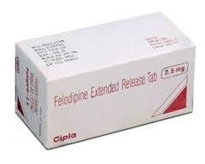
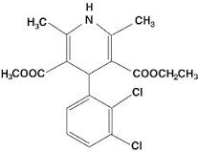
THE SOLUBILITY OF NEW DRUGS
The drug development process has identified many chemicals with useful pharmacological activity.
However a high proportion of these also have poor dissolution and solubility profiles, and as a consequence poor bioavailability e.g. felodipine.
Amorphous solid dispersions of water-insoluble drugs with water-soluble polymers represent a possible solution.
But the release profiles of amorphous solid dispersions remain poorly understood, with little chemical or time-resolved information.

Slide 4
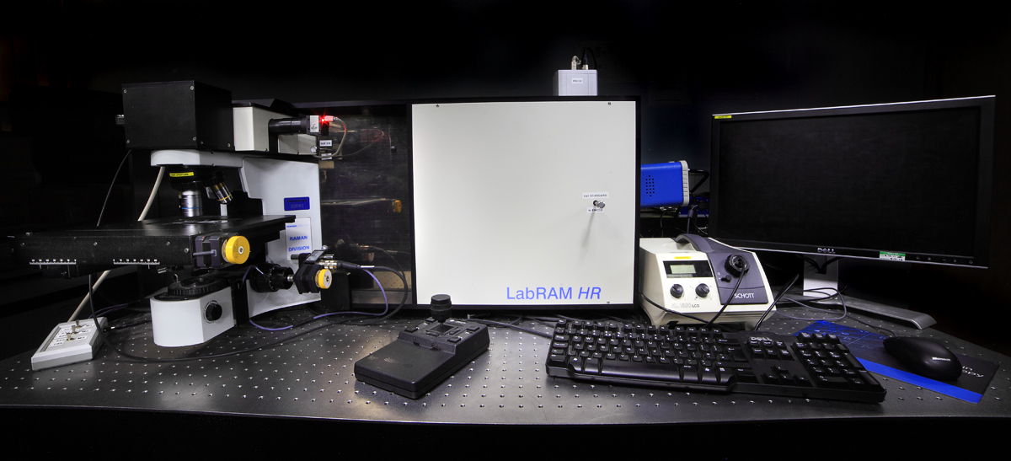
RAMAN SPECTROSCOPY
Raman spectroscopy allows for real-time, ‘in-situ’ chemical and morphological analysis that can be used to monitor subtle dissolution dynamics.
The technique uses the inelastic scattering of light to generate spectra unique to a material’s molecular composition and state, and can then track changes with time.
It can be applied to a diverse range of samples (solid, liquid etc.) in ambient or controlled conditions (i.e. hot, cold) under static or dynamic (e.g. flow through) conditions.
The Horiba LabRAM HR Raman Microscope available at the Nanoscale and Microscale Research Centre (nmRC), University of Nottingham.

Slide 5
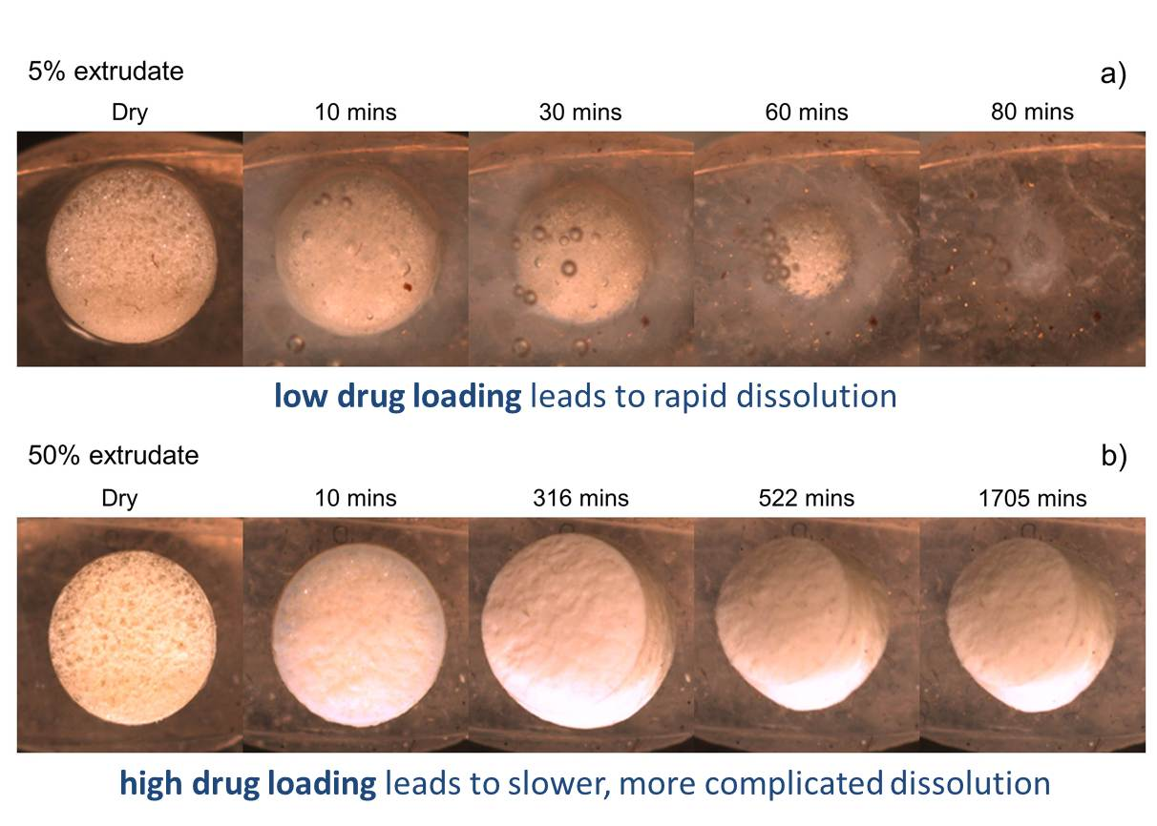
OPTICAL MICROSCOPY
Optical micrographs reveal that the dissolution of a felodipine amorphous solid dispersion depends on the loading of the drug in the polymer.

Slide 6
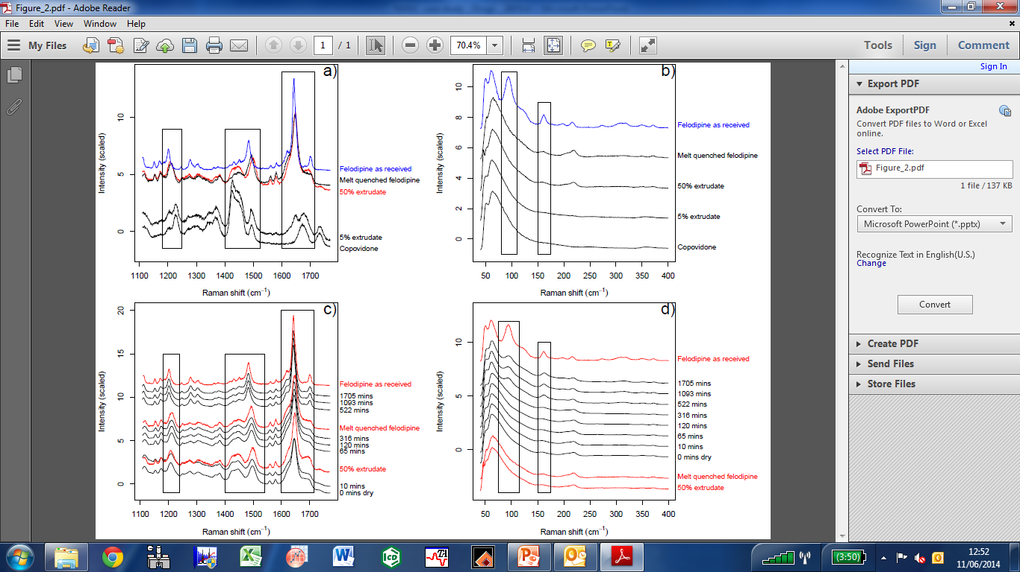
RAMAN SPECTRAL ANALYSIS
Time resolved Raman spectral analysis on sample variations highlight chemical differences in the samples.
Live time-resolved spectral analysis demonstrate changes in chemistry as dissolution occurs.

Slide 7
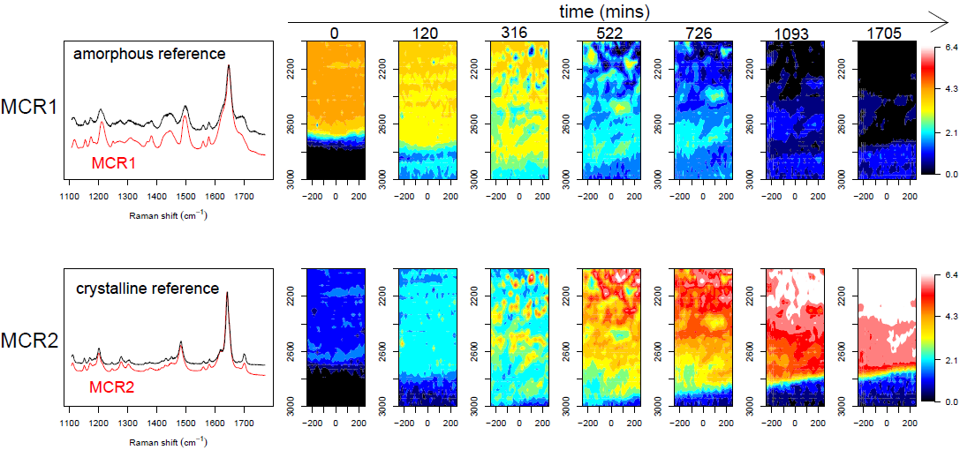
RAMAN MAPPING
It is also possible to spatially map a dissolving tablet and overlay the spectral changes representative of time resolved chemical variation e.g. the change in crystallinity seen with dissolution.

Slide 8
SUMMARY
Raman spectroscopy is a powerful imaging and chemical analysis tool that can be used to track real time subtle changes in chemistry such as the dissolution behaviour of a sold amorphous dispersion.
Optical microscopy reveals the dissolution profile of an amorphous solid dispersion of felodipine depends on the loading of the drug in the polymer.
Raman spectroscopy is a powerful chemical analysis and mapping tool that shows:
Low drug loadings – The drug and polymer dissolve as a single entity.
High drug loadings – The drug and polymer dissolve on different time scales, enriching the concentration of the drug as the polymer dissolves and leading to re-crystallisation.
This study demonstrates the critical role Raman spectroscopy can play in understanding the release profile of poorly water-soluble drug molecules.

Slide 9
REFERENCES / ACKNOWLEDGEMENTS
For more details on the work showcased in this case study see the following publications:
F. Tres, K. Treacher, J. Booth, L.P. Hughes, S.A.C. Wren, J.W. Aylott and J.C. Burley. Real time Raman imaging to understand dissolution performance of amorphous solid dispersions. J. Controlled Release, 2014, DOI:10.1016/j.jconrel.2014.05.061
The Raman spectroscopy analysis documented here was performed at the Nanoscale and Microscale Research Centre (nmRC) at the University of Nottingham. www.nottingham.ac.uk/nmrc

Slide 10
ADDITIONAL INFORMATION
If you wish to get in touch with us to discuss the information provided, raise a query/concern or provide feedback then please feel free to get in touch via any of the methods listed below:
The Interface and Surface Analysis Centre (ISAC)
^{Boots Science Building (C08)}
^{University Park}
^{Nottingham}
^{NG7 2RD}
Telephone: +44(0)115 951 5046 / +44(0)115 645 3130
^{Email: isac@nottingham.ac.uk}
^{Fax: +44 (0)115 846 7969}
Website: www.nottingham.ac.uk/isac

