Slide 1

ISAC CASE STUDY
CHARACTERISING BLEACHED HAIR DAMAGE
ISAC_CS_05

Slide 2
Characterizing Bleached Hair Damage
Materials Characterisation Case Study

Slide 3
INTRODUCTION
Bleaching is a common cosmetic treatment used to eliminate or tone down the natural hair colour.
However the process also causes damage to the hair fibres e.g. loss of hair cuticles, surface modification etc. that can impact hair feel, volume and longevity.
Understanding the physical and chemical changes that occur to hair fibres during bleaching treatment plays an important role in the design and development of hair care products that can protect against or reverse some of this damage to preserve the hair state.
This case study showcases the use of multiple surface analytical techniques to characterise the damage process.
***CONFIDENTIAL***

Slide 4
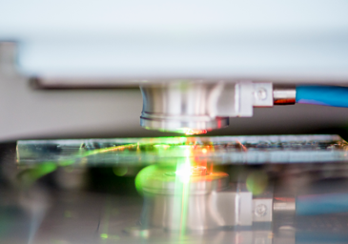
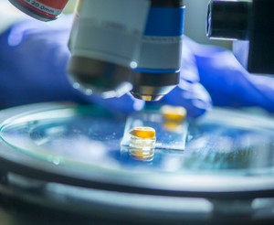
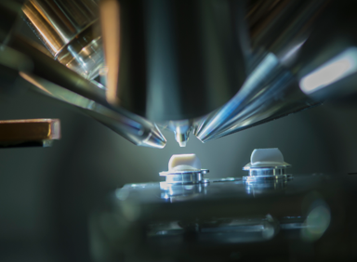
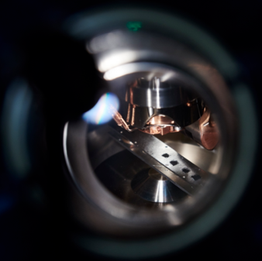
INTRODUCTION
3D Optical Profilometry
Atomic Force Microscopy
(AFM)
Surface Analysis
X-Ray Photoelectron Spectroscopy (XPS)
Secondary Ion Mass Spectrometry (SIMS)

Slide 5
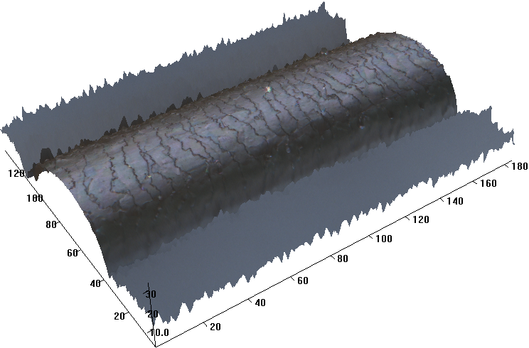
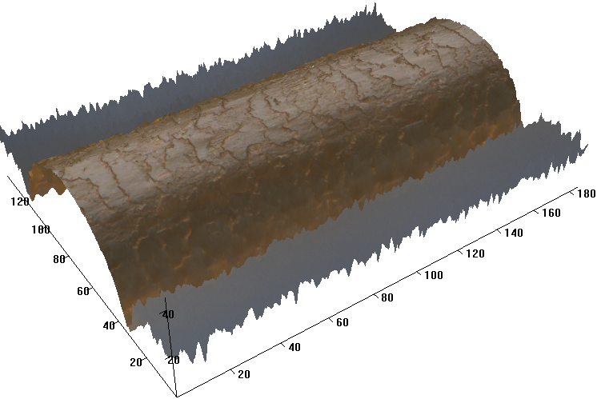
3D OPTICAL PROFILOMETRY
Untreated
Optical profilometry provides true colour 3D imaging of a hair fibre and allows a quick overview of morphological features.
The colour of a hair is toned down after bleaching as expected.
Damage to the hair cuticles after bleaching can be easily identified by comparing the 3D images of untreated and bleached hair fibres.
Bleached

Slide 6
ATOMIC FORCE MICROSCOPY (AFM)
AFM provides nano- and micro-scale characterisation of hair fibre morphology on a cuticle by cuticle basis.
Height
Modulus
Adhesion
Untreated
Bleached

Slide 7
ATOMIC FORCE MICROSCOPY (AFM)
Simultaneous mapping of chemical and physical properties of the hair (such as adhesion and stiffness [Young’s Modulus]) can be performed using technical variants.
While AFM topographic images may show little difference between the surfaces of untreated and bleached hair fibre cuticles, the stiffness and adhesion data highlight variation induced by the bleaching process.
Bleaching can be seen to have removed some native hair structure and modified the cuticle surface.

Slide 8
TIME-OF-FLIGHT SECONDARY ION MASS SPECTROMETRY (ToF-SIMS)
ToF-SIMS allows analysis on chemical changes between the surfaces of untreated and bleached hair fibres.
Total Ion⁻
HS⁻
SO₃⁻
Untreated
Significant oxidation is suggested at the bleached hair by the enhanced SO₃⁻ ion intensity and spatial distribution coupled with the suppression and and absence of the HS⁻ ion intensity relative to the untreated hair.
Bleached

Slide 9
TIME-OF-FLIGHT SECONDARY ION MASS SPECTROMETRY (ToF-SIMS)
C₂₁H₄₁SO⁻
Specific chemistries can be mapped for by isolating characteristic secondary ions
Untreated
18-MEA (18-methyleicosanoic acid) on the surface of the hair plays an important role in surface hydrophobicity, which makes hair feel smooth.
The distribution of C₂₁H₄₁SO⁻ which is a characteristic ion of 18-MEA on the hair fibre samples shows that bleaching removes 18-MEA from the surface of native hair.
Bleached

Slide 10
TIME-OF-FLIGHT SECONDARY ION MASS SPECTROMETRY (ToF-SIMS)
Hair fibres could be sectioned using an ultramicrotome allowing the chemical mapping of hair cross sections.
Total Ion⁻
HS⁻
SO₃⁻
Resin
Untreated
Hair
After bleaching, the content of SO₃⁻ is enhanced significant in the near surface region of a hair fibre.
Bleached

Slide 11
X-RAY PHOTOELECTRON SPECTROSCOPY (XPS)
XPS is used to measure the elemental composition at hair surface and provide information on chemical state changes.
Bleached
Untreated
XPS wide scan data and elemental quantifications show that bleaching has lowered the atomic percentage of both oxygen and nitrogen at the hair surface, potentially indicative of protein degradation.

Slide 12
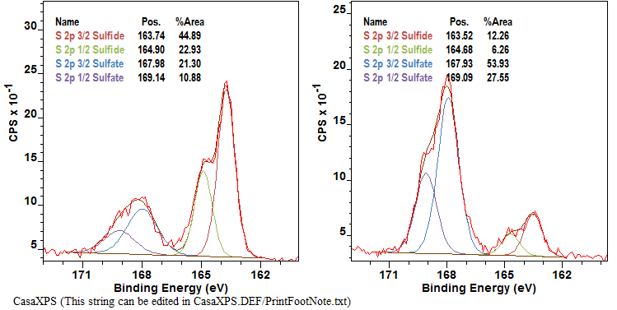
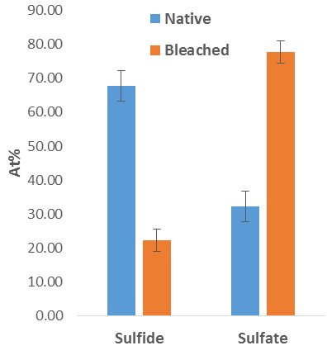
X-RAY PHOTOELECTRON SPECTROSCOPY (XPS)
Untreated
Bleached
High resolution scans show that after bleaching the chemical state of the sulfur content of the hair surface has changed dramatically. Sulfate proportionality increases from 37 At% to 78 At%, while the sulfide proportionality decreases from 68 At% to 22 At%.
The chemical state of sulfur can indicate the level of damage to the hair: the higher the sulfate content the higher degree of aging or oxidation.

Slide 13
CONCLUSIONS
3D Optical profilometry shows that, while eliminating the hair pigment, bleaching induces obvious alteration to hair cuticle morphology on the micron-scale.
ToF-SIMS shows substantial differences caused by bleaching on the top surface chemistry of the hair. These include significant oxygenation of sulphur groups and a loss of native hair state ion markers (e.g. 18-MEA).
XPS suggests that chemical damage to the hair caused by bleaching could include protein degradation and supports the evidence for significant oxidation in the hair structure.
AFM reveals that bleaching also removes native surface coatings from the untreated hair and causes nano-scale alterations to topography.
Multi-technique surface analysis enables a comprehensive understanding of the effects of bleaching treatment on native hair.

Slide 14

ADDITIONAL INFORMATION
We hope that the information documented in this report is to a standard that meets expectation.
If you wish to get back in touch with us to discuss the information provided, arrange follow-up work, raise a query/concern or provide feedback then please get in touch via any of the methods listed below:
The Interface and Surface Analysis Centre (ISAC)
^{Boots Science Building (C08)}
^{University Park}
^{Nottingham}
^{NG7 2RD}
Telephone: +44(0)115 951 5046 / +44(0)115 645 3130
^{Email: isac@nottingham.ac.uk}
^{Fax: +44 (0)115 846 7969}
Website: www.nottingham.ac.uk/isac

