Slide 1
ISAC CASE STUDY
SOOT-IN-OIL DIAGNOSTICS
ISAC_CS_08

Slide 2
Soot-in-Oil Diagnostics
Transmission Electron Microscopy (TEM) & Nanoparticle Tracking Analysis (NTA) Case Study

Slide 3
SOOT-IN-OIL CONTAMINATION
A build-up of soot in engine oil reduces performance.
Oil thickening increases viscosity, raising CO₂ emissions and fuel consumption.
Increased engine wear occurs as anti-wear additive effectiveness is reduced.
Level of wear depends upon the characteristics of the particles and agglomerates of soot.
The understanding of soot-in-oil characteristics and their impact is impeded by the limitations of experimental techniques for soot analysis

Slide 4
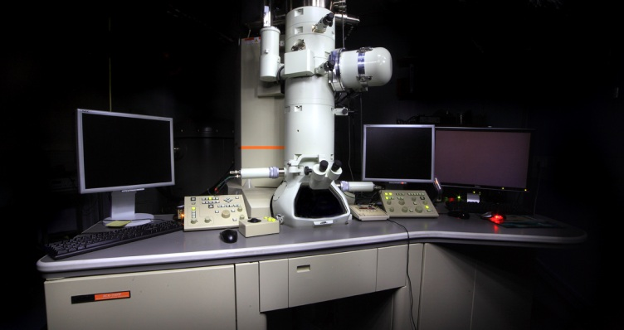
NANOPARTICLE CHARACTERISATION
The size distribution and morphology of soot particles is critical.
Inﬂuences oil properties and gives insight into particle formation and growth.
Better characterisation should help develop strategies to combat engine wear.
Novel strategies have been developed using the application of specialist imaging analytics.
Transmission Electron Microscopy (TEM)
Nanoscale Visualisation
Particle and Feature Sizing
Nanoparticle Tracking Analysis (NTA)
‘In-situ’ Particle Size Distribution
JEOL 2100F FEG TEM at the Nanoscale and Microscale Research Centre (nmRC)

Slide 5
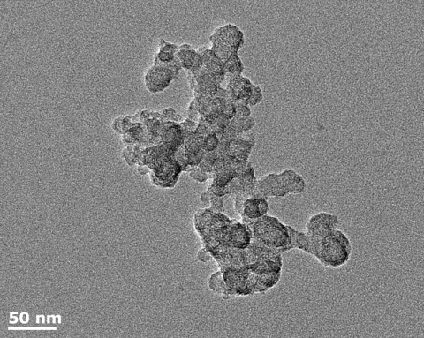
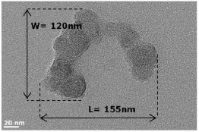
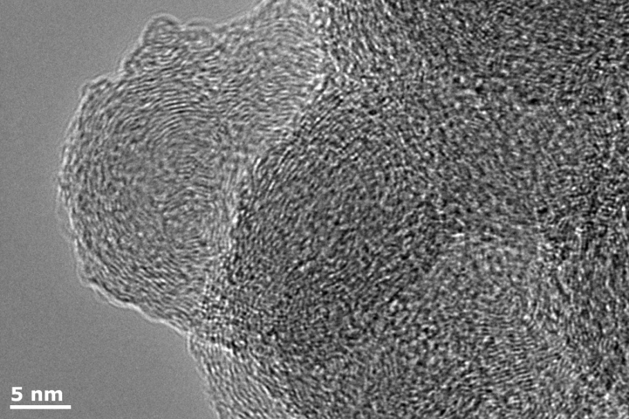
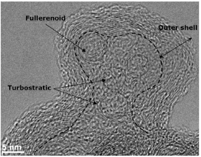
TRANSMISSION ELECTRON MICROSCOPY (TEM)
An electron microscopy technique with Ångstrom resolution capability.
It uses the contrast in electron transmission as a beam passes through ultra-thin specimens to generate an image of soot particulates.
Particle sizing and morphology
Frequency, size distribution, structure
etc. of nanometre structures
Structure of primary particles
High resolution (HRTEM) imaging identifies molecular structures e.g. inner core, graphitic layers, outer shell crystallites

Slide 6
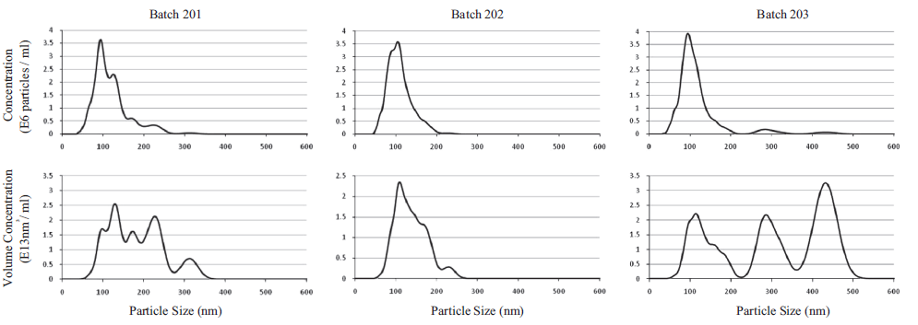
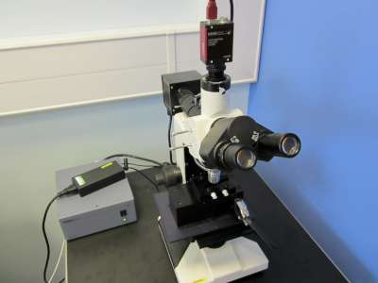
NANOPARTICLE TRACKING ANALYSIS (NTA)
A technique used to size nanoparticles (10-2000 nm) and evaluate concentrations in liquid samples.
A laser beam illuminates the particles, causing them to act as point scatterers, and an optical microscope with camera visualises and records the path of the particles under Brownian motion.
‘In-situ’ analysis
Nanosight LM14 at the nmRC
Nanoparticle size distributions and concentrations
Batch to batch comparisons of particle size distributions and concentrations.

Slide 7
SUMMARY
Soot-in-oil contamination reduces engine performance.
Characterisation of size distribution and morphology of such contamination has been limited.
TEM and NTA offer novel diagnostics of nanoparticulate soot-in-oil contamination.
Soot particle size distributions, concentrations and structural assessments were recorded.
Soot particle contamination of engine oil was better characterised, opening the door for the development of prophylactic strategies and screening processes.
Click right to see a 3D image of a soot particulate built from TEM imaging.

Slide 8
REFERENCES / ACKNOWLEDGEMENTS
For more details on the work showcased in this case study see the following publications:
A. La Rocca, G. Di Liberto, P.J. Shayler, C.D.J. Parmenter, M.W. Fay. Application of nanoparticle tracking analysis platform for the measurement of soot-in-oil agglomerates from automotive engines. Tribology International 70 (2014) 142–147
The transmission electron microscopy (TEM) and nanoparticle tracking analysis (NTA) documented here were performed at the Nanoscale and Microscale Research Centre (nmRC) at the University of Nottingham. www.nottingham.ac.uk/nmrc

Slide 9
ADDITIONAL INFORMATION
If you wish to get in touch with us to discuss the information provided, raise a query/concern or provide feedback then please feel free to get in touch via any of the methods listed below:
The Interface and Surface Analysis Centre (ISAC)
^{Boots Science Building (C08)}
^{University Park}
^{Nottingham}
^{NG7 2RD}
Telephone: +44(0)115 951 5046 / +44(0)115 645 3130
^{Email: isac@nottingham.ac.uk}
^{Fax: +44 (0)115 846 7969}
Website: www.nottingham.ac.uk/isac

