Slide 1
ISAC CASE STUDY
POLYMER COMPOSITION AND SPATIAL DISTRIBUTION
ISAC_CS_09

Slide 2
Polymer Composition and Spatial Distribution
X-ray Photoelectron Spectroscopy (XPS) Case Study

Slide 3
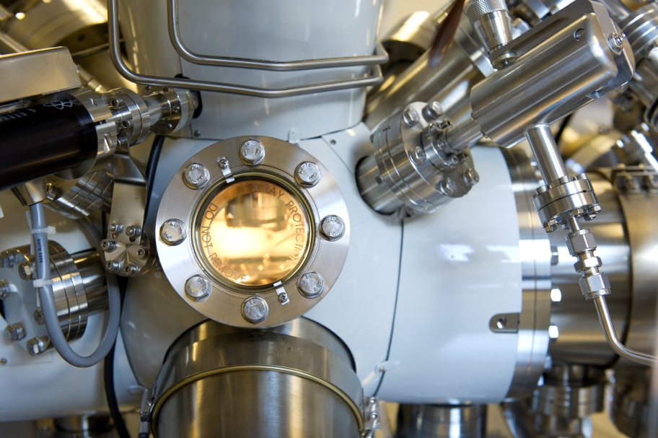
POLYMER CHARACTERISATION
Polymers are not always directly or easily identifiable at the surfaces of materials.
Macro distributions and thicknesses may be of interest, but how can they be assessed?
X-ray photoelectron spectroscopy (XPS) is a means of chemical analysis sensitive to light elements.
XPS is also a highly surface sensitive technique (~ top 10nm), ideal for studying thin films of polymers or liquids*.
* Analyse ionic liquids with the liquid phase photoelectron spectroscopy instrument (LiPPS) at the NNNC.

Slide 4
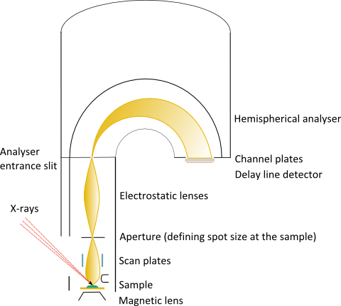
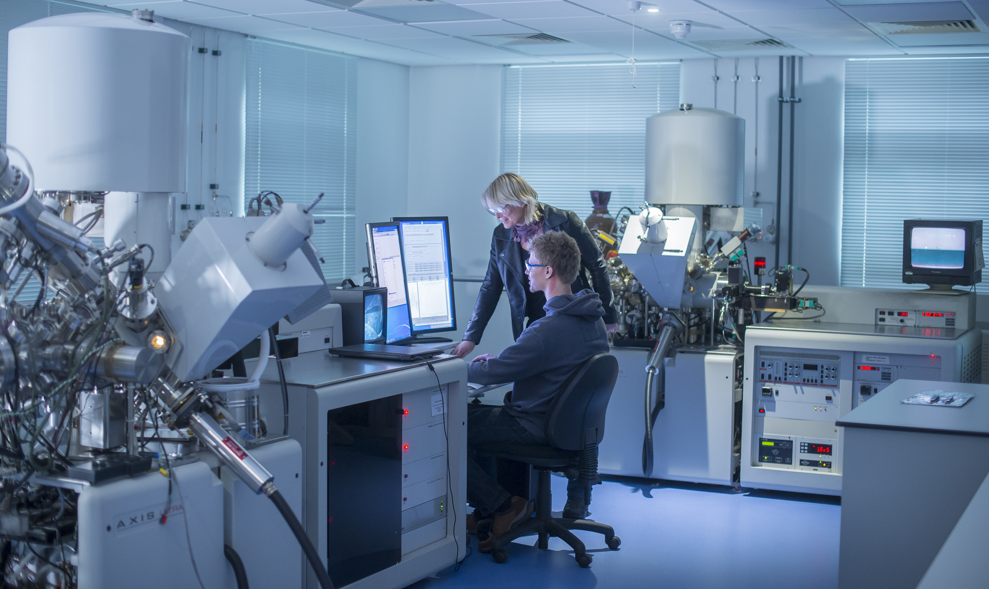
XPS PRINCIPLES
X-rays excite electrons out of the sample surface.
These are collected and their energy analysed.
Electron energies depend on the element they originated from.
The resulting spectrum is dependent on what elements are in the surface layer and in what abundance.

Slide 5
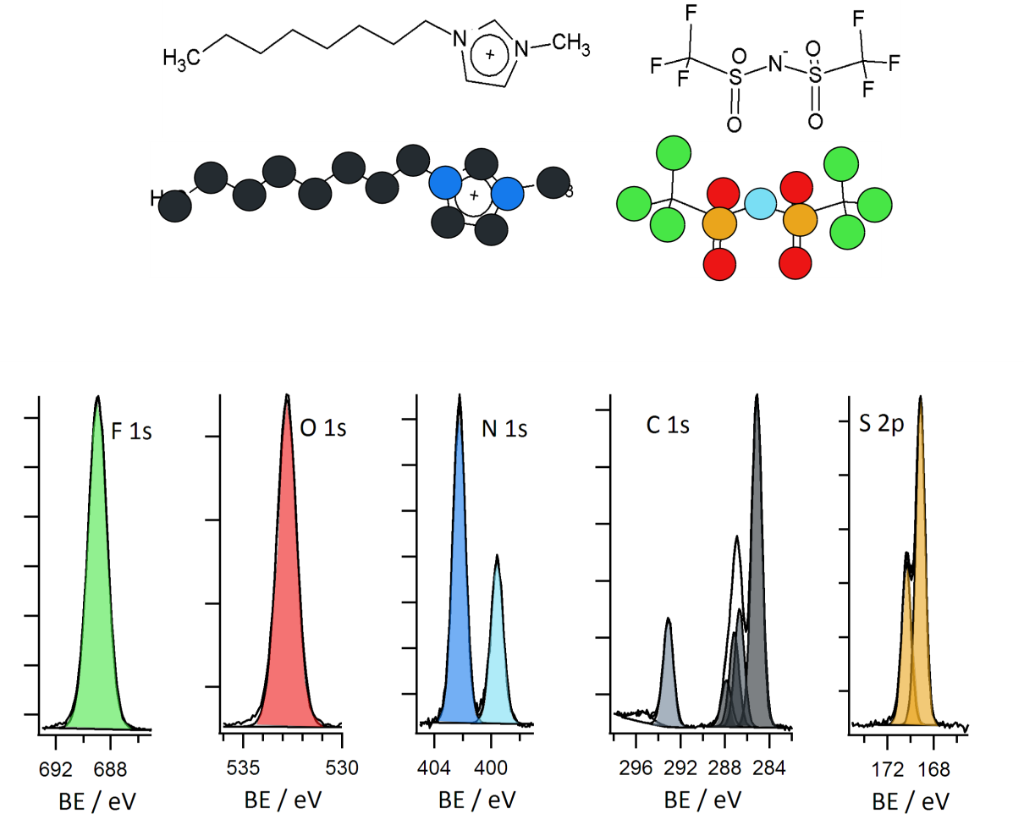
SPECTRAL IDENTIFICATION
XPS Identification of polymers possible by elemental spectra.
Example analysis of an ionic liquid:
 | Fluorine | Oxygen | Nitrogen | Carbon | Sulphur | Total
No Atoms | 6 | 4 | 3 | 14 | 2 | 29
At% Expected | 20.7 | 13.8 | 10.3 | 48.3 | 6.9 | 100

Slide 6
SPATIAL LOCALISATION
Parallel imaging of a sample surface can be performed.
This can provide the spatial distribution of elements, and therefore surface components e.g. polymers
Example XPS mapping of ionic liquid droplet distribution on a gold surface.
400 µm

Slide 7
SUMMARY
XPS is a highly surface sensitive technique capable of chemical identification localisation, and quantification.
Sensitive to light elements with ~0.1% atomic sensitivity it can play a key role in thin film polymer and liquid characterisation.
Potential applications:
Polymer identification.
Surface enrichments of one polymer constituent.
Drug entrapment and depth and coverage with protective layers.
Micron scale polymer spatial segregation or coating distributions.
Chemical stability of coatings.
Polymer mixing in cross section.

Slide 8
REFERENCES / ACKNOWLEDGEMENTS
For more details on the work showcased in this case study see the following publications:
E. F. Smith, D. Briggs, and N. Fairley, “Further developments in quantitative X-ray photoelectron spectromicroscopy: preliminary results from the study of germanium corrosion,” Surf. Interface Anal., vol. 38, no. 2, pp. 69–75, 2006.
E. F. Smith, F. J. M. Rutten, I. J. Villar-Garcia, D. Briggs, and P. Licence, “Ionic Liquids in Vacuo: Analysis of Liquid Surfaces Using Ultra-High-Vacuum Techniques,” Langmuir, vol. 22, no. 22, pp. 9386–9392, Oct. 2006.
The X-ray photoelectron spectroscopy (XPS) analysis documented here was performed at the Nanoscale and Microscale Research Centre (nmRC) at the University of Nottingham. www.nottingham.ac.uk/nmrc

Slide 9
ADDITIONAL INFORMATION
If you wish to get in touch with us to discuss the information provided, raise a query/concern or provide feedback then please feel free to get in touch via any of the methods listed below:
The Interface and Surface Analysis Centre (ISAC)
^{Boots Science Building (C08)}
^{University Park}
^{Nottingham}
^{NG7 2RD}
Telephone: +44(0)115 951 5046 / +44(0)115 645 3130
^{Email: isac@nottingham.ac.uk}
^{Fax: +44 (0)115 846 7969}
Website: www.nottingham.ac.uk/isac

