Slide 1
CASE STUDY
CHARACTERISING 3D PRINTED ELECTRONICS
ISAC_CS_10
***CONFIDENTIAL***

Slide 2
CHARACTERISING 3D PRINTED ELECTRONICS
***CONFIDENTIAL***
Materials Characterisation Case Study

Slide 3
INTRODUCTION
Additive manufacturing, also known as 3D printing, has recently been used in a wide range of polymeric and metallic material applications due to the significantly increased geometrical complexity available when compared to traditional production methods.
This case study showcases how a prototype-encapsulated strain sensor manufactured using 3D inkjet printing can be achieved and interrogated using multiple analytical techniques to investigate it’s organic-metal interface and the conductive layer.

Slide 4
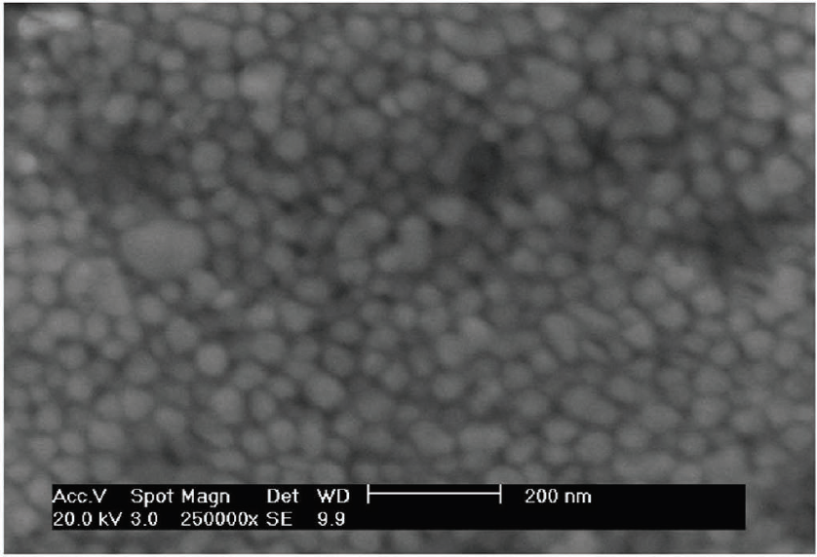
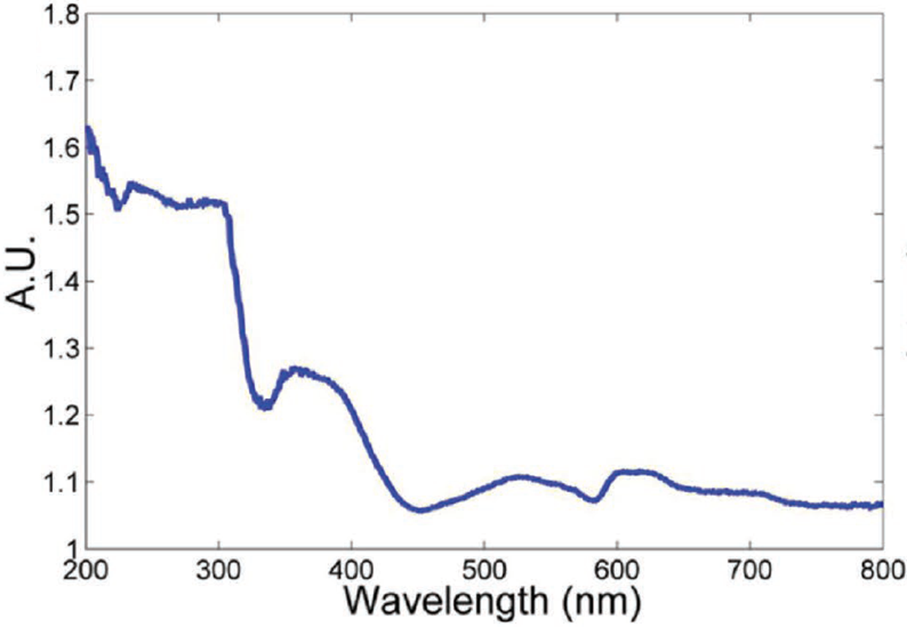
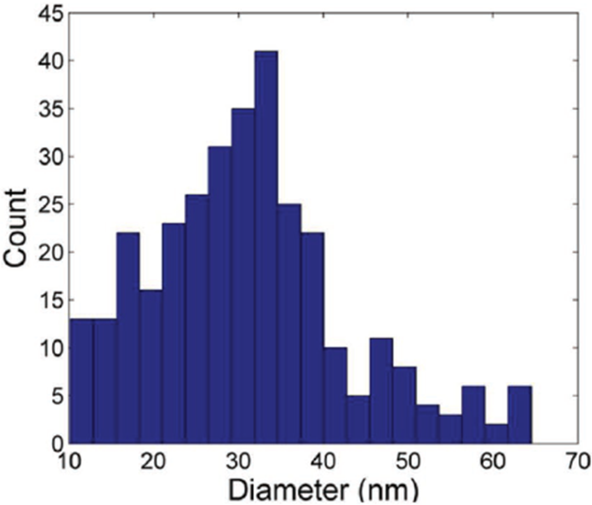
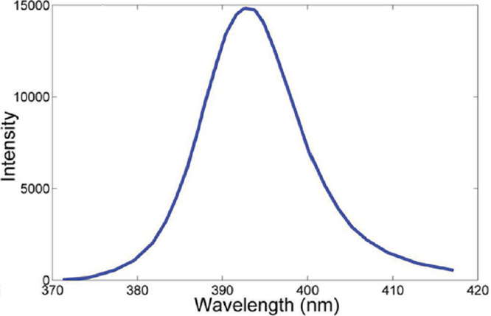
3D INKJET PRINTING OF ELECTRONICS
A new method to rapidly sinter silver nanoparticle (AgNP) ink in ambient conditions
A
B
TGME
Fig. 1 A) FE-SEM image of unprocessed silver nanoparticle ink with insert showing the size distribution of the nanoparticles computed from the FE-SEM image; B) UV-vis spectrum of silver nanoparticle ink with inset showing the emission spectrum of UV light source [1].
Ag
Prior to sintering, most AgNP had diameters below 50 nm, as seen by field-emission gun scanning electron microscopy (FEG-SEM Fig. 1A).
UV-VIS absorption spectrum of the AgNP ink showed two absorption regions: one absorption region below 310 nm, which is likely due to the presence of organic additives, e.g. TGME, and the other between 330 and 430 nm, a result of the AgNP absorption (Fig. 1B).
Based on the optical properties of the AgNP ink, thermal sintering of AgNP in ambient conditions was performed using a low power LED-based UV light source with a wavelength of 395 nm.
[1] E. Saleh et al, Adv. Mater. Technol. 2017, 2, 1700134

Slide 5
3D INKJET PRINTING OF ELECTRONICS
3D Inkjet Printing of a Prototype-Encapsulated Strain Sensor
A
B
Fig. 2 A) Schematic showing 3D inkjet printing and sintering of electronic circuits using simple UV radiation;
B) Optical image of encapsulated strain sensor integrated with a disposable glove and schematic of the sample layers [2].
Both a UV curable polymer (TPGDA) ink and the conductive (AgNP) ink were printed and cured/sintered contemporaneously by a LED-based UV source connected to the print-heads.
The printed sample is constructed with, from bottom to top, a ~250 µm thick polymer layer, a ~10 µm thick silver layer, and a ~50 µm thick polymer layer.
[2] M. Tiddia et al, Appl. Mater. Interfaces 2019, 11, 4500-4506

Slide 6
FOCUSED ION BEAN (FIB) TIME-OF-FLIGHT SECONDARY ION MASS SPECTROMETRY (ToF-SIMS)
Focussed Ion Beam (FIB) milling and Secondary Ion Mass Spectrometry (SIMS) enables the comprehensive understanding of organic-inorganic interfaces
A
B
FIB milling oblates material in a defined pattern to provide access to buried/internal interfaces: a silver layer sandwiched between two polymer layers here.
The damaged layer on the FIB-crater is removed using Ar⁺ sputtering by time-of-flight secondary ion mass spectrometry (ToF-SIMS).
ToF-SIMS can be then used to map the chemical distribution of the polymer-silver interfaces.
By correlating the two techniques the interface between the polymer and silver can be accessed and chemically defined.
C
Fig. 3 A) Total secondary ion image of a milled and cleaned FIB-crater; B) High-resolution ion distribution map of the organic – inorganic interface with characteristic polymer fragment m/z 51 (green) and silver (sum of Ag₃ and Ag₅) (red); C) Normalised intensity profile of summed lines centred at the interface in B) [2].
[2] M. Tiddia et al, Appl. Mater. Interfaces 2019, 11, 4500-4506

Slide 7
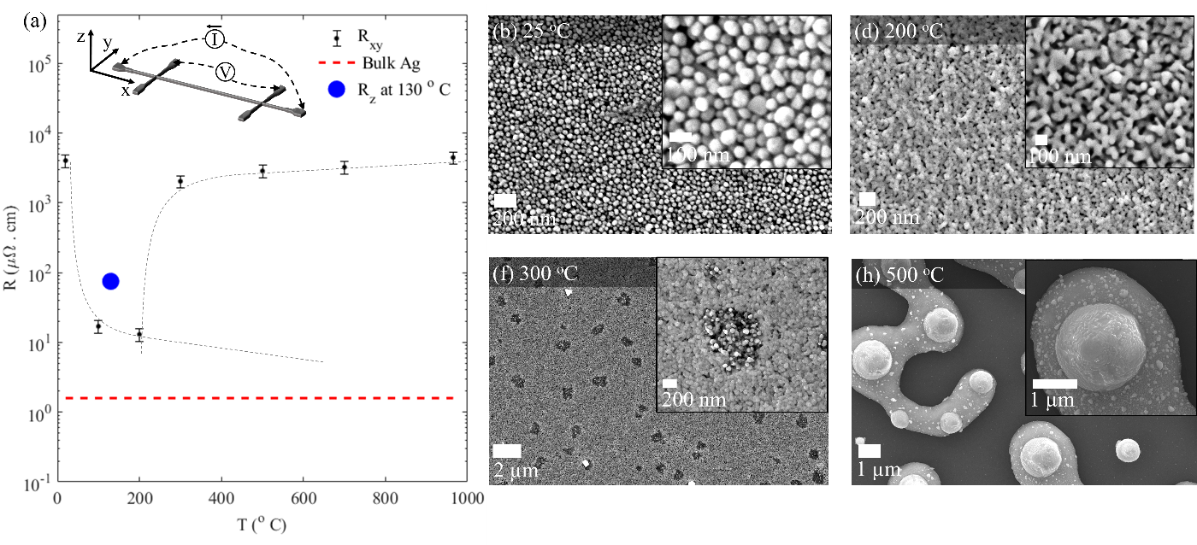
SCANNING ELECTRON MICROSCOPY (SEM)
SEM imaging helps visualise structural features that define the resistivity of sintered silver layer
A
B
C
D
E
For an annealing temperature of 100 ºC the resistivity decreases and remains low up to 200 ºC . This is due to the removal of additives from the ink, leading to sintering of metal nanoparticles and formation of conductive channels (Fig. 4B-E).
Resistivity of the printed silver remains about one order of magnitude above that expected for bulk silver, which indicates the presence of residual organics.
SEM shows that high sintering temperatures (over 300 ºC ) lead to deterioration of continuity of the printed Ag structure (Fig. 4F-I), which results in an increase in resistivity (Fig. 4A).
F
G
H
I
Fig. 4 (a) Resistivity of single layer AgNP samples sintered at different temperatures (black) ). Insert represents the sample design used for resistivity measurements (b)-(i) Secondary electron microscopy images of single layer printed AgNP samples sintered at different temperatures.
[3] G.F Trindade et al. Unpublished

Slide 8
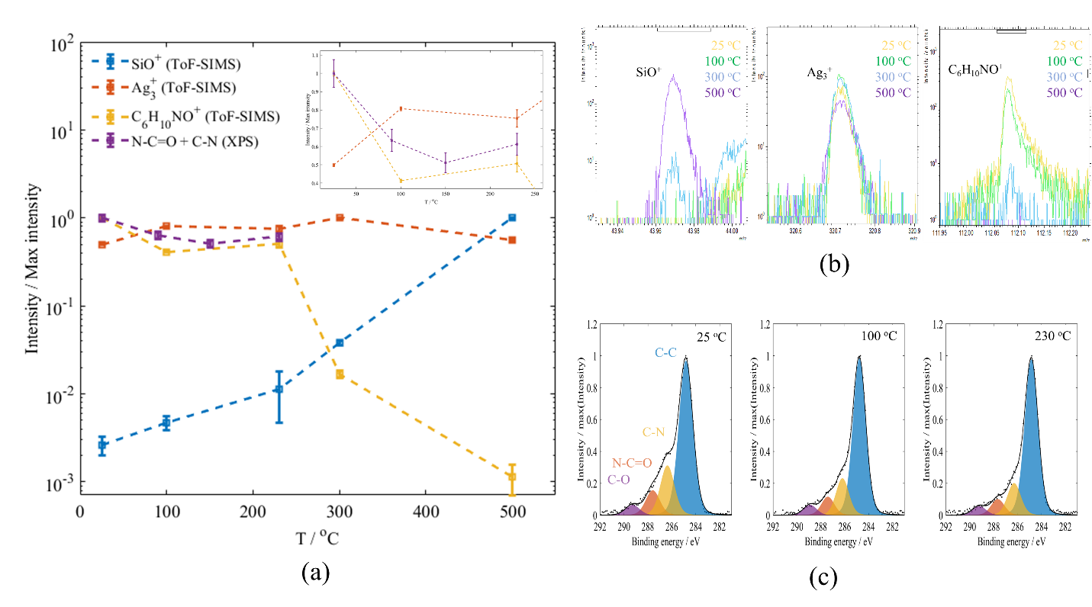
SURFACE CHEMICAL ANALYSIS
ToF-SIMS and X-ray photoelectron spectroscopy (XPS) assess the surface chemistry of sintered silver layer
Both ToF-SIMS and XPS identify the presence of polyvinylpyrrolidne (PVP), one of the main stabilising agents for AgNPs, on the surface of printed layers.
Results from both techniques show that PVP is still present after sintering at temperatures between 100 ºC and 230 ºC, where planar resistivity is optimal (Fig. 4A).
ToF-SIMS shows a significant decrease in the intensity of PVP at sintering temperatures 300 ºC and 500 ºC likely due to the degradation of PVP.
B
A
C
Fig. 5 Surface analysis results measured on the surface of a single printing layer of Ag samples printed and sintered at different temperatures. A) Characteristic ToF-SIMS secondary ions for PVP (C₆H₁₀NO⁺), silver (Ag⁺) and the substrate (SiO⁺) and XPS C1s peak-fitted components N-C=O + C-N; B) ToF-SIMS peaks. C) XPS C1s peak fitting.
[3] G.F Trindade et al. Unpublished

Slide 9
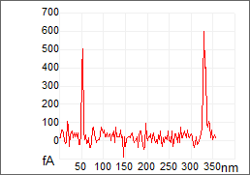
ATOMIC FORCE MICROSCOPY (AFM)
PeakForce Tunneling AFM (PF-TUNA) offers nanoscale mapping of surface topography, adhesion and current
A
B
C
D
Fig. 6 AFM images of sintered silver layer from PF-TUNA mode: A) Topography, B) adhesion, C) Current, and D) current profile in C).
Physical properties of the conductive silver layer can be explored using AFM.
Topography images from PF-TUNA (Fig. 6A) reveal the existence of loose AgNP on the sintered silver layer, which have close to zero adhesion (Fig. 6B). The adhesion of the sintered silver layer is likely a result of the surfactant covering the sintered AgNP.
Due to shielding by the surfactant, only a few conductive points are observed by PF TUNA mapping as the AFM tip only taps at the very surface gently (Fig. 6C). The Current values by PF-TUNA is also very low, only around 500 fA (Fig. 6D).

Slide 10
ATOMIC FORCE MICROSCOPY (AFM)
Tunneling Current AFM can localise electrical defects
Tunneling current AFM imaging of the same sample regions as examined by PF-TUNA was performed (See Fig. 6A and Fig. 7A).
In Tunneling Current mode, the AFM tip is consistently contact with sample. As the AFM tip sweep away surface organics, a much higher current can be observed compared to PF-TUNA.
Surface conductivity is mainly detected on those loose AgNPs.
Regions with different conductivities can also be observed, indicating a different level of surfactant coverage.
B
A
B
15nA
90nA
3nA
500nA
24nA
130nA
50nA
Fig. 7 AFM results from Tunneling Current mode: A) topography and B) current.

Slide 11
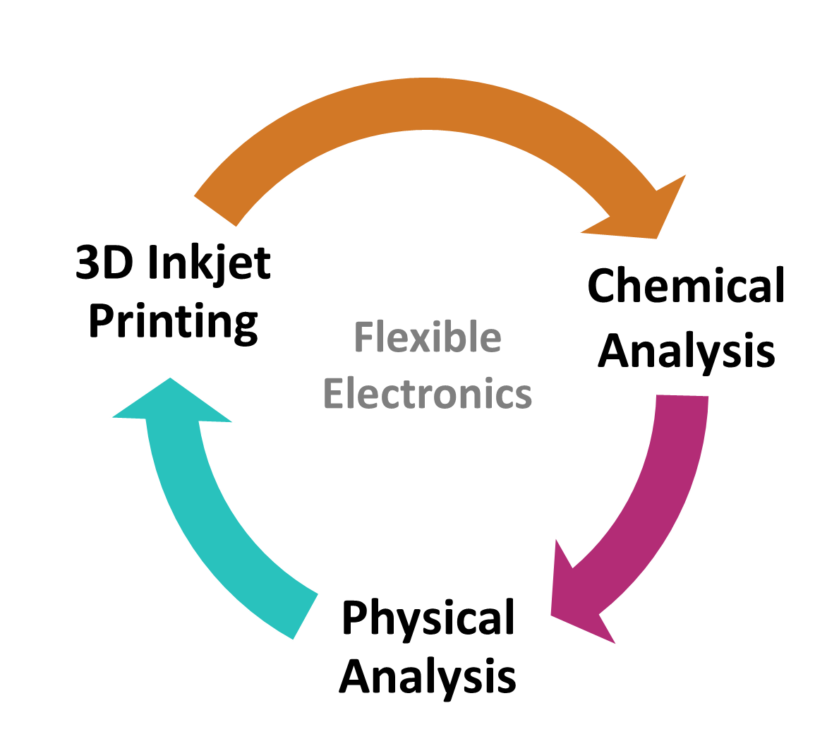
CONCLUSIONS
The CAM at UoN has developed a novel method to rapidly process and sinter AgNP inks in ambient conditions using LED-based UV light contemporaneously with UV-curing of deposited polymer structures.
This 3D inkjet printing method can be used to manufacture prototype-encapsulated strain sensors.
Multi-technique surface analysis enables a comprehensive understanding of the polymer-metal interface and the conductive metal layer in the 3D printed electronics to validate the output.

Slide 12
ADDITIONAL INFORMATION
We hope that the information documented in this report is to a standard that meets expectation.
If you wish to get back in touch with us to discuss the information provided, arrange follow-up work, raise a query/concern or provide feedback then please get in touch via any of the methods listed below:
^{Telephone:}
^{Email:}
^{Website:}
The Interface and Surface Analysis Centre (ISAC)
^{Boots Science Building (C08)}
^{University Park}
^{Nottingham}
^{NG7 2RD}
Centre for Additive Manufacturing
Advanced Manufacturing Building
^{Jubilee Campus}
^{Nottingham}
^{NG7 2GX}
⁺⁴⁴⁽⁰⁾¹¹⁵ ⁹⁵ ¹⁵⁰⁴⁶
^{isac@nottingham.ac.uk}
^{www.nottingham.ac.uk/isac}
⁺⁴⁴⁽⁰⁾¹¹⁵ ⁸⁴ ⁶⁶³⁷⁴
^{CfAM@Nottingham.ac.uk}
www.Nottingham.ac.uk/research/groups/cfam

