Slide 1
Avoiding complaints and claims: the importance of patient-centred care
Bev Fitzsimons - Point of Care
The King’s Fund
July 2011

Slide 2
Your experience
Thinking about a recent healthcare experience...
Were you generally satisfied?
Was your care well-coordinated between different parts of the system?
Did you always know what to expect, what was going on, and what would happen next?

Slide 3
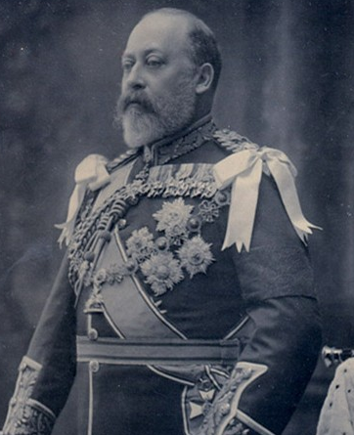


Slide 4
What do we know about patients’
experience?
complaints
claims
patients’ accounts
surveys
How can delivering patient centred
care help avoid complaints and claims?

Slide 5
What do we know
about complaints ?

Slide 6

The tip of the iceberg?

Slide 7

The complaints system
Complex
Plethora of individuals and organisations involved
You complain to different people, about different aspects of care, and relating to different healthcare organisations
Ever changing

Slide 8
Complaints and Regulation: who to turn to?
MENTAL HEALTH
ACT
COMMISSION
Royal
COLLEGEs
CQC
SPECIALIST
AUDITS*
NICE
NICE
Health
OMBUDSMAN
NMC
NHS ORGANISATION
NHS
LITIGATION
AUTHORITY
COMMISSIONERS
HEALTH &
SAFETY EXECUTIVE
GMC
DEPT OF
HEALTH
*ICNARC, MINAP etc.

Slide 9
Who?
What?

Slide 10
Looking back at the complaints process, would you say it was:
28%
20%
18%
16%
13%
2%
Patients’ Association 2008 – NHS Complaints, Who cares, Who can make it better?

Slide 11
In your opinion, what is the purpose of the complaints process?
Patients’ Association 2008 – NHS Complaints, Who cares, Who can make it better?

Slide 12
To what extent do patients’ complaints improve the quality of healthcare? Do you think that they:
Patients’ Association 2008 – NHS Complaints, Who cares, Who can make it better?

Slide 13
What do we know
about claims?

Slide 14
0.6% of complaints become claims (NPSA)
6652 clinical claims and 4074 non-clinical (2009/10)
75% of non-clinical claims concern Employers’ Liability
Clinical claims projected to be up 26% in the year, and up 54% in the 4 years to 2010/11
Specialties most represented: Orthopaedics, Obstetrics – but represents 60% of payouts, A&E and
General surgery

Slide 15
Cause of claim
Failure / delay to diagnose 13,834
Failure / delay to treat 10,034
Inadequate nursing care 2,038
Failure to warn / consent 1,955
Lack of assistance / care 1,571

Slide 16
Mistakes as opportunities to learn?
Do you think the process for investigating healthcare staff allows them to learn from any past errors?
Patients’ Association 2008 – NHS Complaints, Who cares, Who can make it better?

Slide 17
What else do we know about the quality of care?

Slide 18
How patient centred are we now?
It depends ....
Who you ask
What you ask
How you ask

Slide 19
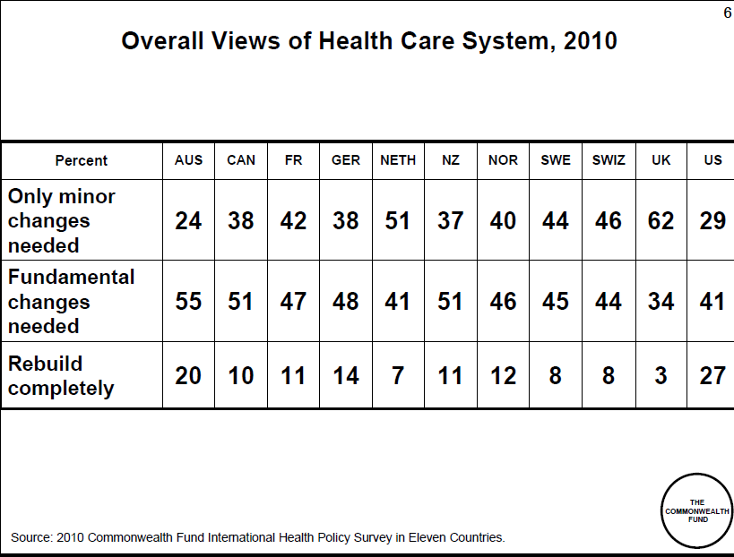
How patient centred are we now?

Slide 20







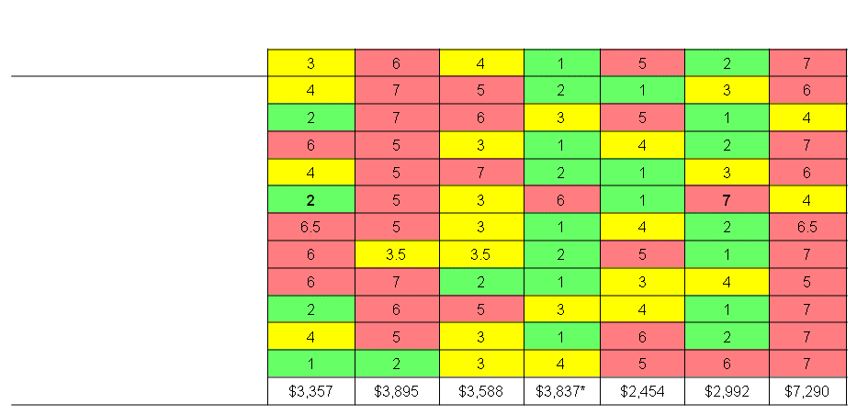
Overall Country Rankings 2009: Healthcare Quality
Source: The Commonwealth Fund 2007 Survey of 7,500 sicker adults in 8 countries and Nov

Slide 21
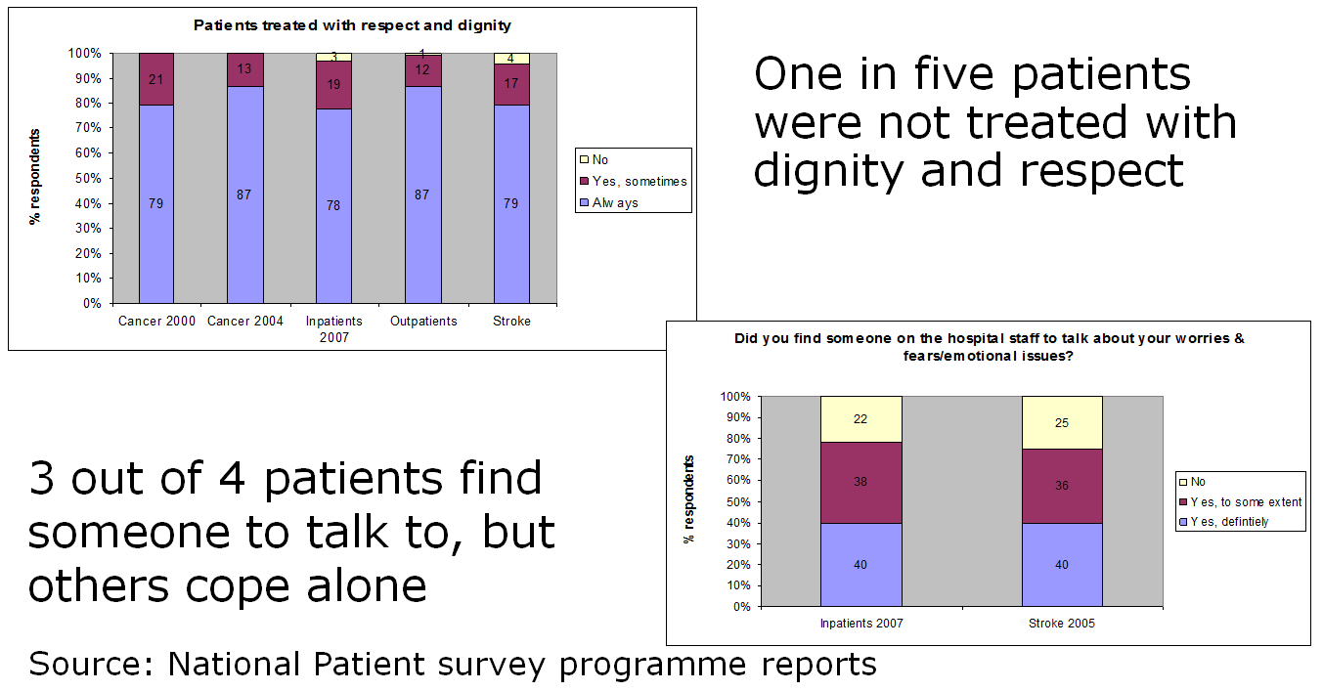
How patient centred are we now?

Slide 22
Patients’ accounts
“… I thought, that when you'd just had an operation, and had lost your breast, and were worried that the cancer might have spread and you might die, the nurses might try to be just a little bit nice. I thought that if the blood vessels needed to be checked every 15 minutes, and no one came near you for two and a half hours, you pressed your buzzer, the person who finally did come to see you wouldn't be cross. I thought that if they were the person looking after you, they might even know what operation you'd had.”
Christina Patterson – The Independent 11/2/11

Slide 23
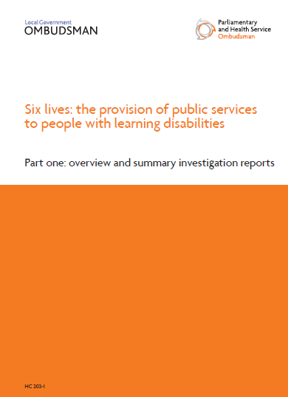
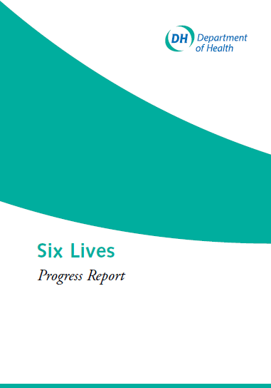
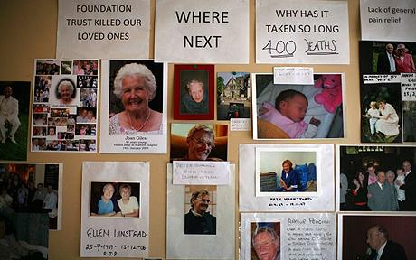

SOME SERIOUS FAILURES OF CARE

Slide 24
NHS Boards: How do they report patients’ experience?
Source: Dr Foster surveys of non-executive and executive directors, 2010

Slide 25
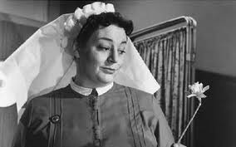
What do you think a service would be like
if it were patient-centred?

Slide 26
What is patient-centred care?
Compassion, empathy and responsiveness to needs, values and expressed preferences
Co-ordination and integration
Information, communication and education
Physical comfort
Emotional support, relieving fear and anxiety
Involvement of family and friends
Source: Crossing the Quality Chasm: A New Health System for the Twenty-first Century Washington: National Academy Press, 2001

Slide 27
Why does it matter?

Slide 28
Functional arguments
Better experiences higher patient satisfaction
Organisations that are more patient-centred better outcomes (Meterko M 2010)
Improved doctor-patient communication greater compliance and self-management
Anxiety and fear delay healing

Slide 29
Moral arguments
The first aim must be do no harm
NHS pays attention to physical harm and safety
Much less attention to harm to
the patient’s sense of self
their integrity as a person
and confidence and trust in carers
Harm to the self can be as severe and enduring as physical harm

Slide 30

Why is it hard to get it right?
Because health care is messy
Patients (and staff) have to work in complex environments
It is at the joins, that there is the greatest risk of mis-information, misunderstanding, and mis-communication

Slide 31
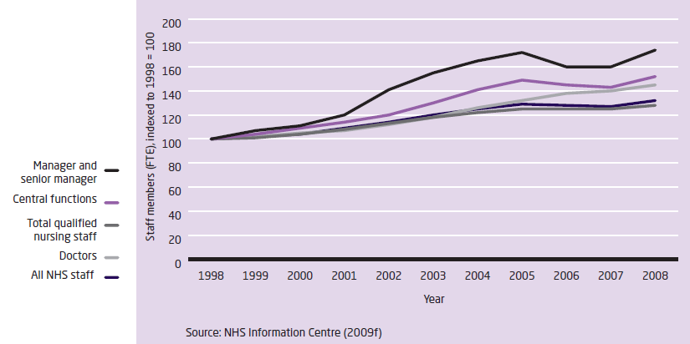
Scale and intensity of healthcare has grown

Slide 32
Volume of activity has increased
Admission Episodes (only the first episode of care in each hospital stay is counted) | 2003-4 | 2004-5 | 2005-6 | 2006-7 | 2007-8 | 2008-9
Total | 11,699,163 | 12,102,006 | 12,678,628 | 12,976,273 | 13,479,828 | 14,152,692 (17%)
Emergency | 4,158,734 | 4,428,680 | 4,659,054 | 4,700,017 | 4,753,368 | 5,010,670 (20%)
Others (including Maternity and births) | 1,880,601 | 1,972,978 | 4,659,054 | 2,051,107 | 2,117,031 | 2,094,729 (10%)

Slide 33
How to be different

Slide 34
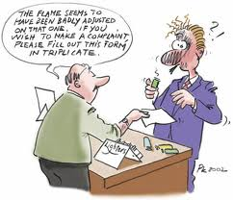
Remember the human side as well as the
process

Slide 35
Apology : saying sorry means both patients and nurses feel better
Saying sorry to a patient is difficult
Sincere and prompt apology can help those involved come to terms with something that has gone wrong
Staff worry that saying sorry will make litigation more likely
Patients are less likely to resort to the courts if they feel they have been listened to and have been offered a "proper" apology that expresses regret and acknowledges fault or shortcoming
Nursing Times 2009; 105 (44): 16-19

Slide 36
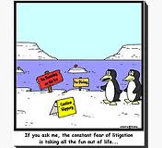
Explain and learn
The over-whelming majority of respondents who took action following an adverse event "were seeking explanations, treatment, or the prevention of recurrence".
"significant effort could usefully be directed to improving the uptake of mediation and conciliation, and fostering the constructive approach that such processes embody".
Legal Services Research Centre (LSRC) Clinical Risk 2003; 9 (6): 211-217

Slide 37
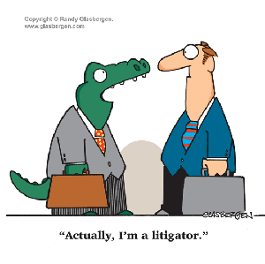
Litigation – do claimants and
professionals share common goals?
Does litigation (or the threat of it) help improve standards?
Both parties want swift resolution and to “move on”
Artificial distinction between complaints and claims
Many patients and relatives only want an apology, not money

Slide 38
Pay attention to the reality of patients’ experience
Value patients’ experiences at all levels of the NHS – including Boards
Recognise the connections between all dimensions of quality
Recognise the impact of staff experience on patients’ experience

Slide 39
www.kingsfund.org.uk/pointofcare

