Slide 1
Top Tips!
Maths activities work best when….
…we remember that it’s not just about completing a task – it’s about understanding the mathematics.
…we work together and explain what we are doing.
…we are prepared to say that we don’t understand!

Slide 2
1. Setting the scene

Slide 3

Setting the Scene
Ali and Blair run a decorating company.
Ali works for 2 hours on their latest job whilst Blair works for 3 hours.
After receiving payment Ali suggests that they share the payment in the ratio 2:3.
Blair works this out as a fraction and transfers some of the payment to Ali.
This starts a discussion between them of how to share the money for a variety of other time combinations given as both ratios and fractions.

Slide 4
2. Cards

Slide 5
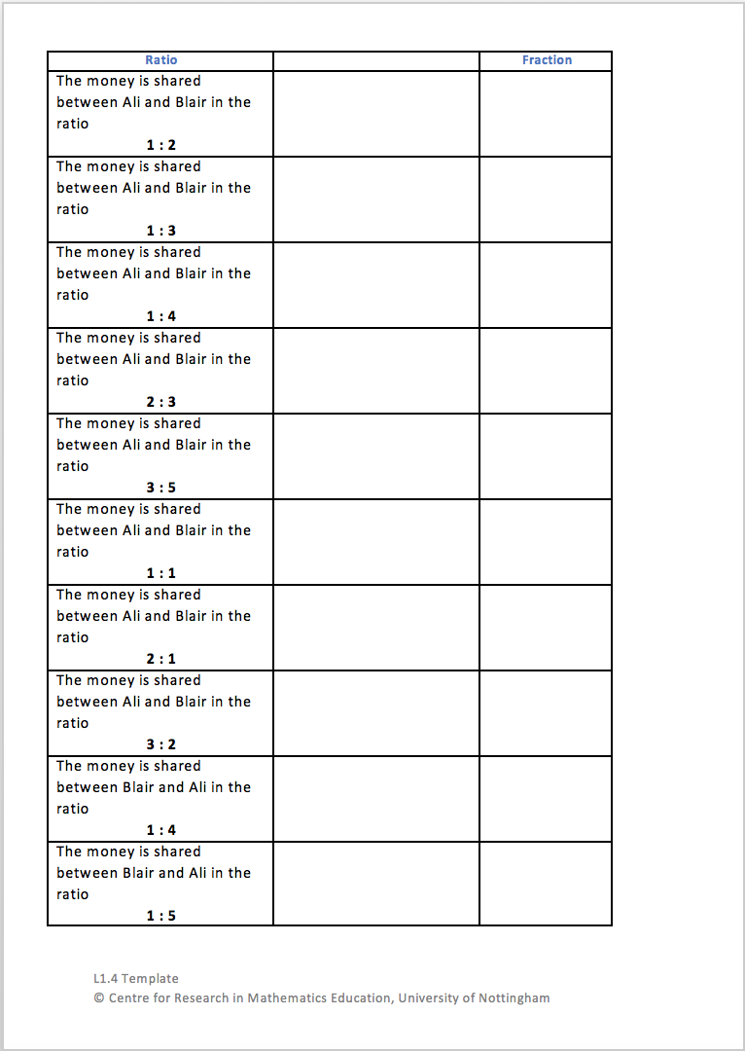
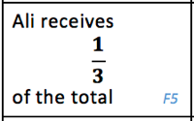
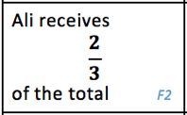
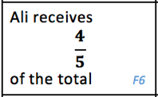
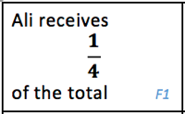
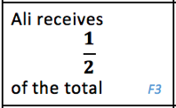
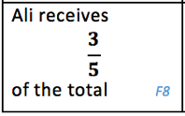
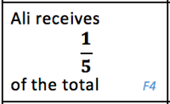
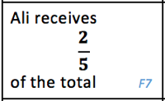
Cards
In your pairs you will be given a set of matching cards and an A3 template.
Take turns to place the cards on the template.
For each match the first person must explain why they’re placing it there and the second person must agree/disagree/ask for further explanation.

Slide 6
3. Review

Slide 7
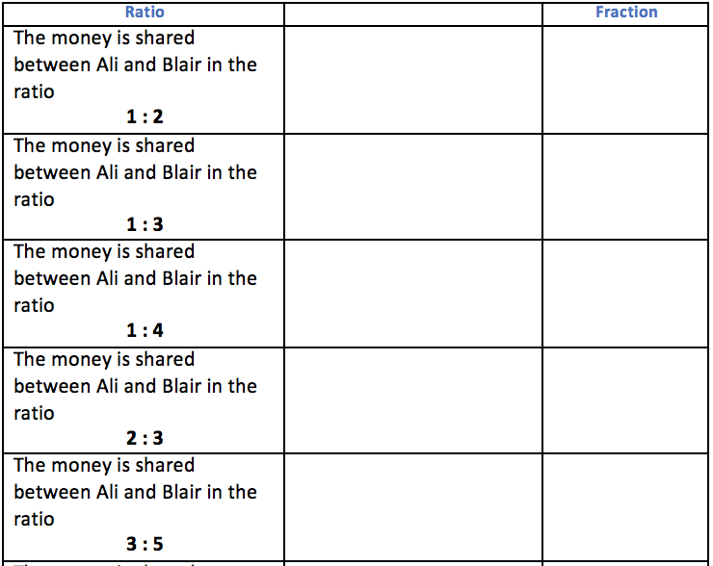
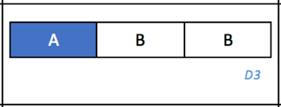
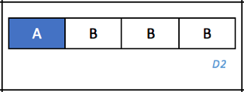
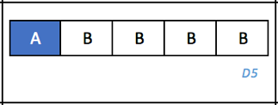
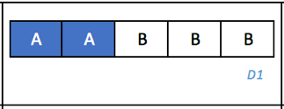
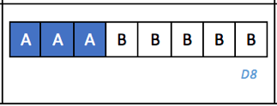
Review – part 1

Slide 8
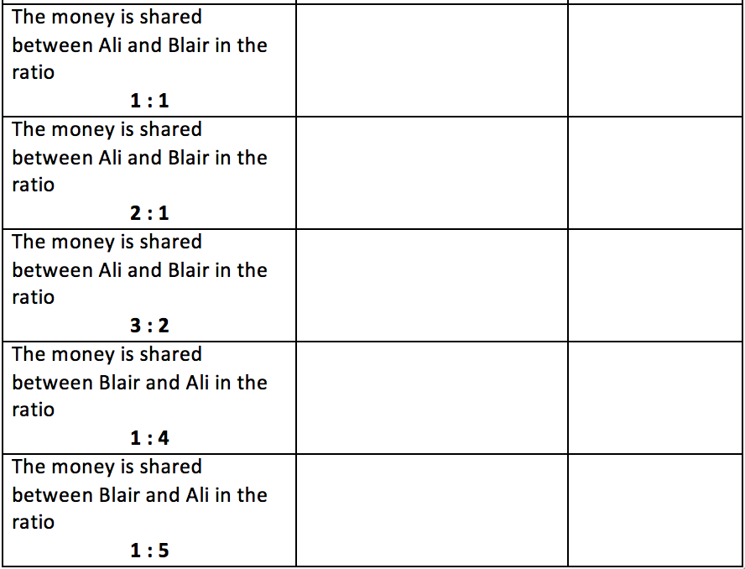
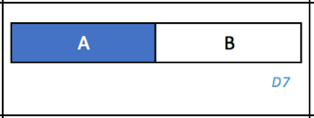
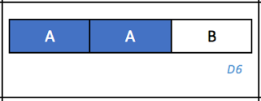
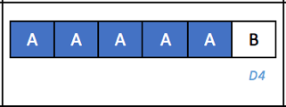
Review – part 2

Slide 9
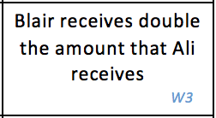
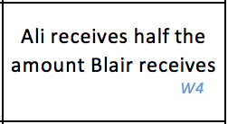
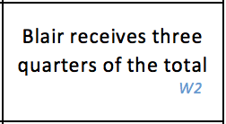
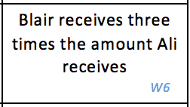
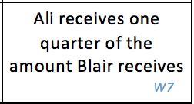
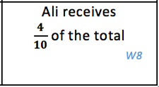
Review – part 3

Slide 10
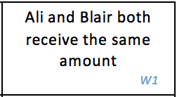
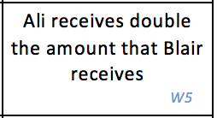
Review – part 4

Slide 11
4. Closure

Slide 12
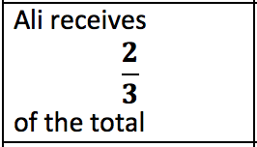
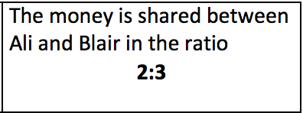
Closure 1
Ali and Blair matched these two cards together.
Why have they?
Draw a diagram for the fraction card – what ratio should correspond to this card?
Draw a diagram for the ratio card – what fraction should correspond to this card?
How are the numbers in a fraction linked to the numbers in a ratio?

Slide 13

Closure 1 - Answers
Ali and Blair matched these two cards together.
A | A | B
A | A | B | B | B
2:1 $\frac{2}{5}$

Slide 14
Closure 2
If the total payment received for the job is £30, how much would Ali and Blair each receive?
A | A | B

Slide 15
Closure 2
If the total payment received for the job is £30, how much would Ali and Blair each receive?
A | A | B | B | B

Slide 16
Closure 2 - Answers
If the total payment received for the job is £30, how much would Ali and Blair each receive?
A | A | B
A | A | B | B | B
£30
£30
Ali receives £20
Blair receives £10
Ali receives £12
Blair receives £18

Slide 17
5. Extension

Slide 18
Extension 1
Draw a diagram to illustrate Ali and Blair sharing money in the ratio 3:1
A | A | A | B
How many different ways can you describe how the money is shared?

Slide 19
Extension 2
A | A | A | B
What questions could be asked if the monetary amount involved is £36?

Slide 20
6. Additional Practice

Slide 21
Additional Practice 1
Share £84 between Blair and Ali in the ratio 3:4
Notes:
How else could this question be asked to give the same answer?

Slide 22
Additional Practice 2
The total payment for a job is £400.
Blair works one quarter the amount of time that Ali works on a project.
If they use this information to split the payment, what would be the amount they share?

Slide 23
Additional Practice 3
Ali and Blair have so much work to do that they also employ Col to work with them.
They work on a job for 2 hours, 1 hour and 3 hours respectively, so decide to share money in the ratio 2:1:3.
If Col receives £48, how much did Ali and Blair receive?

Slide 24
Additional Practice 4
The counters in a bag are red or blue.
One fifth of the counters are red.
Work out the ratio red counters : blue counters.

Slide 25
Additional Practice 5
Kiri and Peter share some sweets in the ratio 6:7.
What fraction of the sweets does Kiri receive?

Slide 26
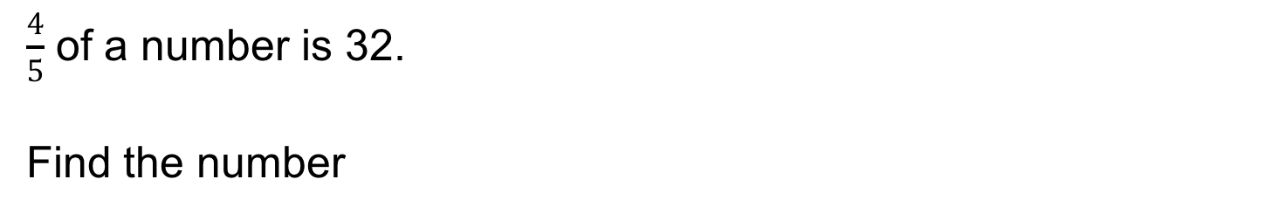
Additional Practice 6
$\frac{4}{5}$ of a number is 32.
Find the number

Slide 27
Additional Practice 7
For every 1 student eating pizza, 3 eat a sandwich.
If 30 more students eat a sandwich than pizza, how many students ate a sandwich?

