Slide 1
Top Tips!
Maths activities work best when….
…we remember that it’s not just about completing a task – it’s about understanding the reasons for the mathematics.
…we work together and explain what we are doing.
…we are prepared to say that we don’t understand!

Slide 2
1. Setting the scene

Slide 3
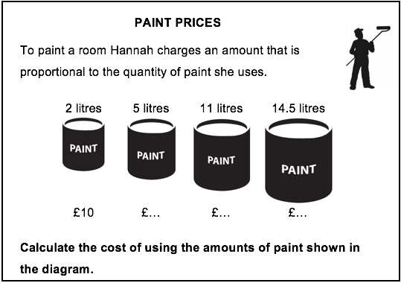
Setting the scene
Notes:
The amount of paint a decorator uses is proportional to the amount she charges.

Slide 4

Extension
Write down and explain your method.
How good is your method for finding the cost of 4.54 litres (1 gallon)?
Notes:
The amount of paint a decorator uses is proportional to the amount she charges.

Slide 5
Class Methods for 11 litres
0
2
11
Litres
0
10
Charge (£)
Notes:
The amount of paint a decorator uses is proportional to the amount she charges.

Slide 6
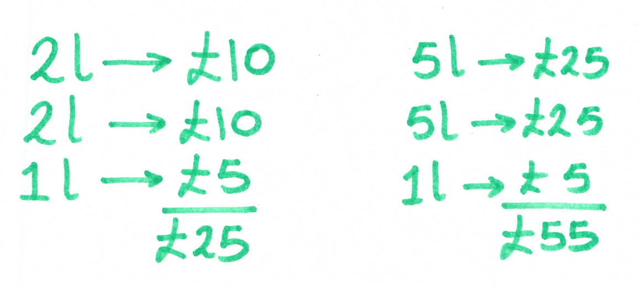
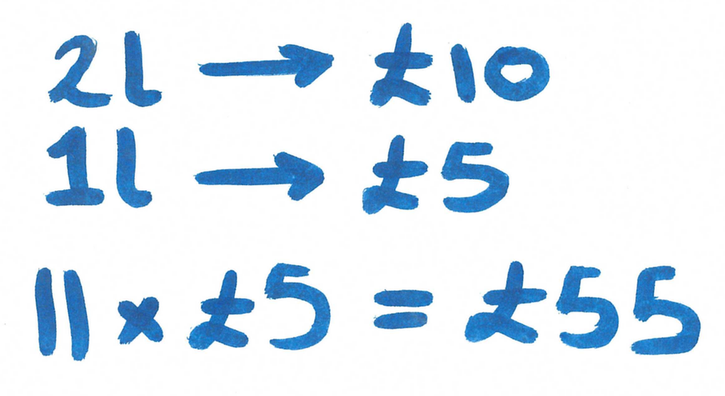
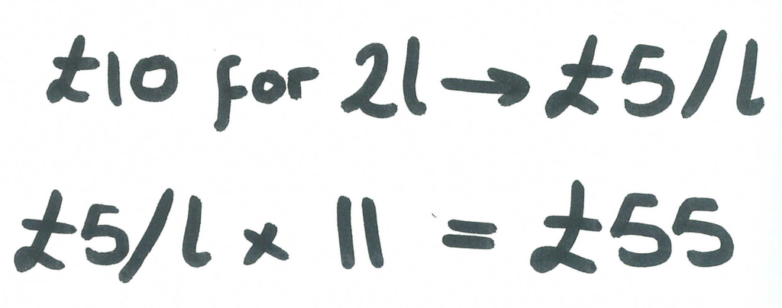
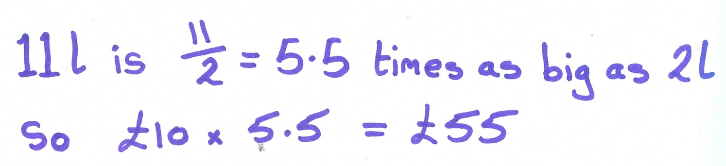
Which method is yours closest to? Can you explain the others?
Additive Thinking
Unitary Thinking
Rate Thinking
Scale Factor Thinking

Slide 7
Additive Thinking
Return
1 Gallon
0
2
4
5
10
11
Litres
0
10
20
25
50
55
Charge (£)

Slide 8

Unitary Thinking
Return
1 Gallon
$$×11$$
0
1
2
11
Litres
0
5
10
55
Charge (£)
$$×11$$

Slide 9


Rate Thinking
Return
1 Gallon
0
2
11
Litres
$$×5$$
$$×5$$
0
10
55
Charge (£)

Slide 10

Scale Factor Thinking
Return
1 Gallon
$$×5.5$$
0
2
11
Litres
0
10
55
Charge (£)
$$×5.5$$

Slide 11
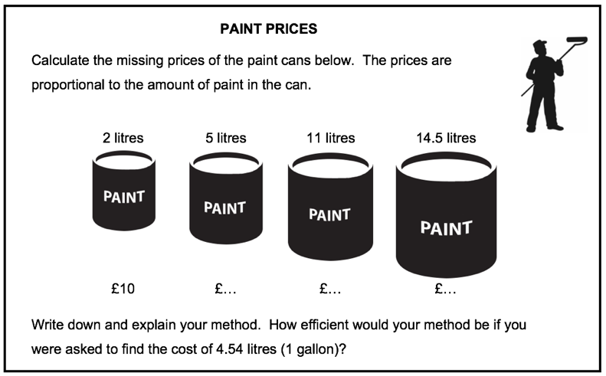
Paint Prices – the cost of 1 gallon
0
2
4.54
Litres
0
10
Charge (£)

Slide 12
2. Cards

Slide 13
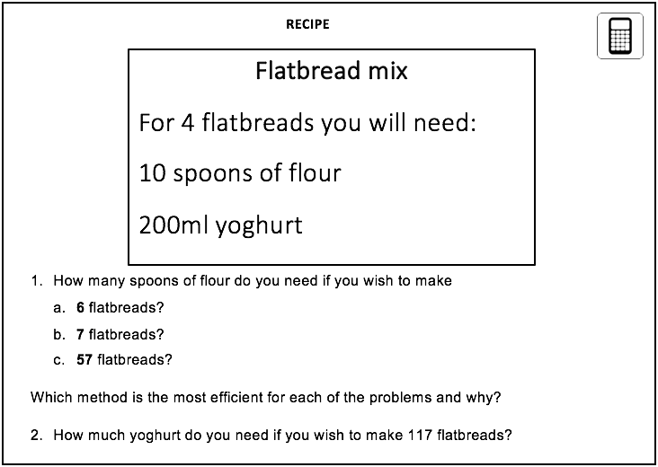
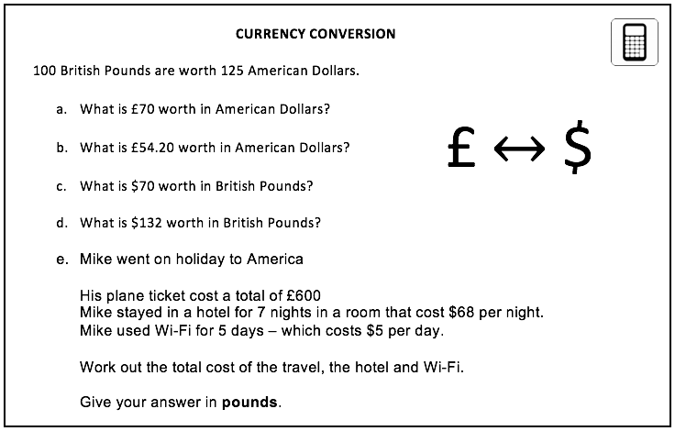
Card Problems
Work together to solve the problems on the card.
For each part of the question try to explain your thinking to each other with the help of a diagram.
Once you have completed the first card problem ask for the second one.

Slide 14
Card Problems - Extension
If the exchange rate changed for there to be more dollars for every £100, what effect would this have on the total cost, in pounds, of Mike’s holiday?
Explain your answer.

Slide 15
3. Review

Slide 16
Review - Recipe

Slide 17
Review – Recipe (flour)
0
4
Number of flatbreads
0
10
Spoons of flour

Slide 18
Review - Recipe (yoghurt)
0
4
Number of flatbreads
0
200
Yoghurt (ml)

Slide 19
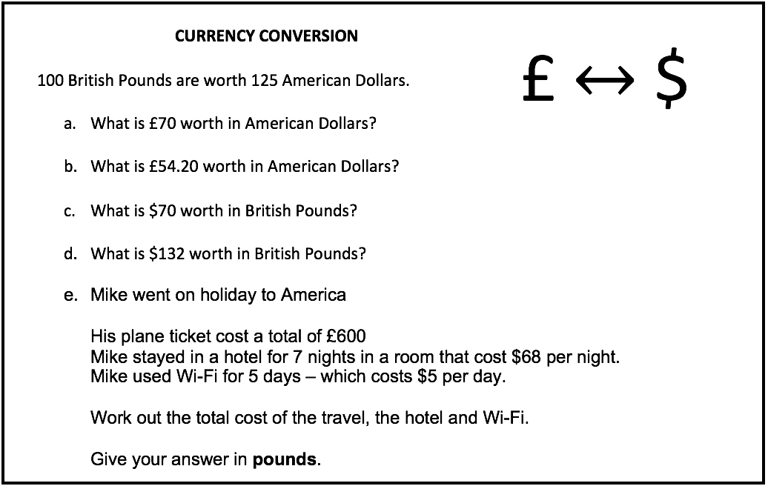
Review - Currency Conversion

Slide 20
Review - Currency Conversion (parts a and b)
0
100
Pounds
0
125
Dollars

Slide 21
Review - Currency Conversion (parts c and d)
0
100
Pounds
0
125
Dollars

Slide 22
4. Closure

Slide 23
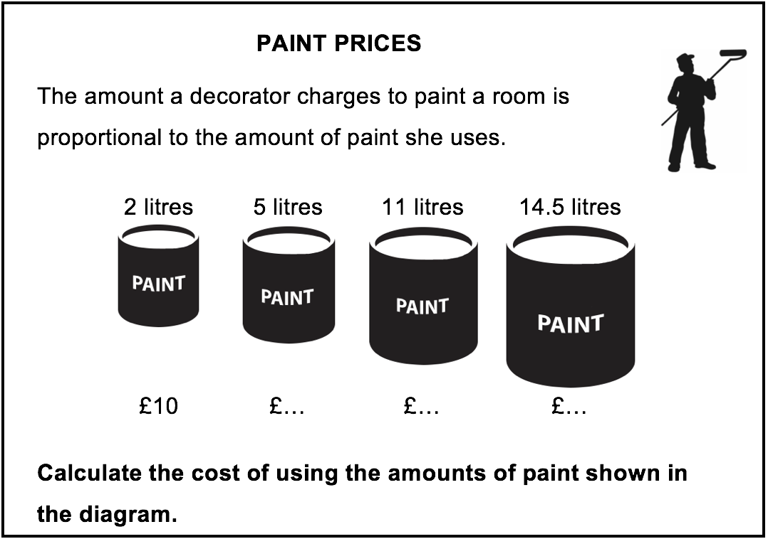
Closure
Hannah, the decorator from the start of the lesson charged £55 for using 11 litres of paint.
A different decorator, Mo, also charges an amount that is proportional to the quantity of paint he uses.
He charges £33 for using 6 litres of paint.
Which painter charges the least for using 11 litres, and by how much?

Slide 24
5. Extension

Slide 25
Extension
The exchange rate between the UK and America is £1 for $2.
Mike orders an iPod from America for $650, but argues with his wife, Caroline, about how to convert the value in to pounds.
Mike says “you should multiply by 0.5”
Caroline says “you should divide by 2”
Draw a diagram to explain what they are both doing and show that both are correct.

Slide 26
6. Additional Practice

Slide 27
Additional Practice 1
a. Harry needs dollars to go on holiday.
He can buy $50 for £40.
How much will $720 cost at the same rate?
b. Tony returns from holiday with these notes.
The exchange rate is £1 = €1.17.
Work out how much he will get in total when he changes these notes.
Note | Number of notes
€50 | 2
€20 | 4
€10 | 9
€5 | 12

Slide 28
Additional Practice 2
Apple crumble is made using these ingredients.
Apple crumble (Serves 6 people)
550g apple
200g sugar
120g flour
30g butter
a. Susumu makes apple crumble to serve 12 people.
How much flour should he use?
b. Natalie makes apple crumble for 10 people.
How much butter should she use?
c. Abena has 1.3 kg of apples and plenty of other ingredients.
Can she make apple crumble for 15 people?
Explain how you got your answer.

Slide 29
Additional Practice 3
The scale of a map is 1cm represents 25m.
The length of a path is 240m.
Work out the length, in centimetres, of the path on the map.

